Slide 1
CTI League
Disinformation
2020-04-29
MISP open source threat intelligence platform

Slide 2
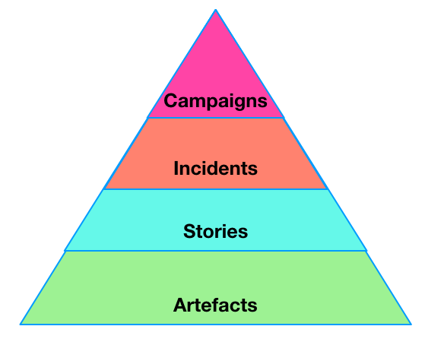
Disinformation Pyramid

Slide 3

MISP
Collaborative Threat Intelligence
Correlation & Contextualization of data
MISP sharing community for disinformation is brand new. We’re building all the required objects as we go.

Slide 4
MISP
CTI League - https://covid-19.iglocska.eu/
COVID-19 specific disinformation.
CogSec Collab - https://misp.cogsec-collab.org/
MISP disinformation sharing community.

Slide 5
Using MISP Directly

Slide 6
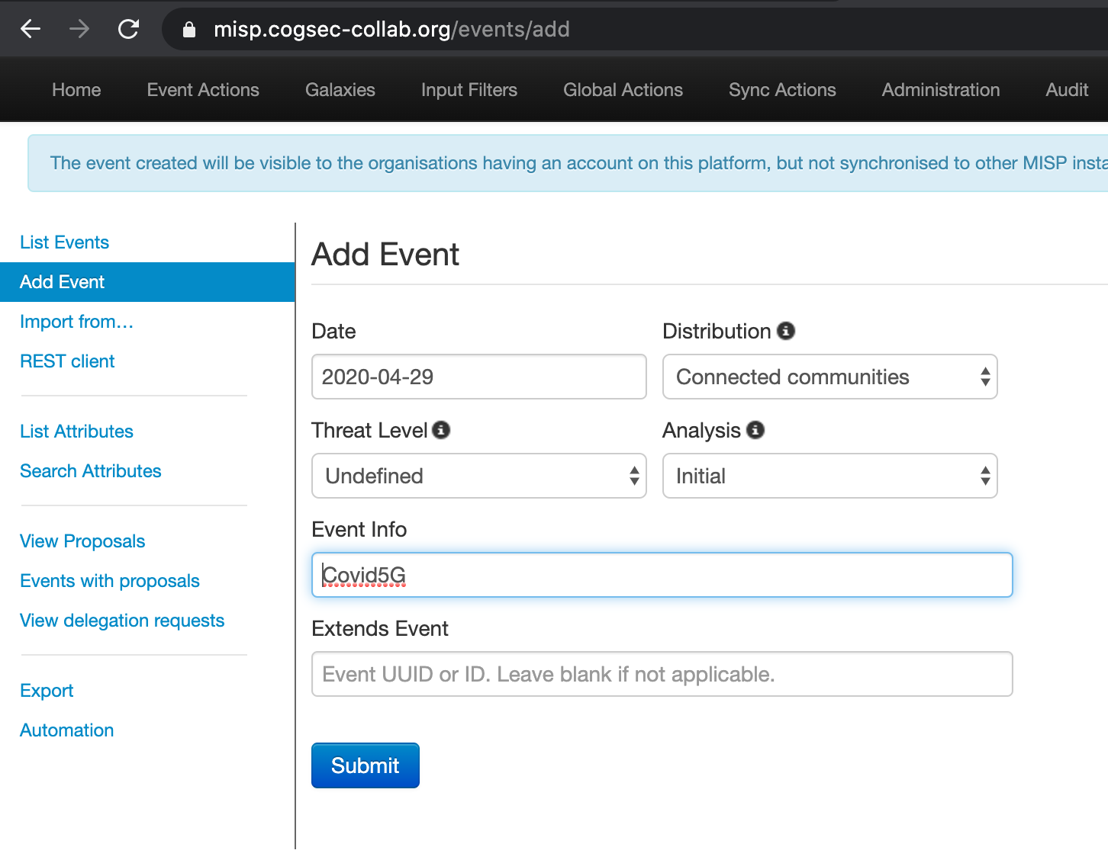
Add an Incident to MISP
Create a New Event
Distribution: “Connected Communities”
Threat Level: “undefined”
Use a bespoke event name
“COVID 5G”

Slide 7
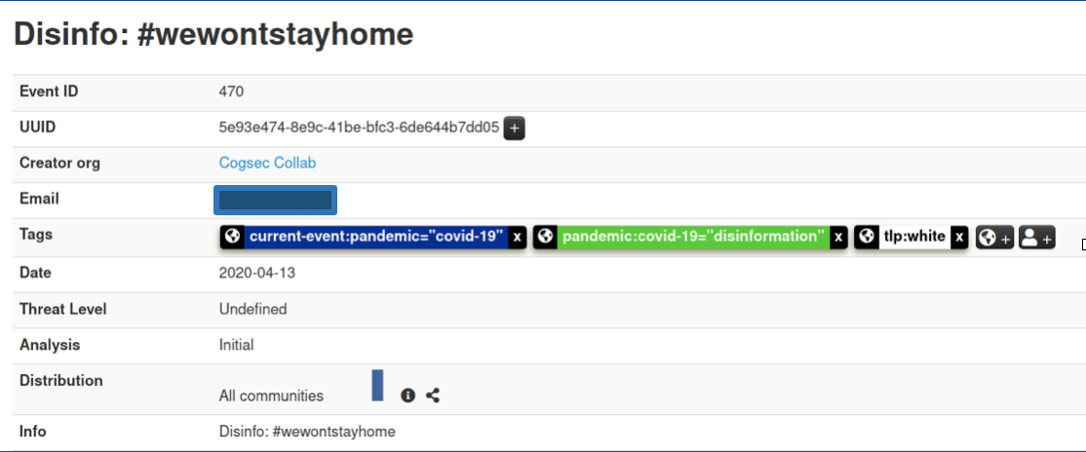
Add Tags to an Event
Tags provide context
covid-19=”disinformation”
pandemic=”covid-19”
Tlp:white

Slide 8
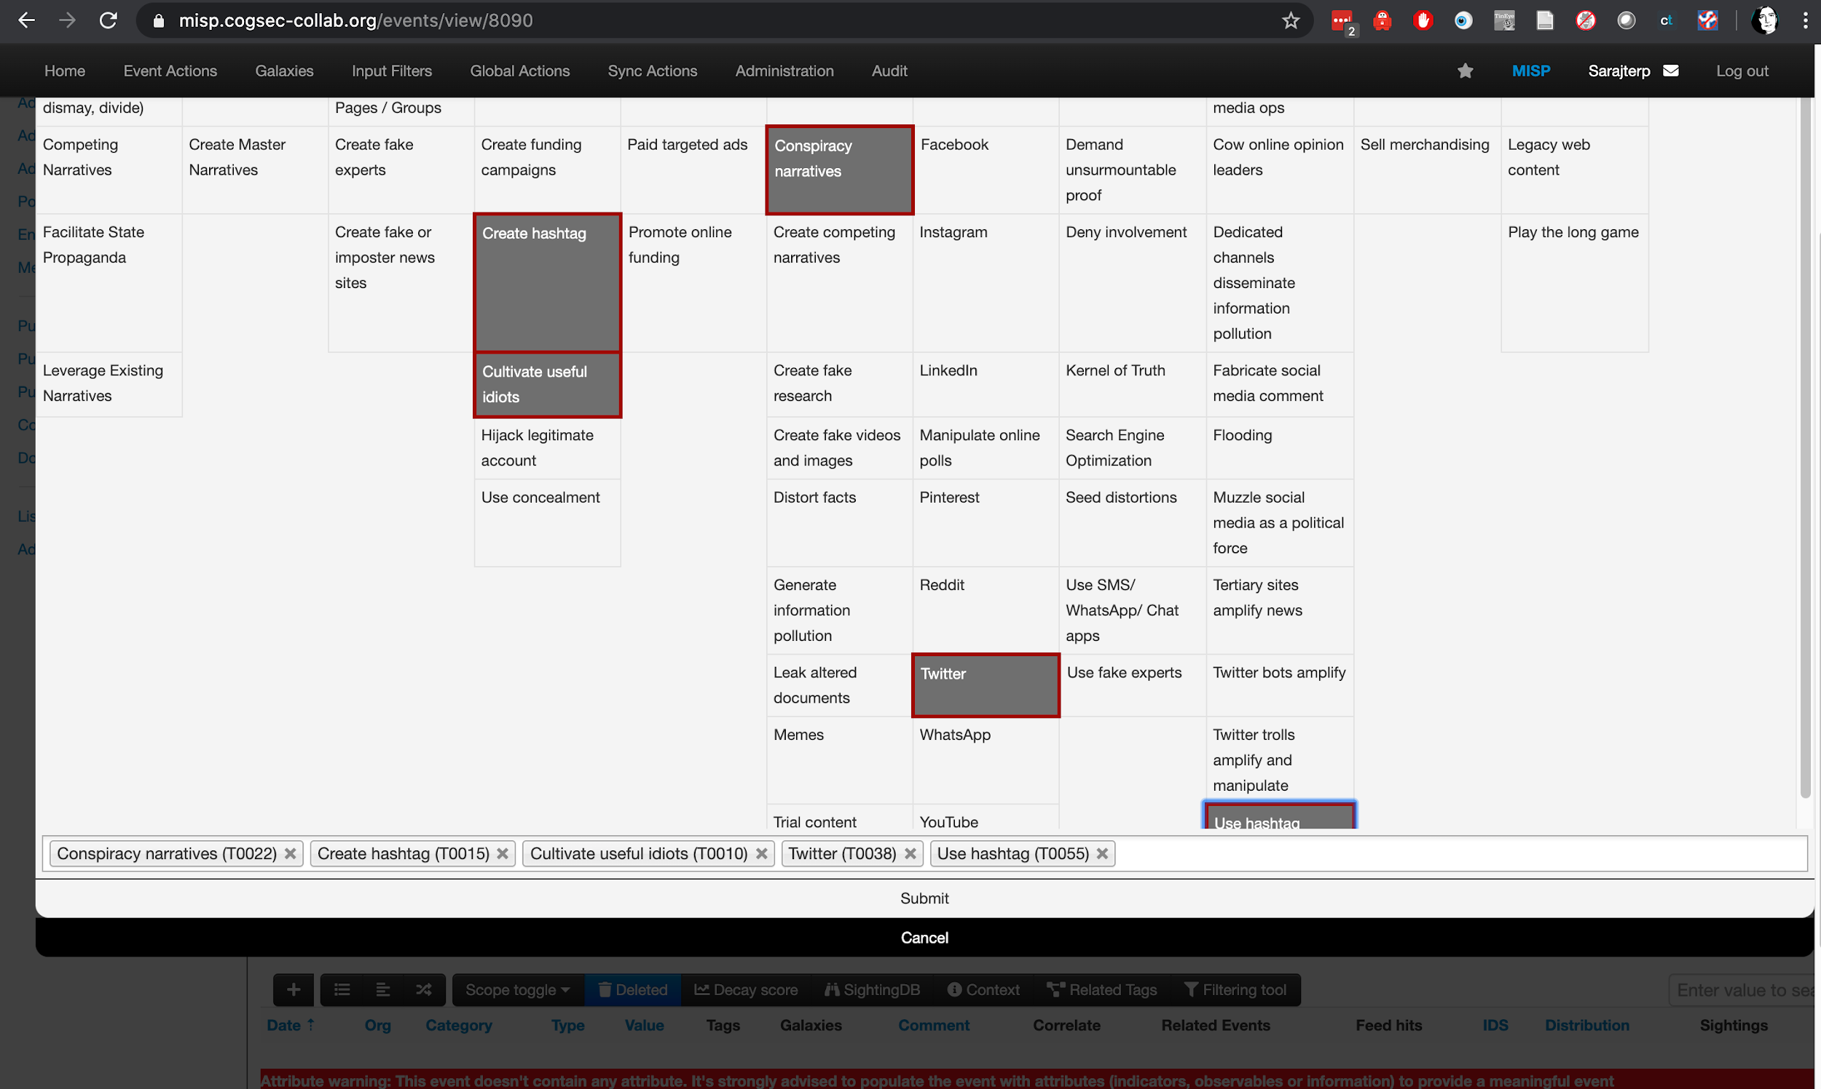
Add TTPs to an Incident

Slide 9
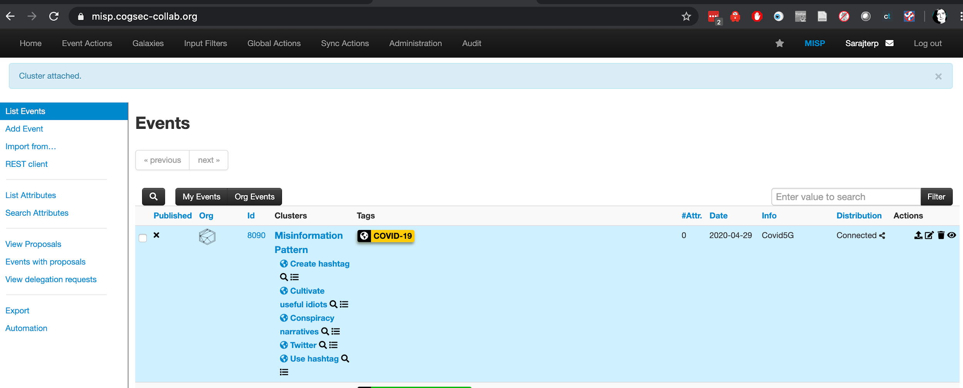
Your incident in the Events List

Slide 10
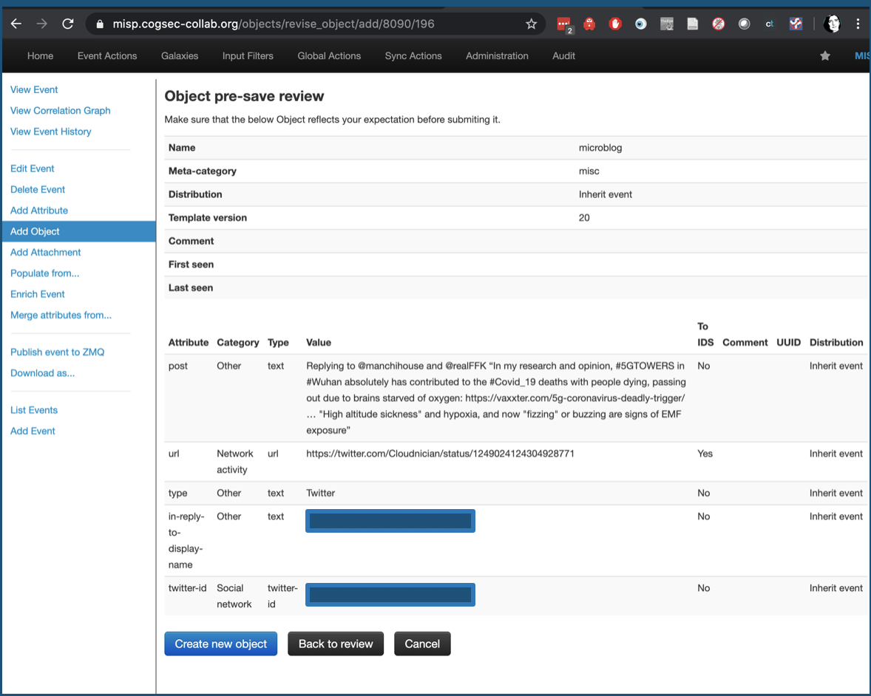
Add a Tweet to an Incident

Slide 11
Speeding that up:
Using PyMISP

Slide 12
Access a MISP instance using pymisp
Before running this, you'll need:
Pip install pymisp
Access token for a MISP instance
More help at
https://pypi.org/project/pymisp/
Pymisp notebooks

Slide 13
Start a link to MISP
from pymisp import ExpandedPyMISP
# Get MISP creds
cscsecret = open('/Users/sara/cscstagemisp.txt', 'r')
(cscurl,csckey) = [x.strip() for x in cscsecret.readline().split(',')]
cscsecret.close()
misp = ExpandedPyMISP(cscurl, csckey, False)

Slide 14
Reading wishlist
1) see all the MISP events of interest to us
Get a list of events for our group - or all connected groups
Filter that list by topics of interest (e.g. COVID-19 tags)
See event ids that correspond to incident names used in our other systems
2) read data on a specific event, so we can use it in analysis
Get data for a named incident
3) know about the data that's connected to a specific event, so we can analyse that too
Get objects connected to a named incident

Slide 15
Look at incidents already in the MISP
results = misp.search("events", tags="COVID-19")
[(result['Event']['id'], result['Event']['info']) for result in results]
Gives me
[('31', 'US Piracy'), ('8090', 'Covid5G')]

Slide 16
Look at a specific incident
misp.get_event(8090)
Gives me:
{'Event': {'id': '8090',
'orgc_id': '1',
'org_id': '1',
'date': '2020-04-29',
'threat_level_id': '4',
'info': 'Covid5G',
'published': False,
'uuid': '5ea8ded8-c790-457e-ba18-04e8ac150006',
'attribute_count': '5',
'analysis': '0',
'timestamp': '1588126766',
'distribution': '2',
'proposal_email_lock': False,
'locked': False,
'publish_timestamp': '0',
'sharing_group_id': '0',
'disable_correlation': False,
'extends_uuid': '',
'event_creator_email': 'sarajterp@gmail.com',
'Org': {'id': '1',
'name': 'CogSec Collab',
'uuid': '5e2dd31a-3bcc-45e8-ba7e-2ab890d945c8',
'local': True},
'Orgc': {'id': '1',
'name': 'CogSec Collab',
'uuid': '5e2dd31a-3bcc-45e8-ba7e-2ab890d945c8',
'local': True},
'Attribute': [],
'ShadowAttribute': [],
'RelatedEvent': [],
etc

Slide 17
Writing wishlist
1) add a new incident to MISP
set event info to the name of the incident
set tags to e.g. "Covid-19"
set distribution to "connected communities" and set threat level to undefined
(maybe) add the misinformation pattern - although that's probably better done by hand
get the event id for this incident
2) add multiple incident objects to this event, probably from a spreadsheet
Add an object for every microblog (tweet or facebook post)
Add an object for every facebook group
Add an object for every URL
Fill out as many details as we can for each type of object
3) add incident data to this event from slack, via bot
as above, but using bot commands

Slide 18
Create an incident in MISP
from datetime import date
from pymisp import MISPEvent
incidentstart = date.today() #'2020-04-29'
incidentname = 'testincident'
tags = ['tlp:white', 'COVID-19']
# Create event object
event = MISPEvent()
event.info = incidentname
event.distribution = 2
event.threat_level_id = 4
event.analysis = 0 #initial analysis
event.set_date(incidentstart)
for tag in tags:
event.add_tag(tag)
newevent = misp.add_event(event, pythonify=True)

Slide 19
Adding a tweet to an incident (unfinished)
from pymisp import MISPObject
from microblogobject import MicroblogObject
# Get the MISP Event you want to modify.
event = misp.get_event(event_id, pythonify=True)
# Build an attribute dictionary containing the properties of the misp object.
object_properties = {‘url’: 'https://twitter.com/[Name Redacted]/status/1250539109246001152?s=19'}
# Instantiate the MISP object
misp_object = MicroblogObject(parameters=object_properties)
# Append the object to the MISP Event
response = event.Object.append(misp_object)
# Update the original MISP Event
response = misp.update_event(event_id, event)
Notes:
We have new classes: microblog, news-media, narrative in https://github.com/MISP/PyMISP/tree/master/pymisp/tools

Slide 20
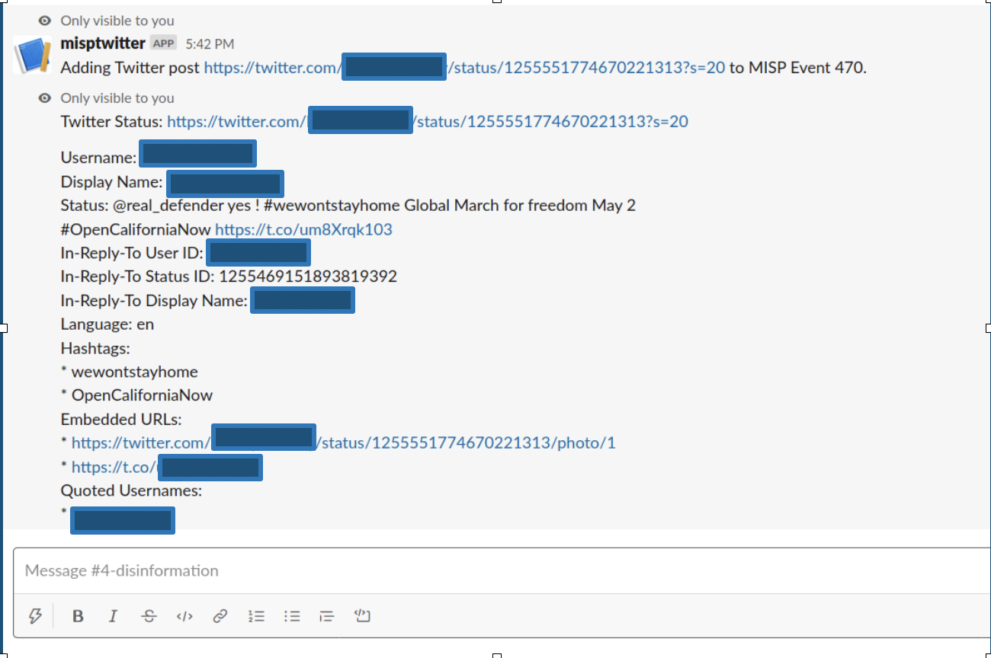
Our first bot!
Twitter API gets Status
Read response into MISP microblog object
Add the microblog object to a MISP event
/misp_twitter <misp_event_id> <twitter_url>

Slide 21
MISP things to finish
Code to upload details for facebook, urls, ?
Bots for facebook, urls, ?
Code to push data from googledoc to MISP incident
Host python code somewhere friendly but secure?
Push all existing data up to the “dirty MISP” for analysts’ use
Push all clean data up to the “clean MISP” for sharing
BigBook section on how to use all these things
Data governance piece

