Slide 1
CTI League
Disinformation
2020-07-01
TheHive Case Workflow

Slide 2
Dilemma Consultancy Protocol
Introduction (5 min)
Presenter shares dilemma (20 min)
Clarifying questions (3 min)
Probing questions (7 min)
Discussion (15 min)
Response (2 min)
Debrief (3 min)
Full Protocol from SRI (link)

Slide 3
Framing questions
Is theHive the right tool to drive our incident management?
What’s working? What’s not?
What are a few PoCs that make theHive more useful to us on a daily basis?

Slide 4
Disinformation Incident Workflows
Information operations are ...
Time
Resources
Infrastructure
Execution
… and multidisciplinary...
InfoSec
Data Science
Social Science
++

Slide 5
Disinformation Incident Workflows
Workflows frame a problem...
AMITT Tactics
AMITT Techniques
… define procedures ...
Incident Response Lifecycle
Investigation procedures
Technical procedures
++
… and indicate progress.
Who did what?

Slide 6
TheHive Case Workflows
What is a workflow in TheHive?
A set of tasks to complete.
That’s it.
How are we currently using them?
Define sane minimum investigation steps.
Break complex investigations down into distributable chunks.
Guardrails to help individuals identify next actions.
Quick reference to links and materials.
Record of work.
Notes:
TheHive is supposed to make life easier. It’s supposed to be fast. If it doesn’t do that we need to reevaluate if it’s the correct tool for the job.
To what extent does it make our work more efficient and what are the subtasks we need to complete to improve efficiency?

Slide 7
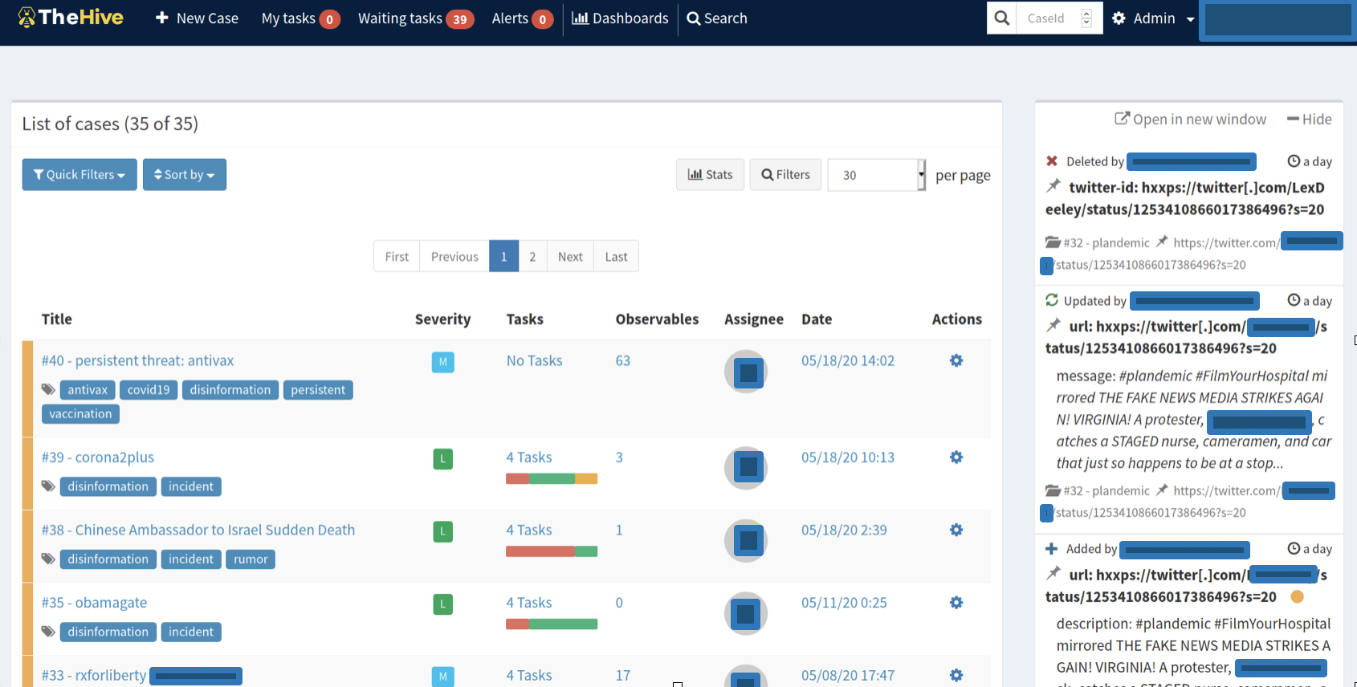
Cases
Cases store IOCs, IODs, notes, tasks
Real-time updates
Live change log
Notes:
Dont havea ll the answer, buildind as we go. Can add more as we comes across them.

Slide 8
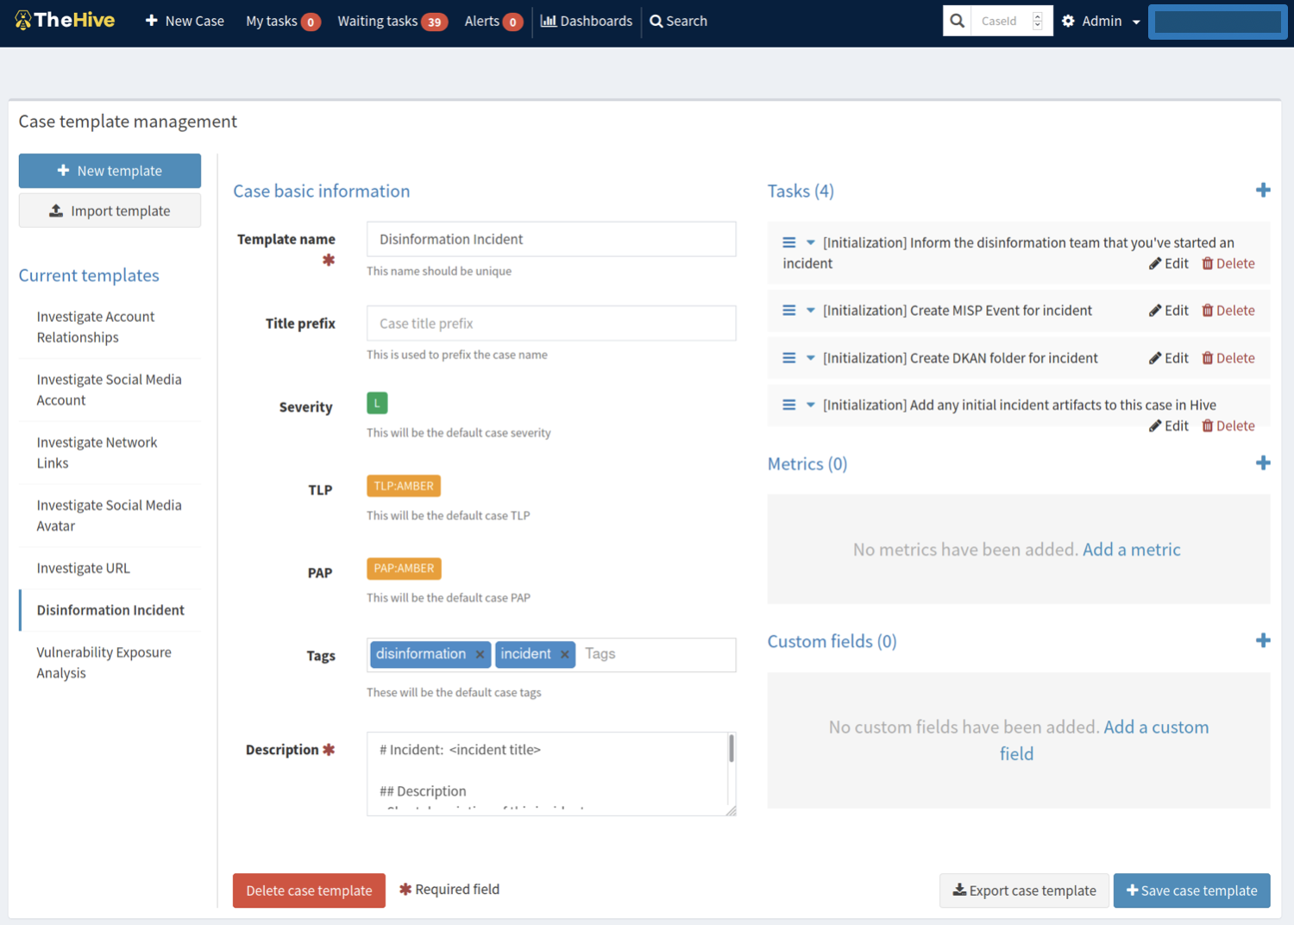
Cases Templates
Base Template
“Disinformation Incident”
Base Tasks
Create MISP Event
Create DKAN folder
Tell people in channel
Notes:
All investigations start with the same base template for now. It includes some basic tasks to get the incident set up but doesn’t tell us how to start investigating.

Slide 9
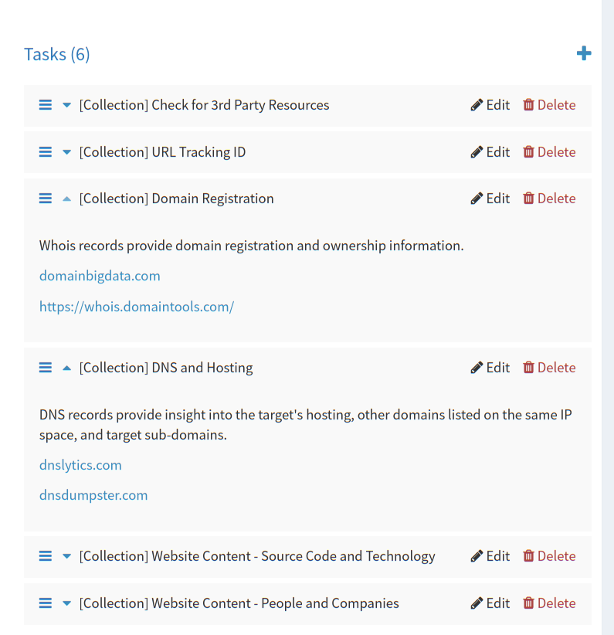
Cases Templates - Workflows
Task Groups
Phases
Tactics
IR lifecycle
Hive workflows are linear
It’s just a list of things to do.
Keep it simple. Abstract workflow logic out of the platform.

Slide 10
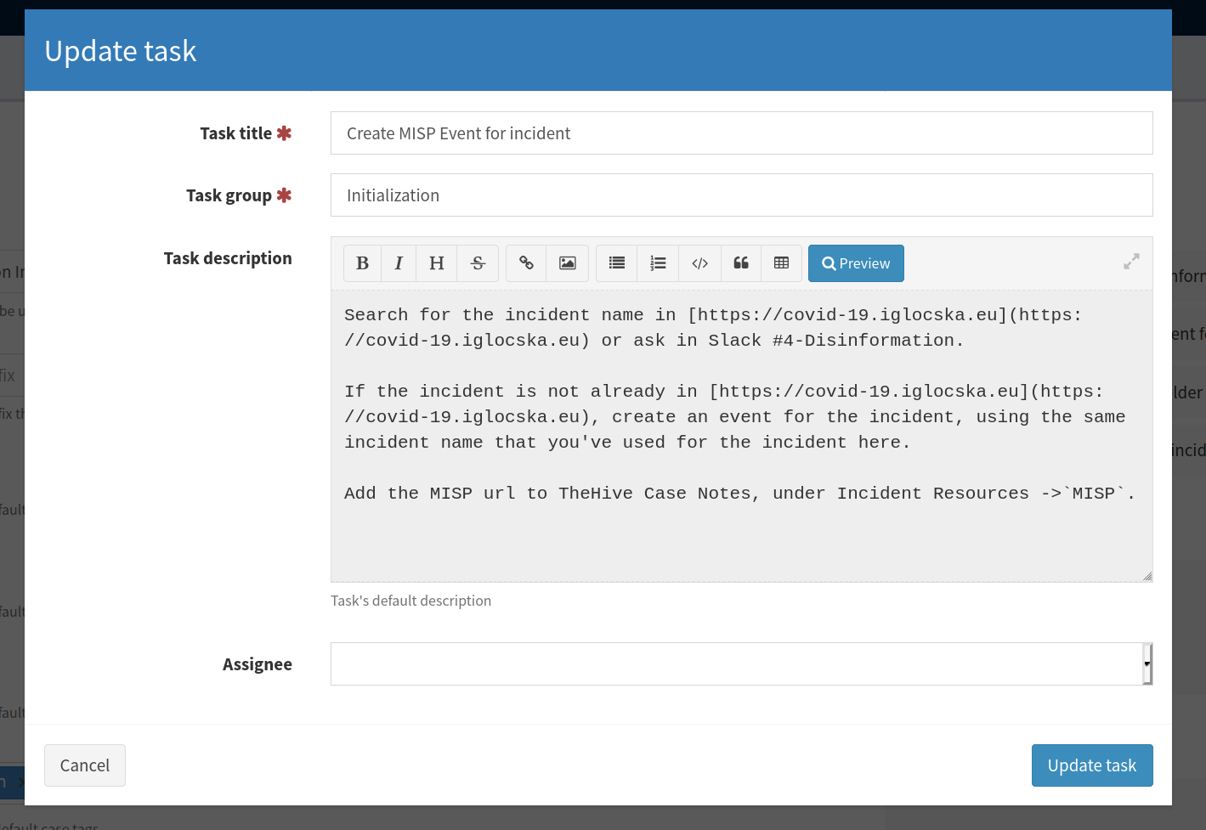
Add Task to Case Template
Tasks are
Title
Group
Description (Markdown)
(optional) Assignee

Slide 11
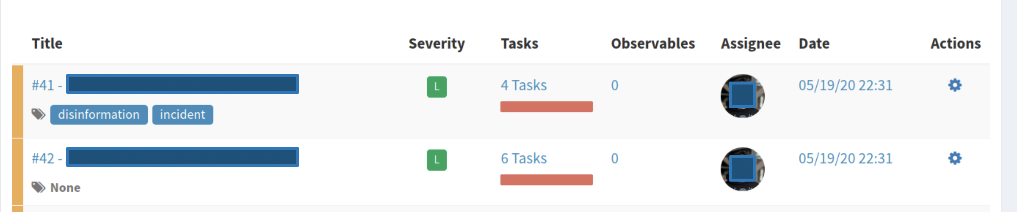
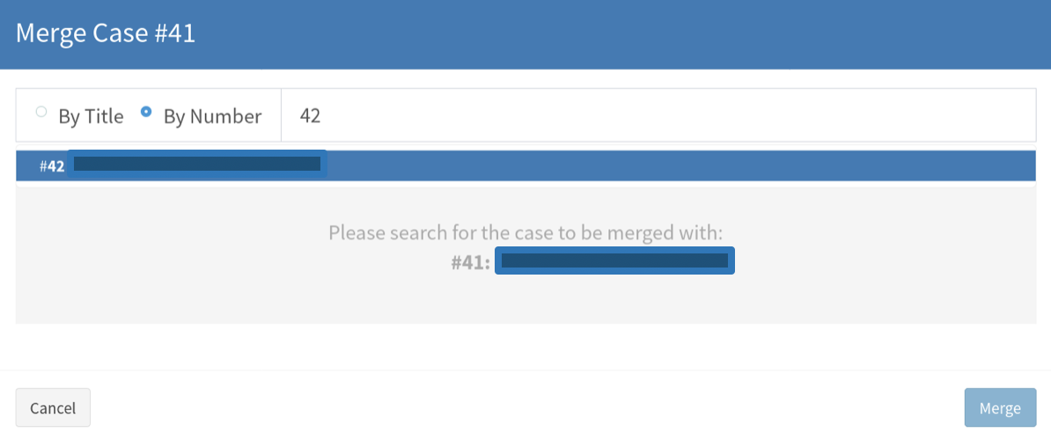
More Case Templates! + merge

Slide 12
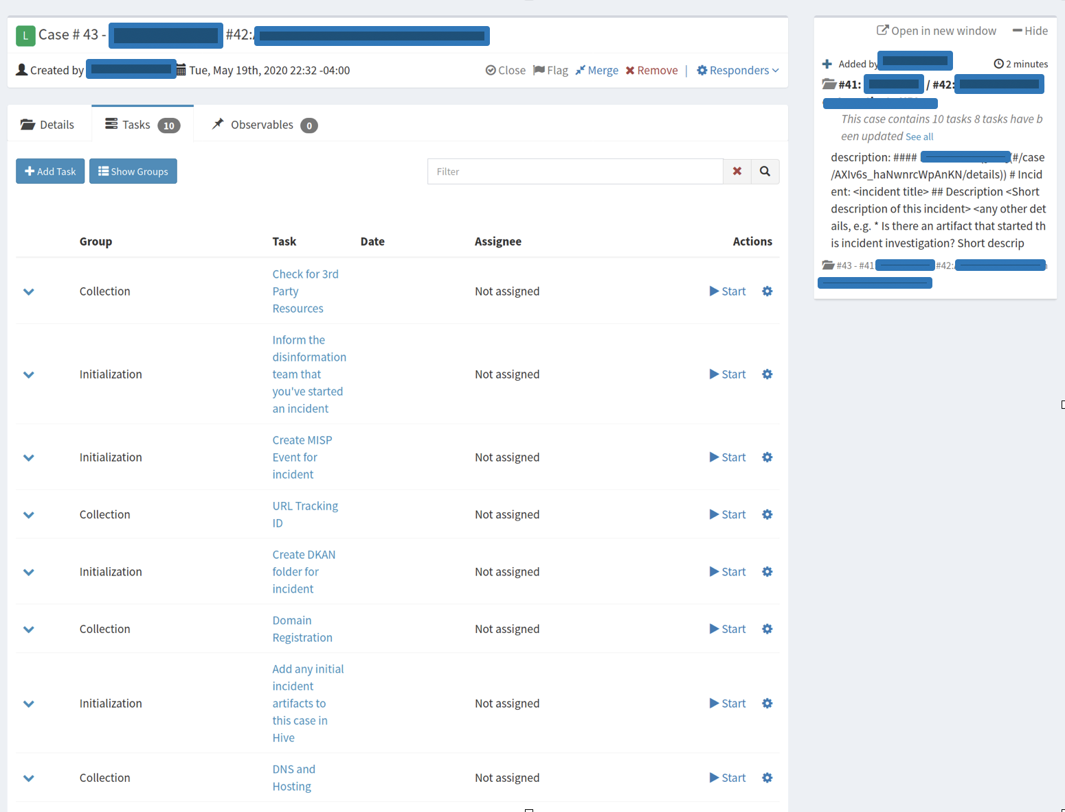
Merged Case
Merged cases have ugly titles but it’s something we can script away

Slide 13
Next Step
AMITT Framework
Move content from Big Book to case templates
Ideas
Merges are ugly and not really user friendly → Create tab with subcases
Tag searches are “or” not “and” search
Still feels easier to use a Google doc, how do we fix that?
Can we pull in slack threads and put into cases? (Like threadreader unroll)
How can we use Cortex analyzers to automate what we’re doing?
URLs:
Who owns that URL?
Which URLs are connected?
DNS checks
Who has referenced it in Facebook, Twitter, Socials

Slide 14
Next Step
Ideas
How can we use Cortex analyzers to automate what we’re doing?
Hashtags
Check across social networks
Related hashtags
Groups
Facebook pages
Pages related to this
Jupiter Notebook Integration
Tool that calls all the Cortex analyzer jobs that have been executed
[Name Redacted] question for [Name Redacted]: Export to DKAN?
[Name Redacted]: Pulling stuff out of pinned Slack threads: could work from this
Slackbot can work with different Emoji: Use MISP/HIVE emoji for trigger

Slide 15
Debrief
Enjoyed breaking out different types of questions
More context about the type of meeting
Moderation: checking in

