Slide 1
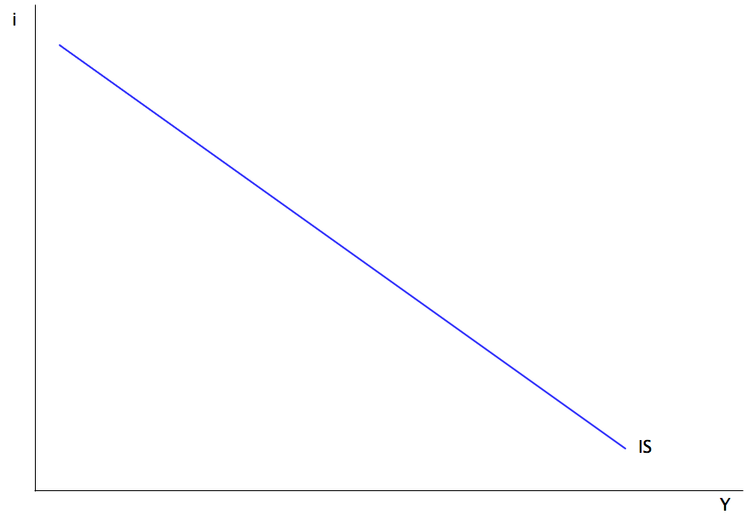
How many pageviews it gets
How much I enjoy writing a post

Slide 2

DATA ANALYSTS NOT LEARNING PYTHON
MAKES SOME SAD PANDAS

Slide 3



Every quarter
Ohio gives out free workforce development money?

Slide 4

