Slide 1
POWER PIVOT
Create PivotTables
Calculated fields/DAX
KPIs
DATA MODEL
Define relationships
Create date tables
Format columns
Calculate columns

Slide 2



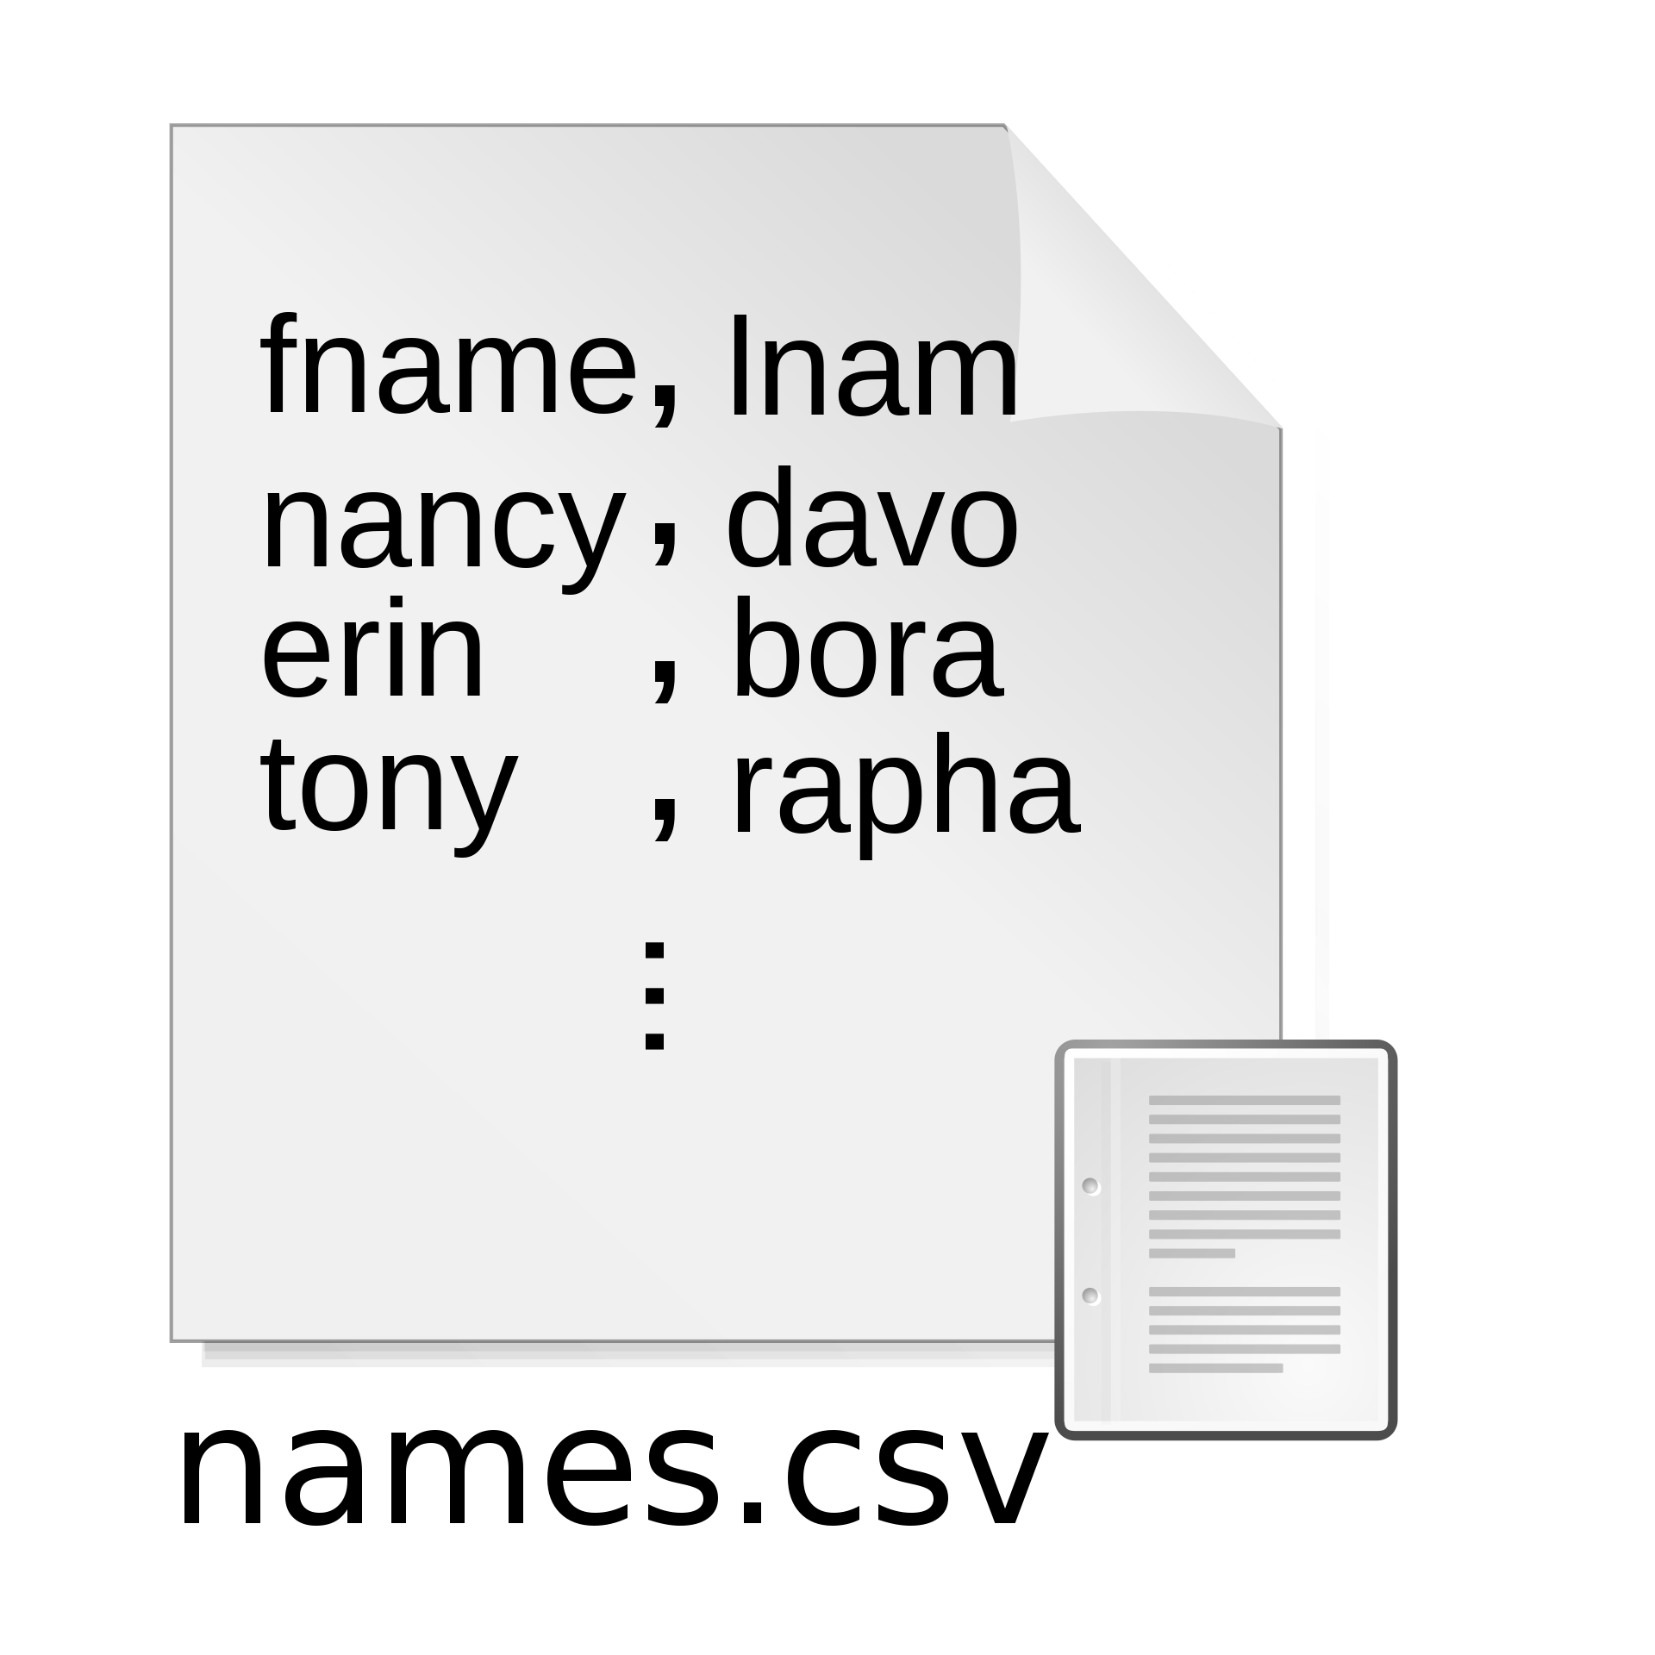


Raw data sources
Power Query Power Pivot
Power BI interactive dashboards
Extract
Transform
Load
Data model: define relationships
DAX: create measures
“Power” PivotTables

