Slide 1

Tableau data visualization
Tableau data model

Slide 2



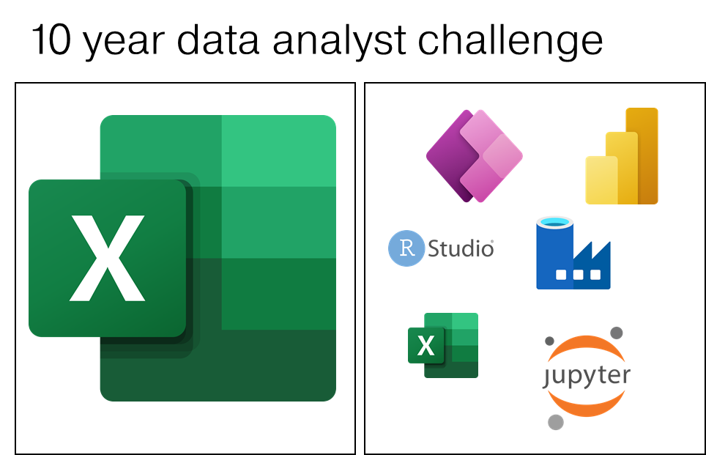



10 year data analyst challenge

