Slide 1
SMASAC - Data Collection and Filtering
GRÉGOIRE BUREL, MAYANK KEJRIWAL AND PRASHANT KHARE
Collect
Analyse
Understand & Visualise
Gather data from various information sources
Extract key information, verify trustworthiness, classify, etc.
Connect and Visualise information.

Slide 2
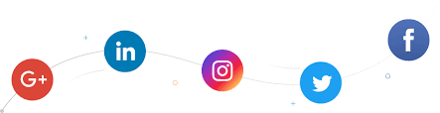
Social Media Usage during Crises
Social media usage during crises varies depending on:
Type of information shared (e.g., affected individuals, caution and advice, donation or volunteering, message of support, etc. ). (Olteanu et al, 2014)
Type of content shared (e.g., text, images, videos, links).
Content source (e.g., news organisation or journalist, eyewitness, government, NGO, company or for-profit organisation). (Olteanu et al, 2014)
Target audience (e.g., general public, other organisation, followers, friends/family).
Type of social media platform used (e.g., Facebook, Twitter, etc.)
Notes:
There is multiple challenges when dealing with social media data..

Slide 3
Access to Social Media
Automatic access to social media data can be restricted in different ways:
Public / Non-public data: Most social media websites do not allow access to the information posted unless reading access is given explicitly by the information creator.
Query restrictions: Data access can be limited by API restrictions (e.g., rate limiting, query allowance).
Data Sampling: High velocity data is sometimes sampled by social media companies. As result, it is only possible to retrieve a portion of the relevant information.
Query Filtering: Often data is retrieved using query parameters (e.g., keywords, geolocation, etc.). Access to relevant data can be negatively impacted.
Notes:
Besides the way social media is used. Data collection methods and limitations depdent on the platform used…

Slide 4
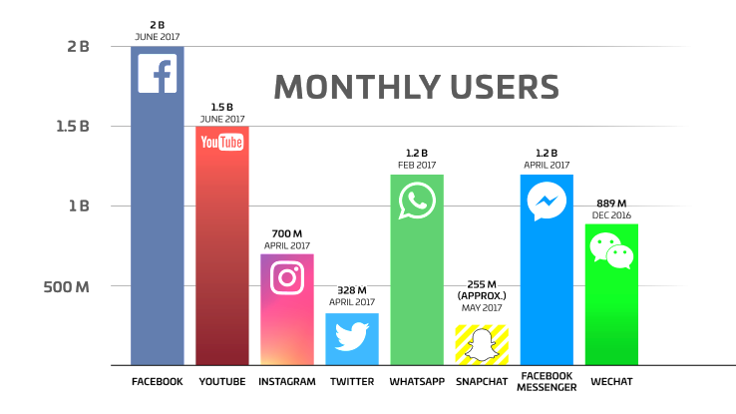
Most used Social Media Platforms
Source: https://techcrunch.com/2017/06/27/facebook-2-billion-users/
Notes:
Also, as you can see twitter is not used as widely as other methods… yet it is the most accessible platform for data collection..

Slide 5








Most used Social Media Platforms
 | Platform | API Access | Usage | Audience
 | Facebook | Low | High | Mostly Personal
 | YouTube | High | Medium | General
 | Instagram | High | - | Personal/General
 | Twitter | High | High | Mostly General
 | WhatsApp | NA | High | Personal
 | Snapchat | Low | - | Personal
 | Facebook Messenger | Low | - | Personal
 | WeChat | Low | - | Personal
Notes:
Discuss availability, api etc… for each

Slide 6
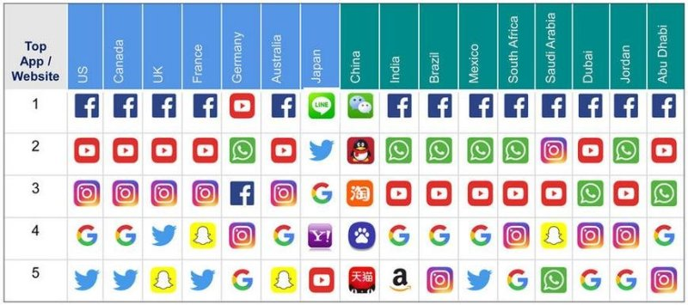
Worldwide Social Media App Usage
Notes:
Source https://techcrunch.com/2017/06/27/facebook-2-billion-users/

Slide 7
Data Collection/Processing Methods
Manual Methods
Go to social media website or solicit contributions.
Check for relevant content.
Copy/Paste content into spreadsheet.
Annotate spreadsheet.
Visualise the data.
Take action.
Automatic Methods
Use platform APIs
Perform query using the API (e.g., keyword search)
Automatically populate a database or spreadsheet.
Annotate manually or automatically the data.
Visualise the data
Take action
Notes:
Again, lets look at the approaches used for collecting data…

Slide 8
Data Collection/Processing Methods
Manual Methods
Go to social media website or solicit contributions.
Check for relevant content.
Copy/Paste content into spreadsheet.
Annotate spreadsheet.
Visualise the data.
Take action.
Automatic Methods
Use platform APIs
Perform query using the API (e.g., keyword search)
Automatically populate a database or spreadsheet.
Annotate manually or automatically the data.
Visualise the data
Take action

Slide 9

Automatic Data Collection APIs (Twitter)
Automatic data collection generally relies on JSON APIs and OAuth credentials. For example, for Twitter, you need to:
Create a Twitter account (https://twitter.com).
Obtain an OAuth access credentials (i.e., access token, access secret, consumer key and consumer secret) (https://apps.twitter.com/app/new).
Use Search API for collecting tweets (https://developer.twitter.com).
Save Tweets in JSON or other format for later analysis.
Example
$ gem install twurl
$ twurl authorize --consumer-key key \
--consumer-secret secret
$ twurl authorize --consumer-key key \
--consumer-secret secret
$ twurl "/1.1/search/tweets.json?q=earthquake“
{
"statuses": [
{
"created_at": "Mon Feb 12 10:58:42 +0000 2018",
"id": 963004430915289100,
"id_str": "963004430915289088",
"text": "RT @Independent: Magnitude 4.4 earthquake strikes near Beijing https://t.co/usygUyOkyA",
"truncated": false,
"entities": {
"hashtags": [],
"symbols": [],
"user_mentions": [
{
"screen_name": "Independent",
"name": "The Independent",
"id": 16973333,
"id_str": "16973333",
"indices": [
3,
15
]
}
],
"urls": [
{
"url": "https://t.co/usygUyOkyA",
"expanded_url": "http://www.independent.co.uk/news/world/asia/beijing-earthquake-latest-update-china-magnitude-hebei-tremors-capital-a8206336.html",
"display_url": "independent.co.uk/news/world/asi…",
"indices": [
63,
86
]
}
]
},

Slide 10

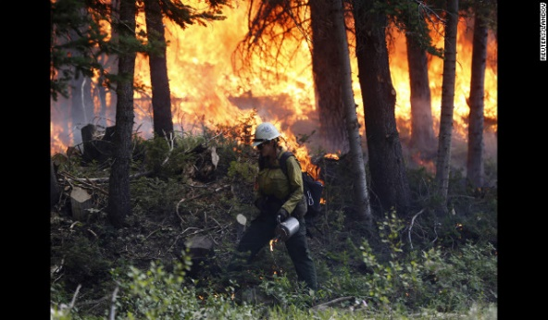
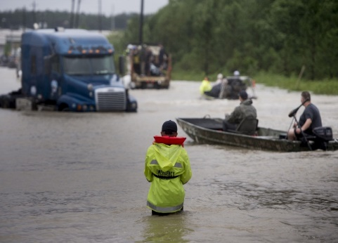
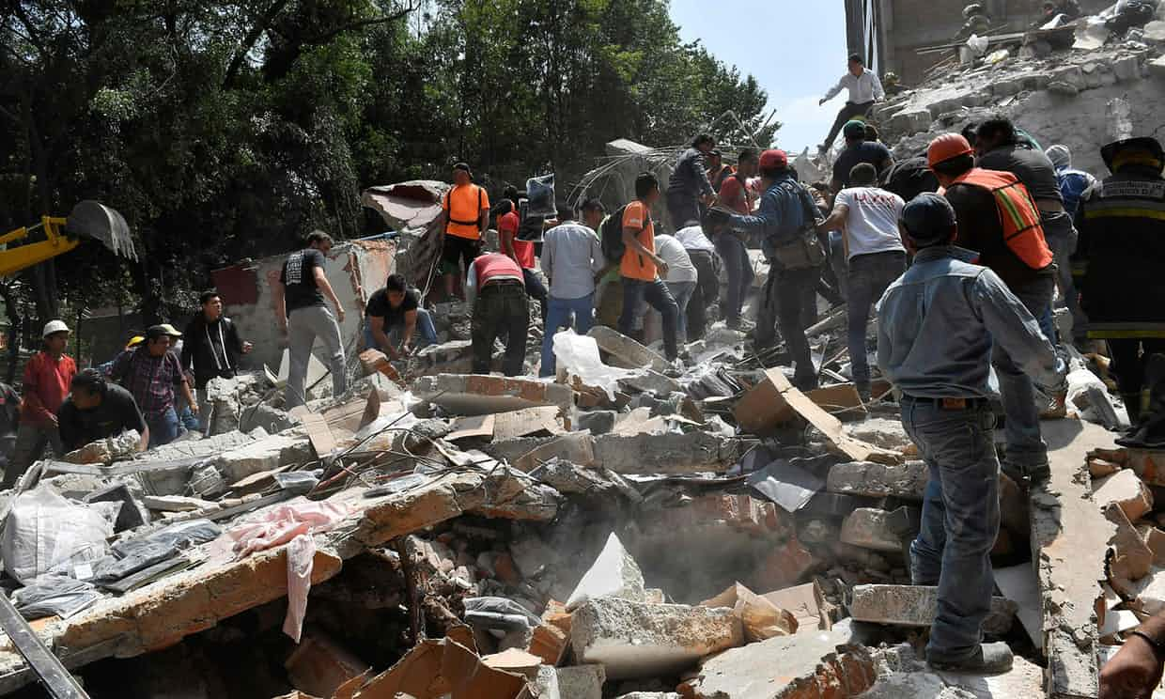
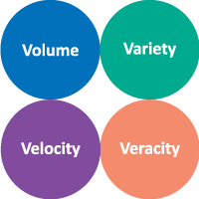
Twitter Data and Crises
People of NSW, be careful because there's fires spreading! Stay safe everyone!
Floods
CRISIS
Wildfire
Hundreds of volunteers in Mexico tried to unearth children they hoped were still alive beneath a school's ruins
Two trucks and one car in the water after a road collapse at Hwy 287 and Dillon. #cowx #boulderflood
Earthquake
Notes:
There are many tipe of crises discussed on social media…
All characterised by the 4Vs… note that we wont discuss much about veracity due to time constrains…

Slide 11
Accessing Relevant Information
Information overload:
During crises, a flood of data gets generated. For example:
Over a million tweets generated during Hurricane Harvey 2017.
500% increase in the tweets bandwidth during 2011 Japan earthquake.
The characteristics of social media posts such as short length, colloquialism, syntactic issues pose additional challenges of processing the data.
Almost impossible to manually absorb and process the sheer volume.
How do we separate crisis-related content from irrelevant information?
How to ensure that a wide range of crisis related topics across diverse crisis situations are filtered in?
Notes:
Why do we need filtering?
-> Information Overload
Other issues:
Format of messages
Too much to absorb

Slide 12
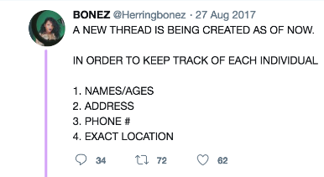


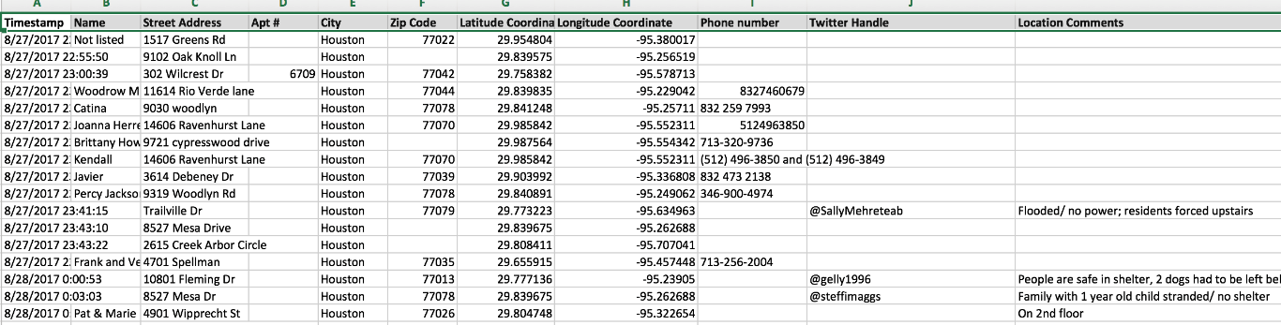
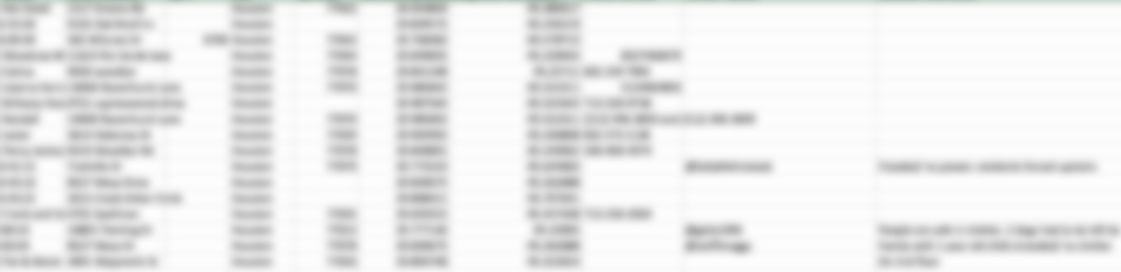
Hurricane Harvey – Data Collection/Filtering
Solicit
Information solicited on social media.
Collect and Enrich
Copy/Paste and manually extract information in spreadsheet.
Google Sheets
Notes:
How do people get information on social media during harvey?
-> they solicit help….

Slide 13
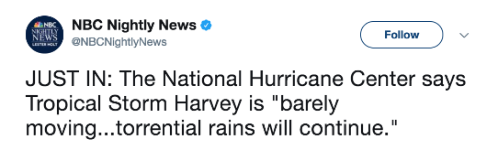
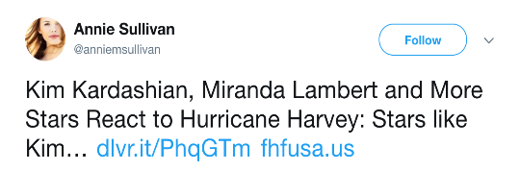
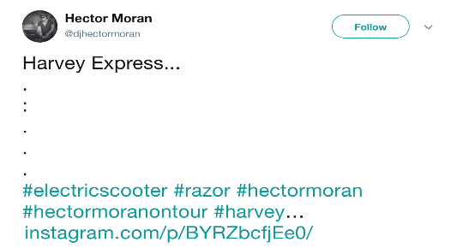
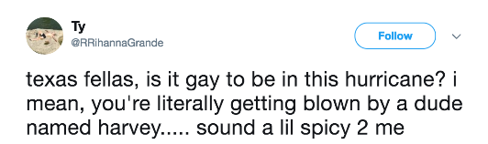
Data Curation (Filtering)
Content Curation:
Methods and processes used for gathering relevant information relevant to a particular topic of interest.
Information Filtering Systems:
Approaches for removing irrelevant and unwanted information from an information stream using partially-automated or computerized methods prior to presentation to a human user.
Notes:
Something that we need to do is to filter such data..

Slide 14


Filtering Methods
flood crisis, victims, flood victims, flood powerful, powerful storms, hoisted flood, storms amazing, explosion, amazing rescue, rescue women, flood cost, counts flood, toll rises, braces river, river peaks, crisis deepens, prayers, thoughts prayers, affected tornado, affected, death toll, tornado relief, photos flood, water rises, toll, flood waters, flood appeal, victims explosion, bombing suspect, massive explosion, affected areas, praying victims, injured, please join, join praying, prayers people, redcross, text redcross, visiting flood, lurches fire, video explosion, deepens death, opposed flood, help flood, died explosions, marathon explosions, flood relief,
Query filtering using social media APIs:
Use hashtags, keywords, crisis specific phrases or lexicon (impacted location name, canonical form of disaster name - e.g. Hurricane Harvey).
Post collection filtering (before or after storage):
Text search (similar to above).
Semantic search (requires entity extraction)*.
Automatic categorisation / Tagging (clustering approaches, topic modelling, Machine Learning models)*.
* Entity extraction methods and automatic categorization is discussed later on in this tutorial
Notes:
We can distinguish 2 types of filtering methods…

Slide 15
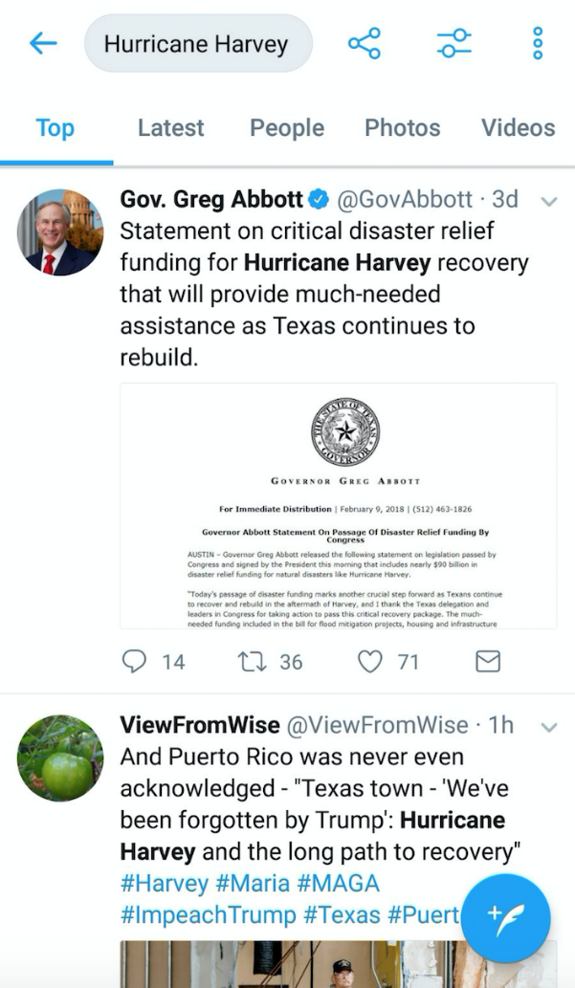
Filtering using Social Media APIs
Twitter API:
Use hashtags, keywords, crisis specific phrases or lexicon (e.g., CrisisLex lexicon).
Use Geolocation constrains (but many documents do not have geolocation information).
Use language restrictions.

Slide 16
Filtering using APIs: Information Vs Noise
Hashtag Hijacking:
Hashtags, Keywords can be a convenient way to create a broad set of data, but they do not always reflect the crisis related information.
Overly specific query terms:
The real crisis information is contained in a very diverse form.
Document geolocation may be inaccurate or missing.
Unknown situation / insufficient context:
The subjects in the information range from health/well-being of affected individuals, infrastructure, donations etc.
Obviously, various concepts together form a context which reflects relevance with the crisis situations.
Notes:
How do you filter using apis? What are the limitaitons?
Typically, you use keywords… but keywords can be:
Hijacked
too specific (miss big picture)
Insufficient to represent the situation

Slide 17
Post Collection Filtering
Text search:
More complex queries can be used after indexing the data that may be not doable using the APIs (e.g. tokenisation, query expansion, etc.)
Semantic search (requires entity extraction)*:
Semantic search can be used after extracting entities of interest from documents (e.g., place names, actors, etc.)
Automatic categorisation / Tagging (clustering approaches, topic modelling, Machine Learning models)*:
Topic modelling and clustering can discover hidden topics in the collected documents.
Machine learning can be used for filtering data (e.g., relatedness, event type, information type).
* Entity extraction methods and automatic categorization is discussed later on in this tutorial
Notes:
Post filtering…
Text search is similar…
Semantic search such as geolocation…. When geolocation is not in the document but present as an entity… E.g., what is going on in Lyon

Slide 18
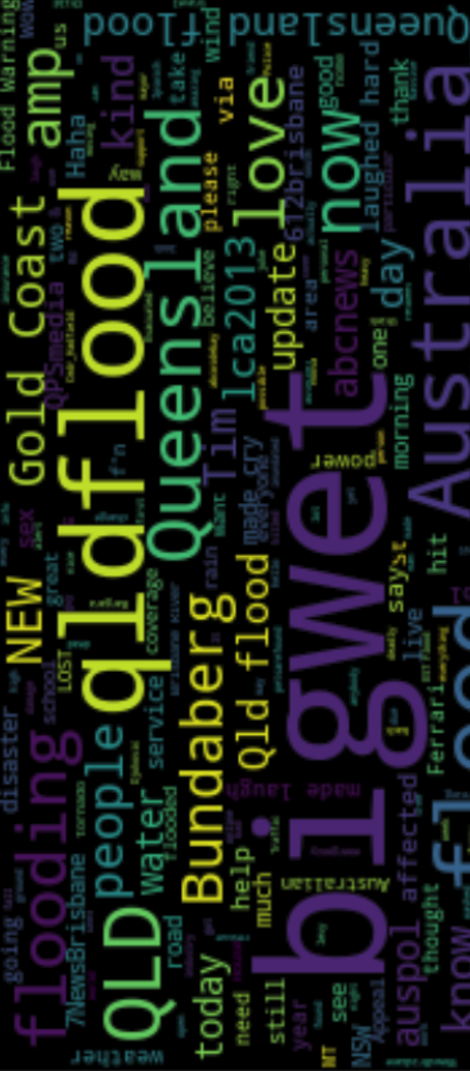
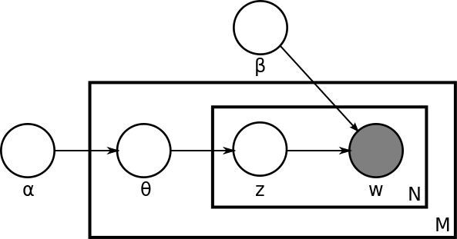
Text Clustering
A simple approach for filtering textual data is to group related documents automatically (clustering).
E.g., K-Nearest Neighbour (KNN), Latent Dirichlet Allocation (LDA) (Blei et al., 2003).
Text clustering approaches are unsupervised: manual annotations are unnecessary.
Filtering can then be done using the clusters generated by those models.
Unsupervised approaches are limited and may not always produce relevant clusters.
Notes:
Lets talk first about simple approaches that do not require specific knowledge such as annotated information.
KNN compare document representation vectors.
LDA generate document topics based on the topic associated with the individual words of a document.
Those methods can be used for filtering documents but they may not return very useful clusters (e.g., language cluster, hashtag cluster, etc.)

Slide 19

Semantic Search
Query based systems, where the relevancy of a document is established based on the context of a query (Mangold et al., 2007):
Describe events as semantic queries and use knowledge graphs and ontologies to map the data and the query.
Use of Natural Language Processing techniques and external Knowledge Graphs.
Can be tailored to a certain type of events or broad category of events.
WGS841
Notes:
Semantic search is more structured that traditional keyword search and relies on data structures that represent evens and the actors that are involved (e.g., organisations, individuals, resources, locations).
We discuss event extraction more in details later on in this tutorial.

Slide 20
Semantic Search - Motivation
Complex event/information types are non-trivial to be described by single entity or keywords.
N-grams or bag of words do not directly contain semantic information.
Search for content based on a theme/context instead of precise information.

Slide 21
Semantic Search - Approach
Extract Entities
Entity extraction is used for obtaining fined grained information within documents.
Entity extraction systems are used such as TextRazor, Dbpedia Spotlight, etc.
An indexing and search system such as Lucene/Solr is used.
A graph database store uniquely defined properties for each document
Index
The data is indexed using regular information retrieval tools or stored in a graph database.
Query
Relevant information is retrieved using entities and relations between related content.
Notes:
How semantic search work?
Extract
Collect in graph databases or index
query

Slide 22
Document Entities - Example
Alberta
Canada
Weather Hazard
Natural Hazard
High River- Town in Alberta
Flood
Police
“A 15 year old
High River
boy
is missing
due to
flood.
Call police if you
see
Eric St. Denis”
Boy-
young male
Lost
See- perceive
Person
Notes:
How entities contain context:
E.g., High river –> alberta -> Canada
You can ask things like where in Canada or in what country a person is missing?

Slide 23
Graph Representation of Tweet
Alberta Floods
rdf:Type
dbr:Canada
dbo:Country
Timestamp
myOnt:TweetEvent
myOnt:Tweet Country
dbr:Alberta
rdf:Type
myOnt:TweetCity
myOnt:CreatedAt
yago:Location
Tweet
rdf:Type
Tw:XX123
High River
myOnt:Tweet Location
myOnt:TweetText
“15 year old…”
myOnt:TweetEntity
Lost
myOnt:TweetEntity
Boy
Flood
dct:Subject
dbc:Weather Hazard
rdf:Type
dbr:Person
Concept Source: Tonon, A., Cudré-Mauroux, P., Blarer, A., Lenders, V. and Motik, B., 2017, May. ArmaTweet: Detecting Events by Semantic Tweet Analysis. In European Semantic Web Conference (pp. 138-153). Springer, Cham.
Notes:
Of course we need a representation, it can be an custom ontology or existin ontology:

Slide 24
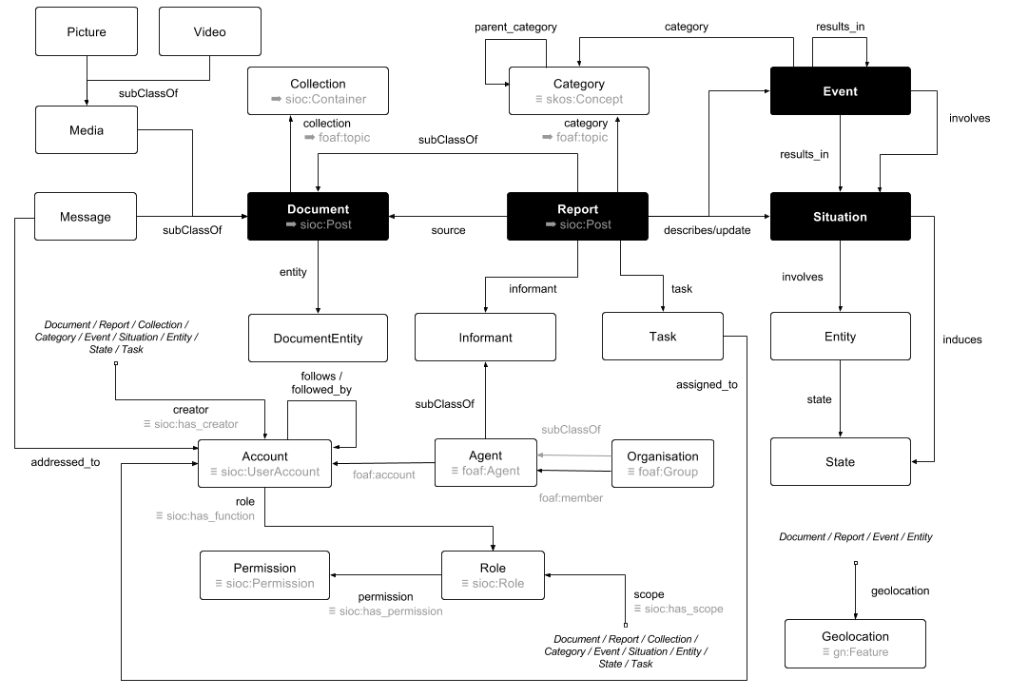
Ontological Representation
(Burel et al., 2017)
Notes:
For instance using the DoRES ontology we can ask who was involved in an event and where is this information from?

Slide 25
Automatic Data Collection on Twitter
Hands-on

Slide 26
Summary
Data collection can be done automatically using the APIs of different social media platforms.
Social media platform usage varies greatly across countries and demographics (e.g., target, information, etc.).
Access to social media data can be limited using APIs restrictions.
Multiple methods can be used for filtering quickly irrelevant information or focusing on specific content of interest.

