Slide 1
SMASAC - Classification
GRÉGOIRE BUREL, MAYANK KEJRIWAL AND PRASHANT KHARE
Collect
Analyse
Understand & Visualise
Gather data from various information sources
Extract key information, verify trustworthiness, classify, etc.
Connect and Visualise information.
Notes:
In these slides, we describe the methods for automatic text categorization, which will allow us to make sense of the heterogeneous data by sorting them into category/classes.

Slide 2
Machine Learning Classification Methods:
Supervised Approaches:
Often making use of n-grams, linguistic features, and/or statistical features of tweets.
Unsupervised Approaches:
Keyword processing and clustering.
Notes:
So, broadly there are two families of classification methods: supervised and unsupervised approaches. Usually in supervised classification methods, we first get a human annotated data which are categorised into labels and classes. And then we use these are the ground truth data to train the classifier so they can automatically learn to classify new unseen data into these labels/categories. In UNSUPERVISED classification, we do not provide any training data a priori, instead discover the related elements based on some similarity metric.

Slide 3
Popular Supervised Machine Learning methods
Support Vector Machines.
Logistic Regression
Random Forest
Decision Trees
Deep Learning (Neural Networks: CNN, RNN, LSTM)
Notes:
Often the classification problem is reduced to three main scenarios: binary, multiclass, and multi-label. In this work and demonstration, we are going explore the binary classification problem. Following are the more common machine learning algorithms that have been seen to be used in such type of problems in the literature.

Slide 4
Incorporate semantics to n-grams and BOW
n-grams are the tokenized form of the original text of a document which are used as features.
Adding semantics to individual tokens can establish a consistency within crisis relevant information and enhance the discriminative power of classifiers.
Add statistical features to the feature set to inject various statistical properties of the text.
Notes:
As a broad overview to the approach we are going to discuss- we adapt the method of adding the external semantics to the original text document. The n-grams are tokenized, and for each token if we can add the semantics, then it is expected to increase the contextual consistency within the crisis related information. And this aid the classifier in its discriminative power. Other than semantics we also extract statistical features.

Slide 5
Statistical Feature
Text length
Number of words
Presence and count of various Parts of Speech
Data specific features such as HashTags (in tweets)
Readability Score (Gunning Fox Index using average sentence length (ASL) and percentage of complex words (PCW) : 0.4*(ASL + PCW))
Notes:
As shown here we determine a number of statistical features: length, number of words, various part of speech such as noun, verbs, pronouns, hashtags, and some can also calculate the readability score that scores a tweet on how easy or complicated it is structured to read. Gunning Fox Index is one of the methods to calculate that.

Slide 6
Semantic Features
Co-occurring words (from a data corpus)
Extracted entities
Properties from knowledge graphs:
Type
Label
Subject
Same as
Contextual hierarchy – hypernyms, hyponyms, synonyms
Notes:
When it comes to the semantics, there are various additional knowledge that we can think of. Co-occurring words (words that are very common to occur together across large scale corpuses). Word-embeddings are a good example of it. Extracted entities- the fragments in the text can actually refer to a particular entity, so incorporating the entity along with the original text can sharpen the context more. Next, we can refer to the knowledge base (such as DBpedia) to retrieve extra information/properties about that entity. We can also use hierarchical context (from WordNet) to retrieve hypernyms, synonyms to each concept to generalise the context more.

Slide 7
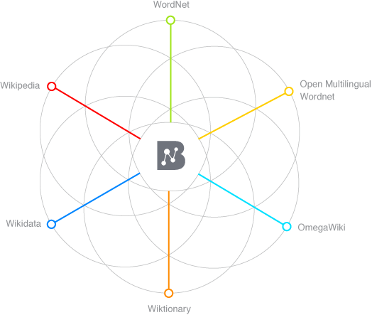
Semantic Enrichment Example
Lets us consider this Tweet from Colorado Wildfire 2012:
#HighParkFire
burn area map
as of
Monday night 10 p.m.
http://t.co/1guBTcXX
Annotated Tokens
Semantically enriched (augmented hypernyms)
burn
Burn destroy
area
area region map representation
map
Monday weekday
day_of_the_week night period
Monday
night
Image source: http://babelnet.org/about
Notes:
Here is an example of using BabelNet to semantically enrich a tweet by extracting entities and their hypernyms.

Slide 8
Feature Representation
Text : “#HighParkFire burn area map as of Monday night 10 p.m. http://t.co/1guBTcXX”
Text Tokens: {highparkfire, burn, area, map, monday}
Semantic Tokens: {area, burn, fire, destroy, region, representation, day_of_the_week}
Combined document features = Text Tokens + Semantic Tokens
{highparkfire, burn, area, map, Monday, area, burn, fire, destroy, region, representation, day_of_the_week}
Notes:
Just to get an idea about how the semantic enhancement would transform the text feature representation.

Slide 9
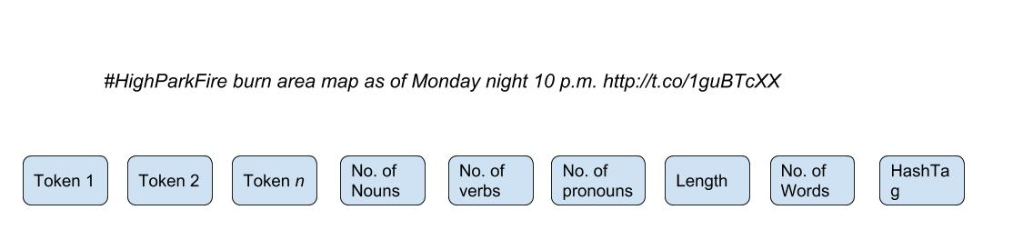
Feature Representation
Statistical Features:
Nouns = 6, verb = 0, pronoun= 0, length = 75, no. of words = 13, no. of hashtag = 1
Feature Set representation
Notes:
Now, we look at the statistical features . So, in the above example we find out following number of nouns verbs, pronouns, length etc. So the overall feature set representation looks like this. Token 1 to Token N are basically different uni-grams in a text and then these 6 statistical features. In this type of case, we utilise both the statistical attributes as well as knowledge from external knowledge bases.

Slide 10
Bottleneck!
How do you learn unless there is a data to learn from!
Notes:
While all this sounds good. We always will get stuck at a point here we require substantial labeled data to train any classification system. So, to begin with we have identified some very relevant resources!

Slide 11
Data Sources
Labelled Social Data related to Crisis is available at-
CrisisLex- http://crisislex.org/
CrisisNLP - http://crisisnlp.qcri.org/
Crisis News Sympathy- https://github.com/abdoelali/CrisisNewsSympathy
Notes:
CrisisLex is a very popular data repository which has time and again been referred to for various related research studies. Similarly CrisisNLP and CrisisNews Sympathy also have different types manually labelled crisis data.

Slide 12
CrisisLex Data (CrisisLexT26)
4 Categories of labels:
Related and Informative
Related and Not Informative
Not Related
Not Applicable
Converge to 2 labels for binary classification:
Related
Not Related
Notes:
We have used one particular data corpus from Crisis Lex, and that is called CrisisLexT26. This dataset comprises of manually labelled tweets of 26 crisis events that occurred between 2012 and 13. Each of these 26 events have close to 1000 labelled tweets. So, here they have 4 labels. We merge the two to create a binary class system.

Slide 13
An Approach
Preprocess the tweets
Extract statistical features (Stanford Core NLP, spaCy)
Perform Named Entity Recognition (IBM Alchemy, Babelfy) and extract semantics.
Merge the semantics with the original text (document)
Tokenise to generate n-grams
Pass the n-grams and statistical features to the Machine Learning Classifier
Notes:
So, as an end to end approach. We can preprocess the tweet. We can do multiple things in pre-processing such as say handling URLs (if you want to keep it, remove it), handling special characters, removing duplicate set of tweets from the data. You can handle hashtags (if you feel they are not important to your objectives). So, a lot of preprocessing can also be curated based on what your objectives are. So, after pre processing we can use spaCy or Stanford NLP tool to extarct the statistical features, then use any NER library to perform named entity recognition and linking and further generate the semantics.

Slide 14
Preprocessing
The entire data can be redundant with duplicate tweets (often gathered in the stream as retweets)
Removing the duplicates gives the classifier a scope to learn from more variety of content.
Duplicate removal can be handled via removing tokens such as ’RT’,@user_handles, and special characters and then comparing the raw form of text of a tweet with other tweets (processed similarly).
Methods such as determining cosine similarity between texts and opting a threshold to select/discard can also be applied.
Notes:
Ok. So already mentioned what you can possibly do in preprocessing.

Slide 15
Extracting Statistical Features
As earlier mentioned the statistical features may comprise of linguistic attributes and other morphological attributes such a length and number of words etc.
To determine the linguistic parameters such as occurrence of various POS tags, it is important to know the language of the text (tweet).
Language detecting libraries- detectlanguage, langdetect, TextBlob.
Extract POS using NLP tools such as spaCy, Stanford CoreNLP etc.
Notes:
So just to elaborate a little more on the statistical features, we are basically looking at the linguistic and other morphological parameters of the text. You can also extract the language using the following libraries in order to generate the statistical features.

Slide 16
Extracting Semantics
Use entity recognizing and entity linking APIs to extract entities.
Determine Dbpedia URIs+properties/BabelNet Sense/Hypernyms to extend the semantics.
Concatenate text + semantics.
Generate n-grams and pass on to binary classifier alongside statistical features to learn.
Notes:
So, from here everything which has been explained. I will demonstrate the most of it to give a fundamental idea of what this is meant to work like.

