Slide 1
Visualizations and End-to-End Systems
Collect
Analyse
Understand & Visualise
Gather data from various information sources
Extract key information, verify trustworthiness, classify, etc.
Connect and Visualise information.

Slide 2
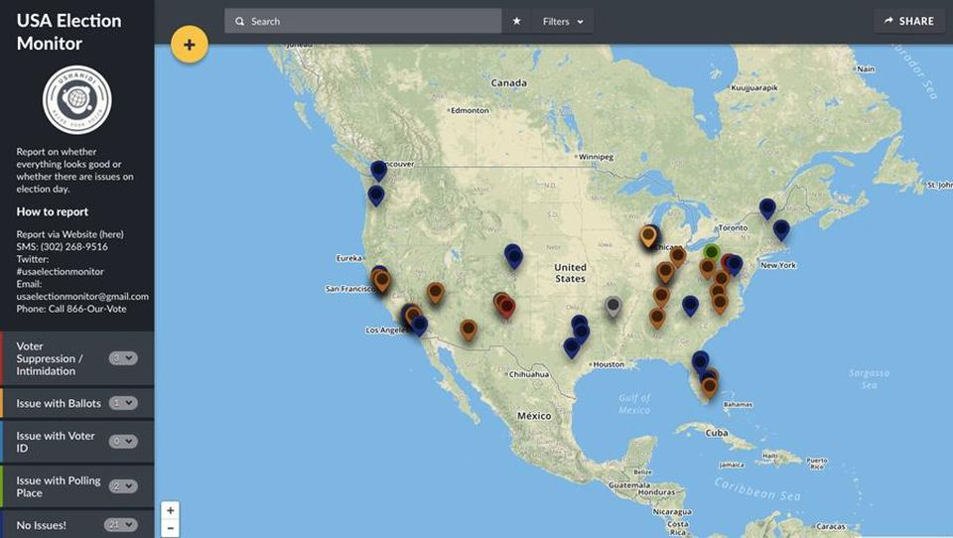
Ushahidi

Slide 3
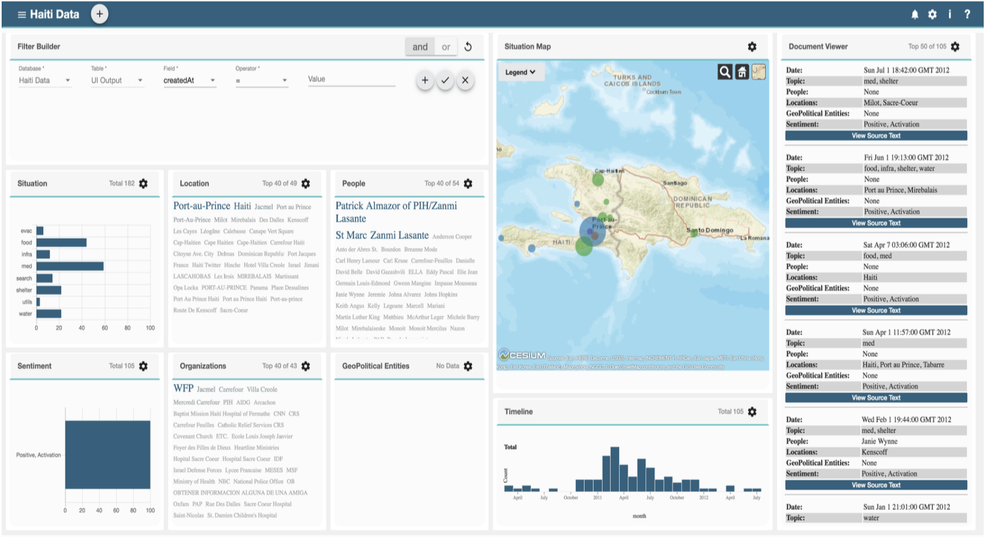
THOR

Slide 4
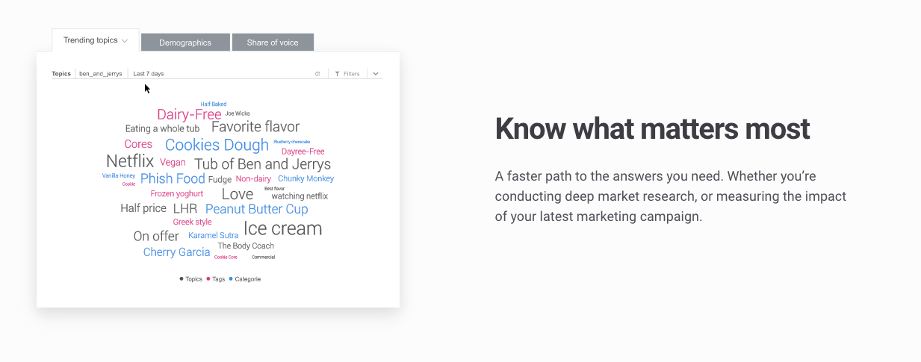
Social Data Visualization
Source: Brandwatch

Slide 5
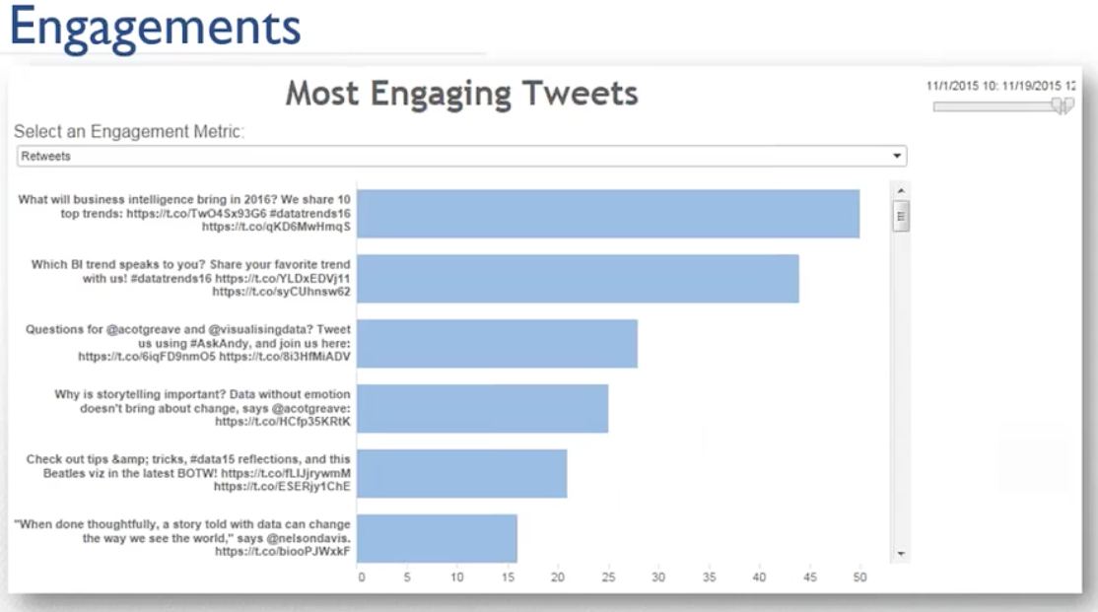
Social Data Visualization
Source: Crimson Hexagon

Slide 6
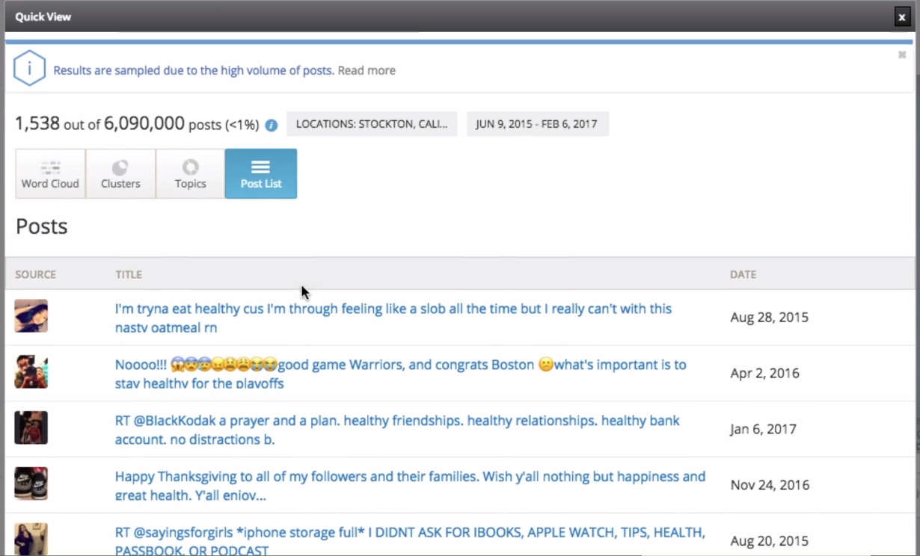
Social Data Visualization
Source: Crimson Hexagon

Slide 7
Platforms Demo
Hands-on

