Slide 1
Entity Extraction
Collect
Analyse
Understand & Visualise
Gather data from various information sources
Extract key information, verify trustworthiness, classify, etc.
Connect and Visualise information.

Slide 2
Approach
Consider a tweet T_{x} = t_{w}
Tweet is formed of words t_{w} = {w₁, w₂,… w_{n}}
Identify existing POS, entities, and concepts, and link to knowledge base such as Dbpedia or WordNet (via NLP and NER tools).
Resolve the tweet t_{w} as an n-tuple of concepts/properties.
For e.g. a quadruple (quad): subject, predicate, object, location or a collection of rdf:type of each extracted entity.
Resolve the query into semantically extended concepts from knowledge graphs.

Slide 3
n-Tuple form
{Tweet, Flood, Canada}
{Tweet, Flood, Alberta}
{Tweet, Flood, Lost, Person}
{Tweet, Lost, Person, Natural Hazard}
A tweet can be associated with multiple n-tuples.
- Schema : {Tweet, event type, location, participating entity}

Slide 4
Example Continued…
Query : “lost people in flood”
Semantic expansion of query:
Lost , missing , people, person, flood, natural hazard, weather hazard

Slide 5
Little about the knowledge graphs
A ‘graph’ — that understands real-world entities and their relationships to one another.
Another definition- A knowledge graph (i) mainly describes real world entities and their interrelations, organised in a graph, (ii) allows for potentially interrelating arbitrary entities with each other and (iv) covers various topical domains. [1]
1. Paulheim, H., 2017. Knowledge graph refinement: A survey of approaches and evaluation methods. Semantic web, 8(3), pp.489-508.

Slide 6
How are they created?
More often extracting information from Wikipedia, Wikidata, WordNet, GeoNames, VerbNet.
Wikipedia consists mainly free text with some structured information.
That includes: categories, info box, links to other entity pages, coordinates, title, abstract, relationships to other entities (people, organisation, location).

Slide 7
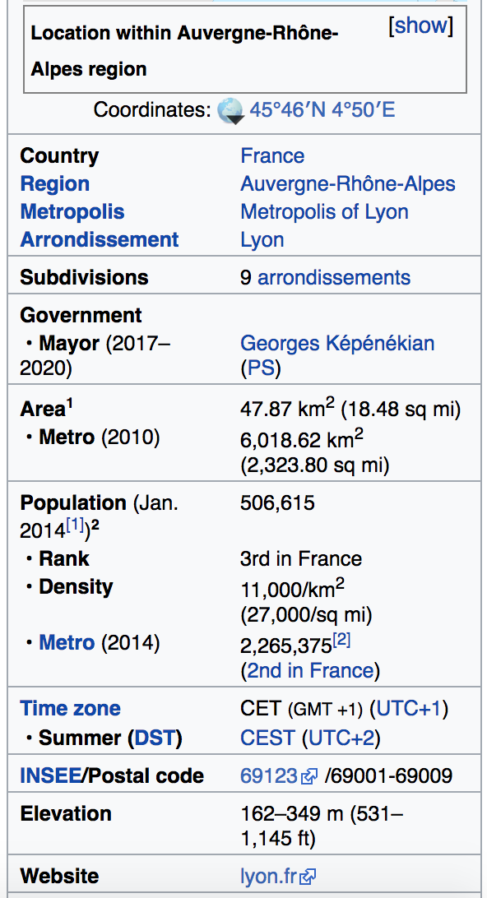
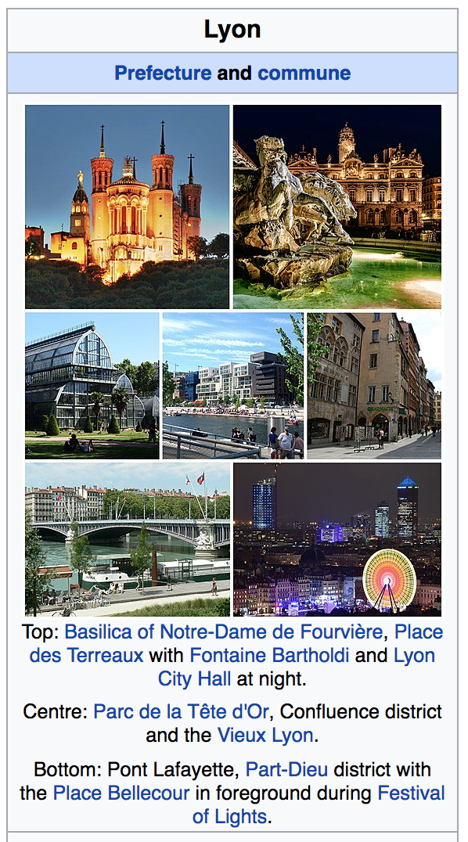
Structured Information-Wikipedia

Slide 8
Existing Knowledge base
Dbpedia
Google Knowledge Graph
BabelNet
YAGO
Wikidata

Slide 9
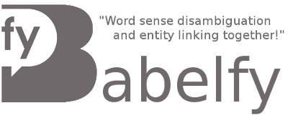




Entity Linking and Disambiguation APIs
Dbpedia Spotlight
Alchemy (IBM)
Babelfy (BabelNet)
Text Razor NLP API
Aylien Text Analysis API

Slide 10
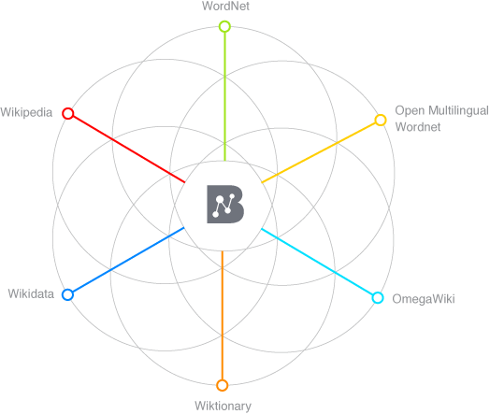
Semantic Enrichment Example
Lets us consider this Tweet from Colorado Wildfire 2012:
#HighParkFire
burn area map
as of
Monday night 10 p.m.
http://t.co/1guBTcXX
Annotated Tokens
Semantically enriched (augmented hypernyms)
burn
Burn destroy
area
area region map representation
map
Monday weekday
day_of_the_week night period
Monday
night
Image source: http://babelnet.org/about

Slide 11
Preprocessing
The entire data can be redundant with duplicate tweets (often gathered in the stream as retweets)
Removing the duplicates gives the classifier a scope to learn from more variety of content.
Duplicate removal can be handled via removing tokens such as ’RT’,@user_handles, and special characters and then comparing the raw form of text of a tweet with other tweets (processed similarly).
Methods such as determining cosine similarity between texts and opting a threshold to select/discard can also be applied.

Slide 12
Extracting Semantics
Use entity recognizing and entity linking APIs to extract entities.
Determine Dbpedia URIs+properties/BabelNet Sense/Hypernyms to extend the semantics.
Concatenate text + semantics.
Generate n-grams and pass on to binary classifier alongside statistical features to learn.

Slide 13
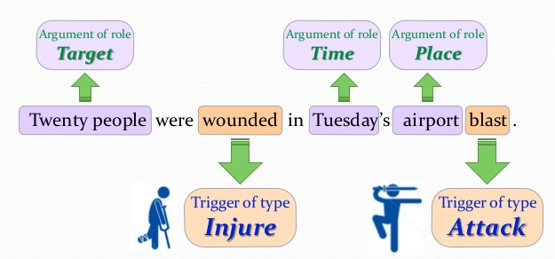
Simple Motivating Example

Slide 14
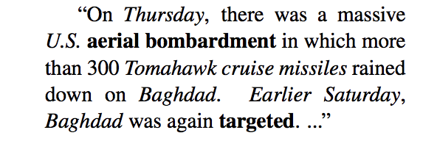
(More Complex) Motivating Example
Entities and spatio-temporal info are italicized
Event 1 anchor
Event 2 anchor
Event 1 provides context for Event 2

Slide 15
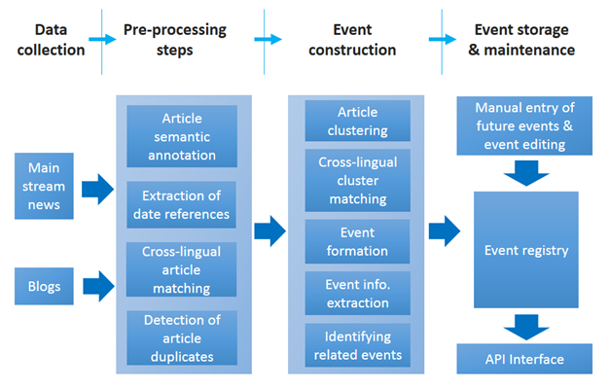
An Example Workflow

Slide 16
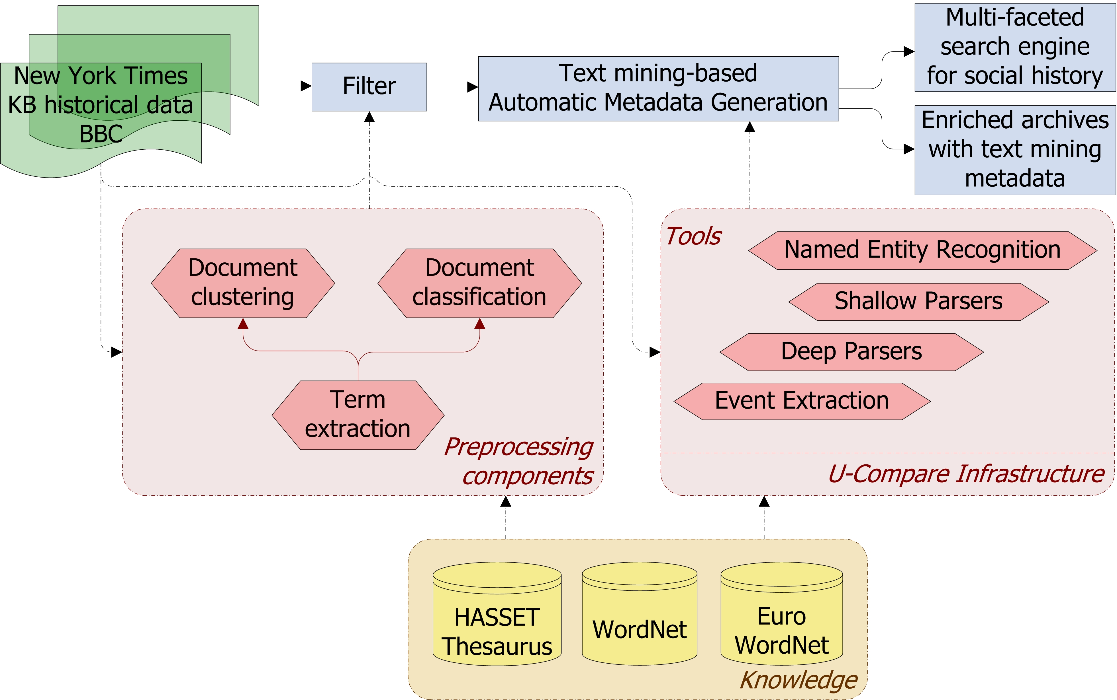
A Second Workflow

Slide 17
Classification of Techniques
Data-driven event extraction
Supervised machine learning models
Clustering
Inference models
Drawbacks?
Knowledge-driven event extraction
Lexico-syntactic patterns
Domain expertise
Knowledge bases
Drawbacks?
Hybrid systems

Slide 18
Hands-on
(Presently, could change) Yang and Mitchell’s work on joint event-entity extraction

Slide 19
Open Research Issues
Context-based advantages of data-driven, knowledge-driven or hybrid approaches
Understanding the limitations of specific event extraction techniques
The domain-dependency of event extraction procedures, affecting both their flexibility and effectiveness
The scalability of event extraction approaches when dealing with Big Data
The complexity of extracted events
Extraction from noisy sources like Twitter

Slide 20
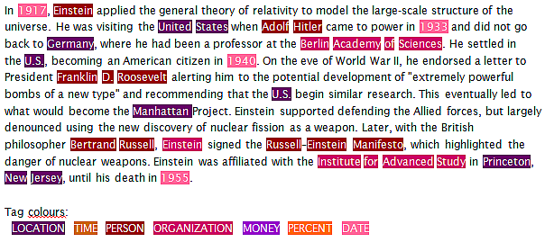
Entity Extraction aka Named Entity Recognition (NER)
NER is a classic problem in the Natural Language Processing (NLP) literature
Decades of research, with recent methods including deep learning and zero-shot learning
(Nadeau and Sakine, 2007)

Slide 21
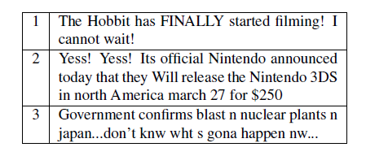
Entity Extraction aka Named Entity Recognition (NER)
NER is a classic problem in the Natural Language Processing (NLP) literature
Decades of research, with recent methods including deep learning and zero-shot learning
Social media involves some unique challenges for NER due to irregular text
(Ritter et al., 2011)

Slide 22
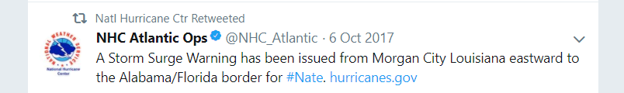

Relevance to Crisis Informatics
Many named entities mentioned in tweets and other social media

Slide 23
Relevance to Crisis Informatics
Many named entities mentioned in tweets and other social media
Extracting such entities (and also relations) enables us to pose interesting queries
What locations have received ‘Storm Surge Warnings’ from the NHC in the last 10 days?
What organizations were involved in relief efforts for Hurricane Irma?

Slide 24
Relevance to Crisis Informatics
Many named entities mentioned in tweets and other social media
Extracting such entities (and also relations) enables us to pose interesting queries
Interesting research question: what is an entity?

Slide 25
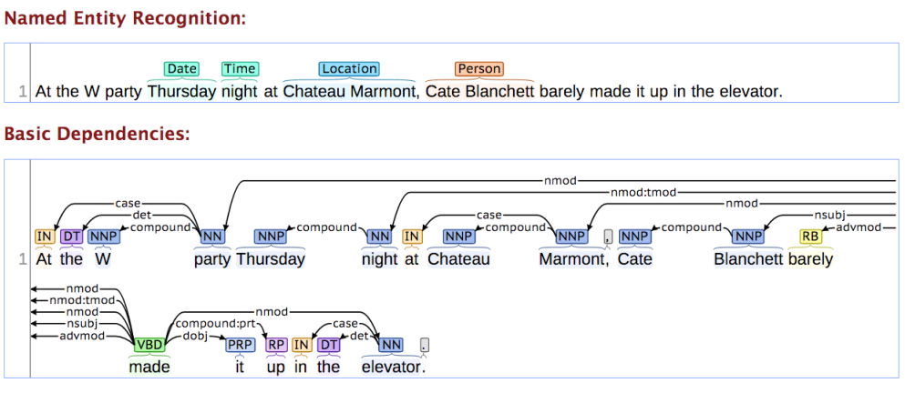
Typical NER Approach
Till recently, most models framed the problem as ‘sequence labeling’ using techniques like Conditional Random Fields and (earlier) Hidden Markov Models
(Lafferty et al., 2001)

Slide 26

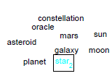

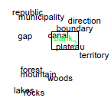

Embedding-based Models
Feature engineering was an impediment to training robust and powerful CRFs
Recently, word embeddings (and more complex sense-aware variants) have been used to address the problem

Slide 27

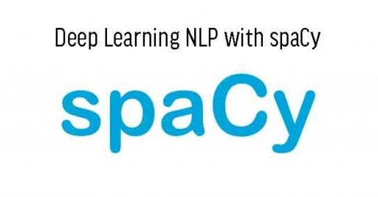


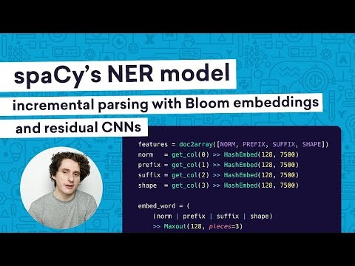
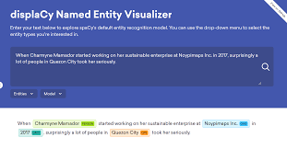
Powerful Tools and Packages Available

Slide 28
Powerful Tools and Packages Available
Demonstration of SpaCy

Slide 29
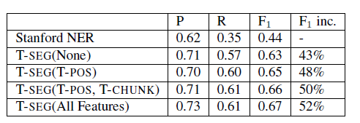
Observation: Off-the-shelf NER is Inadequate for Social Media
Example: Stanford NER (off-the-shelf) vs. T-SEG (a Twitter-specific NER tool)
P, R and F1 below stand for Precision, Recall and F1-Measure resp.
(Ritter et al., 2011)

Slide 30
Observation: Off-the-shelf NER is Inadequate for Social Media
Example: Stanford NER (off-the-shelf) vs. T-SEG (a Twitter-specific NER tool)
P, R and F1 below stand for Precision, Recall and F1-Measure resp.
Training Twitter-specific models and using Twitter-specific features offers significant performance advantages
(Ritter et al., 2011)

Slide 31
Twitter-specific NER Systems
Common Themes
Impact
Best systems maximize ‘signal’ by leveraging joint contexts, distributional similarity, word embeddings and even URLs
Geotagging tweets has emerged as its own ‘mini-area’ of research in the KDD, SW and WWW communities
Performance is improving slowly, albeit still far from performance on traditional inputs like newswire
Social-media specific NLP packages have emerged e.g., ArkNLP, T-SEG; workshops, shared competitions etc.
Lots of research into how to parse irregular text, NLP methods have arguably become more robust as a result
Spurred research on joint models, cross-domain entity linking

Slide 32
Classic System: T-SEG
First system to (arguably) show that Twitter-specific NER far outperforms off-the-shelf state-of-the-art NERs
Standard features (e.g., POS tags), with some optimized for Twitter
Twitter-specific features include new tags for hashtags, retweets etc.
Showed results earlier
In-domain training data (i.e. actual tweets)
Also used IRC chat data to supplement small training data
Used distributional similarity to account for spelling variations, predated similar ‘word embedding’ techniques like fastText by many years (conceptually)!
Clusters words like ‘tomarrow’, ‘tomm’, ‘tommarow’, ‘tommarrow’
(Ritter et al., 2011)

Slide 33
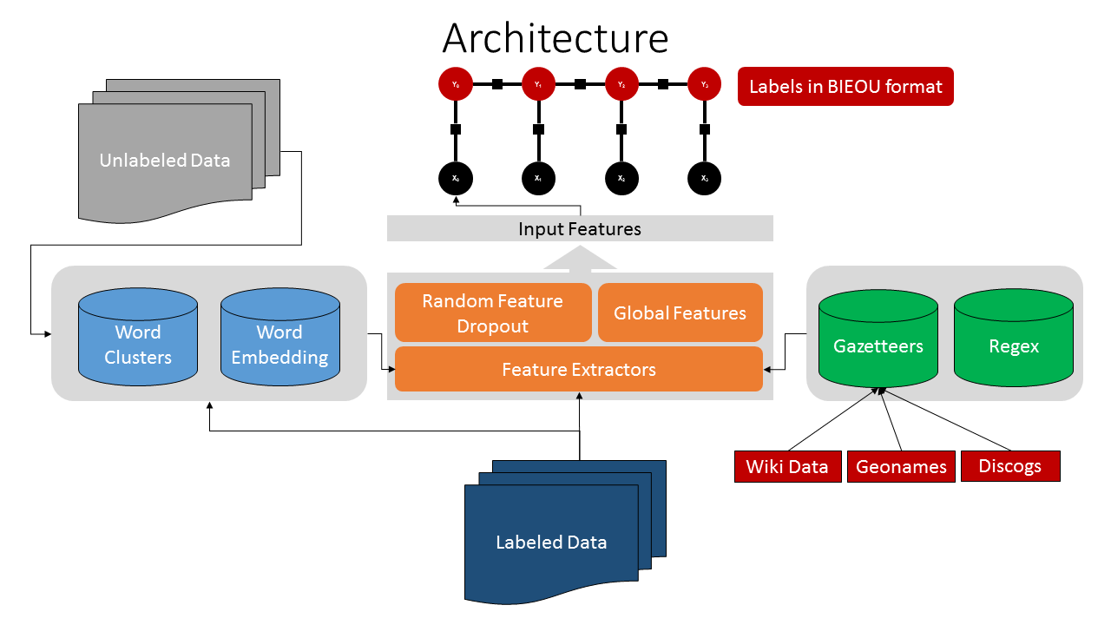
More Recent: TwitterNER
(Mishra and Diesner, 2013)

Slide 34
ArkNLP
Social-media specific NLP packages have emerged e.g., ArkNLP
Lots of research into how to parse irregular text, NLP methods have arguably become more robust as a result
Spurred research on joint models, cross-domain entity linking
Performance is improving slowly, albeit still far from performance on traditional inputs like newswire
Demonstration of TwitterNER

Slide 35
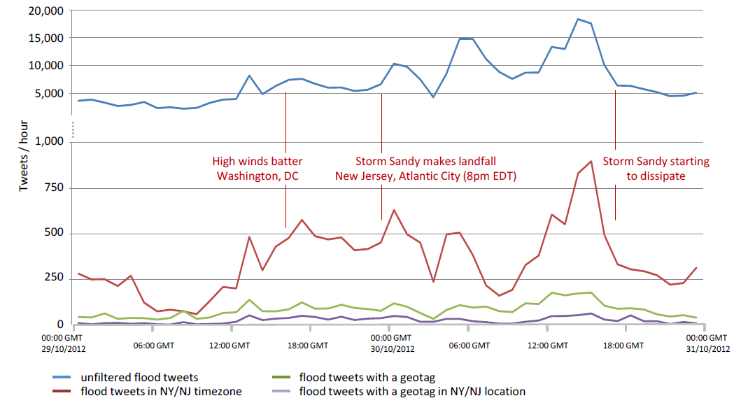
How to improve performance even further?
Models can be made more precise by treating each entity type (such as locations) individually i.e. train type-specific models
In some instances, entities can be ‘extracted’ despite not being explicitly present in the text (e.g., geotagging)
(Middleton, Middleton and Modafferi, 2014)

Slide 36
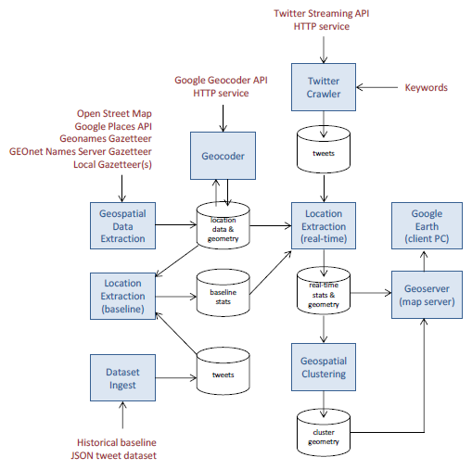
Example of crisis domain-specific geotagging system
Examples of domain-specific components
(Middleton, Middleton and Modafferi, 2014)

Slide 37
Open Research Issues
Accuracy still low for social media (SM) NER, how to improve performance without increasing training annotations?
How to work directly with noisy inputs (e.g., machine translated texts) and consume noisy NER outputs?
NER for cross-domain and multi-lingual/non-English SM
Chinese social media (He and Sun, AAAI’17)
How to leverage external contexts such as URLs in tweets, images, multi-modal signals, entity linking to sources like DBpedia...?
Can significantly enhance the ‘signal’ in the data e.g., see (Gattani et al., VLDB’13)
How to combine NER and event identification/extraction models by leveraging joint context?
Promising work in this area e.g., (Vavliakis et al., DKE, 13)
Novel applications and interfaces for crisis informatics pipelines

