Slide 1
Event Extraction
Collect
Analyse
Understand & Visualise
Gather data from various information sources
Extract key information, verify trustworthiness, classify, etc.
Connect and Visualise information.

Slide 2
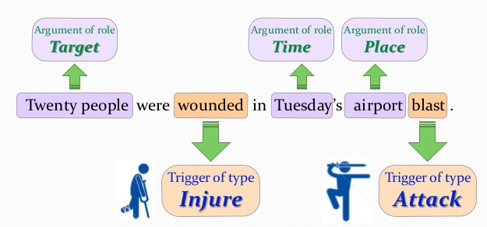
Simple Motivating Example

Slide 3
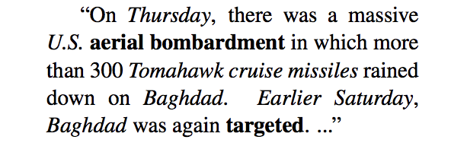
(More Complex) Motivating Example
<Entities and spatio-temporal info are italicized>
Event 1 anchor
Event 2 anchor
Event 1 provides context for Event 2

Slide 4
Definition: Event Extraction
Given an event ontology O, and a text corpus of documents, event extraction is the problem of automatically extracting instances (‘events’) in terms of the event classes in O
Because of the ontology, events are structured representations amenable to querying/analytics
What do real-world event ontologies ‘look’ like?

Slide 5
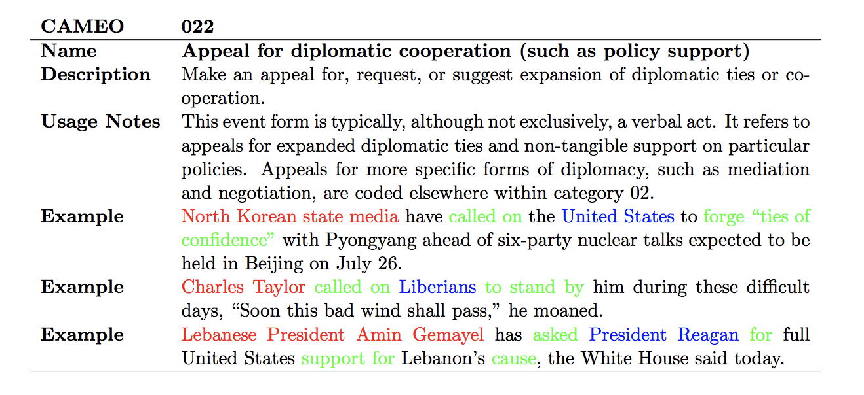
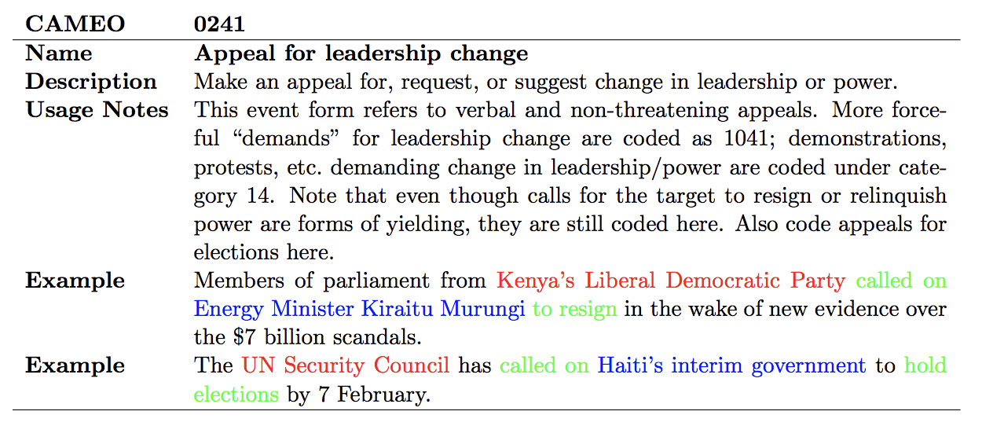
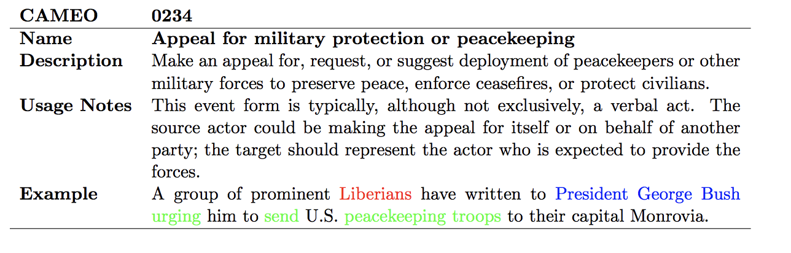
Examples of event classes in CAMEO ontology

Slide 6
Events involve entities, relations, triggers, verbs, modifiers…
A much harder problem than just extracting entities!
Correctly classifying an extracted event with respect to an event type in ontologies like CAMEO (containing hundreds of types) also difficult
Event co-reference resolution also a hard problem: F-measures well below 50% in state of the art systems

Slide 7
In Social Media…
Additional problem of first detecting whether the tweet is describing an event
Can be defined as a binary classification problem: does the tweet describe an event or not?
Short text of tweet makes this essential for performance
Detection and extraction complement each other
Forces us to decide what an event really is, for the purposes of extraction/detection/inference

Slide 8
Event Detection in Twitter: Examples
RT @jc_stubbs: Another tragic day in #Ukraine – More than 50 rebels killed as new leader unleashes assault: http://t.co/wcfU3kyAFX
RT @Stump4TrumpPAC: These are the 58 people killed in the Las Vegas massacre, the deadliest mass shooting in modern U.S. history.. 💐🙏🏻 http…
RT @dragoner_JP: うげえ……「ラスベガス銃撃の(カナダ人)犠牲者が巨額の医療費に直面」→ Las Vegas shooting victims facing large medical bills https://t.co/1F3bgH17Jv

Slide 9
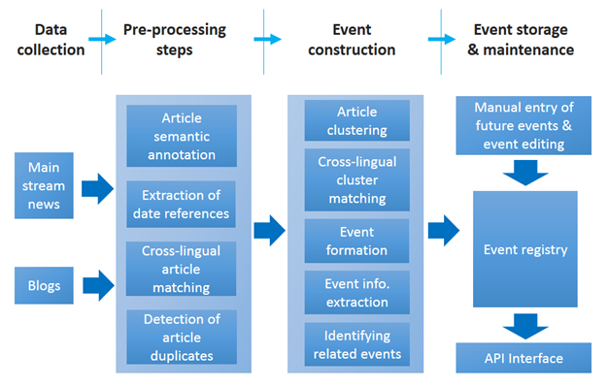
An Example Workflow

Slide 10
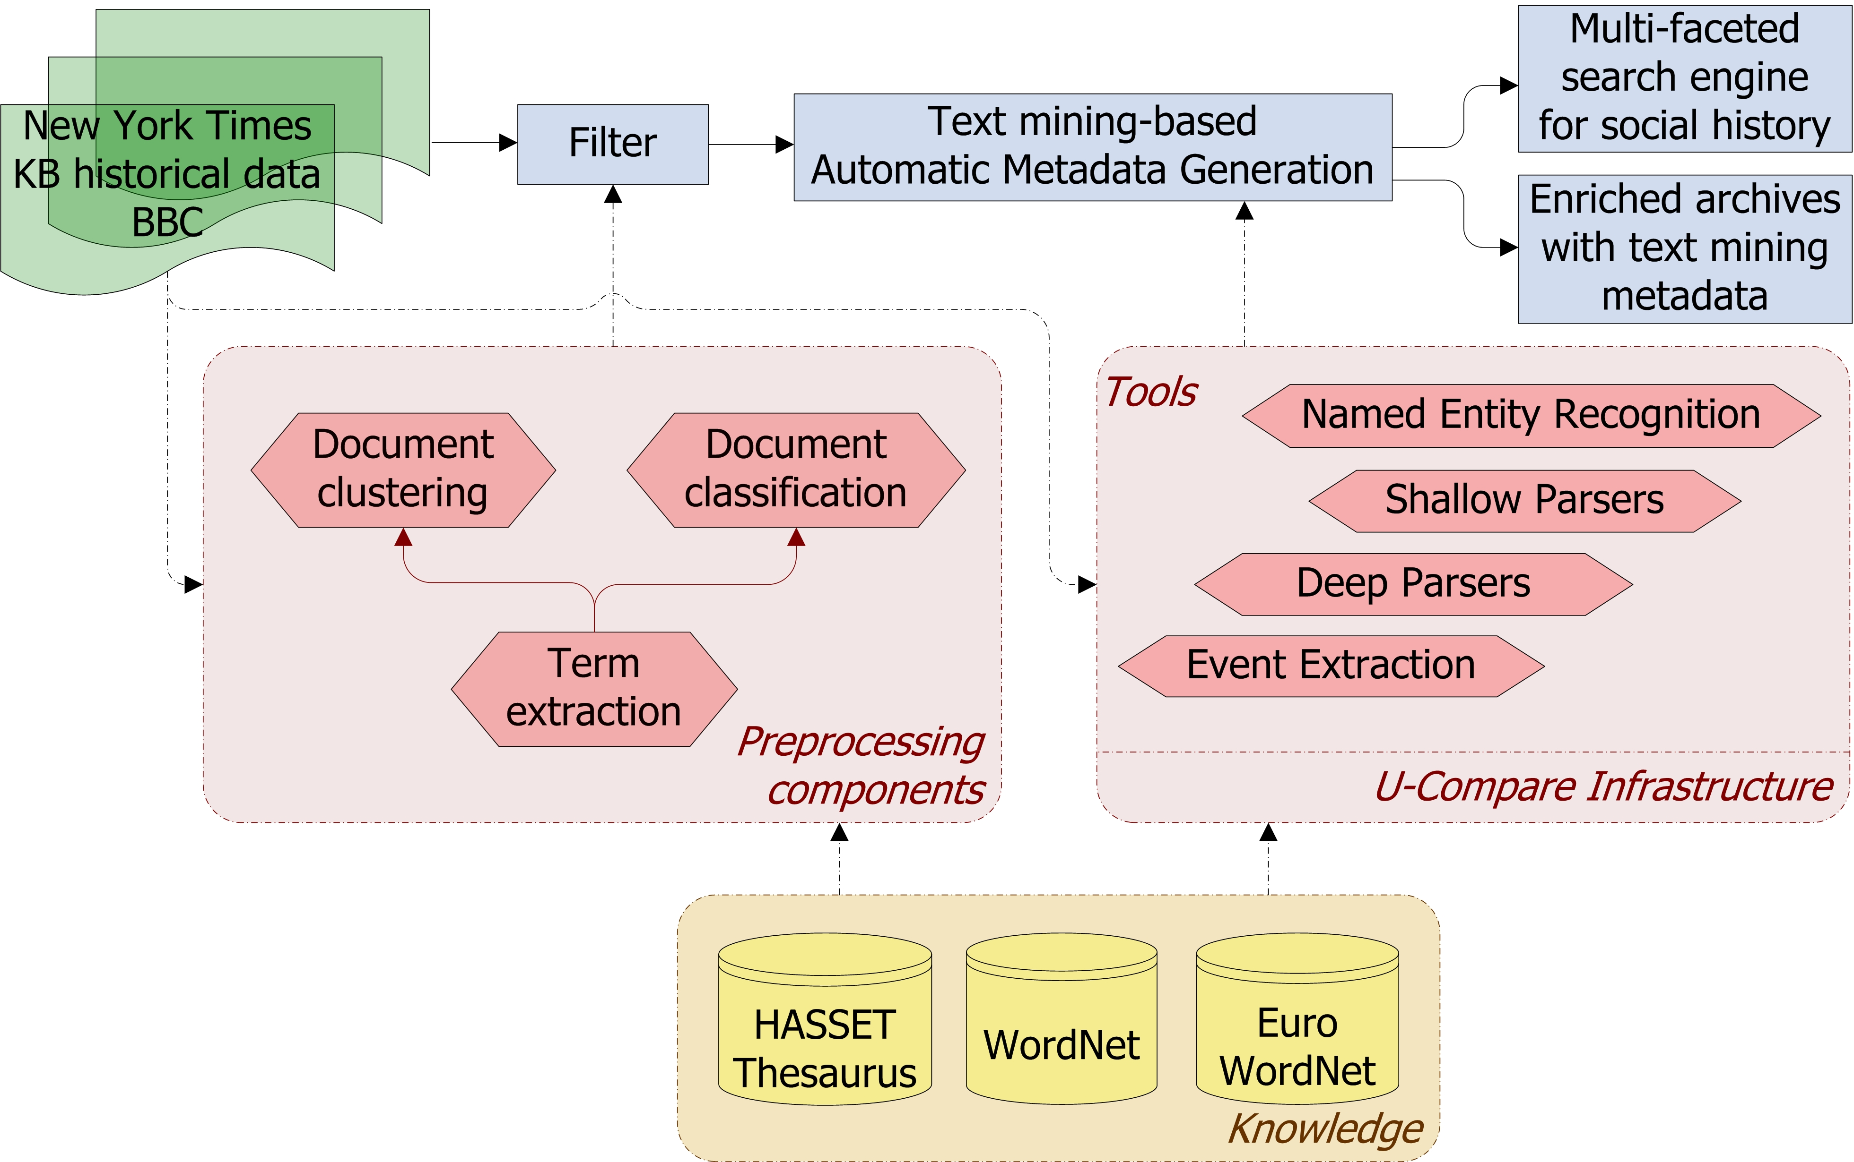
A Second Workflow

Slide 11
Classification of Techniques
Data-driven event extraction
Supervised machine learning models
Clustering
Inference models
Drawbacks?
Knowledge-driven event extraction
Lexico-syntactic patterns
Domain expertise
Knowledge bases
Drawbacks?
Hybrid systems

Slide 12
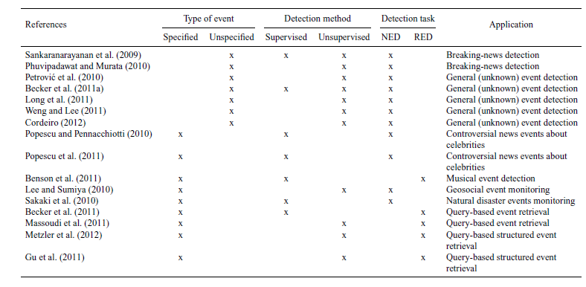
Event Detection in Twitter: A Taxonomy
Notes:
We show

Slide 13
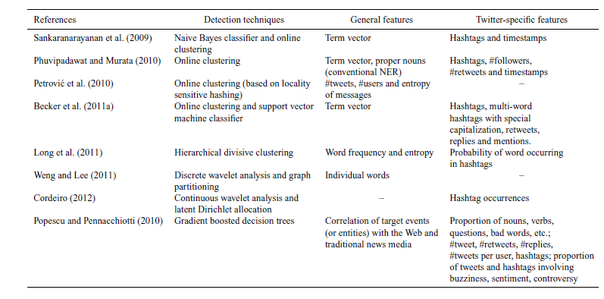
Feature Representation

Slide 14
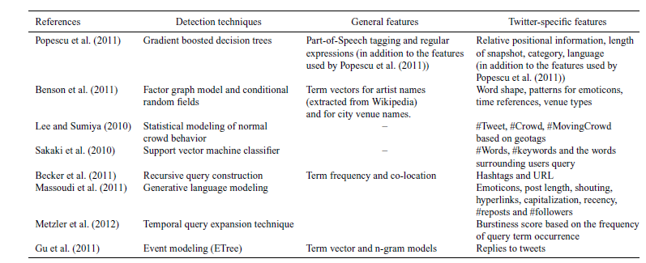
Continued

Slide 15
Open Research Issues
Context-based advantages of data-driven, knowledge-driven or hybrid approaches
Understanding the limitations of specific event extraction techniques
The domain-dependency of event extraction procedures, affecting both their flexibility and effectiveness
The scalability of event extraction approaches when dealing with Big Data
The complexity of extracted events
Better extraction from noisy sources, including social media

Slide 16
Open Research Issues
More accurate filtering
Improved techniques to combine and analyze information from multiple sources and languages
Enhanced summarization and visualization
Non-static and non-stationarity assumptions
More principled and robust evaluations

Slide 17
Summary

