Slide 1
SMASAC - Entity Extraction/Named Entity Recognition (NER)
GRÉGOIRE BUREL, MAYANK KEJRIWAL (PEDRO SZEKELY) AND PRASHANT KHARE
Collect
Analyse
Understand & Visualise
Gather data from various information sources
Extract key information, verify trustworthiness, classify, etc.
Connect and Visualise information.

Slide 2
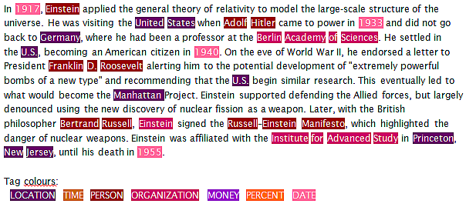
Named Entity Recognition (NER)
NER is a classic problem in the NLP literature
Decades of research, with recent methods including deep learning
(Nadeau and Sakine, 2007)

Slide 3
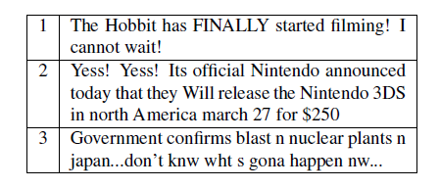
Named Entity Recognition (NER)
NER is a classic problem in the NLP literature
Decades of research, with recent methods including deep learning
Social media involves unique NER challenges due to irregular text
(Ritter et al., 2011)

Slide 4
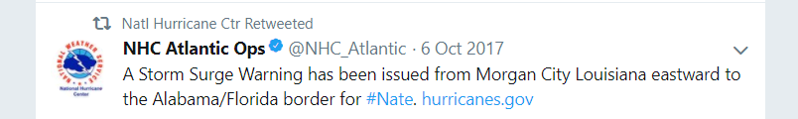
Named Entity Recognition (NER)
NER is a classic problem in the NLP literature
Decades of research, with recent methods including deep learning
Social media involves unique NER challenges due to irregular text
Crisis data is even more difficult due to presence of ‘uncommon’ entity types (e.g., weather warnings)
(Ritter et al., 2011)

Slide 5
Definition: NER
Given a set of entity types (e.g., PERSON, LOCATION, ORGANIZATION...) and a text corpus, automatically detect and extract typed instances (entities) from the text
The finer-grained the types (or the ontology), the harder the problem!

Slide 6

Motivation for NER
Many named entities in tweets and social media

Slide 7
Motivation for NER
Many named entities mentioned in tweets and other social media
Extracting such entities (and also relations) enables semantic search and analytics applications
What locations have received ‘Storm Surge Warnings’ from the NHC in the last 10 days?
What organizations were involved in relief efforts for Hurricane Irma?

Slide 8
Motivation for NER
Many named entities mentioned in tweets and other social media
Extracting such entities (and also relations) enables us to pose interesting queries
Interesting research question: what is an entity?
Weather warnings, disaster types, wind speeds…

Slide 9
Motivation for NER
Many named entities mentioned in tweets and other social media
Extracting such entities (and also relations) enables us to pose interesting queries
Interesting research question: what is an entity?
Good entity extraction proves crucial in event extraction, a much harder problem (covered later)

Slide 10
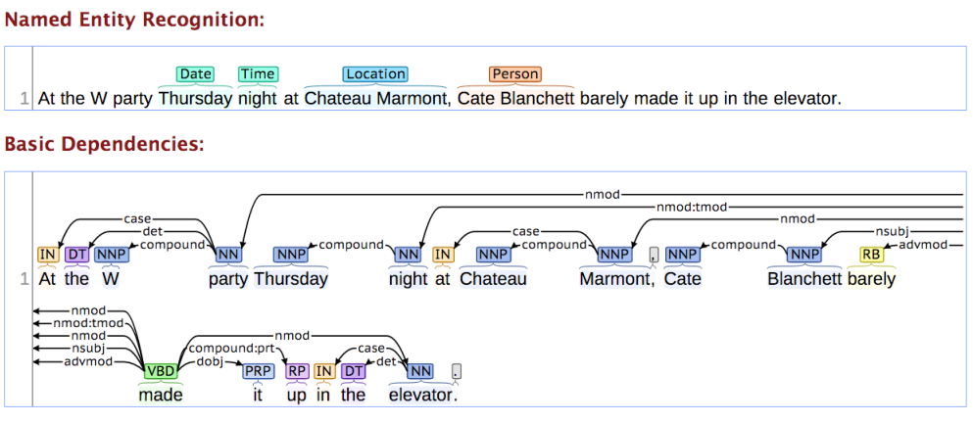
Classic NER Approach
Till recently, most models framed the problem as ‘sequence labeling’ using techniques like Conditional Random Fields or (earlier) Hidden Markov Models
(Lafferty et al., 2001)

Slide 11
Embedding-based Models
Feature engineering was an impediment to training robust and powerful CRFs
Recently, word embeddings (and more complex sense-aware variants) have been used to address the problem
(Mikolov et al., 2013)

Slide 12

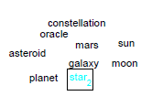

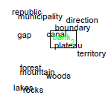

Embedding-based Models
Feature engineering was an impediment to training robust and powerful CRFs
Recently, word embeddings (and more complex sense-aware variants) have been used to address the problem
Demonstration of fastText over Twitter data

Slide 13

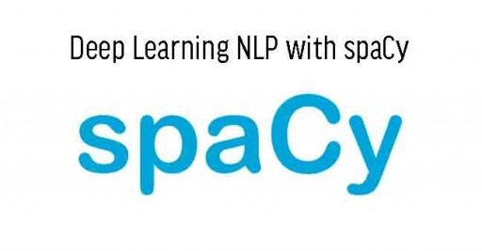



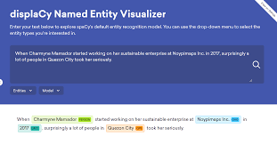
Powerful Tools Available

Slide 14
Powerful Tools Available
Tools like SpaCy and Stanford NER can work directly with embeddings

Slide 15
Powerful Tools Available
Demonstration of SpaCy

Slide 16
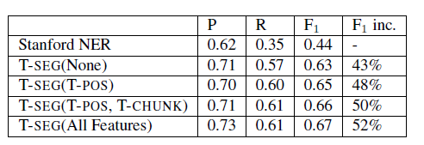
Are Off-the-shelf Tools Good Enough?
Example: Stanford NER (off-the-shelf) vs. T-SEG (a Twitter-specific NER tool)
P, R and F1 below stand for Precision, Recall and F1-Measure resp.
(Ritter et al., 2011)

Slide 17
Are Off-the-shelf Tools Good Enough?
Example: Stanford NER (off-the-shelf) vs. T-SEG (a Twitter-specific NER tool)
P, R and F1 below stand for Precision, Recall and F1-Measure resp.
Training Twitter-specific models and using Twitter-specific features offers significant performance advantages
(Ritter et al., 2011)
Notes:
But more recently, packages like spacy have made enormous progress in dealing with noisy data, given their ubiquity

Slide 18
Twitter-specific NER Systems
Common Themes
Impact
Best systems maximize ‘signal’ by leveraging joint contexts, distributional similarity, word embeddings and even URLs
Geotagging tweets has emerged as its own ‘mini-area’ of research in the KDD, SW and WWW communities
Performance is improving slowly, albeit still far from performance on traditional inputs like newswire
Social-media specific NLP packages have emerged e.g., ArkNLP, T-SEG; workshops, shared competitions etc.
Lots of research into how to parse irregular text, NLP methods have arguably become more robust as a result
Spurred research on joint models, cross-domain entity linking
Notes:
However, the best performance still tends to be achieved by Twitter-specific NER systems. These systems have some common themes, and we describe both a classic and a more recent example shortly. In the notebooks, a link and description is provided for TwitterNER, a recently developed system

Slide 19
Classic System: T-SEG
First system to (arguably) show that Twitter-specific NER far outperforms off-the-shelf state-of-the-art NERs
Standard features e.g., POS tags, with some optimized for Twitter
Twitter-specific features include new tags for hashtags, retweets etc.
Showed results earlier
In-domain training data i.e. actual tweets
Also used IRC chat data to supplement small training data
Used distributional similarity to account for spelling variations,
Predated similar ‘word embedding’ techniques like fastText by many years (conceptually)!
Clusters words like ‘tomarrow’, ‘tomm’, ‘tommarow’, ‘tommarrow’
(Ritter et al., 2011)

Slide 20
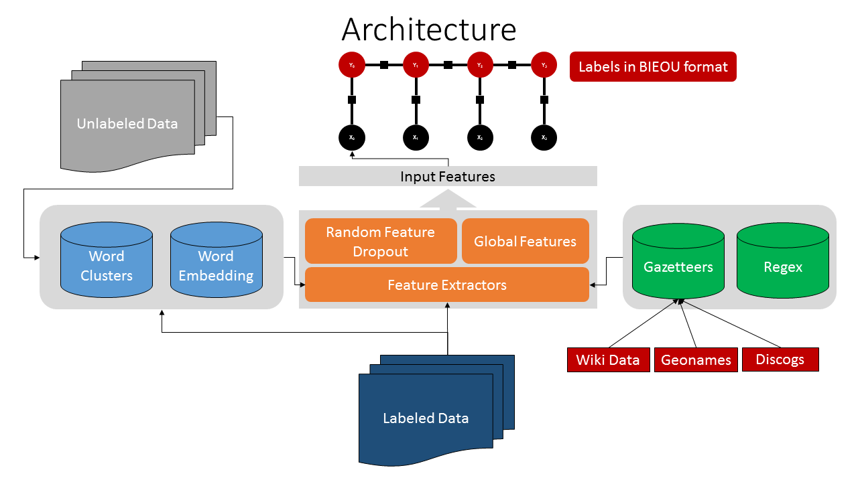
More Recent System: TwitterNER
(Mishra and Diesner, 2013)
Notes:
Show people the link to TwitterNER in the notebook, but we will not be doing the hands on in the tutorial

Slide 21
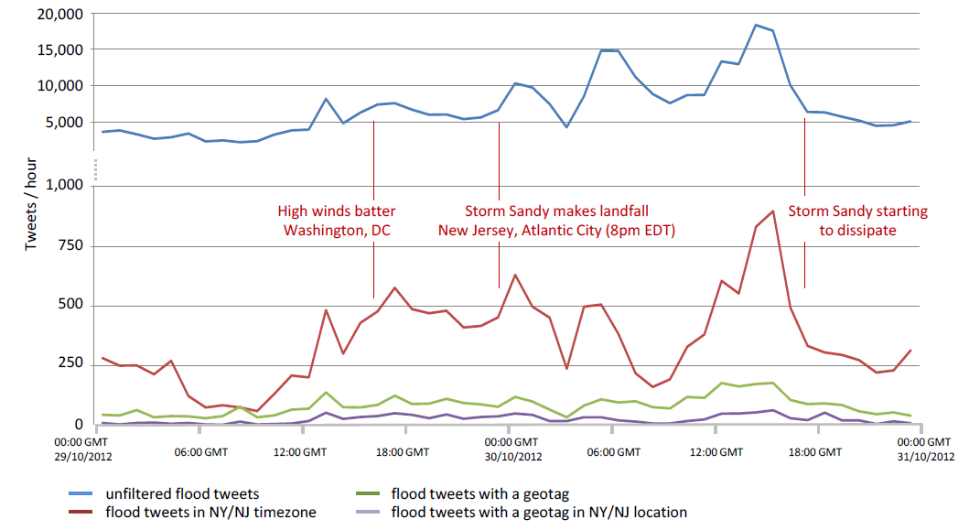
How to Further Improve?
Models can be made more precise by treating each entity type (such as locations) individually i.e. train type-specific models
In some instances, entities can be inferred despite not being explicitly present in the text (e.g., geotagging)
(Middleton, Middleton and Modafferi, 2014)

Slide 22
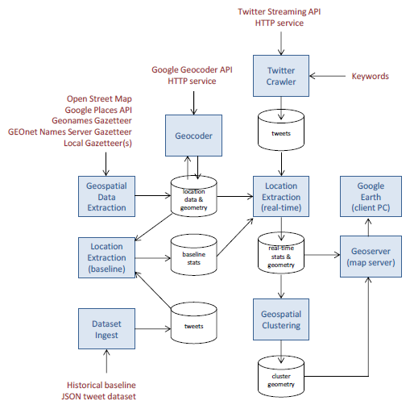
Example of crisis domain-specific geotagging system
Examples of domain-specific components
(Middleton, Middleton and Modafferi, 2014)

Slide 23
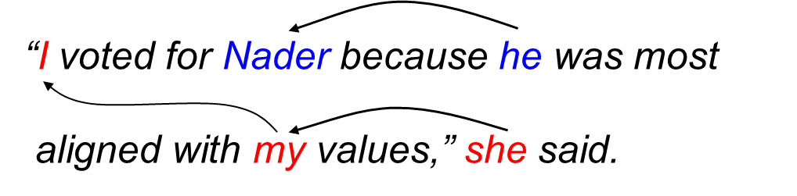
What happens after NER?
What if the same entity got extracted multiple times in the text?
What is the same entity got extracted multiple times in multiple texts?
NER system can’t tell that it is dealing with ‘one’ entity…treats every extraction as separate!
Notes:
This problem is known as co-reference resolution and is very difficult

Slide 24
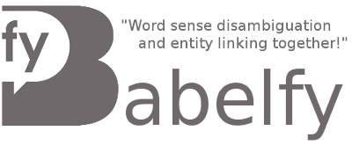




Entity Linking/Resolution
Entity Resolution is the problem of automatically determining when a pair of entities (extracted or otherwise) refers to the same underlying entity
DBpedia Spotlight
Alchemy (IBM)
Babelfy (BabelNet)
Text Razor NLP API
Aylien Text Analysis API
Notes:
In the NLP community one tries to link the entity extractions to a canonical knowledge base like Dbpedia. Other communities pursue the same problem in slightly different ways (e.g., record linkage)

Slide 25
Open Research Issues
Accuracy still low for social media (SM) NER
How to improve performance without increasing training annotations?
How to work directly with noisy inputs (e.g., machine translated texts) and consume noisy NER outputs?
NER for cross-domain and multi-lingual/non-English SM
Chinese social media (He and Sun, AAAI’17)

Slide 26
Open Research Issues
How to leverage external contexts such as URLs in tweets, images, multi-modal signals, entity linking to sources like DBpedia...?
Can significantly enhance the ‘signal’ in the data e.g., see (Gattani et al., VLDB’13)
How to combine NER and event identification/extraction models by leveraging joint context?
Promising work in this area e.g., (Vavliakis et al., DKE, 13)
Novel applications and interfaces for crisis informatics pipelines

Slide 27
Summary
Named Entity Recognition (NER) is an important problem in NLP and any situational awareness pipeline
NER quality is much lower on Twitter data than ‘ordinary’ corpora like news or long text articles
Not known how tools currently perform on crisis-specific data
State-of-the-art techniques make extensive use of embeddings and other creative uses of neural networks
NER is only the first step, one must also perform co-reference resolution and entity linking!

