Slide 1
SMASAC - Classification
GRÉGOIRE BUREL, MAYANK KEJRIWAL AND PRASHANT KHARE
Collect
Analyse
Understand & Visualise
Gather data from various information sources
Extract key information, verify trustworthiness, classify, etc.
Connect and Visualise information.

Slide 2
Machine Learning Classification Methods:
Supervised Approaches:
Often making use of n-grams, linguistic features, and/or statistical features of tweets.
Unsupervised Approaches:
Keyword processing and clustering.

Slide 3
Popular Machine Learning methods
Support Vector Machines.
Logistic Regression
Random Forest
Decision Trees
Deep Learning (Neural Networks: CNN, RNN, LSTM)

Slide 4
Incorporate semantics to n-grams and BOW
n-grams are the tokenized form of the original text of a document which are used as features.
Adding semantics to individual tokens can establish a consistency within crisis relevant information and enhance the discriminative power of classifiers.
Add statistical features to the feature set to inject various statistical properties of the text.

Slide 5
Statistical Feature
Text length
Number of words
Presence and count of various Parts of Speech
Data specific features such as HashTags (in tweets)
Readability Score (Gunning Fox Index using average sentence length (ASL) and percentage of complex words (PCW) : 0.4*(ASL + PCW))

Slide 6
Semantic Features
Co-occurring words (from a data corpus)
Extracted entities
Properties from knowledge graphs:
Type
Label
Subject
Same as
Contextual hierarchy – hypernyms, hyponyms, synonyms

Slide 7
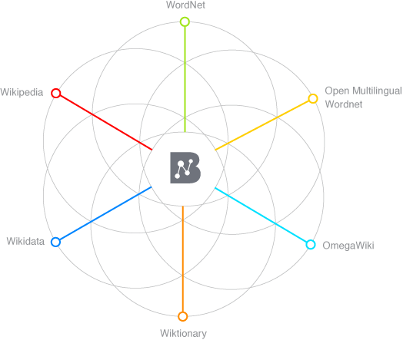
Semantic Enrichment Example
Lets us consider this Tweet from Colorado Wildfire 2012:
#HighParkFire
burn area map
as of
Monday night 10 p.m.
http://t.co/1guBTcXX
Annotated Tokens
Semantically enriched (augmented hypernyms)
burn
Burn destroy
area
area region map representation
map
Monday weekday
day_of_the_week night period
Monday
night
Image source: http://babelnet.org/about

Slide 8
Feature Representation
Text : “#HighParkFire burn area map as of Monday night 10 p.m. http://t.co/1guBTcXX”
Text Tokens: {highparkfire, burn, area, map, monday}
Semantic Tokens: {area, burn, fire, destroy, region, representation, day_of_the_week}
Combined document features = Text Tokens + Semantic Tokens
{highparkfire, burn, area, map, Monday, area, burn, fire, destroy, region, representation, day_of_the_week}

Slide 9
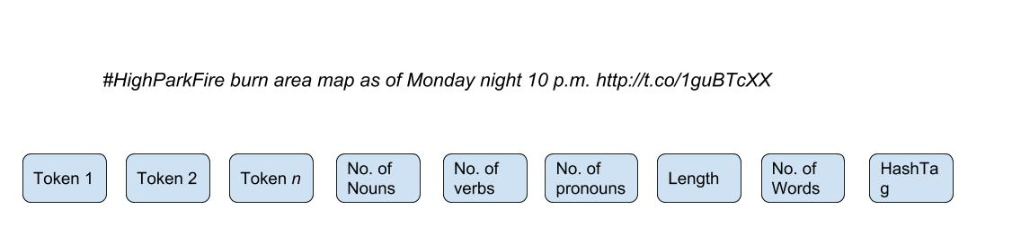
Feature Representation
Statistical Features:
Nouns = 6, verb = 0, pronoun= 0, length = 75, no. of words = 13, no. of hashtag = 1
Feature Set representation

Slide 10
Bottleneck!
How do you learn unless there is a data to learn from!

Slide 11
Data Sources
Labelled Social Data related to Crisis is available at-
CrisisLex
CrisisNLP
Crisis News Sympathy- https://github.com/abdoelali/CrisisNewsSympathy

Slide 12
CrisisLex Data
4 Categories of labels:
Related and Informative
Related and Not Informative
Not Related
Not Applicable
Converge to 2 labels for binary classification:
Related
Not Related

Slide 13
An Approach (can expand these points to individual slides)
Preprocess the tweets
Extract statistical features (Stanford Core NLP)
Perform Named Entity Recognition (IBM Alchemy, Babelfy) and extract semantics.
Merge the semantics with the original text (document)
Tokenise to generate n-grams
Pass the n-grams and statistical features to the Machine Learning Classifier

Slide 14
Preprocessing
The entire data can be redundant with duplicate tweets (often gathered in the stream as retweets)
Removing the duplicates gives the classifier a scope to learn from more variety of content.
Duplicate removal can be handled via removing tokens such as ’RT’,@user_handles, and special characters and then comparing the raw form of text of a tweet with other tweets (processed similarly).
Methods such as determining cosine similarity between texts and opting a threshold to select/discard can also be applied.

Slide 15
Extracting Statistical Features
As earlier mentioned the statistical features may comprise of linguistic attributes and other morphological attributes such a length and number of words etc.
To determine the linguistic parameters such as occurrence of various POS tags, it is important to know the language of the text (tweet).
Language detecting libraries- detectlanguage, langdetect, TextBlob.
Extract POS using NLP tools such as spaCy, Stanford CoreNLP etc.

Slide 16
Extracting Semantics
Use entity recognizing and entity linking APIs to extract entities.
Determine Dbpedia URIs+properties/BabelNet Sense/Hypernyms to extend the semantics.
Concatenate text + semantics.
Generate n-grams and pass on to binary classifier alongside statistical features to learn.

