Slide 1
SMASAC - Event Extraction
GRÉGOIRE BUREL, MAYANK KEJRIWAL (PEDRO SZEKELY) AND PRASHANT KHARE
Collect
Analyse
Understand & Visualise
Gather data from various information sources
Extract key information, verify trustworthiness, classify, etc.
Connect and Visualise information.

Slide 2
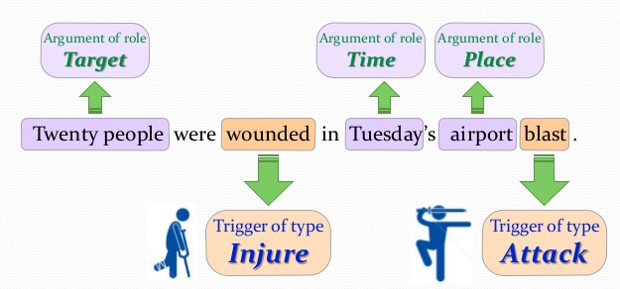
Simple Motivating Example
Notes:
Even the simple example shows how complicated it can be to extract a structured event from unstructured text

Slide 3
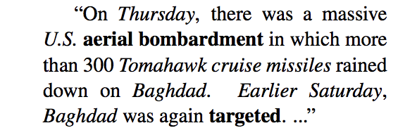
(More Complex) Motivating Example
<Entities and spatio-temporal info are italicized>
Event 1 anchor
Event 2 anchor
Event 1 provides context for Event 2
(Yang and Mitchell, 2016)
Notes:
Events do not have to be independent! Nor is it the case that sentence ordering indicates temporal ordering. Time can have a relative notion, e.g., how can one automatically convert ‘earlier Saturday’ into a date?

Slide 4
Crisis Examples from Twitter
RT @jc_stubbs: Another tragic day in #Ukraine – More than 50 rebels killed as new leader unleashes assault: http://t.co/wcfU3kyAFX
RT @Stump4TrumpPAC: These are the 58 people killed in the Las Vegas massacre, the deadliest mass shooting in modern U.S. history.. 💐🙏🏻 http…
RT @dragoner_JP: うげえ……「ラスベガス銃撃の(カナダ人)犠牲者が巨額の医療費に直面」→ Las Vegas shooting victims facing large medical bills https://t.co/1F3bgH17Jv

Slide 5
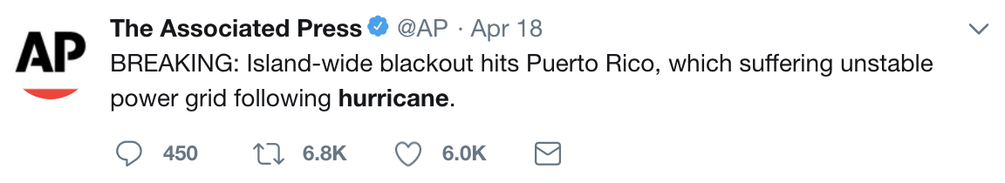
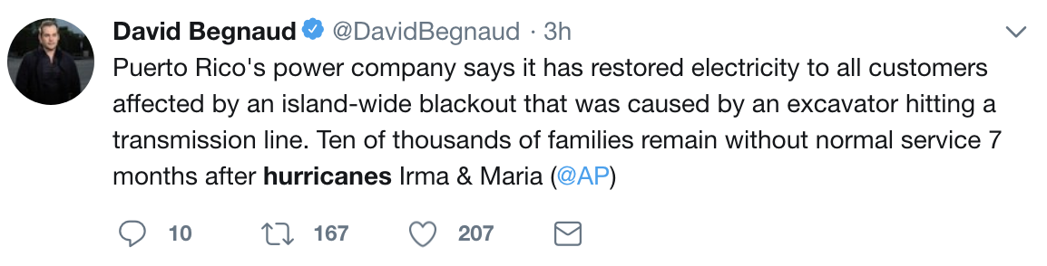
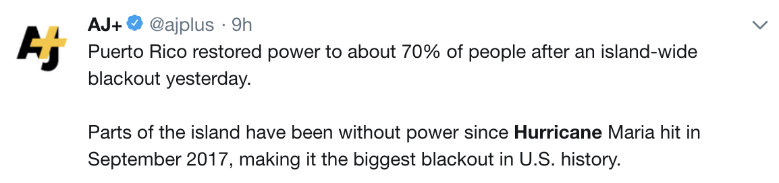
Natural Disaster Examples from Social Media ‘Reporting’

Slide 6
Definition: Event Extraction
Given an event ontology O, and a text corpus of documents, event extraction is the problem of automatically extracting instances (‘events’) in terms of the event classes in O
Because of the ontology, events are structured representations amenable to querying/analytics
What is an ‘event ontology’?
What do real-world event ontologies ‘look’ like?
In many versions of the problem, the ontology is implicit, not known or not required by the extractor
But still in the background, conceptually

Slide 7
Ontology Example 1: ACE
Much flatter than Semantic Web ontologies, which contain rich sets of classes, properties and axioms
Contains eight event classes, each of which has sub-classes (indicated in parantheses)
Life (Be-Born, Marry, Divorce, Injure, Die)
Movement (Transport)
Transaction (Transfer-Ownership, Transfer-Money)
Business( Start-Org, Merge-org, Declare-Bankruptcy, End-Ord)
Conflict (Attack, Demonstrate)
Contact (Meet, Phone-Write)
Personnel (Start-Position, End-Position, Nominate, Elect)
Justice (Arrest Release, Fine, Execute, Extradite…)
Events have four other attributes: modality, polarity, genericity and tense

Slide 8
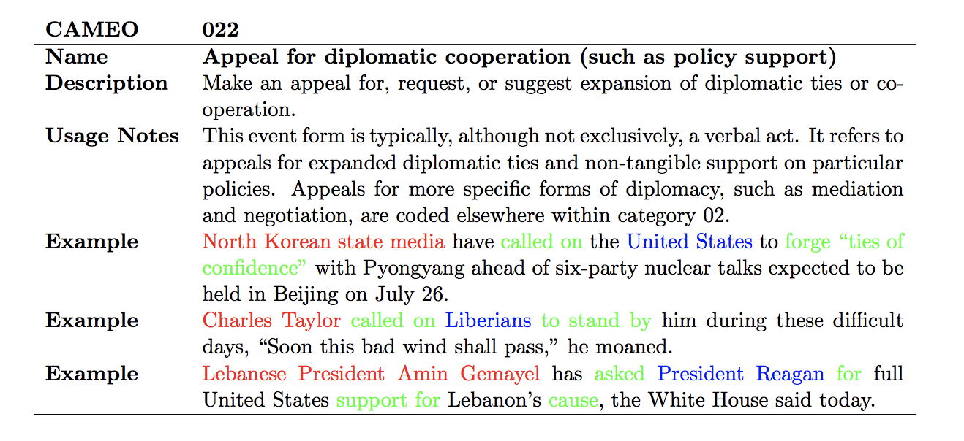
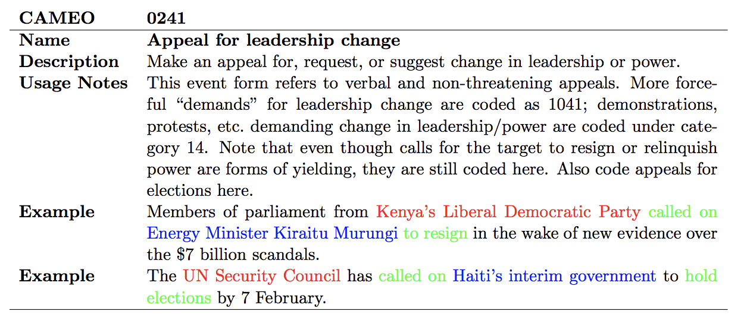
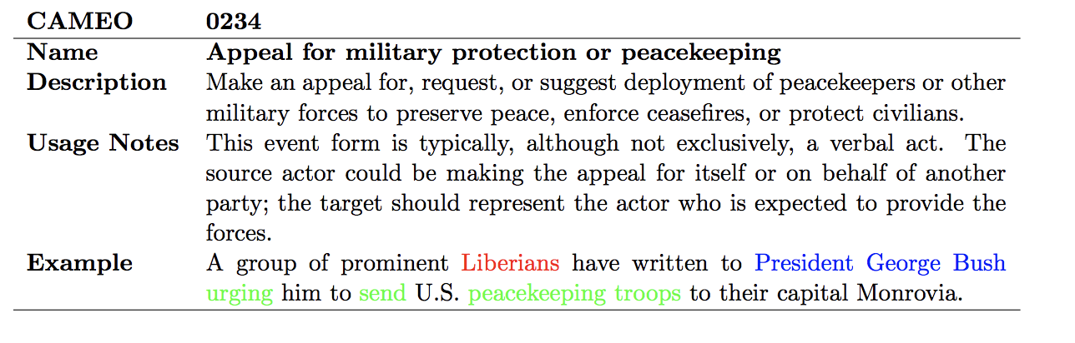
Ontology Example 2: CAMEO

Slide 9
Events involve many components (entities, relations…)
A much harder problem than just extracting entities!
Correctly classifying an extracted event with respect to an event type in ontologies like CAMEO (containing hundreds of types) also difficult
Event co-reference resolution also a hard problem: F-measures well below 50% in state of the art systems
Notes:
Colors indicate different kinds of annotations in CAMEO

Slide 10
In Social Media…
Additional problem of first detecting whether the tweet is describing an event
Can be defined as a binary classification problem: does the tweet describe an event or not?
Short text of tweet makes this essential for performance
Detection and extraction complement each other
Forces us to decide what an event really is, for the purposes of extraction/detection/inference

Slide 11
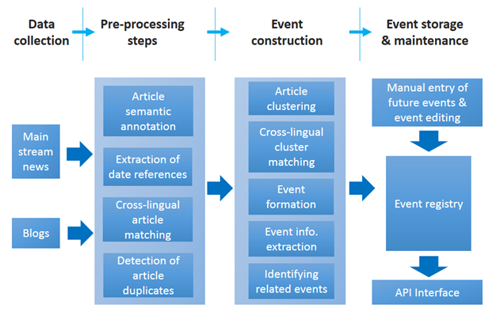
An Example Workflow
Notes:
Many steps involved before an event extraction system ‘works’ including high level clustering, semantic annotations and preprocessing

Slide 12
Event Extraction Sub-Problems
Extracting entity mentions
Extracting time expressions, including dates, times of day…
Extracting event mentions, where a single event mention has exactly one trigger, and an arbitrary number of arguments
An event trigger (usually a verb or noun) is the main word that clearly expresses an event occurrence
Extracting event arguments (roles), defined as both the entity mentions involved in an event (e.g., Baghdad) and their relation to the event (e.g., Place)

Slide 13
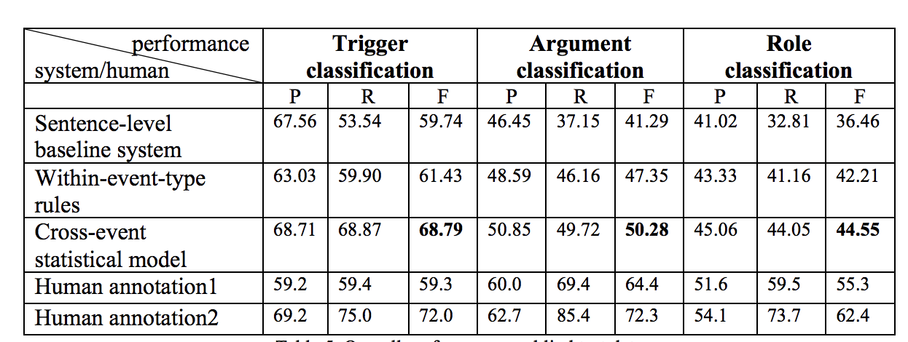
Some Tasks Harder Than Others
Blind test set based on ACE newswire
Performance on social media much worse
Even humans don’t do too well on role classification

Slide 14
Classification of Techniques
Data-driven event extraction
Supervised machine learning models
Clustering
Inference models
Drawbacks?
Knowledge-driven event extraction
Lexico-syntactic patterns
Domain expertise
Knowledge bases
Drawbacks?
Hybrid systems
(Hogenboom et al., 2016)

Slide 15
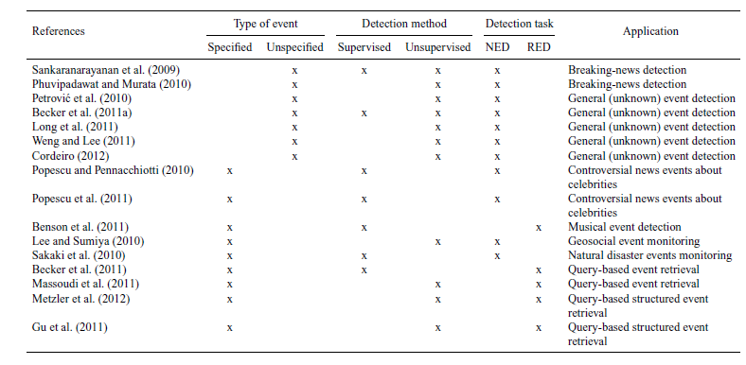
Event Detection in Twitter: A Taxonomy
Techniques tend to be classified along several dimensions including:
Whether the type of event is specified or unspecified
Whether the method is supervised or unsupervised
Whether the task is to detect retrospective events (RED) or new events (NED)
(Atefeh and Khreich, 2013)
Notes:
We show

Slide 16
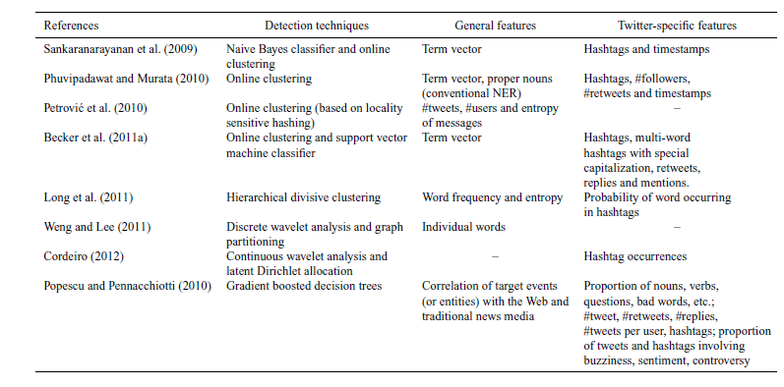
Feature Representation
In general, many features are necessary to achieve good performance
See survey by Atefeh and Khreich (2013) for full list
(Atefeh and Khreich, 2013)

Slide 17
Case Study: Joint Event Extraction
Key idea was to model event and entity extraction as a joint problem
Model the jointness using a graphical model such as factor graph
Outperformed state-of-the-art systems at the time
Joint models continue to be state-of-the-art
(Yang and Mitchell, 2016)

Slide 18
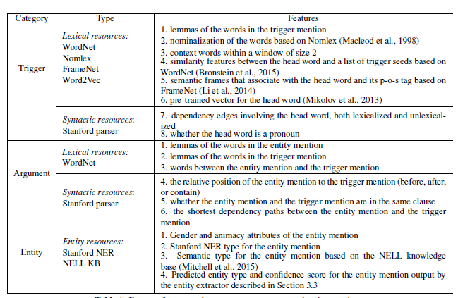
Case Study: Joint Event Extraction
Features used in Yang and Mitchell’s joint IE system
(Yang and Mitchell, 2016)

Slide 19
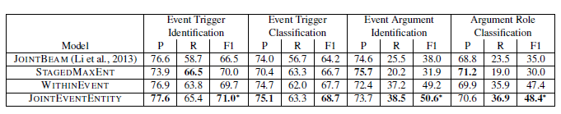
Experimental Results (ACE2005 test set)
P=Precision, R=Recall and F1=F1-Measure
(Yang and Mitchell, 2016)

Slide 20
Open Research Issues
Context-based advantages of data-driven, knowledge-driven or hybrid approaches
Understanding the limitations of specific event extraction techniques
The domain-dependency of event extraction procedures, affecting both their flexibility and effectiveness
The scalability of event extraction approaches when dealing with Big Data
The complexity of extracted events
Better extraction from noisy sources, including social media

Slide 21
Summary
Event extraction is a difficult problem for which performance continues to be relatively poor (compared to NER)
Some sub-tasks (e.g., event trigger identification) tend to be easier than others (e.g., argument role classification)
Joint models have emerged as a solid choice for relatively clean text
Twitter presents new challenges that continue to be the subject of ongoing research
Techniques can be classified along many dimensions, depending on application, algorithm, inputs and outputs

