Slide 1
SMASAC - Visualizations, End-to-End Systems and Conclusion
GRÉGOIRE BUREL, MAYANK KEJRIWAL AND PRASHANT KHARE
Collect
Analyse
Understand & Visualise
Gather data from various information sources
Extract key information, verify trustworthiness, classify, etc.
Connect and Visualise information.

Slide 2
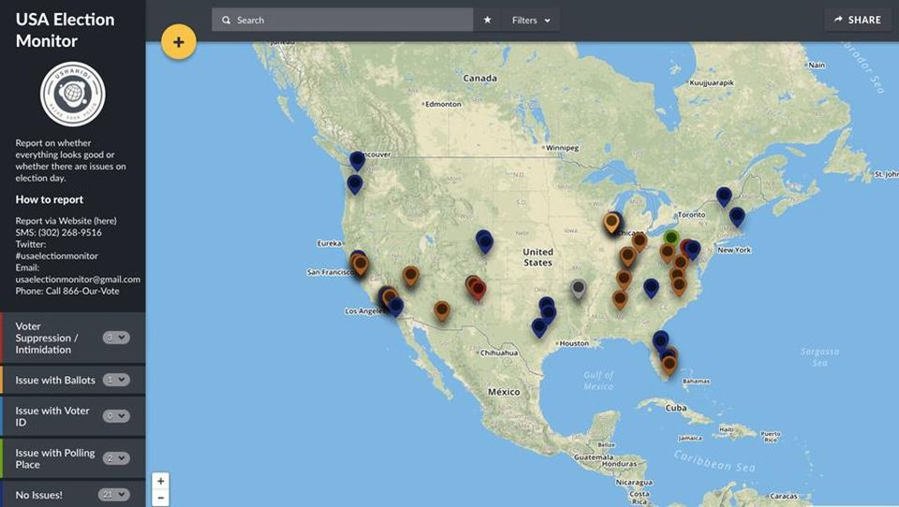
Ushahidi

Slide 3
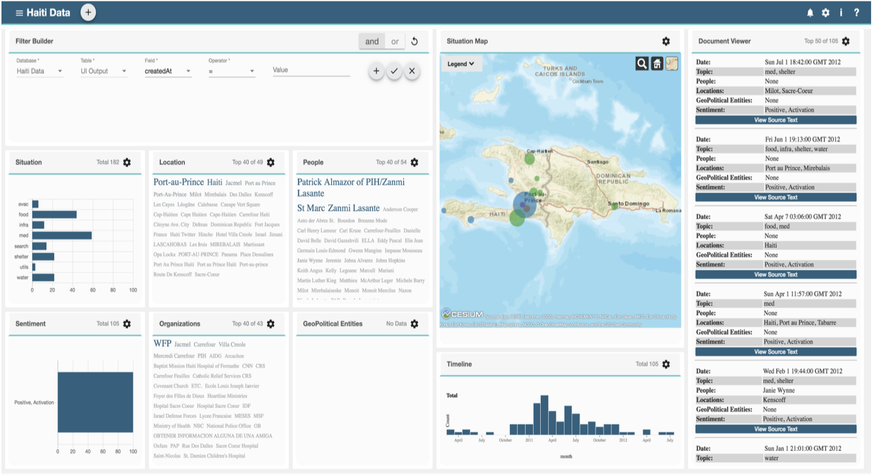
THOR
THOR stands for Text-enabled Humanitarian Operations in Real Time
Developed under the DARPA LORELEI program to assist in situational awareness in low-resource regions
Come check out our demo on Uighyur dataset, and 2015 Nepal Earthquake Twitter dataset!

Slide 4
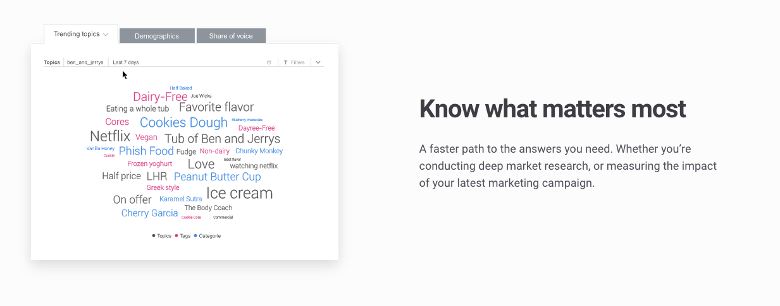
Social Data Visualization
Source: Brandwatch

Slide 5
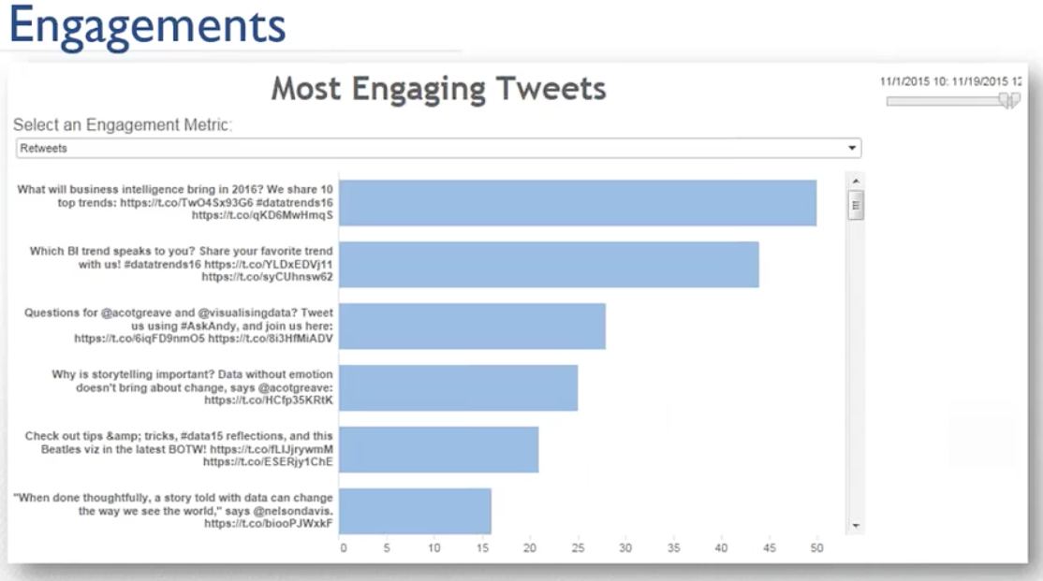
Social Data Visualization
Source: Crimson Hexagon

Slide 6
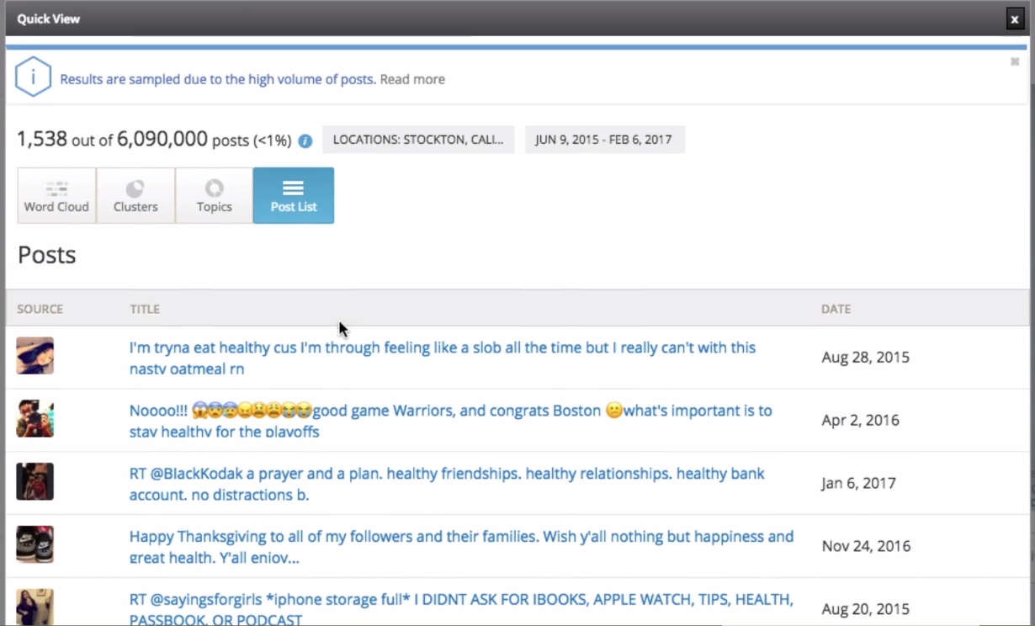
Social Data Visualization
Source: Crimson Hexagon

Slide 7
HashViz
Hashtags contain a lot of important semantic information explicitly tagged by users
How do we visualize and ‘play with’ hashtags from an arbitrary multi-million tweet corpus collected in the aftermath of the disaster?
Demo
Notes:
Hashviz notebook

Slide 8
Platforms Demo
Hands-on

