Slide 1
SMASAC - Classification
GRÉGOIRE BUREL, MAYANK KEJRIWAL AND PRASHANT KHARE
Collect
Analyse
Understand & Visualise
Gather data from various information sources
Extract key information, verify trustworthiness, classify, etc.
Connect and Visualise information.
Notes:
In these slides, we describe the methods for automatic text categorization, which will allow us to make sense of the heterogeneous data by sorting them into category/classes.

Slide 2
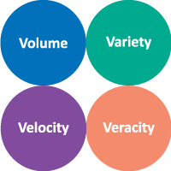
Accessing Relevant Information
Information overload:
During crises, a flood of data gets generated. For example:
Over a million tweets generated during Hurricane Harvey 2017.
500% increase in the tweets bandwidth during 2011 Japan earthquake.
The characteristics of social media posts such as short length, colloquialism, syntactic issues pose additional challenges of processing the data.
Almost impossible to manually absorb and process the sheer volume.
How do we separate crisis-related content from irrelevant information?
How to ensure that a wide range of crisis related topics across diverse crisis situations are filtered in?
Notes:
As already presented in the data collection, the kind of challenges that exist with the enormous voluminous data which calls for additional methods to process and classify.

Slide 3


Filtering Methods
flood crisis, victims, flood victims, flood powerful, powerful storms, hoisted flood, storms amazing, explosion, amazing rescue, rescue women, flood cost, counts flood, toll rises, braces river, river peaks, crisis deepens, prayers, thoughts prayers, affected tornado, affected, death toll, tornado relief, photos flood, water rises, toll, flood waters, flood appeal, victims explosion, bombing suspect, massive explosion, affected areas, praying victims, injured, please join, join praying, prayers people, redcross, text redcross, visiting flood, lurches fire, video explosion, deepens death, opposed flood, help flood, died explosions, marathon explosions, flood relief,
Query filtering using social media APIs:
Use hashtags, keywords, crisis specific phrases or lexicon (impacted location name, canonical form of disaster name - e.g. Hurricane Harvey).
Post collection filtering (before or after storage):
Text search (similar to above).
Semantic search (requires entity extraction)*.
Automatic categorisation / Tagging (clustering approaches, topic modelling, Machine Learning models)*.
Notes:
We have seen earlier that approaches like selective query filtering for gathering data, or clustering technique using LDA has its own limitations. For instance, you might have clusters containing mutually related documents, but the mutually related criteria could be very diverse for each cluster. Hence we can identify the the significance of deploying machine learning methods to train the methods on data dedicated to fixed type of labels.

Slide 4
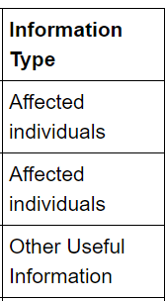
Machine Learning Classification Methods
We can broadly distinguish two types of text classification approaches:
Unsupervised text classification: e.g., clustering, LDA.
+ Do not need categories and existing annotations.
- Inferred classes are not typed and may have limited usefulness.
2. Supervised methods: e.g., SVM, CNN.
+ More precise and accurate classifications.
- Needs annotated content.
Notes:
**We have already seen LDA in the data collection hands on**
So, broadly there are two families of classification methods: supervised and unsupervised approaches. Usually in supervised classification methods, we first get a human annotated data which are categorised into labels and classes. And then we use these are the ground truth data to train the classifier so they can automatically learn to classify new unseen data into these labels/categories. In UNSUPERVISED classification, we do not provide any training data a priori, instead discover the related elements based on some similarity metric.
Supervised Approaches:
Often making use of n-grams, linguistic features, and/or statistical features of tweets.
Unsupervised Approaches:
Keyword processing and clustering.

Slide 5
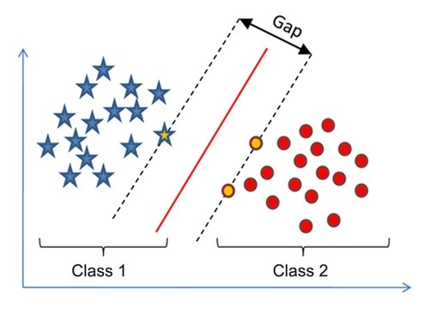
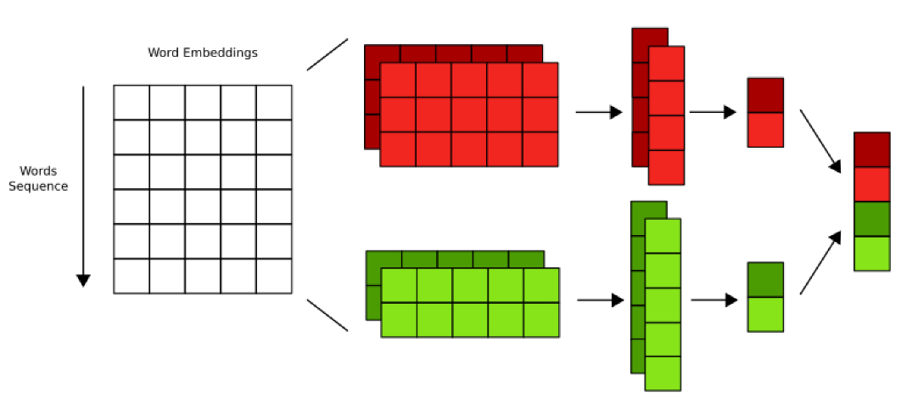
Popular Supervised Machine Learning methods
Support Vector Machines (SVM).
Logistic Regression.
Random Forest.
Decision Trees.
Deep Learning (Deep Neural Networks):
E.g., CNN, RNN, LSTM.
Notes:
Often the classification problem is reduced to three main scenarios: binary, multiclass, and multi-label. In this work and demonstration, we are going explore the binary classification problem. Following are the more common machine learning algorithms that have been seen to be used in such type of problems in the literature.

Slide 6
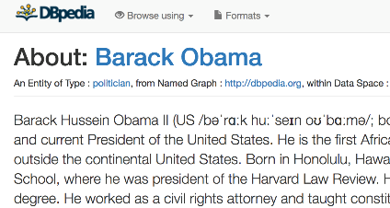
Beyond n-grams – Contextual Semantics and Statistical Features (1)
Obama attends vigil for Boston Marathon bombing victims
Politician / Person
Sports Event / Social Event / Event
Disaster / Event
Additional context about textual structure and semantics can improve the classification of short documents:
N-grams (n-words tokens )are the tokenized form of the original text of a document which are used as features.
Adding semantics to individual tokens can establish a consistency within crisis relevant information and enhance the discriminative power of classifiers.
Add statistical features to the feature set to inject various statistical properties of the text.
Notes:
As a broad overview to the approach we are going to discuss- we adapt the method of adding the external semantics to the original text document. The n-grams are tokenized, and for each token if we can add the semantics, then it is expected to increase the contextual consistency within the crisis related information. And this aid the classifier in its discriminative power. Other than semantics we also extract statistical features.

Slide 7
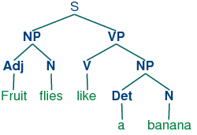
Statistical Feature
Example of statistical features:
Text length.
Number of words.
Presence and count of various Parts of Speech (PoS).
Data specific features such as hashtags (in tweets).
E.g., #neworleans #nola #gretna #westbank #algiers #avondale #nolafood #nolanightlife #twt #hurricanekatrina.
Readability Score (Gunning Fox Index using average sentence length (ASL) and percentage of complex words (PCW) : 0.4*(ASL + PCW)).
Notes:
As shown here we determine a number of statistical features: length, number of words, various part of speech such as noun, verbs, pronouns, hashtags, and some can also calculate the readability score that scores a tweet on how easy or complicated it is structured to read. Gunning Fox Index is one of the methods to calculate that.

Slide 8
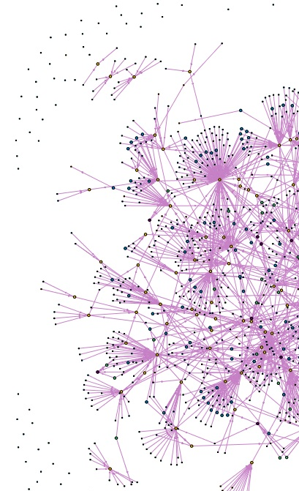
Semantic Features
Additional information about the terms found in document can be extracted using NER tools, entity linking tools and semantic databases (e.g., Dbpedia, Wordnet, etc.):
Co-occurring words (from a data corpus).
Extracted entities
Properties from knowledge graphs:
E.g., Type, Label, Subject, Same as, etc.
Contextual hierarchy – hypernyms, hyponyms, synonyms
Notes:
When it comes to the semantics, there are various additional knowledge that we can think of. Co-occurring words (words that are very common to occur together across large scale corpuses). Word-embeddings are a good example of it. Extracted entities- the fragments in the text can actually refer to a particular entity, so incorporating the entity along with the original text can sharpen the context more. Next, we can refer to the knowledge base (such as DBpedia) to retrieve extra information/properties about that entity. We can also use hierarchical context (from WordNet) to retrieve hypernyms, synonyms to each concept to generalise the context more.

Slide 9
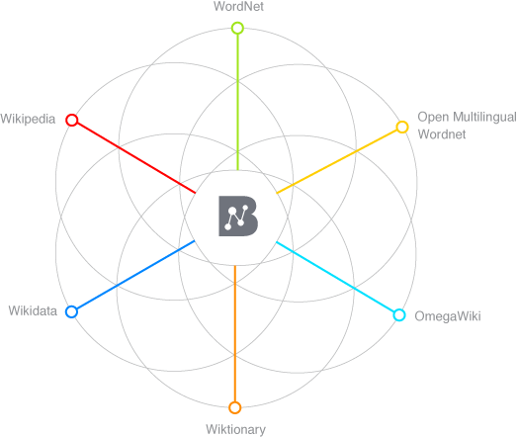
Semantic Enrichment Example
Lets us consider this Tweet from Colorado Wildfire 2012:
#HighParkFire
burn area map
as of
Monday night 10 p.m.
http://t.co/1guBTcXX
Annotated Tokens
Semantically enriched (augmented hypernyms)
burn
Burn destroy
area
area region map representation
map
Monday weekday
day_of_the_week night period
Monday
night
Image source: http://babelnet.org/about
Notes:
Here is an example of using BabelNet to semantically enrich a tweet by extracting entities and their hypernyms. We annotate the key entities in the text and then look for their corresponding hypernyms and augment them to the overall context.

Slide 10
Feature Representation
Text : “#HighParkFire burn area map as of Monday night 10 p.m. http://t.co/1guBTcXX”
Text Tokens: {highparkfire, burn, area, map, monday}
Semantic Tokens: {area, burn, fire, destroy, region, representation, day_of_the_week}
Combined document features = Text Tokens + Semantic Tokens
{highparkfire, burn, area, map, Monday, area, burn, fire, destroy, region, representation, day_of_the_week}
Notes:
Just to get an idea about how the semantic enhancement would transform the text feature representation.

Slide 11
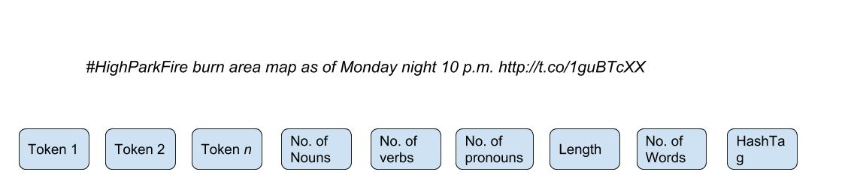
Feature Representation
Statistical Features:
Nouns = 6, verb = 0, pronoun= 0, length = 75, no. of words = 13, no. of hashtag = 1
Feature Set representation
Notes:
Now, we look at the statistical features . So, from the above example we find out following number of nouns verbs, pronouns, length etc. So the overall feature set representation looks like this. Token 1 to Token N are basically different uni-grams in a text (include semantics) and then these 6 statistical features. In this type of case, we utilise both the statistical attributes as well as knowledge from external knowledge bases.

Slide 12
Bottleneck!
How do you learn unless there is a data to learn from!
Notes:
While all this sounds good. We always will get stuck at a point here we require substantial labeled data to train any classification system. So, to begin with we have identified some very relevant resources!

Slide 13


Data Sources
Labelled Social Data related to Crisis is available:
CrisisLex: http://crisislex.org/ (olteanu et al., 2015)
CrisisNLP: http://crisisnlp.qcri.org/ (Nguyen et al., 2016)
Crisis News Sympathy: https://github.com/abdoelali/CrisisNewsSympathy
Notes:
CrisisLex is a very popular data repository which has time and again been referred to for various related research studies. Similarly CrisisNLP and CrisisNews Sympathy also have different types manually labelled crisis data.

Slide 14
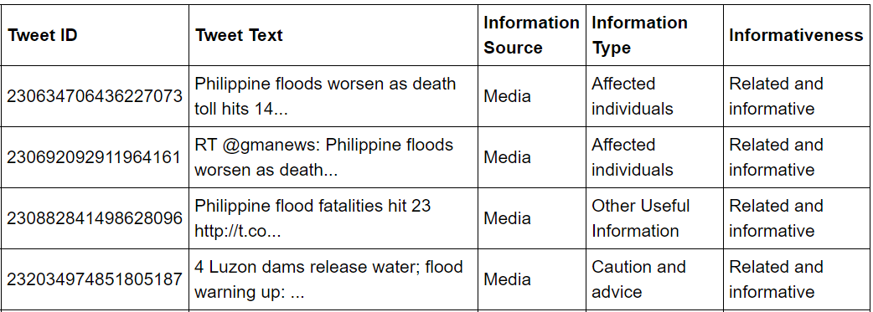
CrisisLex Data (CrisisLexT26)
4 Categories of labels:
Related and Informative
Related and Not Informative
Not Related
Not Applicable
Related
Not Related
Notes:
We have used one particular data corpus from Crisis Lex, and that is called CrisisLexT26. This dataset comprises of manually labelled tweets of 26 crisis events that occurred between 2012 and 13. Each of these 26 events have close to 1000 labelled tweets. So, here they have 4 labels. We merge the two to create a binary class system.

Slide 15
Processing and Training Approach (1)
Preprocess the tweets
Extract statistical features (Stanford Core NLP, spaCy)
Perform Named Entity Recognition (IBM Alchemy, Babelfy) and extract semantics.
Merge the semantics with the original text (document)
Tokenise to generate n-grams
Pass the n-grams and statistical features to the Machine Learning Classifier
Notes:
So, as an end to end approach. We can preprocess the tweet. We can do multiple things in pre-processing such as say handling URLs (if you want to keep it, remove it), handling special characters, removing duplicate set of tweets from the data. You can handle hashtags (if you feel they are not important to your objectives). So, a lot of preprocessing can also be curated based on what your objectives are. So, after pre processing we can use spaCy or Stanford NLP tool to extarct the statistical features, then use any NER library to perform named entity recognition and linking and further generate the semantics.

Slide 16
Processing and Training Approach (2)
The entire data can be redundant with duplicate tweets (often gathered in the stream as retweets.
Removing the duplicates gives the classifier a scope to learn from more variety of content.
Duplicate removal can be handled via removing tokens such as ’RT’,@user_handles, and special characters and then comparing the raw form of text of a tweet with other tweets (processed similarly).
Methods such as determining cosine similarity between texts and opting a threshold to select/discard can also be applied.
Notes:
Ok. So already mentioned what you can possibly do in preprocessing.

Slide 17
Extracting Statistical Features
As mentioned earlier , the statistical features may comprise of linguistic attributes and other morphological attributes such a length and number of words etc.
To determine the linguistic parameters such as occurrence of various POS tags, it is important to know the language of the text (tweet).
Language detecting libraries such as detectlanguage, langdetect, TextBlob can be used.
Extract POS using NLP tools such as spaCy, Stanford CoreNLP etc.
Notes:
So just to elaborate a little more on the statistical features, we are basically looking at the linguistic and other morphological parameters of the text. You can also extract the language using the following libraries in order to generate the statistical features.

Slide 18





Extracting Semantics
Use entity recognizing and entity linking APIs to extract entities.
Determine Dbpedia URIs+properties/BabelNet Sense/Hypernyms to extend the semantics.
Concatenate text + semantics.
Generate n-grams and pass on to binary classifier alongside statistical features to learn.
Notes:
So, from here everything which has been explained. I will demonstrate the most of it to give a fundamental idea of what this is meant to work like.

Slide 19
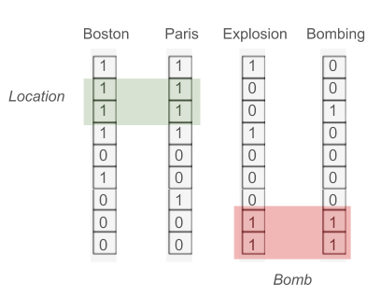
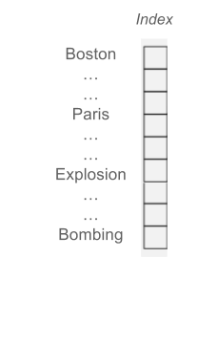
Beyond n-grams – ‘Traditional’ ML vs. Deep Learning
‘Traditional’ ML
Standard classifiers (e.g., SVM, J48…).
Feature engineering (e.g., lemmatisation, TF-IDF…).
Bag of words.
Deep Learning
Artificial neural networks.
Minimum feature engineering
Word embeddings (Bengio et al., 2013).
Notes:
But before that, lets look at another powerful approach in practice. So, we can use two different approach for text classification:
Traditional ML: SVM, decision trees and so on that typically use bag of words.
Deep learning or related methods that rely on word embedding (as mentioned in one of the slides earlier) (learning a distributed representation for words (Bengio et al., 2013). The main idea is that words are represented by their context. (simplistic representation on the figure)
In this context we can see that embeddings are much richer than traditional approach as they capture to some extend word similarities.

Slide 20
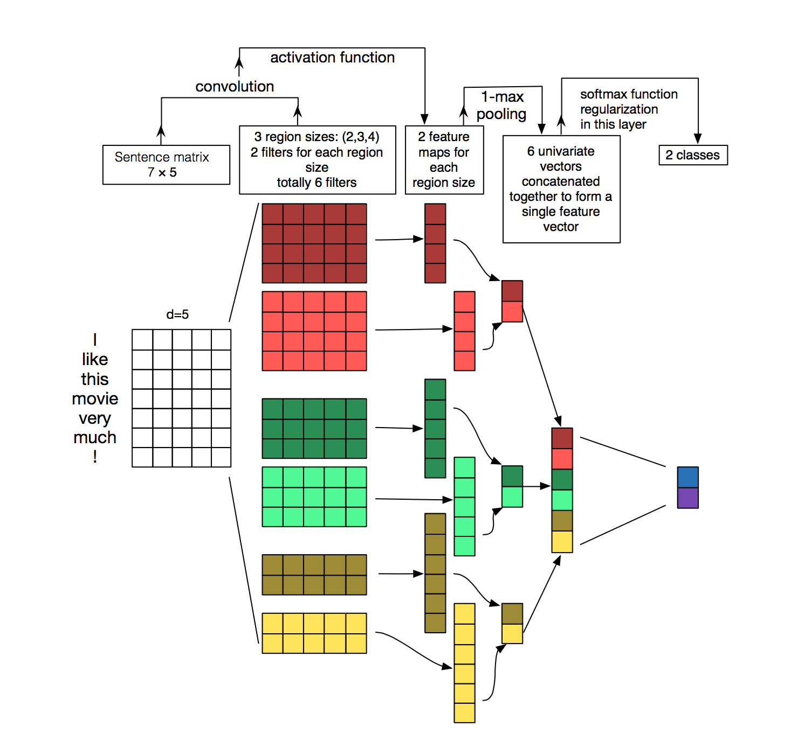
Beyond n-grams – CNN for Sentence Classification (Kim et al., 2014)
Notes:
There are multiple deep learning models such as RNN, Hierarchical Attention Network…
However in here we decide to focus on CNN due to its simplicity and scalability. So broadly you represent text as a matrix (using pre-train embedding), so the model performs convolutions and scans a matrix using given region size. You can perform filtering the features process by doing max-pooling what takes highest activations into considerations.
How do CNN work?
Typically, it is a 5 steps process that can be extended by adding more layers.
Text is converted to a matrix representation (typically using pre-trained using word embeddings).
Convolutions are performed:
- Typically the model scan a given embedding matrix using a given region size (e.g., for a document of size 6, a region size of 3 may lead to 6 – 3 = 2 feature vectors )
- For each region size, multiple filters can be run to generate different feature maps.
3) Max pooling: We take the highest activations for each filter
4) We concatenate the max-pooling outputs
5) A fully connected layer is used with a sigmoid (2-class) or soft-max (multi-class) function is applied for classifying a document.

Slide 21
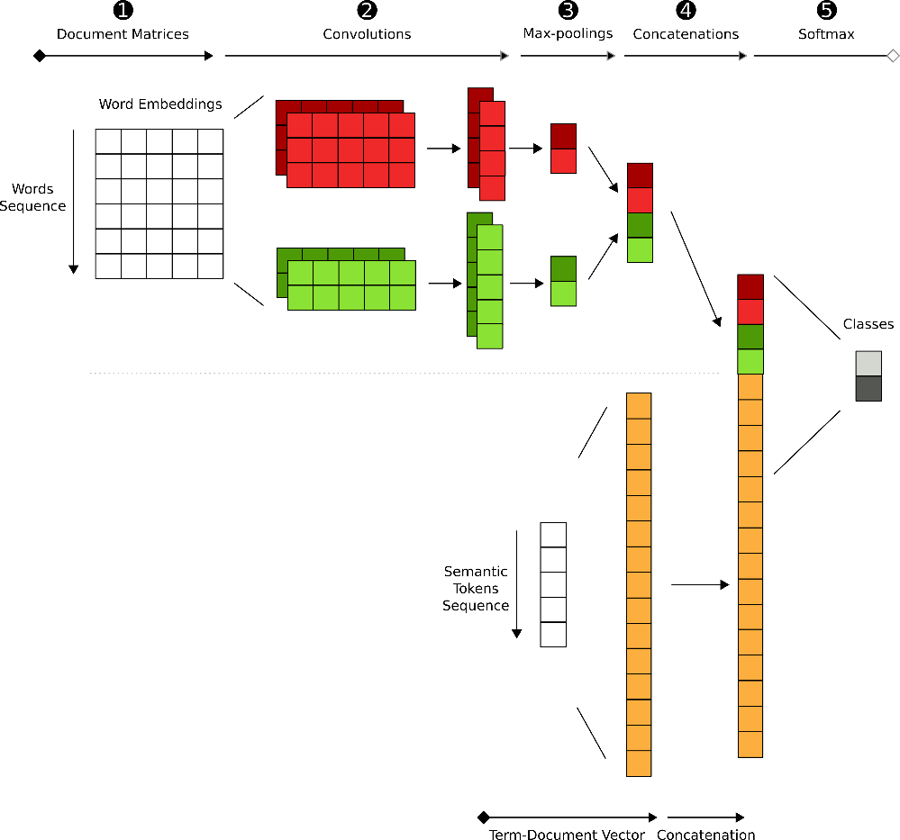

Semantic Deep Learning – Dual-CNN and Sem-CNN
Sem-CNN
Dual-CNN
Notes:
We can extend the context of small documents by adding semantics to a CNN model. A logical approach is to add a semantic channel to the document representation (Dual-CNN).
Another approachis to combine a CNN model with wide and deep models and:
Use a deep shallow word embedding layer
Use a wide deep semantic layer

Slide 22

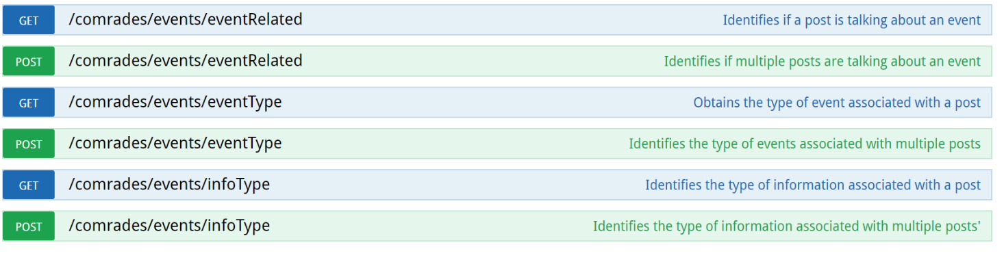
The COMRADES CREES Services (Crisis Event Extraction Service) (Burel et al., 2018) use CNNs to provide a rest API for annotating short text documents (e.g. tweets) by identifying :
If a document is related to a crisis.
The type of event discussed.
The type of information present in a document:
https://evhart.github.io/crees
Notes:
ML classification models exists also as APIS and can be used as needed such as the (CREES)Crisis event extraction service.

Slide 23
Classification of Crisis-related Documents
Hands-on

Slide 24

Summary
Supervised text classification can be used for filtering relevant and irrelevant documents during crises.
Semantic features help situations when new types of events occur.
Publically available tools and APIs can be used for classifying documents on demand.

