Slide 1
SMASAC - Visualizations, End-to-End Systems and Conclusion
GRÉGOIRE BUREL, MAYANK KEJRIWAL AND PRASHANT KHARE
Collect
Analyse
Understand & Visualise
Gather data from various information sources
Extract key information, verify trustworthiness, classify, etc.
Connect and Visualise information.

Slide 2
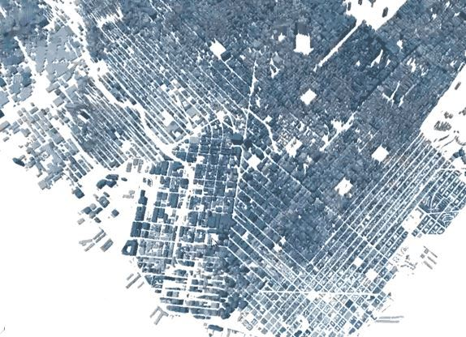
Data Visualisation
Visualisation – a key phase of analysis in crisis informatics. Data interpretation is equally important to data collection and curation.
The visualisation can be driven by multiple objectives:
Geospatial data visualisation.
Emerging trends.
Demographic based analysis.
Mapping logistics.
Predictive analysis.
Collect
Analyse
Understand & Visualise
Notes:
Visualisation forms an important part of data analysis and sense making. Interpreting the data through visual observations is the crucial most aspect of this entire process.
Given the nature of this field, as it is related to crisis management, the need to visualise and comprehend the information can be driven by various objectives. It can be a geospatial picturisation of the situation (like what is happening where), the current trending information, how different sections of people are responding or reacting, mapping the logistics- supply chain progress of logistics, and predicting what might emerge.

Slide 3




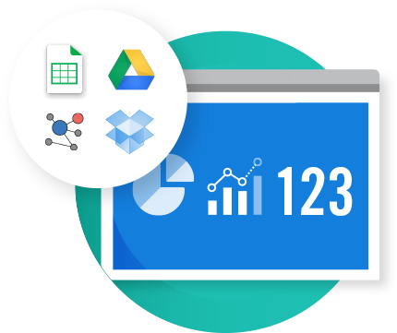
Data Visualisation
Platforms/Libraries for visualisation:
Situation Awareness Platforms-
Ushahidi
Sahana Foundation
Visualisation Libraries –
D3.js ,
Plotly
HDX Quick Charts
Interactive visualisation of Ontology - WebOWL
Notes:
Some of the crisis related tools: Ushanidi and Sahana Foundation. They provide software solutions for crisis data management. Not everything is fully automated, but they are more like solutions to manage the data based on an architecture that suits the disaster management processes. Then there are popular libraries to use for visualisation D3 and Plotly. You might need to bring your data in certain formats:CSV, json. You also have Humanitarian Data Exchange solutions.

Slide 4
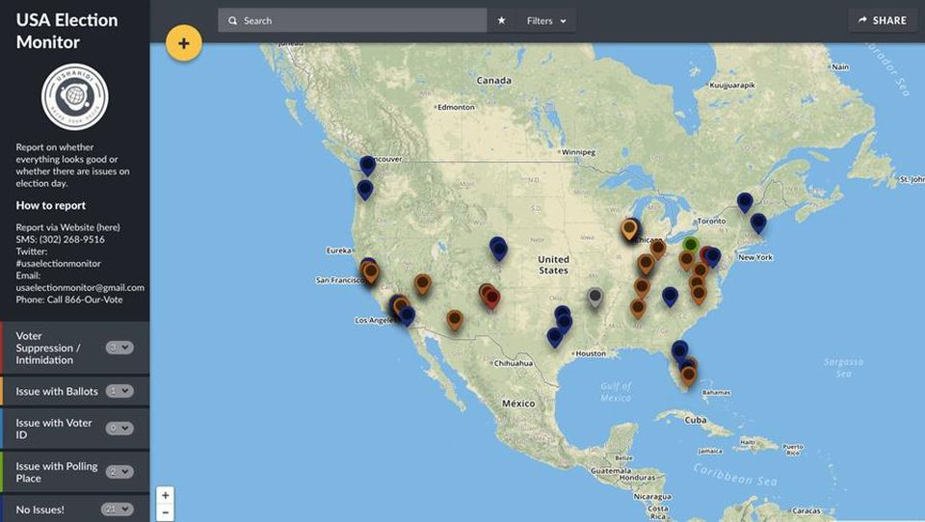
Example - Ushahidi
Notes:
Ushahidi platform provides plotting the information on maps. Here is an example of an analysis done by our team in collaboration with Ushahidi. This demonstrates various reports/user generated content based on location.

Slide 5
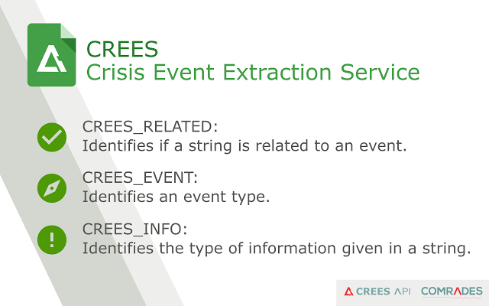
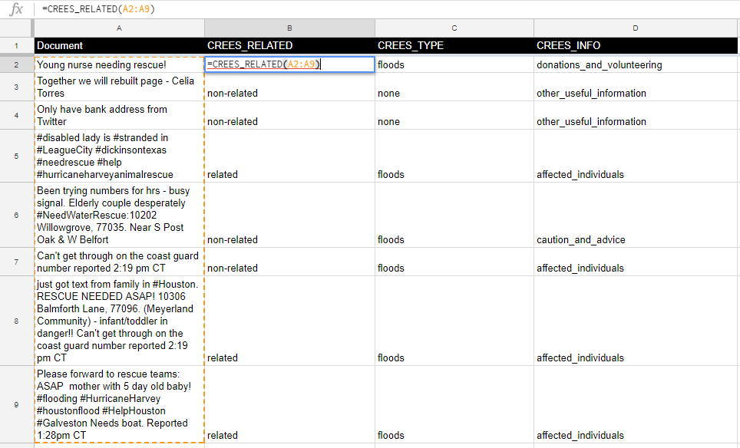
Example - CREES Google Sheet Add-on

Slide 6
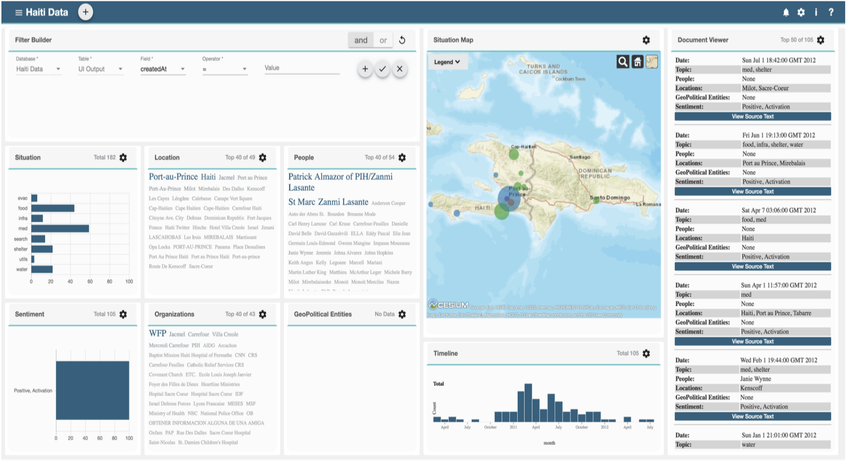
Example - THOR
THOR stands for Text-enabled Humanitarian Operations in Real Time
Developed under the DARPA LORELEI program to assist in situational awareness in low-resource regions
Come check out our demo on Uighyur dataset, and 2015 Nepal Earthquake Twitter dataset!
Notes:
THOR is a tool developed by Pedro/Mayank from ISI, USC. It is a tool developed to process low-resource languages during crisis situations. They also have a DEMO of the same, so wait for it to know about it.

Slide 7
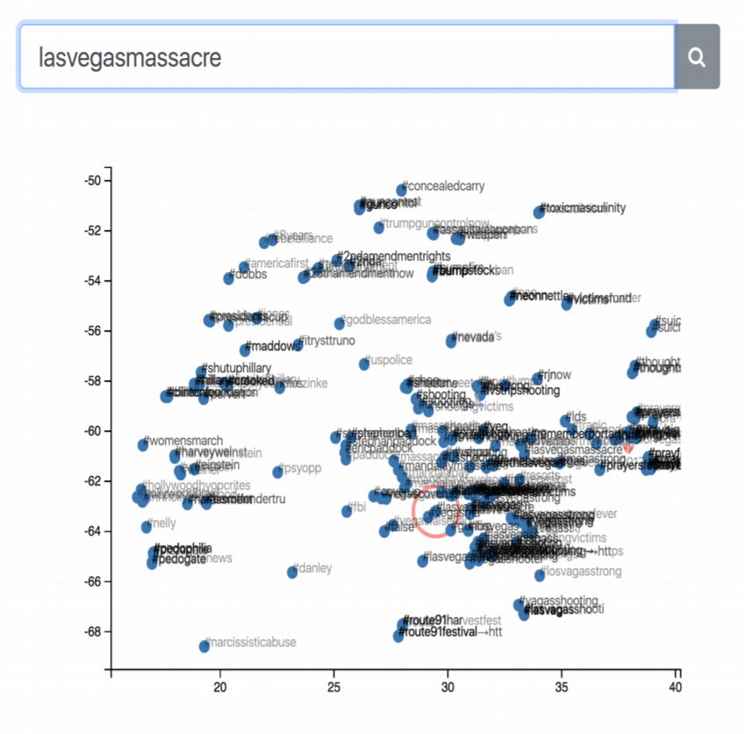
Example - HashViz
Hashtags contain a lot of important semantic information explicitly tagged by users
How do we visualize and ‘play with’ hashtags from an arbitrary multi-million tweet corpus collected in the aftermath of the disaster?
Notes:
I am not sure about details of this slide.

Slide 8
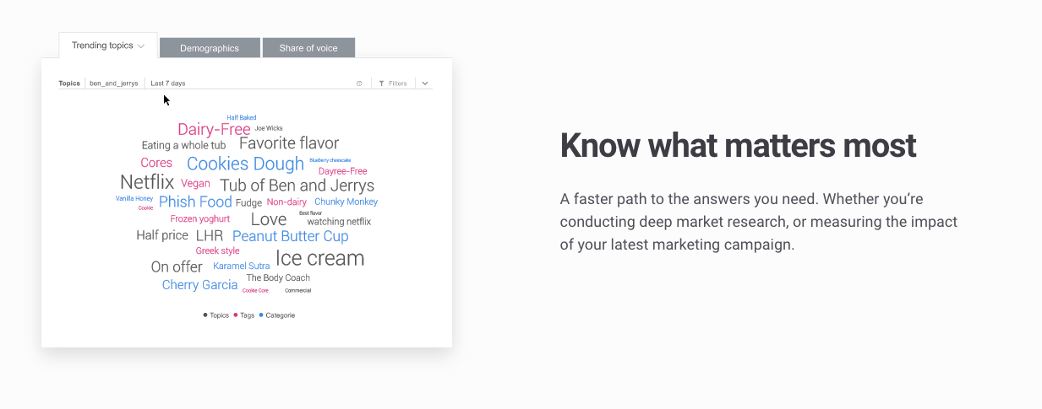
Commercial - Social Data Visualization
Brandwatch is an enterprise that provides tools for analysing social sensor data.
Notes:
Here is an example from commercially software, which are not strictly crisis management software, but just mentioning them here to give a brief idea about how sense making approaches prevail in industry otherwise. Brandwatch is a popular enterprise which excels in harvesting insights from social media data for advertisement and brand management purpose. Here is a good example of word cloud analysis of the data.

Slide 9
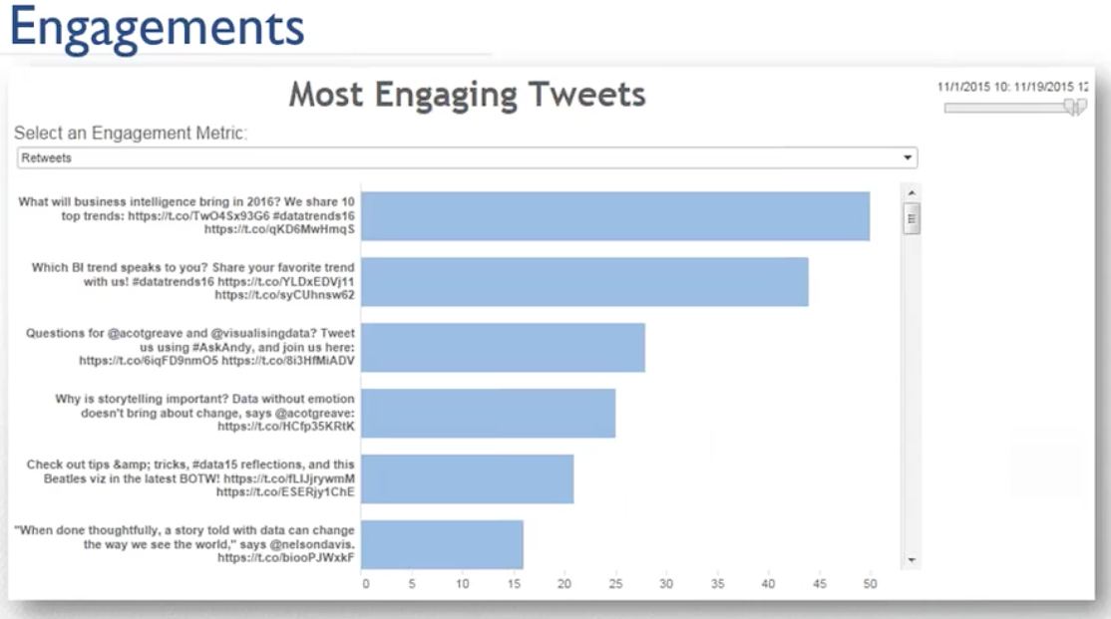
Commercial - Social Data Visualization
Crimson Hexagon is an enterprise that provides solutions to analyse social data and engage deeper with users/audience.
Notes:
Similarly, Crimson Hexagon has an expertise in similar practices. This is an example to showcase, how you can visualise the data based on certain metric of each document, lets say which one is more informative or which one has most impressions or clicks or retweeted. As I said, based on your objectives.

Slide 10
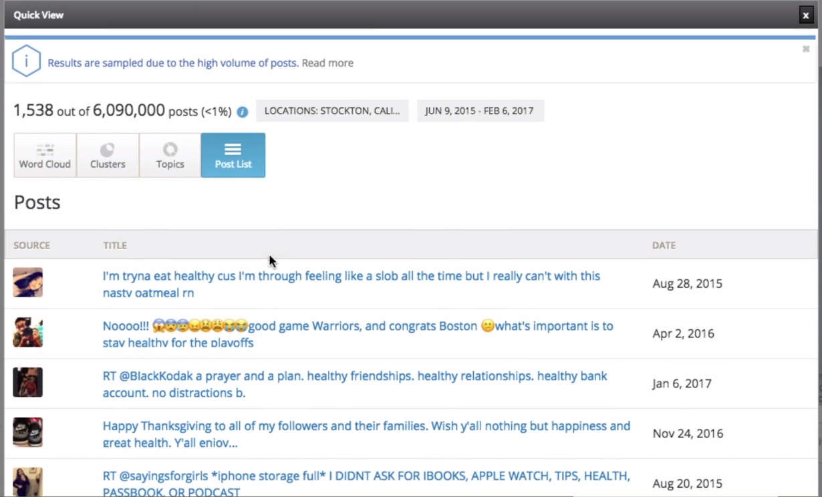
Commercial - - Social Data Visualization
Sort tweets/documents based on temporal relevance.
Source: Crimson Hexagon
Notes:
This could be a way to sort out your data based on temporal parameters, for instance which one are the latest or old. Or which have been addressed in a temporal order. So, as I said, there is not one particular way to treat your information and your needs as a stake holder in crisis situations. Obviously for different stakeholders chances are that the need for visualising the information would vary. But there are some of the ways to go about it.

Slide 11
Platforms Demo
Hands-on
Notes:
Now we will move ahead to another hands on excerise for platform demo.

Slide 12
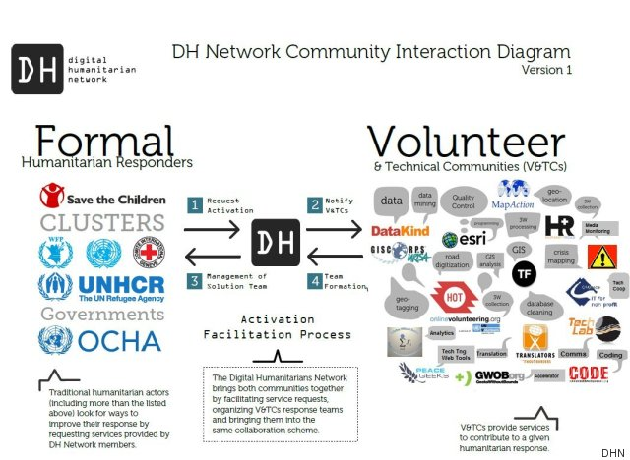


Summary – Data Processing Pipeline
In this tutorial we showed how to collect, analyse and represent crisis-related social media using multiple data processing techniques:
Collect
Analyse
Understand & Visualise
Act
Gather data from various information sources
Extract key information, verify trustworthiness, classify, etc.
Connect and Visualise information.
Decide what to do and organise actors and resources.

Slide 13
Summary - Automatic Processing Pipeline
Supervised or semi-supervised methods as well as APIs an automatic tools can be used for collecting data.
Collect
Use API for collecting data.
Analyse
Curation and Filtering
Classification
Entity Extraction
Use event detection models for filtering documents.
Supervised / non-supervised classification models.
Named Entity Recognition and Entity Linking.
Understand & Visualise
Visualisation
Use visualisation applications (e.g., Ushahidi, OSM) or libraries.

Slide 14







Contact / Feedback
Grégoire Burel
Research Associate
Mayank Kejriwal
Research Associate
Prashant Khare
Ph.D. Student
@evhart
@kejriwal_mayank
@prash_khare
Mailing list: smasac-tutorial@googlegroup.com
Slides and Code: http://github.com/evhart/smasac-tutorial

