Slide 1

World Happiness Report
Chris Oesterling
Notes:
Hello, my name is Chris Oesterling and this is my presentation on world happiness. I made this presentation to reach out to policymakers and stakeholders about the trends that arise in the European regions. It is important to look at and understand these trends to improve global well-being, quality of life, and mimic positively viewed regions.

Slide 2
About
This presentation will display charts from a world happiness report from 2004-2020
The goal is to identify if the countries in Europe are more subject to positive trends than other continents
This will provide insights on whether it would be beneficial for stakeholders to mimic certain habits from EU countries in terms of development, ways of living, environment, sustainability, etc.

Slide 3
Facts/Statistics
The EU covers over 4 million km² and has 448.4 million inhabitants.
Cultural Diversity
High Social Mobility
Universal Healthcare
Low Crime Rates
Strong Education Systems
Notes:
Europe is known for its rich cultural heritage and diversity. European countries celebrate and preserve their cultural identities, languages, traditions, and arts, fostering a vibrant and inclusive society.
European countries prioritize social mobility, providing opportunities for individuals to improve their socioeconomic status regardless of their background. This fosters a sense of fairness and equal opportunity.
Most European countries offer universal healthcare coverage to their citizens, ensuring access to medical services without financial barriers. This contributes to better health outcomes and life expectancy.
European countries often report relatively low crime rates compared to other regions, contributing to a sense of safety and security for residents and visitors alike.
European countries prioritize education and invest heavily in their education systems. As a result, they often boast high literacy rates, quality schools, and opportunities for lifelong learning.

Slide 4

Considerations
Political Instability
Globalization Impacts
Rising Cost of Living
Notes:
Some countries face periodic challenges such as political polarization, populism, or extremism, which can undermine democratic norms and governance.
European countries are interconnected with the global economy, which can expose them to economic fluctuations, trade tensions, and geopolitical risks, affecting their stability and prosperity.
In certain European cities or regions, the cost of living, including housing, food, and transportation, has increased significantly, making it challenging for some residents, particularly young people or low-income earners, to afford a comfortable standard of living.

Slide 5
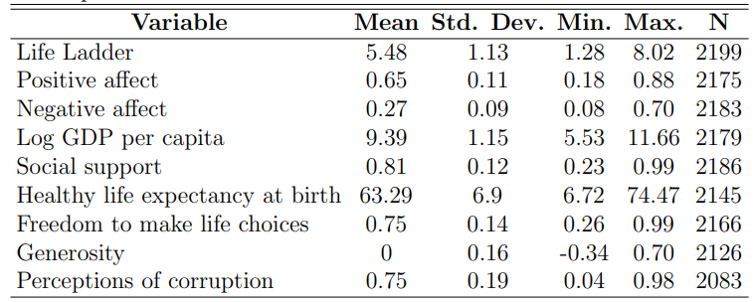
Important Metrics on Global Level
Notes:
Here we have some statistics from each metric in the happiness data report. The mean or the average shows us the most common score amongst the country’s rankings. The standard deviation gives us a sense from how much this metric fluctuates (we can see that negative affect is very high in proportion to the mean, about 1/3). We then can see the minimum score and maximum score from each metric followed by the number of data points observed.

Slide 6
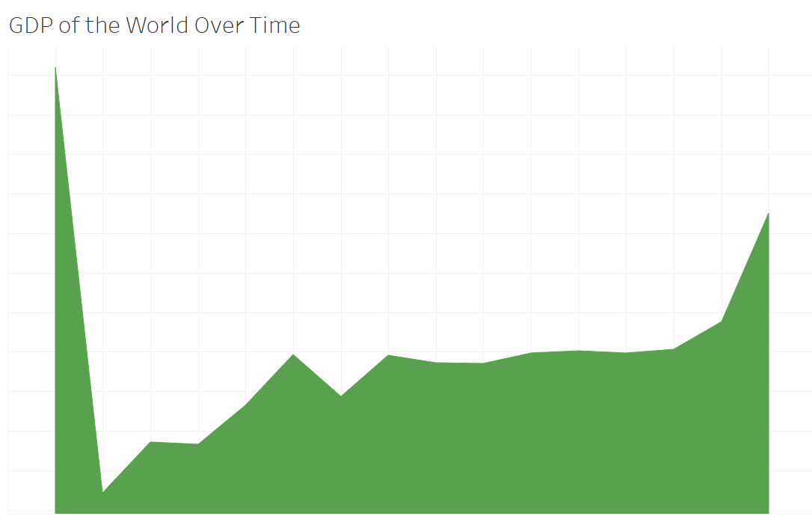
World GDP
Notes:
We can see that there is a massive drop of the world’s GDP in year 2005 and since then we’ve been gradually increasing. This can be due to social and economic factors of the world which are also reasons to consider looking at positively viewed and well-developed countries. Keep in mind this trend as we view some graphs on specific metrics during this time.

Slide 7
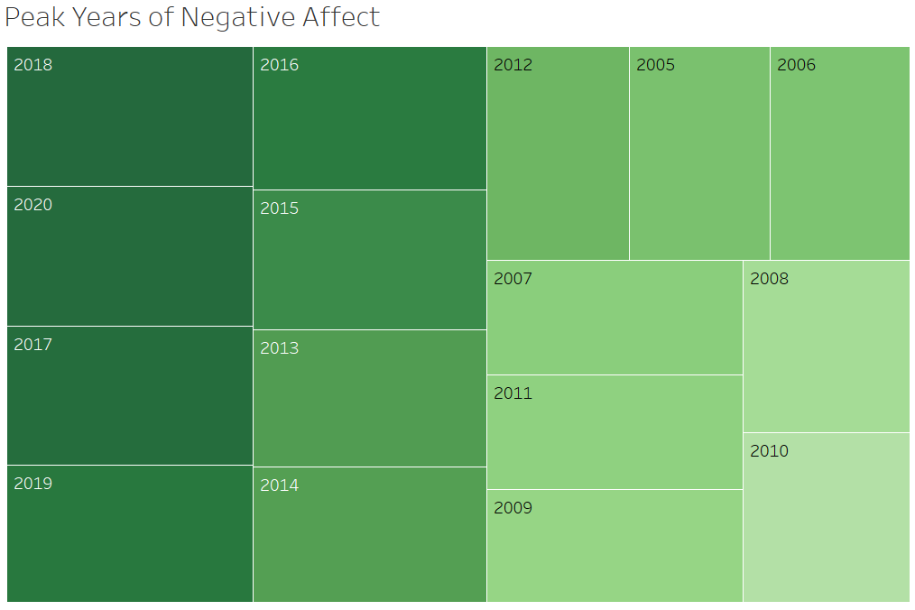
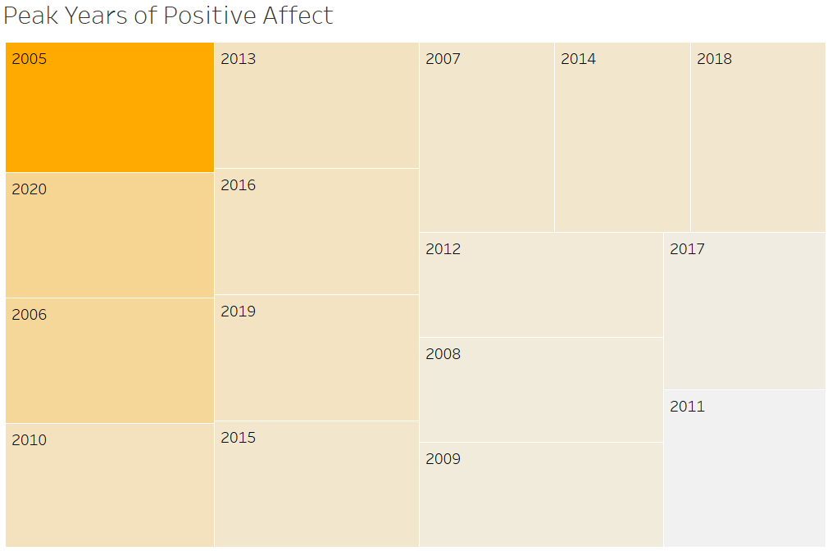
Negative and Positive Affect Years
Notes:
These are the peak years of negative and positive affect. These years aren’t inversely related, but they are close to it. This trend does follow what we see from the plot according to the GDP.

Slide 8
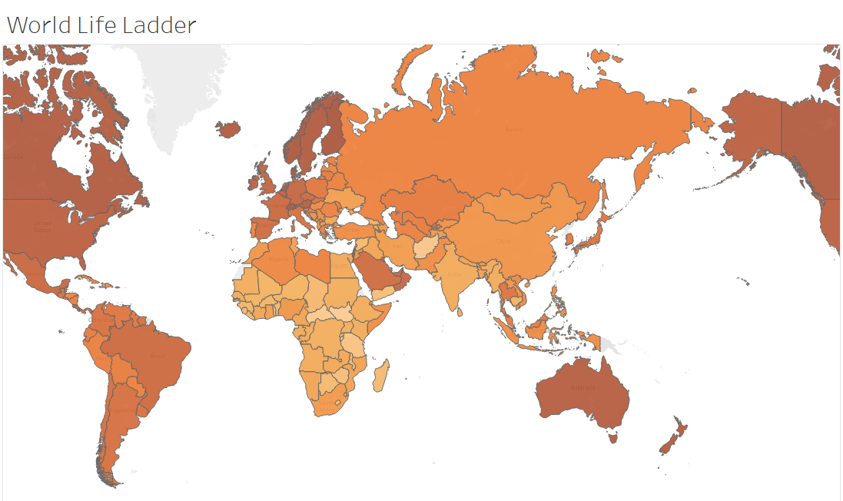
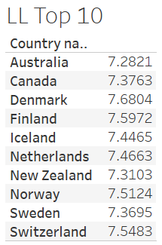
Life Ladder of World
Notes:
Life ladder is a metric that shows the perspective on how well the resident’s life is in their country. In the life ladder index, the darker colored countries mean higher life ladder while the lighter colors mean lower. We can see that countries in the EU are high in this regards.

Slide 9
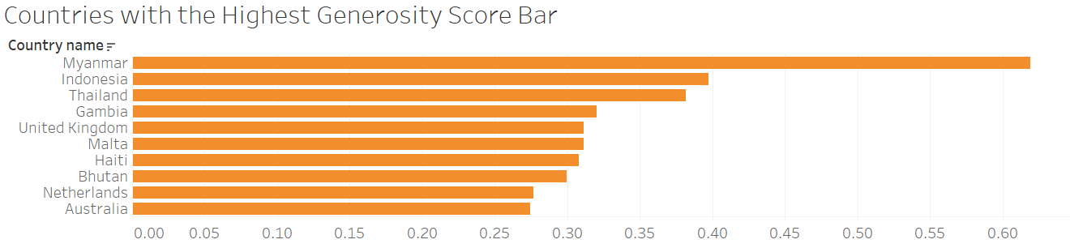
Generosity Top 10
Notes:
Looking at the generosity score, we can see that the highest scoring countries are in western Europe and southeast Asia. There is one country that is outside of these regions which is respect to Haiti.

Slide 10
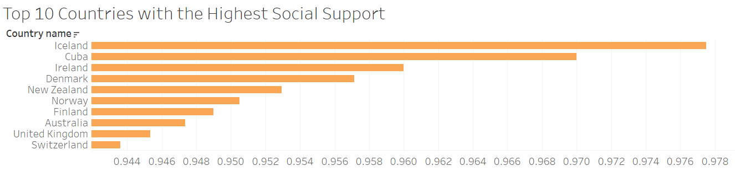
Social Support Top 10
Notes:
In the social support region we can see that the European region is leading this metric in countries as well.

Slide 11
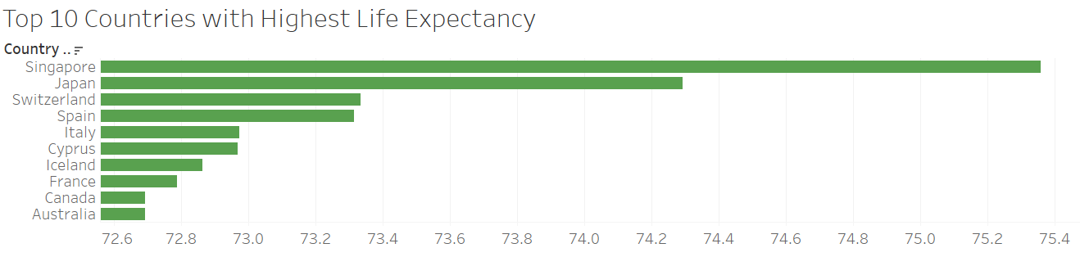
Life Expectancy Top 10
Notes:
This slide represents the top 10 countries with the highest life expectancies at birth. We see part of Asia and North America but most countries reside in the EU region.

Slide 12
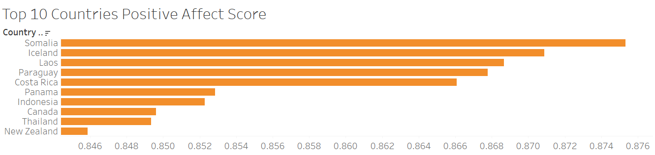
Positive Affect Score Top 10
Notes:
This slide shows the countries with the highest positive affect scores and their negative affect scores placed with their corresponding maps. We can see from the map that this metric is very spread out amongst the continents. Almost every continent in these 10 countries is covered from positive affect. It is interesting to note how some countries had similar average positive affect scores as well as negative.

Slide 13
What Does This All Mean?
Most positive metrics seemed to be in areas around Northern Europe and Southeast Asia
We had metrics such as generosity, social support, life expectancy, and positive affect where many continents of EU were in the top field
In all top 10 fields shared, we found 16/40 = 40% of countries to be in Europe
Notes:
For perspective, the second runner up was Asia with 9/40 = 22.5% in the top 10.

Slide 14
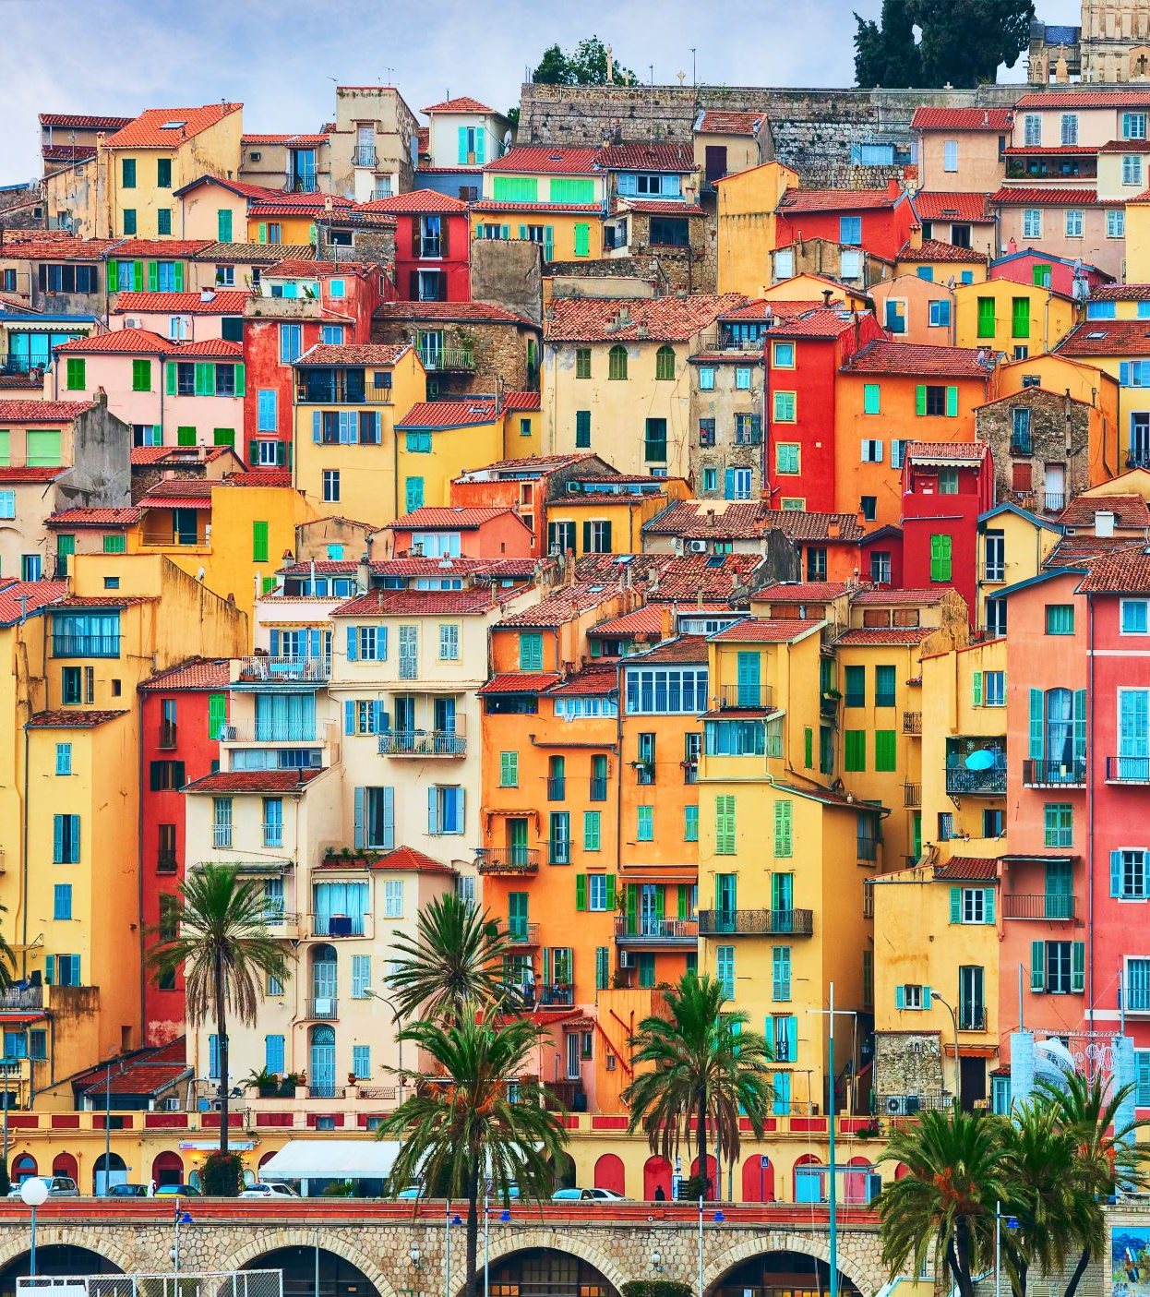
Conclusion
In conclusion, European countries rank high in overall happiness levels offering numerous benefits in terms of quality of life, mental well-being, social connections, and economic opportunities. Southeast Asia was the next runner up for trends that may be impactful to look at, as there may be addition information to obtain
It's essential to consider potential concerns such as the cost of living, social inequality, and cultural adjustment before making decisions about relocation, migration, or investments in the European region

Slide 15

How Other Regions Can Improve
Implement Social Welfare Policies
Promote Work-Life Balance
Invest in Mental Health Services
Develop Social Cohesion
Notes:
EU countries often prioritize social welfare policies such as universal healthcare, education, and social security nets. Policymakers can emulate and adapt these policies to ensure access to essential services for all citizens, thus improving overall well-being.
Many EU countries prioritize work-life balance through policies such as flexible work hours, parental leave, and vacation time. Policymakers can enact similar measures to reduce stress and enhance quality of life for workers globally.
EU countries often allocate resources to mental health services and support networks. Policymakers can prioritize mental health initiatives, including destigmatizing mental health issues, providing access to counseling and therapy, and integrating mental health services into primary healthcare systems.
EU countries often invest in programs that foster social cohesion, such as community centers, cultural events, and initiatives to promote diversity and inclusion. Policymakers can implement similar initiatives to build stronger social ties and reduce social isolation, contributing to overall well-being.
These are just a few suggestions but this can be something to dive into on a larger scale in the future.

Slide 16
Sources
https://www.kaggle.com/ajaypalsinghlo/world-happiness-report-2021?select=world-happiness-report.csv
https://worldhappiness.report/
https://european-union.europa.eu/principles-countries-history/key-facts-and-figures/life-eu_en

Slide 17
Finished
Thanks for watching

