Slide 1
Archerfish
Project Manager: Jasmine Cheng
Notes:
Jasmine

Slide 2
Agenda
Overview
  Mission Scope
  Concept of Operations
  Top Level Requirements
Fluids
GSE
Aerodynamics
Structures
Recovery
Avionics
Testing
Budget
Notes:
Jasmine

Slide 3
Overview
Mission Scope
Mission Objective: To launch an experimental pump-fed bi-propellent liquid rocket.
Mission Success Criteria:
Successful, complete launch and recovery of rocket
Student technical and teamwork development!
FAR Ten Cents per Foot Contest, launch end of May – Early June
Notes:
Jasmine

Slide 4
Overview
Rocket Sizing
Wet Mass: 93.0 lb
Dry Mass: 73.2 lb
Overall Length: 122 in (10' 2")
Diameters:
  Top: 6.20 in Outer | 6 in Inner
  Bottom: 6 in Outer | 5.75 in Inner
CG Location: 74.6 in
CP Location: 85.3 in
Stability: 1.73 caliber
OF Ratio: 2.6
TWR: 4:1
Notes:
Brandon

Slide 5
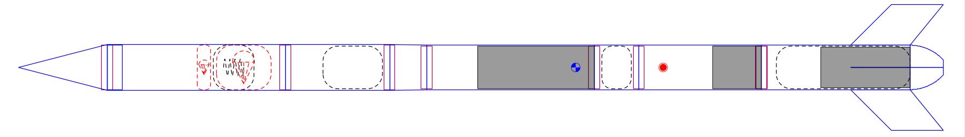
Overview
Open Rocket Model
Liquid Bi-Propellant Rocket
Oxidizer: Nitrous Oxide
Fuel: Ethanol
  Pressurized By GN2
OF Ratio: 2.6
Target Thrust: 400 lbf​​
Wet Mass: 93.0 lb​s
Dry Mass: 73.2 lb​s
TWR: 4:1
Overall Length: 122 in (10' 2")​
Diameters: ​
  Top: 6.20" Outer | 6" Inner​
  Bottom: 6" Outer | 5.75" Inner
CG Location: 74.6 in​
CP Location: 85.3 in​
Stability: 1.73 caliber
Max Apogee: ~13000ft
Recovery
Avionics
Oxidizer
GN2
Fuel
Pump
Engine
Nosecone
Fins
Fig 0.1 Open Rocket Model
Notes:
Brandon

Slide 6
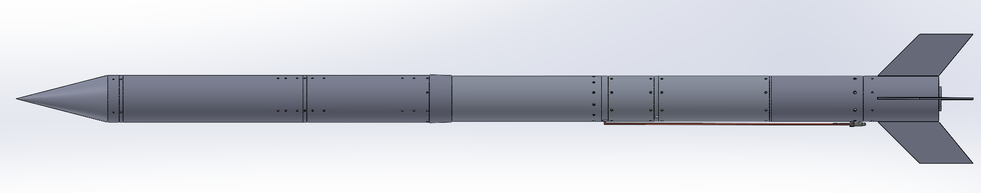
Overview
CAD Model (Full)
Nosecone
Recovery
Avionics
Ox Tank
GN2 Tank
Fuel Tank
Pump
Housing
Engine
Downcomer
Fins
Fig 0.2 Full External CAD

Slide 7
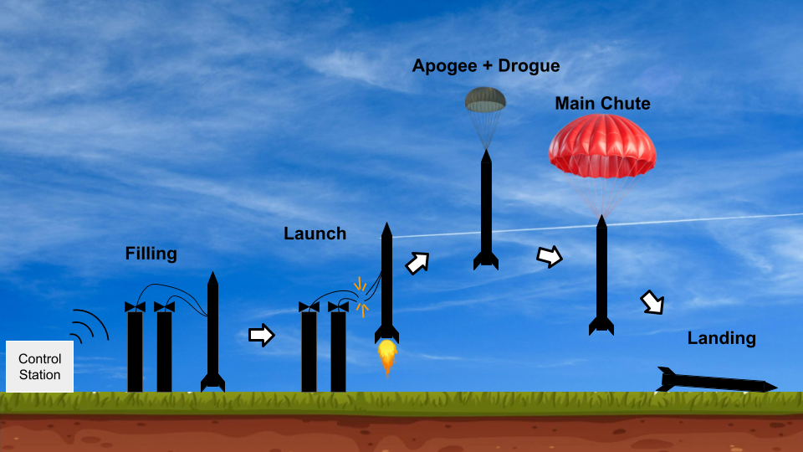
ConOps
Graphic + Phases
Phase 1: Filling
  Ox tank and air tank fill
Phase 2: Launch
  Pump turns on
  Line cutters ignite
  C-motor ignition
Phase 3: Apogee + Drogue Deployment
Coasts to an apogee of ~13000 ft
  Detect deployment at apogee
Phase 4: Main Parachute
  Detect deployment altitude of 1000 ft
Phase 5: Landing
  Archerfish lands safely
  GPS transmits location
Fig 0.3 Concept of Operations
Notes:
Jasmine – Yang not here
Launch: t = 0s
Burnout/Sep : t=6.95s

Slide 8
Requirements
Top Level
RBS | Requirement | Rationale
1 | The rocket shall be a pump-fed bipropellant liquid rocket | This is the primary mission of this rocket.
2 | The rocket shall be fully recoverable | Components and materials are expensive, post launch analysis becomes much more difficult if the rocket is in bad condition afterwards. This is also a FAR requirement.
3 | The rocket shall be structurally stable | Components and materials are expensive, post launch analysis becomes much more difficult if the rocket is in bad condition afterwards
4 | The rocket shall maintain static stability throughout flight | A stability caliber that's too low allows the wind to easily change trajectory or cause tumbling, lowering apogee or potentially mission failure. A too high stability caliber increases the rocket's sensitivity to disturbances and makes it difficult to recover from them, changing the trajectory and lowering apogee.​
5 | The rocket shall have an avionics system | This is a FAR requirement and is also necessary for several functions of the rocket
Note: FAR Requirements in Appendix
Notes:
Jasmine

Slide 9
Requirements
Second Level
RBS | Requirement | Rationale
1.1 | The rocket shall have an engine that produces 400 lbf | The rocket cannot move otherwise
1.2 | The rocket shall have a thrust to weight ratio greater than 3:1 | The rocket cannot move otherwise
1.3 | The rocket shall have a pump for the rocket fuel | This is a requirement for a rocket to be pump-fed
1.4 | The rocket will use Nitrous Oxide and Ethanol | This is a FAR Ten Cents Per Foot challenge requirement
2.1 | The recovery system shall deploy without damaging the rocket | This needs to occur for a successful recovery system
2.2 | The drogue chute shall deploy at apogee | This needs to occur for a successful two stage recovery system
2.3 | The main parachute shall deploy below 1,000 ft | This needs to occur for a successful two stage recovery system
Notes:
Jasmine

Slide 10
Requirements
Second Level (Cont’d)
RBS | Requirement | Rationale
3.1 | All parts of the rocket shall stay intact as designed throughout the internal systems | Components and materials are expensive, post launch analysis becomes much more difficult if the rocket is in bad condition afterwards
3.2 | The rocket body shall be able to support the weight of all internal systems | The rocket will fall apart if the rocket cannot support its own weight
3.3 | The rocket shall have a minimum FOS of 1 during entire flight | Components and materials are expensive, post launch analysis becomes much more difficult if the rocket is in bad condition afterwards
4.1 | The rocket shall have a stability caliber of 2. 5 +/- 0.5 OR 15% | See RBS 4
5.1 | The rocket shall have a telemetry system | This is a FAR requirement
5.2 | The avionics stack shall stay in one piece throughout the flight | The avionics system will likely not work if damaged
Notes:
Jasmine

Slide 11
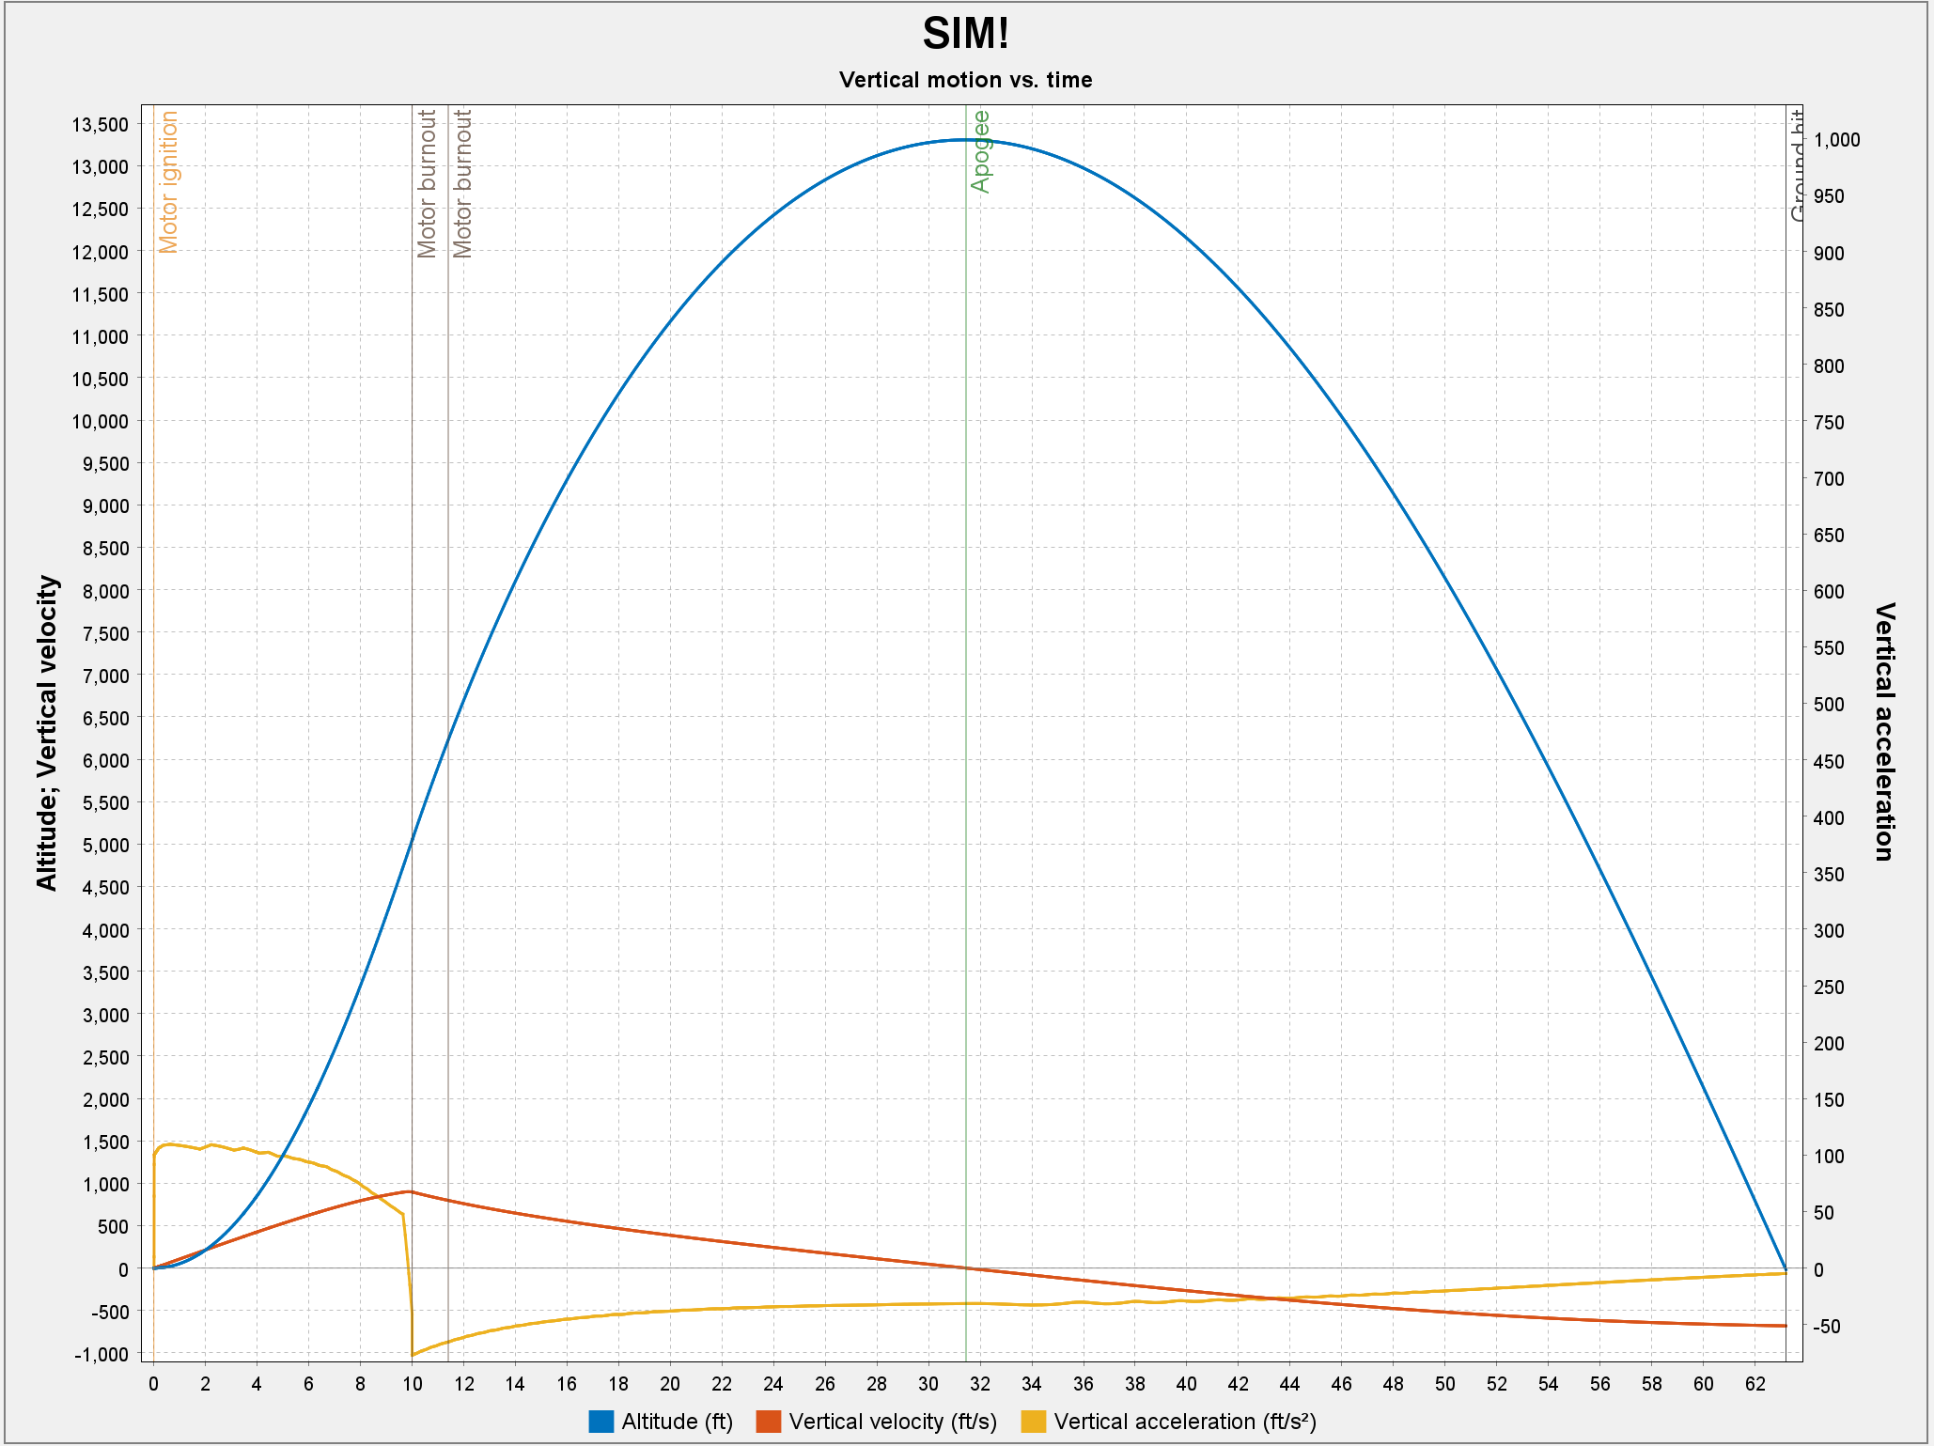
Altitude Plots
Open Rocket
Results:
  Apogee: 13275 ft
  Max Velocity: 906 ft/s =
  [Mach .826]
  Max Acceleration: 110 ft/s^2
  Time to Apogee: 31.5 s
  Flight Time: 63.2 s
Assumptions made:
  5 mph Wind
Fig 1.5 Open Rocket predicted trajectory
Notes:
Arjan

Slide 12
Fluids
Pump
Bulkheads and Tanks
Valves
Injector
Propulsion
Notes:
Matt

Slide 13
Fluids – Pump
Presented by: Tony Casagrande and Tate Manley
Notes:
Tate

Slide 14
Pump Requirements
Design Criteria
1. Head Rise >= 400
Derived from main requirements -> needed for proper engine pressure = 350 psi
2. 0.26 kg/s Mass flowrate
Derived from main requirements for engine -> supports 400 lbf
3. P_{Req} <= 10000 Watts
Derived from capabilities of batteries and choosing a realistic amperage / voltage from past pumps (~50V @ 200 amps)
4. N = 30000 RPM
Based on capabilities of current motor, soft requirement as different motor can be selected
Notes:
Tate

Slide 15
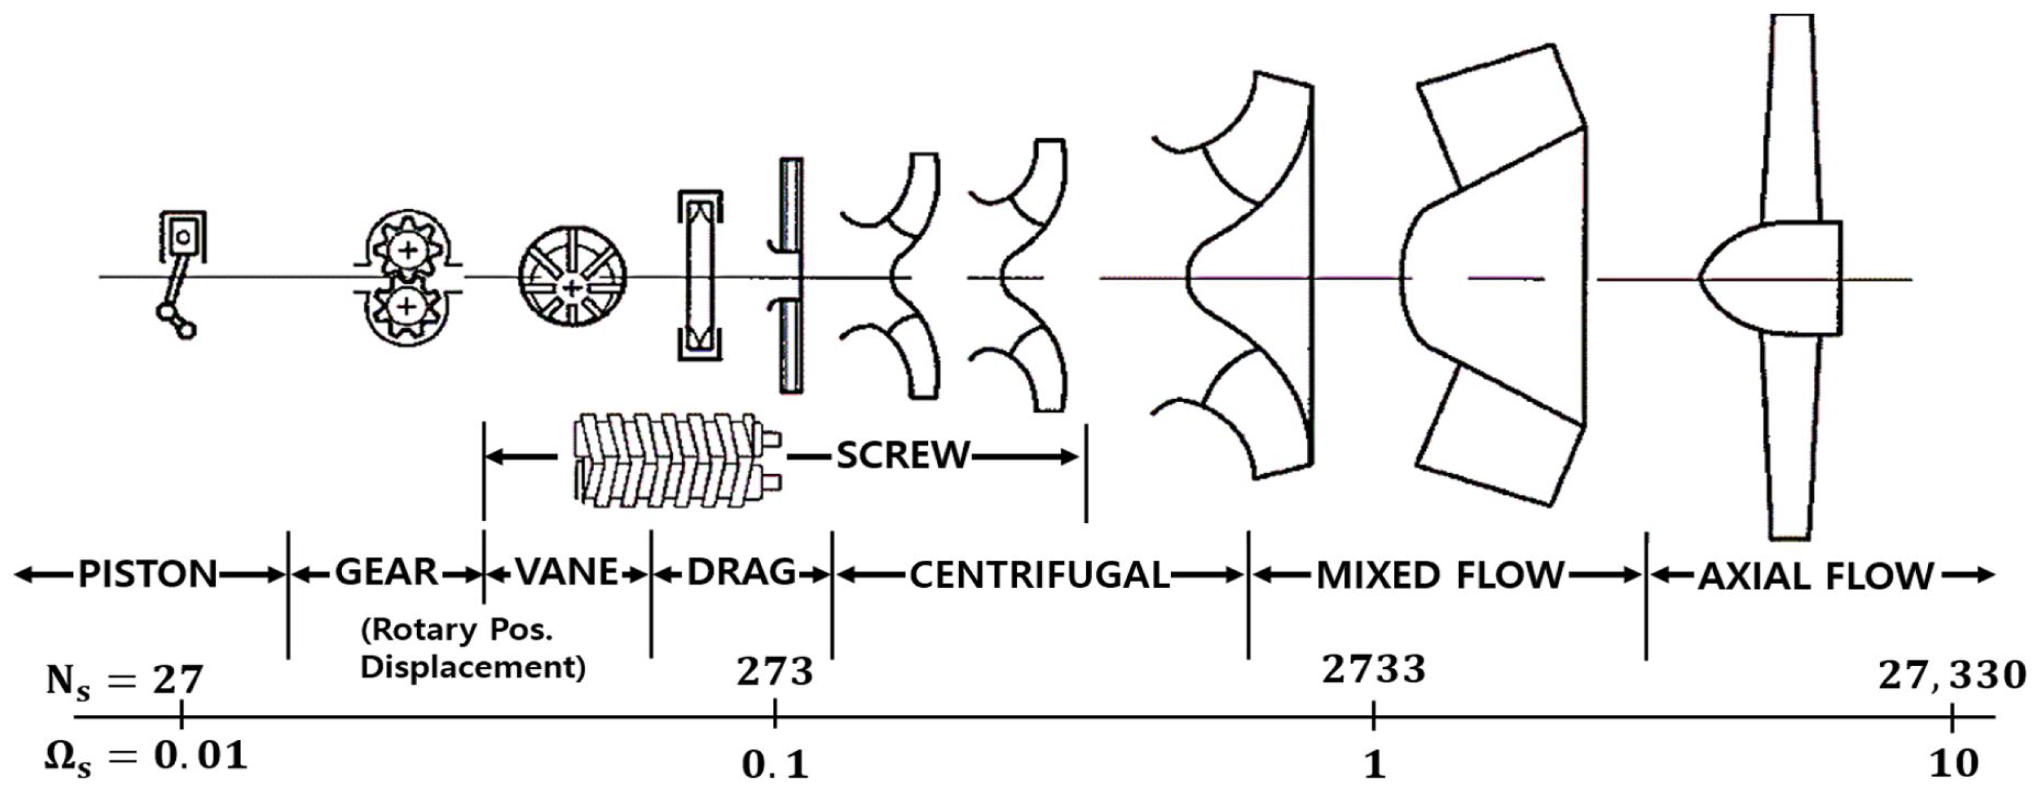
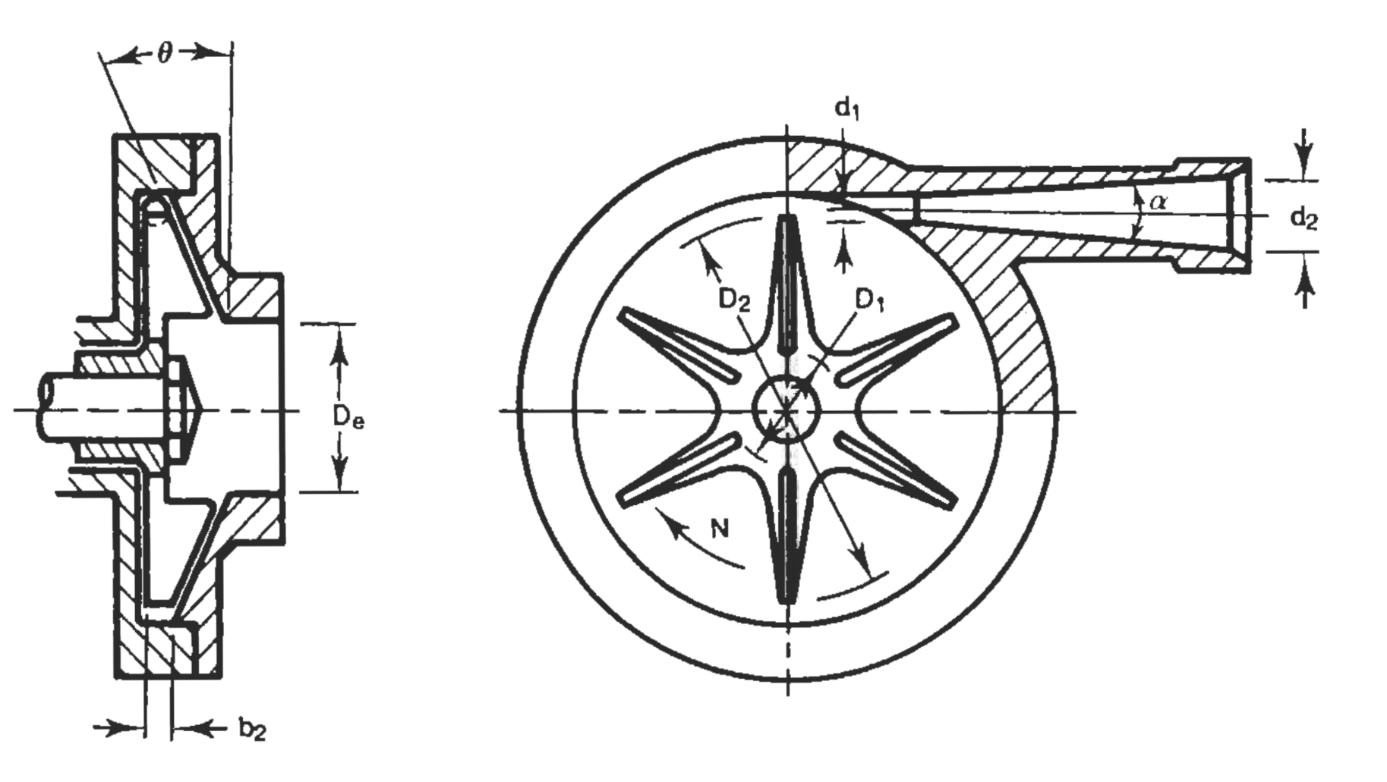
Pump Design
Overall Design Parameters / Considerations
*5.21 [GPM]
Low Specific Speed + High Head Rise ➔ Centrifugal Pump with Barske Impeller
Single Stage: Simplicity/Cost
No Inducer: Small Net Specific Suction Head Require (NPSHR) for impeller
Bearings + Sealing: High speed ball bearings + compressed graphite/PTFE packing rope + Springs and Seal-Plunger
Parameters | Value
Fuel Mass Flow | 0.26 [kg/s]*
Head Rise | 500 [psi]
RPM | 30000
Specific Speed (Ns) | 350
NPSHR | 10 [psig]
Fig 1.1 Pump Types
Fig 1.2 Barske Pump
Notes:
Tate

Slide 16
Pump Design
Overall Design and Parameters/Considerations
Volute: Concentric bowl (No gain with Volute collector at <400 Ns)
  Prior pump
Motor: Castle 2028 Sensored Motor - 800Kv (FOC capable)
Materials:
  Volute/Diffuser + Casing: 3D Printed Aluminum
  Impeller: 3D Printed Stainless (316)
  Motor Mount: SLA Resin
Overall Size (Pump Hardware):
  Impeller Diameter = 2 [in]
  Overall Length = 10.4 [in]
Parameters | Value
Motor Voltage | 9 - 50.4 [V]
Motor Amperage | <= 200 [A]
  Overall Diameter = 3.5 [in]
Notes:
Tate

Slide 17
BP2 Learnings
BP2 Pump Curve -> Flowrate Issue Solved!
Fig 1.3 BP2 Efficiency Curve
Fig 1.4 BP2 Pump Curve
Head Rise | Flow Rate | Mass Flow (Ethanol) | Power | Efficiency
175 [psi] | 6.2 [GPM] | 0.31 [kg/s] | 1800 [W] | 26.8%
Notes:
Tate

Slide 18
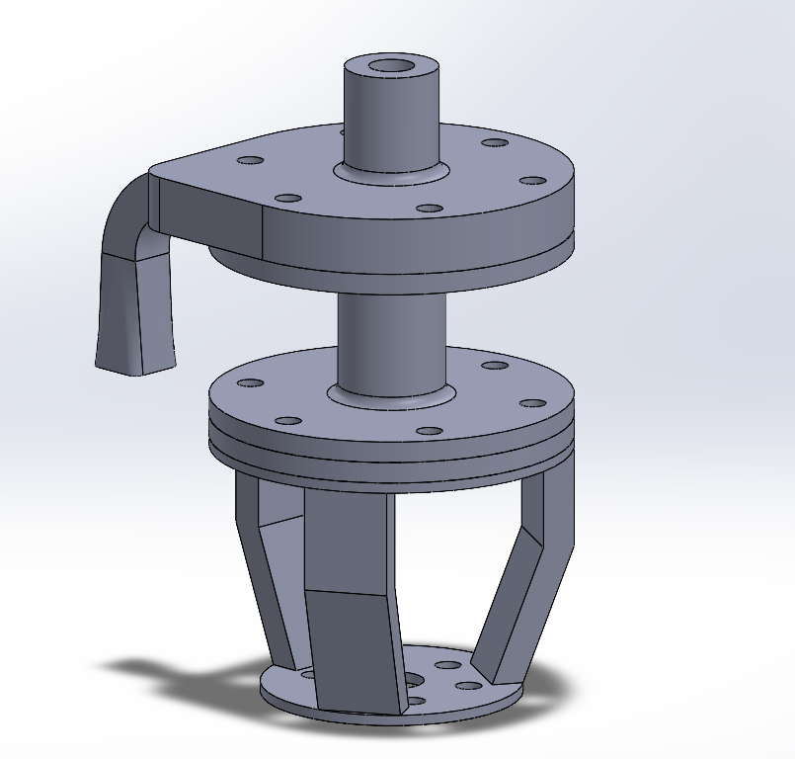
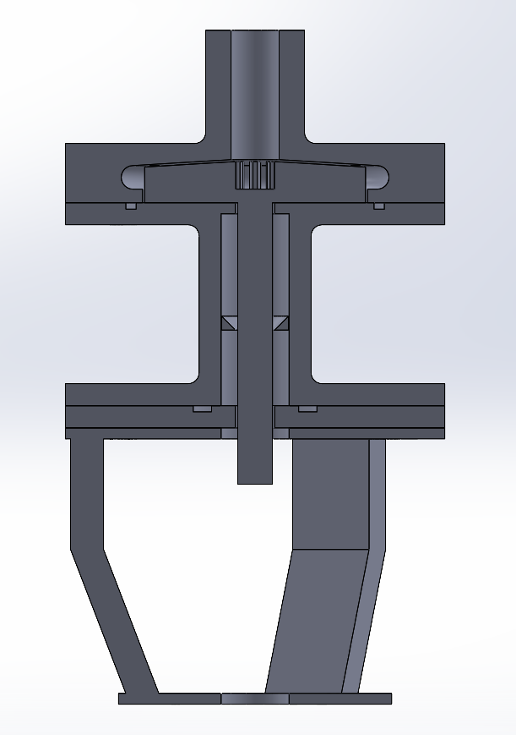
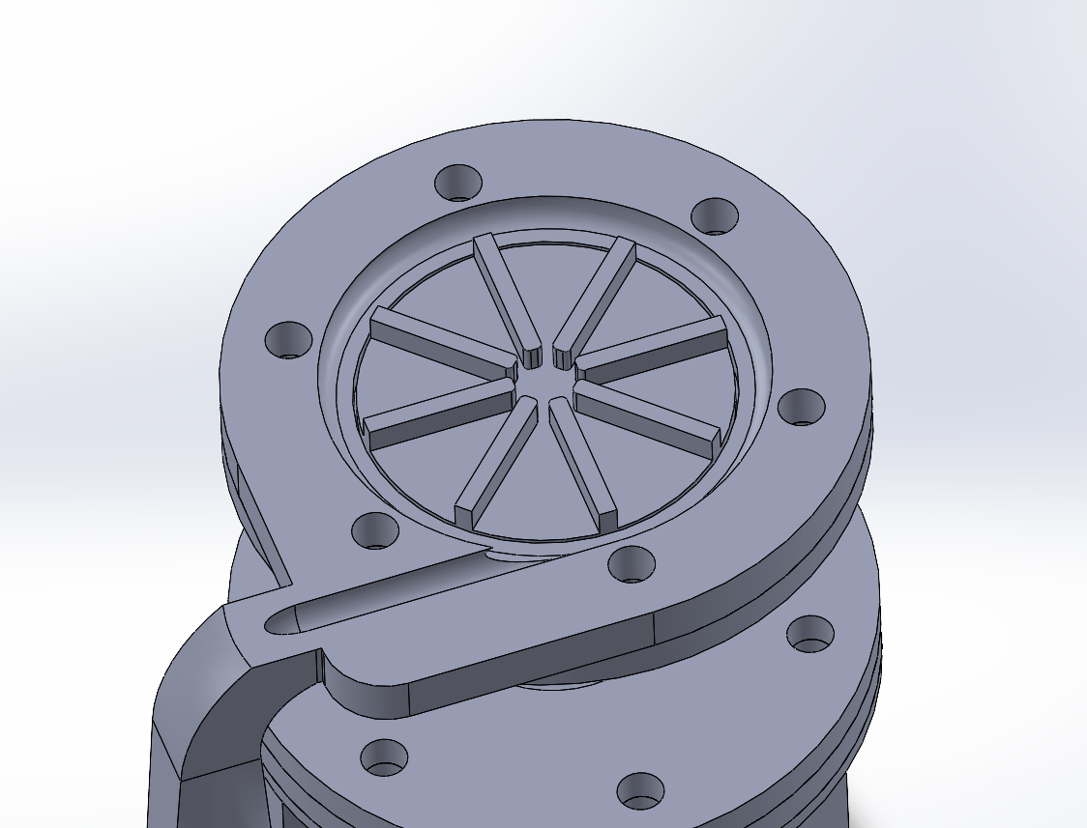
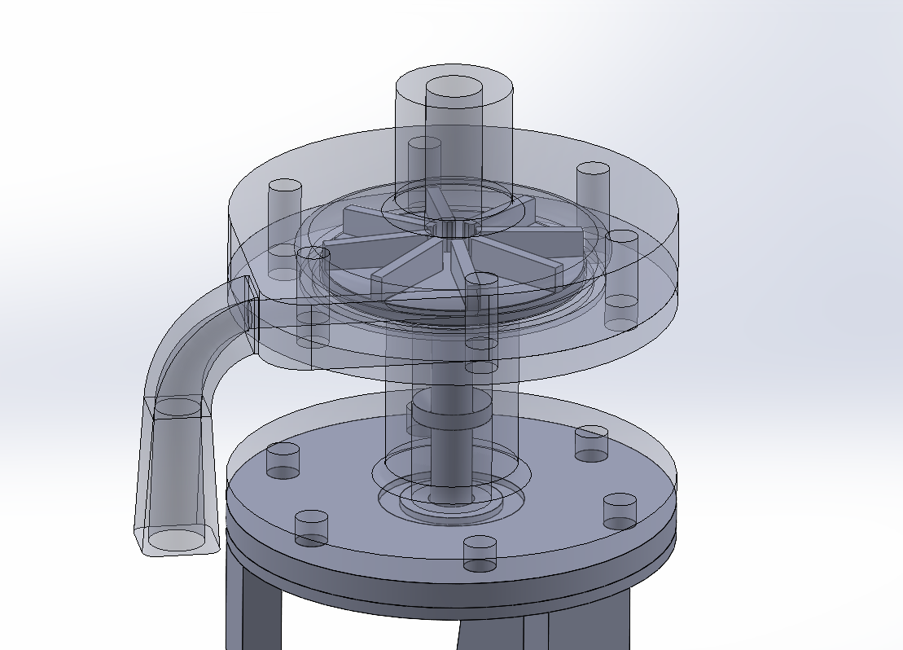
Integrated Design
AP1 -> Actual Design Views
Dynamic Seal
Spring
AP1 Impeller
Seal-Plunger
Fig 1.6 AP1 Full Assembly
FIG 1.8 AP1 Impeller Chamber
FIG 1.7 AP1 Impeller housing
FIG 1.5 AP1 Section View
Notes:
Tony

Slide 19
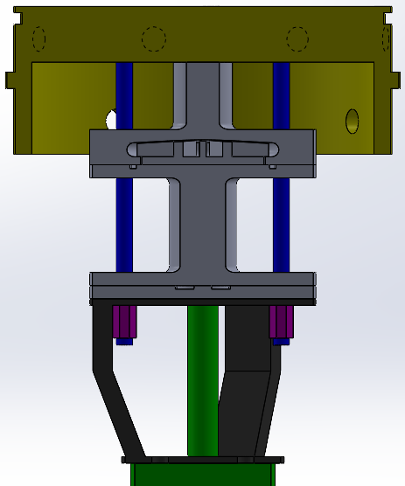
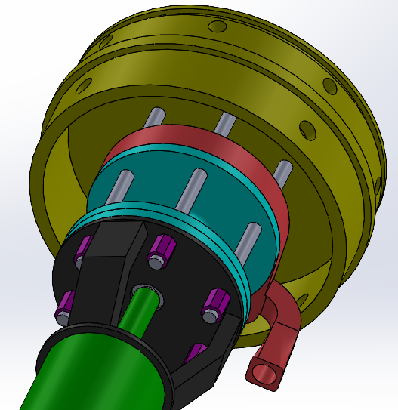
Pump Mounting
Plan for Integration
Fuel Bulkhead
Integrate with bottom of fuel bulkhead
Blind threaded hole w/ thread locker (2nd retention) on bulkhead
Nut with threaded rod (x6)
Will also interface with electronics mounts
Motor Controller / Batteries
Mounts attached to spacer or directly to pump casing/bulkhead
Threaded rod (x6)
Nut (x6)
Motor
Mount
Motor
FIG 1.10 Isometric Mount View
FIG 1.9 Mounting Section View​
Notes:
Tony

Slide 20
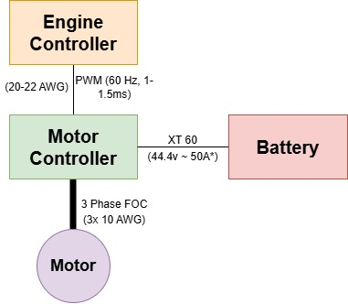
Pump Electronics
Wiring Diagram
Key Features
PWM Command from Engine Controller (0-100% RPM)
FOC Motor Controller – Motor Curve Optimized Automatically
XT60: 60A continuous, 180A peak
Battery:
  2x Drone batteries in series – 2x 6s (22.2V each)
  Size: 5000 mAh minimum – uses ~12% of capacity for 10s spin at 10000W.
  C rating: >= 50 (for worst case of 200A)
Weight: <= 6 lbs (Motor + Controller + Batteries + Mounts)
Fig 1.11 Flight Pump Wiring Diagram
Notes:
Tate

Slide 21
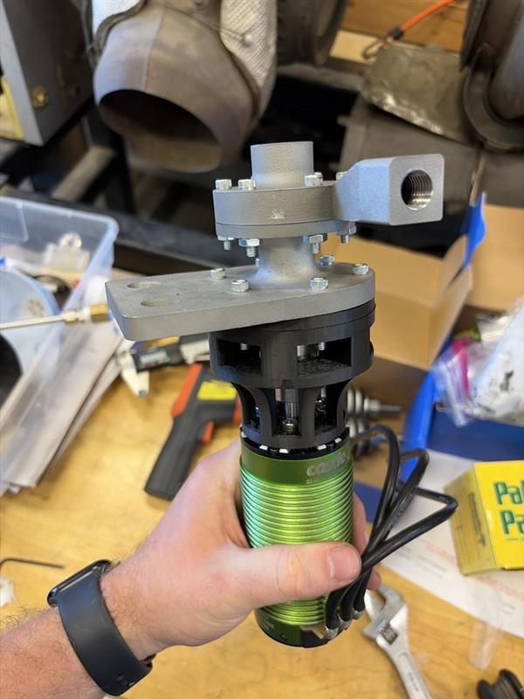
Future Steps
To-Do
Design – Update design with feedback
Manufacture – Casing, Impeller, Mounting, etc.
Testing – Test AP1 (Pump curve + Integrated Hot Fire Test)
Fig 1.12 BP2 Integrated for Testing
Notes:
Tate

Slide 22
Fluids – Bulkheads and Tanks
Presented by: Devin Chen, Gustavo Chavez, Joshua Chung, Sloan Robbins
Notes:
Tate

Slide 23
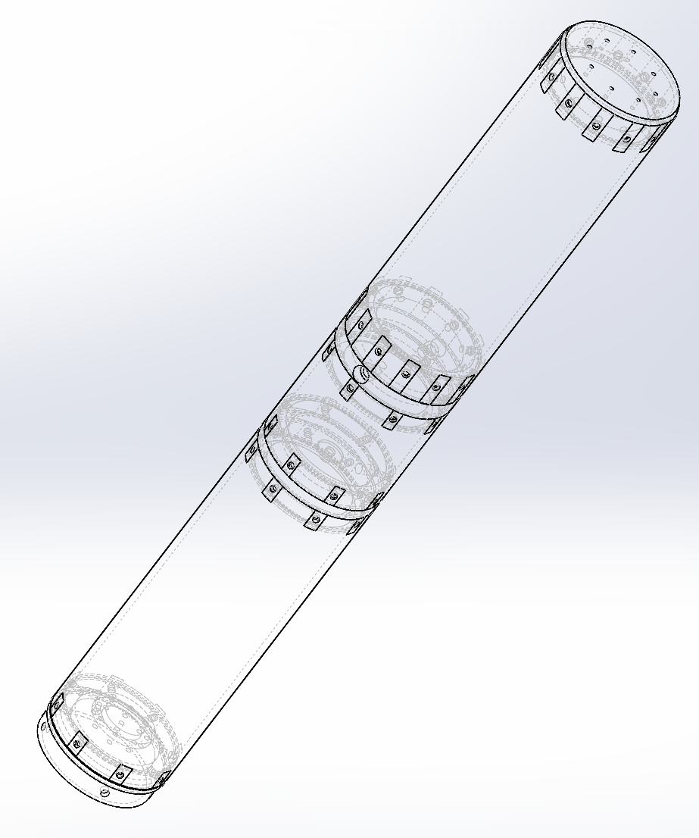
Bulkhead Requirements
Design Criteria
RBS | Requirement | Rationale | Verification
1 | Design OX tank for 750 psi MEOP (1500 psi for FS 2) Fuel tank for 100 psi MEOP (200 psi for FS 2) GN2 tank for 100 psi MEOP (200 psi for FS 2). This means that the bulkhead will also have to be rated to these pressure with a factor safety of 2 | This is to ensure that the pressure vessel will be able to withstand pressures than may result from unexpected temperature fluctuations which would allow for higher-than-normal pressures. | SolidWorks FEA, Hand Calculations, and pressure vessel testing
2 | All Bulkheads are to be manufactured out of 6061 T6 Aluminum and need to be manufactured in house | The material constraint is due to 6061-T6 aluminum being lightweight while being strong enough to withstand the pressures in the system, they are also much more affordable than other material that have these properties.
3 | All bulkhead should meet or safely be below the allowable weight so that the thrust to weight ratio of 4.51 | A too low of a TWR leads to stability issues during launch and flight
4 | All bulkheads must have a tab in the middle | Provides space for check values to ensure no gases/ liquids will mix.
Fig 2.1 Tank Assembly
Notes:
Devin, Sloan, Noah, Gustavo, Joshua

Slide 24
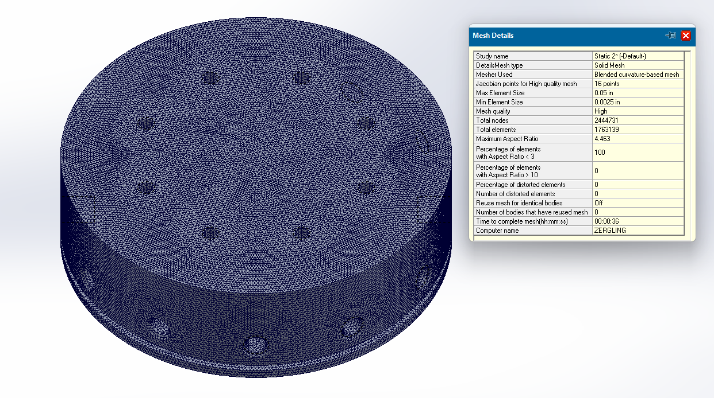
Bulkheads
FEA Approach
Sufficiently high mesh quality to capture stress concentrations.
Simulated at pressures far higher than application for safety. (e.g., 1500psi for a bulkhead with 750psi tank pressure)
Simulated with maximum von Mises scale being a full order of magnitude lower than actual yield strength.
Bulkheads under 2 pressures simulated with both pressures individually and together, highest stress result shown.
0.0015in maximum displacement
Fig 2.2 OX Sample Bulkhead Mesh

Slide 25
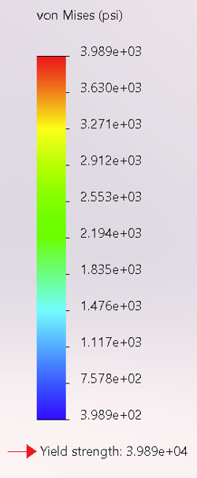
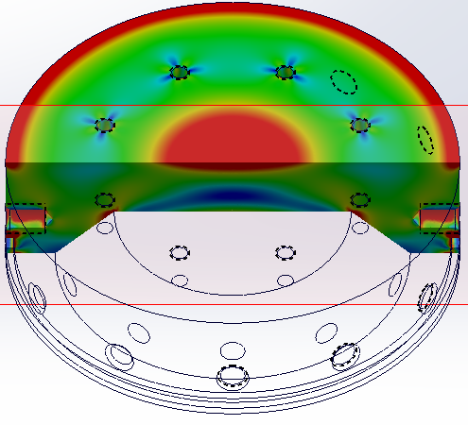
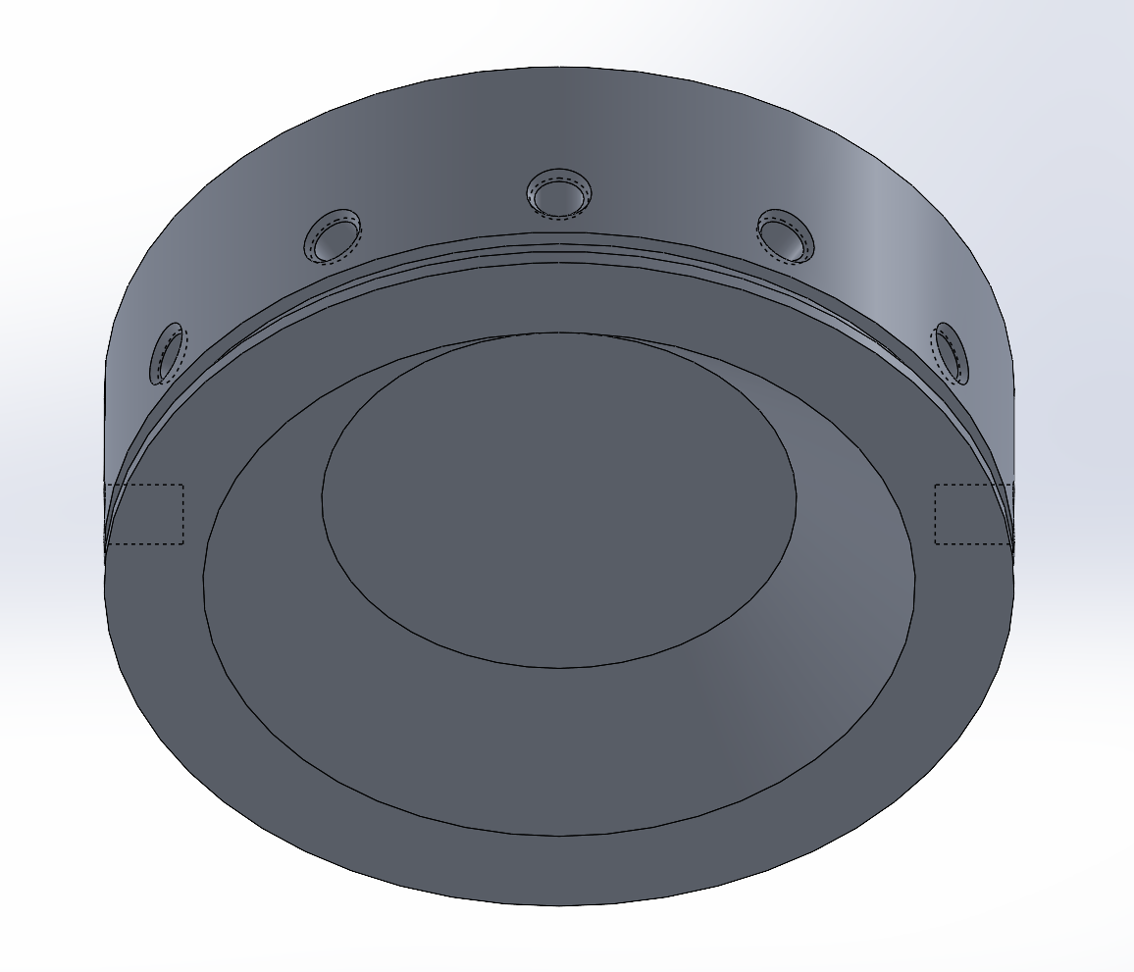
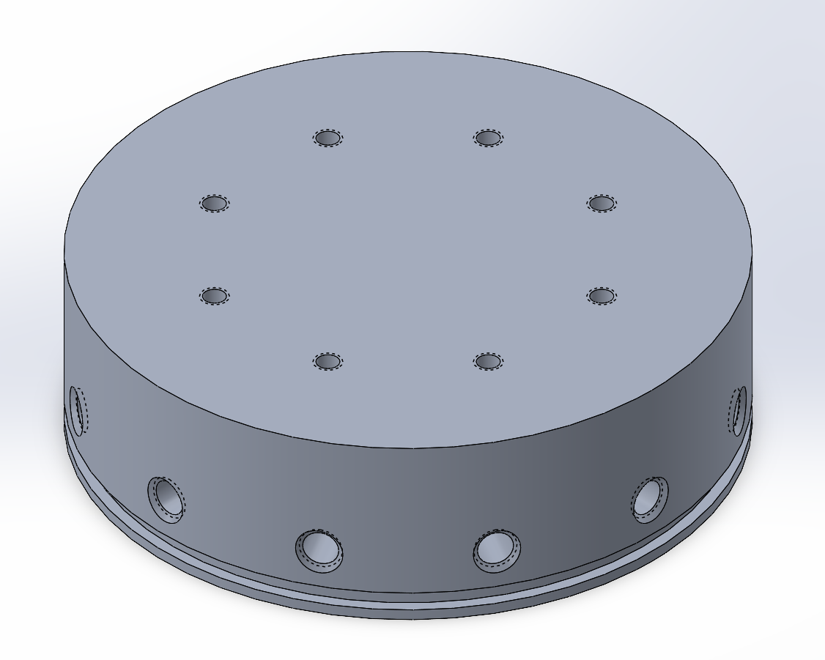
Bulkheads OX
CAD/FEA
Fig 2.3 OX Bulkhead Model
1500 psi
Dimensions:
Height: 1.75 in
Width: 5.75 in OD
Mass = 3.52 lbs.
Fig 2.4 OX Bulkhead FEA
Constrained on face meeting tank
Tested @ 1500psi internal pressure
Notes:
Devin, Sloan, Noah, Gustavo, Joshua

Slide 26
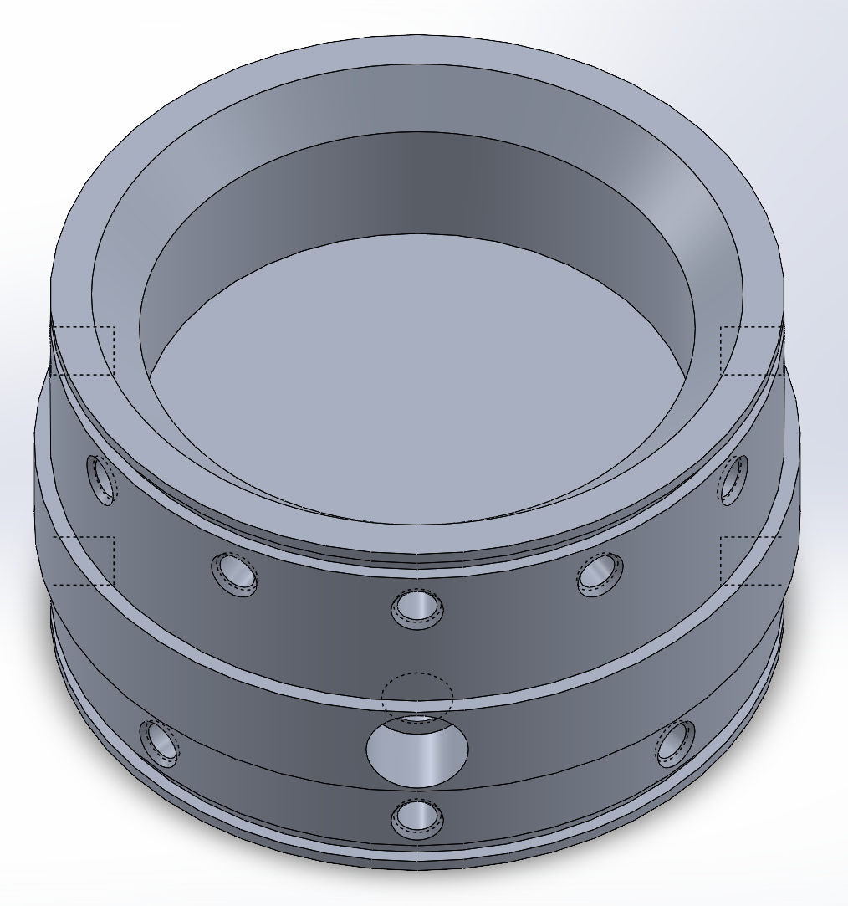
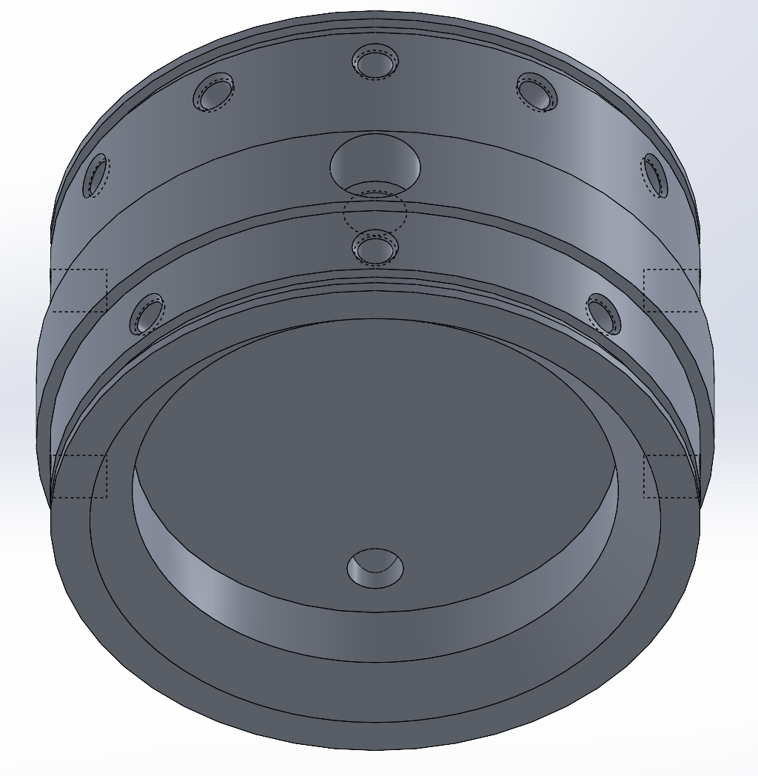
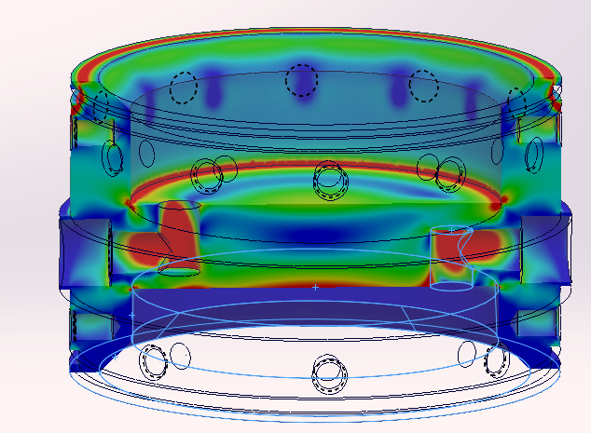
Bulkheads OX/GN2
CAD/FEA
1500 psi
Fig 2.5 OX and GN2 Bulkhead Model
Dimensions:
Height: 3.6255 in
Width: 6.00 in OD
Mass = 5.02 lbs.
200 psi
Fig 2.6 OX and GN2 Bulkhead FEA
Constrained on faces meeting tanks
Tested @ 1500psi
Notes:
Devin, Sloan, Noah, Gustavo, Joshua

Slide 27
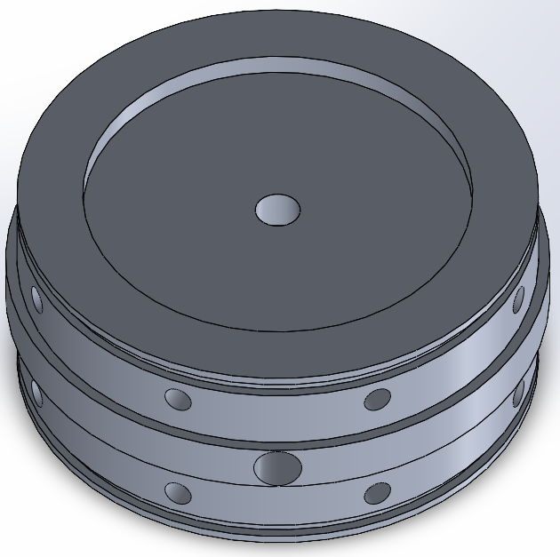
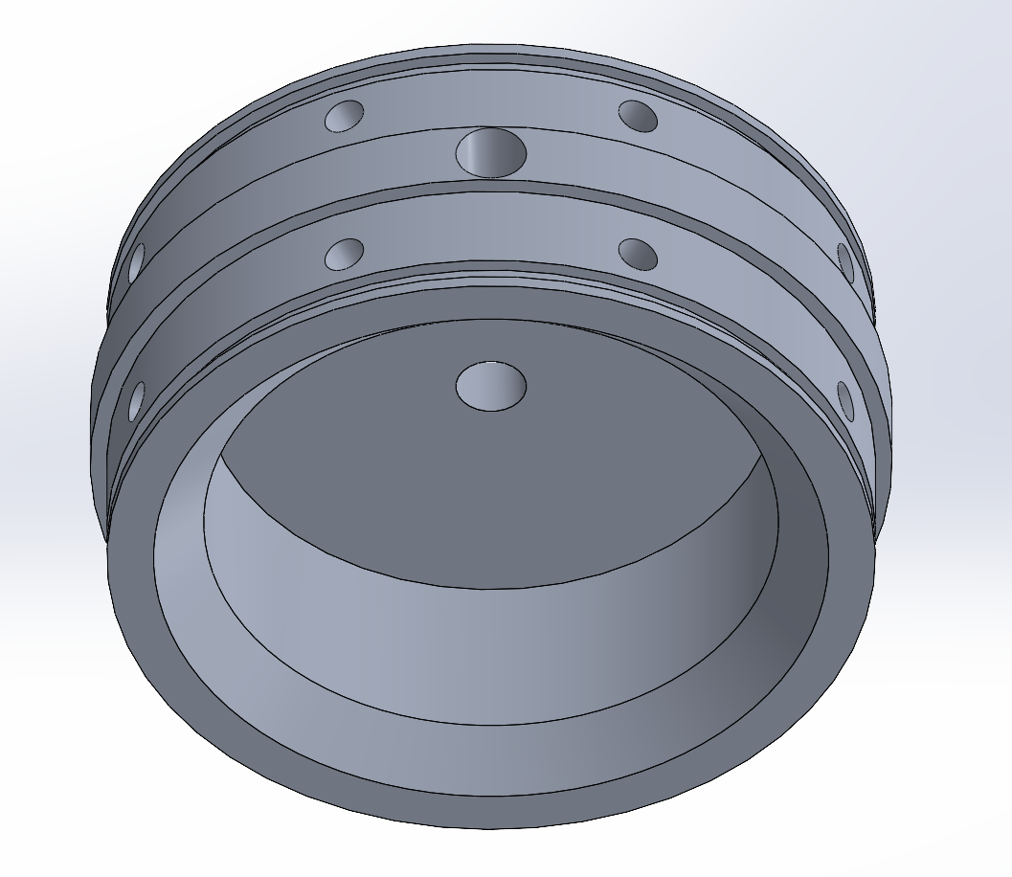
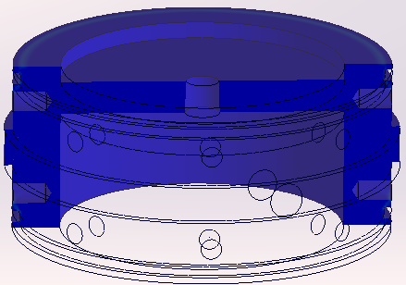
Bulkheads GN2/Fuel
CAD/FEA
200 psi
Fig 2.7 OX and GN2 Bulkhead Model
Dimensions:
Height: 2.587 in
Width: 6.00 in OD
Mass = 3.19 lbs.
200 psi
Fig 2.8 GN2 and Fuel Bulkhead FEA
Constrained on faces meeting tanks
Tested @ 200psi
Notes:
Devin, Sloan, Noah, Gustavo, Joshua

Slide 28
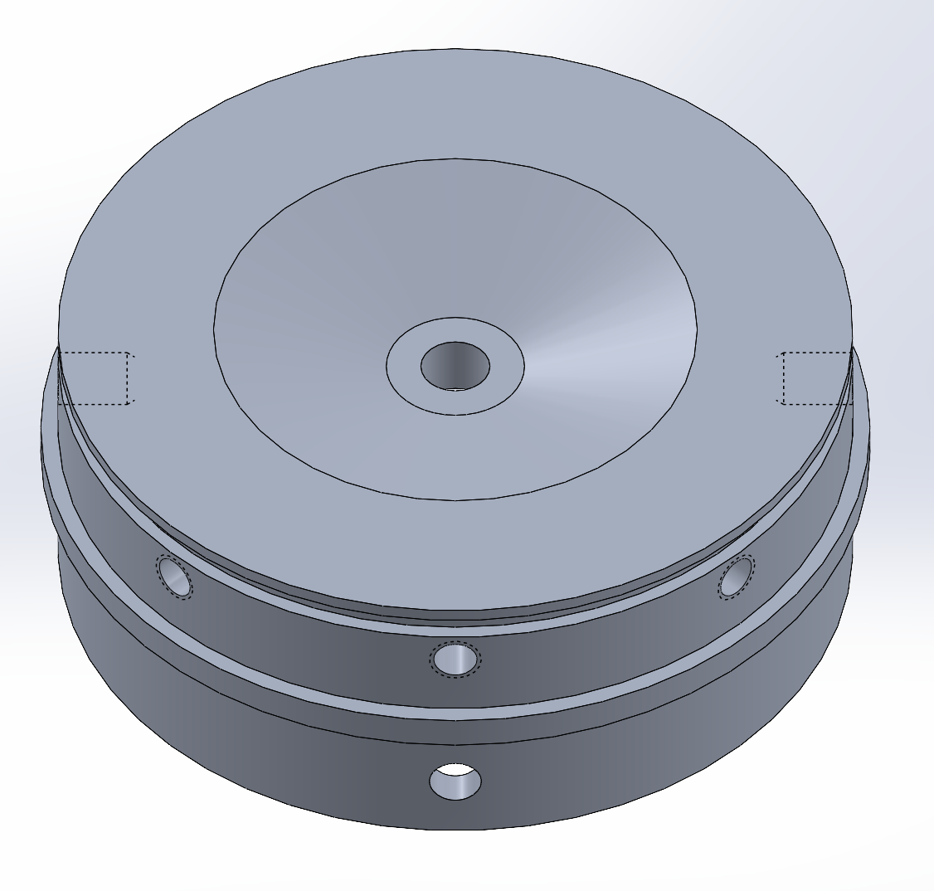
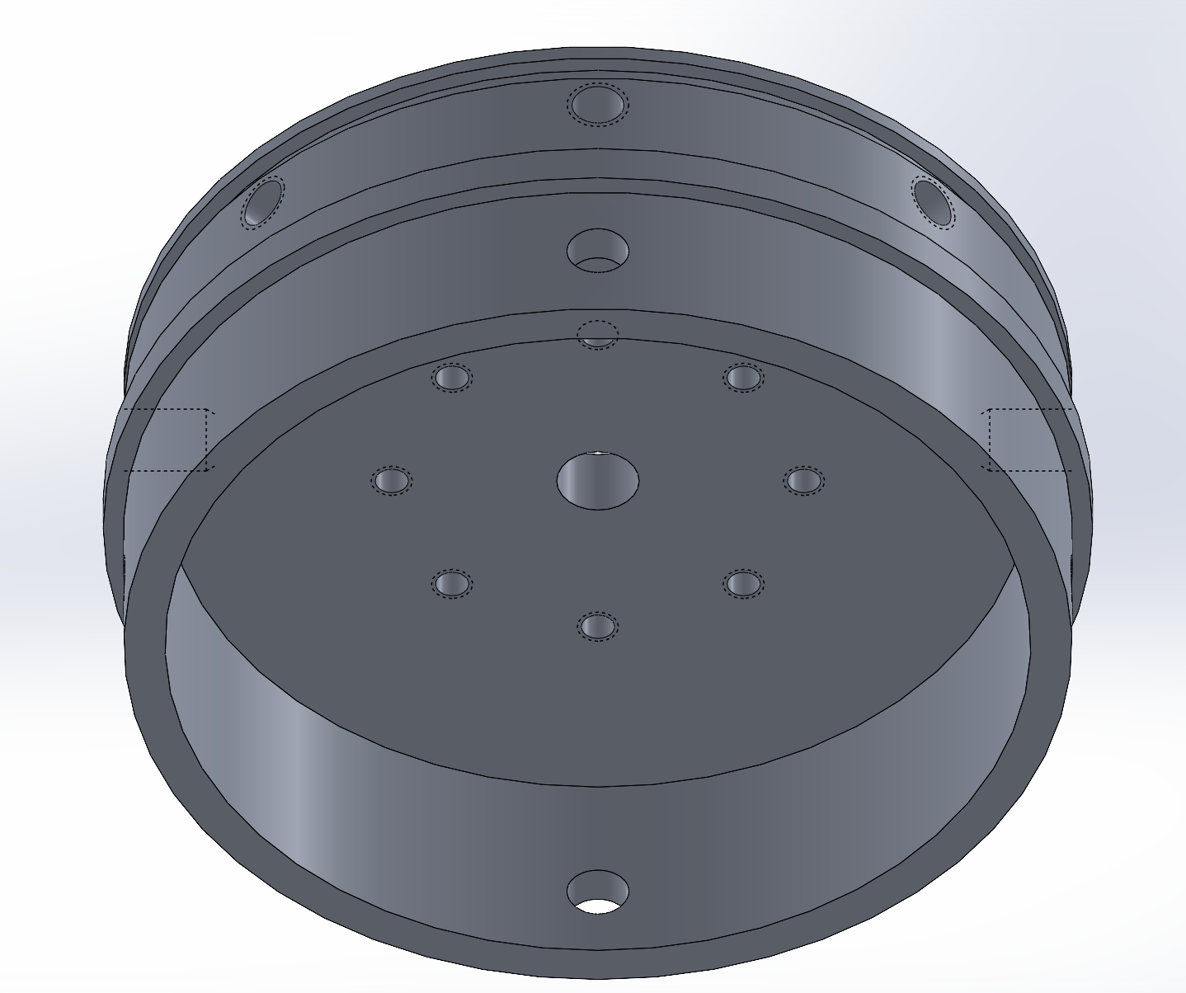
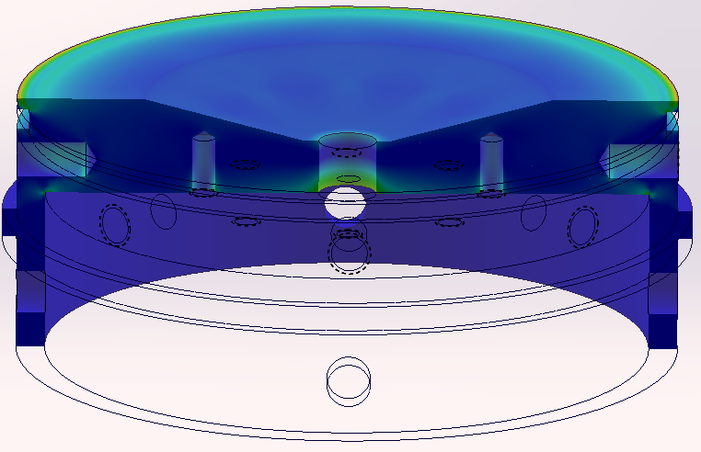
Bulkhead Bottom Fuel
CAD/FEA
200 psi
Fig 2.9 GN2 and Fuel Bulkhead Model
Dimensions:
Height: 2.587 in
Width: 6.00 in OD
Mass = 2.54 lbs.
Fig 2.10 Fuel Bottom Bulkhead FEA
Constrained on face meeting tank
Tested @ 200psi
Notes:
Devin, Sloan, Noah, Gustavo, Joshua

Slide 29
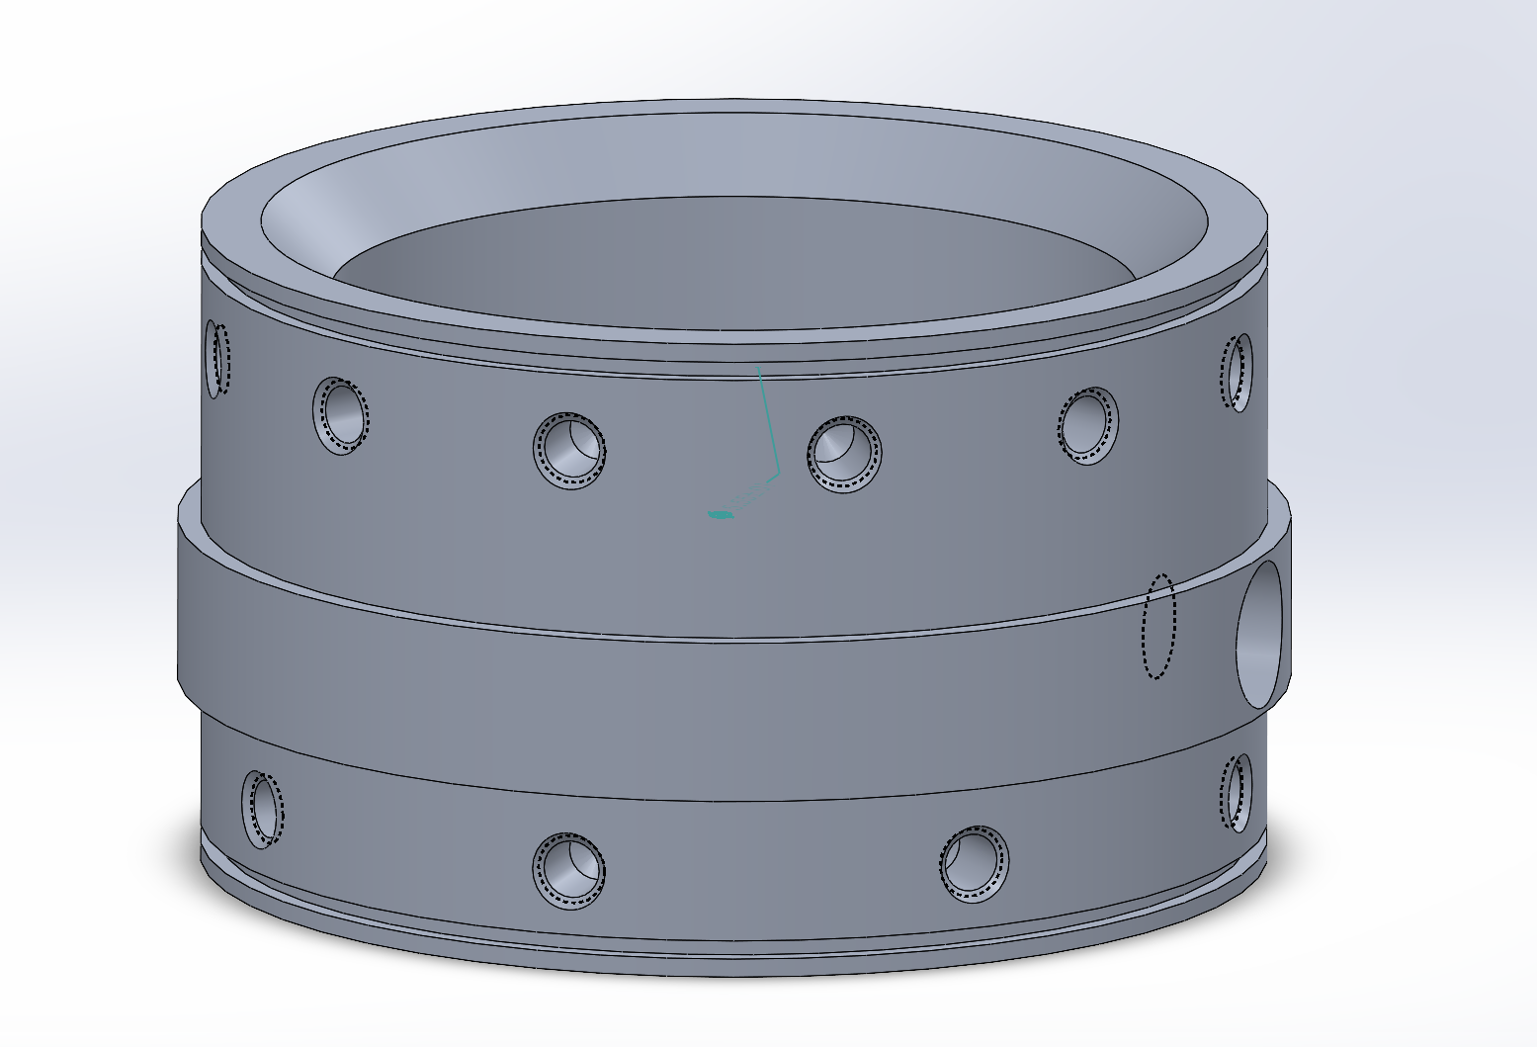
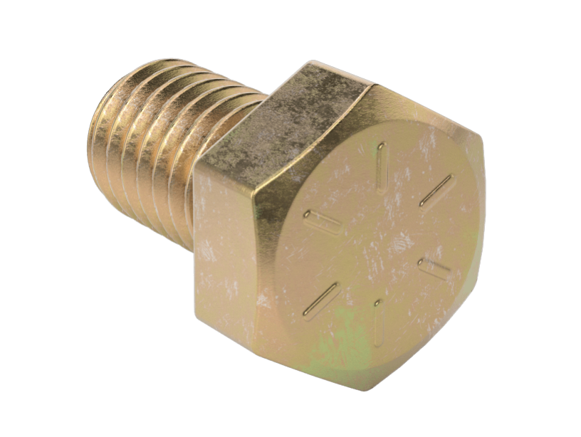
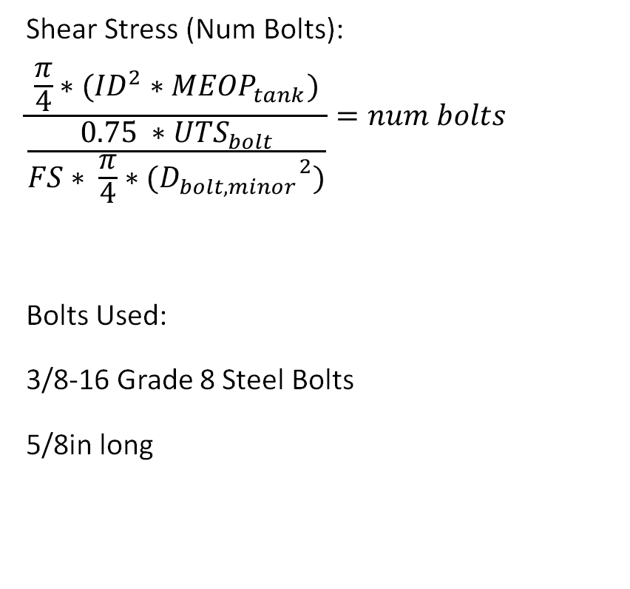
Bulkhead Calcs
Bolts
Num Ox Bulkhead bolts: 10.2002 --> 12 bolts
Num Fuel Bulkhead bolts: 1.3327 --> 8 bolts
Num Air Bulkhead bolts: 1.3327 --> 8 bolts
Shear Stress (Num Bolts):
$$\frac{\frac{π}{4}∗({ID}^{2}∗{MEOP}_{tank})}{\frac{0.75 ∗{UTS}_{bolt}}{FS∗ \frac{π}{4}∗({D_{bolt, minor}}^{2})}}=num bolts$$
Bolts Used:
3/8-16 Grade 8 Steel Bolts
5/8in long
https://www.mcmaster.com/92620A621/
Fig 2.11 Grade 8 Steel Bolt
Fig 2.12 OX and GN2 Bulkhead Model
Notes:
Devin, Sloan, Noah, Gustavo, Joshua

Slide 30
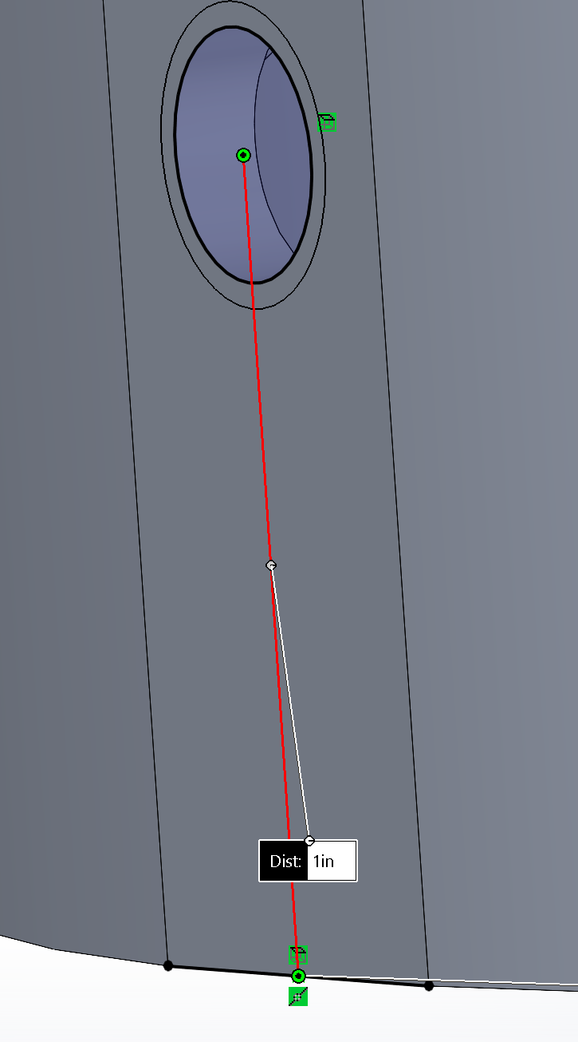
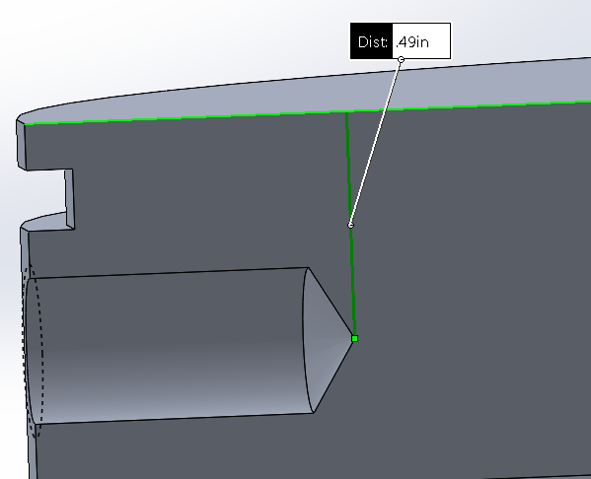
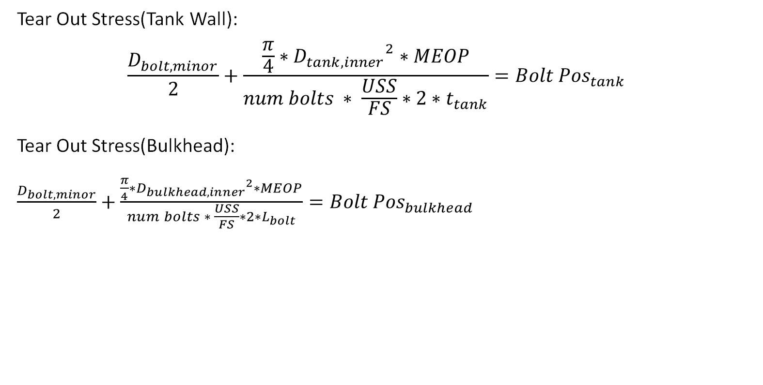
Bulkhead Calcs
Bolts
Tear Out Stress(Tank Wall):
$$\frac{D_{bolt,minor}}{2}+\frac{\frac{π}{4}∗{D_{tank,inner}}^{2}∗MEOP}{num bolts ∗ \frac{USS}{FS}∗2∗t_{tank}}={Bolt Pos}_{tank}$$
Tear Out Stress(Bulkhead):
$\frac{D_{bolt,minor}}{2}+\frac{\frac{π}{4}∗{D_{bulkhead,inner}}^{2}∗MEOP}{num bolts ∗ \frac{USS}{FS}∗2∗L_{bolt}}={Bolt Pos}_{bulkhead}$
Tank Wall: Ox Bulkhead: Air and Fuel Bulkhead:
0.9531in 0.3983in 0.2156in
Fig 2.13 Bulkhead Bolt Distances
Notes:
Devin, Sloan, Noah, Gustavo, Joshua

Slide 31
Bulkheads
O-Ring
Series 2-255 O-Rings
Material: Viton®
Sizing:
  OD > 5.75in
  ID < 5.75in
Fractional(in) | Actual(in) | Gland Dimension(in)
OD: 5 7/8 | OD: 5.887 | Depth: .115
ID: 5 5/8 | ID: 5.609 | Width: .196
Width: 1/8 | Width: .139

Slide 32
Tanks Requirements
Design Criteria
RBS | Requirement | Rationale | Verification
1 | Design OX tank for 750 psi MEOP (1500 psi for FS 2) Fuel tank for 100 psi MEOP (200 psi for FS 2) GN2 tank for 100 psi MEOP (200 psi for FS 2). This means that the bulkhead will also have to be rated to these pressure with a factor safety of 2 | This is to ensure that the pressure vessel will be able to withstand pressures than may result from unexpected temperature fluctuations which would allow for higher-than-normal pressures. | SolidWorks FEA, Hand Calculations, and pressure vessel testing
2 | Sized to a 10 seconds of burn time | Gives us a basis for how much fuel and OX we need to pressurize too in order to reach 10 seconds.
3 | Static Vent in Ox Tank (Unknown Hole Size) | Prevents pressure buildup during filling and to provide a constant, controlled way to release excess pressure
4 | Tank Lengths: OX 14.5", GN2 3.6", Fuel 15.16" | Lengths used to allow for enough fuel with pressures rated for the tanks.
Notes:
Devin, Sloan, Noah, Gustavo, Joshua

Slide 33
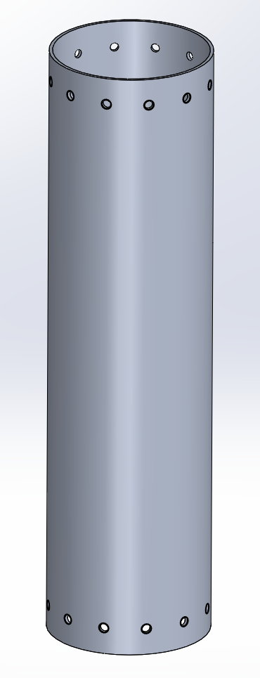
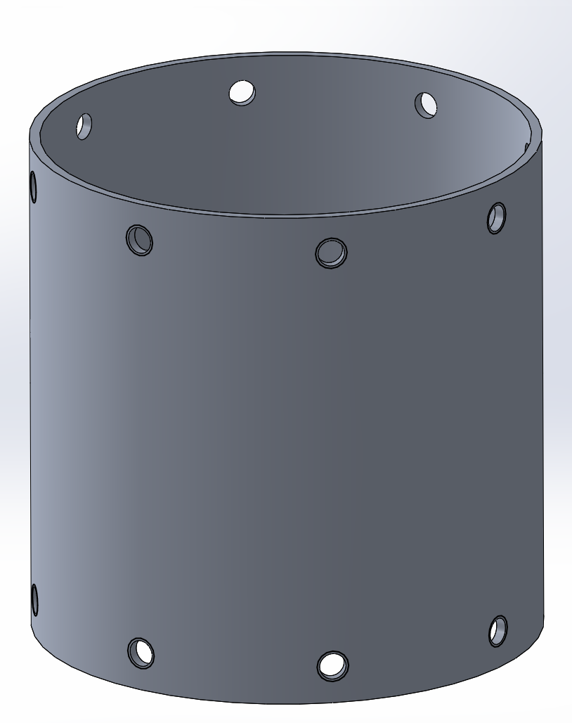
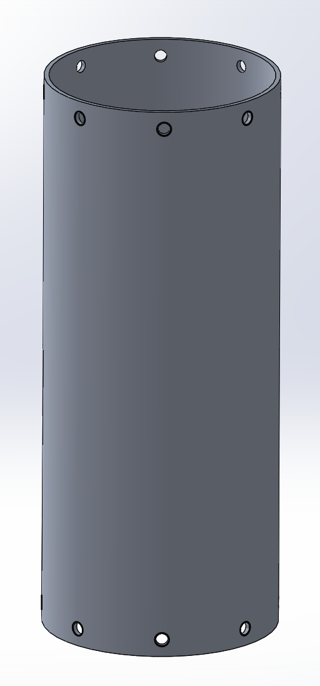

Tank CAD
OX/Air/Fuel
Lengths:
OX Tank: 22.5in
GN2 Tank: 6in
Fuel Tank: 14.5in
Fig 2.15 GN2 Tank
Fig 2.14 OX Tank
Fig 2.16 Fuel Tank
Notes:
Devin, Sloan, Noah, Gustavo, Joshua

Slide 34
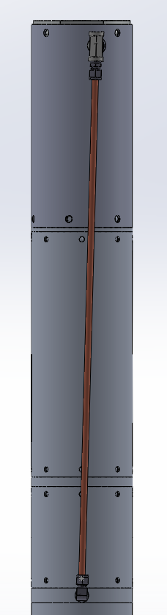
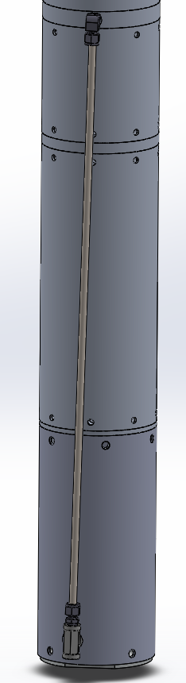
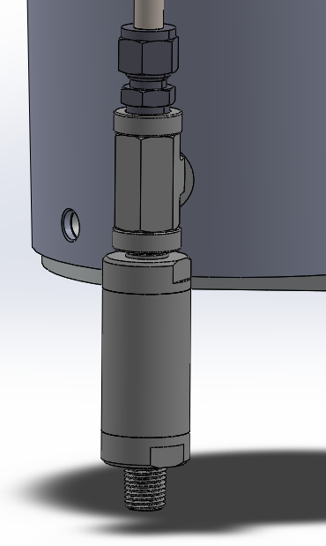
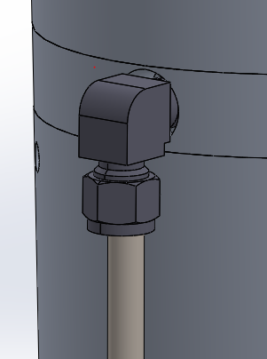
Down Pipe CAD
OX to Manifold
OX Down Pipe:
Pipe Material: Aluminum Rated for 3200psi
Length: 29.5in
Fittings: ¼ NPT T Male and 2 Female
¼ NPT Female to Swage 3/8 Male Straight
¼ NPT Female to Swage 3/8 Male Elbow
¼ to ¼ NPT Check Valve: Rated for 3000psi
Fig 2.19 Downcomer Fitting
Fig 2.18 Check Valve
Fig 2.17 Downcomer
Notes:
Devin, Sloan, Noah, Gustavo, Joshua

Slide 35
Manufacturing
Operations
The Bulkheads and Tanks will be manufactured in house.
We will be using a combination of Mill and Lathe to complete this task.
Lathe will be used for Turning, Boring, Facing
Mill will be used for Rotary Vise for Drill, Tap of Side holes, and milling operation
If more weight reduction (Isogrids) is needed CNC can also be used

Slide 36
Bulkhead and Tank BOM
 | Description | Part Number | Unit Price | Quantity | Subtotal | Taxes | Shipping | Total
1 | 6in OD 24in Length Stock | R36 | $297.81 | 2 | $570.62 | $26.80 | $16.20 | $613.62
2 | 6in OD 5.875ID 35 in Length Tubing |  | $36.41 | 1 | $96.89 | $2.64 | $10.51 | $110.04
3 | Bolts | 92620A621 | $16.15 | 2 packs (100) | $32.30 | $0 | $0 | $N/A
4 | O-Rings | 9464K554 | $7.62 | 4 packs (8) | $30.48 | $4.55 | $11.23 | $78.56
 |  |  |  |  |  |  | TOTAL: | $802.22

Slide 37
Fluids – Valves and Injector
Presented by: Shiv Patel and Kevin Quintana
Notes:
Tate

Slide 38
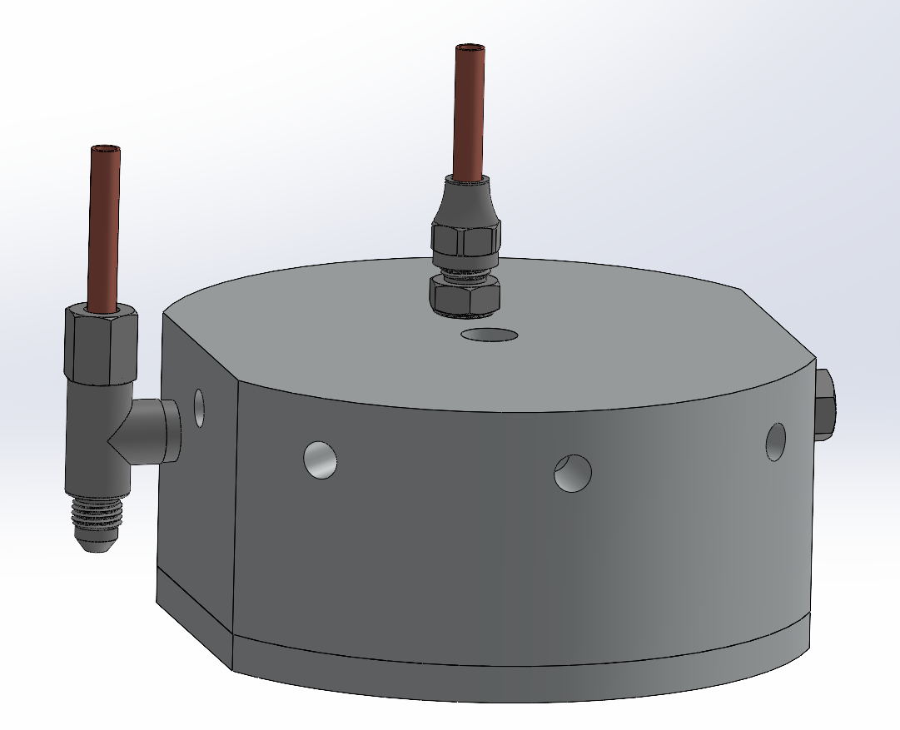
Valve Requirements
Design Criteria
The Injector Valve shall prevent the flow of fluid during Closed state
The Injector Valve shall allow for the flow of fluid during Open State
The Plunger must remain in the system for the duration of the vehicle's flight
Line cutters shall be triggered and allow the Plunger to slide
Fig. 3.0

Slide 39
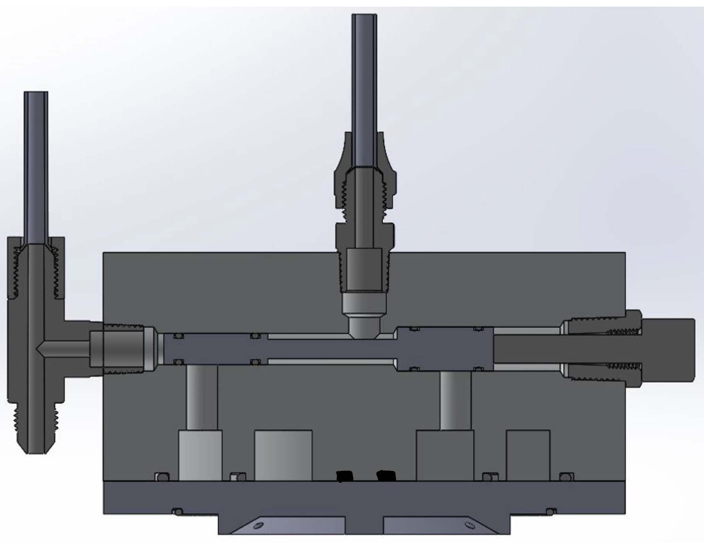
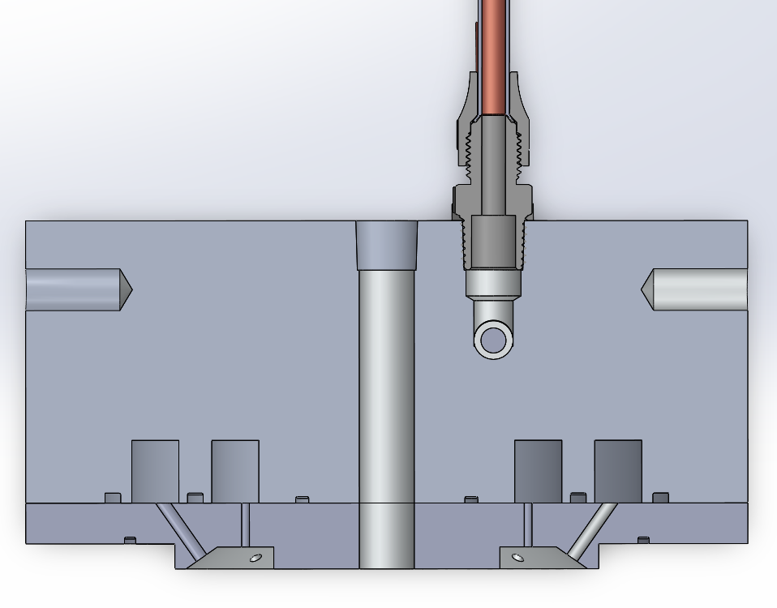
Injector Valves
Isometric + Cross-sections Views
Fig. 3.1
Fig. 3.2a
Fig. 3.2b

Slide 40
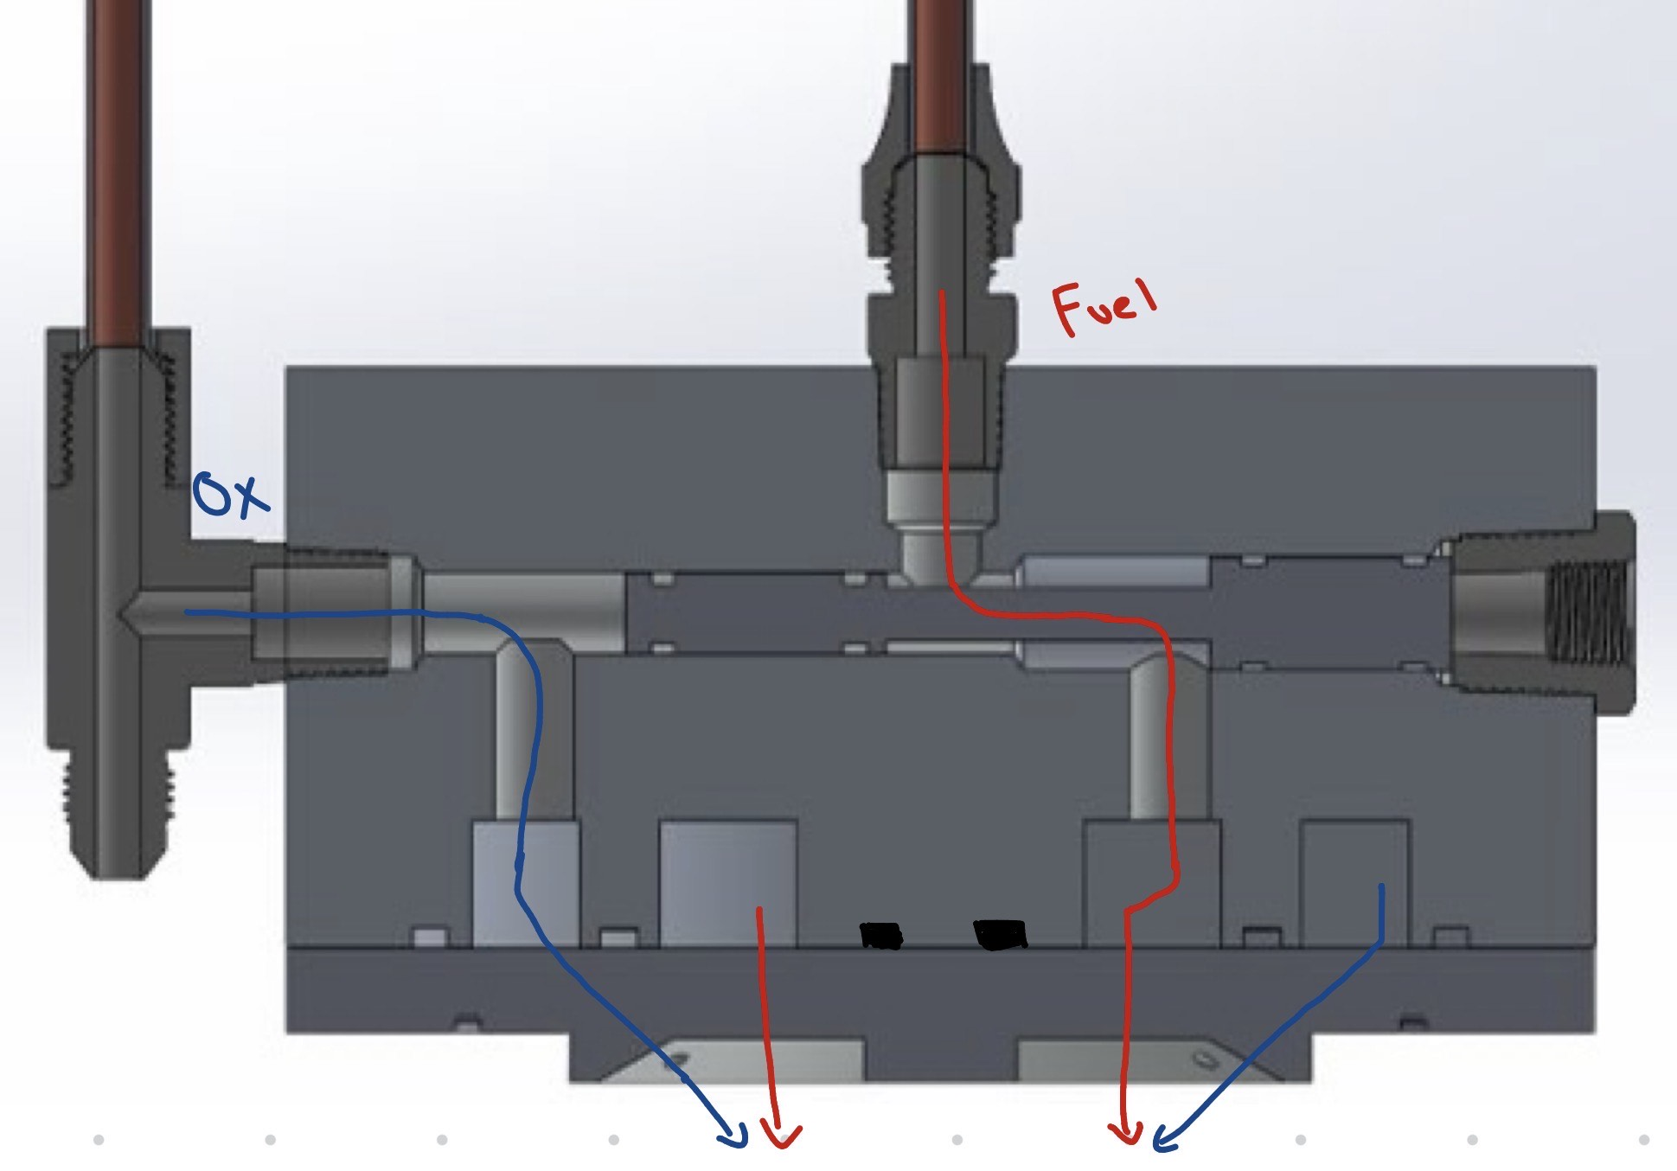
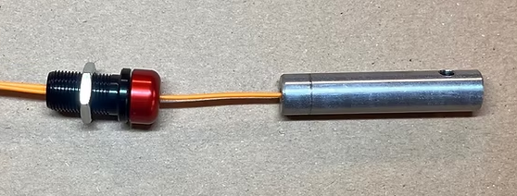
Valves
Injector Valves + Manifold
Line cutters trigger mechanical transition from Closed to Open State
Reducer in place to prevent Plunger from falling off during flight
Igniter is in the center, Inlet and Exit ports are offset 0.85" from center
5.75" OD, 2.25" Tall, ¼" NPT Ox and Fuel Inlets, Deburred Exit Holes, 6061 Aluminum
Closed State
(no fluid flow past Plunger)
Open State
Fig. 3.3
Fig. 3.4
Fig. 3.5: Line Cutters

Slide 41
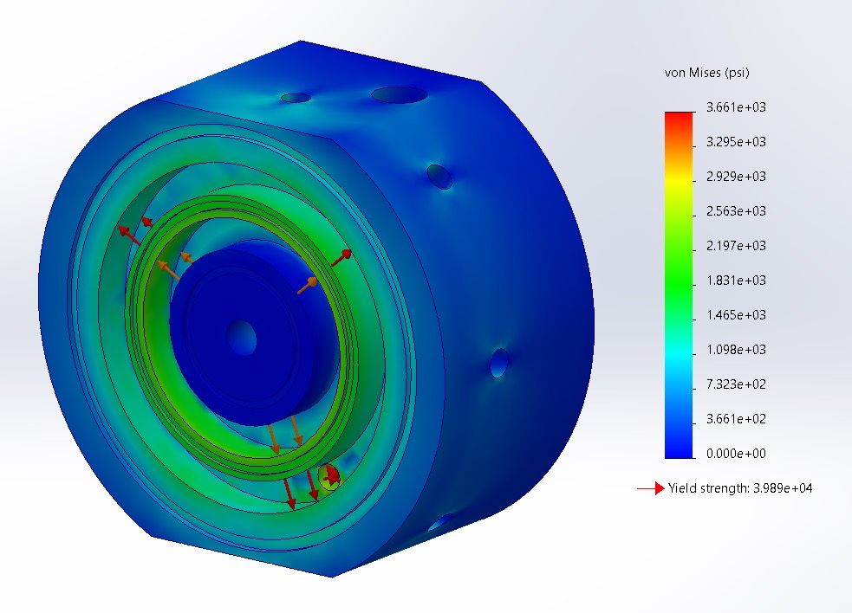
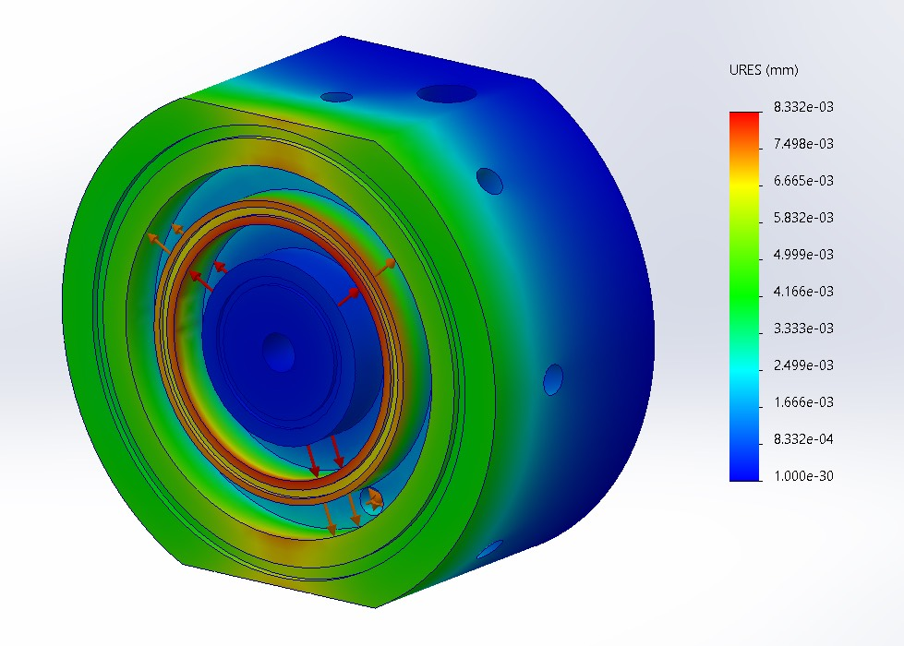
Injector Manifold
FEA Simulations
Very little deformation is observed
Fig. 3.6
Fig. 3.7

Slide 42
Valves BOM
 | Description | Part Number | Supplier Link | Unit Price | Quantity | Subtotal | Taxes | Shipping | Total
1 | Plunger: ½" dia. x 3.25" long Aluminum Stock | N/A | Midwest Steel and Aluminum | $9.40 | 1 | $9.41 | $ | $19.88 | $29.28
2 | Manifold & Injector: 5.75" dia. x 3-1/4" long Aluminum Stock | N/A | Midwest Steel and Aluminum | $143.48 | 1 | $143.48 | $ | $24 | $167.48
3 | O rings | TBD | McMasterr Carr | $ TBD | TBD | $ | $ | $ | $
4 | 3/8"-16 Thread, 1-3/4" Long Aluminum Hex Head Screw | 93306A913 | McMaster Carr | $10.05 | 1 | $10.05 | $ | TBD | $10.05
5 | 3/8 Male x 1/8 Female NPT Bushing (Reducer) | 4464K641 | McMaster Carr | $7.12 | 1 | $7.12 | $ | TBD | $7.12
6 | 45 Degree Flare Nut | TBD |  |  | 1
7 | 45 Degree Flare to ¼" NPT Fitting (Fuel) | TBD |  |  | 1
8 | Line Cutters | TBD |  |  | 1
 |  |  |  |  |  |  |  | TOTAL: | $213.77

Slide 43
Next Steps
Begin manufacturing to validate Two Phase Flow results
Testing Closed and Open State sealing and transitions
Validating Valve Timings to ensure we have an Ox Lead (to prevent a hard start)

Slide 44
Propulsion
Presented by: Brandon Muck
Notes:
Brandon

Slide 45
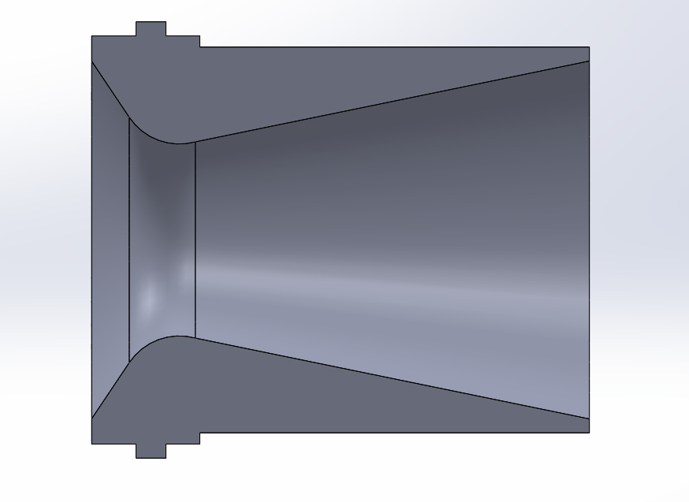

Engine Design
Nozzle Design Parameters
Sizing (Off The Shelf):
Expansion Ratio: 7.49
Contraction Ratio: 11.39
  Chamber Diameter: 3.375"
  Throat Diameter: 1.000"
  Exit Diameter: 2.737"
  Converging Half Angle: 60°
  Diverging Half Angle" 15°
L*: 1.42 m
C*: 1360 m/s
Nozzle Type: Conical
Engine Requirements
  Burn Time: 10 s
  Max Thrust: 400 lbf
  Chamber Pressure: 350 psi
  Propellant: N2O (Oxidizer) / Ethanol (Fuel)
  O/F Ratio: 2.6 : 1
    Fuel Rich
  Mass Flow: 0.94 kg/s
    Oxidizer: 0.68 kg/s
    Fuel: 0.26 kg/s
  Ambient Pressure: Δ0.13 atm
    (0.93 to 0.80) atm
  Exit Pressure: 5.42 psi
  Pressure Thrust: -43 lbf
Fig 4.3: Nozzle Geometry
Fig 4.4: Engine-Injector Assembly
Notes:
Brandon

Slide 46


Engine Design
Nozzle Choice
Stratum Engine Design:
Commercial Single-Throat nozzle
  Supplied by RCS Rocket Motor Components
  Molded Glass Phenolic Nozzle
  Ablatively Cooled
Used in previous year in static testing (300lbf)
  Tested in cold flows & 8 hot fires
  Proven thermal performance
  Pre-sized Ablative Lining
    Store Bought
Fig 4.1: Stratum Engine Nozzle
Fig 4.2: RCS Engine Drawing
Notes:
Brandon

Slide 47


Thrust Curve
Halfcat Sim v1.3.8 and Thrust Curve Tool
Fig 1.3 Current Stratum Geometry– HalfCat Sim
Fig 1.4 400 lbf
Notes:
Arjan

Slide 48


Engine Design
Manufacturing Plan
Chamber Sleeve
  Turn / Bore Stock to Sleeve Dimensions
    Upper
      5.75" OD / 3.61" ID
    Lower
      4" OD / 3.61" ID
  Upper Retaining Ring
    Bore x8 .25" Radial Holes
      0.5" Depth
      Thread with ¼"-20 tap
Lower Retaining Ring
  Turn / Bore Stock to 3.61" OD / 3" ID
  Bore x8 .25" Radial Holes
    .25" depth
    Thread with ¼"-20 tap
Fig 4.6: Chamber Sleeve
Fig 4.7: Retaining Ring

Slide 49

Engine Design
Assembly Plan
Injector Integration
  Chamber Sleeve
    Upper Retaining Ring
      5.75 OD
      ¼"-20 High Strength Hex Screws
        X8 Radially Bolted to Body Shell
Bottom Retaining Ring
  Material for lip of nozzle to sit on
  ¼"-20 High Strength Hex Screws
    X8 Radially Bolted to Chamber Sleeve
Nozzle / Ablative
  Ablative sits on top of nozzle lip
  JB Weld RTV Silicon applied on OD of
  sleeve
Fig 4.5: Exploded Engine Assembly

Slide 50



Engine Design
Force Calculations
Fig 4.8: Stress Analysis of Bottom Retaining Ring

Slide 51
Engine BOM
 | Description | Part Number | Unit Price (Estimates) | Quantity | Subtotal | Taxes | Shipping | Total
1 | RCS 98mm Nozzle | 01880 | $89.99 | 1 | $89.99 | + 9% | + 10% | $107.09
2 | RCS 13" 98mm Phenolic Motor Liner | 03040-2 | $19.99 | 1 | $19.99 |  |  | $23.80
3 | C-Class Motor | NA | $14.00 | 1 | $14 |  |  | $16.55
4 | JB Weld Hi-Tem RTV Silicone 11oz | NA | $9.40 | 1 | $9.40 | + 9% | + 10% | $11.19
5 | 5.75" dia x 6.25" long 6061 Aluminum Round Bar | NA | $252.31 | 1 | $52.91 | + 9% | + 10% | $300.00
6 | 3.61" OD, 3" ID 6061 Aluminum Retaining Ring | NA | $18.80 | 1 | $18.80 | + 9% | + 10% | $22.37
7 | ¼-20 High Strength Hex Bolts | NA | $12.44 | 1 | $12.44 | +9% | +10% | $14.40
 |  |  |  |  |  |  | TOTAL: | $498.46
Notes:
Tate

Slide 52
Ground System Equipment
Presented by: Arjan Reyes

Slide 53
Overall System
Communication between components
  Onboard computers (TOM, engine controller)
  GSE controller
  Main computer
  Control Box
Safety
  Fill, pressurize, dump, and launch system efficiently
  Ability to abort launch without sacrificing entire rocket
  Fill station will fail into a safe mode if control or power are lost
R&D Implementation
  Utilize TOM in new ways
  Content: more context behind what separation mechanism is used for (specify for valves, etc.)
ARCHERFISH CDR
/ 53

Slide 54

Fluid Systems/P&ID

Slide 55



Separation Mechanism
Design
2-016 O-Ring
2-022 O-Ring
Fig 5.1 Quick Disconnect with Plunger Mechanism
Fig 5.3a QD U-clip Connection
Fig 5.b Separation Mechanism Assembly

Slide 56


Separation Mechanism
Diagram

Slide 57
GSE BOM
 | Description | Part Number | Unit Price | Quantity | Subtotal | Link | Taxes | Shipping | Total
1 | pneumatic valves | C26NRXC8SC | $264.00 | 2 | $528.00 | Assured Automation | + 9% | + 10% | $633.07
2 | 1500 psi Pressure Transducer |  | $79.00 | 2 | $158.00 | www.dataq.com | + 9% | + 10% | $189.44
3 | 1/4" 750-1500 PSI Relief Valve | SRV60-S-4T-S6 | $147.82 | 2 | $295.64 | www.sprayerdepot.com | + 9% | + 10% | $354.47
4 | 316 Stainless Steel Check Valve | 1874N15 | $62.35 | 2 | $124.70 | www.mcmaster.com | +9% | +10% | $149.52
5 | GN2 hand regulator | FHS4 | $295.77 | 1 | $295.77 | www.ebay.com | + 9% | + 10% | $354.63
6 | solenoid valves | JFHSV00022 | $95.99 | 2 | $191.98 | ussolid.com | + 9% | + 10% | $230.18
7 | 3 way 2 position solenoid valves | 3V210-08-24VDC | $24.65 | 2 | $49.30 | www.electricsolenoidvalves.com | + 9% | + 10% | $59.11
8 | Polyurethane Tubing | 5648K25 | $16.25 | 11 | $178.75 | https://www.mcmaster.com/ | +9% | +10% | $214.32
 |  |  |  |  |  |  |  | TOTAL: | $2,184.75

Slide 58
GSE BOM
 | Description | Part Number | Unit Price | Quantity | Subtotal | Link | Taxes | Shipping | Total
9 | QD aluminum stock 1ft of 2" round | R32 | $41.56 | 1 | $41.56 | www.metalsdepot.com | + 9% | + 10% | $49.83
10 | Clip Stock 6" of 0.5"x2" aluminum flat | F4122 | $10.68 | 1 | $10.68 | www.metalsdepot.com | + 9% | + 10% | $12.81
11 | 1/2" NPT male to male fittings |  | $11.99 | 1 | $11.99 | amazon.com | + 9% | + 10% | $14.38
12
13
14
15
16
 |  |  |  |  |  |  |  | TOTAL: | $77.01

Slide 59
Break
10 Minutes - Return at __:__
Notes:
Jasmine

Slide 60
Aerodynamics
Presented by: Brayant Silva and Juan Godina

Slide 61

Aerodynamics
Nose Cone
Shape: Conical
Length: 12 in
Inner Diameter: 6 in
Wall Thickness: .2 in
Neck length: 2 in
Manufacturing Method:
  Wet layup using carbon fiber on mold
  2D cutout for 3D shape
Fig 6.1 Nose Cone

Slide 62

Aerodynamics
Fins
Root Chord: 8 in
Tip Chord: 7 in
Height: 5.5 in
Thickness: 0.2 in
Fin Flutter Safety Margin: Mach 1.7
Manufacturing Method: prepreg layup and waterjet cut
Fig 6.2 Fin

Slide 63

Aerodynamics
Fin Adapter
Length:9.6 in
Outer Diameter: 6.0 in
Inner Diameter: 5.75 in
Manufacturing Method: carbon fiber wet layup
Fig 6.3 Fin Can

Slide 64
Star-CCM+ CFD
Aerodynamic Analysis Goals
  Predict drag coefficient trends across the expected Mach range
  Compare CFD-derived drag to OpenRocket and RASAero models
  Quantify sensitivity of trajectory predictions to drag uncertainty

Slide 65

CFD Models
Flow & Solver Setup
  3D Flow, Compressible RANS
  Steady-state simulations
  Ideal gas air model
  Turbulence model: k-ω SST
Boundary Conditions
  Freestream Mach number prescribed
  No-slip wall on rocket surface
Simulation Scope
  Mach sweep: M = 0.1 -0.8
  Primary outputs: drag coefficients
Outlet
Inlet
Fig 6.4 Flow Domain

Slide 66


CFD Mesh
Mesh Parameters
  3D Automated Polyhedral Mesh
  Near-wall prism layers
Custom Controls
  Wake refinement downstream of rocket
  Nose Cone Refinement
Grid Convergence
  Local refinement studies on wake and nose regions
  Global size refinement to verify CD convergence
Fig 6.5 Rocket Mesh

Slide 67
CFD Results
Fig 6.6 Drag Comparison

Slide 68

Altitude Sensitivity
Results
OpenRocket Cd:
  Apogee: 12690 ft
RASAero Cd:
  Apogee: 13745 ft
CFD Cd:
  Apogee: 13460 ft
Data Spread
Max Spread:
  1058 ft
Deviation From Mean Apogee:
  ±4%
Fig 6.7 Altitude Sensitivity to Drag

Slide 69

Altitude Plots
MATLAB
Results:
  Apogee: 11930 ft
  Max Velocity: 843 ft/s
  [Mach 0.77]
  Max Acceleration: 104.7 ft/s^2
  Time to Apogee: 29.6 s
Assumptions made:
  Temperature: ISA
  Wind Speed: 10 mph
  Atmospheric pressure: ISA
Fig 6.8 MATLAB predicted trajectory

Slide 70

Altitude Plots
OpenRocket
Results:
  Apogee: 12720 ft
  Max Velocity: 873 ft/s =
  [Mach 0.77]
  Max Acceleration: 105 ft/s^2
  Time to Apogee: 31 s
Assumptions made:
  Temperature: 90 F
  Wind Speed: 10 mph
  Atmospheric pressure: 27.3 inHg
Fig 6.9 OpenRocket predicted trajectory

Slide 71


Wind Analysis
Explain Wind Gradients

Slide 72
Wind Analysis
Average Wind @ FAR: 13.3 mph
No Wind
Average Apogee: 12873 ft
Average Maximum Velocity: 873 ft/s
Average Maximum Acceleration: 105 ft/s^2
Average Time to Apogee: 31.1 s
Low Wind-10mph
Average Apogee: 12750 ft
Average Maximum Velocity: 873 ft/s
Average Maximum Acceleration: 105 ft/s^2
Average Time to Apogee: 31 s
Mid Wind-20mph
Average Apogee: 12446 ft
Average Maximum Velocity: 871 ft/s
Average Maximum Acceleration: 105 ft/s^2
Average Time to Apogee: 30.7 s
Big Wind-30mph
Average Apogee: 12085 ft
Average Maximum Velocity: 868 ft/s
Average Maximum Acceleration: 105 ft/s^2
Average Time to Apogee: 30.2 s

Slide 73
Wind Analysis
Graphic

Slide 74
Aerodynamics BOM
 | Description | Part Number | Supplier Link | Unit Price | Quantity | Subtotal | Taxes | Shipping | Total
1 | Vaccuum Bag |  | Link | $3.33 | 50 | $166.5 | $ | $ | $
2 | Heat-Shrink Tape |  | Link | $22.88 | 2 | $45.76 | $ | $ | $
3 |  |  |  | $ |  | $ | $ | $ | $
4 |  |  |  | $ |  | $ | $ | $ | $
5 |  |  |  | $ |  | $ | $ | $ | $
6 |  |  |  | $ |  | $ | $ | $ | $
7 |  |  |  | $ |  | $ | $ | $ | $
8 |  |  |  | $ |  | $ | $ | $ | $
 |  |  |  |  |  |  |  | TOTAL: | $212.26

Slide 75
Next Steps
Start Composite Manufacturing
Collect real weights as parts get manufactured

Slide 76
Overall Model
Fig 5.7 Overall Model

Slide 77
Structures
Presented by: Timothy Barry

Slide 78
Content:
Materials of everything
Bulkheads, couplers, AV bay, recovery tube design
Bending calc of AV bay, couplers, etc.
CAD models of what currently have
Include risks/concern slide if you want, leaving it in slidedeck

Slide 79

Material Choices
6061 Aluminum
  Great Strength to Weight Ratio
  Easy to machine and work with
  Familiarity with it overall as a club
Fiberglass
  Required for avionics signals to get through
  Still great overall strength
Carbon fiber
  Low density, high tensile strength
  Have hours of layup experience with it
  Still have a large amount of donated material
  Good for bonding with epoxy

Slide 80


Main Body
Body Tubes
Recovery (Carbon Fiber)
  Inner Diameter: 6in
  Wall Thickness: 0.1in
  Length: 24in (approx.)
  Manufacturing Method: Composite Layup
AV Bay (Fiberglass)
  Inner Diameter: 6in
  Wall Thickness: 0.1in
  Length: 14in (approx.)
  Manufacturing Method: Composite Layup
Fig 7.1 Avionics Tube
Fig 7.2 Recovery Tube

Slide 81


Couplers
Old Coupler Design
New Coupler Design
General Dimensions:
6” OD, 5.5”ID
4.5-6.5” Long
Fig 7.4 Example Coupler
Fig 7.3 Forte/Fortissimo Coupler
Still made from hollow aluminum stock
  Ordered generally to length
  Longer and more holes for more stiffness
Coupler Band
  Will replace metal lip that separates tubes
  Changed from ABS to Fiberglass
Machine out of hollow aluminum stock
  Long time to manufacture due to lathe concentricity issues
  Short length is believed to cause stiffness issues with last year's rocket

Slide 82


Bulkheads
Old Bulkhead Design
New Bulkhead Design
General Dimensions:
5.5” OD
½” Thick
Fig 7.5 Generic Forte/Fortissimo Bulkhead
Fig 7.6 Example Bulkhead for the Recovery section
Machine out of solid Aluminum
  Very heavy, lots of wasted material
  Long time to manufacture
Difficult to line up with couplers and body tubes
Water jetted out of 1/2” Aluminum Sheet
  Much lighter and faster to make
Hybrid of Encore Couplers and last year's bulkheads
  Inserted inside couplers
  No need to line up with body tube first
¼-20 Screws for all holes

Slide 83



Bulkheads cont.
Fig 7.7 Nose Cone Bulkhead
Fig 7.8 Recovery Bulkhead
Fig 7.9 Fluids Adapter Bulkhead
Made from two water-jetted pieces of ½” Aluminum Sheet
Bolted Together
Peregrine holes can be water-jetted out
Is more like and can be installed like a bulkhead from last year
Better for a pressure seal
Designed to Secure Oxidizer Bulkhead to top half of rocket
Eight ¼-20 Holes to Secure Bulkhead
Highly important part to secure rocket together
Pockets for weight reduction
Hole for I-bolt for shock cord
Four ¼-20 Holes to Secure Bulkhead
Epoxy can be used around edges for a pressure seal

Slide 84




Integration of Couplers and Bulkheads
Fig 7.10 Nose Cone Bulkhead integration
Fig 7.11 Fluid Adapter Bulkhead integration
Fig 7.12 Full Recovery Coupler Assembly
Fig 7.13 Recovery Coupler Cross Section

Slide 85


Force and Moment Calculations
Values are between those of Forte and Fortissimo last year
Rocket is going faster (Around Mach 0.75)
Overall, good safety factors
Assumes a thicker wall thickness of around 0.1in
Fig. 7.14 Force, Moment and Safety Factor Values
Fig. 7.15 Bending and Shear Diagrams for Archerfish

Slide 86

Bolts
General Bolt for all Bulkheads and Couplers
  ¼-20 Bolt (Length Varies)
Shear Safety Factor for Bulkheads: 4250

Slide 87


Manufacturing (Couplers)
Overall Improved Processed
  Couplers ordered cut generally to length
  Should result in better end to avoid concentricity issues
Still will need to face and likely turn down diameter a bit
New Manufacturing Jig
  Square Design to use in drill press
  Should make it easier to hold couplers and have consistent hole locations
Overall should be a faster process
​
Fig 7.16 Isometric View of a coupler with a manufacturing jig
Fig 7.17 Sectional View of the Manufacturing Jig

Slide 88


Manufacturing (Bulkheads)
Significant Improvements Made
  Water Jetted from 0.5" Aluminum Plate
  Cuts out additonal holes for like pergrines for recovery
  Saves loads of time
New Jig to hold bulkheads so we can drill holes in the drill press
Fig 7.18 Isometric View of a Bulkhead with a manufacturing jig
​
Fig 7.17 Sectional View of the Bulkhead Jig

Slide 89
Next Steps
Once Rail Button Placement is finalized perform analysis
Pring Jigs and begin to manufacture parts
Fig 6.13 Figure of the next step above

Slide 90
Preliminary Structures BOM
 | Description | Part Number | Supplier Link | Unit Price | Quantity | Subtotal | Taxes | Shipping | Total
1 | Aluminum Round Tubing (6" OD, 5.5ID, 6.5" long) | N/A | Link | $57.06 | 1 | $57.06 | $4.99 | Combined | $
2 | Aluminum Round Tubing (6" OD, 5.5ID, 5.5" long) | N/A |  | $51.77 | 1 | $51.77 | $4.53 | Combined | $
3 | Aluminum Round Tubing (6" OD, 5.5ID, 4.5" long) | N/A |  | $51.77 | 1 | $51.77 | $4.06 | Combined | $
4 | 1/2" Aluminum Plate (18"x18") | N/A |  | $233.06 | 1 | $233.06 | $20.39 | $26.45 | $448.98
5 | Bambu Lab White ABS Filament | Bambu Lab |  | $19.99 | 2 | $45.98 | $3.49 | Unknown | $49.47
6 |  |  |  | $ |  | $ | $ | $ | $
7 |  |  |  | $ |  | $ | $ | $ | $
8 |  |  |  | $ |  | $ | $ | $ | $
 |  |  |  |  |  |  |  | TOTAL: | $498.95

Slide 91
Recovery
Presented by: Metztli Singha

Slide 92

Recovery Layout
Top Coupler
Main Chute + Bag
Drogue Chute
Bottom Coupler
Shock Cord
Tender Descenders
CO2 Peregrines
Body Tube
Fig 8.1 Recovery System Layout
ARCHERFISH CDR

Slide 93


Internal Components
Line Diagram
Fig 8.2 Before Tender Descender Ignition
Fig 8.3 After Tender Descender Ignition

Slide 94



Outer Profile
Body Tube & Couplers/Bulkheads
Pressure vessel created from a carbon fiber body tube and aluminum couplers/bulkheads
  Nose cone rests on the lid of the pressure vessel
Bottom bulkhead will require four through holes
  One 1/4" eyebolt secured with backing located in center of bulkhead
  One small hole to allow wires to connect from tender descenders to avionics
  Two holes to secure CO2 peregrines
Top bulkhead will require one through hole
  Another 1/4" eyebolt
Fig 8.4 Top-down View of Bottom Coupler
Fig 8.5 Top-down View of Nose Cone Coupler
Fig 8.6 Sectional View of the Recovery Tube

Slide 95

Internal Components
CO2 Peregrines
CO2 Peregrine Kits from Tinder Rocketry (12 g)
  Placed around eyebolt, sticks through the bottom coupler
  Two are used for redundancy
Used to release drogue chute at apogee
  CO2 will fill pressure vessel
  Resulting pressure will force off top coupler and pull out the drogue
Fig 8.7 Labelled Diagram of CO2 Peregrines

Slide 96


Internal Components
Tender Descenders
Tender Descenders from Tinder Rocketry
  Placed in series, connects top portion of shock cord to eyebolt
    Keeps main chute and main chute shock chord length inside body tube until deployment
  Two tender descenders used for redundancy
Used to release main chute
  Will deploy at 1000 ft
  Black powder within tender descenders will detonate upon receiving signal from avionics
  Allows main chute to be pulled out of its bag by the drogue
Fig 8.8 Fully Assembled Tender Descender
Fig 8.9 Labelled Parts of a Tender Descender

Slide 97

Internal Components
Altimeters & Related Avionics
Egg Timer
  Connected to CO2 peregrines and programmed to apogee
  Connected to each tender descender and programmed to sense altitude of 1000 ft
  Avionics system will serve as redundant system
E-Matches
  Used to ignite the pyrotechnics
    Ideally 10 feet in length
  Connects from Tender Descenders and Peregrines to avionics
    Tender Descender wires route through bottom bulkhead/coupler
Fig 8.10 E-match from MJG Technologies

Slide 98
Material Analysis
Shock Cords and Parachutes
Kevlar Shock Cords
Fruity Chutes - Ripstop Nylon
Stronger than nylon
Lightweight
Flexible and easy to handle
½ in. wide is ideal
More prone to zippering and has less shock absorption than nylon
Lightweight
Resists tearing and abrasions
Elastic
Absorbs shock during deployment
More durable than standard nylon, especially when subjected to sudden forces
Fruity Chutes have a Cd of 2.2

Slide 99
Recovery Calcs
Sizing and Descent
Parachutes + Shock Cords
Velocity & Drift
Drogue Parachute
  36" diameter Iris Ultra Standard
Main Parachute
  144" diameter Iris Ultra Compact
Shock Cord
  30.6 ft (9.33 m)
Packing Volume
  Needed: 292 in³ (4770 cm³)
  Available: 642 in³ (10524 cm³)
Velocity
  Must be 15-20 ft/s
  Apogee Rockets Eq: 16.2 ft/s (4.94 m/s)
    Weight 1.25x greater: 18.1 ft/s (5.52 m/s)
  Fruity Chutes Sim: 16.0 ft/s (4.87 m/s)
Drift
  For 5 mph winds:
    0.349 miles (0.563 km)
  For 20 mph winds:
    1.40 miles (2.25 km)

Slide 100
Recovery Calcs
Drogue Deployment
Nose Cone Force Exerted
CO2 Forces
Drogue will deploy when rocket is in free fall
If force of CO2 can overcome force of the nosecone while stationary, then it can in free fall
Force of Nose Cone:
  14.5 lbf (64.5 N)
    Note: does not account for friction/latch forces
Force for One Peregrine:
  20.8 lbf (92.7 N)
Safety Factor: 1.44
With two peregrines, force is 41.7 lbf and SF is 2.87
Ideally both peregrines deploy, but system will work with only one
  Redundancy

Slide 101


Recovery Calcs
Pressure Vessel
Thin-walled pressure vessel
  Wall thickness to diameter ratio: 0.0162 < 0.10
  Uses 24 g of CO2
Fig 8.11 Safety Factor vs Height at CO2 Release
Fig 8.12 Safety Factor vs. Height Before CO2 Release

Slide 102

Pressure Vessel
Clearance
Target clearance: Will follow the recommended tolerance for a H7/h6 fit.
  0.001 inches of clearance
  Coupler diameter goal: 5.999 to 6.001 inches
    Realistically 0.005 -.01 in of clearance
Fig 8.13 Preferred mechanical tolerances Metric ISO 286 from Engineers Edge

Slide 103
Bill of Materials
Preliminary Recovery BOM
# | Item | Qty. | Price per Unit | Price (Total) | Source
1 | Tender Descenders | 2 | $155 | $310 | Link
2 | CO2 Peregrine Kit | 2 | $185 | $370 | Link
3 | Parachute Bag | 1 | $69.36 | $69.36 | Link
4 | Shock Cord (1 yd) | 12 | $7.69 | $92.28 | Link
5 | E-Matches (10 ft) | 1 | $32.99 | $32.99 | Link
6 | Parachute (144 in) | 1 | $965.89 | $965.89 | Link
 | Total (Not including Tax/S&H) |  |  | $1840.26

Slide 104
Next Steps
Help with manufacturing
Start testing

Slide 105
Avionics
Presented by: Brian Payne and Aidan Sacco
Notes:
Cameron

Slide 106
Systems Overview
TOM 2.0
Telemetry Operations Manager, responsible for sending GPS Location and Altitude to Mission Control
Flight Recorder
Backup logging computer for data from TOM or Engine Controller
Engine Controller
Controls the Engine's Fuel/Ox Pump
Mission Control
Ground Communication station and Data Visualization
Control Box
Human-in-the-loop controller where an operator presses switches to cause an effect in the system
Fill Station
Controls Oxidizer filling procedure
Notes:
Cameron

Slide 107

Message Flow
Notes:
Cameron

Slide 108

Complete Electronics Diagram
ARCHERFISH PDR
/ 108
Notes:
Cameron

Slide 109

Mission Control
Operator interacts with Control Box
  Contains all buttons and switches needed to remotely operate fill station solenoids and ignition
  Wired directly to Mission Control computer over Ethernet
Acts as the Avionics communication "hub"
  Facilitates ConOps by sending commands
  Instructs Fill Station (over WiFi) to actuate solenoids for filling oxidizer
  Instructs TOM (over LoRa) to Initiate launch sequence and gather telemetry
Logs and visualizes telemetry data
  Displays fill station and flight telemetry to the operator

Slide 110
Mission Control System Requirements
RBS | Requirement | Rationale | Traced From | Verification Method
0 | Mission Control Shall remotely send commands to Fill Station and TOM to control the Sequencing of Launch | Launch sequence needs to be controlled by operators | Liquids Safety Procedure | HITL testing, demonstrate communication with other systems and response from other systems
0.1 | Mission Control shall have an interface for the operators to send commands | Operators must be able to input commands | RBS 0 | HITL testing, demonstrate interface results in sent commands
0.1.1 | Mission control shall only send control signals to Fill Station and TOM when corresponding inputs are selected by the operator | All control signals should be controlled by operators | RBS 0.1 | HITL testing, demonstrate interface results in sent commands. Test with various inputs that only correct signals are sent
0.2 | Mission Control Shall communicate wirelessly with TOM and Fill Station | Operators must be able to execute commands from a distance | RBS 0 | HITL testing, demonstrate communication with other systems over various distances
0.2.1 | Mission Control Shall display pressure readings from the fill station | Operators must be able to read pressure in the tanks for go/no go procedures | RBS 0.2 | HITL testing, demonstrate Mission control can receive pressure readings over a distance
0.3 | Mission Control Shall display a video feed from Fill Station of the static release valve | Operators must be able to see static release Valve for determining go/no go | RBS 0 | HITL testing, demonstrate video can be received over a distance from Fill Station
0.4 | Mission Control shall send the following signals to Fill station: Toggle Ox, Toggle Air, Toggle Dump1, and Toggle Dump2 | These are the signals fill station uses for fill procedure sequencing | RBS 0 | HITL testing, demonstrate that signals get sent to and acknowledged by fill station
0.5 | Mission Control shall send the following signals to TOM: CutLine, and Start Ignition | These are the signals TOM uses for launch sequencing | RBS 0 | HITL testing, demonstrate that signals get sent to and acknowledged by fill station
1 | Mission Control Shall receive, store and display telemetry data sent from TOM | This is necessary for data collection and recovering the rocket | Far Requirement | HITL testing, Demonstrate
Notes:
Brian

Slide 111
Fill Station
Actuates Ox and Pressurization valves
Sends pressure transducer data to mission control for visualization
  Used for determining go/no go conditions
Communicates with Mission control over wifi for signals to start/stop valve actuations
Sends live video of static release valve to determine when oxidizer is done filling

Slide 112
Fill Station Requirements
RBS | Requirement | Rationale | Traced From | Verification Method
0 | The Fill Station shall control propellant filling and dumping operations | This is the primary mission of the Fill Station. | Mission Requirements | Hardware-in-Loop Testing
1.0 | The Fill Station shall actuate 4 solenoid ball valves when commanded by Ground Station | This is necessary to control oxidizer fill, GN2 fill, oxidizer dumo, and GN2 dump. | Mission Requirements | Hardware-in-Loop Testing
1.1 | The Fill Station shall be capable of actuating all 4 valves independently | Different Failure cases require different valves to be toggled | RBS 1.0 | Hardware-in-Loop Testing
2 | The Fill Station shall receive commands from Ground Station at distances up to 400 m | This is necessary to allow operators to control propellant operations from a safe distance per FAR requirements. | FAR Requirement | Field Range Testing
2.1 | The Fill station shall only toggle valves upon receiving the corresponding signals from Mission Control | All valve control should be handled by operators through Mission Control | RBS 2 | HITL testing, demonstrate interface results in sent commands. Test with various inputs that only correct signals are sent
3 | The FIll Station shall provide visual monitoring of the pressure relief valve area | This is necessary to detect propellant venting during operations | Mission Control RBS 0.3 | Field Testing
4 | The Fill Station shall wirelessly transmit data from the pressure transducers to Mission Control | This is necessary data for operators to make decisions on possible failure cases | Mission Control RBS 0.2.1 | HITL testing, demonstrate that correct pressure readings can be sent to Mission Control
Notes:
Brian

Slide 113


Avionics Bay
Logic center for Avionics during flight
Contains TOM and Black Box Recorder
Contains redundant COTS altimeters (Featherweight Blue Raven) for activating recovery
Sends flight telemetry data to Misson control
Relays messages from Mission Control to Engine Controller
Receives engine data from Engine controller
Notes:
CPSS TOM
Blue Ravens used on Goose
Battery used last year, need to check if it meets this year's power
CPSS Flight Recorder being able to log inter-process communication is made possible by the software stack we've chosen (Zenoh)
Thermal Management solution will be included to shuttle heat from TOM to the bulkhead. Design currently in progress, not sure if we have CAD

Slide 114
Avionics Bay Requirements (TOM)
TOM
RBS | Requirement | Rationale | Traced From | Verification Method
0 | The system shall stream Telemetry data throughout the entire mission duration. | This is a FAR requirement. | FAR Requirement | Field Range Testing
0.1 | The system shall include GPS latitude and longitude in telemetry. | This is necessary for recovering the rocket. | FAR Requirement | HITL testing, demonstrate correct GPS measurements
0.2 | The system shall include altitude in telemetry. | This is necessary for preliminary scoring and scoring on system failure. | FAR Requirement | HITL testing, demonstrate correct Altimeter measurements over I2C with varying altitudes
0.3 | The system shall send telemetry up to an altitude of 26400 ft | This is necessary to send telemetry throughout the mission duration. | Archerfish Requirement | Field Range Testing
0.4 | The system shall send telemetry up to a distance of 4 miles. | This is necessary to send telemetry throughout the mission duration. | Archerfish Requirement | Field Range Testing
0.5 | The system shall send telemetry at a minimum of 1Hz | This is necessary to maintain real-time telemetry. | Archerfish Requirement | Visual confirmation on mission control
1 | The system shall fire the drogue parachute at apogee | This is a FAR requirement. | FAR Requirement | HITL testing with simulated flight data from Certs/previous launches/openrocket
1.1 | The system shall fire the main parachute during descent at 1K ft AGL | This is a FAR requirement. | FAR Requirement | HITL testing with simulated flight data from Certs/previous launches/openrocket
2 | The system shall collect IMU data for review | This is useful data that can be re-used for testing on future missions | Avionics Requirement | HITL testing, demonstrate correct IMU measurements over I2C with varying velocities
3 | The system shall receive and relay the following signals from Mission Control to the Engine Controller: Launch and Cut Line | All launch and failure case procedures are controlled by operators through mission control and need to be passed to Engine controller which does not have wireless communication with Mission Control | Mission Control RBS 0.5 | HITL testing, demonstrate communication between TOM and engine controller over UART on long wires. Test both with simulated data and Motor Controller in the Loop
Notes:
Brian

Slide 115
Avionics Bay Requirements (Black Box)
RBS | Requirement | Rationale | Traced From | Verification Method
0 | Black Box shall store data persistently | This is necessary for recovering data in the case of critical failure from the rocket | Mission Objective | HITL testing to verify storage is persistent after power on/off
1 | Black Box shall receive data over a common interface from TOM | This is necessary to collect data for storage | Mission Objective | HITL testing, demonstrate functional communication with TOM
2 | Black Box shall record data regardless of malformedness | Necessary for debugging if data collection/distribution is not correct | Mission Objective | HITL testing with simulated malformed datasets
3 | Black Box shall fit in a volume with space 8cm x 5cm x4cm | This is the space allocated in the avionics bay | Mission Objective | Design

Slide 116
Engine Controller
Performs timed launch sequence operations
  Signaled by TOM over UART
  Fires Line Cutter and Ignition e-matches
  Sends a (constant duty cycle) PWM signal to enable the pump motor controller
Sends pump data to TOM over UART
  RPM for logging

Slide 117
Engine Controller Requirements
RBS | Requirement | Rationale | Traced From | Verification Method
0 | The engine controller will only turn on if the arming key is turned and an enable signal is sent from TOM | The engine controller needs to be completely off and isolated when the engine is not armed to provide redundancy and avoid early ignition on the pad | FAR requirements | Demonstrate engine controller only turns on when key is turned
1 | The engine controller shall have a common wired interface with TOM | This is necessary for by-proxy communication with Mission control | TOM RBS 3 | HITL testing, demonstrate functional, bilateral communication between TOM and engine controller and signals are relayed correctly
1.1 | The engine controller shall be prepared to receive the following signals through the communication with TOM: Start ignition and Cut Line | These are the control signals for launch and failure cases | RBS 1 | HITL testing, demonstrate functional, bilateral communication between TOM and engine controller and signals are relayed correctly
1.1.1 | The engine controller will send the signal for the line cutter | This is a part of the rocket launch sequence and some failure cases | RBS 1.1 | HITL testing, demonstrate signal works on output and corresponds to correct signal from TOM
1.1.2 | The engine controller will send the signal for the Igniter | This is a part of the rocket launch sequence | RBS 1.1 | HITL testing, demonstrate signal works on output and corresponds to correct signal from TOM
1.1.3 | The engine controller will generate and output a PWM signal to the motor controller | This is the input to the motor controller to control the pump motor | RBS 1.1 | HITL testing, demonstrate signal works on output and corresponds to correct signal from TOM
1.1.4 | The Engine Controller shall turn on the ignitor, then send the PWM signal to the pump, then activate the line cutter only upon receiving the "start ignition" signal | This is the launch sequence and should only be started when operators are prepared to launch | RBS 1.1 | HITL testing, demonstrate signal works on output and corresponds to correct signal from TOM
1.1.5 | The Engine Controller will cut the line upon receiving the "CutLine" signal | This is a part of some failure cases | RBS 1.1 | HITL testing, demonstrate signal works on output and corresponds to correct signal from TOM
2 | The Engine Controller shall record data from the engine | This is data will be useful for future liquid engine designs | Archerfish Requirement | HITL testing, demonstrate engine controller can read data off of TOM
2.1 | The Engine Controller shall send data over the common wired interface with TOM | This is how the data will be sent somewhere to be stored | RBS 2.1 | HITL testing, demonstrate functional, bilateral communication between TOM and engine controller and data is relayed correctly. Test with simulated data and as full loop system including engine controller

Slide 118
Testing
Presented by: Jasmine Cheng

Slide 119
Revisions
Line-cutter testing
  Find rope that works
  No need to test carbon fiber rods effect on signal
Line-cutter Testing Attempts:
  Received: Line Cutters engaged, e-matches went off
  Problems: Rope was not cut through

Slide 120

Testing
Propulsion, Liquids, and GSE (1 of 3)
Propulsion, Liquids, and GSE
GSE:
Goal: Validate all electronics, solenoids, pneumatics, etc.
Line Cutters
Separation Mechanism Testing
Filling Ox and Air controls (Tanks)
Mission control and Fill Station Communication
Next Steps:
Line Cutter Testing: Test new rope
Continue manufacturing
Line Cutter
Fig 10.1 Line cutters in Example Testing Setup
Notes:
What constitutes each test as succesful, road map,

Slide 121


Testing
Propulsion, Liquids, and GSE (2 of 3)
Propulsion, Liquids, and GSE
Cold Flows:
Goal: Full Liquid System Cold Flow – Early Feb.
  Tanks, GSE, Valves, Bulkheads, Engine - Not on Bluegrass
Valves:
Hydrostatic Testing (Water Hand Pump)
  Full liquids system (See Fig. 10.3)
Pump – Bluegrass
Valves (Bluegrass, engine, line-cutters)
Fig 10.2 "Bluegrass" Test Stand
Fig 10.3 Picture of Test Stand to Mount Liquid System

Slide 122


Testing
Propulsion, Liquids, and GSE (3 of 3)
Propulsion, Liquids, and GSE
Hot Fires:
Main Goal: Get Engine Data, Ensure Pump + Engine are integrated and produce desired results, valve timing
Engine (no pump) - Bluegrass
Pump + Engine - Bluegrass
Fig 10.4 "Stratum" Hot Fire on Bluegrass
Fig 10.5 "Stratum" Hot Fire on Bluegrass

Slide 123

Testing
Liquids Timeline
Fig 10.6 Fluids Testing Timeline

Slide 124



Testing
Composites
Compression load with load cell in the structures lab on carbon fiber tube
Fig 10.5 Strain vs Stress Curve
Fig 10.6 Carbon Fiber Tube Testing in Instron
Fig 10.7 Instron 5969

Slide 125

Testing
Recovery
Peregrine Testing
  Previously tested system; testing will be combined in pressure vessel test
Pressure Vessel Testing
  Ensure the top coupler of the pressure vessel successfully separates from the body tube in a safe manner
  Combine with avionics system to ensure the stack can fire the peregrines
Tender Descender Testing
  Ensure the quick links of the TDs successfully detach from the housing
Fig 10.8 Successful Pressure Vessel Test
Necessary Next Steps:
  Safety procedure write ups
  Propulsion lab and black powder safety briefings

Slide 126
Budget

Slide 127
Project Budget Estimates (In-Progress)
Subsystem | Allotted Budget | Estimated Cost
Propulsion | $1200 | $498.46
Fluids | $1900 | $1045.58
Ground System Equipment | $2000 | $2,261.75
Aerodynamics | $400 | $212.26
Structures | $600 | $498.95
Recovery | $875 | $1840.26
Avionics | $500 | TBD
Total | $7,475 | $6358.26+ TBD

Slide 128
Questions?

Slide 129


Slide 130
APPENDIX

Slide 131
Far Requirements
RBS | Requirement | Rationale
0.1 | Altitude shall be determined by two commercially available recovery electronics | This is a FAR requirement
0.2 | The system shall have dual deployment for recovery. | This is a FAR requirement
0.2.1 | Drogue parachute shall deploy at apogee | This is a FAR requirement
0.2.2 | The main parachute shall deploy below 1000 ft. | This is a FAR requirement
0.3 | The system shall contain a tracker. | This is a FAR requirement. GPS telemetry, radio beacon, or other approved in advance
0.4 | The system shall be recovered successfully. | This is a FAR requirement
0.5 | Rocket must be rail or tower launched. | This is a FAR requirement
0.6 | The rocket shall meet FAR/Mars safety requirements. | This is a FAR requirement
0.7 | The system shall not exceed 250,000 feet in apogee. | This is a FAR requirement based on FAA COA
Notes:
Jasmine

