Slide 1
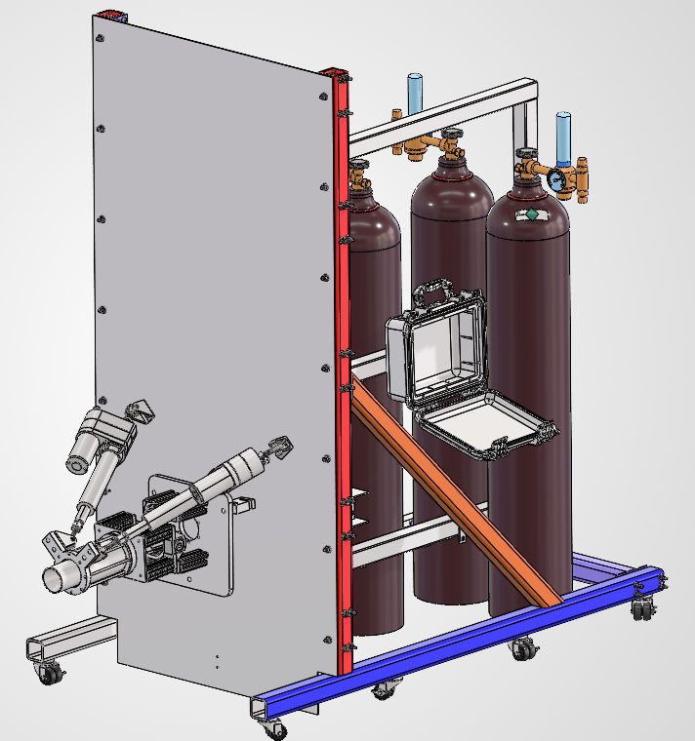
Thrust Vector
Control
Project Managers:
Gustavo Chavez, Robert Saunders, Tony Casagrande
Team Members: Calla Woodruff Lyons, Cruz Segura, Leo Ramirez, Eddie Salazar, Zach Klaus, Theodore Goh, & Raymond Lopez
Notes:
Jasmine

Slide 2
Agenda
Overview
Requirements
Systems
CAD
Engine
Mathematical Model
Structures
Electronics
Testing Plan
Budget
Notes:
Jasmine

Slide 3
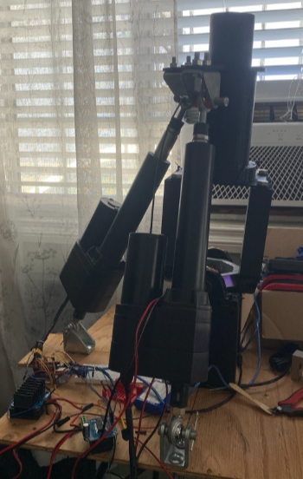
Overview
Project Proposal:
Thrust Vector Control isn't as difficult as building and designing a entire rocket, and we have most of the expensive materials on hand.
It's a great way of connecting mechanical, aero, controls, and electrical sides of engineering all under one roof allowing for not only primarily aero to join this club.
Because it's more of a friendly project first years are more welcome and not as intimidated to join.
Engine design will be the most difficult thing to manufacture, the rest will be easier and allow for first years who have their shop tags to participate with the preparation of the assembly.

Slide 4
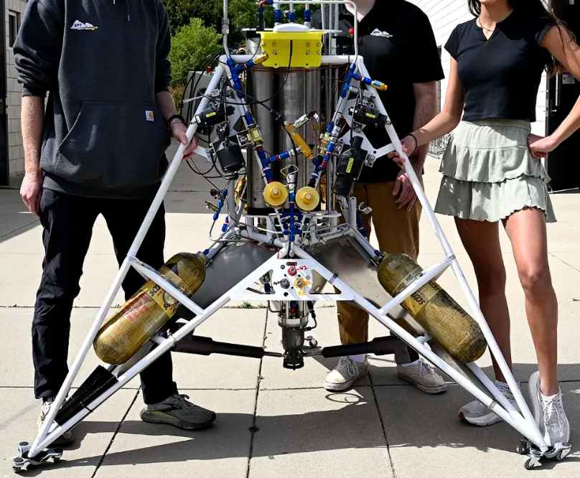
Overview
Mission Statement
TVC is only one components of the lander challenge, in doing a TVC we will prove that we are capable of testing in a safe and capable manner.
This hardware is currently in Paso Robles waiting for a ready team to make use of it with a liquid competition rocket.
Currently, our team is comprised of multiple students from mechanical engineering to electrical engineering from first years to fourth years.
Notes:
Brandon

Slide 5
Requirements
Regulations and Rules
Requirements Breakdown Sheet (RBS): | Requirement | Rationale | Verification Method
0.0 | Thrust Vector Assembly shall comply with all CPLC and Paso Spaceport rules and regulations | Thrust Vector Assembly is not allowed to fire otherwise. | Documentation/Clear Communication
0.1 | We shall only have 1 primary propulsion device. | This is required to comply with CPLC challenge rules. | Visual Inspection
0.2 | The Primary Propulsion device shall be designed by students | This is required to comply with CPLC challenge rules and demonstrate student engineering. | Documentation
0.3 | All components on the Thrust Vector Assembly are designed, or heavily modified, in 2019 or later | The project work should be recent and updated for current day standards. | Documentation
0.4 | Videos of all attempts shall be recorded | To ensure our attempts are verifiable. | Hot fire Procedures
0.5 | Hot fire shall not endanger any personnel or bystander | This is necessary to ensure that no one is injured during testing. | Hot fire Procedures
0.6 | All components on the Thrust Vector Assembly shall be designed with factor of safety of at least 2 | To reduce risk and ensure the system operates under expected conditions. | Documentation/ Stress Strain Calcs
0.7 | Thrust Vector Assembly shall withstand +300lbf of thrust | To ensure the assembly doesn’t fail under expected thrust. | In test loop, recorded data

Slide 6
Requirements: Top Level
Requirements Breakdown Sheet (RBS): | Requirement | Rationale | Verification Method
1 | TCA shall be designed for nitrous oxide as an oxidizer and ethanol as a fuel | To ensure system performance and safety. | Inspection. Documentation
2 | TCA shall be designed to withstand +300psi chamber pressure | This is necessary to ensure the chamber can withhold expected pressure without failure. | Test/Analysis. In test loop, recorded data
3 | TCA shall have an e-stop | In case of emergency, the test operators can stop the test safely. | Inspection. HITL testing, demonstrate that the TCA stops due to e-stop
4 | The Thrust Chamber Assembly shall fire at or above 300lbf of thrust for at least 10 seconds. | To ensure the assembly can withstand the expected thrust for an extended duration without failure. | Test. In test loop, recorded data
5 | The thrust Vector Gimbal shall actuate 7 degrees in every direction in a full circle, in a controlled manner. | To ensure the assembly can actuate in its full range of motion safely and controllably. | Analysis. In test loop, recorded data
6 | Propellants used for testing must fall below 0.5 TNT equivalent. | To keep test risk below maximum. | Documentation TNT equivalent calculation.

Slide 7

Systems Live Doc
Live Doc Summary:
Purpose: Through the Live Document, anyone can view the calculations, data, and documentation for TVC on one page.
Includes:
TVC Calculations Explanation
MATLAB Script
Wiring Diagram
Arduino IDE Linear Move Sketch
Arduino Linear Actuator Scaling
Extension Data
Requirements
TVC Stress Strain Calculations

Slide 8
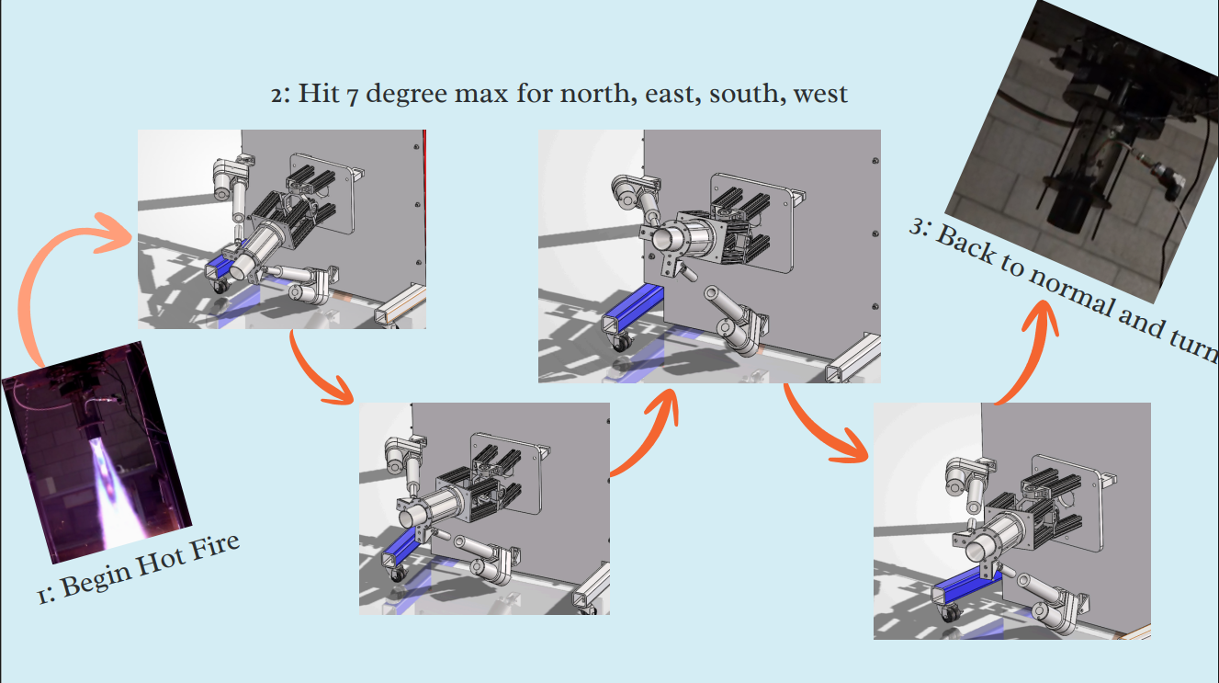
Systems
Concept of Operations(Con-Ops)
Con-Ops Overview:
Hot Fire begins
Linear Actuators tilt the engine from normal to 7 degrees south
Linear Actuators rotate clockwise 360 degrees to return to South
Engine Returns to normal orientation
Engine off

Slide 9
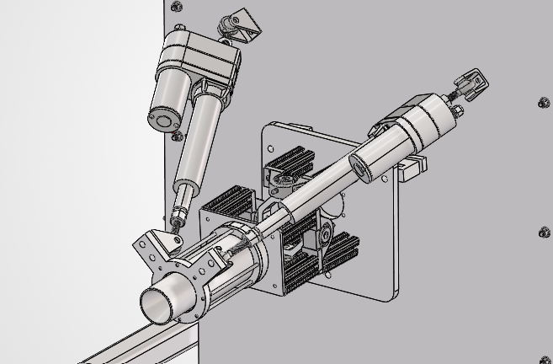
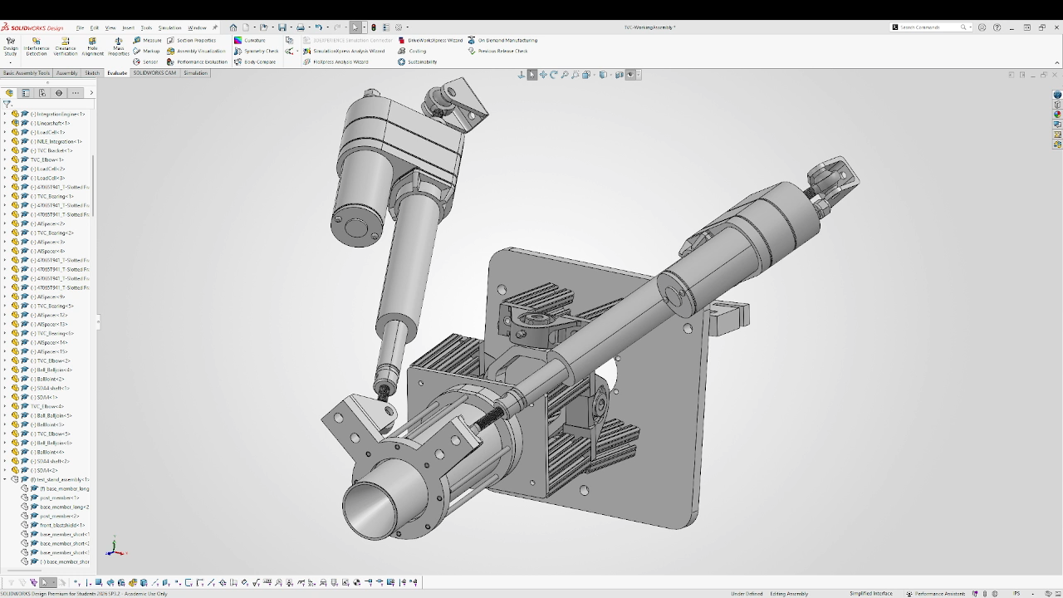
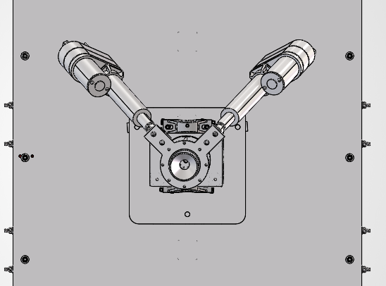
CAD
Photos

Slide 10
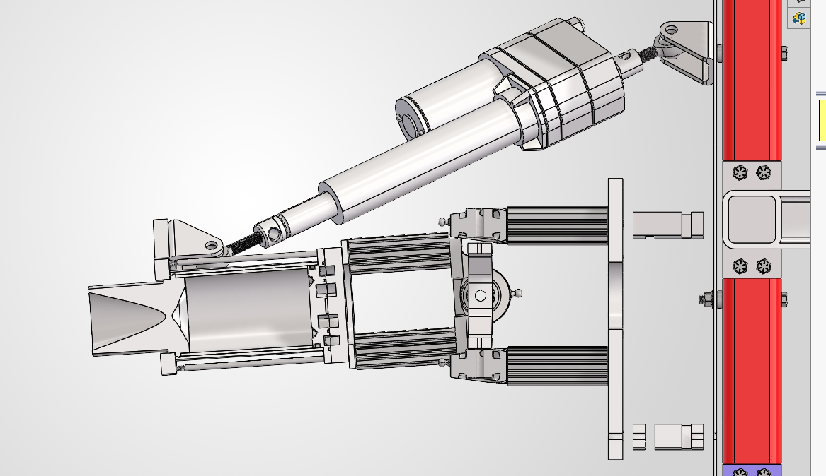
CAD
Cross Sectional View

Slide 11
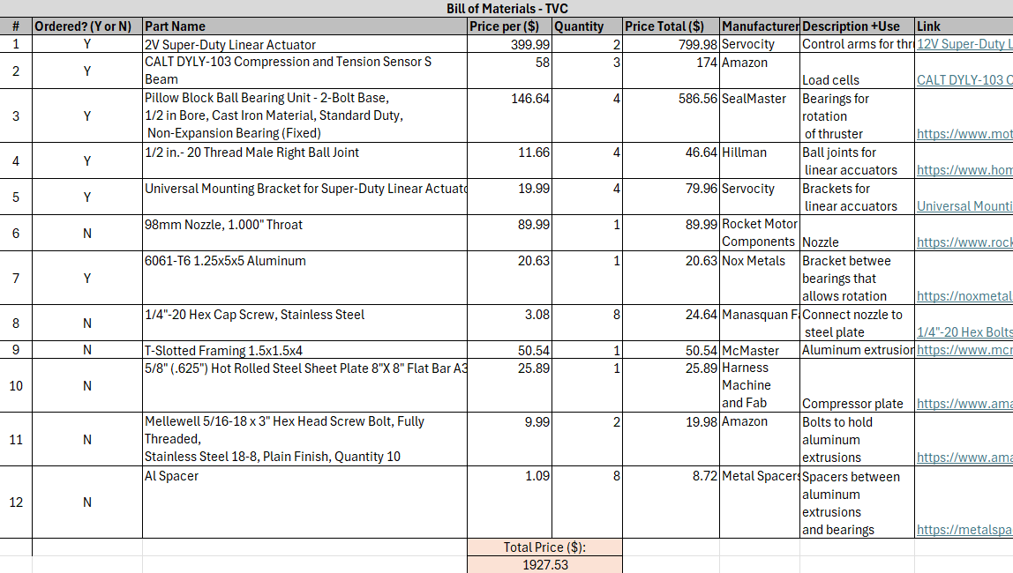
CAD
Bill of Materials:

Slide 12
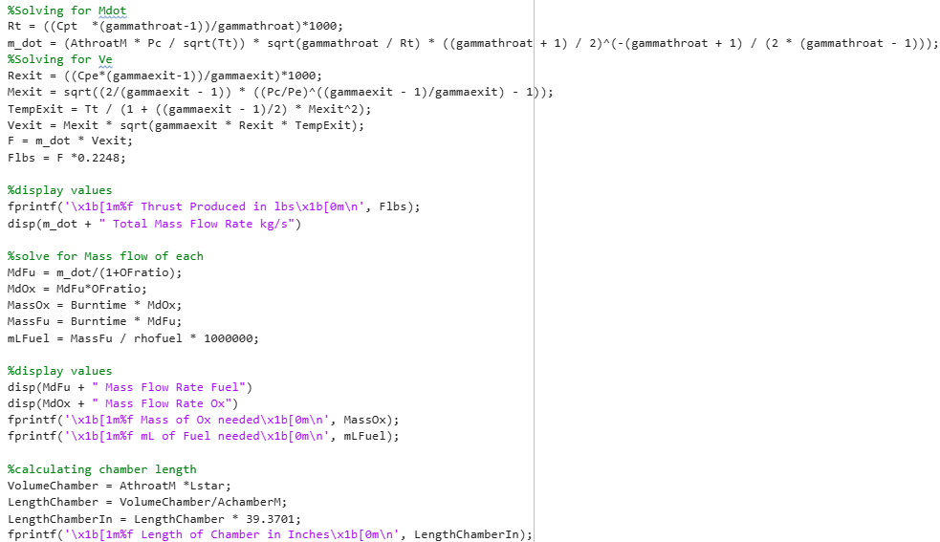
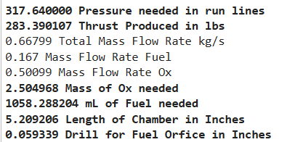
Engine
Calcs for Mass Flow & Chamber Length
Take general equation F = M_dot * Ve
Solve for Mdot and Ve
Then use to solve for F
Necessary because we are using a fixed nozzle,
If we could design our nozzle we'd be able to use thrust as a fixed value

Slide 13
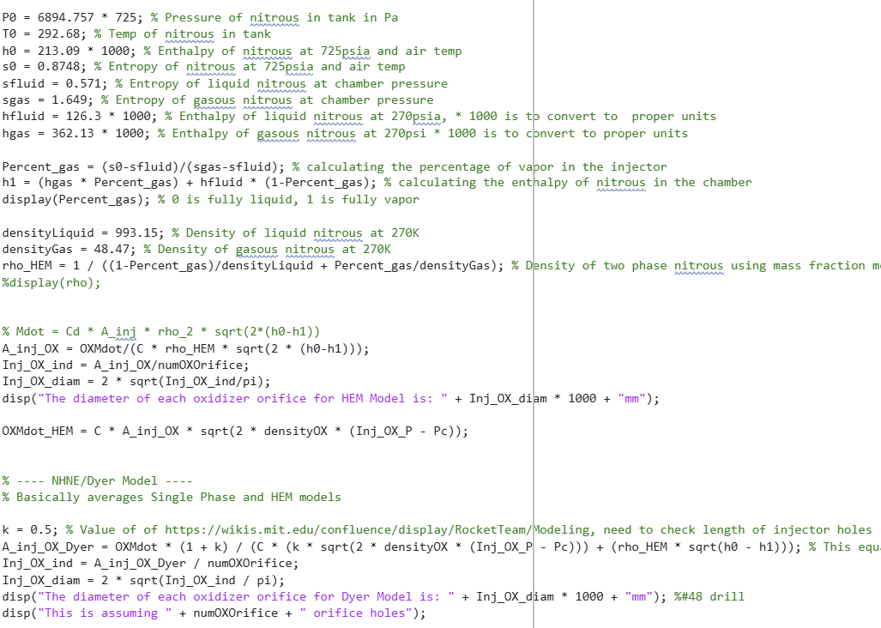
Engine
Calcs for Orifice Sizing
Modeling 2 phase flow through an injector is extremely difficult. We saw this with our previous engine Stratum, where it never hit it's design spec of 300lbf likely due to improperly sized orifice holes.
To solve this, we are using the Dyer Model which combines two other models, SPI & HEM
To create this sizing equation:
This increased the size of our oxidizer orifice holes by ~19%
Source: https://wikis.mit.edu/confluence/display/RocketTeam/Modeling

Slide 14
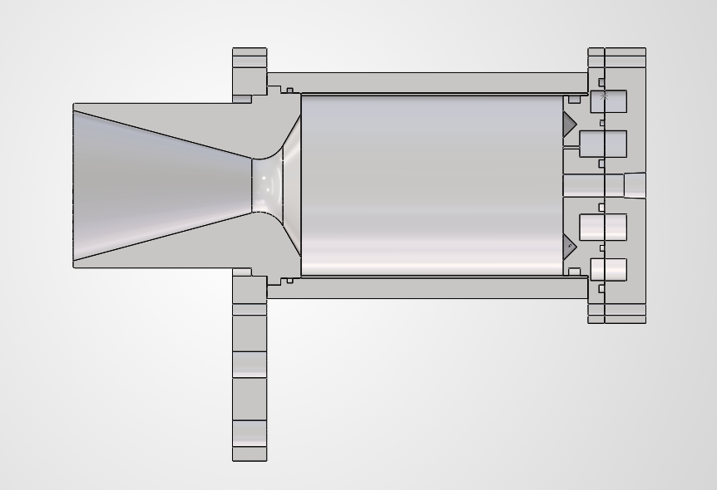
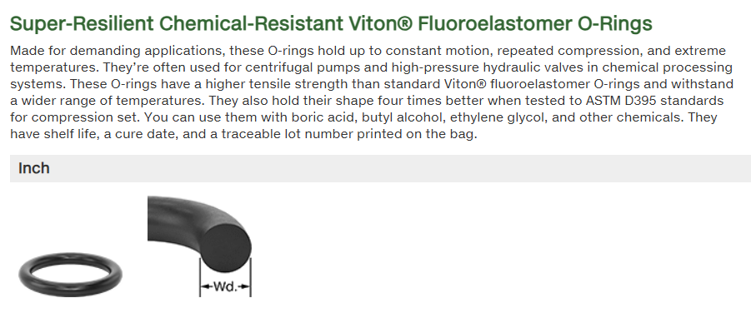
Engine
Physical Design
Bolts go down the sides both to prevent buckling of Chamber and compress the compression plate.
We have a compression plate that doesn’t allow for the rocket nozzle to fall out.
This compression plate also allows for engine hot swap at Paso.
We have O - Rings placed at both ends of the nozzle and will be used to seal combustion chamber gasses from the environment.
Experience testing with a similar injector design has taught us that high-temp resistant O - rings won't melt when exposed to hot combustion gasses.
525 ℉

Slide 15
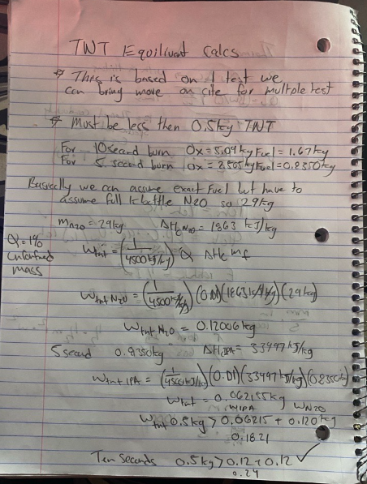
Engine
Propellent TNT Calculation
TNT equivalence must be below 0.5Kg
1/4500(kJ/kg) is the ratio to convert the amount of power produced by the IPA or N2O K bottle to TNT.
We are well below for both a 10 second and 5 second burn.
We must assume the whole N2O K bottle because we can't just use part of it.
We are not taking into account the N2 K bottles because they are inert.

Slide 16
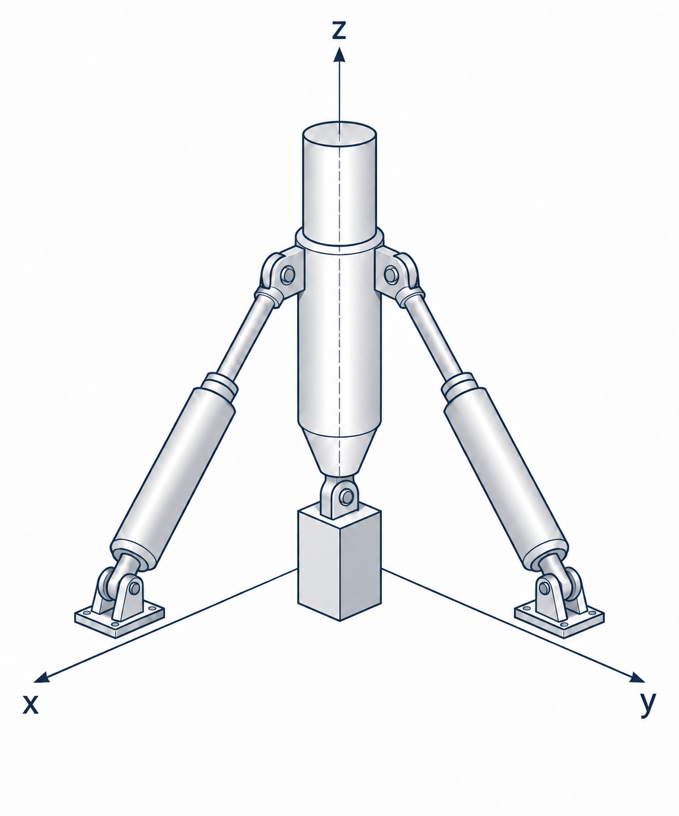
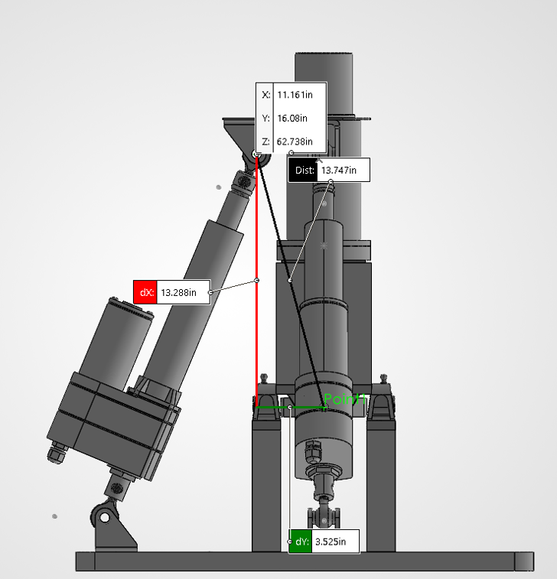
Mathematical Model

Slide 17
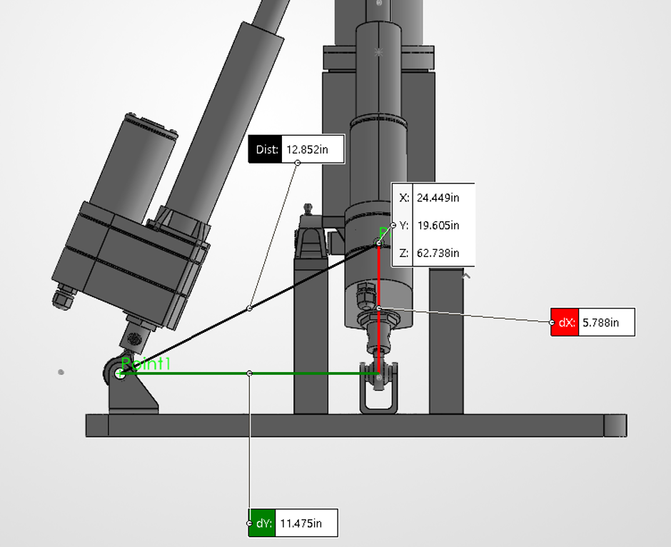
Math Model
Up To Date CAD
At 0 degrees. D = 12.852in and E = 5.788in and F = 11.475in At 0 degrees. A = 3.525in and B = 13.288in and C = 13.747in

Slide 18
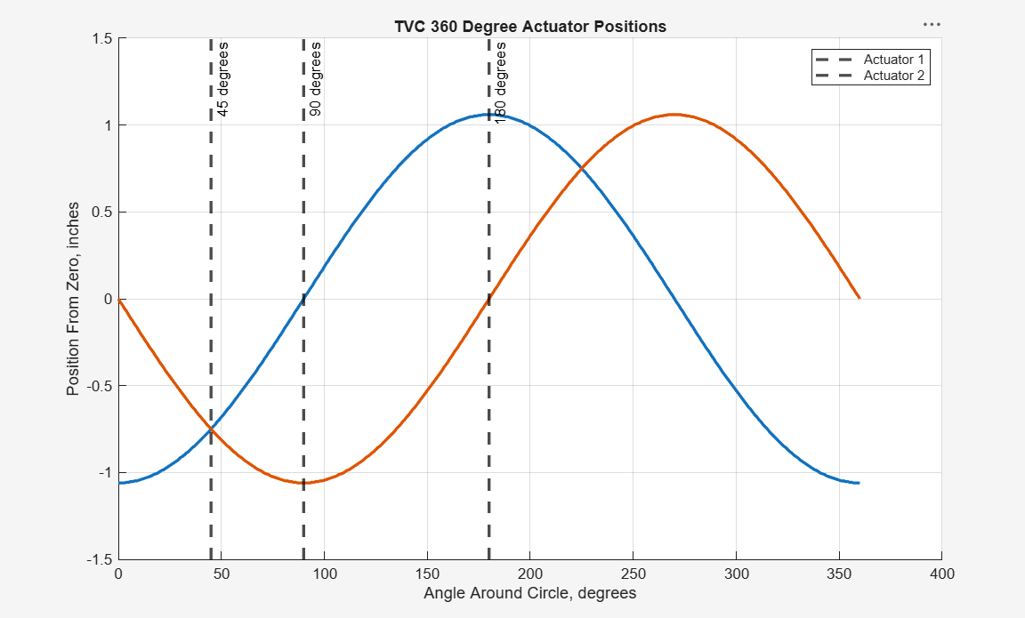
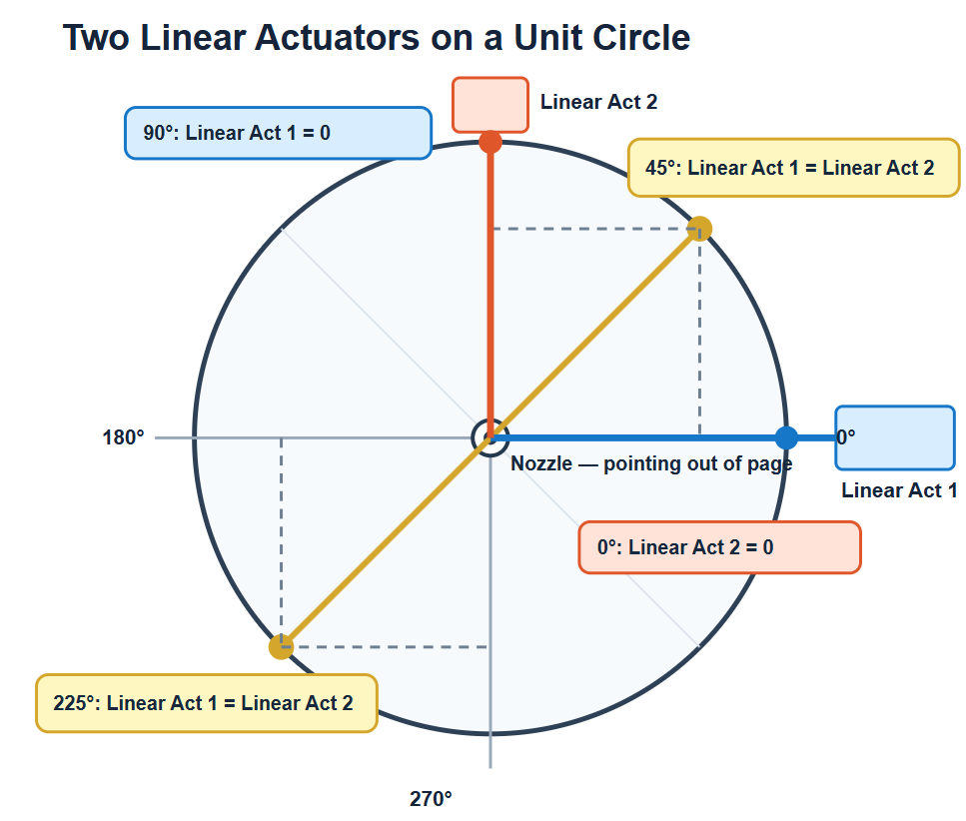
Math Model
Movement Plot

Slide 19
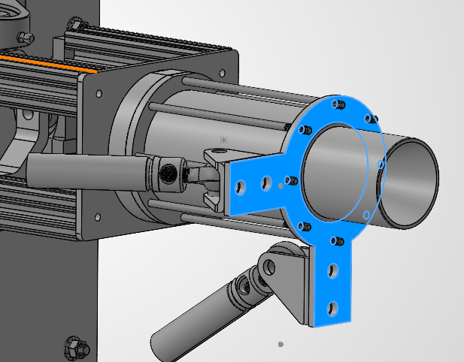
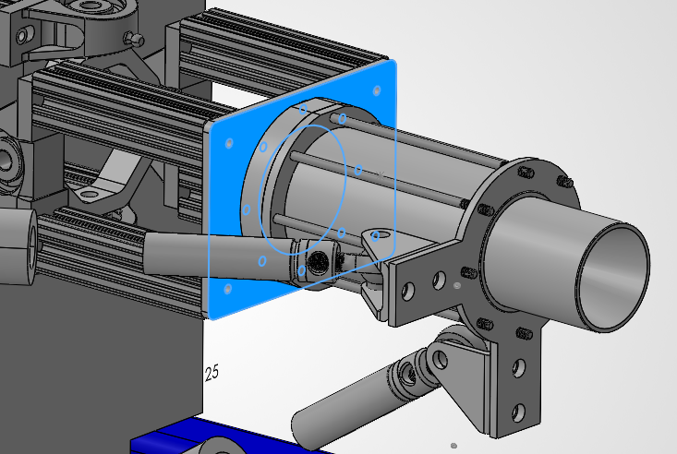
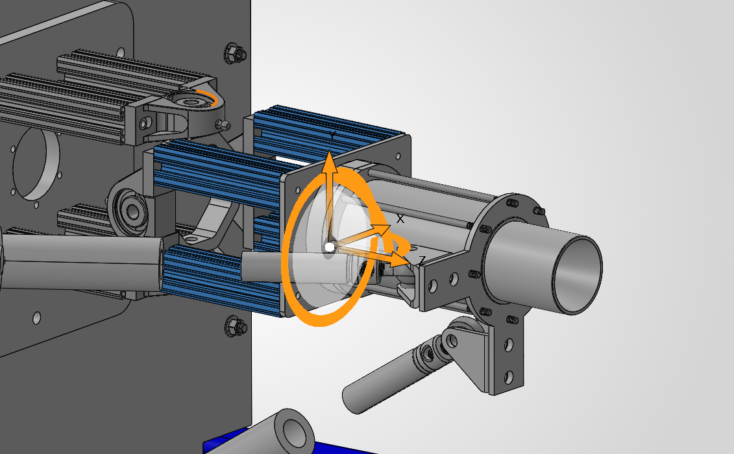
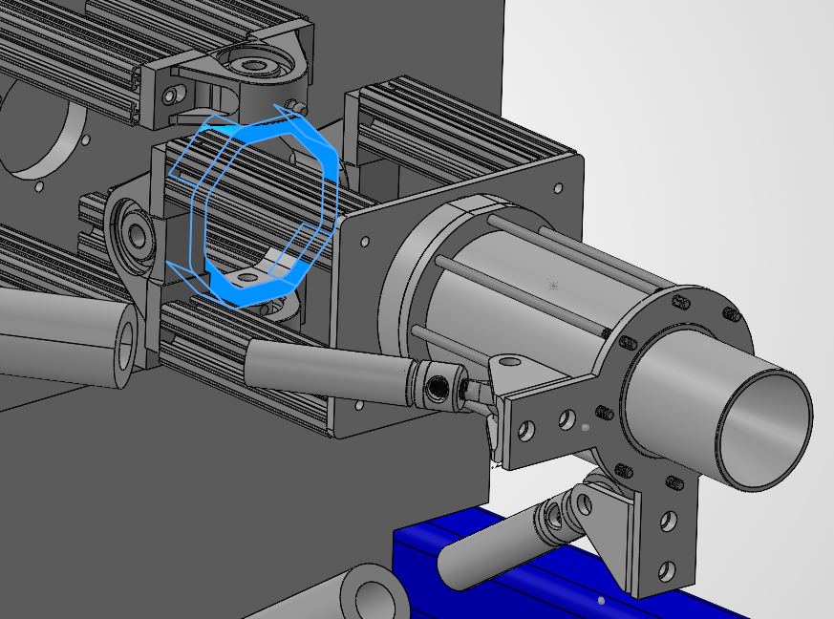
Structures
Aluminum Extrusions
Actuator Plate
Base Plate
TVC Gimble Bracket

Slide 20
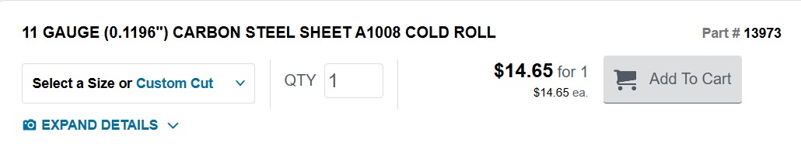
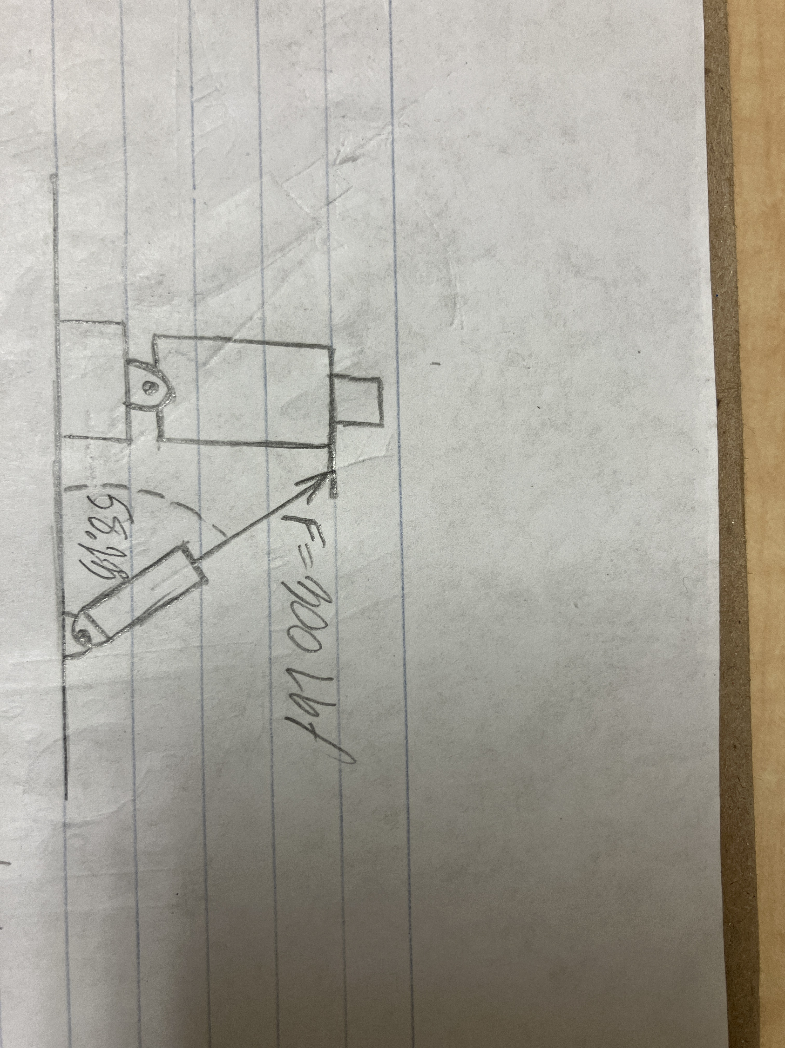
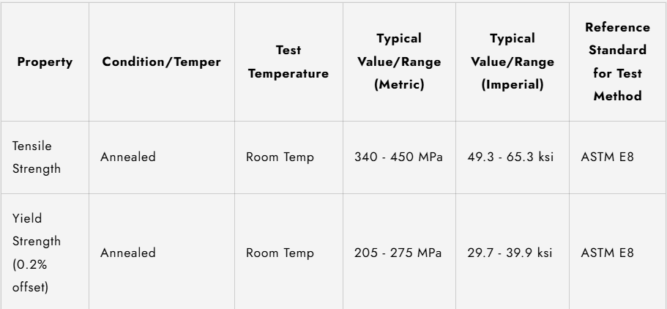

Structures
Material of choice

Slide 21
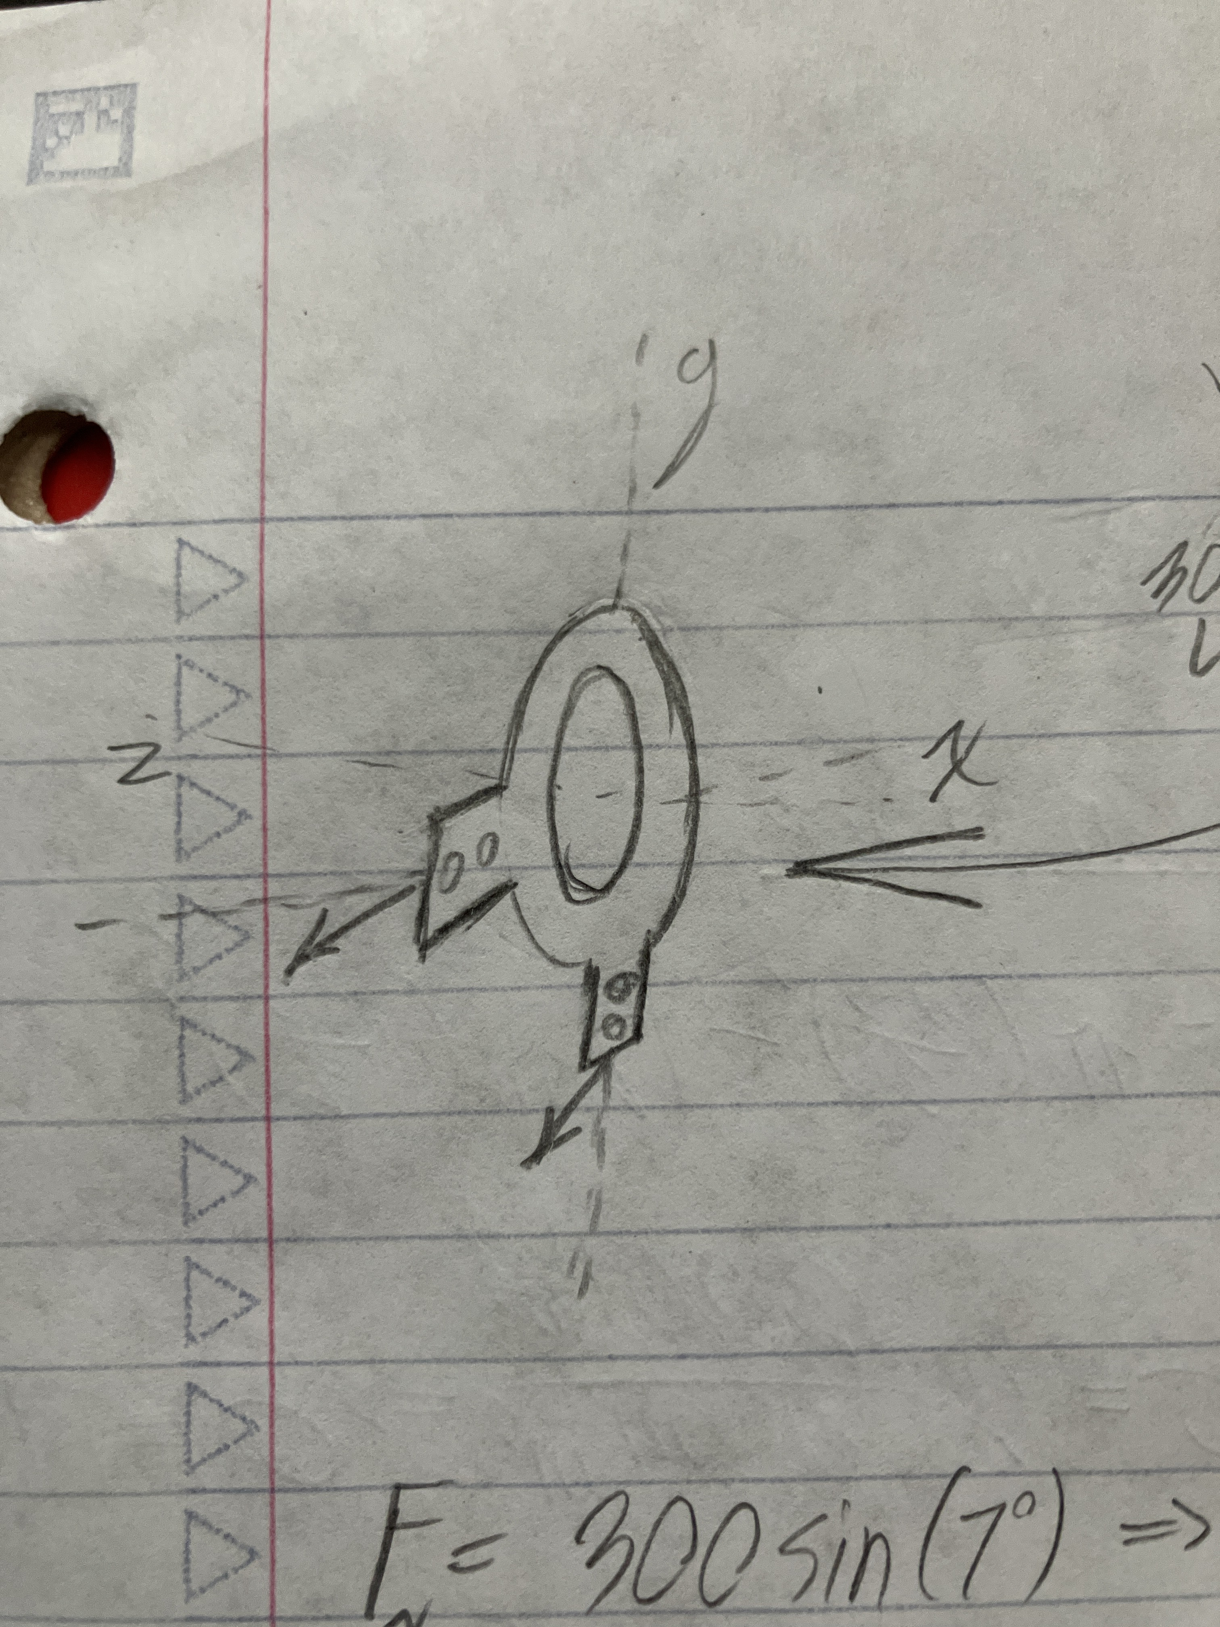
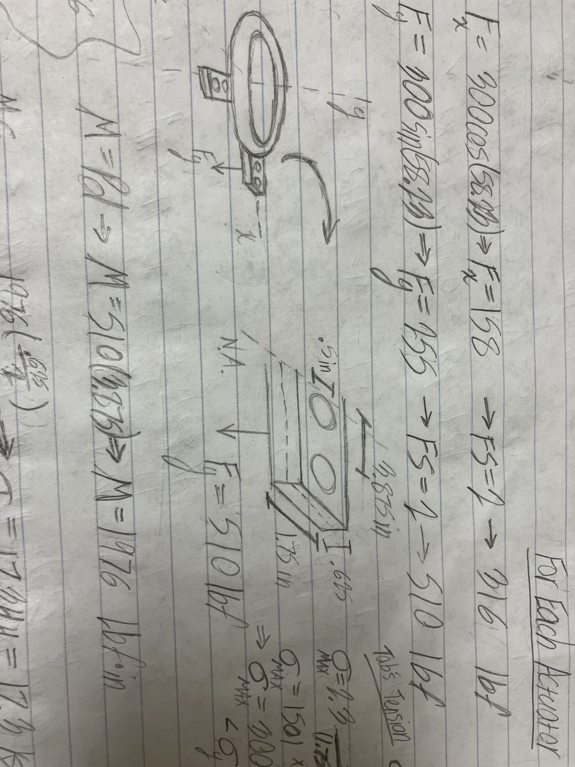
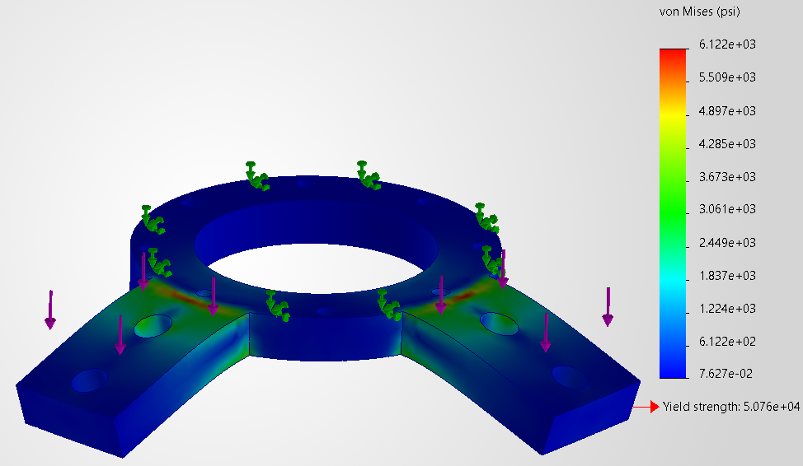
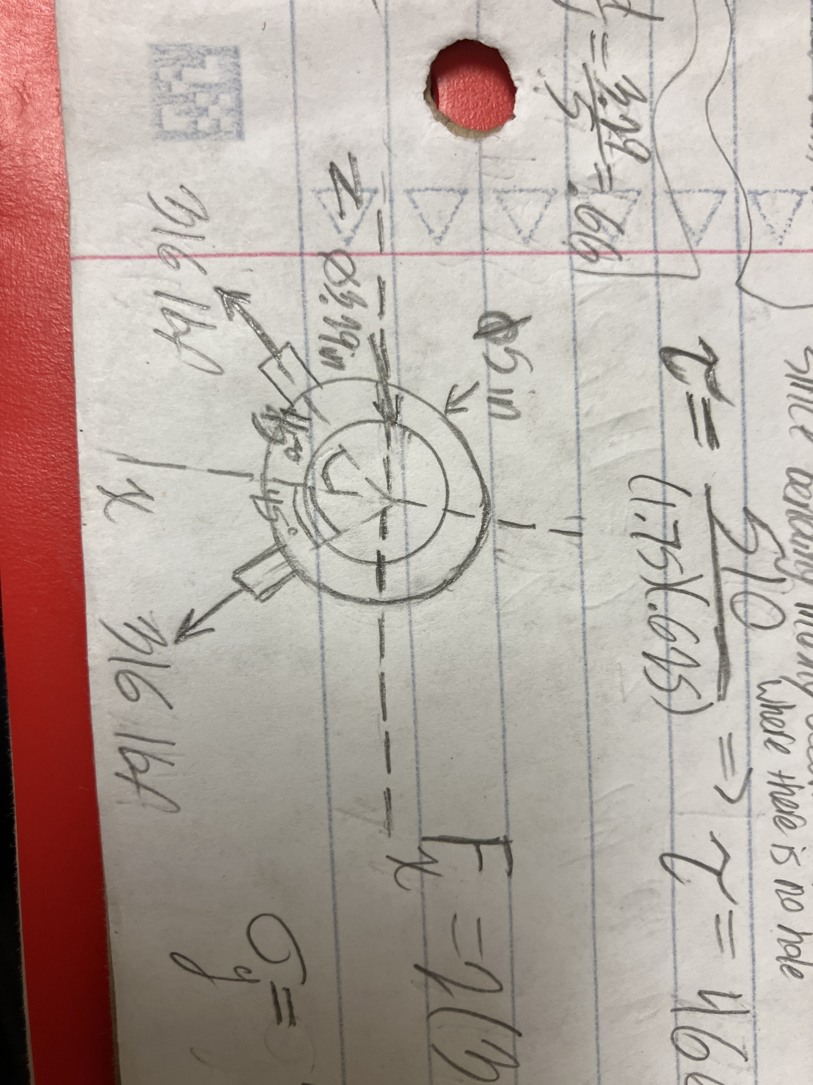
Structures
Actuator Plate
Fx = 316 lbf
300 lbf
300 lbf
Equations Used:
Bending Stress
Shear Stress
Stress = F/A
17.3 ksi
466 psi
M = Pd
Bending Stress = Mc/I
Tensile Stress
Tensile Stress
I = (bh^3)/12
930 psi
623 psi
Heywood/Howland Eqn.

Slide 22
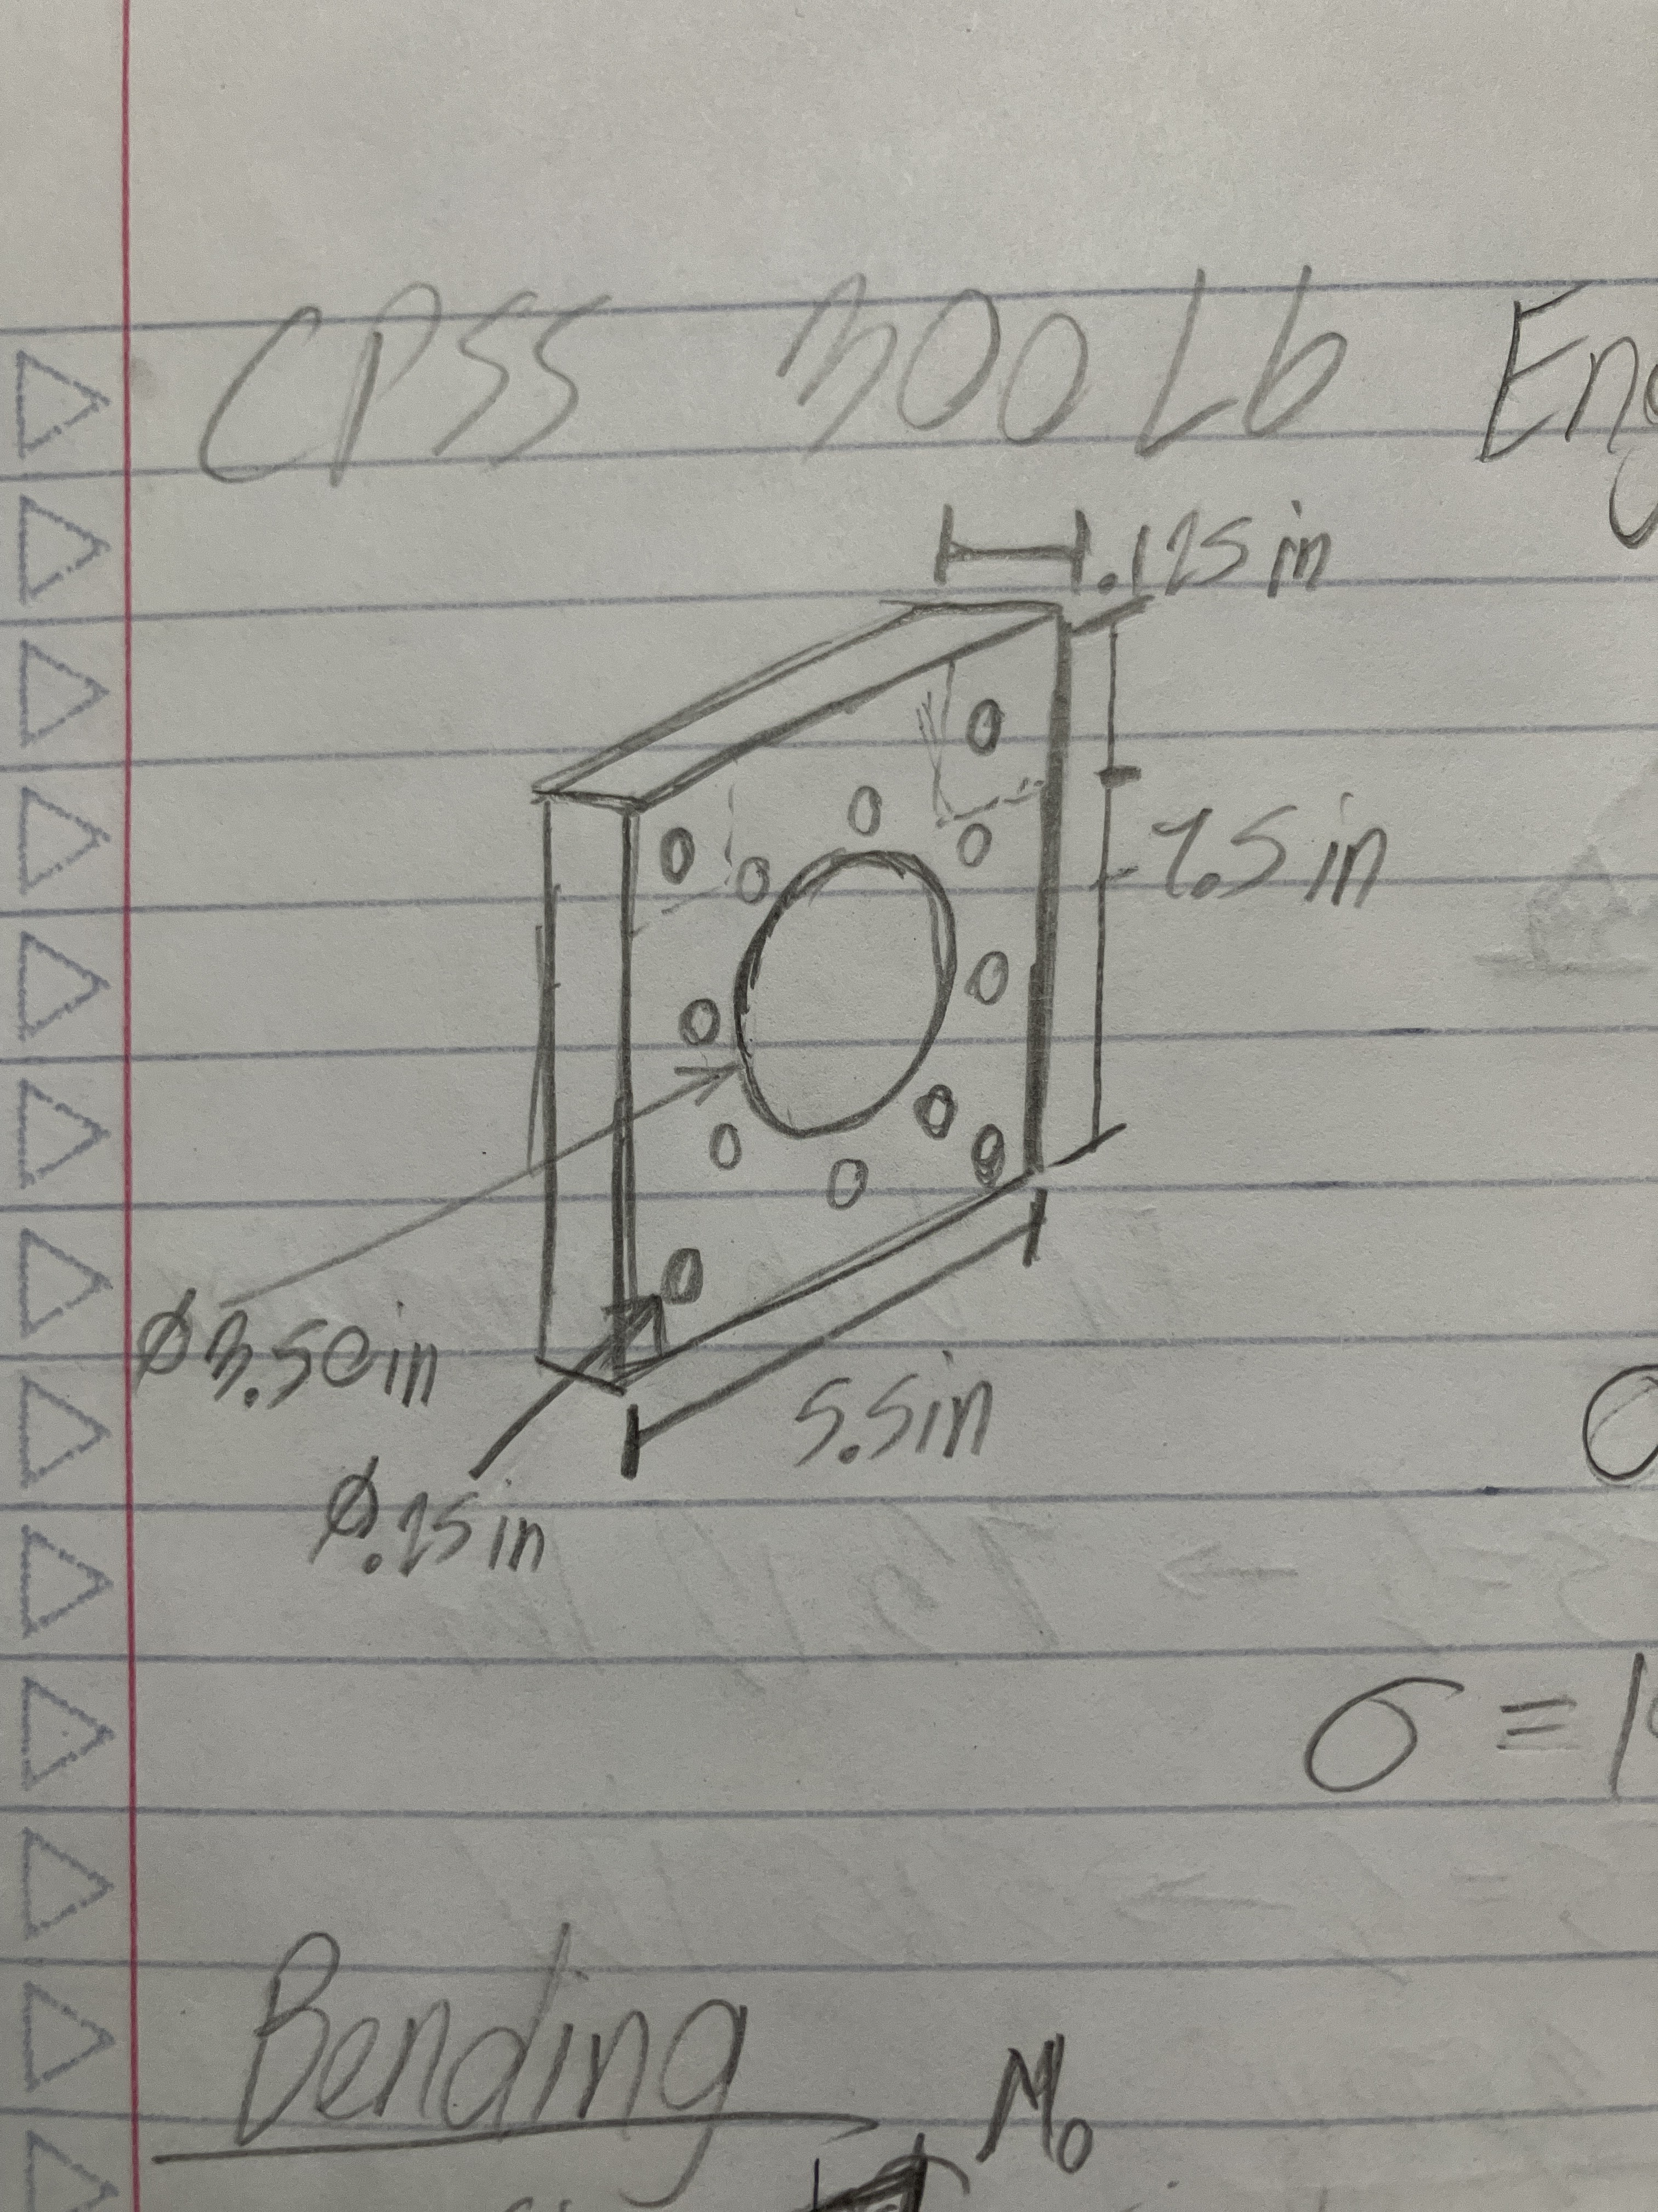
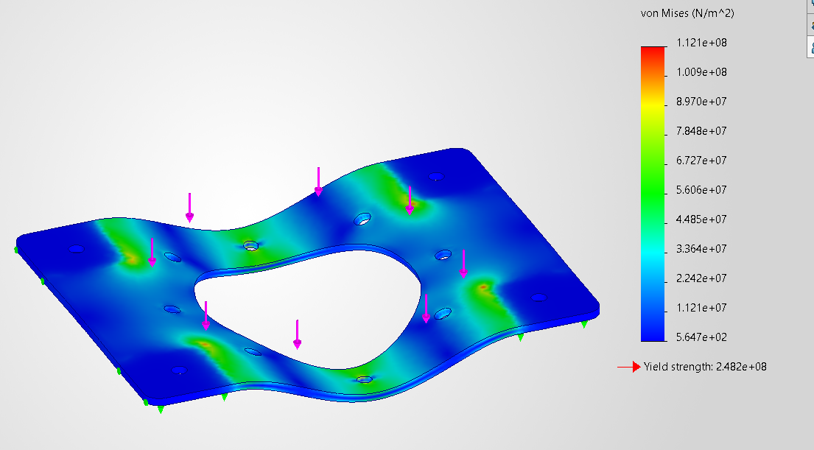
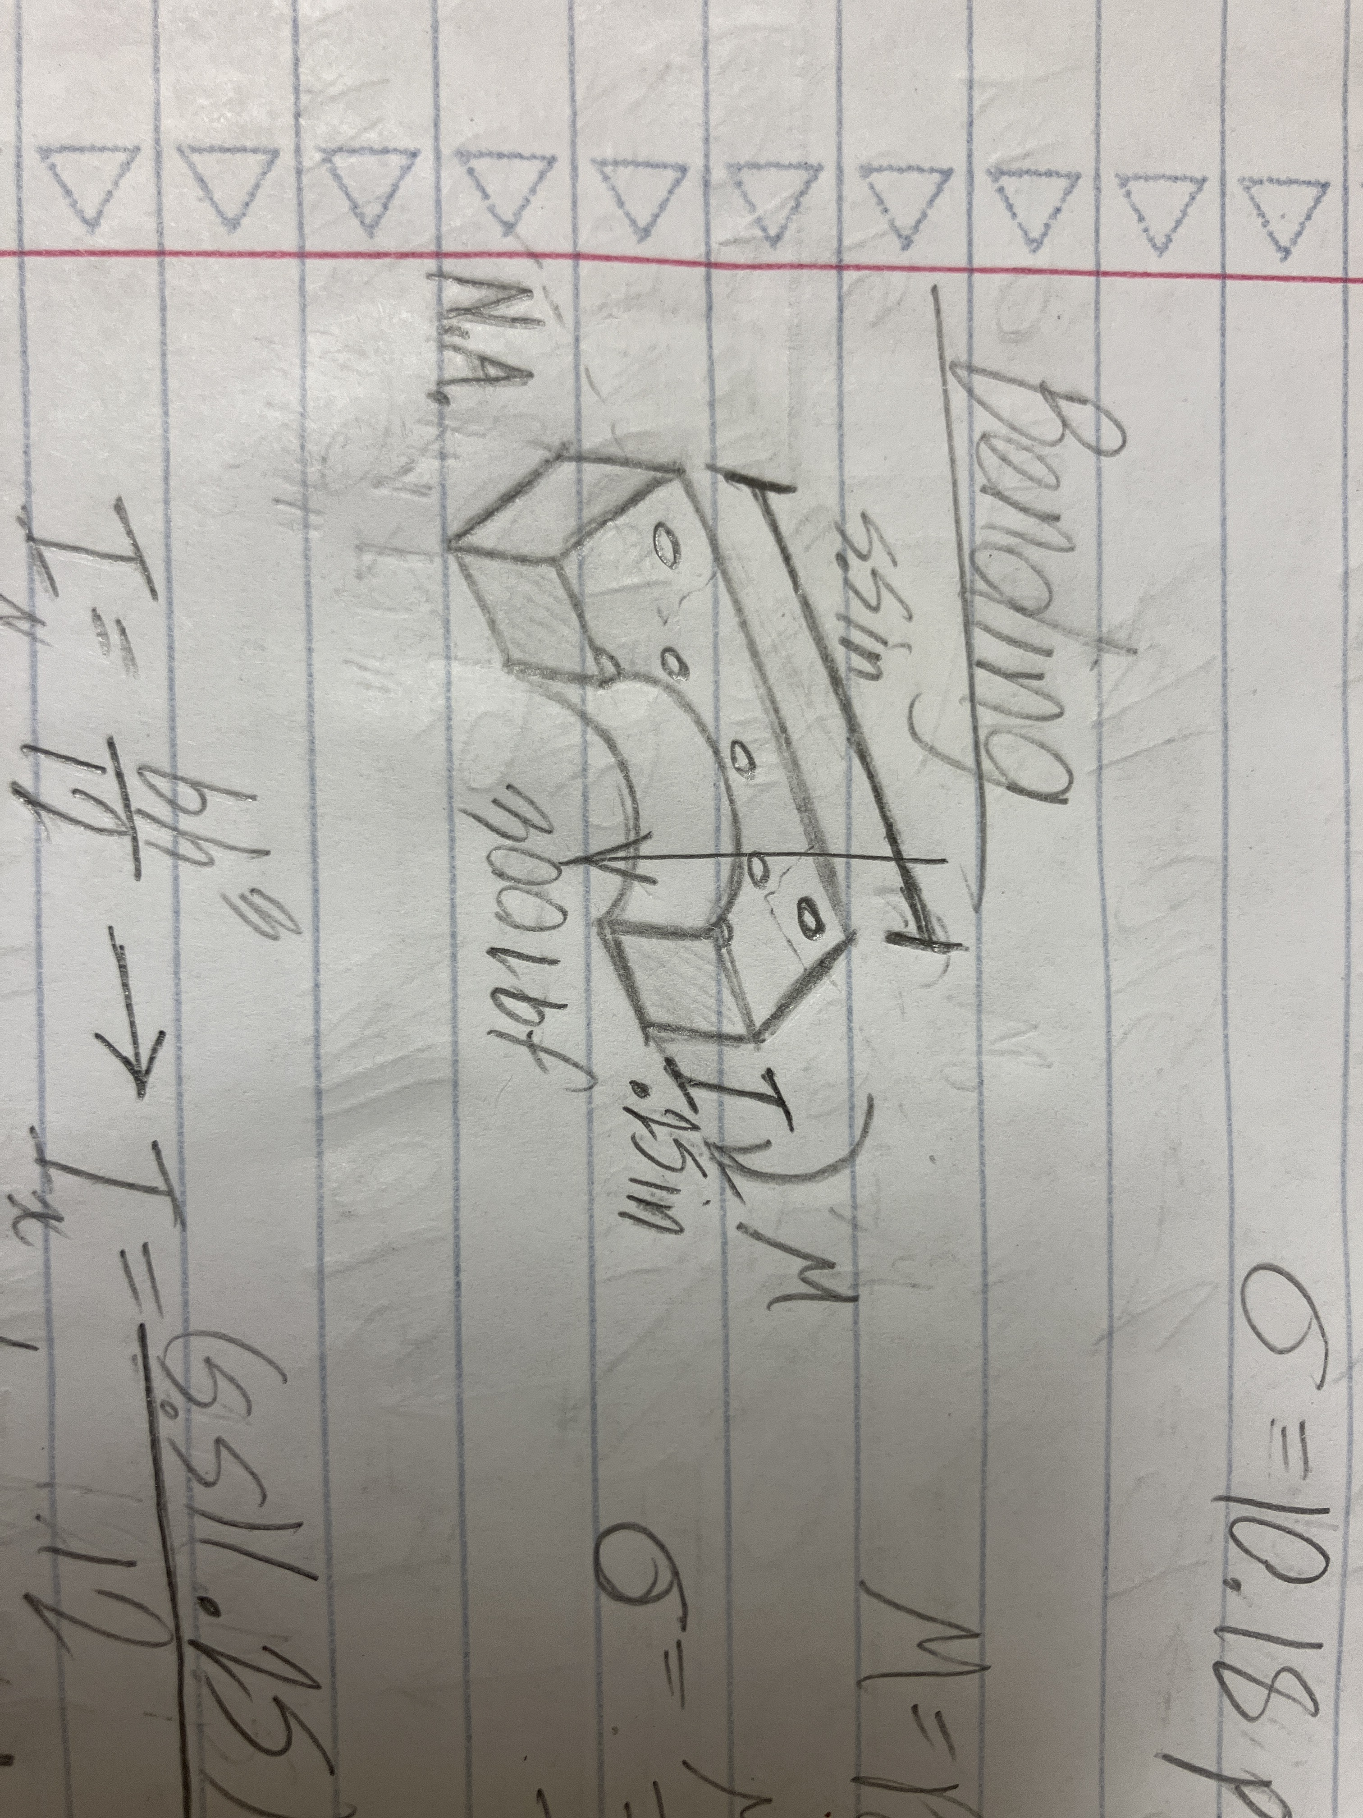
Structures
Base Plate
Equations Used:
Stress = F/A
Compressive Stress
Shear Stress
Bending Stress
M = Pd
10.18 psi
632 psi
12.344 ksi
Bending Stress = Mc/I
I = (bh^3)/12
Heywood/Howland Eqn.

Slide 23
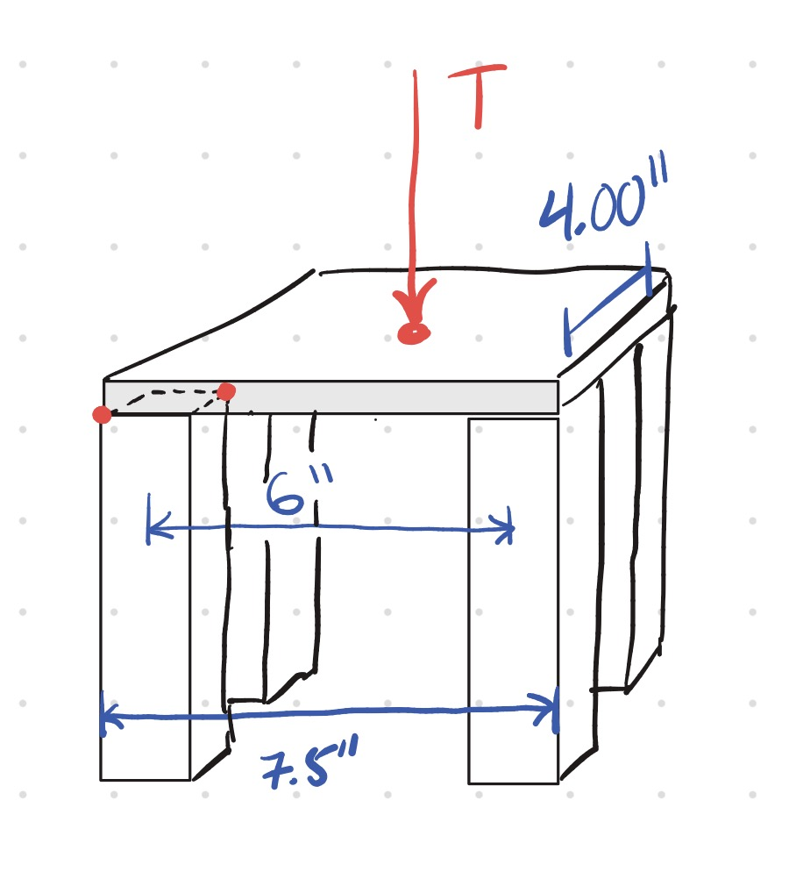
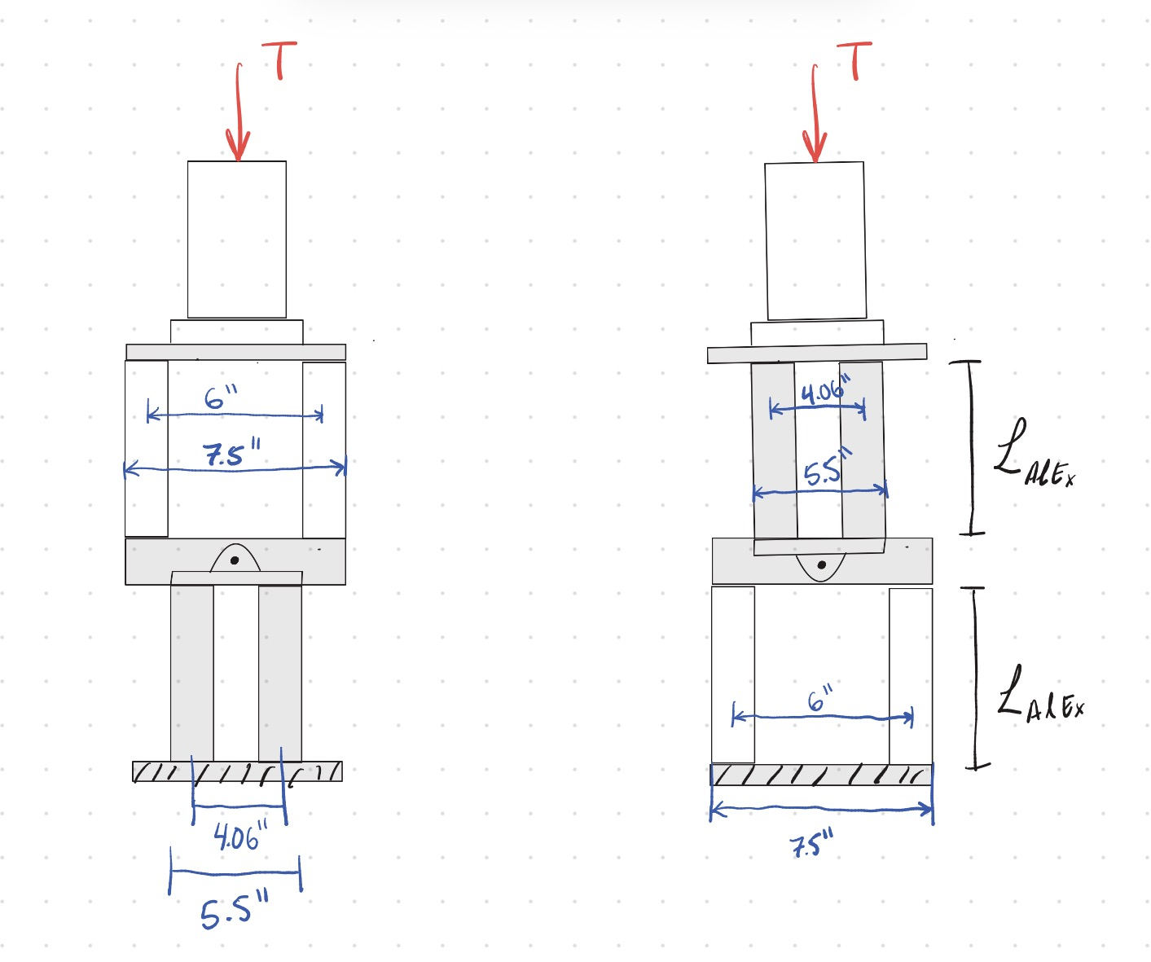
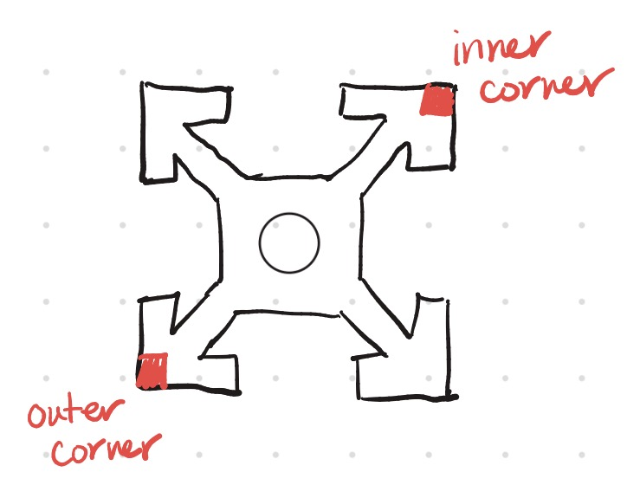
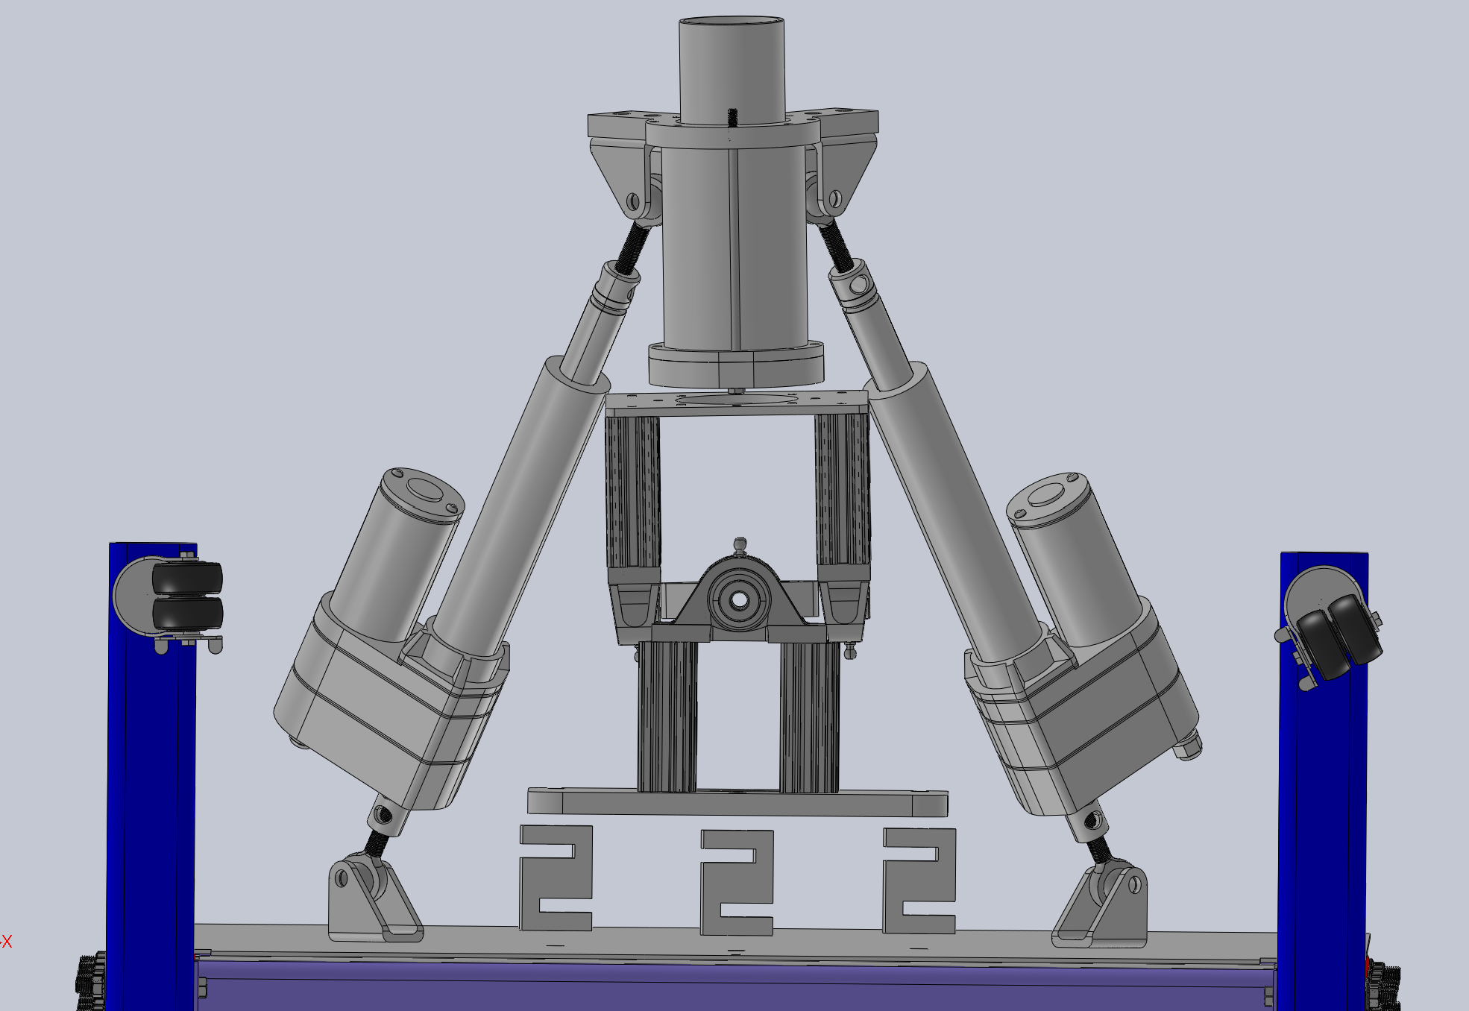
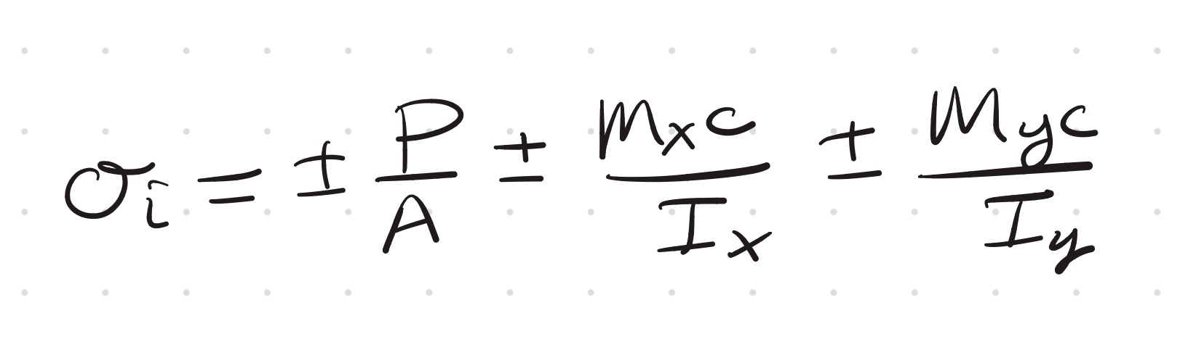
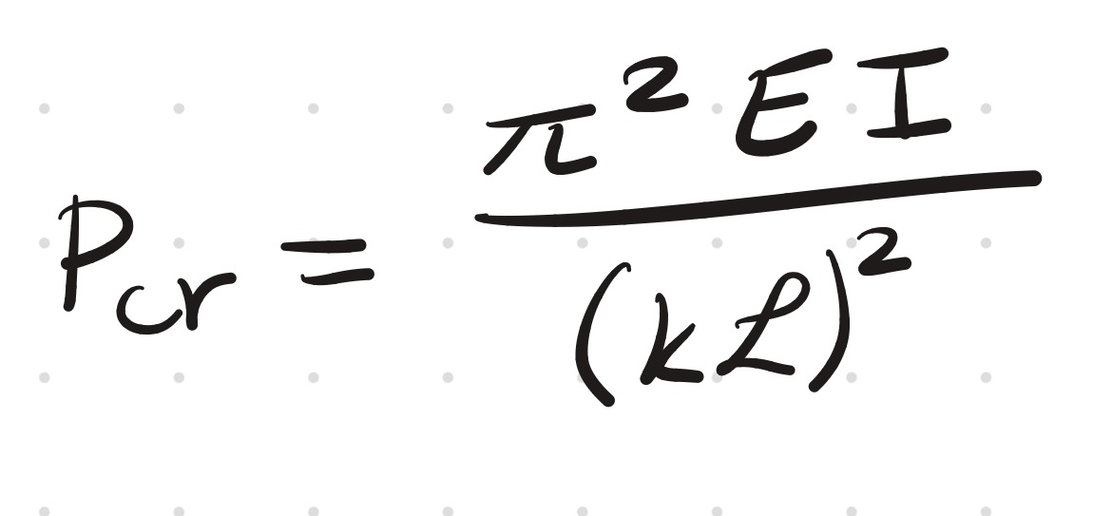
Structures
Aluminum Extrusions (6063 T6)
Cross Sectional Area:
Equations Used:
Yield Strength = ~ 25 ksi
Force Applied to each beam = 75 lb
Compressive Stress per beam = 1.22 ksi
Shear Stress per beam = 0 (force is purely axial)
Critical Load for Buckling = 3084.36 kips
Worst case scenario: All 300 lb in one beam
Compressive Stress = 4.895 ksi

Slide 24
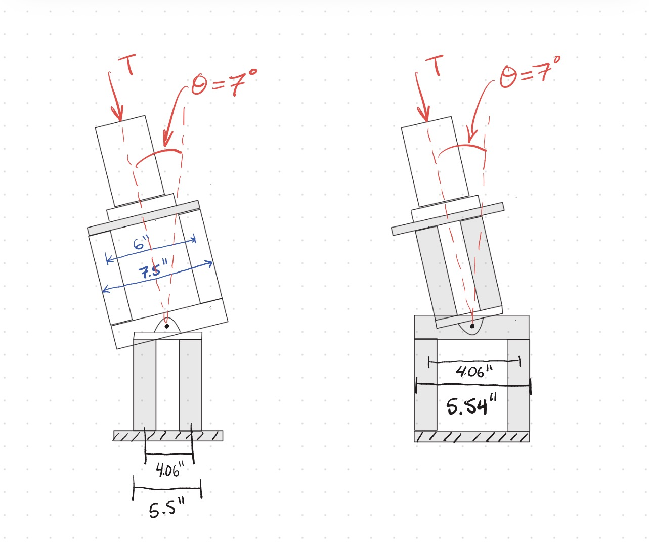
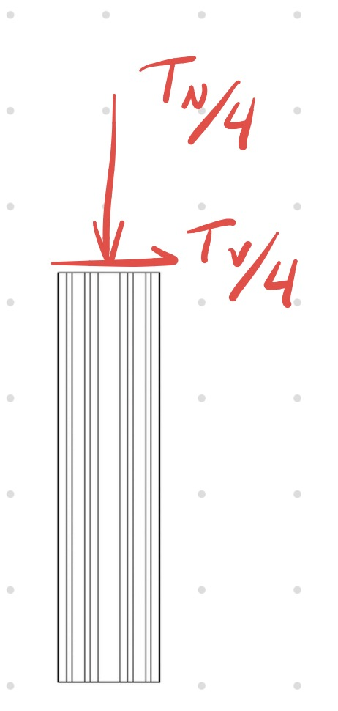
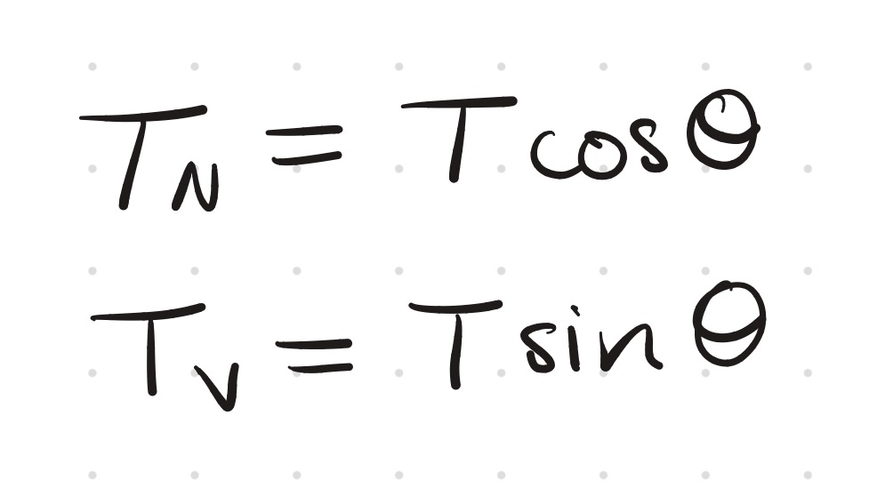
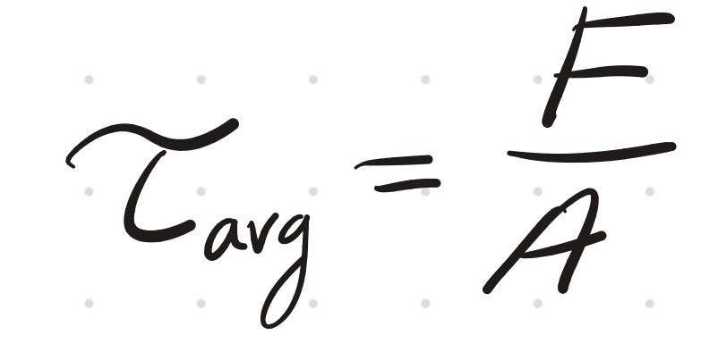
Structures
Aluminum Extrusions (6063 T6)
Normal Force per beam = 74.44 lb
Shear Force per beam = 9.14 lb
Compressive Stress = 1.21 ksi
Shear Stress = 8.09 psi
Yield Strength = ~ 25 ksi
Ultimate Shear Strength = ~ 14.4 ksi
Worst case scenario: All 300 lb in one beam
Compressive Stress = 4.86 ksi
Shear Stress = 32.36 psi
Aluminum Extrusions
Equations used:

Slide 25
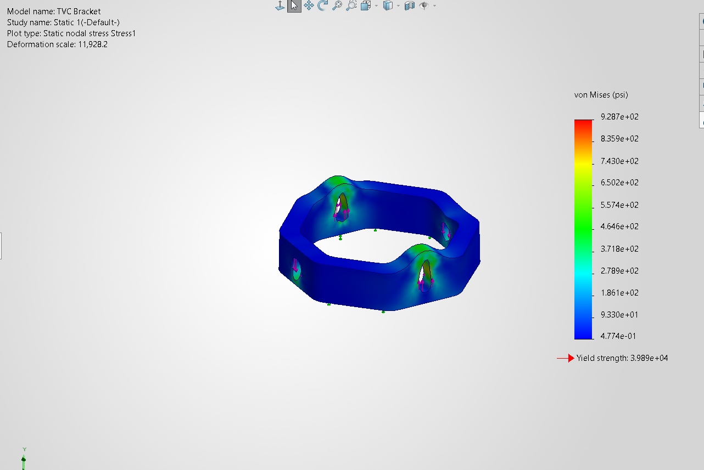
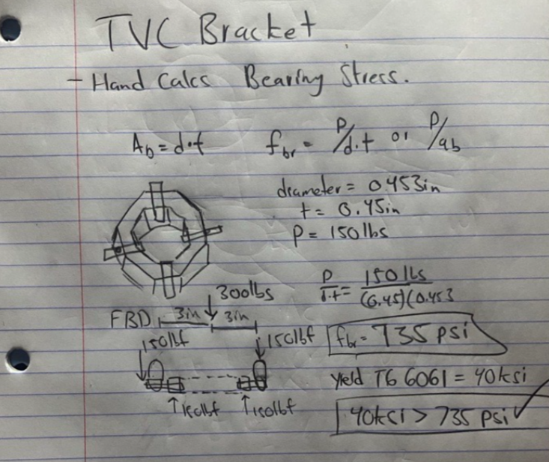
Structures
TVC Gimble Bracket

Slide 26
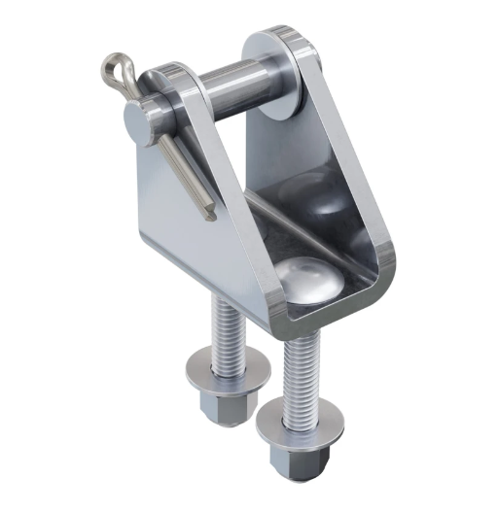
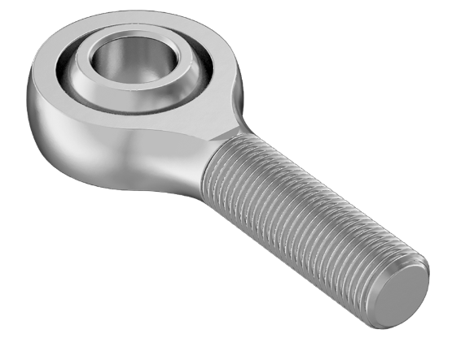
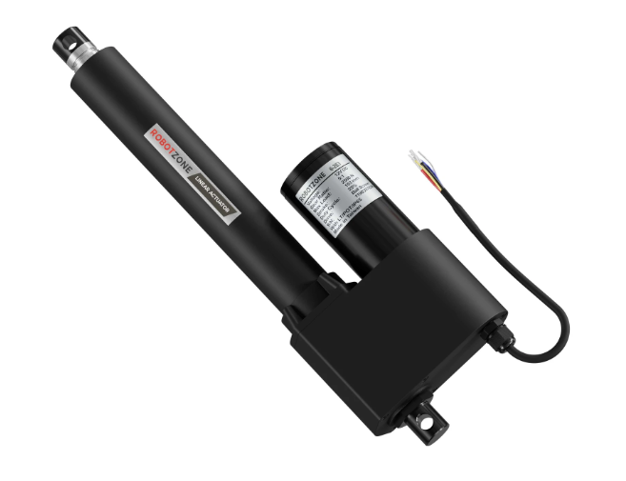
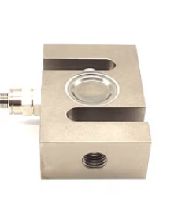
Structures
Other Components (Taken From Spec Sheet)
12V Super-Duty Linear Actuator (560lb Thrust, 2.6"/sec, 6" Stroke)
S Load Cells Rated for 500kg roughly 1100Ibf
Rated for same amount of thrust as linear actuators (Sold by same company as package deal)
Static Radial Load Capacity of 10,000lbs
NILE test stand is rated to support Hot Fires of 1000lbf

Slide 27
Electronics Overview
Part Name | Quantity | Price | Voltage Limit | Use | Data Sheet
Arduino Uno | 1 | 27.60 | 5V | Brain of TVC | https://docs.arduino.cc/resources/datasheets/A000066-datasheet.pdf
Motor Driver BTS7960 | 2 | 9.99 | 27V | Drives Linear Actuators | https://www.handsontec.com/dataspecs/module/BTS7960%20Motor%20Driver.pdf
Buck Convertor | 1 | 9.39 | 40V | Powers Arduino from Power Supply | https://rajguruelectronics.com/Product/13060/071123123335.pdf
Linear Actuator | 2 | 399.99 | 12V | Moves the Engine | https://www.servocity.com/content/downloads/super_duty_actuators_specification_sheet_v3_1.pdf
Current Sensor | 2 | 9.95 | 40V | Sensors how much current needed, back calc force | https://cdn-shop.adafruit.com/datasheets/ina169.pdf

Slide 28

Electronics
EE Diagram for Testing
Ardiuno is plugged into a computer which will be sending commands, and collect position data.
Ardiuno drives the motor drive using a PWM (basically rapidly turning on and off the digital out pin to send a frequency that corresponds to power needed.
We get power from the (Power supply, Test Stand, or Batteries) which is sent to our motor driver.
Motor driver is plugged into the linear actuator and a 5v from Arduino is plugged into linear actuator as well so get reference of position.
2x

Slide 29



Electronics
Sensor Collection
Data we need to collect:
Thrust, Position, & Power Usage
Current Sensors detect how much current is being pulled by the linear actuators while under load allowing us to back calculate force on linear actuator
Load Cells are used to take the amount of created at the integration plate.

Slide 30
Timeline
Weeks: 5-6 Manufacturing/ Assembly | Weeks: 7-8 System Testing | Weeks: 9-10 Cold Flows | Weeks: 11-13 Hot Fires | Weeks: 14-15 Implementation
No testing can occur until manufacturing and assembly is finished. | Confirm that TVC is capable of moving the 7 degrees pitch and rotating 360 degrees. | Confirm that system can hold pressure and there is no safety issues before hot firing. | Confirm that pressure, thrust, and system is nominal before incorporating TVC. | Confirm that TVC meets objective requirements set by lander challenge.
Actuator Plate, Base Plate, Aluminum Extrusion, TVC Bracket, electronics, Engine, Linear Actuators | MATLAB code & linear actuators work on the stand. Confirm code commands line up with stand. | Actuator Timings, static test/with TVC test, sensor testing, fuel mixture, pump flow testing. | Thermal limits, 300 lbf, timing works. | TVC 3 degree pitch 360 degree rotation and then TVC 7 degree pitch 360 degree rotation.
All structures are machined, assembled, and implemented into the test stand. | All structures perform their function: Code is implemented, linear actuators perform as expected. Successful when TVA is capable of moving 7 degrees pitch. | 2+ successful tests. Considered successful when the system withstands 300lbf, no catastrophic failures occur, and the TVA moves 7 degrees pitch and completes two revolutions clockwise under pressure. | 2+ successful tests. Considered successful when the system experiences no catastrophic failures under load, all testing procedures were performed. | 2+ successful tests for each implementation. Considered successful when no catastrophic failures occur, all testing operations were performed, and all expected conditions were present.
Reasoning
Deliverables
Verification
Timeline may vary.

Slide 31
Budget
Budget 1600$
Already own ($1707.77):
Linear actuators
Load cells
Ball bearings
Ball joints
Mounting brackets (for linear actuator)
Bracket between ball bearings
Already ordered ($492.49):
Physical pressure gauge
Pipe fittings for gauges
Whip check for high pressure hose
Pressure transducers
Waterproof electrical box for pneumatic bank
Chains for K bottles
Pneumatic bank
Metal stock for flat plates
Still need to buy ($219.76):
Nozzle
Bolts to connect nozzle
Aluminum extrusions
5/8” compressor plate
Bolts to hold aluminum extrusions
Aluminum spacers for extrusions and bearings

Slide 32

Budget
(Already owned parts do not count towards this)

Slide 33
Questions?
No question is a bad question.
They will allow for us to critically think about our system and reason a proper solution to problems that might arise, or have never been brought up before.

Slide 34


