Slide 1


Project Manager: Spencer Biernat

Slide 2
Agenda
Introduction
Mission Requirements
Vehicle Overview
Concept of Operations
Aerodynamic Analysis
Subsystem Designs
  Lift and Control Surfaces
  Structures and Recovery
  Avionics and Radio Control
  Telemetry and Ground Station
7. Testing
8. Next Steps
Notes:
Spencer

Slide 4
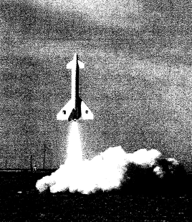
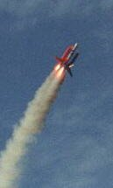
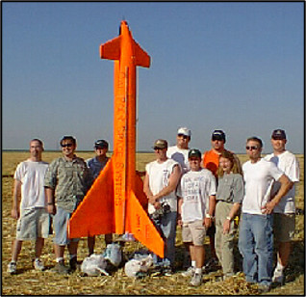
Background
Background on the Booster Project
Final report*: https://ntrs.nasa.gov/api/citations/20020023126/downloads/20020023126.pdf​
CPSS has history with flyback boosters: StarBooster. CPSS booster team’s Sonata 2 project aims to improve sonata 1's design and prove stable, replicable flight for implementation with a second booster segment.
Sonata I is a vertical launch spaceplane conceptualized as a test platform for systems and component designs for eventual inclusion in later Opus program projects.
Because Sonata I is primarily a test platform, modularity, manufacturability, and ability to quickly relaunch are the main focuses in its design.
The CPSS recoverable booster team’s long-term goal with the Opus program is to develop a flyback solid rocket booster system that can serve as a platform to launch future CPSS projects such as propulsive landers, space shots, or other multi-stage projects. Sonata I is the first step in developing the systems, manufacturing processes, operational skills, and infrastructure to support and maintain such a complex system.
Notes:
Spencer

Slide 5
Overview
Mission Scope
Mission Objective: Launch the vehicle as a rocket, land the vehicle as a glider.
Mission Success Criteria
1. The vehicle reaches an apogee of between 1000-2000 feet.
2. The vehicle lands after a successful glide phase
  Lands in a way that the vehicle could hypothetically be reused.
Notes:
Spencer

Slide 6
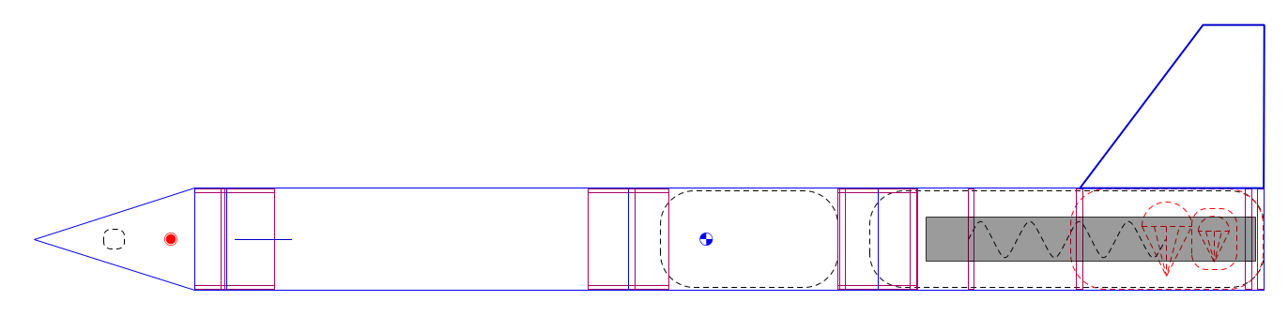
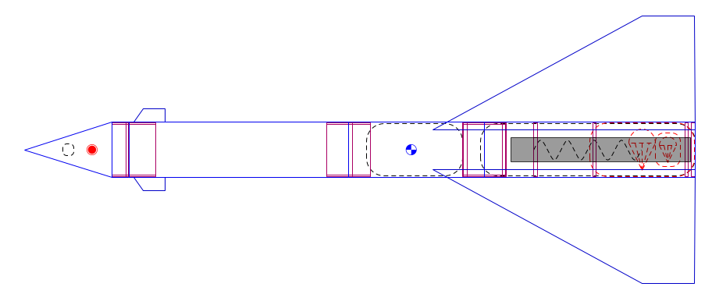
Overview
Open Rocket + mass/dimension estimates
Estimated Loaded Mass: 26.55 lbs*
Estimated Unloaded Mass: 23.12 lbs
Overall Length: 56.70”
CP Location: 15.75” from rear
Stability: Unknown
Side view:
Top view:
Notes:
Spencer

Slide 7
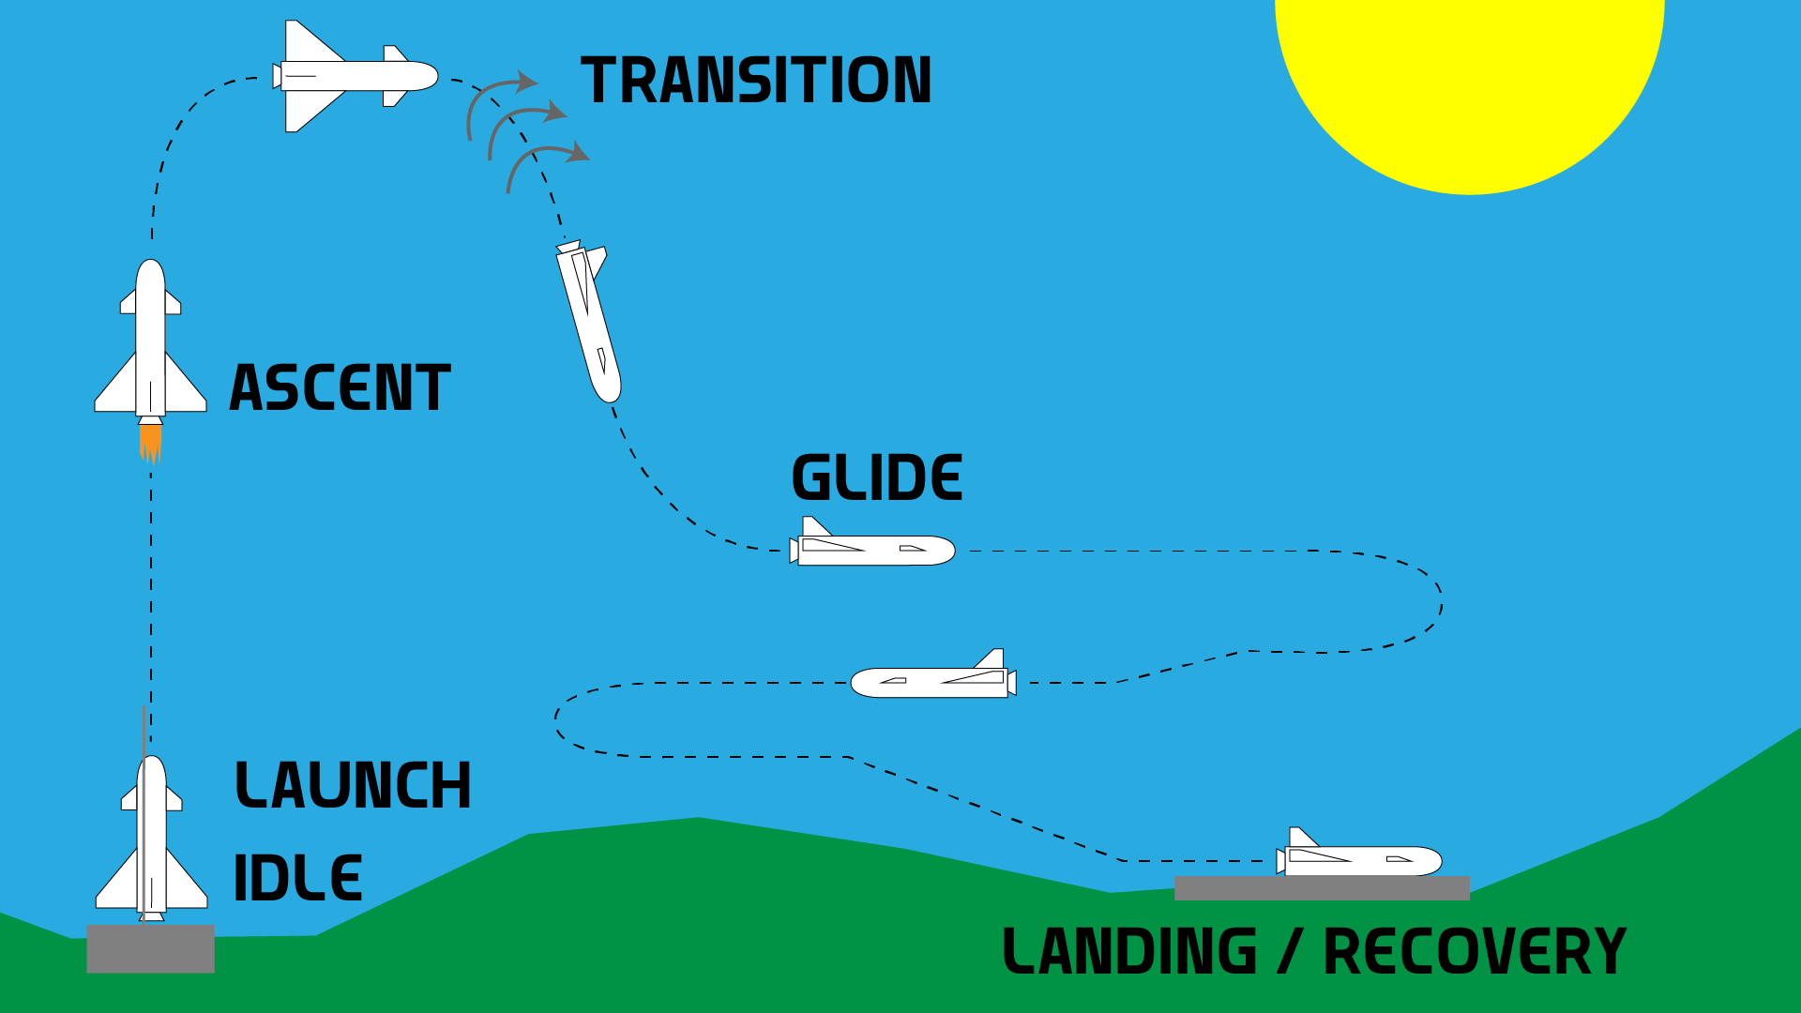
Conops
Graphic
My drawing goes here -Maximus
Notes:
Max

Slide 8
Conops Phases
Phases
Idle
  Begin transmitting telemetry, video feed, and data logging. Video feed is being transmitted to remote operator.
Launch
  Motor ignition.
Ascent
  Flight software will be configured to maintain stable upward trajectory with automatic adjustments of control surfaces. Adjustments will only be minor as vehicle should be naturally stable.
  The operator will be on standby and only observe.
Transition
  Authority over control surfaces is handed off to remote operator. Also given the option to abort from now on.
  Water payload released.
Glide
  Operator glides the vehicle towards landing site, using the video feed to see and controller to operate.
  Glide slope will be very steep, interrupted by periods of leveling off to bleed off speed.
  Flight software will assist with automatic stability corrections when needed.
Landing / Recovery
  Operator safely lands the vehicle at the landing site.
Notes:
Max

Slide 9
Requirements
Top Level
RBS | Requirement | Rationale
1 | The vehicle shall reach an apogee of between 1000-2000 feet. | This apogee is needed for the vehicle to have the altitude necessary to glide and land. Also, a success criteria.
2 | The vehicle shall have fixed wings. | Wings are needed for the vehicle to glide.
3 | The vehicle shall make a controlled descent and landing. | A controlled descent is necessary for the glide phase to be successful.
4 | The vehicle shall remain structurally stable during flight and landing. | Mission failure will occur if vehicle breaks apart during those phases.
5 | The vehicle shall remain aerodynamically stable during all flight phases. | Abort conditions would be met if vehicle becomes uncontrollable.
6 | The vehicle shall transmit telemetry during the flight. | To collect and relay data/video to the ground operator so they can operate the vehicle.
7 | The vehicle shall be legal under FAA/Local regulations and ordinances | The vehicle is to be launched at a site in the local area—not the desert, so adhering to FAA/Local regulations is important.
Notes:
Max

Slide 10
Aerodynamic Analysis
Spencer Biernat, Shiva Pulmamidi, David Carter Oropeza

Slide 11
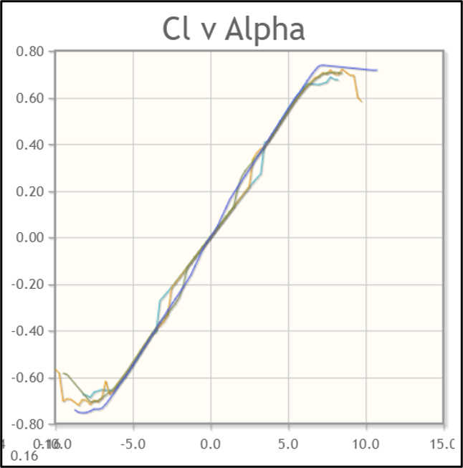
Delta Wings
Purpose:
Delta wings were chosen in place of regular plane wings, due to the former minimizing drag until apogee. Additionally, it provides more structural stability during takeoff, when acceleration and force on the wings is greatest. The delta wings will be the main generators of lift which they will perform by servo-controlled ailerons
Lift= (1/3)1036.84 lbf* = Cl x S x (½) x p x v^2
Cl= Coefficient of Lift= 0.55
-S= Wing surface Area*= 18.254 ft^2
P= density (sea level)= 0.0765 lb/ft^3
V= 30 ft/s
*To be determined/tentative
NACA 0006 Airfoil
Notes:
Shiva. This is the glide we're trying to hit. It goes fast immiedieately after burnout + it will stall but we're hoping the pilot can keep it steady at 30 ft/s
345.613333333 lbf

Slide 12
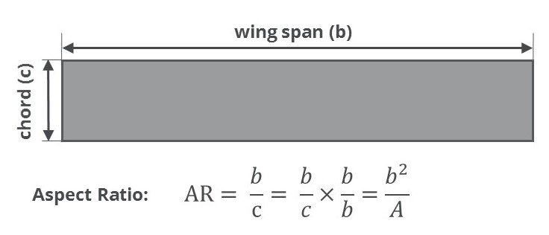
Delta Wings
Wingspan Calculation
Aspect Ratio (A): tan(90-40) ~ 1.19
Wing Area (S)*: 18.254 ft^2
Wingspan*= sqrt(A x S) ~ 4.66 ft
Base of each wing* ~ 2.33 ft
Root Chord* ~ 1.96 ft
*To be determined/tentative
Sweep angle
c= 1.96 ft
b= 2.33
Notes:
Shiva. Key Point: Sweep Angle --> 40 degrees trying to find the sweet spot between maximizing drag

Slide 13
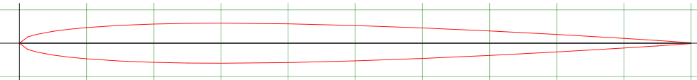
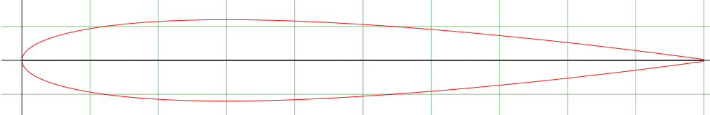
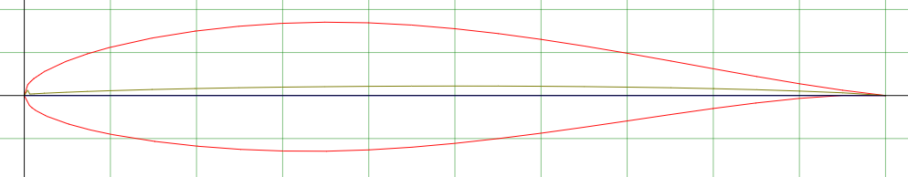
Vertical Stabilizer and Rudder
Purpose of Vertical Stabilizer and Rudder.
Main problem with Sonata I.
CAD is currently using NACA 63-215 AIRFOIL, this design will change.
We will most likely use a NACA 0006 or 0012 design in the future.
NACA 0006:
NACA 0012:
Notes:
David Carter Oropeza
The vertical stabilizer and rudder will be used for helping to land the rocket safely. The rudder and vertical stabilizer will help to keep the rocket centered and decrease yaw. We are not yet sure whether or not we will need to implement a rudder (especially because the biggest problem with the Sonata was how much it rolled during its descent), so this will be tested as we work with DBF to finalize out wing and vertical stabilizer design. For now we have a basic rudder design taken off of the NACA airfoil database (NACA 63-215 AIRFOIL). This design will change, especially with how it is not perfectly symmetrical. We will most likely use a NACA 0006 or 0012 design in the future. The goal of this base design is simply to show that the vertical stabilizer will be thicker than the wings.
David

Slide 14
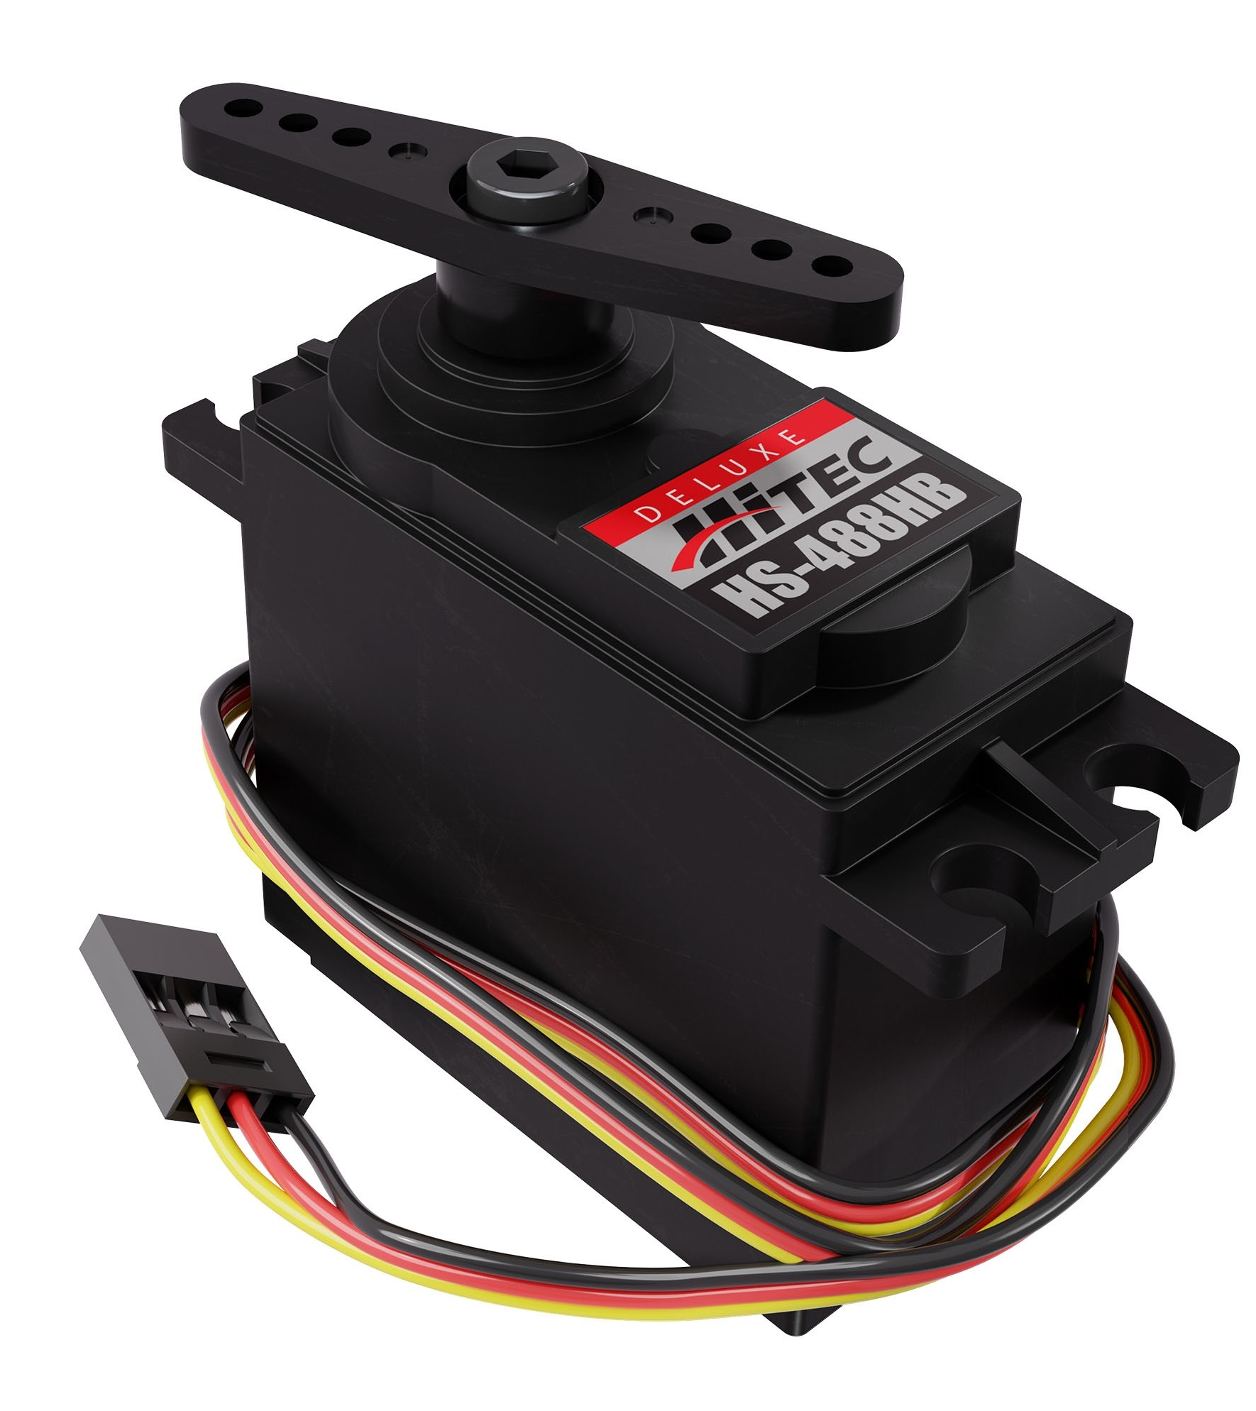
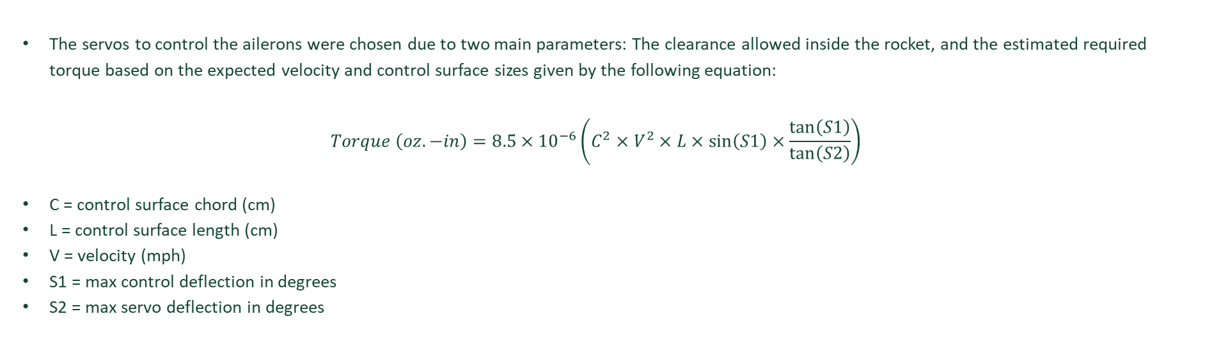
Servos
The servos to control the ailerons were chosen due to two main parameters: The clearance allowed inside the rocket, and the estimated required torque based on the expected velocity and control surface sizes given by the following equation:
$$Torque \left(oz.−in\right)=8.5×{10}^{−6}\left(C^{2}×V^{2}×L×\sin\left(S1\right)×\frac{\tan\left(S1\right)}{\tan\left(S2\right)}\right)$$
C = control surface chord (cm)
L = control surface length (cm)
V = velocity (mph)
S1 = max control deflection in degrees
S2 = max servo deflection in degrees
Notes:
Spencer

Slide 15
Canards & Vertical Stabilizer
Canards:
Since the wing is so far back on the vehicle’s body, canards are used to provide pitch stabilization and elevator control on the way down. For their design they are using the same airfoil and shape as the wing but sized down to 20% of the wings size (as is generally standard). The old StarBooster had each canard sized at about 15% of the wings, so the design is kept in similarity with this. The canards on the old booster were angled upwards slightly, which would create some upward lift on the vehicle. To simplify the aerodynamics, the current design will not feature this. However, the canards will have elevators that will be actuated by an in-line servo directly connected to the elevator.
Vertical Stabilizer:
The vertical stabilizer on the old booster was about 43% the size of one wing. This is pretty big and was likely designed to offset the delta wings mounted on the bottom of the rocket’s body. Since rudder control is not a big concern as compared to weight, the vertical stabilizer is currently sized at 20% of the wing. As the design is meant to be modular then this can be changed out if yaw control/stability is found to be too poor.
Notes:
Spencer

Slide 16
Structures
Jared Lebaron, David Carter Oropeza, Shiva Pulmamidi, Alistair Hynes

Slide 17
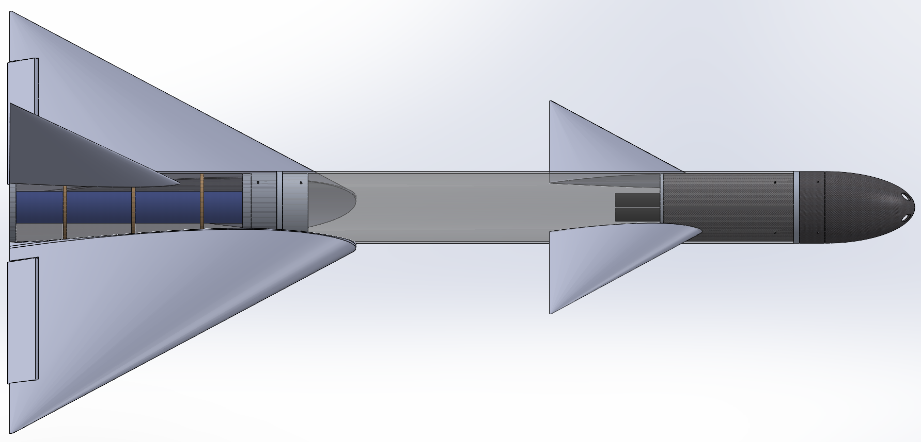
Overview
Bulkhead
Coupler
Coupler
Avionics
Parachute
Assembly
Motor
Notes:
Alistair

Slide 18
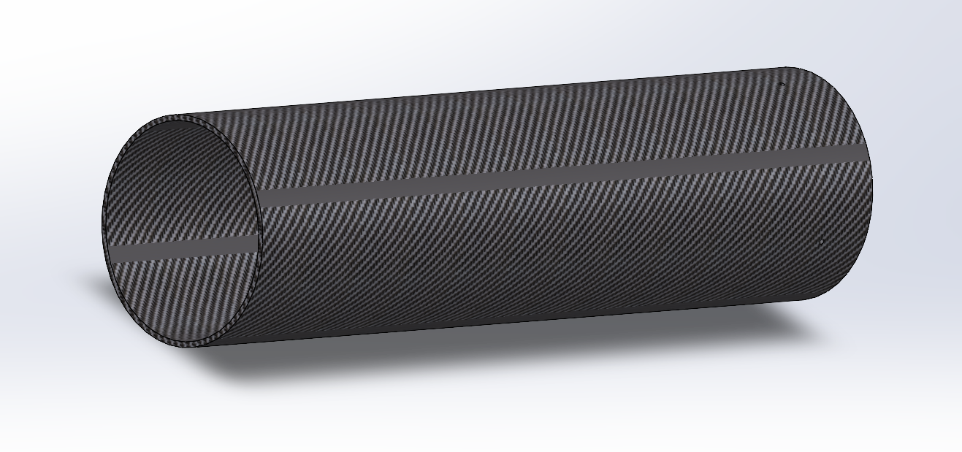
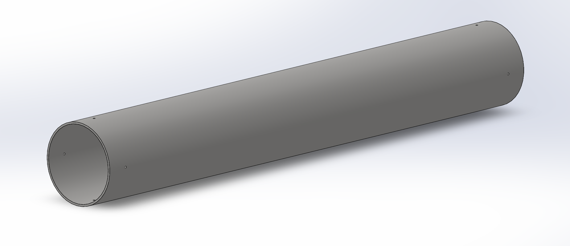
Body Tubes
Lower Body Tube
Upper Body Tube
Material: Carbon Fiber
Length: 18.51”
Outer Diameter: 5”
Inner Diameter: 4.75”
Thickness: .125”
Estimated Weight: 2.56 lbs
Material: Fiberglass
Length: 29.40”
Outer Diameter: 5”
Inner Diameter: 4.75”
Thickness: .125”
Estimated Weight: 5.63 lbs
Notes:
Alistair

Slide 19
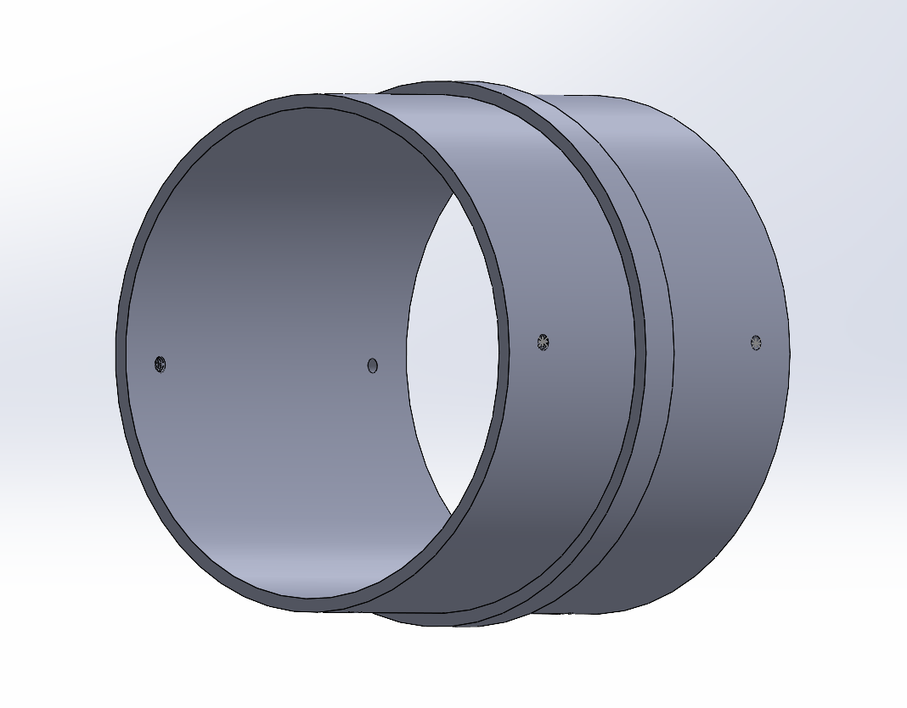
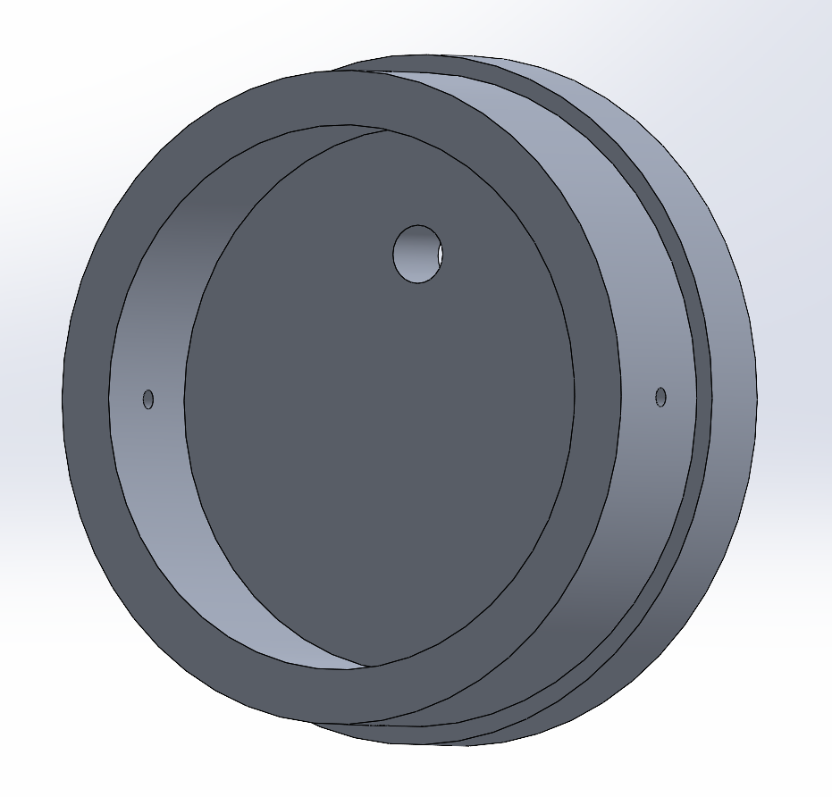
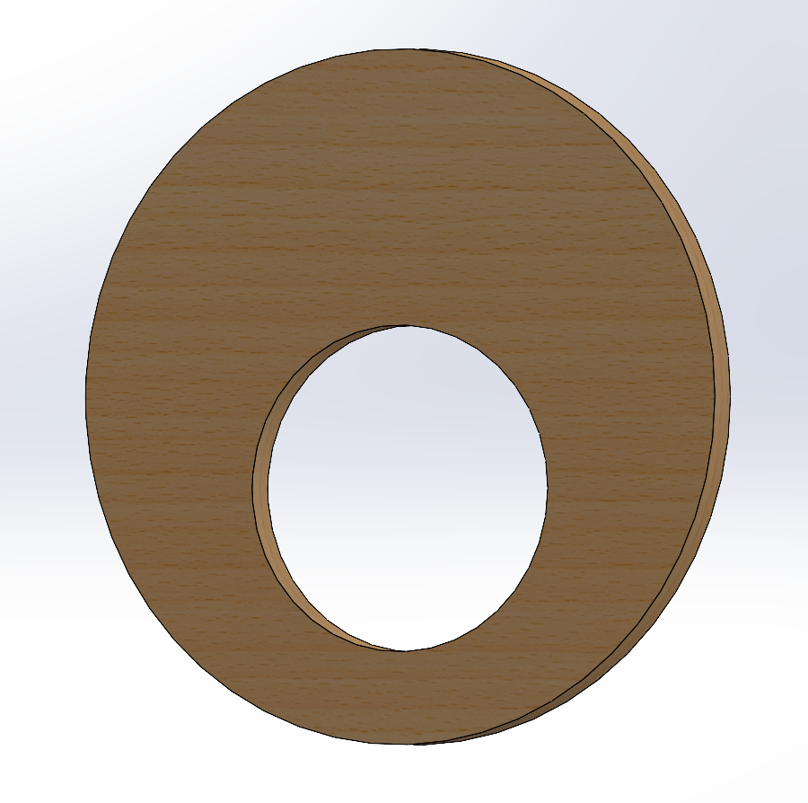
Inner components
Couplers (X2)
Bulkhead
Centering Rings (x2)
Material: Aluminum
Length: 3.94”
Ridge Diameter: 5”
Outer Diameter: 4.75”
Inner Diameter: 4.5”
Thickness: .125”
Weight: .770 lbs
Material: Aluminum
Length: 1.597”
Outer Diameter: 4.75”
Inset Diameter: 4.5”
Inner Diameter: 3.75”
Hole Diameter: .40”
Hole Offset: 1.00”
Weight: 1.50 lbs
Material: Wood
Length: .25”
Outer Diameter: 4.75”
Hole Diameter: 2.23”
Hole Offset: -.625”
Weight: .02 lbs
Notes:
Alistair

Slide 20
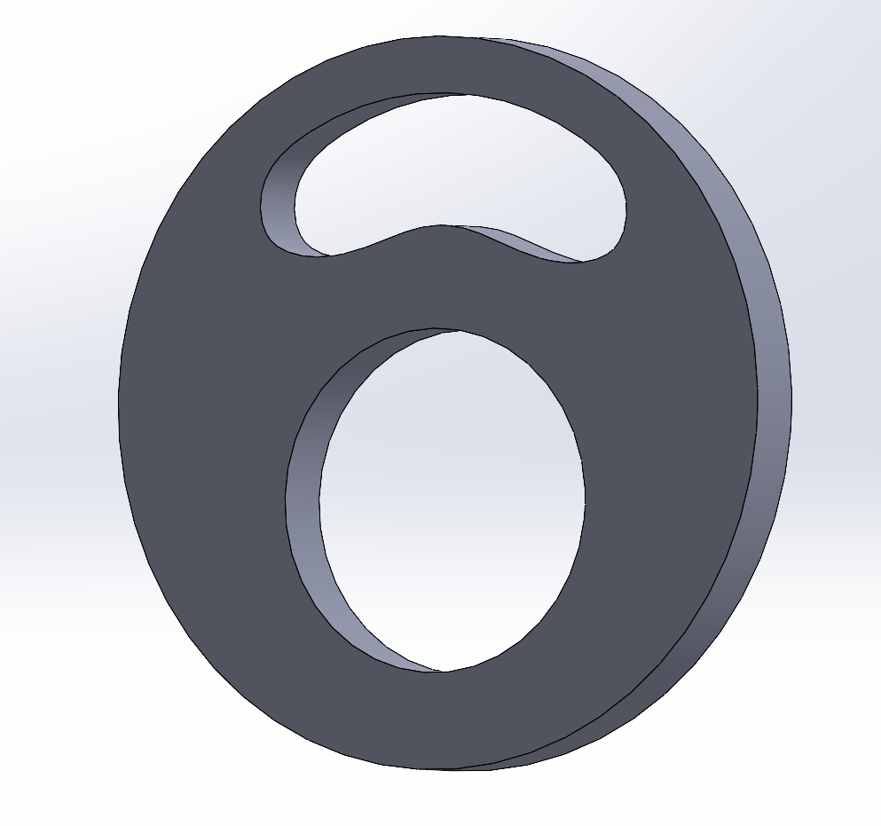
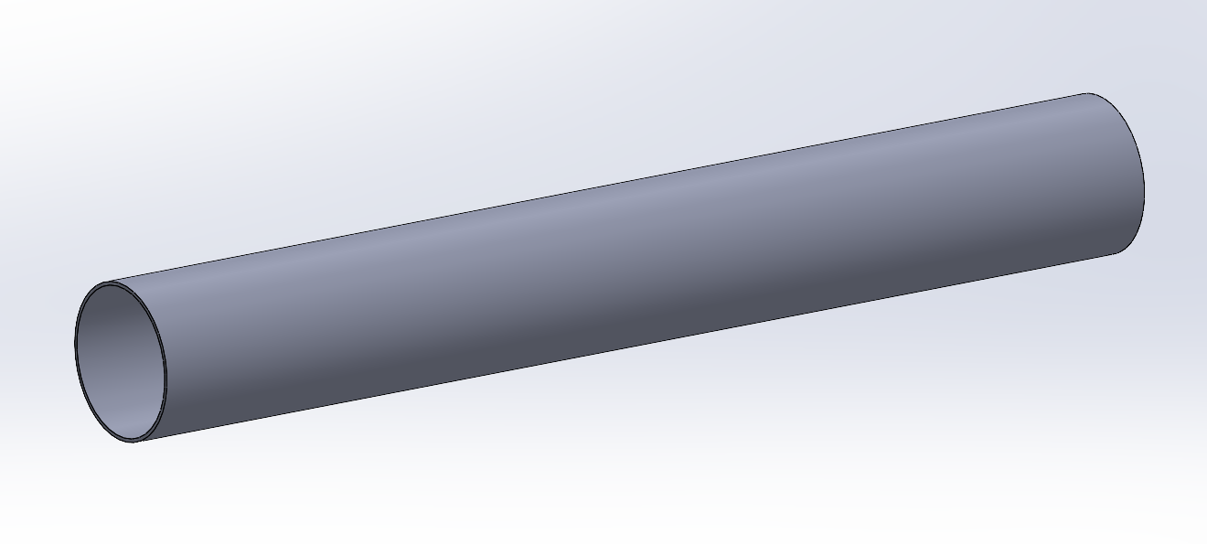
Motor-Related components
Motor Retention Plate
Motor Tube
Material: Aluminum
Length: .45”
Outer Diameter: 4.75”
Hole Diameter: 2.23”
Hole Offset: -.625”
Weight: .51 lbs
Material: TBD
Length: 16.142”
Outer Diameter: 2.23”
Inner Diameter: 2.126”
Thickness: 0.052”
Weight: .56 lbs
Notes:
Alistair

Slide 21
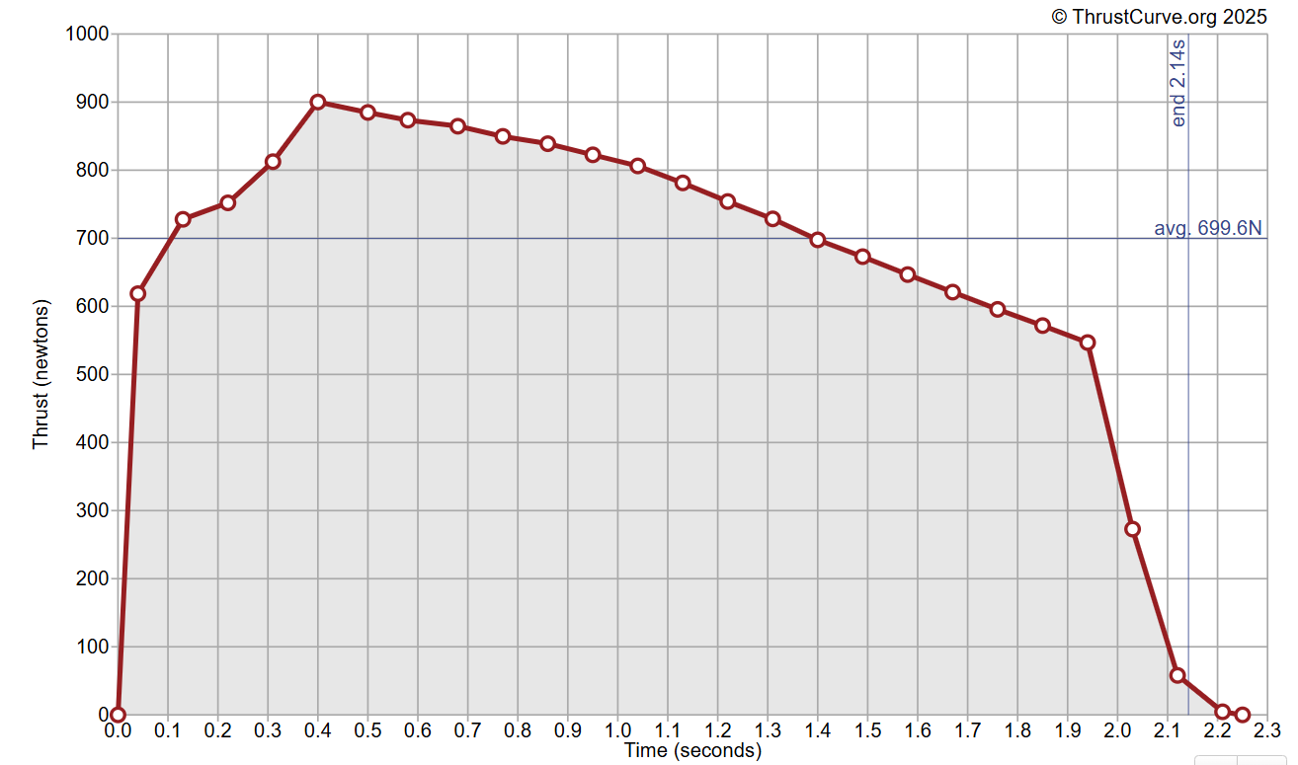
Motor
Aerotech K695 Motor (Model 81445)
Diameter: 2.126”
Length: 16.142”
Total Weight: 3.278 lbs
Propellant Weight: 1.991 lbs
Average Thrust: 695 N
Initial Thrust: 759.7 N
Total Impulse: 1514 Ns
Burn Time: 2.2 s
Delay: 14 s
Chosen for relatively consistent thrust curve, reducing maximum acceleration and impulse on the wings
Aerotech K695 allows us to reach our target apogee and is available for purchase
Notes:
Alistair

Slide 22
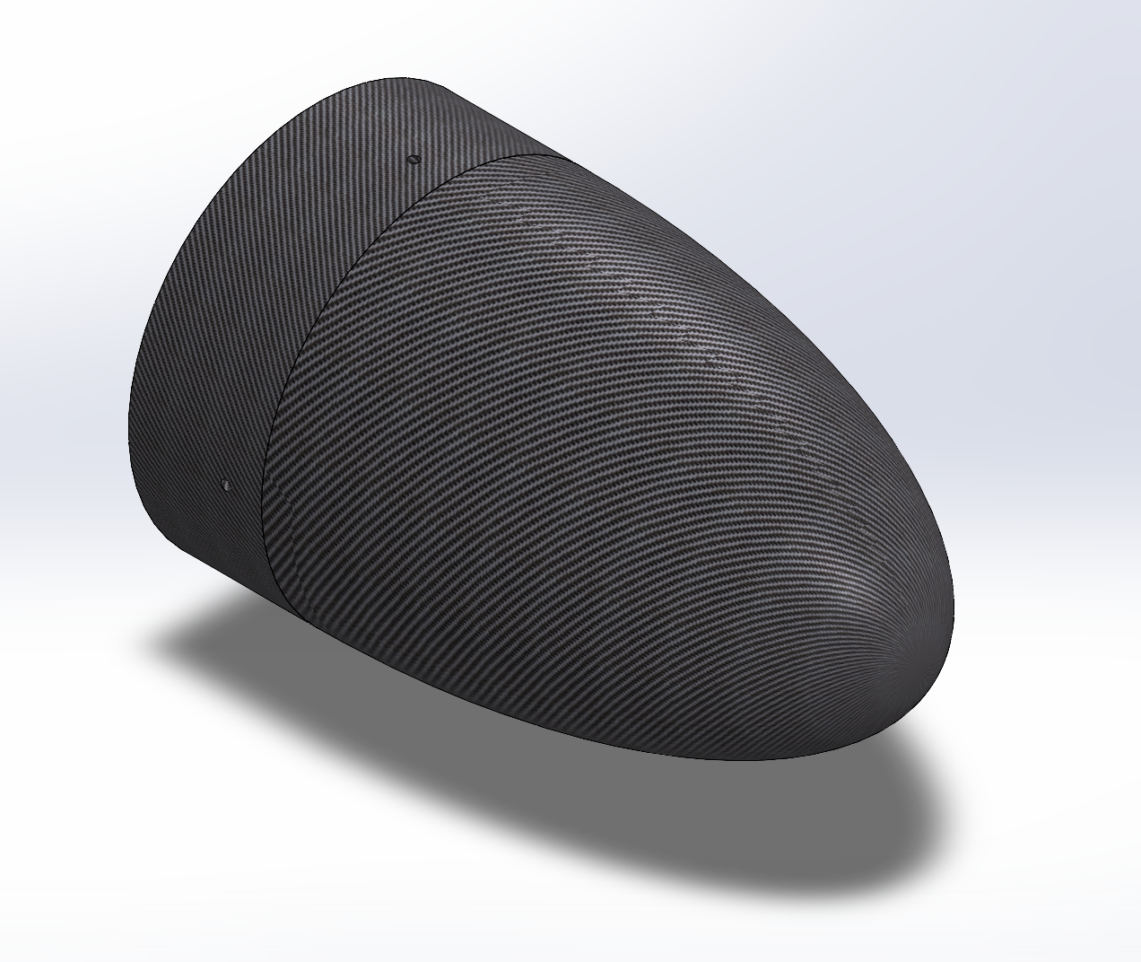
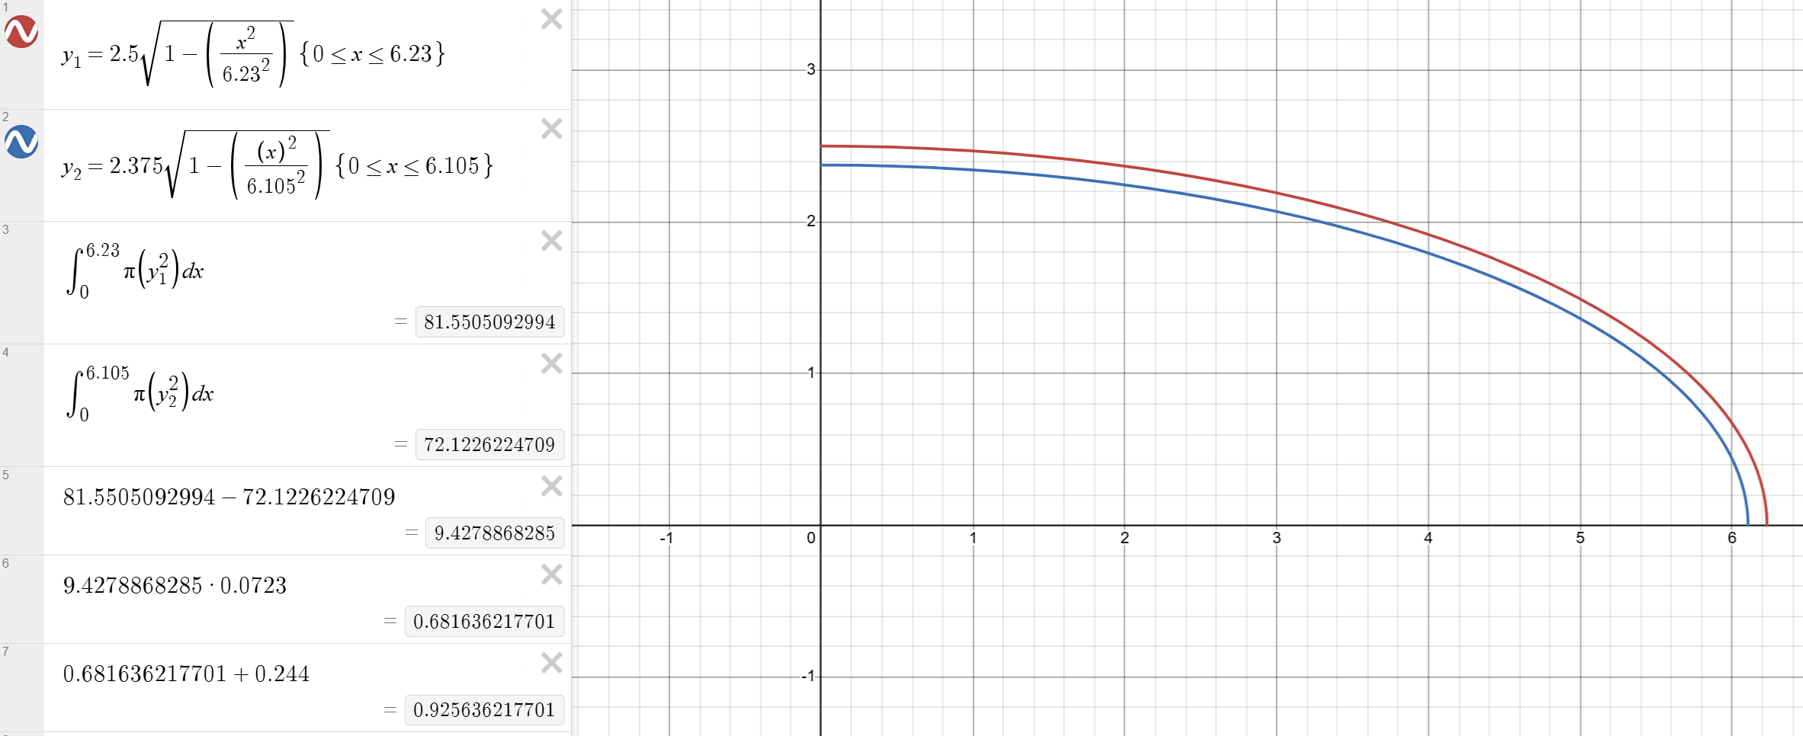
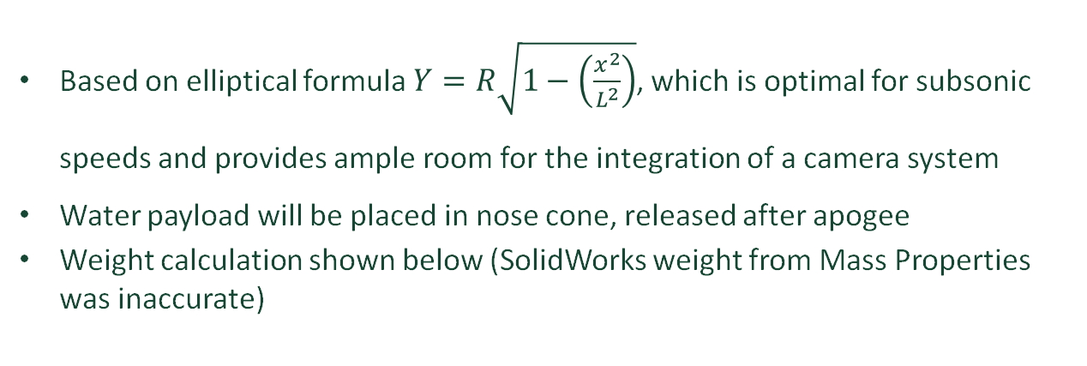
Nose cone
Based on elliptical formula $Y=R\sqrt{1−\left(\frac{x^{2}}{L^{2}}\right)}$, which is optimal for subsonic speeds and provides ample room for the integration of a camera system
Water payload will be placed in nose cone, released after apogee
Weight calculation shown below (SolidWorks weight from Mass Properties was inaccurate)
Material: Carbon Fiber
Length: 8”
Outer Diameter: 5”
Inner Diameter: 4.75”
Weight: 0.926 lbs
Notes:
Shiva

Slide 23
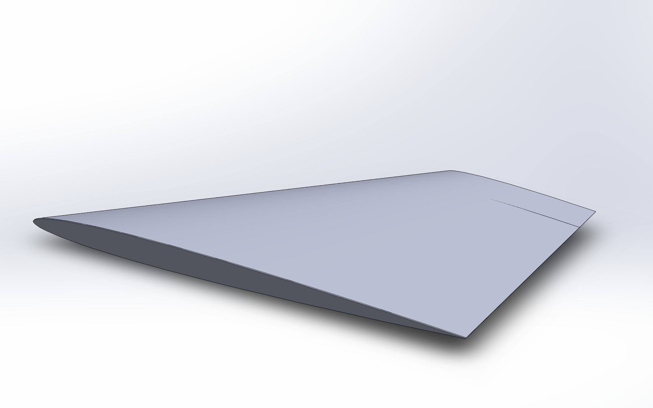
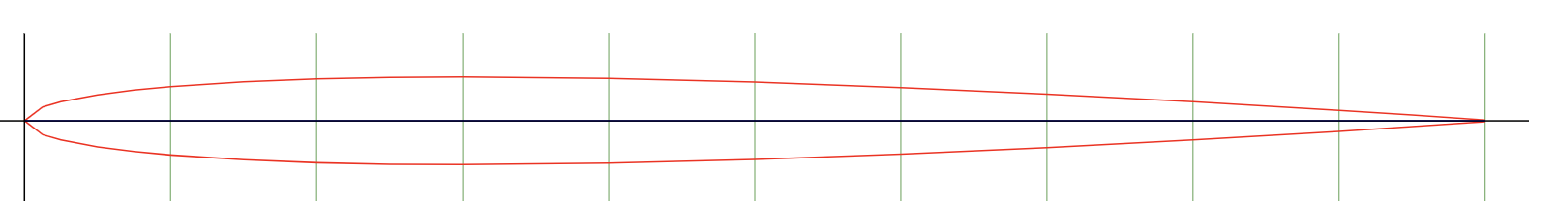
Wings (delta)
NACA 0006 Airfoil- Chosen for its low thickness to minimize drag
Material: TBD
Root Chord ~1.96 ft*
Tip Chord: TBD
Wing Area ~9.127 ft^2
Wing Aspect: 1.19
Wing Loading: 1.46 lb^2/ft^2
Base of wing ~ 2.33*
*Subject to change/Have already changed
*Not made to dimensions on the left
Notes:
Shiva

Slide 24
Wings (canards)
NACA 0006 Airfoil
Material: TBD
Root Chord ~6.89 in*
Tip Chord ~2.36 in*
Wing Area ~1.94 in^2*
Wing Aspect: 2.6*
Wing Loading: 1.26*
Wingspan ~4.722 in*
*Subject to change
Notes:
Shiva

Slide 25
Wing "Mount"
The current wing mounting design follows the approach used in Sonata 1. While this provides a starting point, we recognize potential shortcomings due to increased aerodynamic and landing loads for the glider configuration. As development progresses, we will evaluate more robust alternatives. Potential alternatives we have investigated are listed below.
Through-the-Wall (TTW) Attachment: Integrating structural tabs from the wing root through pre-cut slots in the fuselage, bonding to internal structural supports.
Internal Spar Pass-Through: Extending the wing’s internal spar into the rocket body to directly transfer aerodynamic and landing forces into the airframe.
Reinforced Hardpoint Mounting: Embedding load-bearing plates (e.g., carbon fiber, G10, or aluminum) into the wing root and fuselage to distribute attachment forces more evenly.
One Piece wing with rocket body slot: A single delta wing will be manufactured with a central slot for the rocket fuselage. The wing will have a foam core, fiberglass skin, internal spars, and reinforced slot edges. It will be bonded and/or bolted to the fuselage for strength and load distribution.
Notes:
Jared

Slide 26
Servo Placement
Servo placement is being finalized with a focus on simplicity and proper weight distribution. For the canards, we plan to place the servos inside the rocket body, adjacent to the canard pivot point, allowing for a protected and direct actuation system with minimal linkage complexity. The canard will function as a full-span, actuated control surface.
For the main wings, servos will be mounted flush within the wing structure to reduce control rod distance and simplify mechanics. During manufacturing, a slot will be cut into the wing along the hinge line between the wing and the control surface for servo installation, with the control surface temporarily removed. This approach provides a standard, reliable configuration with good aerodynamic performance.
We will continue evaluating these placements to ensure they meet performance, reliability, and manufacturability requirements.
Notes:
Jared

Slide 27
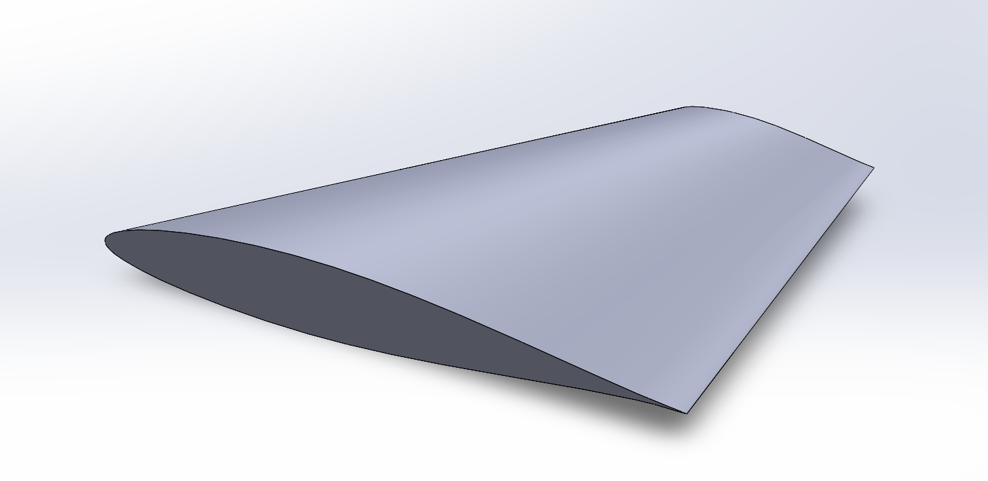
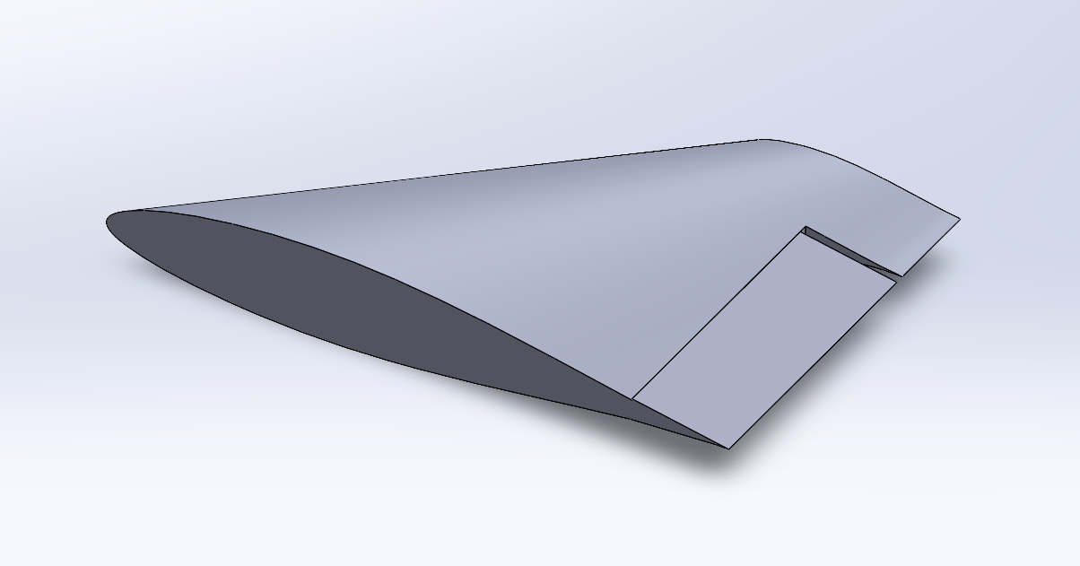
Vertical Stabilizer and Rudder
Vertical Stabilizer:
Material: TBD
Airfoil Design: NACA 63-215 AIRFOIL*
Thickness: 1.5"* (Root Chord)
Tip Chord: 4”*
Root Chord: 12”*
Height: 8"*
Vertical Stabilizer with Rudder:
*Subject to Change
Notes:
David Carter Oropeza

Slide 28
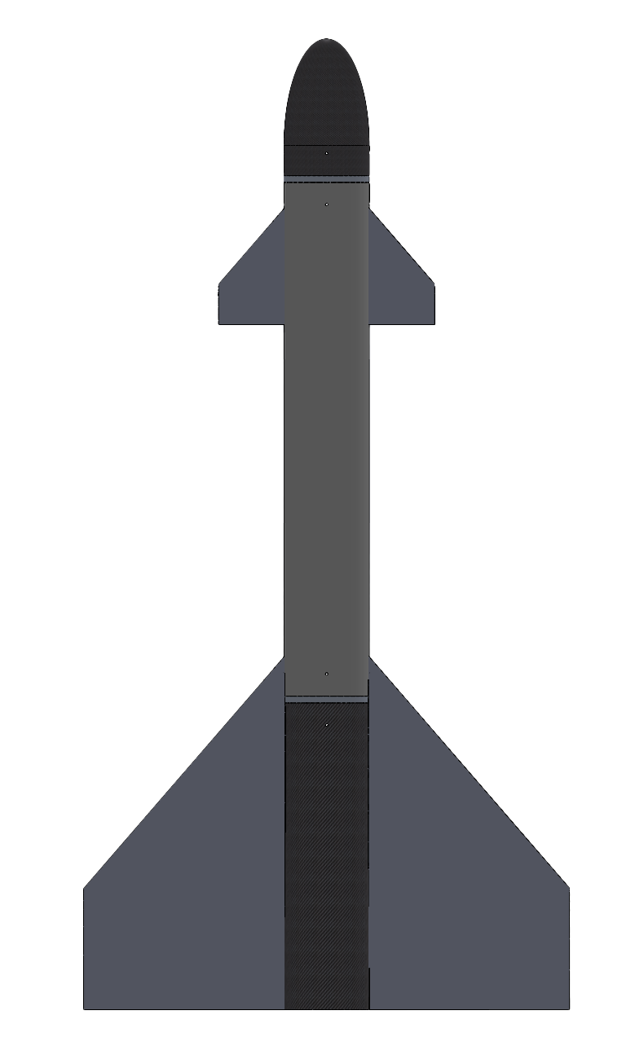
Skid Plate
To prevent damage to the body when landing adding a skid plate to the belly of the rocket is necessary.
The skid plate would have to be easily removable in respect to the surface the rocket is landing on.
The skid plate would be replaced after every launch if need be.
Bottom view of rocket tube
Notes:
Shiva

Slide 29
Materials Overview
Carbon Fiber
  Very strong and stiff, but also lightweight. Helps with trying to make weight with the payload.
Fiberglass
  Allows radio waves to pass through for communication
6061 Aluminum
  Affordable and easy-to-machine stock
Notes:
David Carter Oropeza

Slide 30
Recovery
David Carter Oropeza

Slide 31

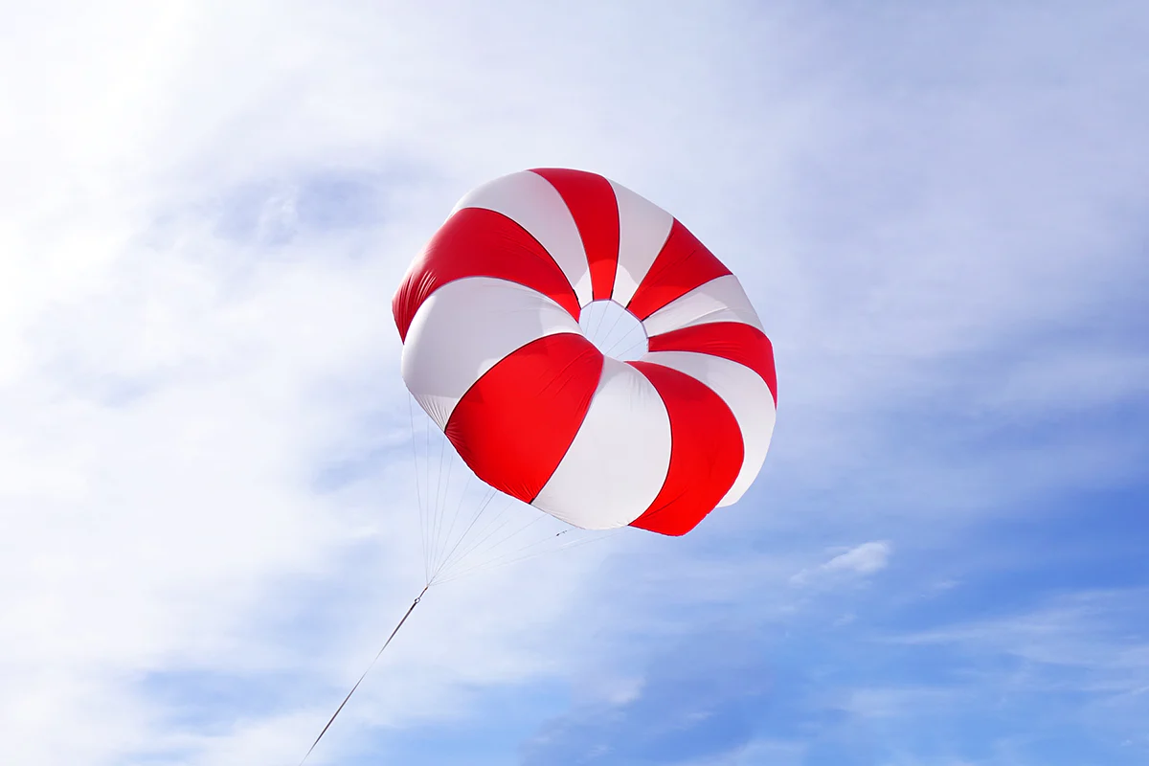
Parachute
Parachute
The parachute is a safety precaution in case anything goes wrong.
It will be stored in the back of the rocket next to the motor.
Basic 60" toroidal parachute weighing 6.8oz, packed 3.9in (D) by 3.2in (L), able to slow 19lb rocket to 20fps. Not the finalized choice for parachute, especially considering it costs $266 and the diameter of its container is too large.
Diameter of Motor (2.23in)
5in
Notes:
David Carter Oropeza
The parachute is a safety precaution in case anything goes wrong (hopefully we will not have to use it).
It will be stored in the back of the rocket next to the motor. This shouldn't add too much weight or offset the center of gravity by a significant amount.
Basic 60" toroidal parachute weighing 6.8oz, packed 3.9in (D) by 3.2in (L), able to slow 19lb rocket to 20fps. Not the finalized choice for parachute, especially considering it costs $266 and its diameter is too large.

Slide 32
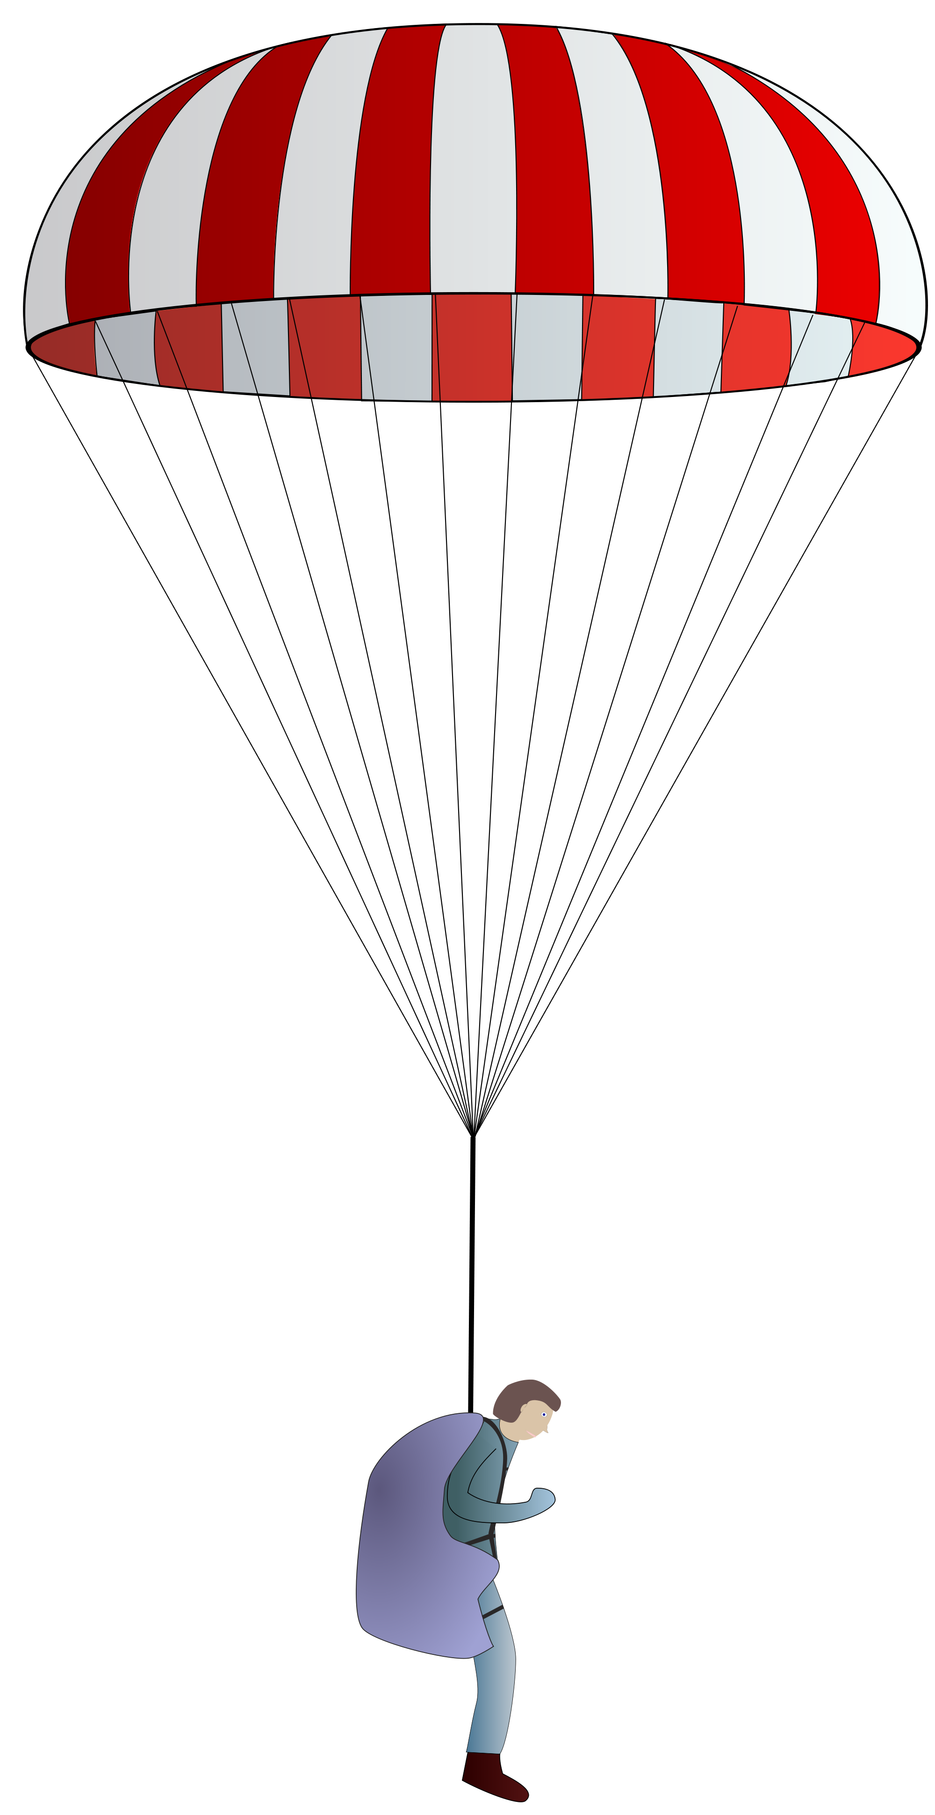
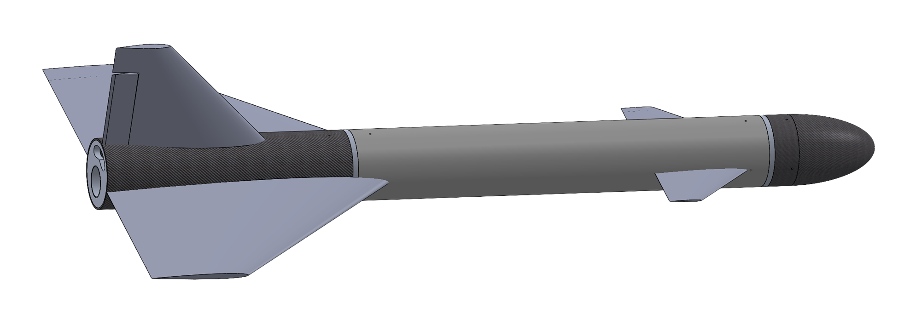
When To Use Parachute
Air against the parachute, not good
Parachute deployed out the back during free fall.
Parachute deployed out the back while gliding.
Activation and reusability of the parachute.
Instances to use parachute:
  Wing servos stop working and we lose control of the rocket.
  Connection to rocket is lost for extended period of time.
  We are not able to get the rocket to glide at a reasonably safe speed for landing.
Air going into the parachute, good
Notes:
David Carter Oropeza
In the event that the parachute needs to be deployed while the nose cone is facing the ground in free fall, the parachute will be better out the back because it will immediately catch the wind and create drag. In the event that the parachute needs to be deployed while the rocket is gliding, the parachute will also be better out the back. This is because if it is released in the front it would catch the wind and be sent back toward the rocket and could get caught on parts of the rocket which could ruin the descent. The parachute will be activated by small explosion to bring it out quickly and effectively. We hope to make the parachute reusable, meaning the only thing that should have to be replaced is the parts needed for the explosion.

Slide 33
Avionics
Spencer Biernat

Slide 34
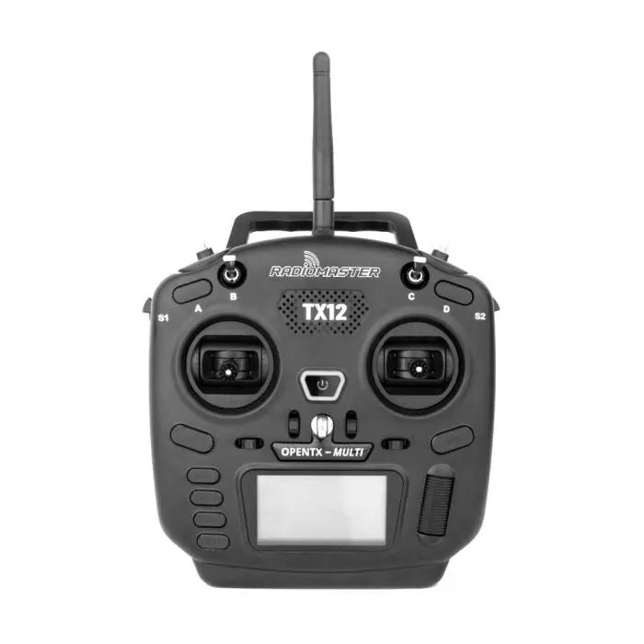
Telemetry and Ground Station: Radio Transmitter
RadioMaster TX12 Multi-Protocol OpenTX 2.4GHz RC Transmitter
Selected because it comes with OpenTX software preinstalled
Also selected for cost.
Notes:
Spencer

Slide 35
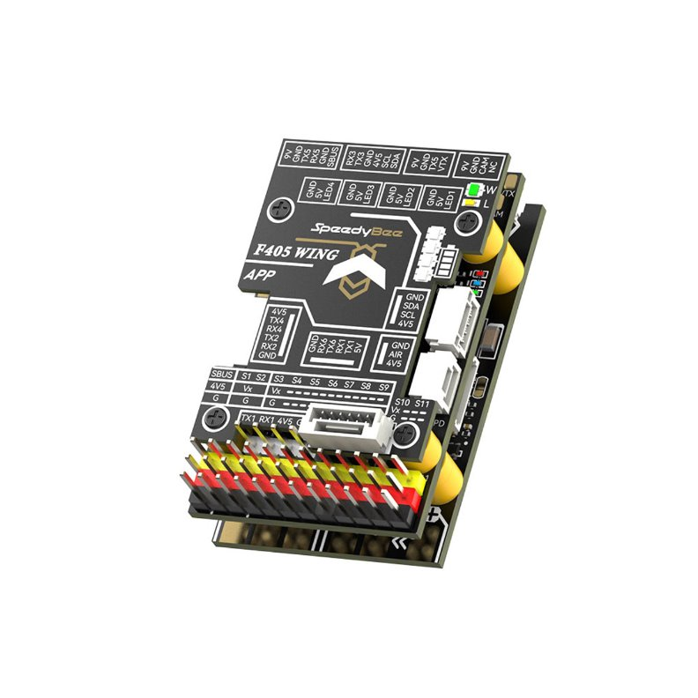
Avionics and Radio Control: Flight Controller
SpeedyBee F405 WING APP Fixed Wing Flight Controller
Picked for size, price, and features
Comes with power distribution board in stack
dedicated pinouts for all Sonata I components
  Airspeed sensor
  GPS
  Camera and Video TX
  EdgeTX/OpenTX ready port for telemetry
Firmware profiles for fixed-wing flight with F405 WING already exist in ArduPilot.
Plenty of servo control pinouts
Blackbox logging micro SD card slot.
Notes:
Spencer

Slide 36
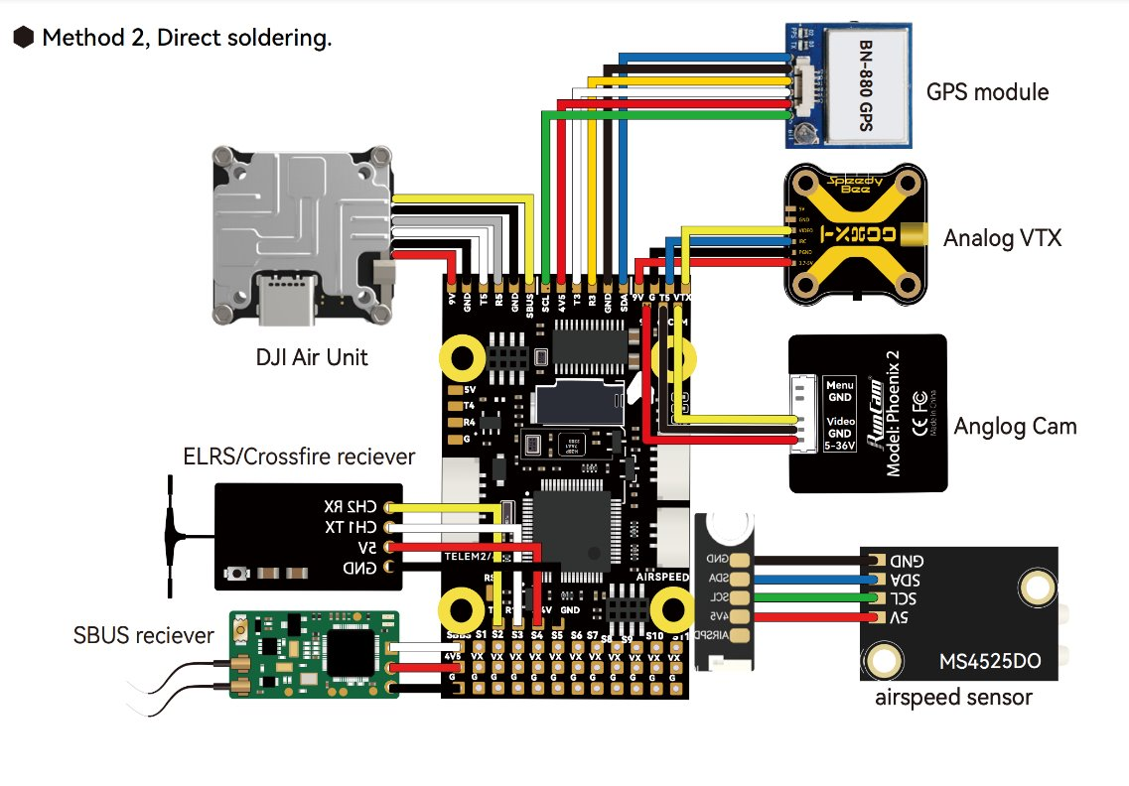
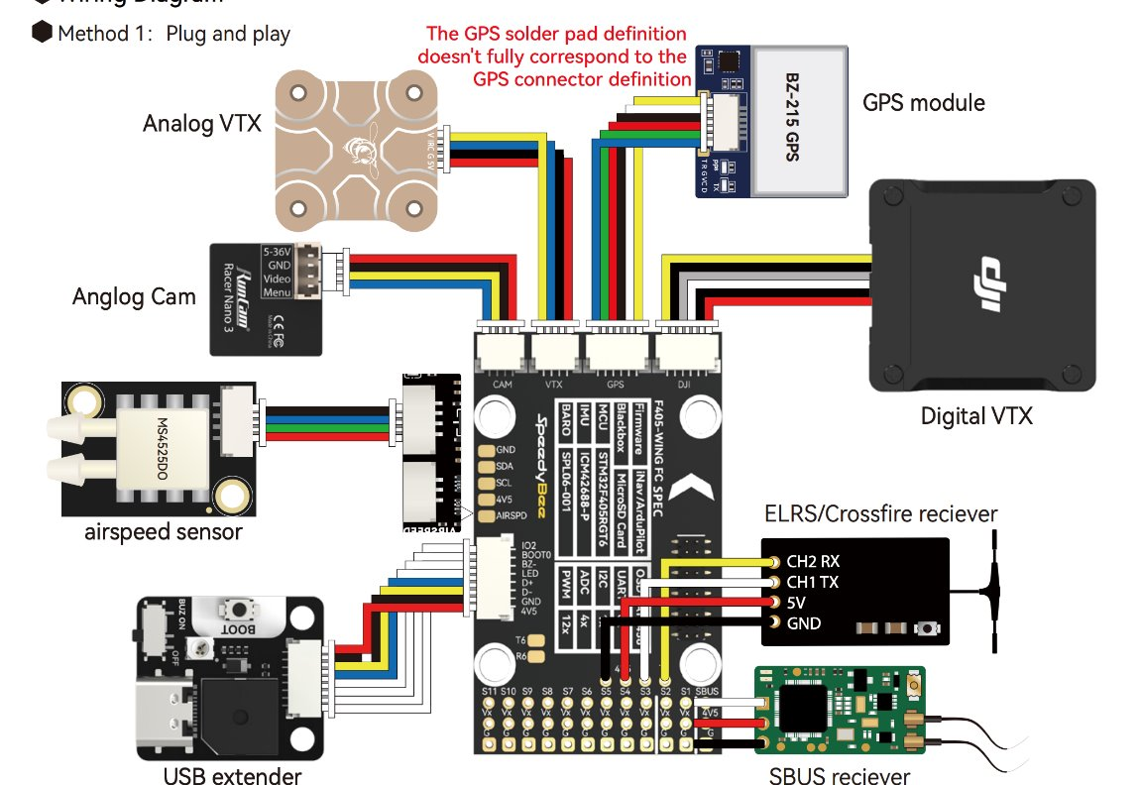
Avionics and Radio Control: Wiring Diagrams
Notes:
Spencer

Slide 37


Avionics and Radio Control: Flight Software
ArduPilot selected for versatility and availability for integration with future CPSS projects.​
  Integration with ground control displays developed using OpenMCT.​
  Mission Planner for future projects involving autonomous return.​
Notes:
Spencer

Slide 38
Testing
Spencer Biernat

Slide 39
Wind tunnel test matrix
wind
Test | Description | Data Recordings | Rationale
WT01 | 50% to 100% speed with NACA s7055 delta wings mounted and canards | -Overall drag -airflow over the main wings & canards. -Lift created with 50% -100% elevator deflection. | -Will test how the canards may interfere with the main wing’s airflow. -Can fit a curve to the overall drag of the model. -Can fit a lift curve to the wing created with elevator deflection
WT02 | Repeat WT01 but with the thicker canard models | -Overall drag -airflow over the main wings & canards. -Lift created with 50% -100% elevator deflection. | Will test how the thicker canards may interfere with the main wing’s airflow.
WT03 | Repeat WT01 but with a different (thicker) canard model | -Check for overall drag -Airflow over the delta wings and canards -Lift created with 50%-100% elevator deflection | The canards and the delta wings are the main control surfaces and testing is required to see how they will perform in various conditions.
Notes:
Spencer

Slide 40
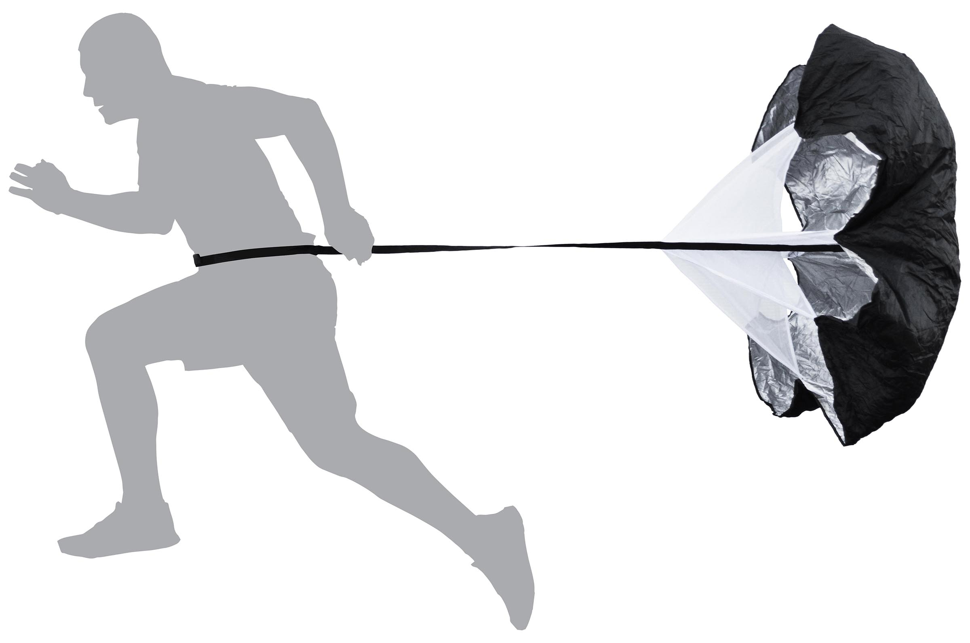
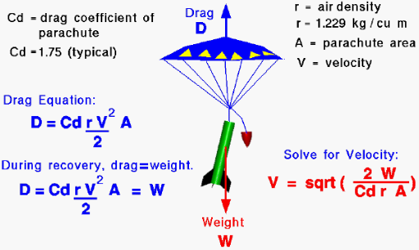
Parachute testing
Testing both types of parachute deployment.
Finding the strength of parachute (drag coefficient).
We will test the strength at different wind speeds.
Notes:
David Carter Oropeza
We will have to keep in mind the strength of the parachute for both the scenario in which it is in free fall and when it is gliding, but we only really need to test it in free fall because of how the rocket will turn up if it is deployed while gliding.
We will test the strength of the parachute by running with it and seeing how much weight it can hold back, similar to resistance training. Through these tests we hope to find the coefficient of drag which will help us determine whether or not the parachute is safe for use.

Slide 41
Scaling up from sonata
Implementing Sonata Testing
Since Ragtime is essentially a scaled-up version of Sonata, we can take data and lessons learned from Sonata's testing and implement them into Ragtime, much like the scale models tested during the design of the original StarBooster.
Since Sonata still hasn't been launched, we don't know what needs to be improved on yet. However, we can use the original StarBooster's testing to give us an idea. Possible alterations may include:
  Control surface dimensions
  Center of gravity location
  Connections between components
  Avionics and telemetry
  Parachute location
  Operation in flight
Notes:
Max

Slide 42
Next-Steps
Sonata 1 testing (Next Week?!?)
Aerodynamic testing using CFD and Matlab to determine more accurate data than Open Rocket simulations.
Modify wings depending on sonata 1 test and wind tunnel analysis
Prepare for CDR
Notes:
Spencer

Slide 43

Notes:
Good work guys

Slide 44
Thank you
Cal Poly Space Systems

