Slide 1
CS3220 Processor Design
Prof. Hyesoon Kim

Slide 2
Fixed Point FP

Slide 3
Fixed Point Operation
Use integer operators to calculate floating point operations
Fixed point integer
12.23 1223
+20.41 + 2041
-------------- --------------
32.64 3264
12.23 1223
x 20.41 x 2041
-------------- --------------
249.61 2496143
a 1.15.16 fixed point number: one bit sign, 15-bit integer, 16-bit fraction. 1+15+16 = 32
Fixed fraction

Slide 4
Fixed Point Operation Types in real hardware
E.g) Nintendo DS device
v16 = 1.3.12 fixed point number (used for 3D)
t16 = 1.11.4 fixed point number
f32 = 1.19.12 fixed point number (used for matrices)
v10 = 1.0.9 fixed point number (whoops! 10 bits don't fit into a normal integer? but 3 v10 numbers fit into a 32 bit integer, so this format is used for normals in 3D (it's also ok for normals to be between -1 and 1, so this is why these fixed point numbers have a long fraction but no integer part!)
0.8.8 fixed point number: this format is used for the scaling of the extended rotation backgrounds and doesn't have a typedef in the NDSlib.

Slide 5
Floating point
From: http://www.pitt.edu/~juy9/142/slides/L5-Multiplication.ppt

Slide 6
IEEE Floating Point
IEEE Standard 754
Established in 1985 as uniform standard for floating point arithmetic
Before that, many idiosyncratic formats
Supported by all major CPUs
Driven by Numerical Concerns
Nice standards for rounding, overflow, underflow
Hard to make go fast
Numerical analysts predominated over hardware types in defining standard
From: www.cs.cmu.edu/afs/cs/academic/class/15213-s01/lectures/class10.ppt

Slide 7
Fractional Binary Numbers
2^{i}
2^{i–1}
4
• • •
2
1
b_{i}
b_{i–1}
• • •
b₂
b₁
b₀
.
b_{–1}
b_{–2}
b_{–3}
• • •
b_{–j}
1/2
1/4
• • •
1/8
2^{–j}
Representation
Bits to right of “binary point” represent fractional powers of 2
Represents rational number:
From: www.cs.cmu.edu/afs/cs/academic/class/15213-s01/lectures/class10.ppt

Slide 8
Fractional Binary Number Examples
Value Representation
5-3/4 101.11₂
2-7/8 10.111₂
63/64 0.111111₂
Observation
Divide by 2 by shifting right
Numbers of form 0.111111…₂ just below 1.0
Use notation 1.0 – ε
Limitation
Can only exactly represent numbers of the form x/2^{k}
Other numbers have repeating bit representations
Value Representation
1/3 0.0101010101[01]…₂
1/5 0.001100110011[0011]…₂
1/10 0.0001100110011[0011]…₂
From: www.cs.cmu.edu/afs/cs/academic/class/15213-s01/lectures/class10.ppt

Slide 9
Floating Point Representation
Numerical Form
–1^{s} M 2E
Sign bit s determines whether number is negative or positive
Significand M normally a fractional value in range [1.0,2.0).
Exponent E weights value by power of two
Encoding
MSB is sign bit
exp field encodes E
frac field encodes M
Sizes
Single precision: 8 exp bits, 23 frac bits
32 bits total
Double precision: 11 exp bits, 52 frac bits
64 bits total
s
exp
frac
Mantissa = Fraction
From: www.cs.cmu.edu/afs/cs/academic/class/15213-s01/lectures/class10.ppt

Slide 10
“Normalized” Numeric Values
Condition
exp ≠ 000…0 and exp ≠ 111…1
Exponent coded as biased value
E = Exp – Bias
Exp : unsigned value denoted by exp
Bias : Bias value
Single precision: 127 (Exp: 1…254, E: -126…127)
Double precision: 1023 (Exp: 1…2046, E: -1022…1023)
in general: Bias = 2^{m-1} - 1, where m is the number of exponent bits
Significand coded with implied leading 1
m = 1.xxx…x₂
xxx…x: bits of frac
Minimum when 000…0 (M = 1.0)
Maximum when 111…1 (M = 2.0 – ε)
Get extra leading bit for “free”
From: www.cs.cmu.edu/afs/cs/academic/class/15213-s01/lectures/class10.ppt

Slide 11
Normalized Encoding Example
Value
Float F = 15213.0;
15213₁₀ = 11101101101101₂ = 1.1101101101101₂ X 2¹³
Significand
M = 1.1101101101101₂
frac = 11011011011010000000000₂
Exponent
E = 13
Bias = 127
Exp = 140 = 10001100₂
Floating Point Representation:
Hex: 4 6 6 D B 4 0 0 Binary: 0100 0110 0110 1101 1011 0100 0000 0000
140: 100 0110 0
15213: 1110 1101 1011 01
From: www.cs.cmu.edu/afs/cs/academic/class/15213-s01/lectures/class10.ppt

Slide 12
Denormalized Values
Condition
exp = 000…0
Value
Exponent value E = –Bias + 1
Significand value m = 0.xxx…x₂
xxx…x: bits of frac
Cases
exp = 000…0, frac = 000…0
Represents value 0
Note that have distinct values +0 and –0
exp = 000…0, frac ≠ 000…0
Numbers very close to 0.0
Lose precision as get smaller
“Gradual underflow”
From: www.cs.cmu.edu/afs/cs/academic/class/15213-s01/lectures/class10.ppt

Slide 13
Special Values
Condition
exp = 111…1
Cases
exp = 111…1, frac = 000…0
Represents value ∞ (infinity)
Operation that overflows
Both positive and negative
E.g., 1.0/0.0 = −1.0/−0.0 = +∞, 1.0/−0.0 = −∞
exp = 111…1, frac ≠ 000…0
Not-a-Number (NaN)
Represents case when no numeric value can be determined
E.g., sqrt(–1), ∞ − ∞
From: www.cs.cmu.edu/afs/cs/academic/class/15213-s01/lectures/class10.ppt

Slide 14
Summary of Floating Point Real Number Encodings
−∞
+∞
-Normalized
-Denorm
+Denorm
+Normalized
NaN
−0
+0
NaN
From: www.cs.cmu.edu/afs/cs/academic/class/15213-s01/lectures/class10.ppt

Slide 15
Tiny floating point example
8-bit Floating Point Representation
the sign bit is in the most significant bit.
the next four bits are the exponent, with a bias of 7.
the last three bits are the frac
Same General Form as IEEE Format
normalized, denormalized
representation of 0, NaN, infinity
7
6
3
2
0
s
exp
frac
From: www.cs.cmu.edu/afs/cs/academic/class/15213-s01/lectures/class10.ppt

Slide 16
Values related to the exponent
Exp exp E 2E
0 0000 -6 1/64 (denorms)
1 0001 -6 1/64
2 0010 -5 1/32
3 0011 -4 1/16
4 0100 -3 1/8
5 0101 -2 1/4
6 0110 -1 1/2
7 0111 0 1
8 1000 +1 2
9 1001 +2 4
10 1010 +3 8
11 1011 +4 16
12 1100 +5 32
13 1101 +6 64
14 1110 +7 128
15 1111 n/a (inf, NaN)
From: www.cs.cmu.edu/afs/cs/academic/class/15213-s01/lectures/class10.ppt

Slide 17
Dynamic Range
s exp frac E Value
0 0000 000 -6 0
0 0000 001 -6 1/8*1/64 = 1/512
0 0000 010 -6 2/8*1/64 = 2/512
…
0 0000 110 -6 6/8*1/64 = 6/512
0 0000 111 -6 7/8*1/64 = 7/512
0 0001 000 -6 8/8*1/64 = 8/512
0 0001 001 -6 9/8*1/64 = 9/512
…
0 0110 110 -1 14/8*1/2 = 14/16
0 0110 111 -1 15/8*1/2 = 15/16
0 0111 000 0 8/8*1 = 1
0 0111 001 0 9/8*1 = 9/8
0 0111 010 0 10/8*1 = 10/8
…
0 1110 110 7 14/8*128 = 224
0 1110 111 7 15/8*128 = 240
0 1111 000 n/a inf
closest to zero
Denormalized
numbers
largest denorm
smallest norm
closest to 1 below
Normalized
numbers
closest to 1 above
largest norm
From: www.cs.cmu.edu/afs/cs/academic/class/15213-s01/lectures/class10.ppt

Slide 18
Interesting Numbers
Description exp frac Numeric Value
Zero 00…00 00…00 0.0
Smallest Pos. Denorm. 00…00 00…01 2– ^{{23,52}} X 2– ^{{126,1022}}
Single ≈ 1.4 X 10^{–45}
Double ≈ 4.9 X 10^{–324}
Largest Denormalized 00…00 11…11 (1.0 – ε) X 2– ^{{126,1022}}
Single ≈ 1.18 X 10^{–38}
Double ≈ 2.2 X 10^{–308}
Smallest Pos. Normalized 00…01 00…00 1.0 X 2– ^{{126,1022}}
Just larger than largest denormalized
One 01…11 00…00 1.0
Largest Normalized 11…10 11…11 (2.0 – ε) X 2^{{127,1023}}
Single ≈ 3.4 X 10³⁸
Double ≈ 1.8 X 10³⁰⁸
From: www.cs.cmu.edu/afs/cs/academic/class/15213-s01/lectures/class10.ppt

Slide 19
Special Properties of Encoding
FP Zero Same as Integer Zero
All bits = 0
Can (Almost) Use Unsigned Integer Comparison
Must first compare sign bits
Must consider -0 = 0
NaNs problematic
Will be greater than any other values
What should comparison yield?
Otherwise OK
Denorm vs. normalized
Normalized vs. infinity
From: www.cs.cmu.edu/afs/cs/academic/class/15213-s01/lectures/class10.ppt

Slide 20
FP Multiplication
Operands
(–1)^{s1} M1 2^{E1}
(–1)^{s2} M2 2^{E2}
Exact Result
(–1)^{s} M 2E
Sign s: s1 ^ s2
Significand M: M1 * M2
Exponent E: E1 + E2
Fixing
If M ≥ 2, shift M right, increment E
If E out of range, overflow
Round M to fit frac precision
Implementation
Biggest chore is multiplying significands
From: www.cs.cmu.edu/afs/cs/academic/class/15213-s01/lectures/class10.ppt

Slide 21
FP Addition
Operands
(–1)^{s1} M1 2^{E1}
(–1)^{s2} M2 2^{E2}
Assume E1 > E2
Exact Result
(–1)^{s} M 2E
Sign s, significand M:
Result of signed align & add
Exponent E: E1
Fixing
If M ≥ 2, shift M right, increment E
if M < 1, shift M left k positions, decrement E by k
Overflow if E out of range
Round M to fit frac precision
E1–E2
(–1)^{s1} m1
+
(–1)^{s2} m2
(–1)^{s} m
From: www.cs.cmu.edu/afs/cs/academic/class/15213-s01/lectures/class10.ppt

Slide 22
New FP formats with Machine learning

Slide 23
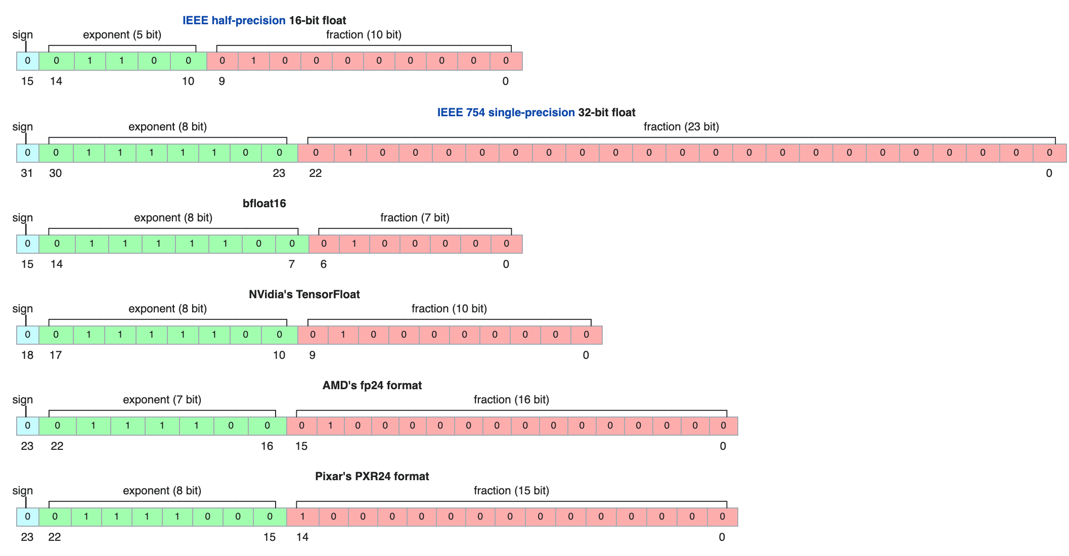
Different Floating Points
From:https://en.wikipedia.org/wiki/Bfloat16_floating-point_format

Slide 24
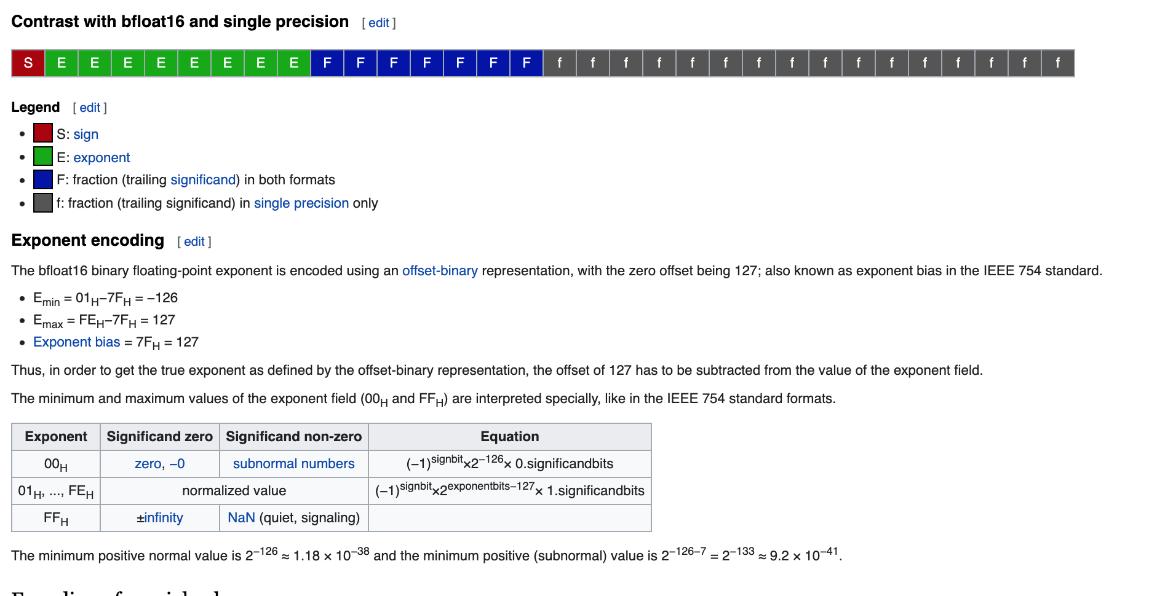
BF16
From:https://en.wikipedia.org/wiki/Bfloat16_floating-point_format

Slide 25
Pros of Low-precision computing
Can fit more numbers (and therefore more training examples, activations, etc.) in memory
Can store more numbers (and therefore larger models) in the cache
Can transmit more numbers per second
Can compute faster by extracting more parallelism in a fixed-width SIMD register
Uses less energy Cons of low-precision computing.
Limits the range of numbers we can represent (the range between the overflow and underflow thresholds)
Need specialized support from the hardware
Introduces quantization error when we store a full-precision number in a low-precision representation
https://www.cs.cornell.edu/courses/cs4787/2019sp/notes/lecture23.pdf

