Slide 1
CS3220 Processor Design
Prof. Hyesoon Kim

Slide 2
Pipelining the pipeline
Let’s remember the single-bus datapath
We’ll divide it into 5 stages
Fetch
Decode/RF Access
Address Generation/Execute
Memory
Store Result
Conservative handling of data and control dependences
Stall on branch
Stall on flow (data) dependence

Slide 4
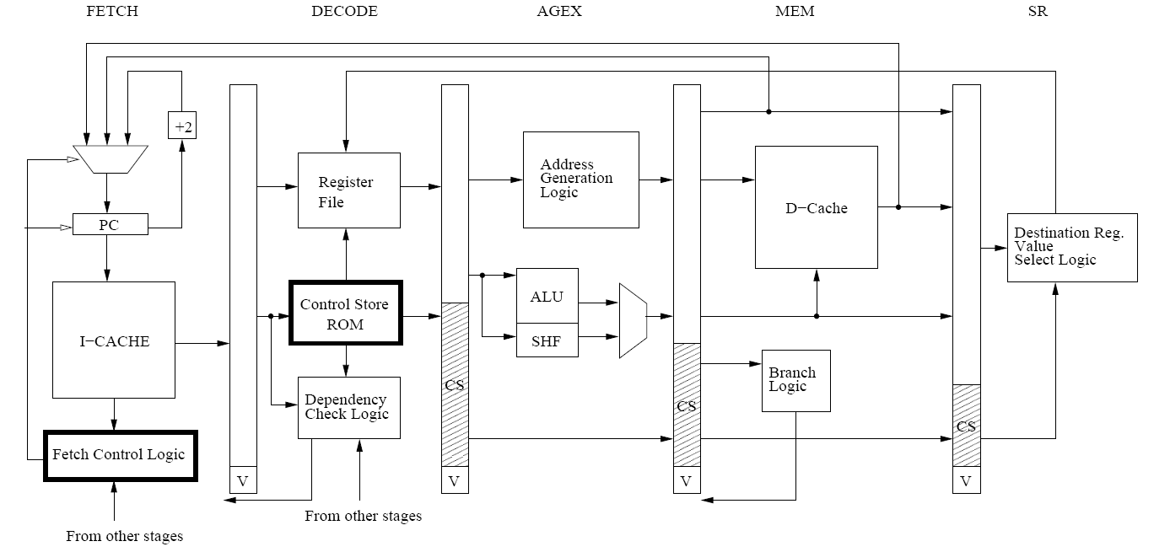
An Example LC-3b Pipeline

Slide 5
5 stage pipeline
IF
ID/RR
EX
MEM
WB
IF: Instruction fetch
ID/RR: instruction decoding & Register reading
EX: Execution
MEM: memory accesses
WB: Register writeback

Slide 6
Example: Execution of Four Independent ADDs
Multi-cycle: 5 cycles per instruction
Pipelined: 5 cycles per 5 instructions (steady state)
F
D
E
M
W
F
D
E
M
W
F
D
E
M
W
F
D
E
M
W
Time
F
D
E
M
W
F
D
E
M
W
F
D
E
M
W
F
D
E
M
W
F
D
E
M
W
Time

Slide 7
Pipeline Hazard
Control-flow hazard
How to handle branch instructions
Data-flow hazard
Data dependency
Designing how to handle pipeline hazard is the key component of this assignment

Slide 8
Data Dependence Types
Flow dependence
r₃ ← r₁ op r₂ Read-after-Write
r₅ ← r₃ op r₄ (RAW)
Anti dependence
r₃ ← r₁ op r₂ Write-after-Read
r₁ ← r₄ op r₅ (WAR)
Output-dependence
r₃ ← r₁ op r₂ Write-after-Write
r₅ ← r₃ op r₄ (WAW)
r₃ ← r₆ op r₇

Slide 9
Dependency logic
Method 1: Scoreboard
At Decode stage, set busy bit for the destination register and at the write back stage, set clear the busy bit (multi-count busy bits will be required instead of 1-bit)
Caution! : We can write and read the same register by the same instruction
Method 2: check destination register ids
Forward destination ids from other pipeline stages
Be careful to check when destination registers are indeed used. Not all instructions have source registers

Slide 10
FAQ
Can we use data forwarding?
We don’t recommend for this assignment.
Data forwarding will change the performance behavior significantly

Slide 11
Pipeline Latches

Slide 12
An Example LC-3b Pipeline

Slide 13
Pipeline Latch
Latch vs. combination logic
Latch: Holds a value. Out value will be available after a new clock.
CLK
1
2
3
4
5
6
in
1
2
5
6
out
Combinational Logic
<in>
<out>
CLK
This example is based on positive edge clock

Slide 14
How to make a pipeline stall?
Option #1: Send the data out back to data in
Option #2: Have an ” enable” signal and set “0” into a write enable signal
Latch
MUX
Data out
Data in
select
clk
Data in
Latch
Enable
clk

Slide 15
How to flush a pipeline
Latch
MUX
Data out
Data in
Valid
select
clk

Slide 16
Front-end Pipeline
Next PC compute logic
Front Latch
PC
instruction
I-cache
PC
CLK
…
CLK
PC (register) : holds a value to indicate where to fetch
W/o branch, next_pc = current_pc + instruction_size

Slide 17
How to handle branch?
0x804
Next PC compute logic
Cycle 2
0x800
Cycle 1
PC
0x800
0x804
I-cache
Branch?
CLK
Decode logic
Inst
br
add
br
1
V
0
Flush
CLK
br cond target 0x800
add r1, r2,r3 0x804
target sub r2,r3,r4 0x900

Slide 18
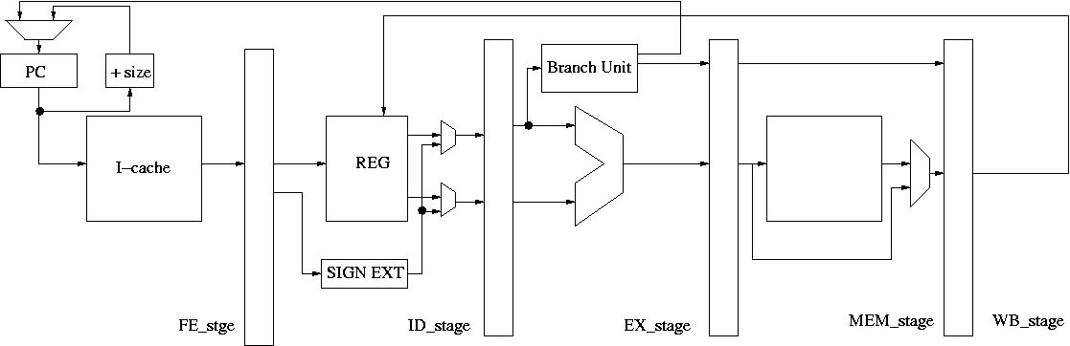
Handling Branches
br cond target 0x800
add r1, r2,r3 0x804
target sub r2,r3,r4 0x900
FE_stage
cycle
PC (latch)
FE
ID
EX
MEM
WB
1
0x800
br
2
0x804
add
br
3
0x804
add
br
4
0x900
sub
br
5
0x904
add
sub
br
6
0x908
mul
add
sub

Slide 19
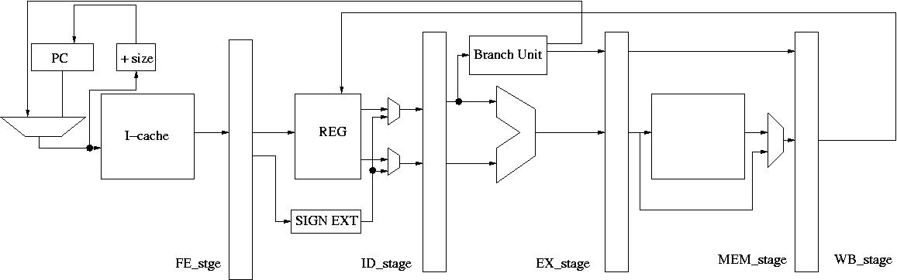
Handling Branches- Alt
br cond target 0x800
add r1, r2,r3 0x804
target sub r2,r3,r4 0x900
FE_stage
cycle
PC (latch)
FE
ID
EX
MEM
WB
1
0x800
br
2
0x804
add
br
3
0x804
sub
br
4
0x904
mul
sub
br
5
0x908
add
mul
sub
br
6
0x90b
div
add
mul
sub

Slide 20
Which option to choose?
We recommend to have two pipeline bubbles.
But how many bubbles in the pipeline is dependent on your design decision.
1 pipeline bubbles looks so better, why are you suggesting 2 pipeline bubbles?
It will increase critical path.
It will be a design trade-off between clock frequency vs. pipeline bubbles.

Slide 21

Handling Branches: V
br cond target 0x800
add r1, r2,r3 0x804
target sub r2,r3,r4 0x900
FE_stage
cycle
PC (latch)
FE
ID
EX
MEM
WB
1
0x800
br
2
0x804
add
br
3
0x804
add
br
4
0x900
sub
br
5
0x904
add
sub
br
6
0x908
mul
add
sub

Slide 22
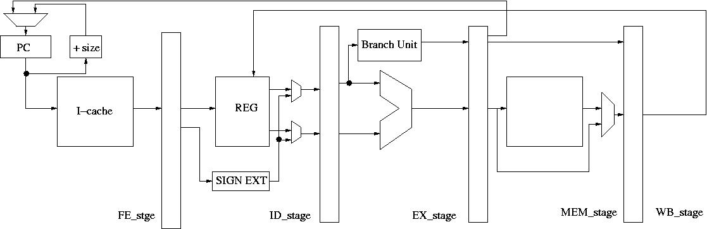
Handling Branches: II
br cond target 0x800
add r1, r2,r3 0x804
target sub r2,r3,r4 0x900
FE_stage
cycle
PC (latch)
FE
ID
EX
MEM
WB
1
0x800
br
2
0x804
add
br
3
0x804
add
br
4
0x804
add
br
5
0x900
sub
br
6
0x904
add
sub

Slide 23
Assignment #1
Draw a pipeline (5 stages)
Draw a dependence check logic (or scoreboard)
Show how you stall the pipeline (insert pipeline bubbles or put invalid in the latches)
Show all backward signals (signals from the later pipeline stages to the earlier pipeline stages)
Submit a video of explaining the pipeline. The detailed descriptions are in Canvas.

