Slide 1





CROSS PLATFORM APPLCATION DEVELOPMENT ASSIGNMENT – 1 TOURISM APPLICATION
Presented By – Group#1
Delia M Dsouza – 2020SP93051
Prakash Raj – 2020SP93048
Sameer – 2020SP93028
Sayantan Pal – 2020SP93050
Utkarsh Verma – 2020SP93057

Slide 2
About the application
An application that helps users find their next best travel destination and book tourism packages.
App Features:
One stop destination to look for different places to visit .
A short description about the place for example what its famous for,
Users can look for famous tourist spots based on different criteria. (Trekking spots, hill station, beaches etc)
App provides tourism packages available across different price range.
App also allows users to post reviews about the places.

Slide 3
List Of Screens In The Application
Login / Sign up
Home Page
Description Page (Consisting description about a particular place)
Payment Screen
Review Screen
User Profile Page

Slide 4

Flutter
Flutter Overview:
Real-time Database − Firebase supports JSON data and all users connected to it receive live updates after every change.
Flutter SDK is a collection of tools that allows you to build any kind of app for both Android & iOS platform in one codebase.
Flutter Framework: Provides all the predefined widgets/widget library, utility functions & packages.
Flutter uses Dart
Because Dart is strongly typed Object Oriented programming language. And it has features of Ahead of time compilation and Just in Time Compilation.
Ahead of time compilation make Flutter SDK and Dart eligible to generate Native ARM Code which can be compiled on Android and iOS.

Slide 5


Flutter
Flutter Dart :
Flutter API
Utility
Widgets
Our Widgets/Code
DART CODE
Code Compilation
ANDROID NATIVE CODE
IOS NATIVE CODE
Flutter SDK

Slide 6

Firebase
Firebase Overview
Firebase is a backend platform for building Web, Android and IOS applications. It offers real time database, different APIs, multiple authentication types and hosting platform.
Firebase Features
Real-time Database − Firebase supports JSON data and all users connected to it receive live updates after every change.
Authentication − We can use anonymous, password or different social authentications.
Hosting − The applications can be deployed over secured connection to Firebase servers.
6
6

Slide 7
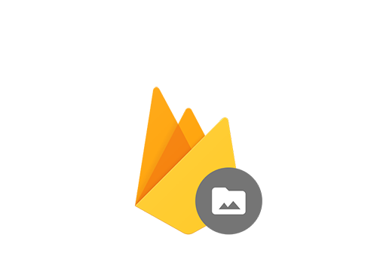
Cloud Storage - Provides scalable file storage. With Cloud Storage for Firebase, you get client SDKs to use in your app that enable you to upload and download files directly to and from your Cloud Storage “bucket”.
Services which we will be using :-
User Authentication and account creation :-
Email
Google Account
Facebook Account
Data operation :-
Read Data
Write Data
Filter data
Cloud Storage
for Firebase

Slide 8
Why REST ?
An architectural style largely viewed as a conventional standard for designing APIs.
Robust Native Caching.
Supports multiple API versions.
Uses HTTP status codes to identify errors easily.
Several mechanisms available for implementing authentication and authorization.
Why Firebase over Netlify?
Firebase supports dynamic websites whereas Netlify supports static websites only.
Ability to perform A/B Testing.
Firebase is packed with all the functionality for rapid application development.
Firebase supports both mobile app development as well as web development.

Slide 9
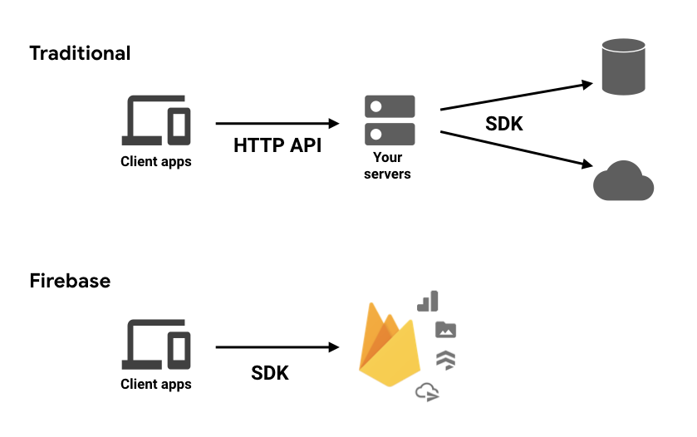
Firebase Architecture

Slide 10


Thank You !

