Slide 1


Mentoring App
If you cannot see where you are going, ask someone who has been there before

Slide 2


Group Members
Rasagnya Gurrala - 2020SP93047
Pravalika Gandesiri - 2020SP93027
Pavan Singh V - 2020SP93071
Vinayaka Naik - 2020SP93029

Slide 3
Introduction
Mentoring application is a platform in which the user asks a mentor for guidance in order to improve his expertise.
The targeted audience or customers for this application are mentees and mentors (Students, working professionals, etc.).
Mentee can search for the domain where he/she wants to enhance their skills.

Slide 4
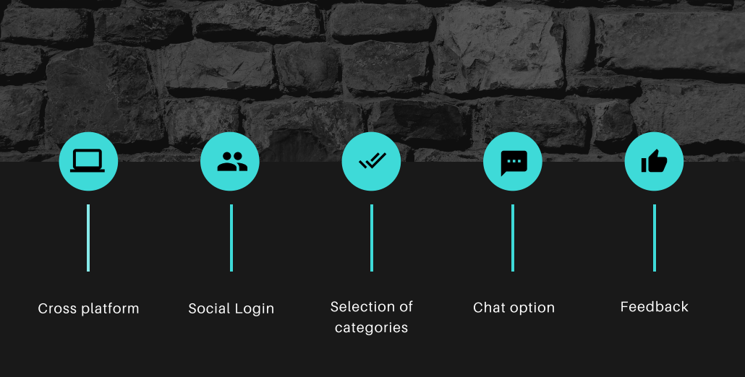
Application Features

Slide 5
List of Screens
Login/Signup Page
Categories Selection Page
Mentor Selection Page
Personalized Chat page
Profile Page
Feedback Page

Slide 6
Tech Stack
Frontend:
Flutter Dart
Backend:
REST
Firebase – Cloud functions – Serverless
Hosting:
Firebase hosting
Tentative

Slide 7
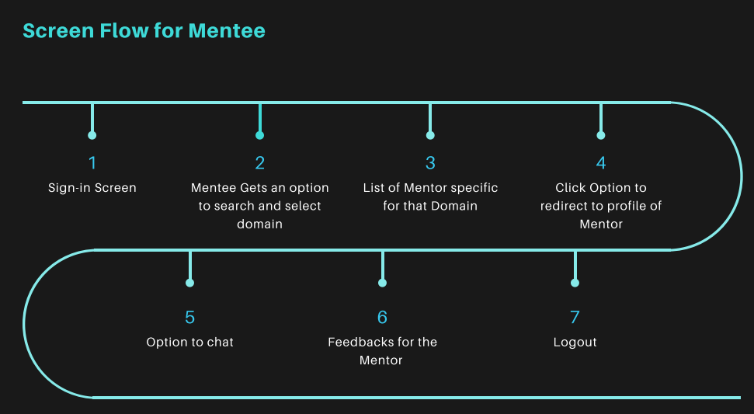


Slide 8
Thank you.!

