Slide 1
Cross Platform Application Development
Assignment 1
Anvitha Bhat [2020SP93093]
Damini Niranjan [2020SP93009]
Keerthana B [2020SP93031]
Madhumitha A [2020SP93006]

Slide 2
About the Application
An application where a user can blog and share their views about a topic.
The features offered in this application are:
Sign in with social login/s
Home tab: Provides an overview of the recent blog posts
New blog: Allows user to create a new blog post and publish it
Categories: Filters the blogs based on categories for easy access
User profile: Displays user information

Slide 3
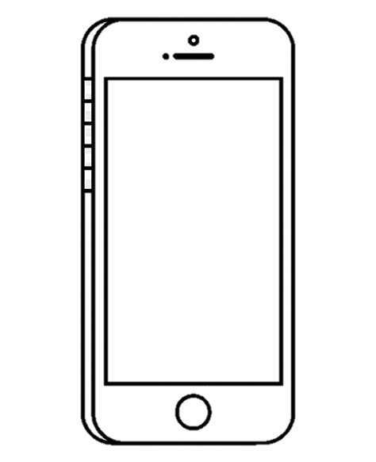









Design Overview
Sign in
with optional social login/s
Home page
with tab to access categories
Manage user profile
Blog editor

Slide 4
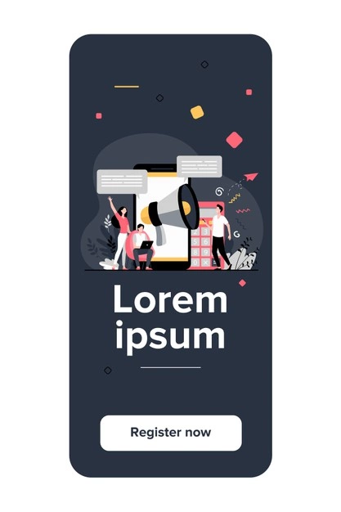
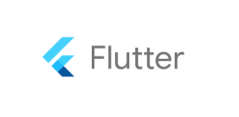

Architecture
Cross-Platform development tool
Backend-as-a-Service
Blog App

Slide 5
Technology Stack
Front-end tool/s:
Flutter Dart
Back-end tool/s:
Firebase
Source-code Management:
Github

Slide 6
Thank You!

