Slide 1





CPAD
Group-8
Gaurav Singh
(2020sp93057)​
Nousheen Sultana (2020sp93062)​
Praveen Kumar
(2020sp93055)​
Noirheeta Chanda
(2020sp93010) ​

Slide 2

AGENDA
INTRODUCTION
FEATURES
TECHNOLOGY STACK

Slide 3

INTRODUCTION: FITNESS APP
An application that helps users stay fit.​
The app will allow users to choose ,complete and track their workout routines.​
The app will keep a track of the daily progress of a user.​
Users will be able to register themselves via social logins or by signing up.​
​

Slide 4


FEATURES
Onboarding screen​
Login Page/ Registration( including social logins )​
Homepage​
User’s Profile Page​
Side Navigation Bar( View Stats, Settings, Logout, About, Contact us)​
Time Tracking screen​​

Slide 5

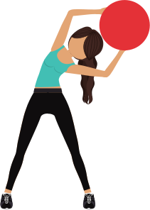
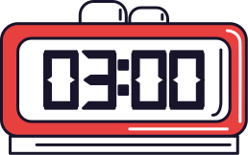

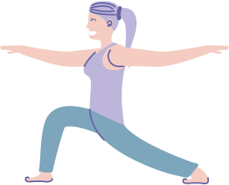


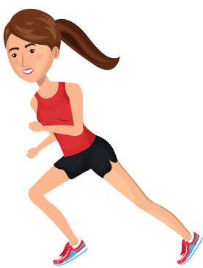
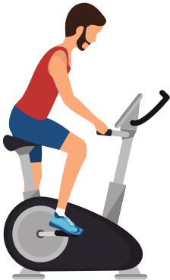
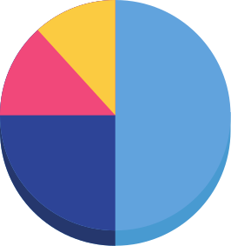





Screens
Time Tracking
25
20
15
10
5
0
Item 1
Item 2
Item 3
Item 4
Item 5
User Profile
Home Page
Onboarding Screen
Login/Registration

Slide 6
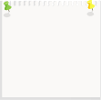


Technology Stack
Front end​
Flutter Dart-Two Mobile – iOS and Android ​
Backend​
Firebase​
REST​
Hosted on laptop​
​

Slide 7
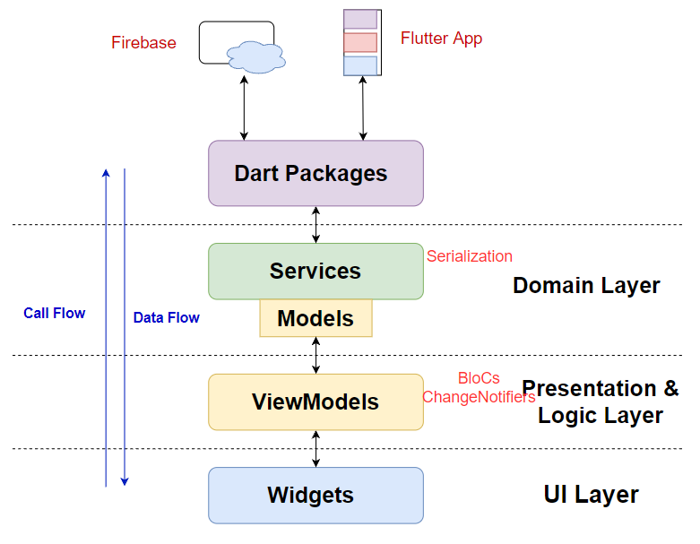
FLOW OF EVENTS

Slide 8


Thank you!
DO YOU HAVE ANY QUESTIONS FOR US?

