Slide 1
E-Voting
Cross Platform Application Development Assignment –1
Group 9
Deepanshu - 2020SP93083
Harpreet Singh - 2020SP93018
Varjeet Singh - 2020SP93020
Rahul Saini - 2020SP9042

Slide 2
Situation
The most important and crucial part of any democratic country are elections.
Currently we all are living in different parts of India, away from our native place.
Whenever there's voting for any political authority etc. We can vote from our constituency only, and that's not possible for many of the people.
As per the survey report from Times of India, 37% of voters can't cast their Vote because of rule to cast vote from the constituency in which their voter id card is registered .
There are many cases of ballot tampering because of this gap between registered voters and total available voters at the time of elections.
There's lot of money is required to conduct the voting and even after that many of the registered voters can't cast their vote.

Slide 3
Screen Flow
Select event
Cast Vote
2
3
1
4
Login
Logout
2’
3’
User
Create/Update Event
Map Candidate
Admin

Slide 4
Proposed Solution
An application through which the users can cast their vote anytime anywhere just authenticating through their social login.
Security and authentication of the user will be based on Aadhar number and a unique id provided to user at the time of election.
The Application will be available on smart phone as well as on the Web.
The Admin(Election Commission Of India) would be the person solely responsible for creating and managing the event.
For all the elections the results will be available on the last day of voting itself.
Application will be based on client server Architecture.

Slide 5
Benefits
Saving the resource required to count votes manually.
Voters will be able to vote even if they are not present physically at the place where their voter id is registered.
Disabled voters would be able to cast votes without bothering to go out physically.
Vote tempering can be saved up to an extent.
Real-time results, no waiting for ballots in the mail.
Each vote will be captured with a date and timestamp along with the voter's internet address that'll improve the transparency.

Slide 6

Architecture
Flutter Application
Android, IOS and Web (UI)
Firebase Backend as a Service and Authentication
Request
Response
User
DB

Slide 7
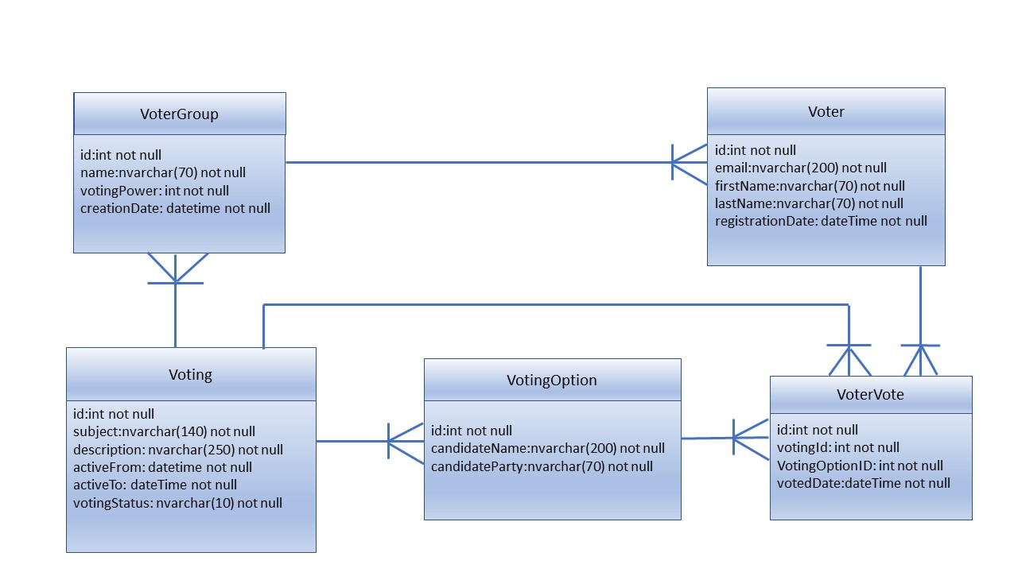
ER diagram

Slide 8
Tech stack
Flutter :
Language Used – Dart
Supported Platforms – IOS, Android
Firebase :
Backend as a Service
For authentication, backend service and database

Slide 9

Thank you

