Slide 1
Cross Platform Application Development
Assignment
FoodZilla
Name | Student ID
Dhiraj Jaiswal | 2020Sp93002
Raviganesh M | 2020SP93026
Prasansha Sureka | 2020SP93069
Shweta Golani | 2020SP93041

Slide 2
Overview
1. FoodZilla is a cross platform app which runs on multiple platforms and software environments.
2. FoodZilla is a restaurant booking app which allow users to book restaurants at their convenience of sitting at home.
3. Consumers can get rewards by ordering from the apps. The apps also support different modes of payment.
4. Consumers can login in different ways like via Facebook, Google or OTP.

Slide 3
Features
1. Social Login
2. Explore restaurants of different categories like fine dining, café etc.
3. Different modes of payment.
4. Different ways to login like via Facebook, google etc.
5. It will show points and rewards earned by each user.
6. Displays various events and offers.
7. A FAQ section for clearing the doubts of consumers.
8. It will also show upcoming bookings for each user.

Slide 4



Tech-Stack
* React Native – Open-source UI Framework (Two devices – Android, iOS)
* JavaScript – Cross-platform Scripting language
* Firebase – Backend Development
* Cloud Firestore – NoSQL Document Database

Slide 5
Mockup

Slide 6
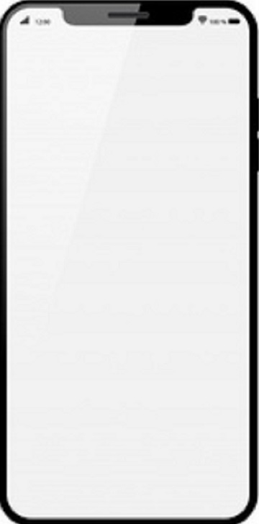



Login Screen
User provides their phone/email number to login.
Upon login, the user will be navigated to main activity page.
Also new users can register using this view.
Mobile Number
Proceed
Not a User? Register Now

Slide 7
Registration Screen
User provides their information and proceed to store the details in database.
Upon registration, the user will be navigated to main activity page.
First Name
Last Name
Gender
Male
Female
Rather not tell
Date Of Birth
dd
mm
yyyy
Mobile Number
Email Id
Proceed

Slide 8
Registration Screen
Enter the OTP which is sent to the registered Mobile Number.
Press the Log In button.
Enter OTP
Log In

Slide 9
Restaurants Near You
Nearby Restaurants
The main page of the application shows list of nearby restaurants.
When a user selects a restaurant band tile, then the user will be navigated to the detail page of the brand containing the food menu items.
BRAND NAME
CATEGORY
PRICE FOR TWO
BRAND NAME
CATEGORY
PRICE FOR TWO
BRAND NAME
CATEGORY
PRICE FOR TWO
BRAND NAME
CATEGORY
PRICE FOR TWO
BRAND NAME
CATEGORY
PRICE FOR TWO

Slide 10
Explore Restaurants
This page show the list of all restaurants from where the service can be provided.
When a user selects a restaurant tile, then the user will be navigated to the detail page of the restaurant.
Explore
Fine Dining
Cafe
Bar
Lounge
Dhabas
Night Life
Casual Dining
Rooftop
Brunch

Slide 11
Events & Offers
Events & Offers
Events Offers
Events and Offers
This page will show the upcoming events and the offers which a consumer will get during that time.
Events Offers
Live Screening
Food Festival
Happy Hours
1:1 on Food
Sports Screening
Live Music
2:2 on Drinks
Super value offer
Ladies Night
Corporate Night
Biryani Binge
Pocket Friendly

Slide 12
Accounts Page
This page will display the user information.
Controls like text box , Labels, Image viewer etc will be used in this page to display the information.
Points gained by the user upon a successful transaction will also be displayed.
Account
FULL NAME
MOBILE NUMBER
EMAIL ID
POINTS
ACTIVE POINTS

Slide 13
Account
Side Navigations
This section has the side navigations related to the account details of logged in user along with Upcoming bookings and History of orders.
An option is given to Log Out from the application.
Account
Points
Upcoming Bookings
History
Contact Us
Log Out
FULL NAME
MOBILE NUMBER
EMAIL ID
POINTS
ACTIVE POINTS
Cash Value
FAQ

Slide 14
Points
Reward Points
For every successful transaction, the user will be rewarded with some points.
The screen has the Frequently Asked Questions(FAQs) related to the reward points.
ACTIVE POINTS
XX
FAQ
What are points?
How to collect points?
How to redeem points?
.
.
.
.
.

Slide 15
Upcoming Bookings
Upcoming Bookings
This section shows the list of all upcoming bookings of the logged in user along with the date and time of booking.
On click of any list item, it navigates to the detailed description of the booking.
BRAND NAME
DATE: XX/XX/XXXX
TIME: XX:XX AM/PM
BRAND NAME
DATE: XX/XX/XXXX
TIME: XX:XX AM/PM
BRAND NAME
DATE: XX/XX/XXXX
TIME: XX:XX AM/PM
BRAND NAME
DATE: XX/XX/XXXX
TIME: XX:XX AM/PM
BRAND NAME
DATE: XX/XX/XXXX
TIME: XX:XX AM/PM

Slide 16
Accounts Page
This page will display the user information.
Controls like text box , Labels, Image viewer etc will be used in this page to display the information.
Points gained by the user upon a successful transaction will also be displayed.
History
BRAND NAME
POINTS EARNED: XX
POINTS REDEEMED: XX
BRAND NAME
POINTS EARNED: XX
POINTS REDEEMED: XX
BRAND NAME
POINTS EARNED: XX
POINTS REDEEMED: XX
BRAND NAME
POINTS EARNED: XX
POINTS REDEEMED: XX
BRAND NAME
POINTS EARNED: XX
POINTS REDEEMED: XX

Slide 17
Contact Us
Contact Us
Contact Us
The customer can contact us in two ways:
1. By writing us an email.
2. By calling us on our customer care.
Write to us
Write to us
Call Us
Call Us

Slide 18
Brands
This section shows the list of all brands with their addresses.
On click of any list item, it navigates to the detailed description of the brand.
BRAND NAME
ADDRESS
ADDRESS
ADDRESS

Slide 19
Brand Name
Brand Details
This section shows the details related to a brand.
It has two sections in which user can see the list of available menu items and the events.
User can make the reservation by clicking on Make a Reservation button.
Make a Reservation
MENU EVENTS
Best Sellers Combos Recommends All
DISH NAME
CATEGORY
PRICE
DISH NAME
CATEGORY
PRICE
DISH NAME
CATEGORY
PRICE

Slide 20
Reservation Page
This will show the details of user like first name, last name, no. of persons , date and time. The consumer can confirm the details before making a reservation.
Self
Guest
First Name
Last Name
Number Of Individuals
Date
dd
mm
yyyy
Time
Hr
Min
AM/PM
BOOK NOW

Slide 21
Order Page
User can book a table with the details.
Details of the transaction will get calculated by fetching the data from database.
Self
Guest
First Name
Last Name
Number Of Guest
Entry Charges: XX
Number of Adults: XX
Total: XX
Discount: XX (%)
Net Amount: XX
PAY NOW

Slide 22
Payment Page
FoodZilla will be integrated to Paytm & GooglePay payment gateways.
2. On click the user will be redirected to the payment gateway page.
PAYTM
PAY AMOUNT
GOOGLE PAY
PAY AMOUNT
CASH ON DELIVERY
PAY AMOUNT

Slide 23
Thank You

