Slide 1
Core Four
Cross Platform Application Development

Slide 2
Team Members:-
Tripti Barsaiyan 2021SP93063
Maadhavi Suvarna 2021SP93031
Prashant Mishra 2021SP93016
Mohammad Zaid 2021SP93037

Slide 3

Project Idea
We are building a cross platform News application. This application will have a homepage with news feed. It will contain list of news.
Once user clicks on a certain news, a new popup screen displays the news in detail.

Slide 4


Tech Stack

Slide 5
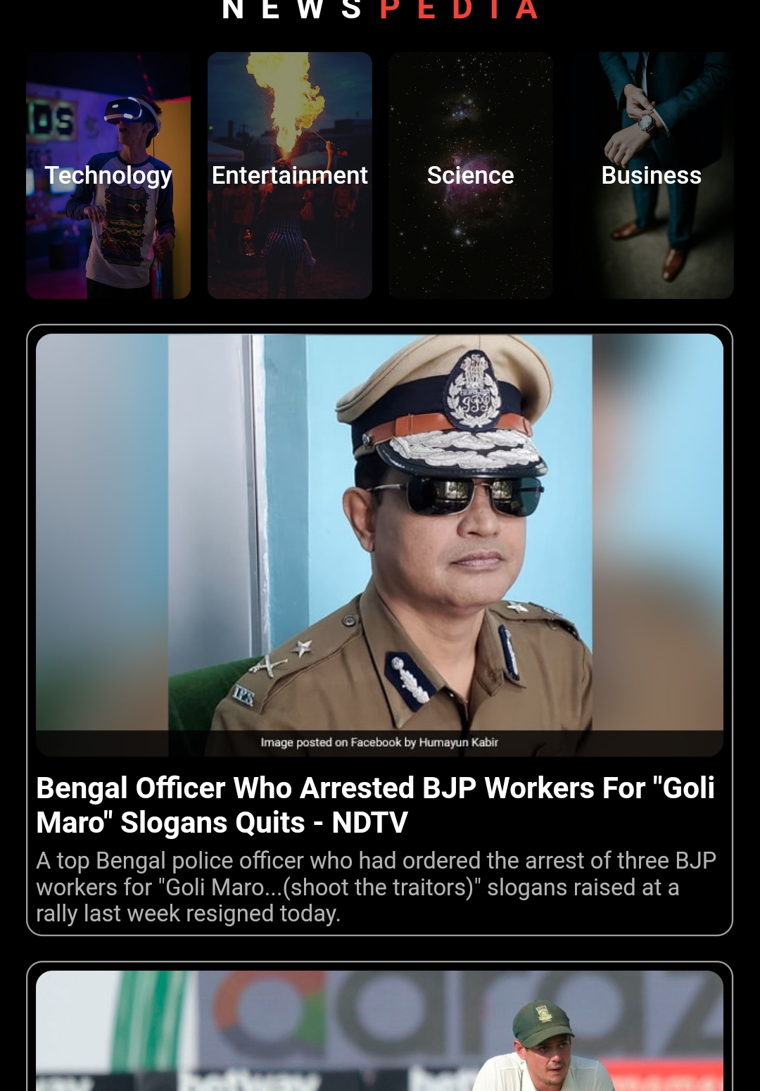
Sample Screen: Home Page

Slide 6
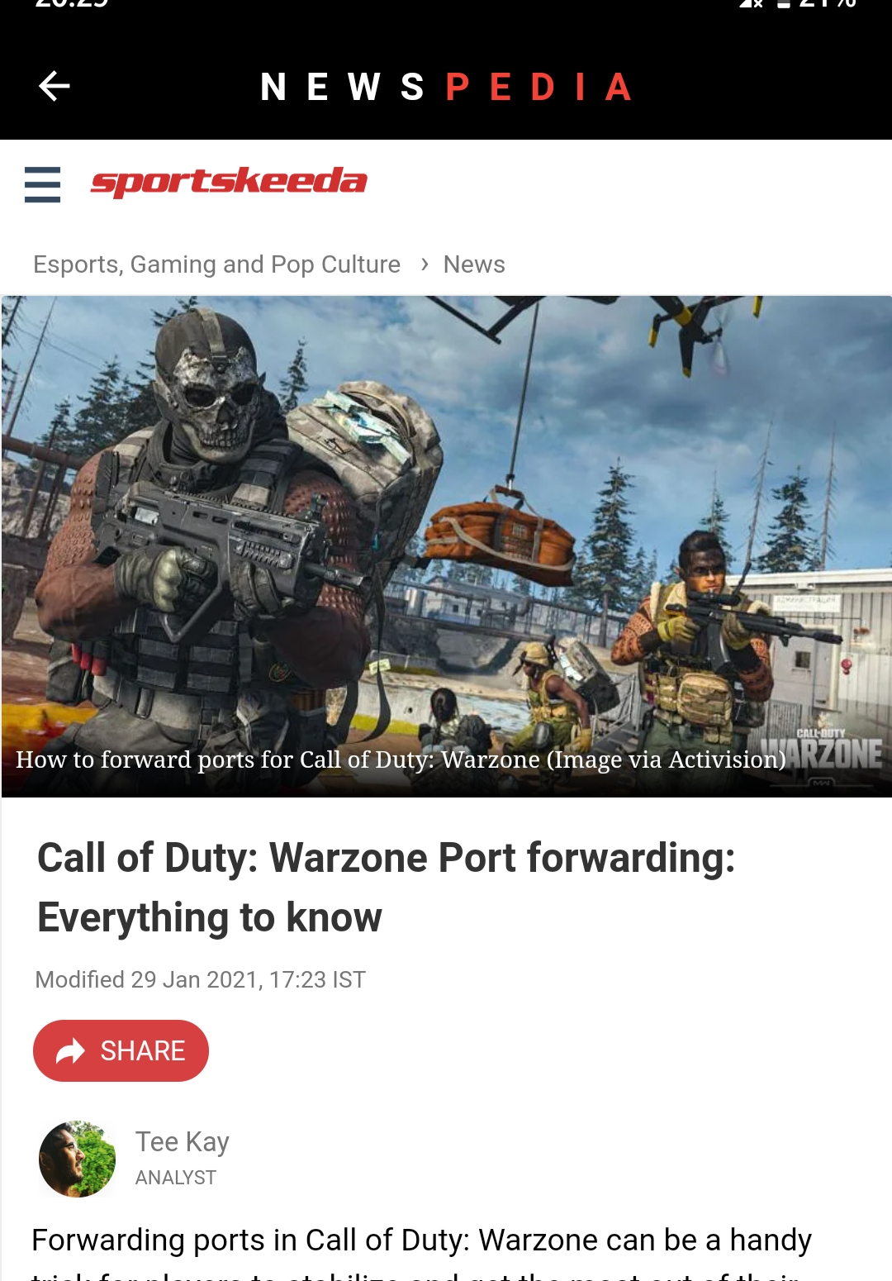
Sample Screen: Detailed Page for the news

Slide 7

Thank You

