Slide 1





Cross Platform Application Development
Prateek Ram – 2021sp93032
Hitesh Hiranmaya – 2021sp93022
Rishabh Sharma – 2021sp93032
Sheikh Samee Jamil – 2021sp3020
Kumar Abhimanyu – 2021sp93079

Slide 2

Idea
CALMKAAJ is the service provider for Maid, Cook, Babysitter, Driver, Servant, Eldercare, Gardener and Pantry Boy. We help customers and businesses to hire trusted professionals for all their service needs. We are staffed with young, passionate people working to make a difference in the lives of people by catering to their housekeeping service needs. We aim to solve the customer pain by keeping trust, safety and quality factors in mind.

Slide 3
Platform & Tech Stack
Reactive Native Firebase : - React Native Firebase is a collection of official React Native modules connecting you to Firebase services.
React Native Firebase is built with four key principles in mind :-
Well tested
Well typed
Well documented
Mirrors official Firebase Web SDK
Platform : - Web and Android

Slide 4
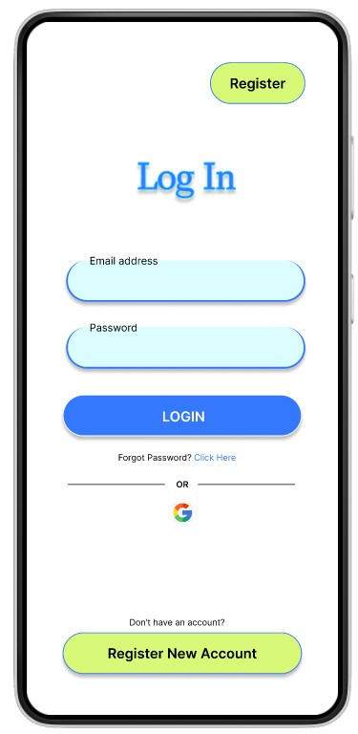
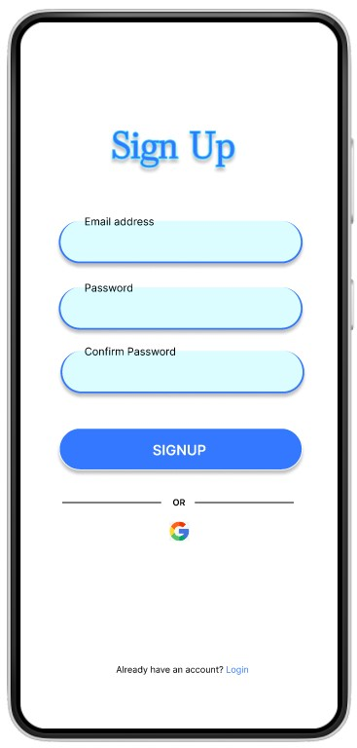
Mock-up
Login Screen
Signup Screen

Slide 5
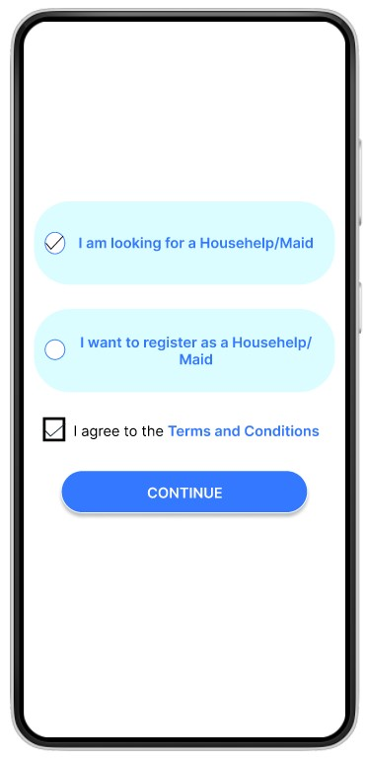
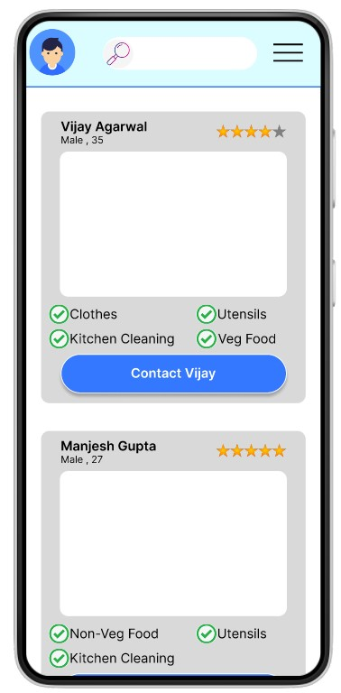
Mock-up
Selection Screen Choice 1
Response Screen Choice 1

Slide 6
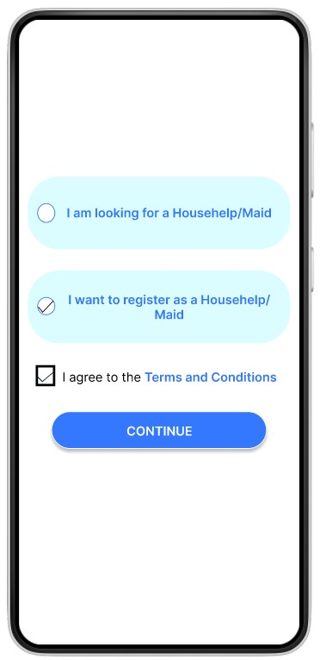
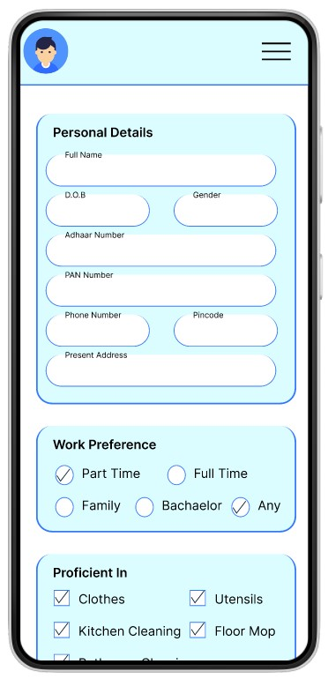
Mock-up
Selection Screen Choice 2
Response Screen Choice 2

Slide 7

THANK YOU

