Slide 1

Cross Platform Application Development Assignment-1
Divya B M | 2021SP93058
H Deepak D Bhat | 2021SP93015
Roshni Kundu | 2021SP93077
Sumedha | 2021SP93078
Valesh Levin Mathias | 2021SP93042
Team 5

Slide 2
Topic: Skin Cancer Detection

Slide 3
Agenda
Scope of the project
Design
List of Screens

Slide 4
Scope of the Project

Slide 5

Introduction
More than 9,500 people are diagnosed with skin cancer every day in U.S. alone. More than 2 people die of the disease every hour. Skin cancer is a disease that can affect anyone.
Research shows that we can increase the survival rate to up to 99% on early detection, and up to 68% when detected in moderate stage of the disease.
With our app, we wish to aid the detection of skin cancer, thereby, improving the early diagnosis.

Slide 6
About Our App
User signs up/ logs in
User uploads photograph
ML model predicts presence or absence of cancer
Displays result

Slide 7
Design

Slide 8







Slide 9
Frontend
Flutter Dart
Cross Platform
Two Mobile – iOS and Android
Social Login

Slide 10
Backend
REST-Firebase-Serverless
Python (ML model)

Slide 11
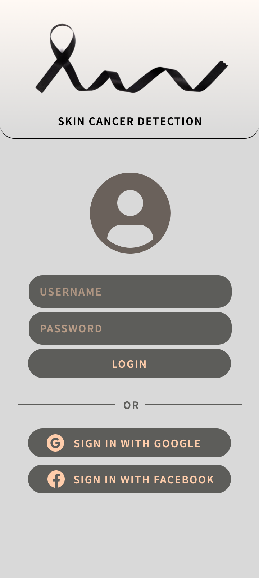
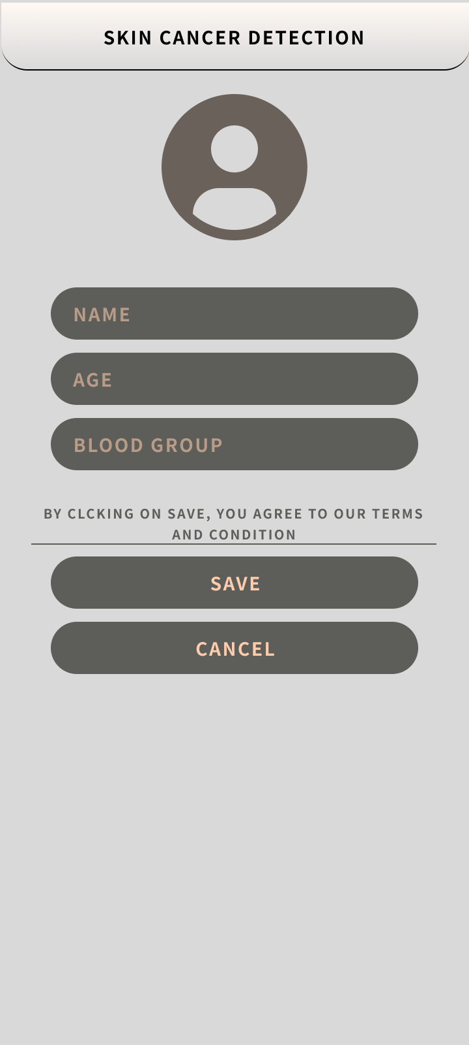
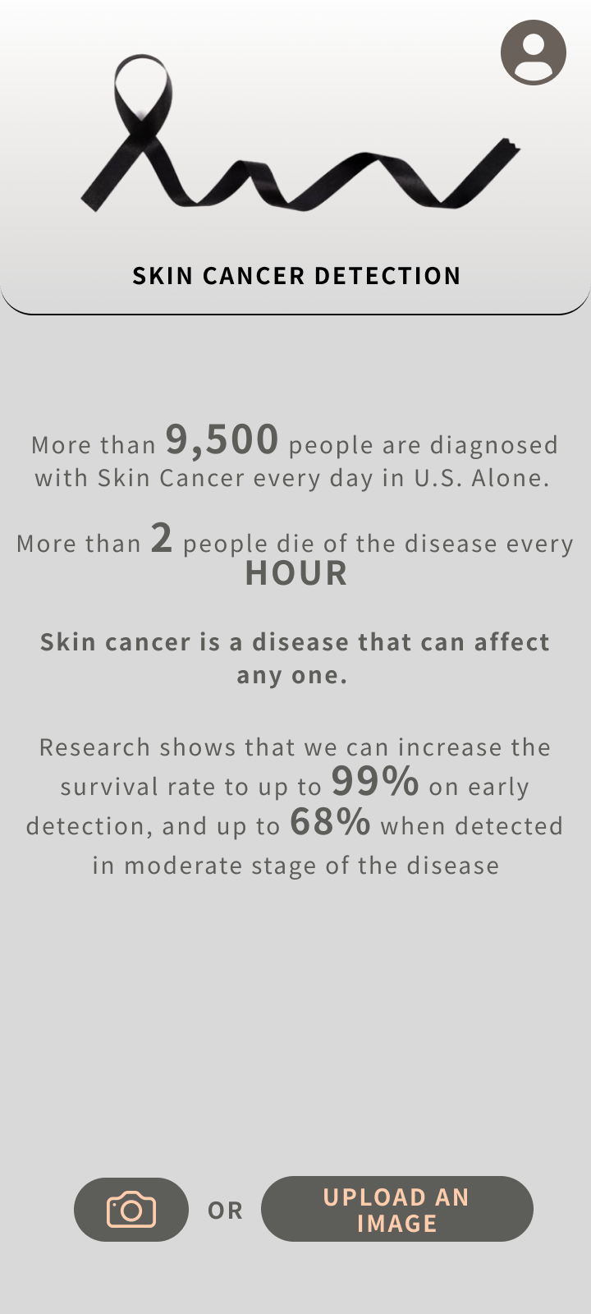
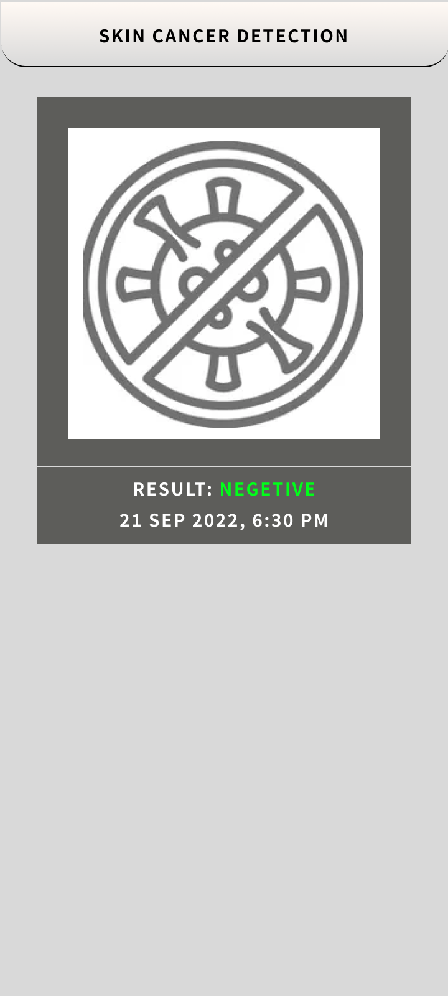
List of Screens

Slide 12
Thank you

