Slide 1

Cross Platform Application Development PROJECT : WOMEN SAFETY APP Section – B Group - 8
NAME | BITS ID
DINESH | 2021SP93062
LIKHITHA B | 2021SP93039
NARINA SAHITHI | 2021SP93084
TEJASWINI B R | 2021SP93028
UMA N M | 2021SP93048

Slide 2


WOMEN SAFETY APP
Women Safety App is an application built using Flutter and Firebase to help women during emergencies.
Through delivering a solution to women needs in any critical time without any hustle.
The main objective or aim of Women Safety App is to provide technological support to help woman in dangerous or emergency situations.
BITS Pilani, Hyderabad CaPmagpeu2s

Slide 3
Features of Women Safety App
Google Sign in / Sign in through Mail
Landing Page – HELP BOARD
SOS
Call
SMs
Police, Pharmacy, Bus stations
Nearby Police Stations addresses
Emergency calls
Make instant calls to ambulance, police, fire station.
Shake feature
To Send an emergency message to the concerned people
News
News about women safety

Slide 4
Tech Stack
Flutter : Flutter is an open source mobile UI framework created by Google which allows us to develop cross platform applications.
Dart : Dart is a programming language designed for client development, such as for the web and mobile apps. It is developed by Google and can also be used to build server and desktop applications.
Firebase : Firebase is a platform developed by Google for creating mobile and web applications.
Cloud Firestore : Cloud Firestore is a cloud-hosted, NoSQL database that your iOS, Android, and web apps can access directly via native SDKs.

Slide 5
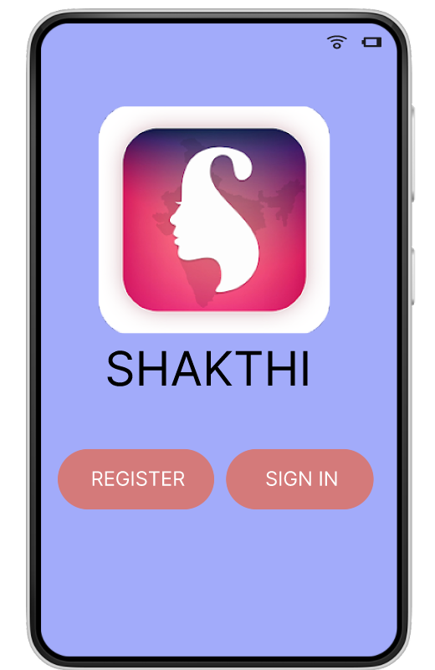
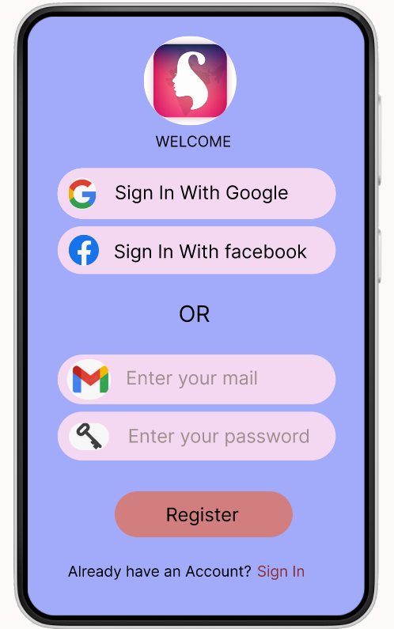
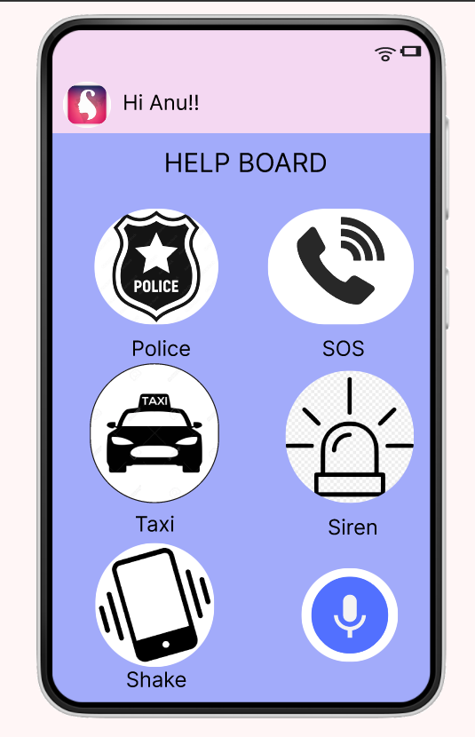
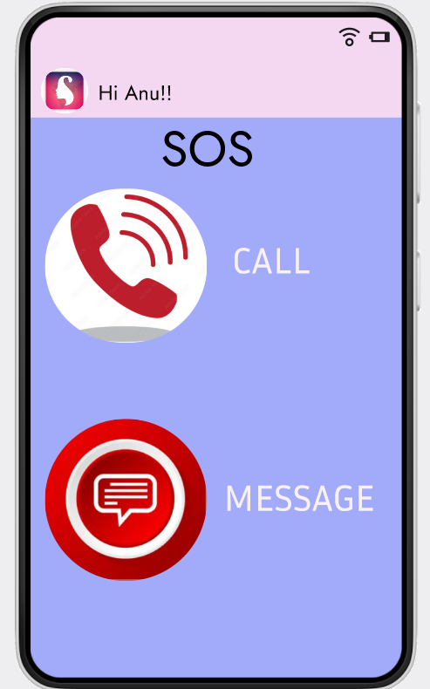
Mock Up Screens

Slide 6
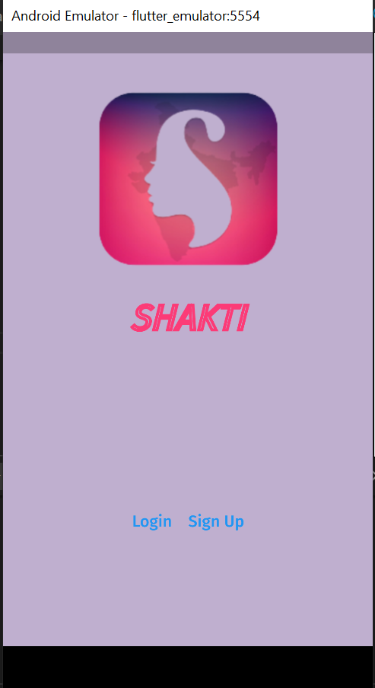
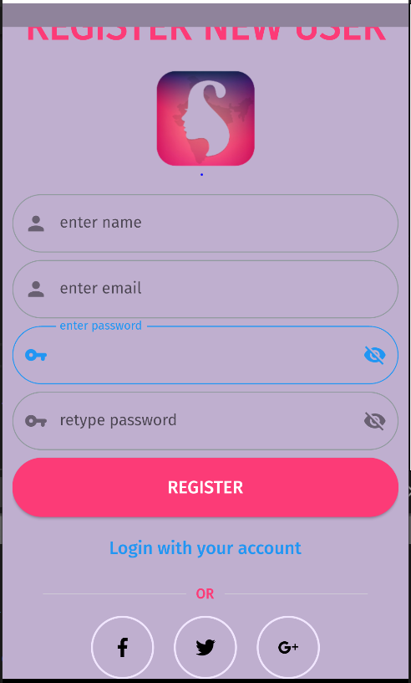
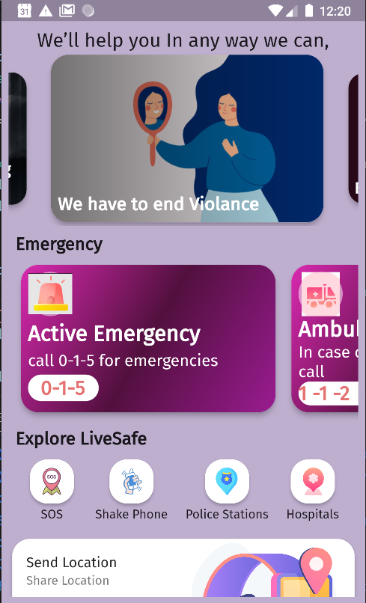
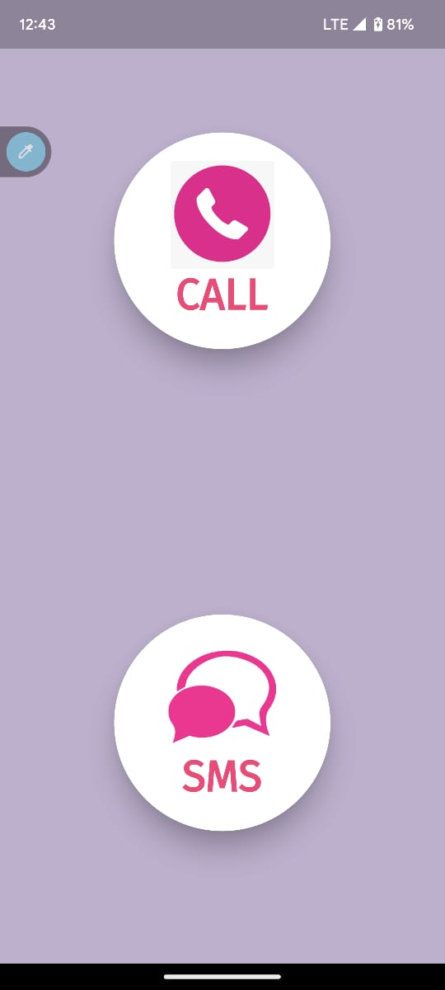
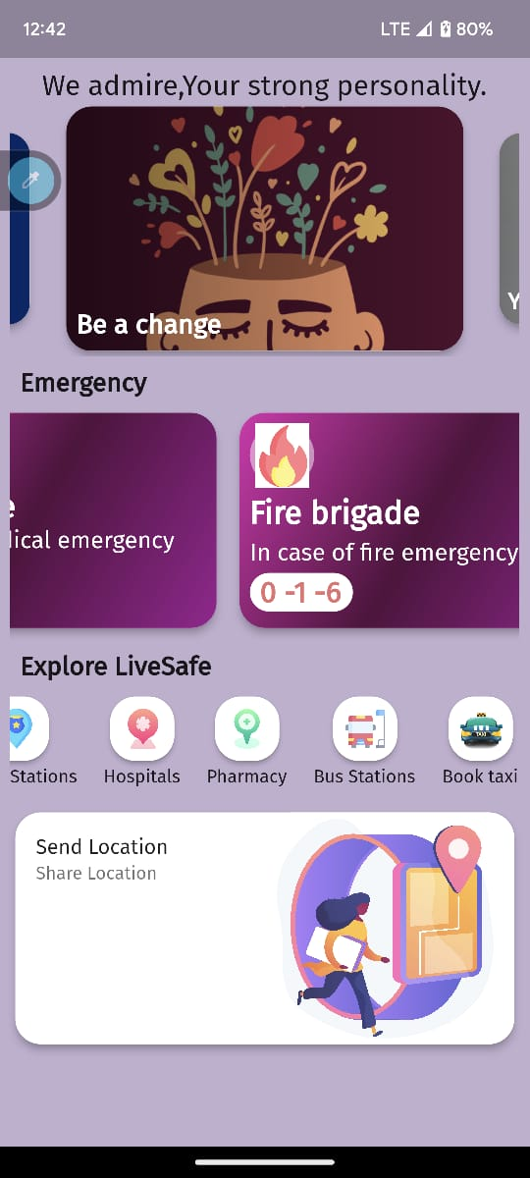
Demo Screens

Slide 7
Thank You!!

