Slide 1
Cross Paper Scissor
Team Number - 05
Batch - 2YA
Members :
Vishal Singh Sengar - 2022SP93022
Ayush Kumar - 2022SP93024
Ankit Mahapatra - 2022SP93027

Slide 2
Introduction
Introducing a cross-device paper-scissors-rock game, this interactive multiplayer experience brings the classic hand game to life, allowing players on two separate devices to engage in thrilling battles of strategy and chance. Developed with a robust networking system and client-server architecture, the game ensures seamless communication between devices, enabling real-time updates and synchronization of gameplay. Players select their moves – rock, paper, or scissors – through intuitive user interfaces, with the game logic determining the victor based on established rules. With engaging graphics and animations, this cross-platform gaming experience not only captures the essence of the traditional game but also adds a dynamic, interactive dimension to the timeless competition. Whether competing with friends or challenging opponents remotely, this cross-device paper-scissors-rock game promises hours of entertaining and strategic fun.

Slide 3
"SymmetricSync Game Framework"
This architecture is named "SymmetricSync" because it emphasizes symmetrical synchronization between the two devices, ensuring that both players experience the game in a synchronized and simultaneous manner. The framework prioritizes real-time updates and responsiveness, making it well-suited for a paper-scissors-rock game where instantaneous feedback is crucial for an engaging experience.
Why it's Best Suited:
Real-Time Synchronization: The "SymmetricSync" framework excels in maintaining real-time synchronization between the two devices. This is essential for a game like paper-scissors-rock, where players need to see each other's moves and the game state simultaneously.
Low Latency Communication: The architecture prioritizes low-latency communication to minimize delays between player actions and system responses. This ensures that the game feels responsive and players can make informed decisions quickly.
Scalability: The framework is designed to handle multiple players seamlessly. While it's optimized for two-player interactions in the context of paper-scissors-rock, it can be easily extended to support additional players, making it scalable for different multiplayer scenarios.

Slide 4
Consistent User Experience: "SymmetricSync" ensures a consistent user experience on both devices. Both players perceive the game state identically, creating a fair and enjoyable gaming environment.
Reliability and Fault Tolerance: The architecture incorporates measures for reliability and fault tolerance, ensuring that the game remains stable even in the face of network fluctuations or disruptions. This reliability is crucial for maintaining the integrity of the gaming experience.
Adaptability: The framework is adaptable to different platforms, allowing the paper-scissors-rock game to run smoothly on various devices, whether they are mobile phones, tablets, or computers.
Security Measures: "SymmetricSync" incorporates security features to prevent cheating or unauthorized access, ensuring the integrity of the gameplay.

Slide 5
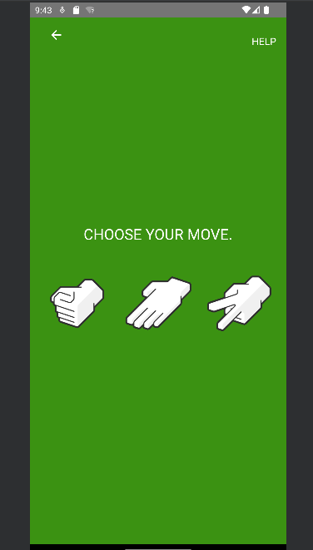
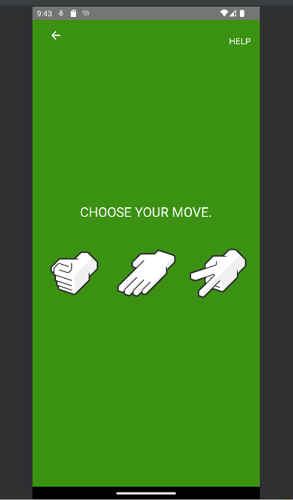
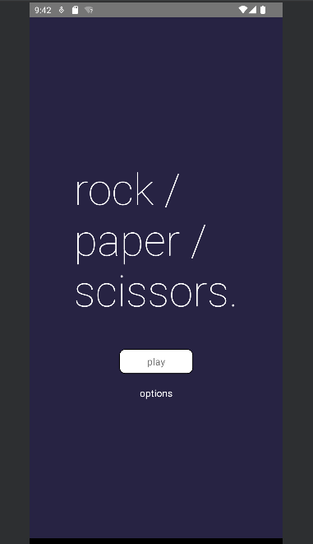
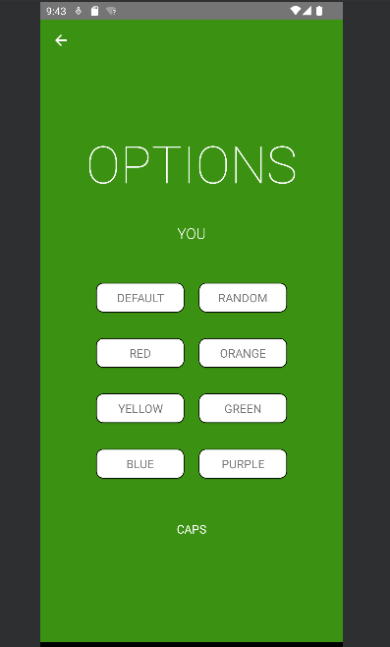
ScreenShots

Slide 6
Challenges or Interesting Points of the project
Real-Time Synchronization:
Achieving real-time synchronization between devices can be challenging. Ensuring that both players receive updates simultaneously and experience minimal latency requires a well-optimized networking infrastructure.
Network Stability:
Dealing with potential network issues, such as dropped connections or varying levels of latency, is crucial. Implementing strategies for handling network disruptions and maintaining game state integrity is a significant challenge.
Security Concerns:
Preventing cheating or unauthorized access is essential. Implementing secure communication channels, validating player inputs, and protecting against potential exploits add complexity to the development.
Player Matching and Connectivity:
Implementing a system for player matching and connectivity is necessary for multiplayer games. Providing a seamless experience for players to find opponents, connect, and start a game introduces an interesting matchmaking component.

Slide 7


