Slide 1
CROSS PLATFORM APPLICATION DEVELOPMENT
ASSIGNMENT 1

Slide 2
TEAM NUMBER | 14
BATCH | 2022 2YA
MEMBERS | 2022SP93035 - VIBHA V 2022SP93085 - JEFFREY RUJEN R
TOPIC | CHURCH DATA MANAGEMENT

Slide 3
Introduction
This application is a cross- platform application to manage the data of people attending the church.
The application allows users to register and login to the application to view and manage their data.

Slide 4
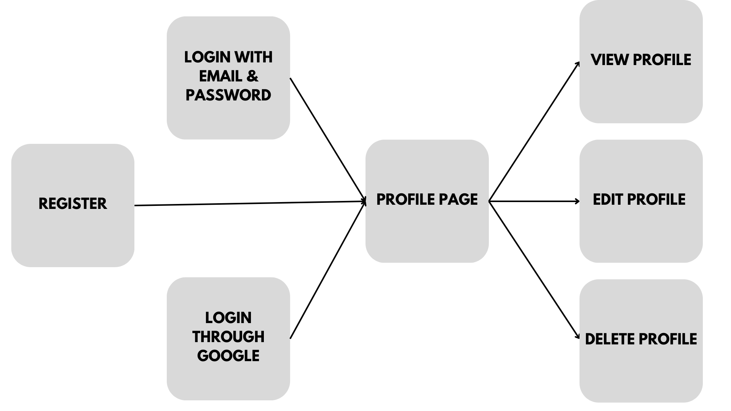
Architecture/Deisgn

Slide 5






Architecture/Design
LOGIN THROUGH THE UI
REGISTER THROUGH THE UI

Slide 6
Point of interest
The aim is to create a highly customized application for the management of church attenders’ data. Using this data the pastor and leaders in the church would be able to help, assist and guide the members to grow in their life in a holistic way. The design has multiple access levels as there are different levels and types of users and leaders who work with different levels and amounts of data. This is just a small beginning to a big project which will keep evolving and growing with time.

Slide 7
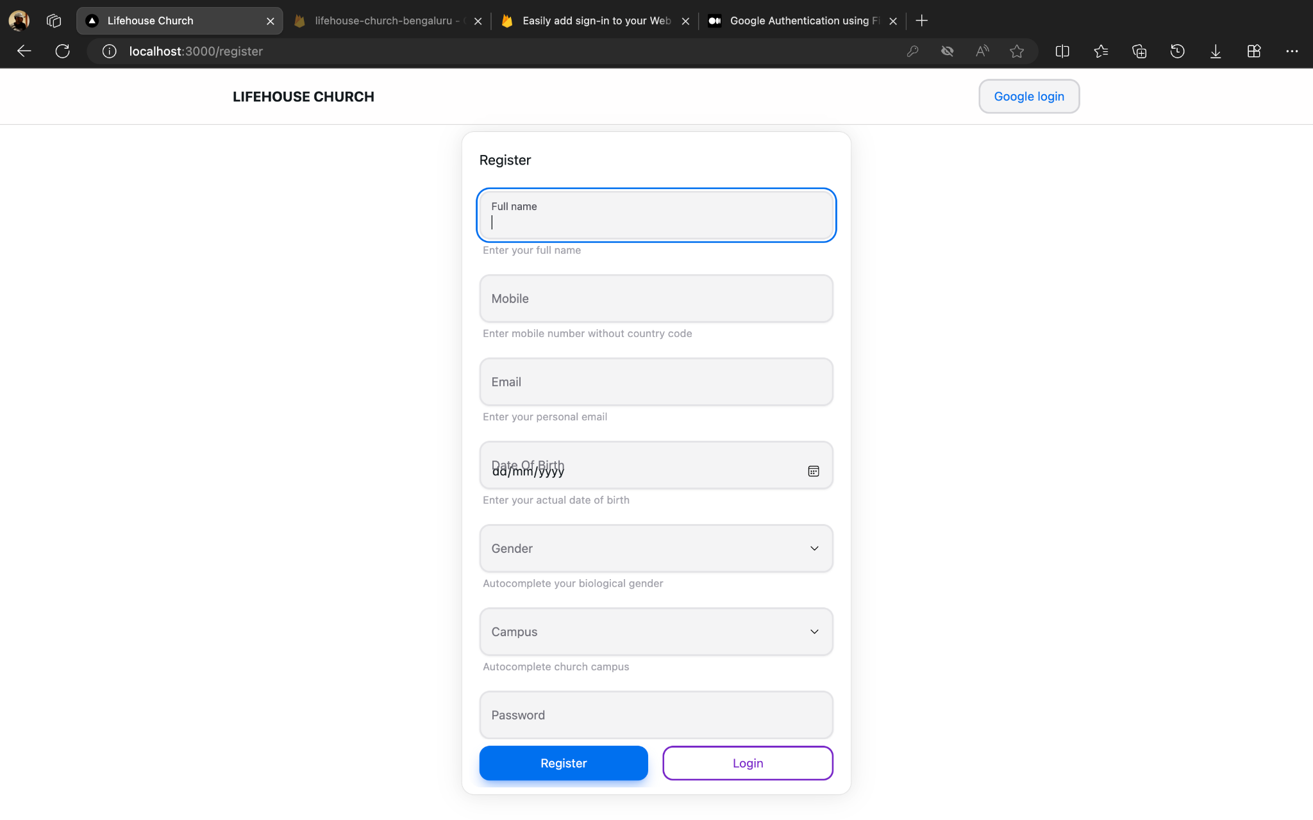
Register

Slide 8
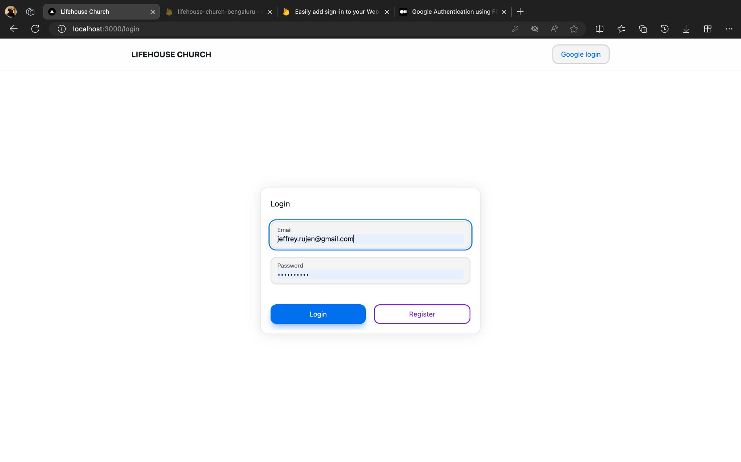
Login

Slide 9
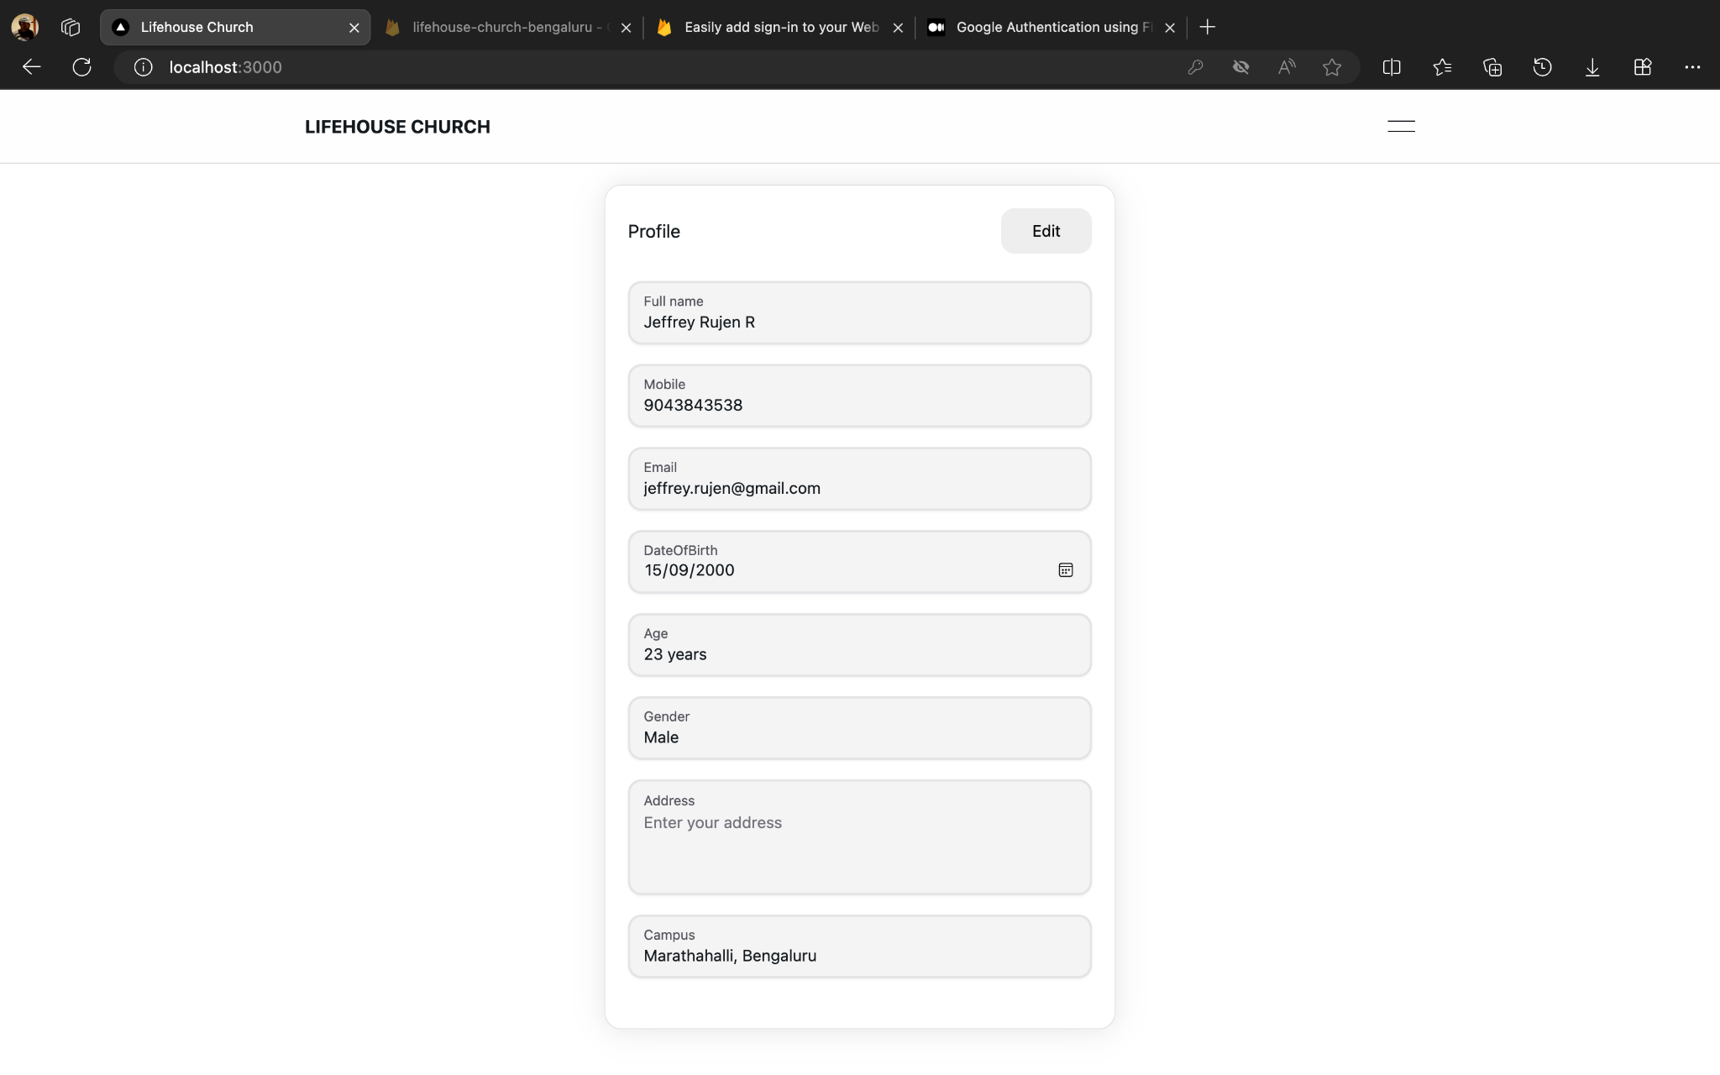
Profile

Slide 10
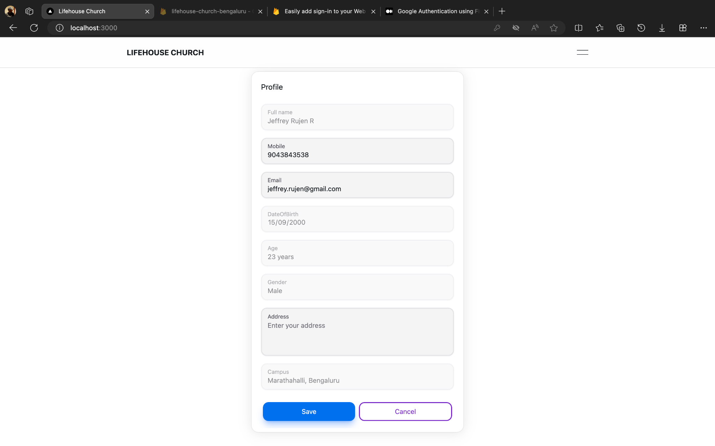
Edit profile

Slide 11
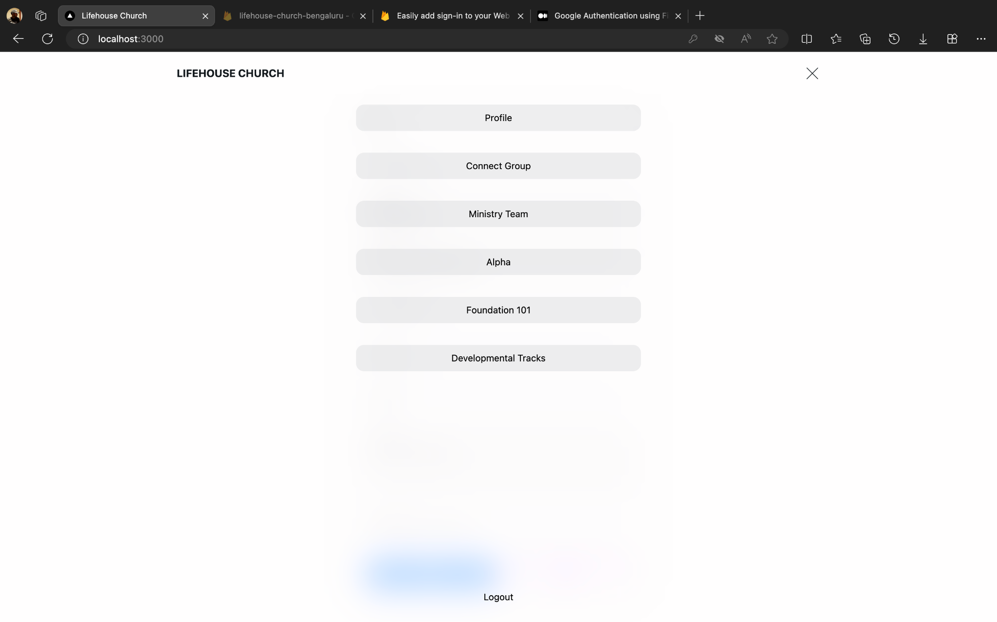
Navbar

