Slide 1
React Native Chat Application
Rajnish Anand ( 2022SP93007)
Ayush Kumar Sinha(2022SP93051)

Slide 2
Introduction
Real-time chat apps facilitate immediate exchange of messages, allowing for quick decision-making and response times in personal and professional scenarios.
React Native allows developers to write a single codebase in JavaScript or TypeScript that can be used to create applications for both iOS and Android platforms. This not only saves time and effort but also ensures consistency across different devices.
Firebase is a comprehensive BaaS platform developed by Google, offering a suite of integrated backend services. These services include real-time databases, authentication, cloud functions, hosting, and more. Developers can leverage these pre-built services to streamline backend development, focusing more on the frontend and user experience.

Slide 3
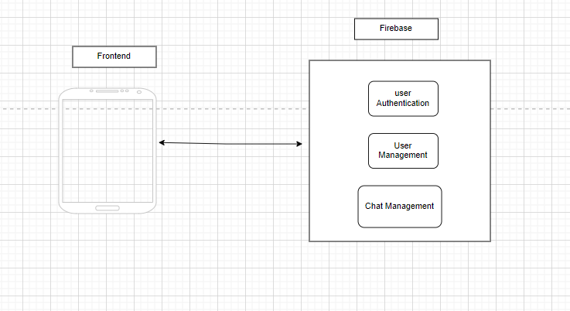
Architecture

Slide 4
How does the chat App Work
Our chat application, developed using React Native and Firebase, ensures a secure and dynamic communication platform. Users register with their email and password through Firebase Authentication, guaranteeing a trusted community. The app facilitates user connections by enabling searches for existing members based on their names. Leveraging Firebase Realtime Database, messages are sent and received in real-time, creating an interactive and responsive chat experience.
In summary, our app provides a comprehensive solution for real-time chatting, combining secure user authentication, efficient search functionality, and instant messaging features for a seamless and engaging user experience.

