Slide 1

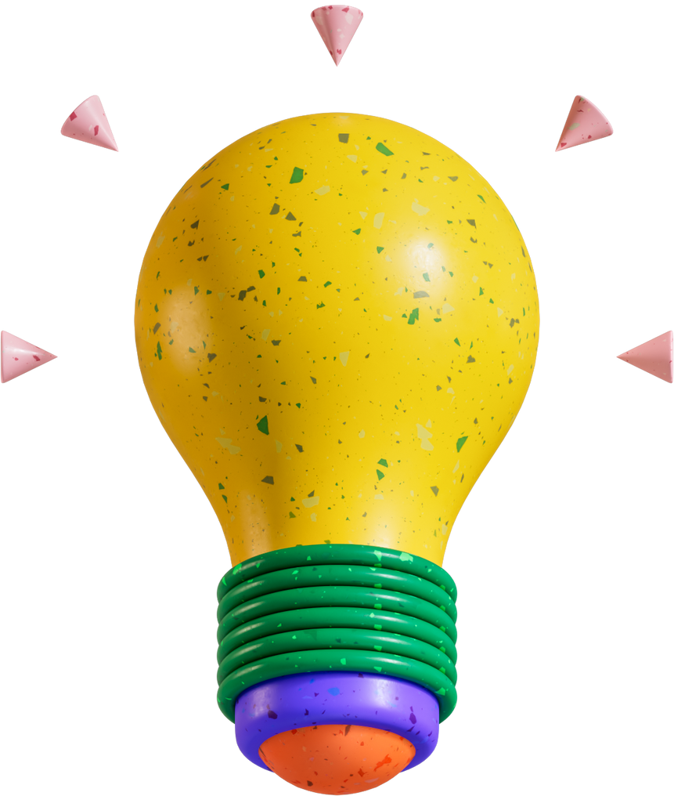

AutoScrum
Automating project tracking....
Tushar Gahlot (2022SP93008) | Abhishek V Tatachar(2022SP93018) | M. Siddharth (2022SP93026)

Slide 2
Current Practices in Teams
What we are proposing?
Teams gather around (or calls) for stand-ups.
GenAI power AI Agent to handle menial tasks of a scrum master.
PO or the SM manually create, update and assign issues to the users.
Automate process such as creating new issues, updating issues and processing scrum updates using an GenAI powered Agent.
Time consuming redundant processes.
The AI Agent is already aware of:
Scrum processes - assigning story points and priority.
Knowledge of the project of the stakeholders.
Exiting older issue details and known impediments.

Slide 3




AI updates the ticket(s) with the details provided by the user / capacity and effort estimation and updates.
Database
AI communicates with the backend to fetch
the status of the tickets or details on any newly created tickets / priority of the tickets.
AI Agent
for Scurm Master
Status of the tasks/backlog items /
Consumed Efforts / Blockers
Analyse the status of the tickets, the updates given my the developers, the bloclers, to update the backend.
Provides updates, backlog status, blockers, efforts consumed.
AutoScrum Application
Analysed outputs
Developer/PO/SM

Slide 4


Bringing the AI Agent in line with the Scrum needs.
RETRIEVAL AUGMENTED GENERATION
FINE TUNING
RAG is a powerful technique that combines prompt engineering with context retrieval from external data sources to improve the performance and relevance of large language models (LLMs). It is especially useful when an application requires the LLM to base its responses on a large set of documents that are specific to the application's context.
Fine-tuning is a technique for improving the performance of LLMs on a specific task. It involves training the LLM on a dataset of labeled examples. The labeled examples provide the LLM with information about how to generate the correct response for a given input.

Slide 5
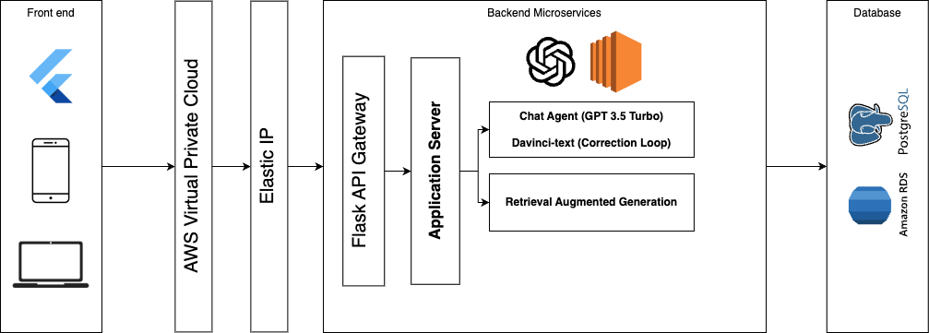
Architecture

