Slide 1
Weather Application
Submitted by:
Team 13
Divya Kumari(2022SP93009)
Shreesha KJ(2022SP93044)
Saurabh Kumar Sharma(2022SP93031)

Slide 2
Weather Application
Description:
WeatherMaster is a user-friendly and comprehensive weather application available for both Android and iOS devices. This app simplifies the process of accessing accurate and up-to-date weather information for any city around the globe. With a sleek and intuitive interface, users can effortlessly input the desired city name and receive detailed weather forecasts in real-time.
Key Features:
1. City-Based Weather Data:
- Users can input the name of their desired city to instantly access current weather conditions.
2. Temperature and Humidity:
- The app provides real-time temperature updates, allowing users to plan their day accordingly.
- Humidity levels are also displayed, aiding users in understanding the overall comfort of the weather.
3. Weekly Weather Forecast:
- WeatherMaster offers a weekly forecast, allowing users to plan for the upcoming days.
- Each day includes predicted temperatures, ensuring users are well-prepared for any changes in weather conditions.

Slide 3
4. Wind Speed Information:
The app provides accurate wind speed data, essential for those who need to consider wind conditions for outdoor activities.
5. Sunny Hours:
Users can access information about the number of sunny hours during the day, assisting in planning outdoor events or activities.on the go. Download the app today to experience a seamless blend of functionality and simplicity for all your weather-related needs.
6.Daily Forecast:
Detailed daily forecasts provide hour-by-hour weather information, helping users plan their activities with precision.
7.User-Friendly Interface:
The app boasts an intuitive and aesthetically pleasing design, making it easy for users to navigate and access the information they need.
8.Multi-Platform Support:
WeatherMaster works on both Android and iOS platforms, ensuring a broad user base can enjoy its features.

Slide 4
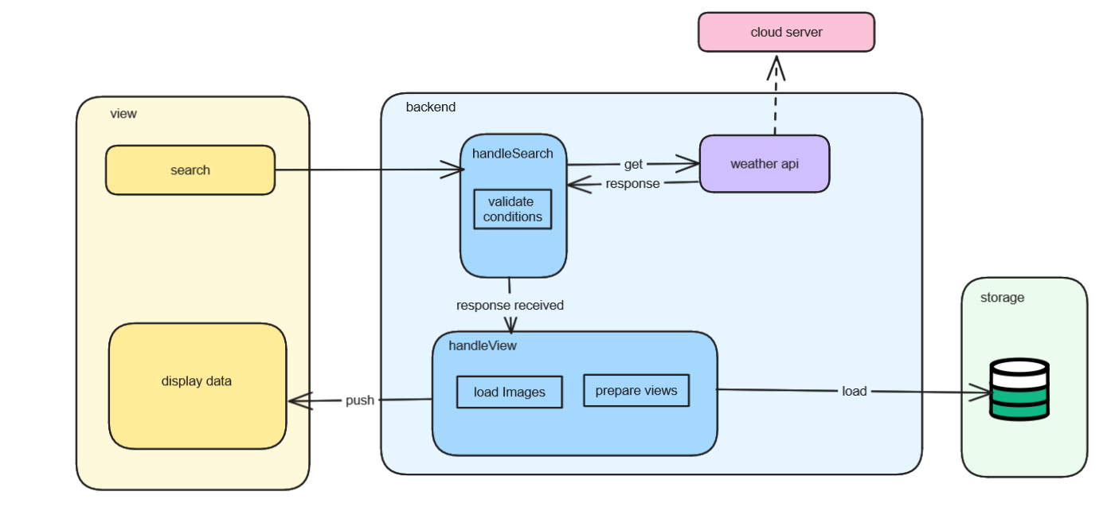
AsyncStorage

Slide 5
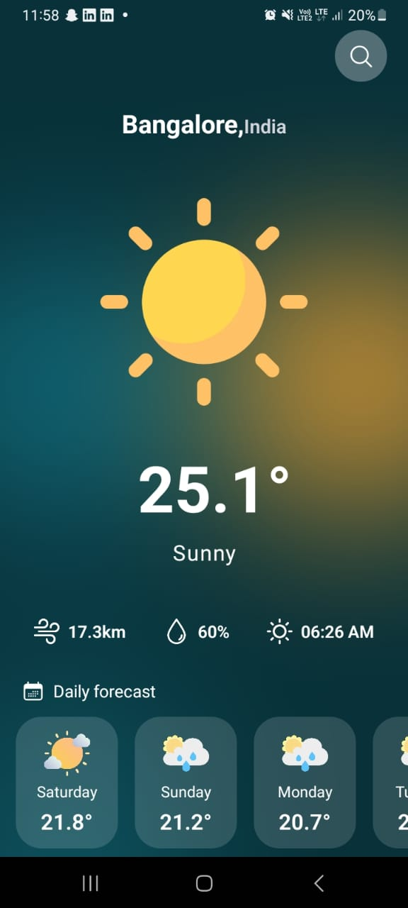
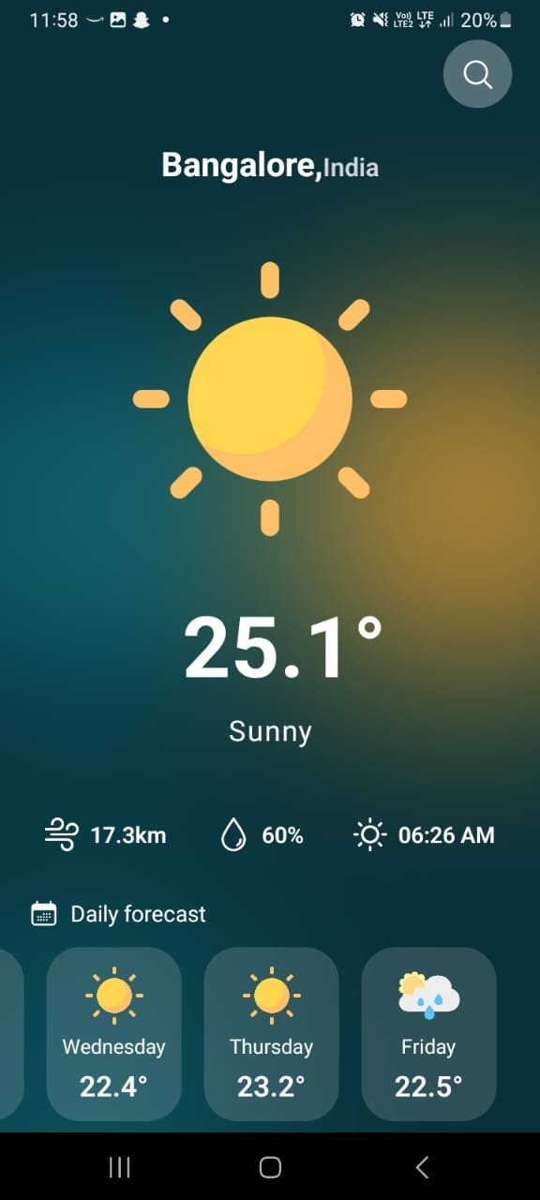

Slide 6
Technology Stack
Front-end:React-Native (Expo Framework)
Backend:Javascript
APIs:WeatherApi(public api)

Slide 7
Challenges Faced
Understanding the use of Expo Framework and how it works for both and ios platforms with same codebase.
Limiting the number of api calls for search bar suggestion of location ( Used debounce function ). Implementing a debounce for the search input to prevent excessive API calls which was tricky.
It was very challenging for us to make sure that when keyboard comes up it doesn’t cover the content of the screen as it was doing it initially.
The app stores the last searched city in async storage. Managing this data and ensuring it's correctly saved and retrieved was a challenge.

