Slide 1

Pharma Code Club
- Get comfortable with coding
16/03-2026
Sebastian Jakobsen (seja@sdu.dk)
Sarah Mittenentzwei (mittenentzwei@health.sdu.dk)
Center for Pharmaceutical Data Science Education

Slide 2
Pharma is full of data, but not of data science. We are here to change that

Slide 3


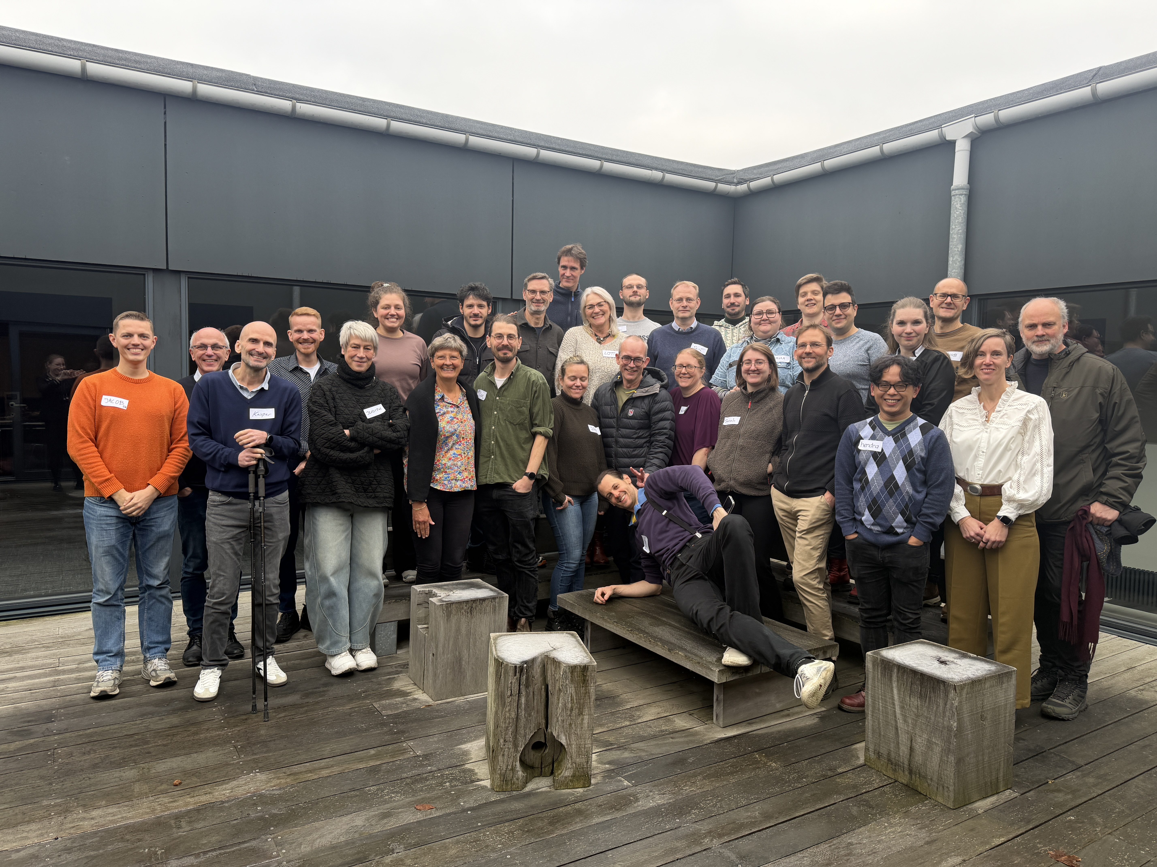
Who is involved in CPDSE?
Department of Computer Science
Department of Physics, Chemistry and Pharmacy
Department of Pharmacy
Department of Public Health
Department of Drug Design
and Pharmacology
Department of Mathematics and Computer Science
Department of Science Education
CPDSE is supported by funding from the Novo Nordisk Foundation, the LEO Foundation, and the Lundbeck Foundation

Slide 4
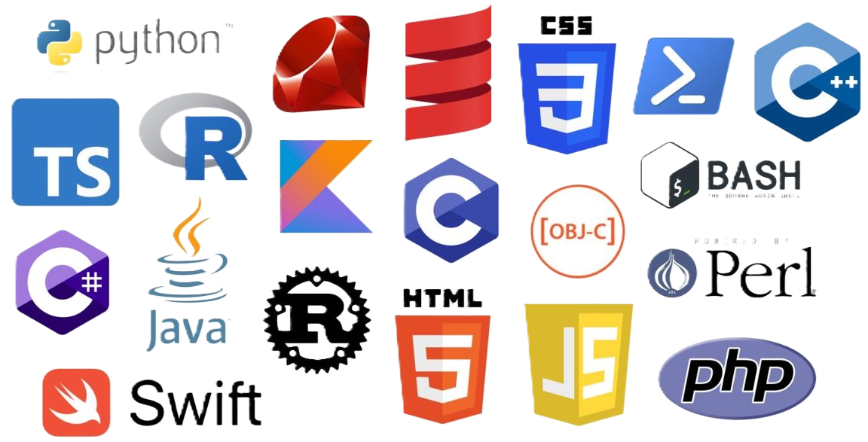
What is a Programming Language?
The Big Idea
A formal set of instructions a computer can understand and execute. → Think of it like a recipe — you list the ingredients (data) and steps (logic) in precise order.
You communicate with the computer through:
Scripts — files of code you write and run
Terminal/Console — a text interface to execute commands
IDE — Integrated Development Environment; your coding workspace (e.g. RStudio, VS Code)
Why do we need coding?
⚡ Automation
Repeat tasks in seconds, not hours
🔁 Iteration
Loop over thousands of data points
📋 Reproducibility
Share & re-run your exact analysis
👨‍💻 Customizability
Build exactly what you need
📈 Scalability
Works on 10 rows or 10 million

Slide 5




What is Data Science?
Domain
Knowledge
(Farma)
Analytics
Programming
Data
Science
Research
Algorithms
Math &
Statistisk
Notes:
Computer Science is an important part both in academia (research) and industry!

Slide 6
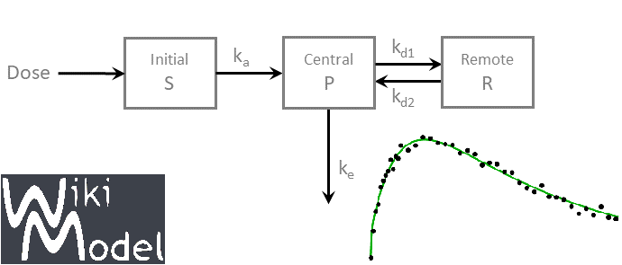
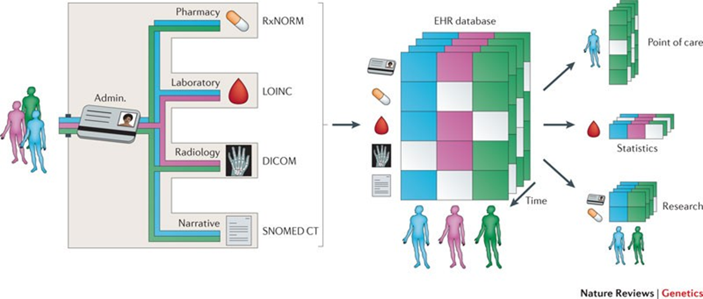
Why Coding in Pharma?
Applications in Pharma Industry
✨ Drug Discovery
ML models predicting compound efficacy
📉 Pharmacokinetics
Modelling drug absorption, distribution, clearance
🧬 Bioinformatics
Genomic data, gene polymorphism (pharmacogenomics)
🏥 Clinical Trials
Statistical analysis, patient subgroup comparisons
📄 Real-world Data
Analysing Electronic Health Registry Data, pharmacovigilance
Notes:
Increased demand for data science skills in the pharma industry
We produce more and more data given the advances in technology

Slide 7
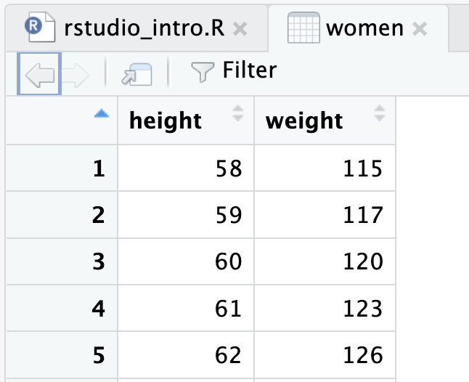

What is an IDE?
A tool that makes working with code much easier! (e.g., RStudio)
# concentration = mass / volume
calculate_concentration<- function(m,v) {
return(m/v)
}
Syntax highlighting
Data Viewer
Debugging
(Eliminating Errors)
# concentration = mass / volume
calculate_concentration<- function(m,v) {
return(m/v)
}
And much more …

Slide 8

Variables & Functions
mass <- 2 # mass in g
volume <- 100 # volume in ml
Variables
Stores values/data
Functions
Performs a specific task
Reusable
# concentration = mass / volume
calculate_concentration<- function(m,v) {
return(m/v)
}
Example: Calulcate Concentration
calculate_concentration(mass, volume)
> 0,2
$$concentration= \frac{mass}{volume}$$
Notes:
FUNCTIONS:
Rule of thumb: if you have to write the same code two (or more ) time -> make a function out of it.
This way, you minimize errors and you have to write less code.
Think of a function like a blender. You can use it to make a smoothie out of bananas and apples. If you want to have another smoothie made of strawberries and apples, you don’t by a new blender – you reuse the one you already have, because it provides exactly the functionality you need!

Slide 9


Variables <- data
Try to always store values in variables
Easier to read the code (If your variables have meaningful names)
Easier to reuse your code (You adjust values in one place, not in 10 different places)
mass <- 2 # mass in g
volume <- 100 # volume in ml
concentration = mass/volume
concentration = 2/100

Slide 10




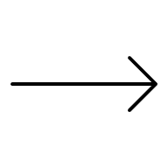

Functions(argument1, argument2)
If you have to write the same code two (or more ) times → Make a function out of it! → Minimizes errors and you have to write less code.
Think of a function like a blender. You can use it to make a smoothie out of bananas and apples. If you want to have another smoothie made of strawberries and apples, you don’t by a new blender – you reuse the one you already have, because it provides exactly the functionality you need!
Variables
Output
Function
Code
Other Variables
Other Output

Slide 11
Libraries and Preexisting Functions
# install package
install.packages("tidyverse")
# import package
library(tidyverse)
Libraries/Packages
Preexisting code
Using functions
Passing arguments
Positional arguments
Named arguments
Documentation
seq() function
# arguments by order
seq(2, 10, 2)
> 2 4 6 8 10
# arguments by name
seq(from = 2, to = 10, by = 2)
> 2 4 6 8 10

Slide 12
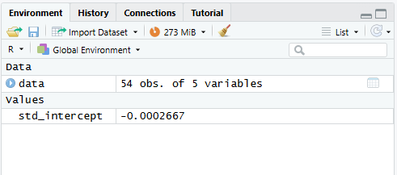
Inspect Errors
← Inspect Data and Values
Read & Google the error message →

Slide 13






Debugging with browser()
Pause the code at a specific line
To continue execution from where you paused, you can type in the console:
c → Continue running the function until the next breakpoint or until it finishes.
n → Execute the next statement (step over).
s → Step into the next function call.
Q → Quit debugging and return to the top-level prompt.
library(tidyverse)
data <- read.csv("dissolution_data.csv")
data <- data %>%
mutate(
conc_ug_ml = ((absorbance + 0.0002667) / 0.04478) * dilution
)
V_total <- 900 # mL
V_sample <- 5 # mL
dose_mg <- 200 # change to your tablet
strengthdata <- data %>%
mutate(
conc_mg_ml = conc_ug_ml / 1000, # µg → mg
sample_mg = conc_mg_ml * V_sample # mass removed each sample
)
Some error in the code
What is stored in the variables right now?
Run Code
browser()
Code crushes
Notes:
Missing line of Code: std_slope <- 0.04478 # absorbance units per µg/mL
Use it to learn about functions & to understand code!

Slide 14
Try it yourself?
github.com/CPDSE-EDUX/SDU-CodeClub

