Slide 1
Data Visualization Workshop

Slide 2
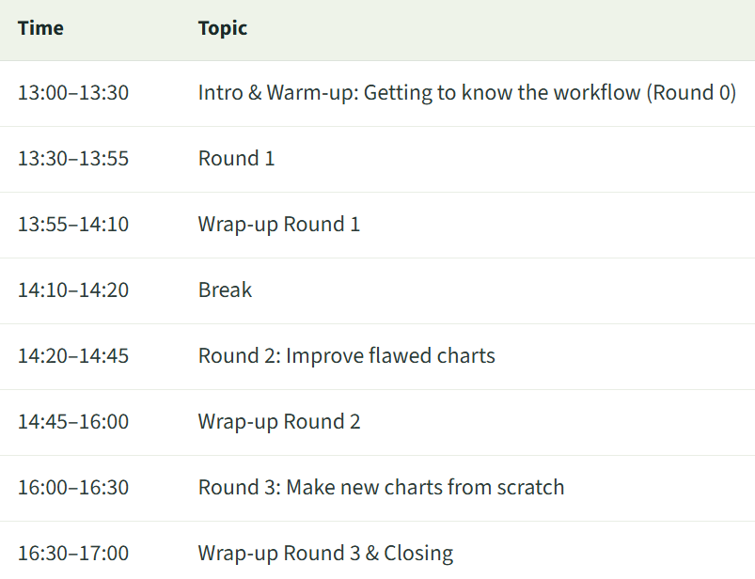
Time Table
A round consists of
Download flawed chart & data
Prompt Claude to change the chart
Copy&Paste your chart to Miro
Reflection round

Slide 3
Time Table
Let me know if something is too slow or fast!

Slide 4
There is nor right or wrong!

Slide 8
Gamma
Alpha
Beta
Delta
Epsilon
Zeta

Slide 9
Gamma
Alpha
Users (thousands)
Beta
Delta
Epsilon
Zeta

Slide 10
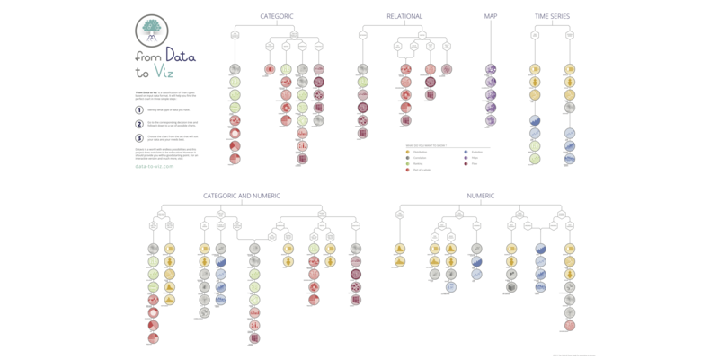
data-to-viz.com

Slide 11
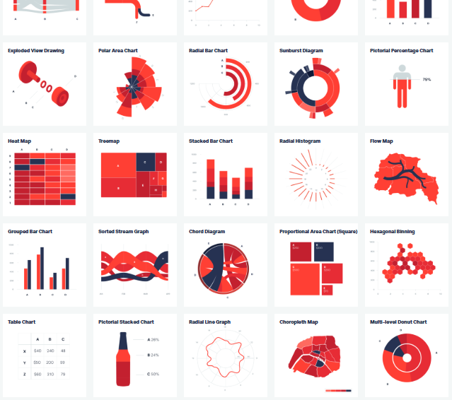
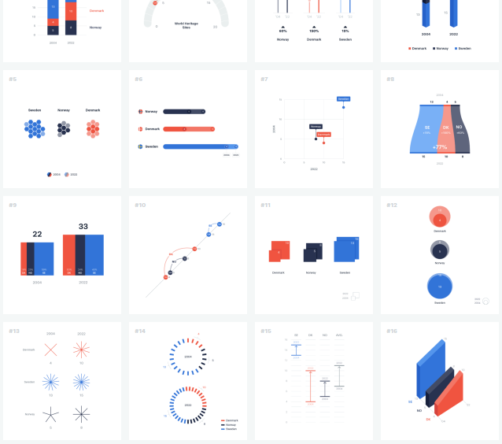
datavizproject.com
100.datavizproject.com

Slide 12
How to Make Charts with AI
Make up your own mind first, then prompt
Check if data is represented correctly
  Do not fall into the “It looks sexy but it’s wrong.” – trap
Save the generated code/script for reproducability

Slide 13
AI Input
Data
  If it is not self-hosted AI, be mindful of privacy and sensitive data!
Prompt
  Specify what you want in detail
Images
  Examples of other charts
  Sketches

Slide 14
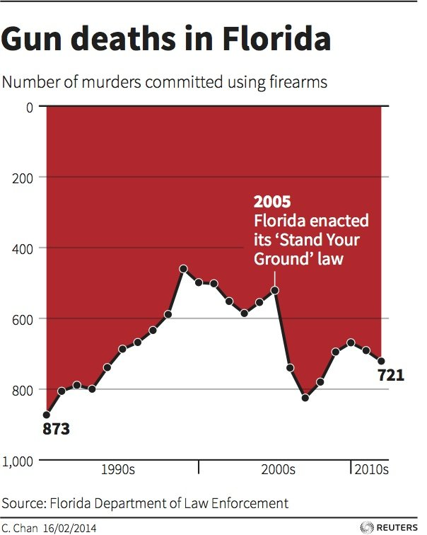
Round 0
Let’s Try it Together!
Notes:
The Y-axis almost always rises from the bottom to the top of the graphic. Here is an example with a reverse Y-axis. It comes from an article in business insider and describes the evolution of gun deaths in Florida.
Disclaimer: I found this image on KD Nuggets

Slide 15
cpdse.dk/dataviz

