Slide 1
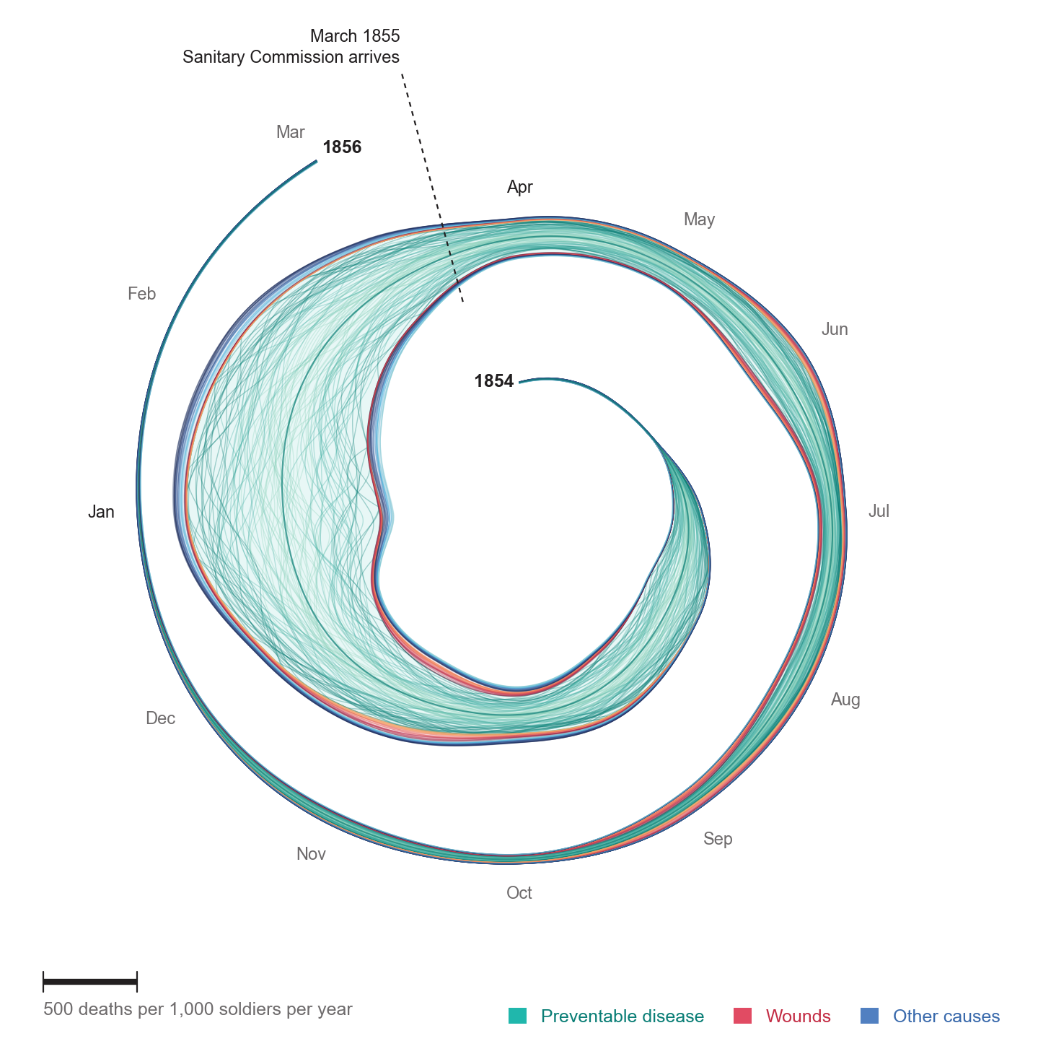
Introduction to Data Visualization
Sarah Mittenentzwei, CPDSE
SDU – IST, Clinical Pharmacology, Pharmacy and Environmental Medicine

Slide 2
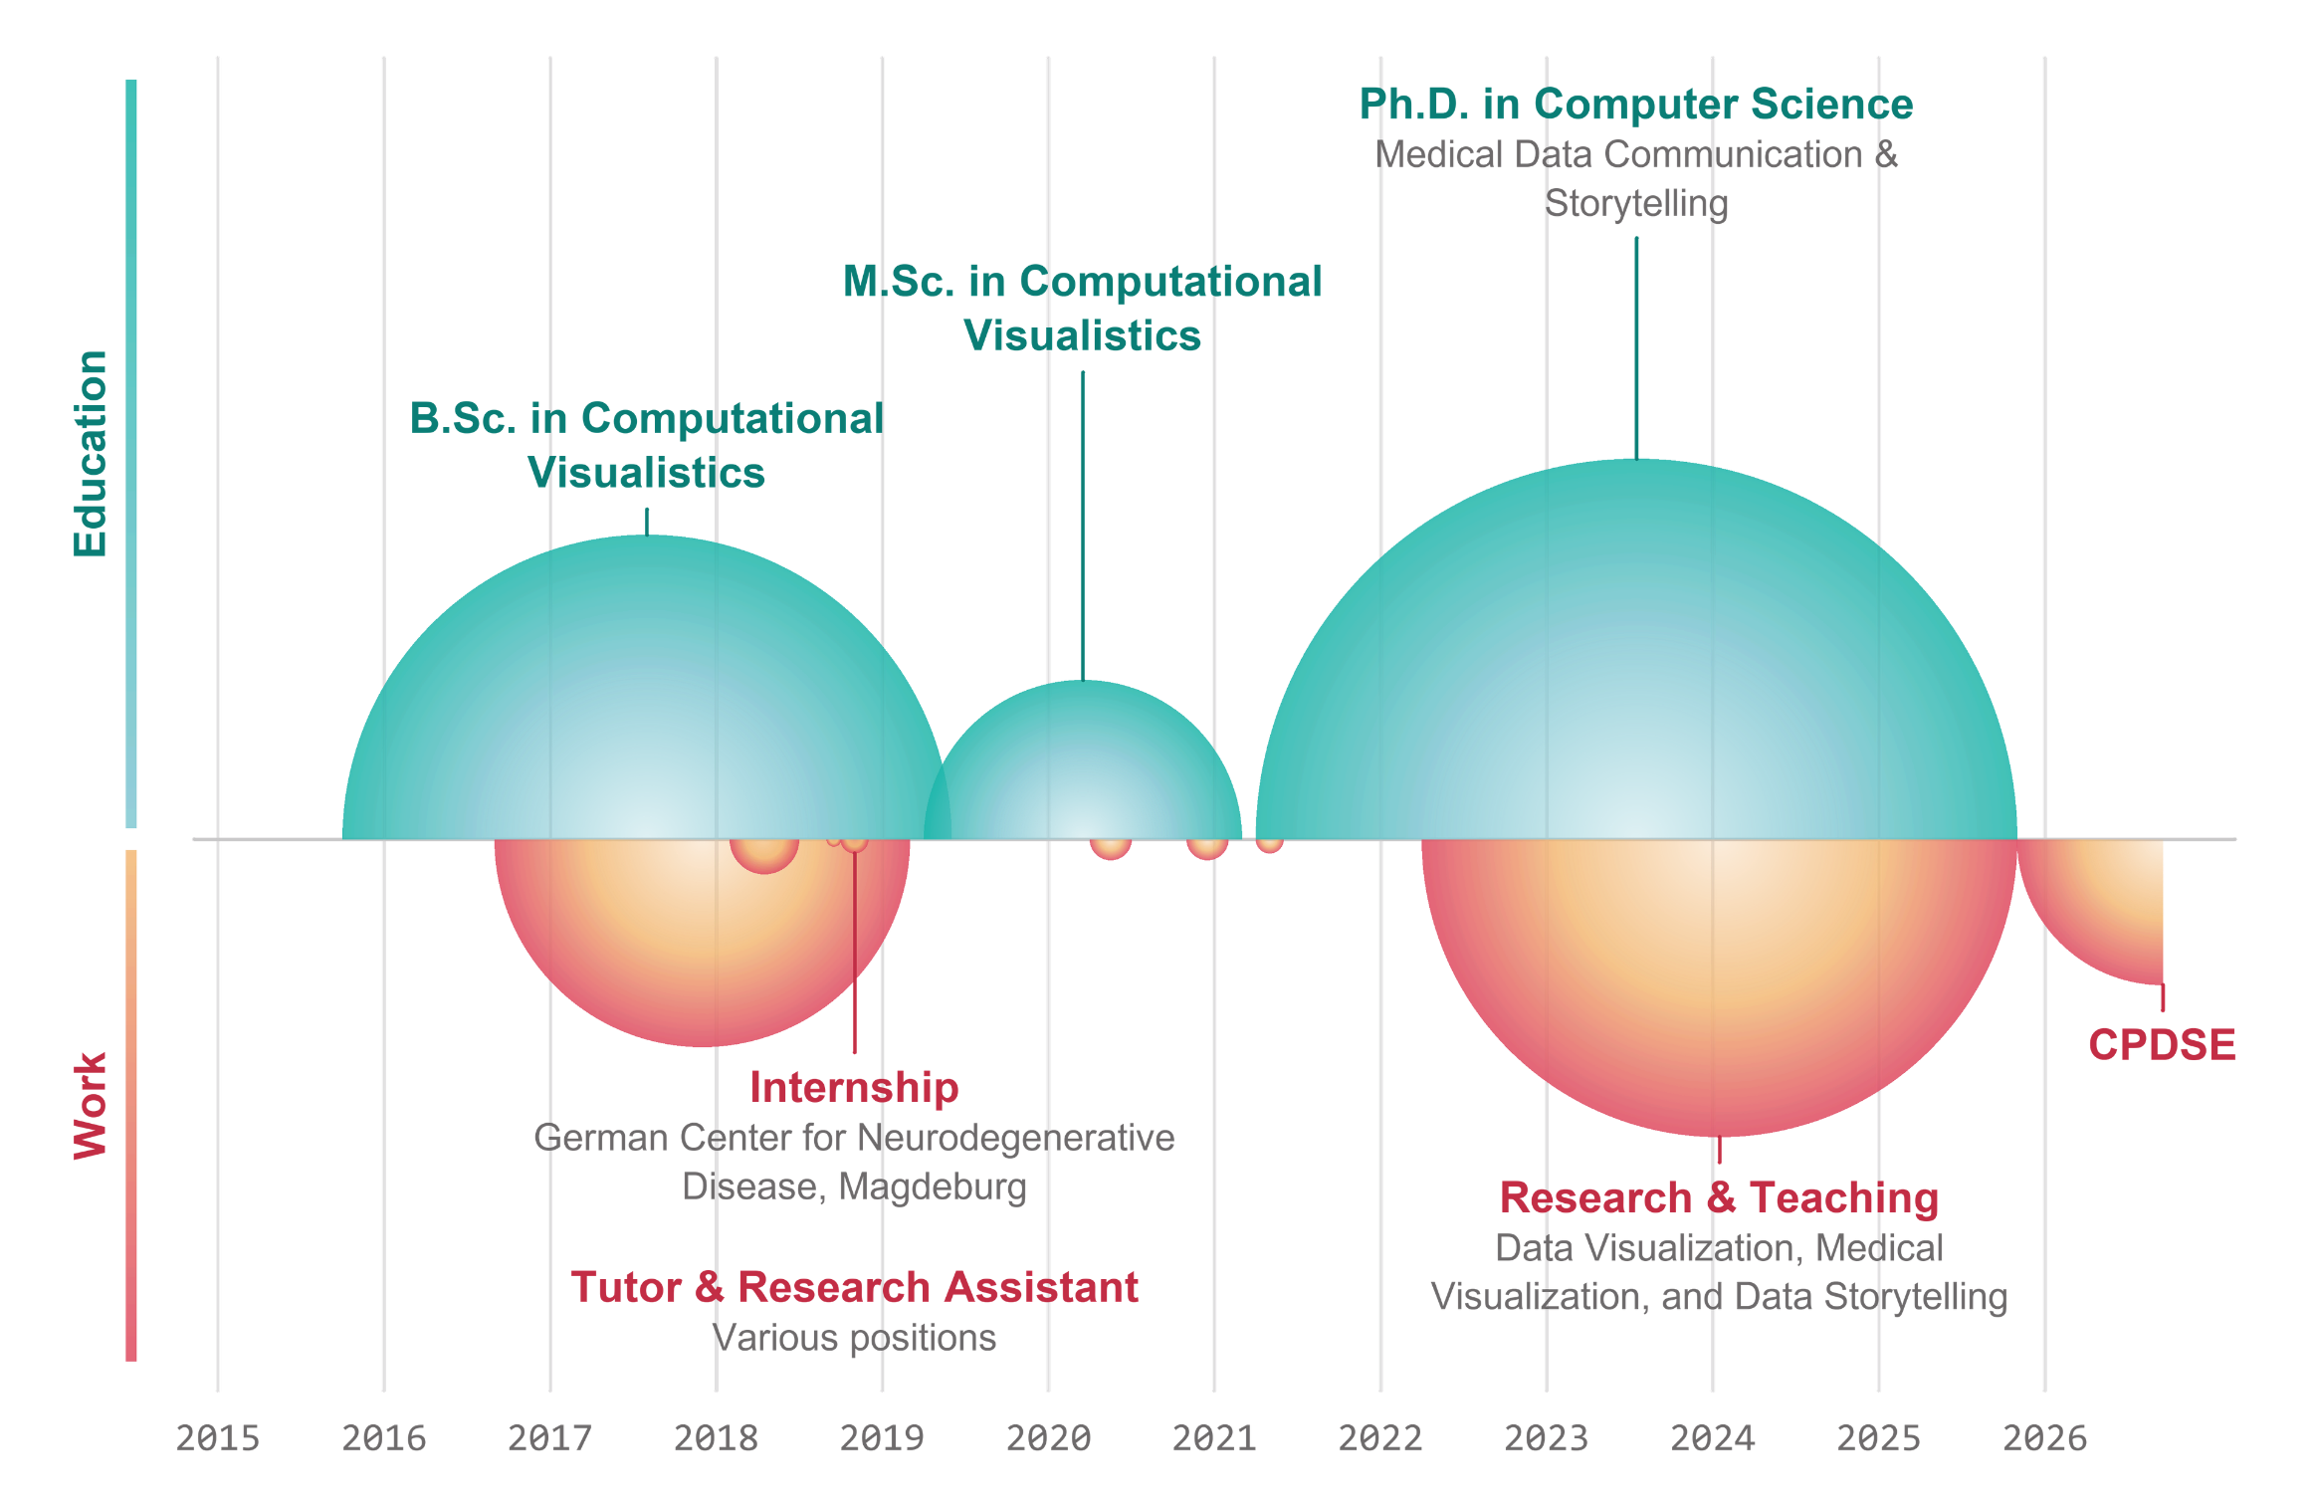
Who am I

Slide 3
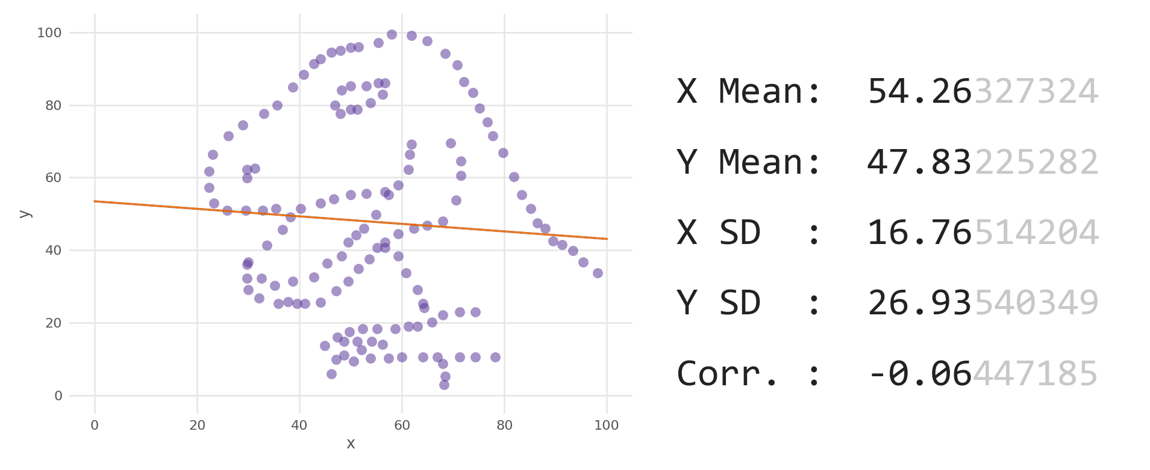
The Datasaurus Dozen

Slide 4
Always plot your data

Slide 5
Visual perception
01

Slide 6
Human Perception
Pre-attentive
Processed in parallel
A quarter of a second or less
No effort, no searching
Only a handful of features
Attentive
Processes one item at a time
Slower with every item added
Needs focus and memory
Reading, counting, comparing

Slide 7
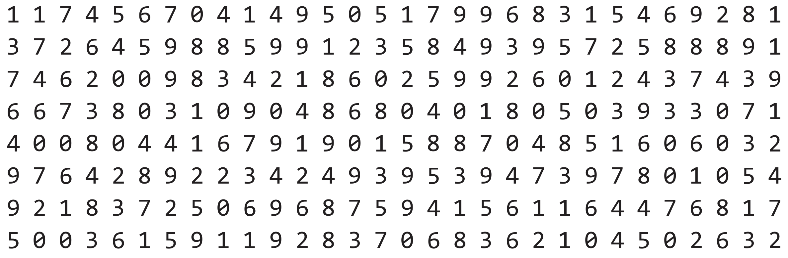
How many 3s are in this block?
Attentive

Slide 8
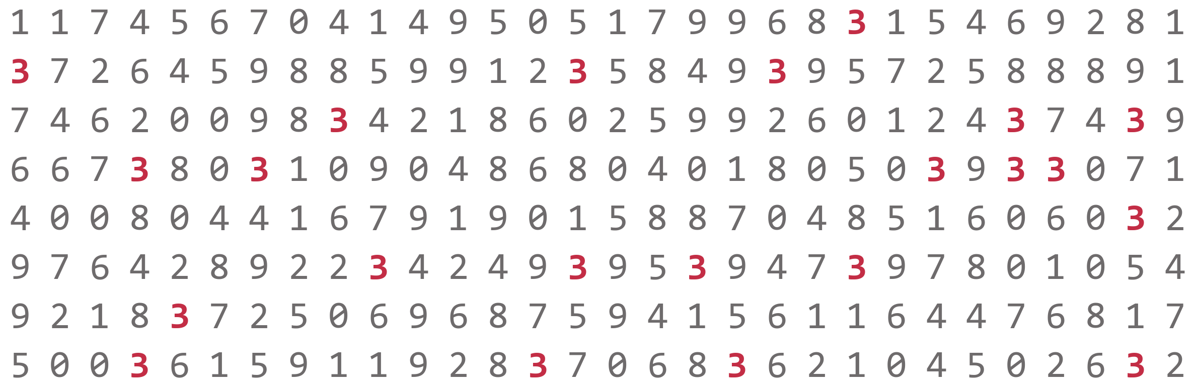
22
Pre-attentive

Slide 9

Find the odd one out
Color
Healey, C., & Enns, J. (2011). Attention and visual memory in visualization and computer graphics. IEEE transactions on visualization and computer graphics, 18(7), 1170-1188.

Slide 10

Find the odd one out
Shape
Healey, C., & Enns, J. (2011). Attention and visual memory in visualization and computer graphics. IEEE transactions on visualization and computer graphics, 18(7), 1170-1188.

Slide 11

Find the odd one out
Color and Shape
Healey, C., & Enns, J. (2011). Attention and visual memory in visualization and computer graphics. IEEE transactions on visualization and computer graphics, 18(7), 1170-1188.

Slide 12
Find the red circle
Color and Shape
Healey, C., & Enns, J. (2011). Attention and visual memory in visualization and computer graphics. IEEE transactions on visualization and computer graphics, 18(7), 1170-1188.

Slide 13
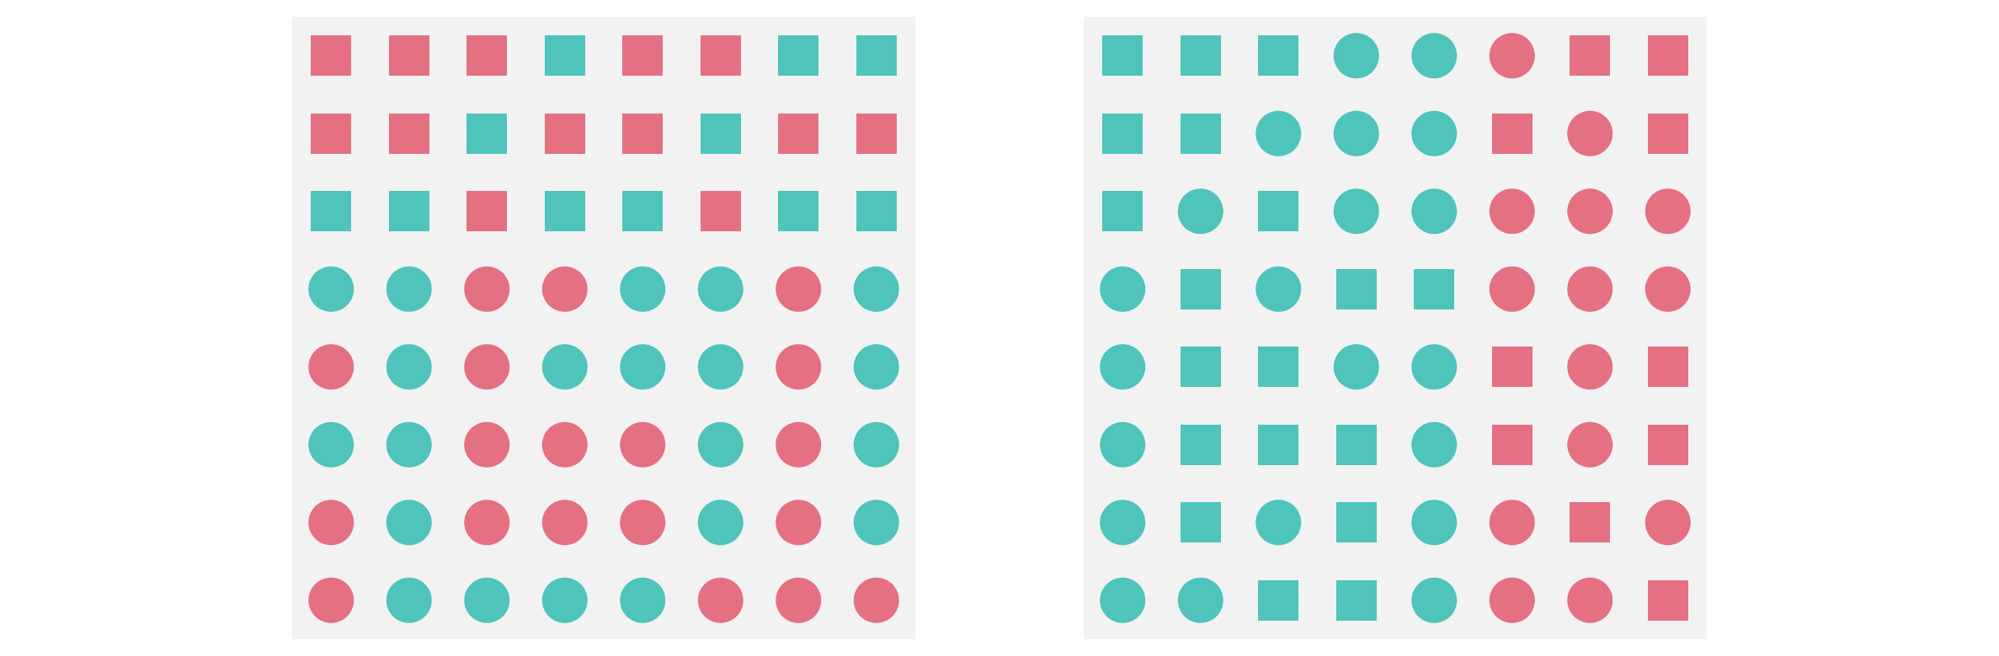
Which is boundary is easier to see?
Healey, C., & Enns, J. (2011). Attention and visual memory in visualization and computer graphics. IEEE transactions on visualization and computer graphics, 18(7), 1170-1188.

Slide 14
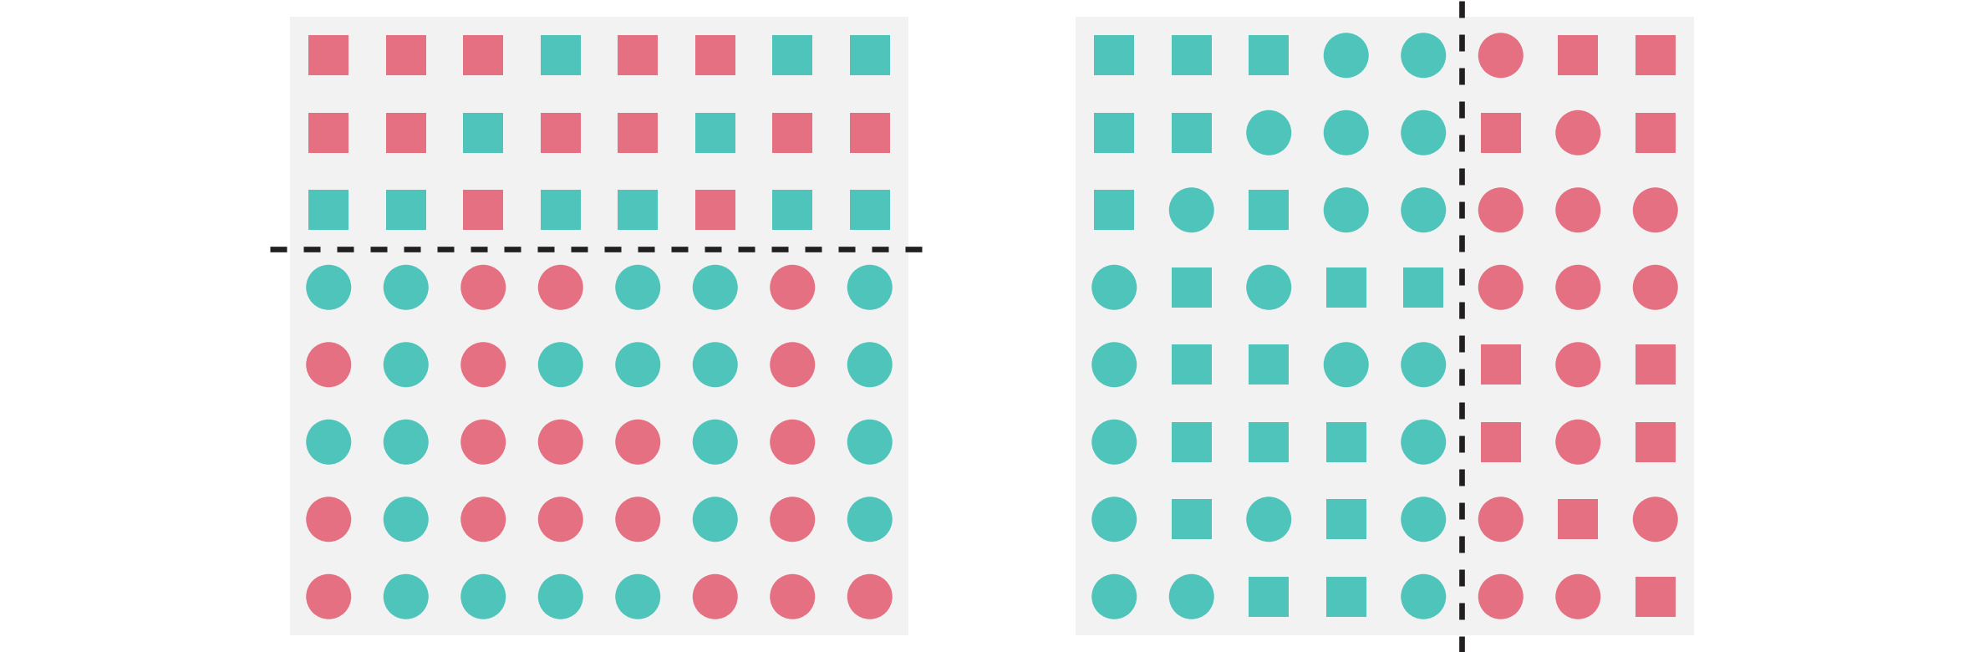
Hue boundary preattentively identified
Hue-on-form hierarchy
Healey, C., & Enns, J. (2011). Attention and visual memory in visualization and computer graphics. IEEE transactions on visualization and computer graphics, 18(7), 1170-1188.

Slide 15
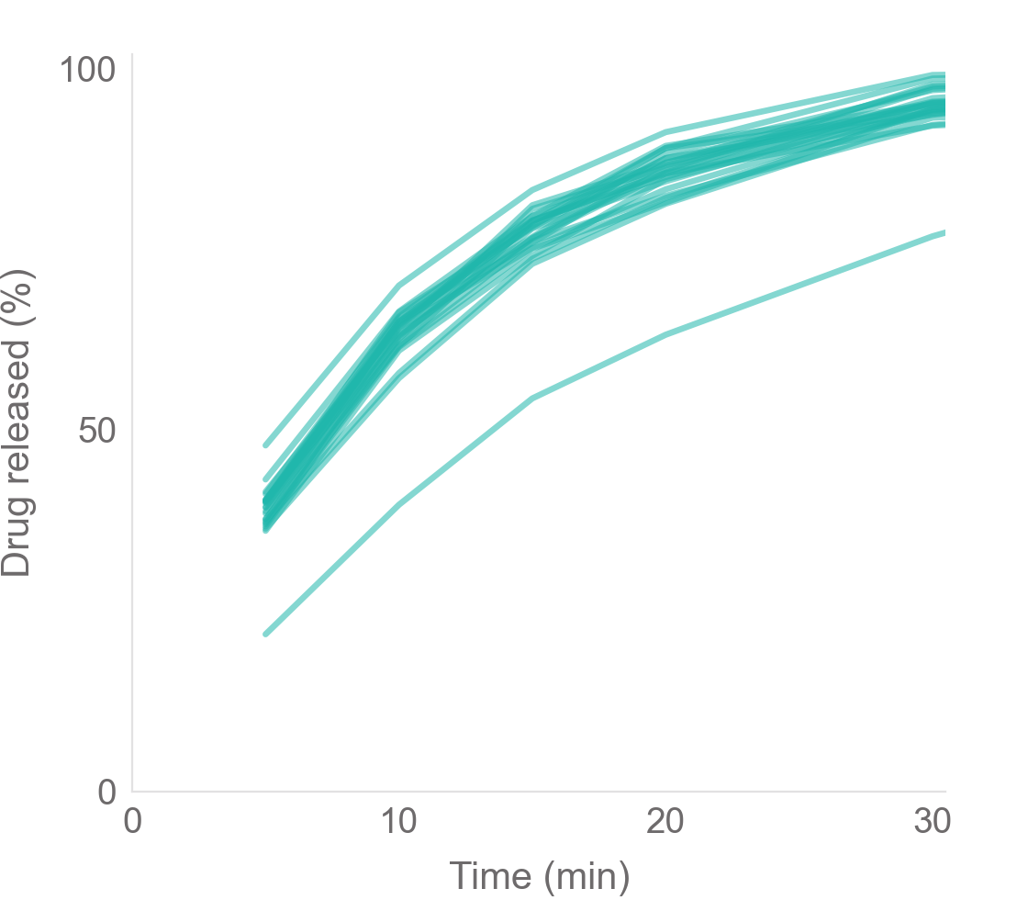
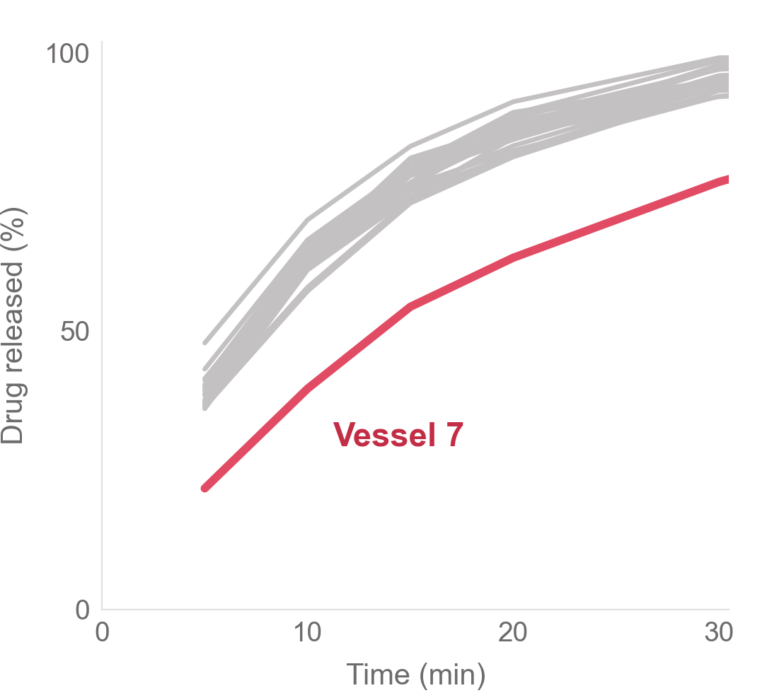
You read the chart
The chart tells you

Slide 16
Data types and visual encodings
02

Slide 17
Types of data
Data
Categorical
Numerical
Nominal
Ordinal
Discrete
Continuous
no order
order
separate values
any value
1
2
3
Batch A, B or C
Mild, moderate, severe
Number of tablets
Tablet weight: 498.3 mg
„Same or different“
„More or less“
„How much more“

Slide 18
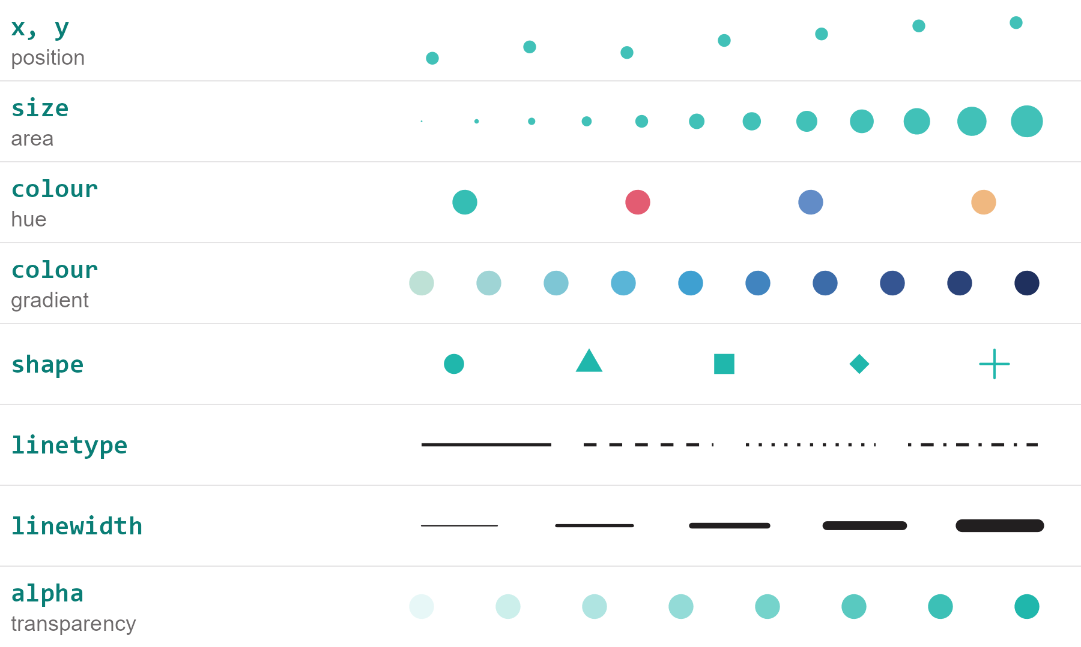
Visual Encodings

Slide 19
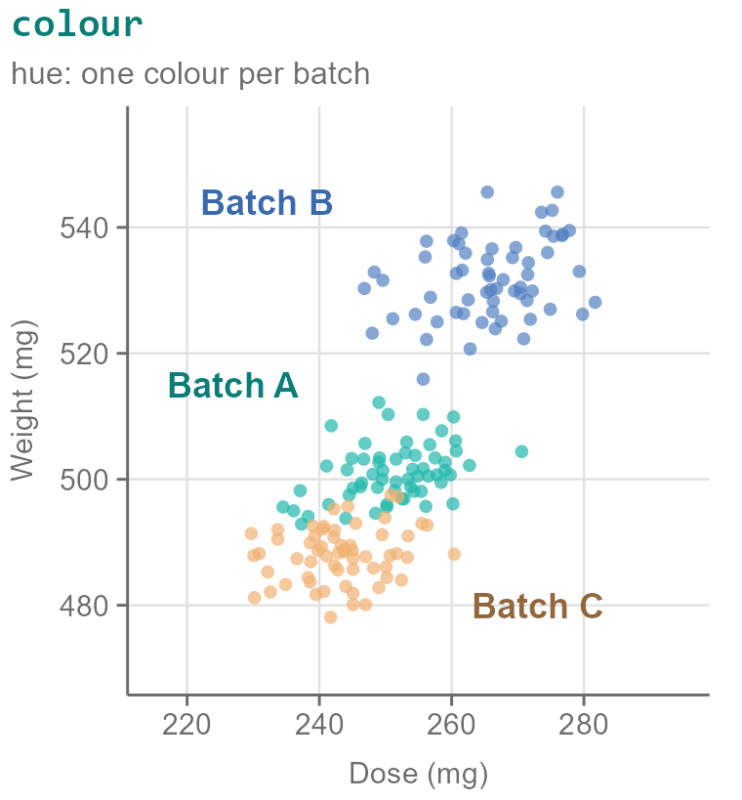
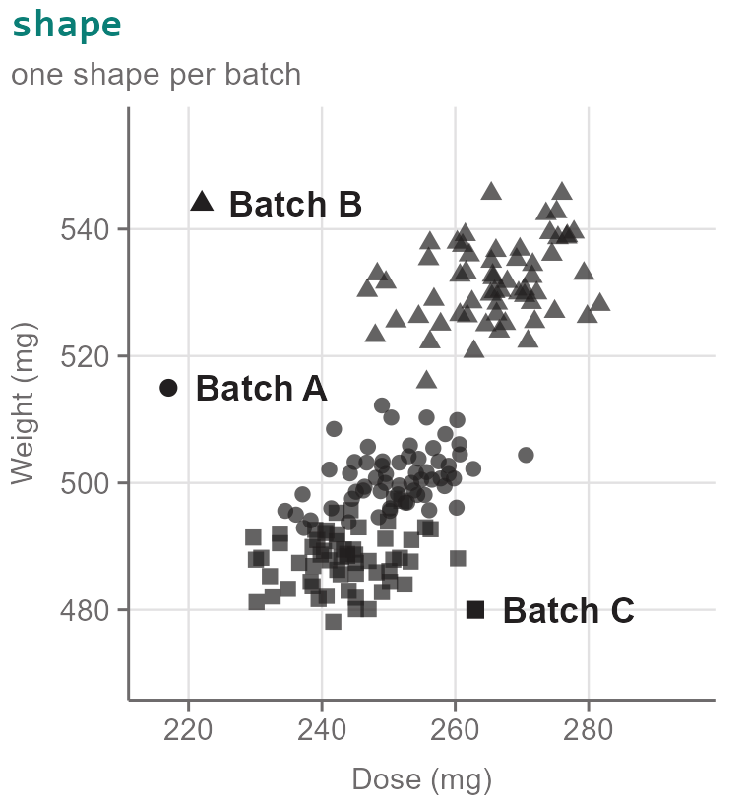
Nominal
no order
Batch A, B or C

Slide 20
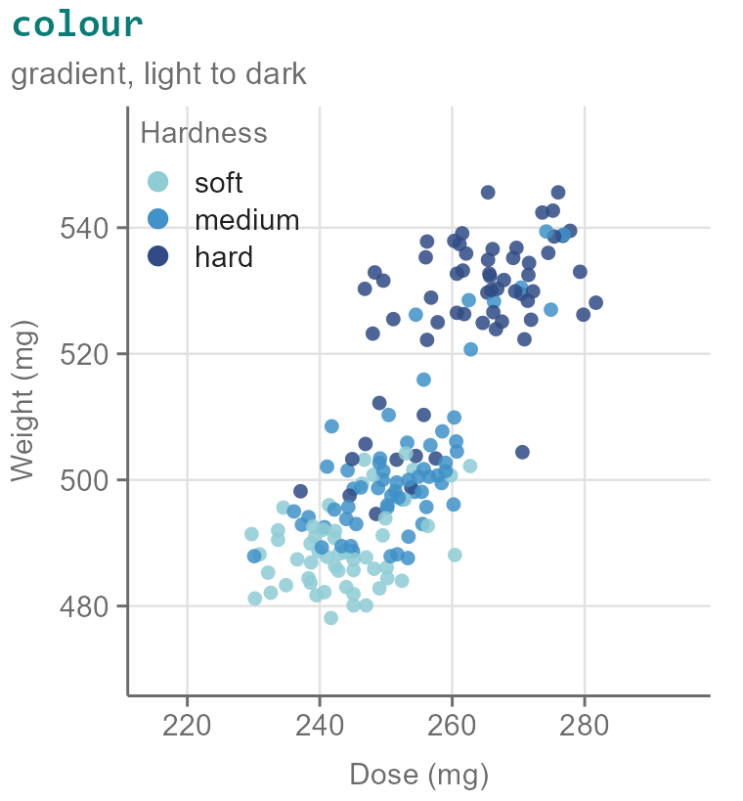
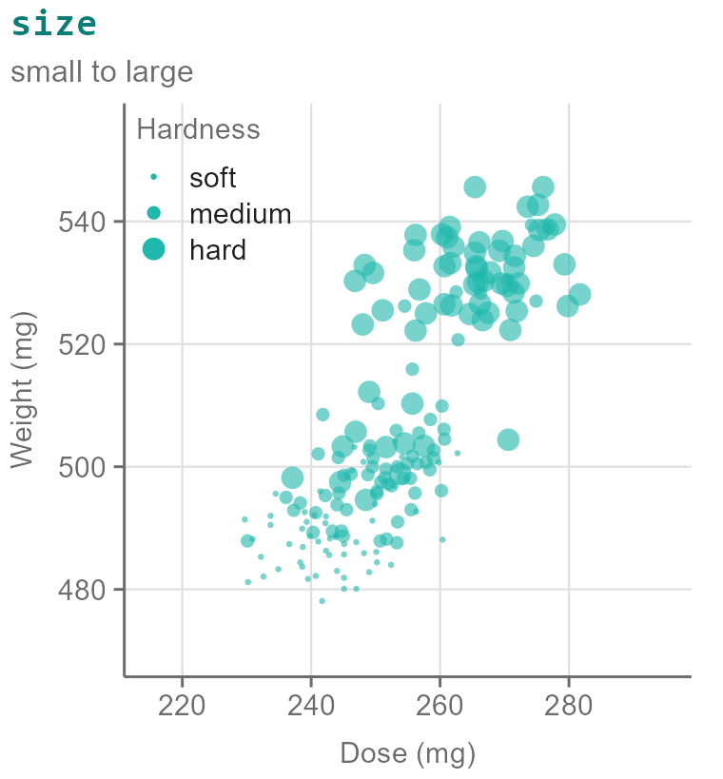
Ordinal
order
Mild, moderate, severe
Discrete
separate values
1
2
3
Number of tablets

Slide 21
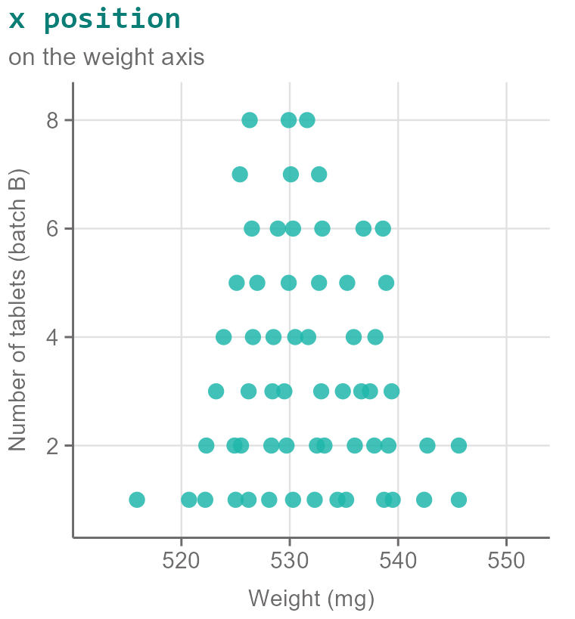
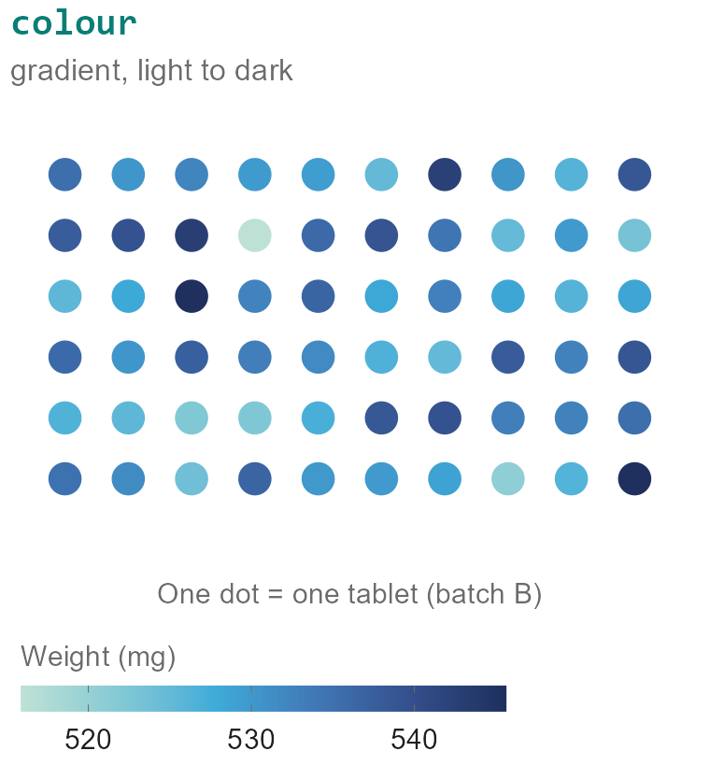
Continuous
any value
Tablet weight: 498.3 mg

Slide 22
Color
03

Slide 23
Colors
HEX
#D05A57
Colors are not just red, green, blue, purple, yellow, orange, …
One color is created through different components
Different systems use different components to create the same color
RGB
RGBA
208
90
87
0.5
Red
Green
Blue
Alpha
(Transparency)
HSV
1
58.2
81.6
Hue
Saturation (%)
Value (%)

Slide 24
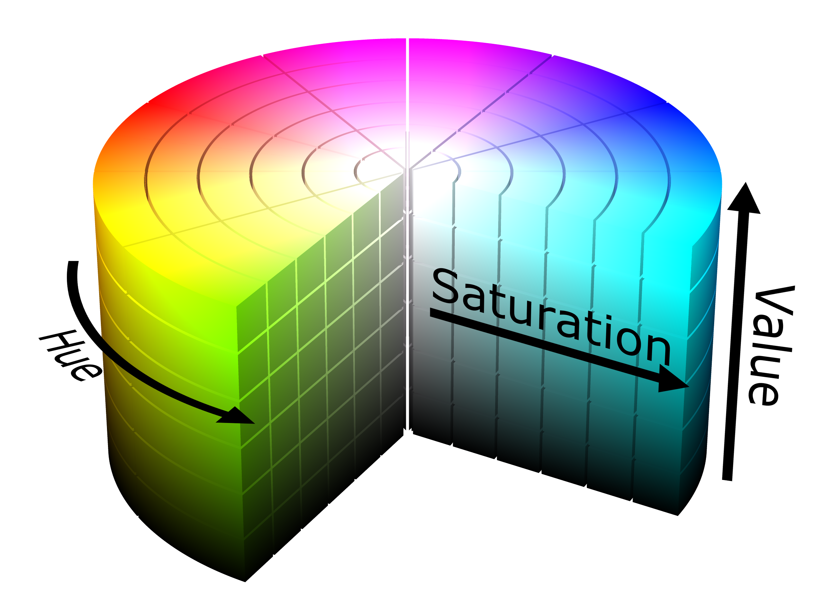
HSV Colors
Hue: blue, green, red, purple, …
Saturation: muted vs. vibrant
Value (Brightness): dark vs. light

Slide 25
HSV Colors
Fx: Blue, vibrant, dark

Slide 26
HSV Colors
Fx: Blue, vibrant, medium bright

Slide 27
HSV Colors
Fx: Blue, muted, medium bright

Slide 28
HSV Colors
Fx: Green, muted, medium bright

Slide 29
Colorblindness
Change in hue and saturation is sometimes not perceivable
Change in brightness value is usually perceivable!

Slide 30
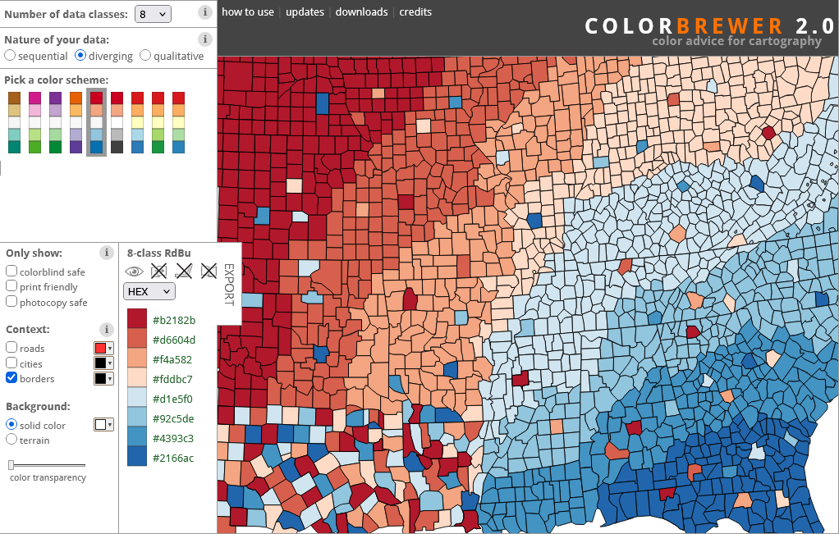
colorbrewer2.org

Slide 31
Sequential Color Map
Continuous
Ordinal
any value
order
Tablet weight: 498.3 mg
Mild, moderate, severe
One-direction scale for ordered data
Continous scale for continuous data
Discrete scale for
  Discrete numerical data
  Ordinal data
Low
High

Slide 32
Diverging Color Map
Continuous
Ordinal
any value
order
Tablet weight: 498.3 mg
Mild, moderate, severe
Two-sided sequential scale around a meaningful mid point.
Use for data where the mid is important
Mid
Low
High

Slide 33
Categorical Colour Map
Nominal
no order
Batch A, B or C
Distinct colors with no order
Use for nominal data

Slide 34
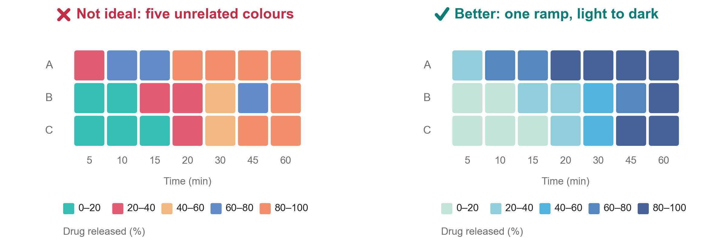
Use a sequential palette for numerical data

Slide 35
Chart types & pitfalls
04

Slide 36
Learn the rules, then break the rules

Slide 37
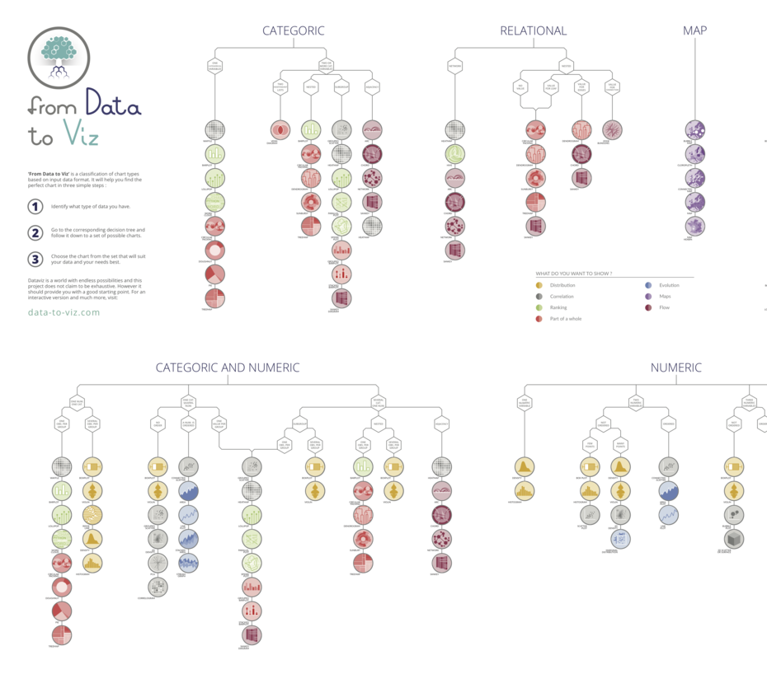
Chart Types
100.datavizproject.com
www.data-to-viz.com

Slide 38
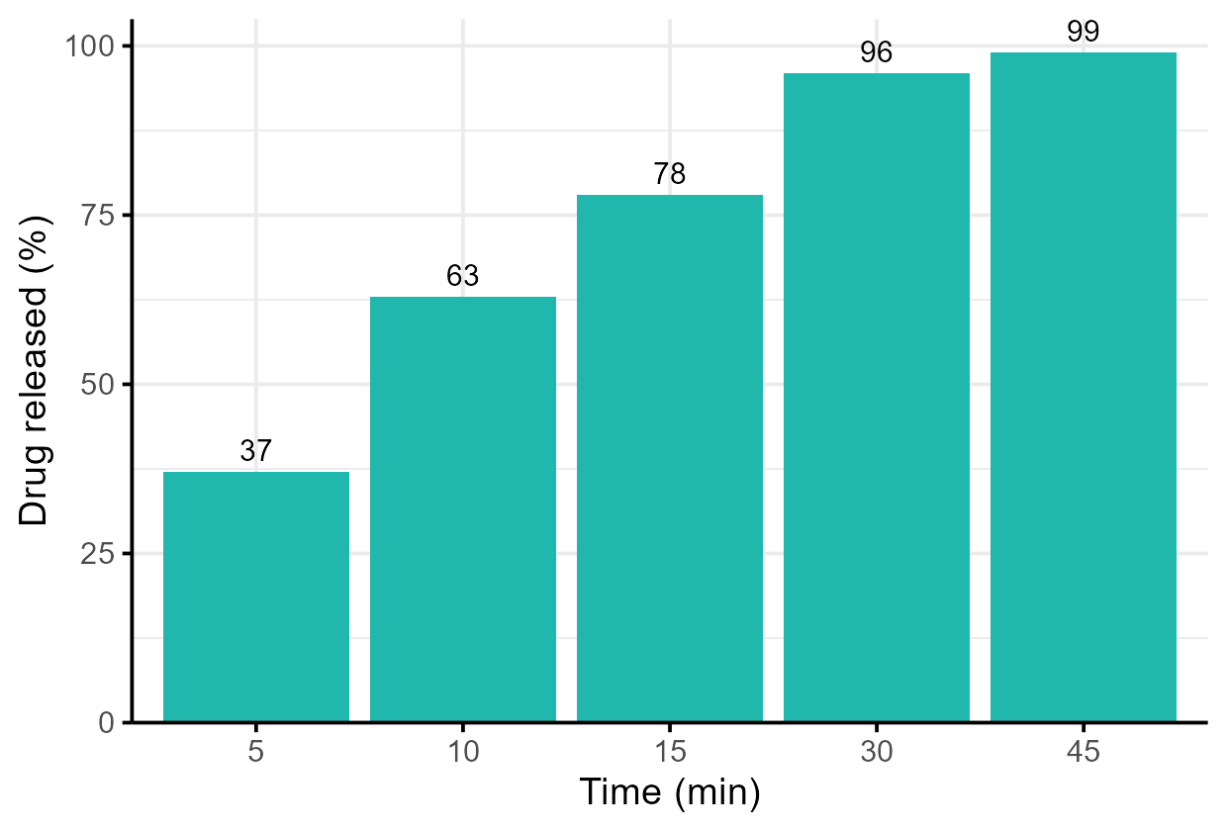
Ticks
theme(axis.ticks)
Gridlines
theme_minimal()
Data labels
geom_text()
Axis labels
labs(x = ..., y = ...)
Canvas
ggplot()
Y-axis
aes(y = released_pct)
Data
geom_col(fill = ...)
X-axis
aes(x = time_min)

Slide 39
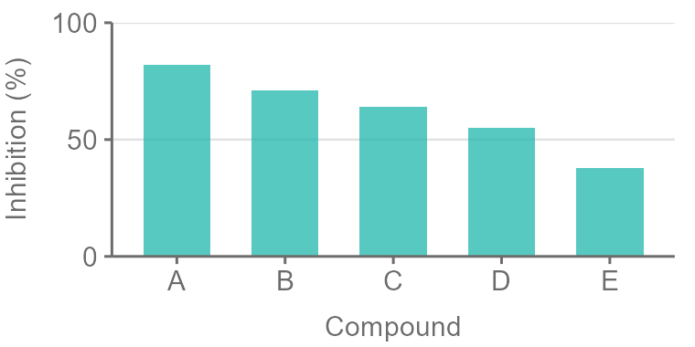
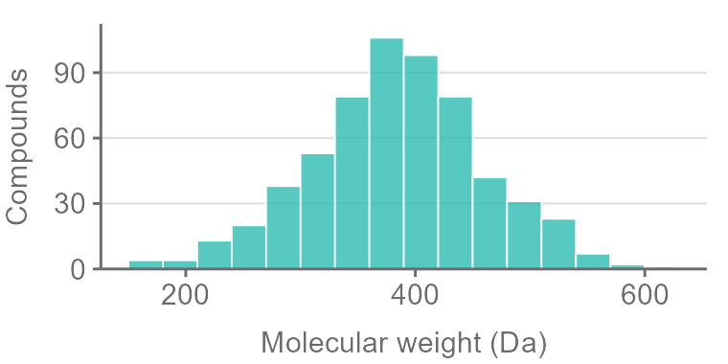
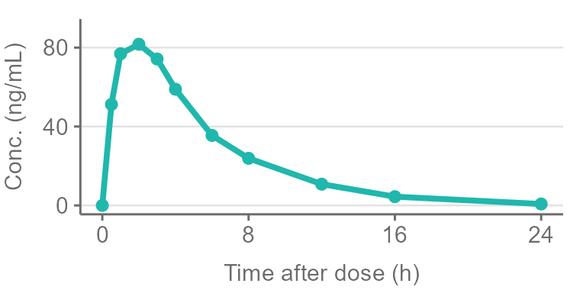
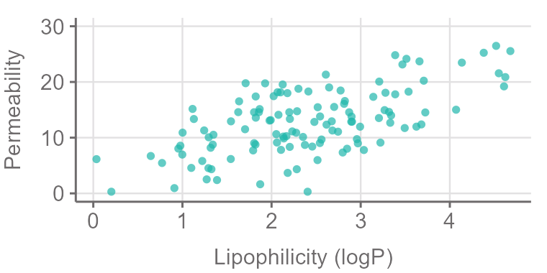
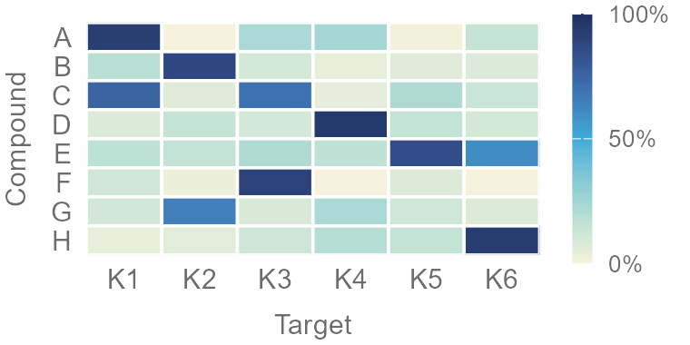
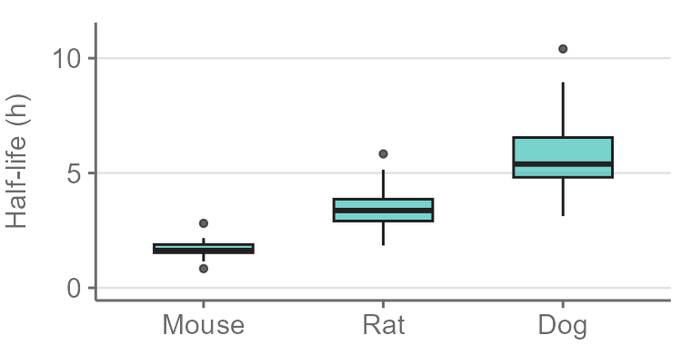
Bar chart
Encoding: bar length/position of bar’s end
Task & Data: Compare numerical data across categories
Histogram
Encoding: bar length/position of bar’s end
Task & Data: Counts frequency of numeric data values
Line chart
Encoding: vertical position
Task & Data: Show trends in continous data (less common for categorical data)
Scatterplot
Encoding: 2D position
Task & Data: Show relationship between 2 numeric variables
Heatmap
Encoding: Color
Task & Data: Shows usually numeric data values across categories (less common for categorical data)
Boxplot
Encoding: Position/Length of box, line, whiskers, outliers
Task & Data: Shows spread and median of numerical data across categories

Slide 40
Simplify

Slide 41
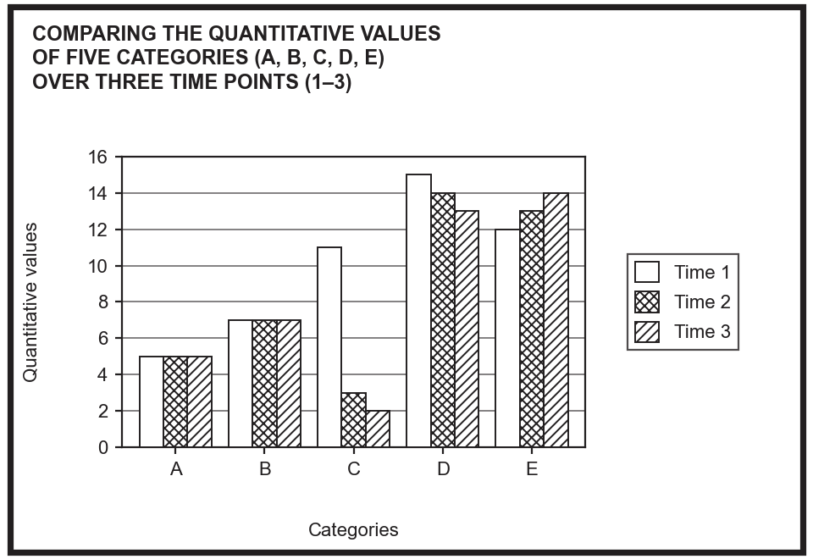
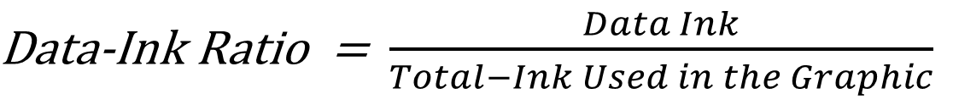
Pixels that cannot be removed without loosing information
$\text{Data‑Ink Ratio}$ = $\frac{Data Ink}{Total−Ink Used in the Graphic}$
Target a number above 0.75
(min 75% of colored pixels should hold information)

Slide 42
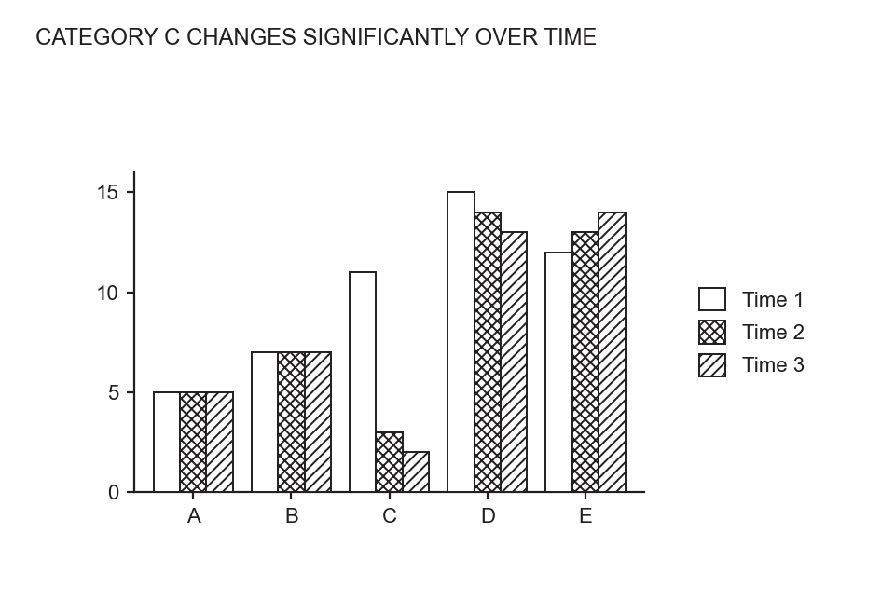
$\text{Data‑Ink Ratio}$ = $\frac{Data Ink}{Total−Ink Used in the Graphic}$

Slide 43
Arrangement & Layout

Slide 44
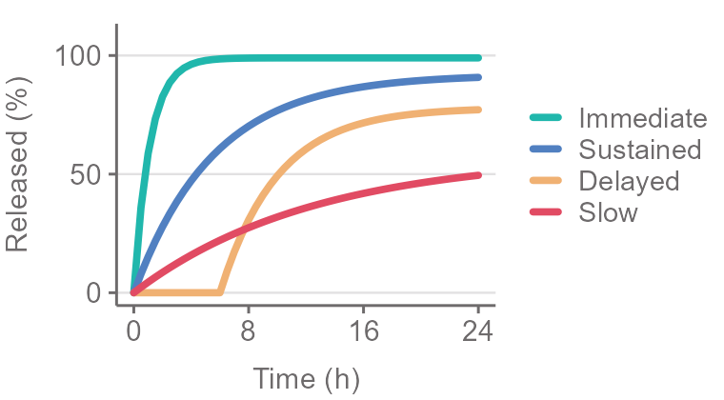
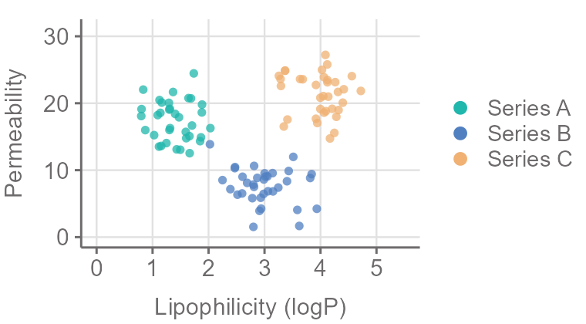
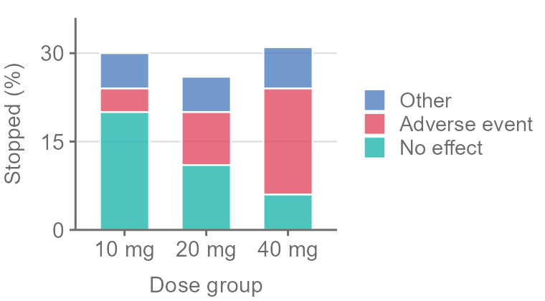
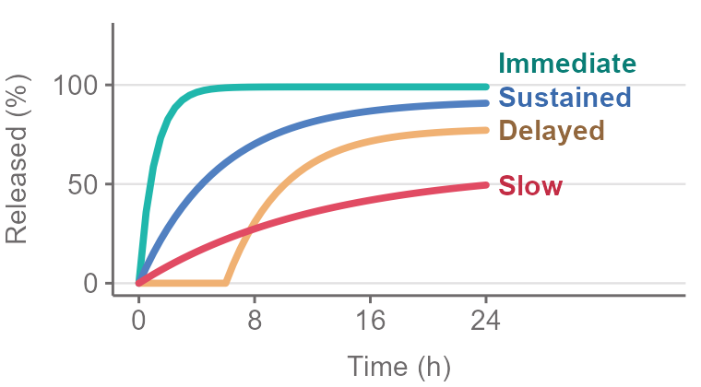
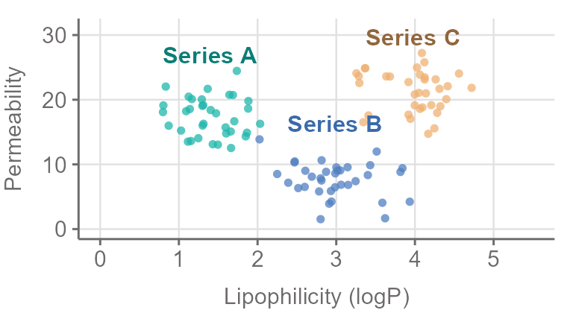
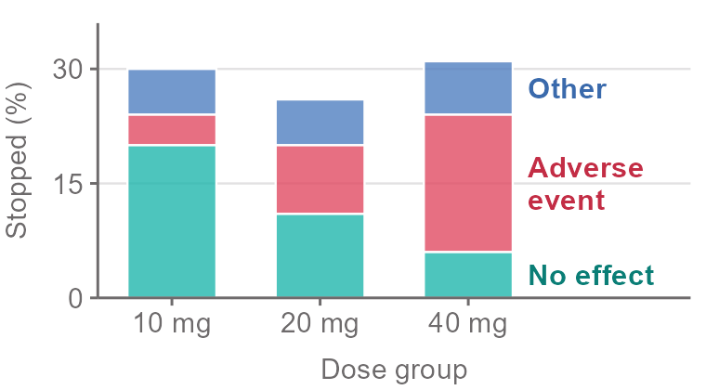
Try to avoid separate legends
Separate legend
Labels in chart

Slide 45
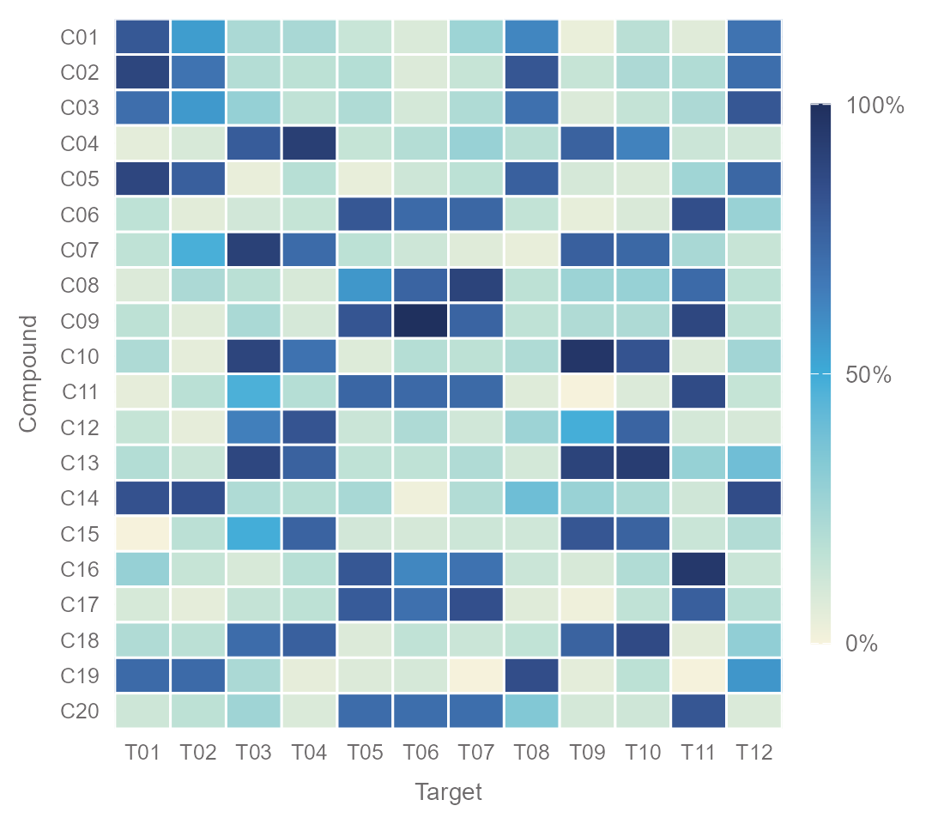
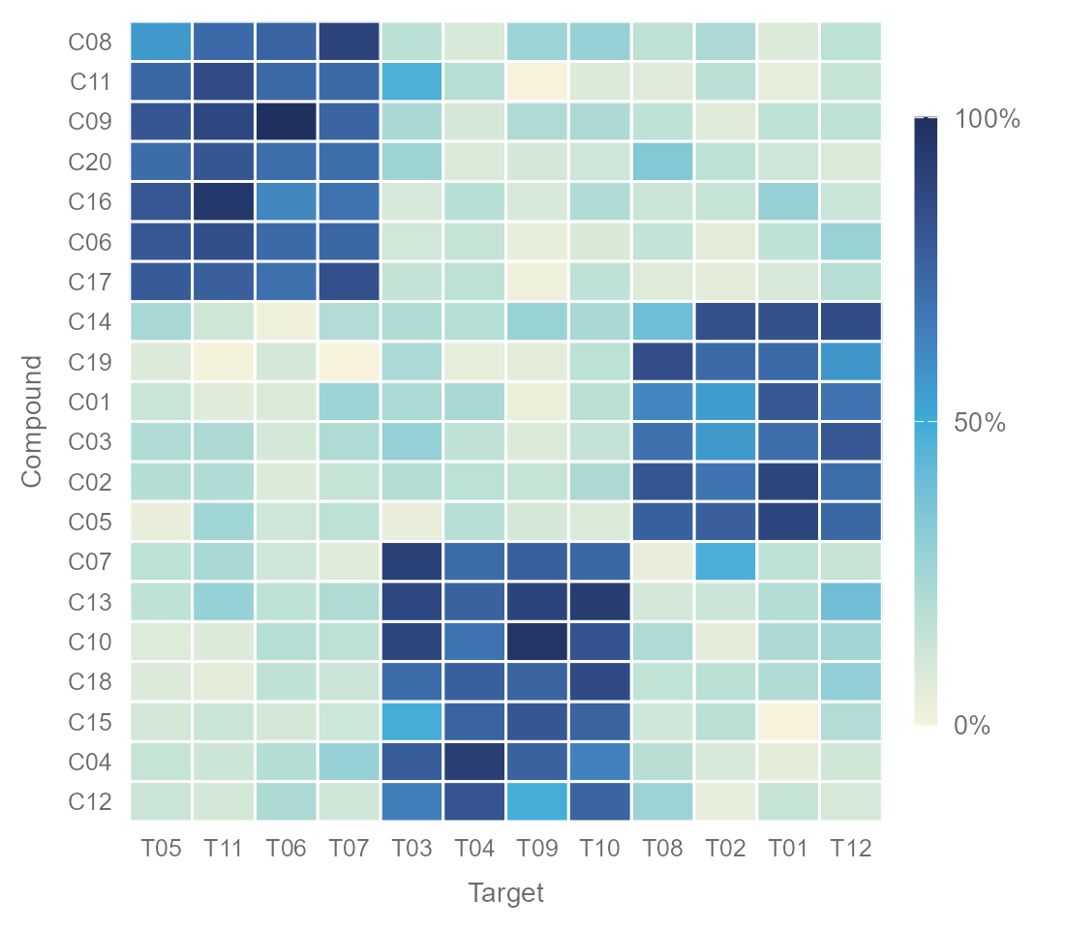
Heatmap
Rows and columns in ID order
Ordered based on similarity

Slide 46
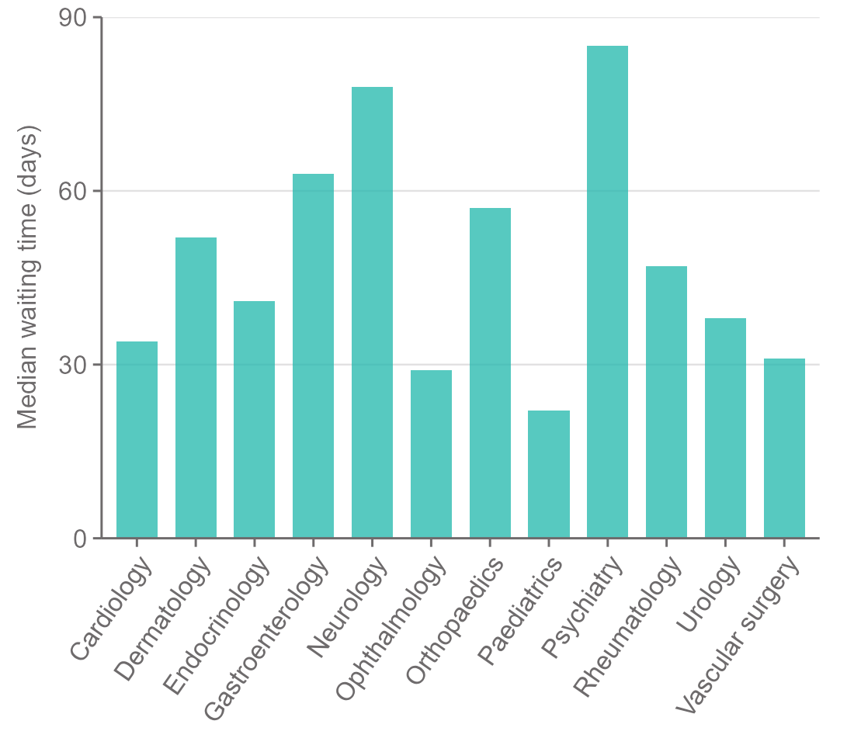
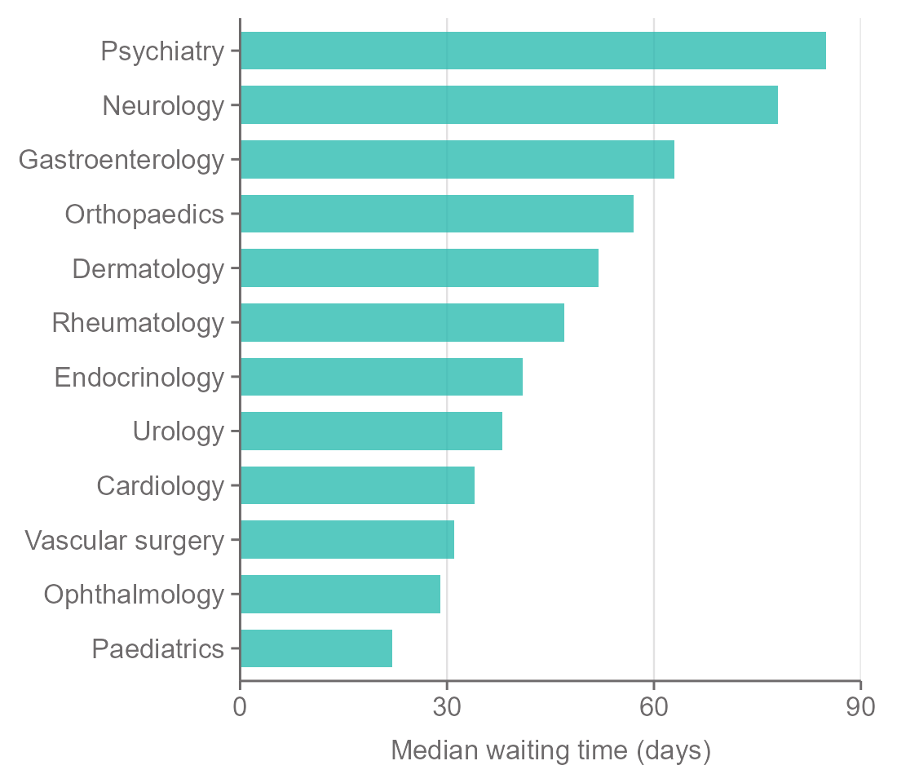
Bar Chart
Alphabetical, tilted labels
Ranked, horizontal labels

Slide 47
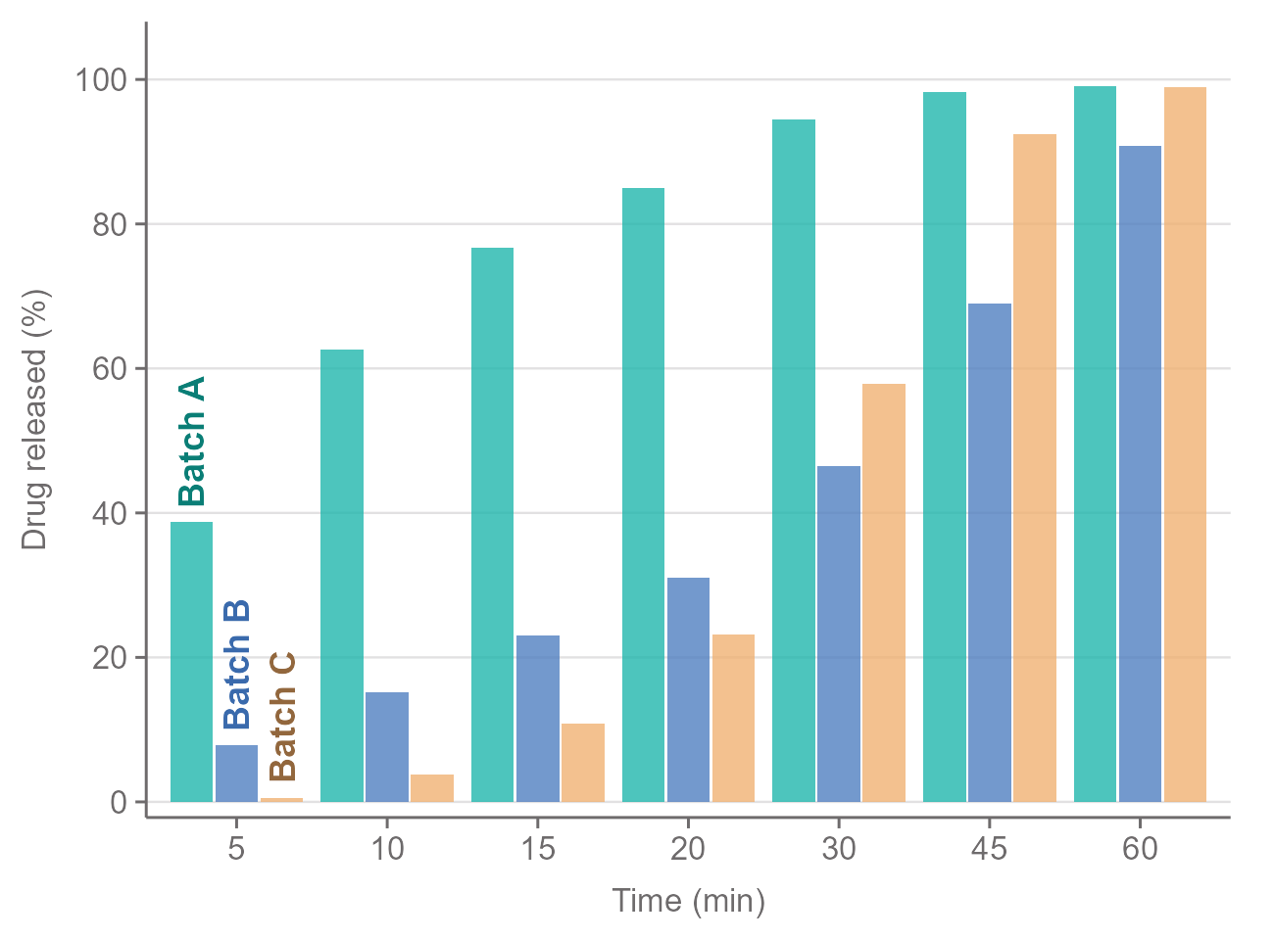
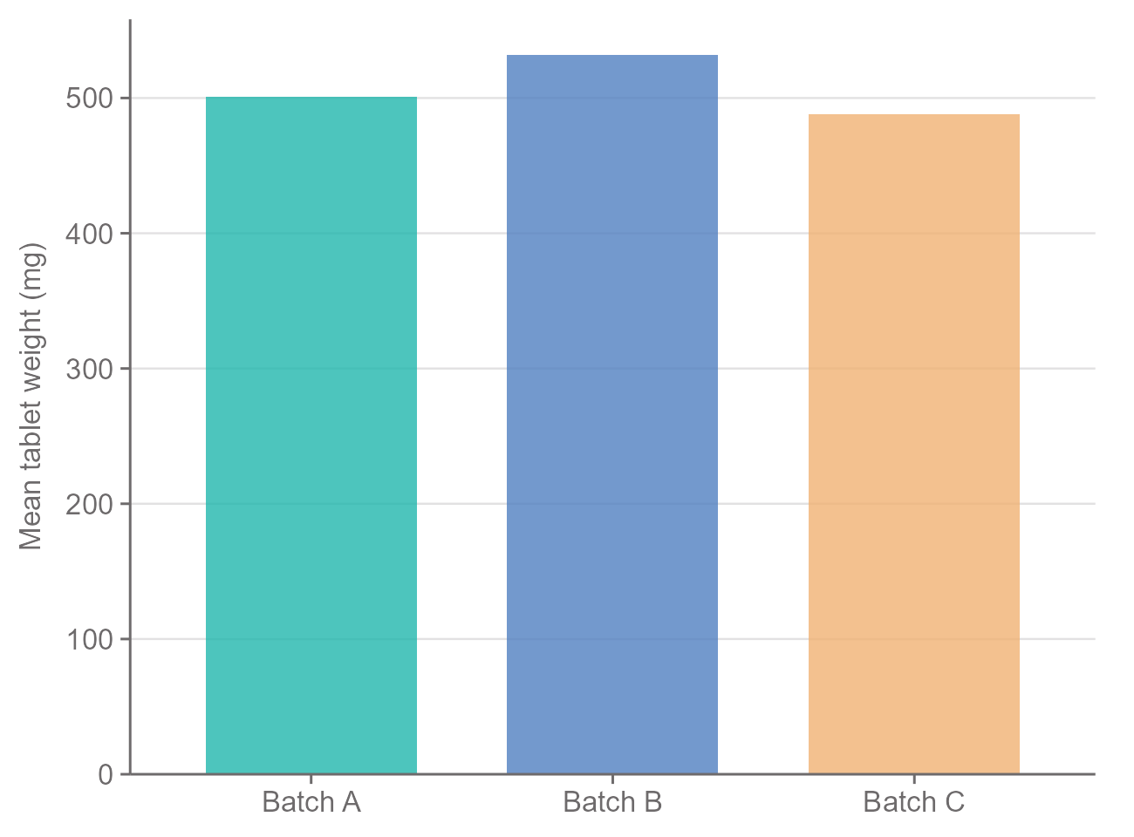
Grouped Bar Chart

Slide 48
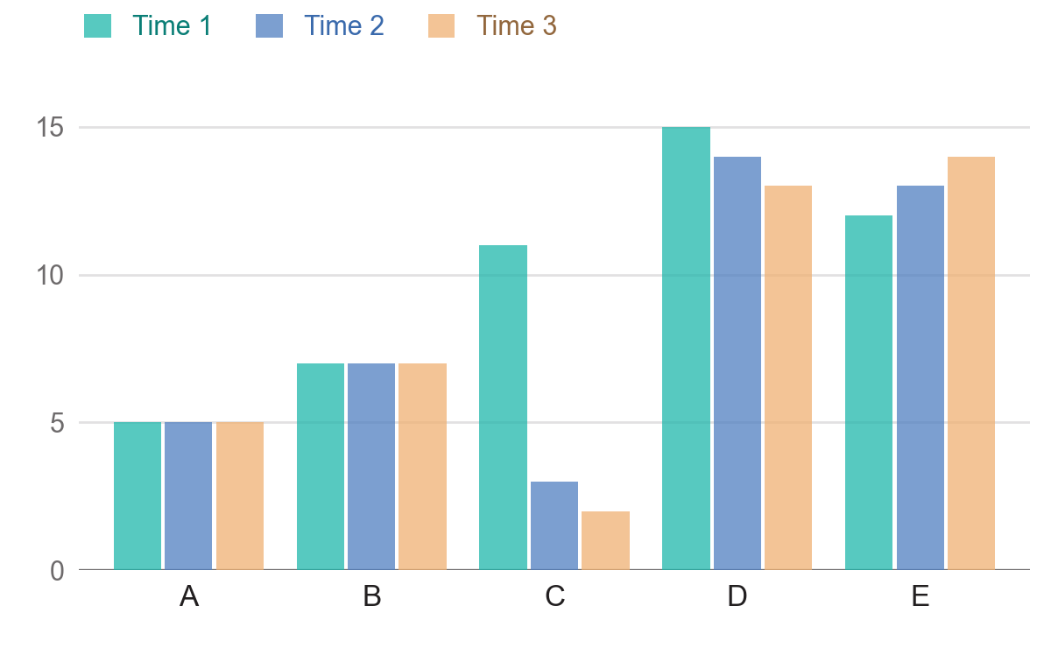
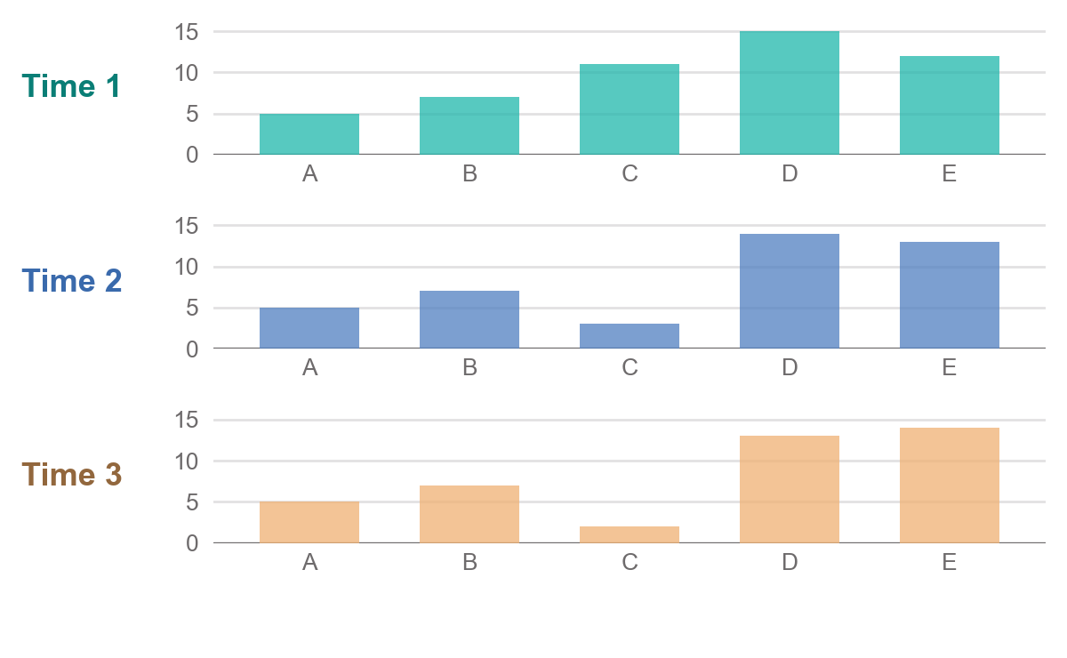
Times and categories in one chart…
… or split by time

Slide 49
Axis

Slide 50
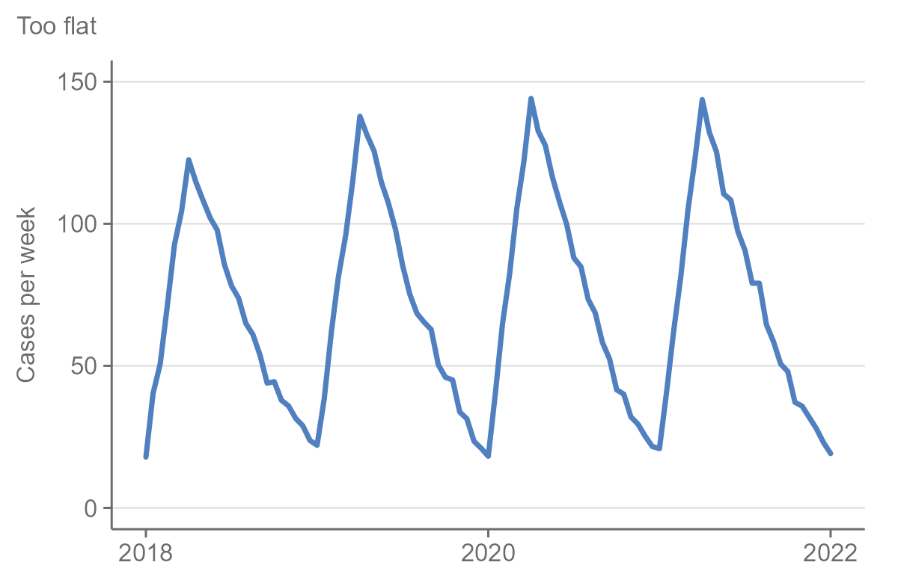
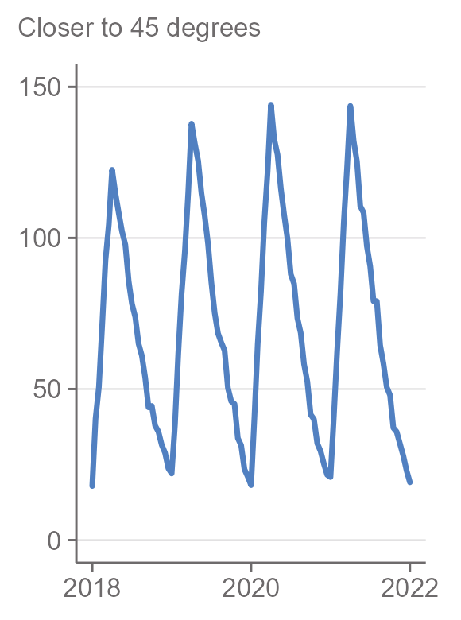
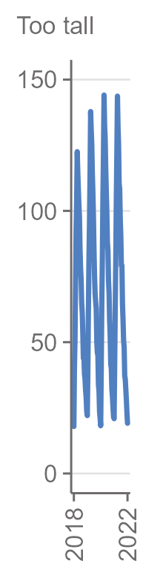
Line Charts & X-Axis Scaling

Slide 51
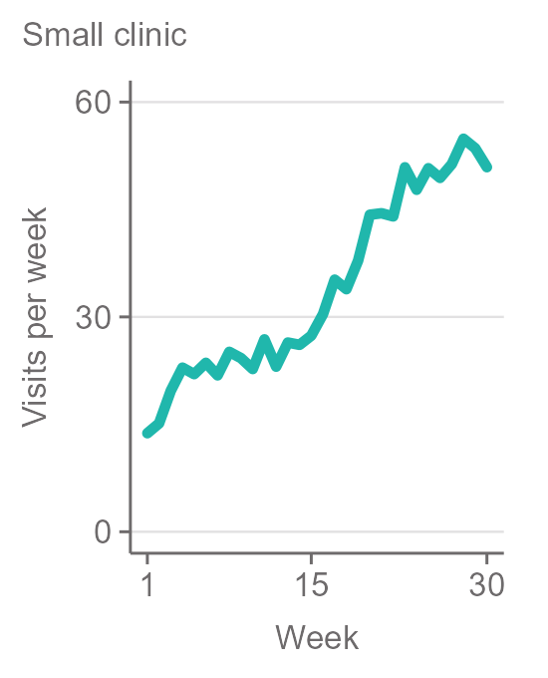
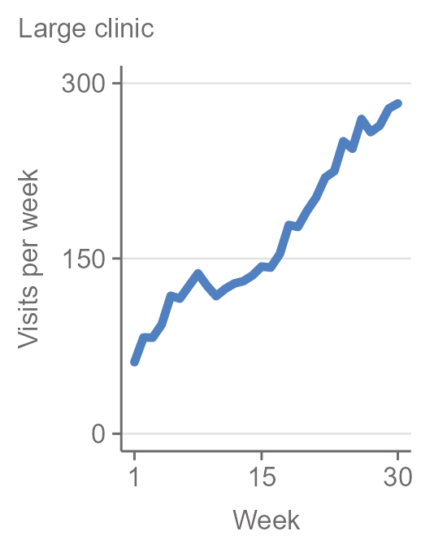
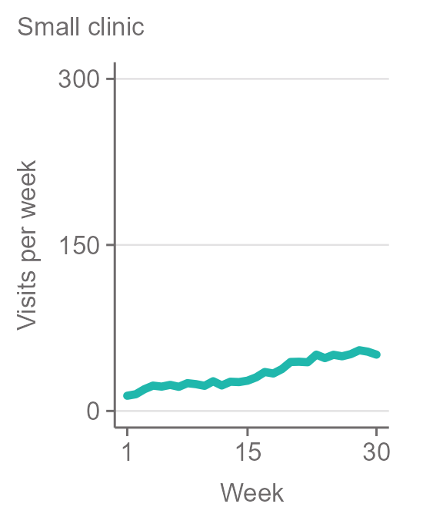
Comparisons with Facets or Small Multiples
Different Axis Limits
Same Axis Limits

Slide 52

Scatterplot Matrix

Slide 53


Bar Chart
Axis starts at 90
Axis starts at 0

Slide 54
Hidden Data

Slide 55




Histogram Bin Sizes

Slide 56



Boxplot
Boxes only
Boxes and points
Violins

Slide 57


Scatterplot & Simpson’s Paradox
All groups together
Split by groups

Slide 58

Clutter & Overplotting
If a chart is too crowded, it is visually cluttered and harder to read
Common problem: Overplotting
  How many points are overlapping in dense regions?

Slide 59



Overplotting
Solve it by changing glyphs, transparency, or applying jitter

Slide 60
Readability

Slide 61

Grouped Bar Chart

Slide 62

… or line chart?

Slide 63

… or line chart?

Slide 64


Color for Categories
Color as Highlight

Slide 65
Audience and medium
05

Slide 66


Scientific Paper or Poster?
Cole Nussbaumer Knaflic: Storytelling with data, ISBN 9781119002260 (ePDF); example with made-up numbers

Slide 67


A chart
A chart with a story

Slide 68
Who is this for, and what should they do or know afterwards?

Slide 69
”A picture is worth a thousand words”
”Visualization is intuitive”
”The data should speak for itself”
”Show, don’t tell!”
Make your data visualization talk!
Misconceptions about data visualizations according to Alberto Cairo

Slide 70

Show AND Tell

Slide 71



Slide 72



Slide 73
Annotation Layer
Text:
(Sub)titles, annotations, legends, …
Area:
Frames, Backgrounds, Trendlines, …
Marker:
Arrows, highlighted data points, …

Slide 74
Chart Design
Chart Type based on Message, Audience, Medium, and Data Type
Declutter & Simplify
Style, Highlight, & Annotate

Slide 75

Questions?

