Slide 1
Kirkland Signature Online Survey Tool
Team Costco

Slide 2
Team Members
Team Lead: Josh Pfeffer
Technical Lead: Jeremy Koletar
Secretary: Joe Thomas
Documentation: Tim Wong
QA: Patrick Cook

Slide 3



Vision & Scope
XYZ Corp. uses a variety of survey tools
Existing tools fall short
Remotely Hosted - Security
No Support for Conjoint Analysis
Trademarks property of their respective owners.
Notes:
While companies like SurveyMonkey may do their best to protect your data, they offer no guarantees.

Slide 4
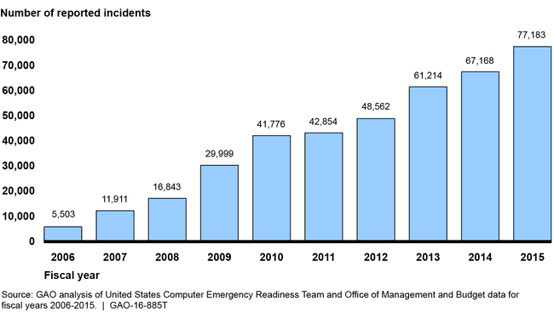
Vision & Scope
Federal Information Security Incidents by Year
Information Security is a perpetually growing concern.
XYZ. Corp’s end product is data.
Ensuring the security of that product is paramount.
Notes:
This chart is specific to incidents within federal agencies. This is the best available data, and is representative of information security trends overall.

Slide 5
Major Requirements

Slide 6
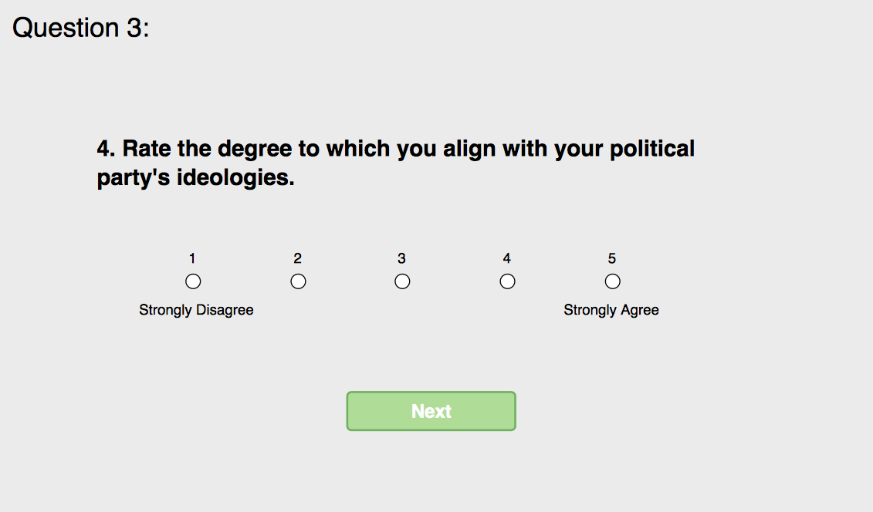

Functional Requirements
Standard Survey Tool Features
Easy creation of surveys
Support for a variety of question types
Manage lists of potential respondents
Control who may respond to a given survey
Question Branching
Analytics
Secure access to survey data by XYZ Corp. employees

Slide 7
Functional Requirements
Conjoint analysis is the pivotal functional requirement for this project.
Generated conjoint trade-off questions
Manually specified conjoint trade-off questions
Computation of preference values
“Conjoint analysis is marketers' favorite methodology for finding out how buyers make trade-offs among competing products and suppliers.” ¹
1: Green, Paul E., Abba M. Krieger, and Yoram Wind. "Thirty Years of Conjoint Analysis: Reflections and Prospects." Interfaces 31.3 - Supplement (2001): 56-73. Web.
Notes:
XYZ Corp. specializes in political polling. There is a strange likeness between choosing a candidate and making a purchasing decision. In fact, because voters pay a politician’s salary, it could be argued that voting is in fact a purchasing decision.

Slide 8
Non-Functional Requirements
Performant at scale:
Up to 10 simultaneous open surveys
Respondents tend to respond within the first 2 hours of solicitation
System must be performant with 10,000 simultaneous users
Performant: response times for HTTP requests should remain below 100 milliseconds, and must remain below 200 milliseconds.
Secure:
Purpose of project is to keep data in the custody of XYZ Corp
SEI CERT’s Top 10 Secure Coding Practices will be taken into account during code reviews

Slide 9
Major Use Cases

Slide 10
UC-7: Set up branching questions
Actors: Survey Creator
Goals: Allow a survey creator to add branching logic to a question
Precondition: User editing a question
Survey Creator adds branching logic to a particular pivot question (the location from where the respondent will branch) by ticking a checkbox. Pivot questions cannot be located during the conjoint segment. | View is updated with parameter fields that will be filled and used for branching logic
Survey Creator adds a conditional expression row to the table | A new empty row is created
Survey Creator can reorder Conditional Expressions, and can chain expressions to require multiple conditional expressions to be satisfied before branching to a new question.

Slide 11
UC-3.7: Add a manual conjoint trade-off question to the survey
Actors: Survey Creator
Goals: Add a manual conjoint trade off question to the survey.
Precondition: User editing a survey
User clicks “Add Question” | “Add Question” dialog opens, listing available types of questions
User selects question type | Format for respective question becomes available to be filled out
User selects number of options (2-3) offered to survey taker | The system renders 2-3 panels which contain input boxes where attributes and attribute levels can be defined by the survey creator
User adds attribute and defines attribute level | The system generates conjoint trade off questions with varying attribute values which are calculated based on the attribute level entered by the user upon question creation.

Slide 12
Data Flow Diagrams
Level 0 DFD:

Slide 13
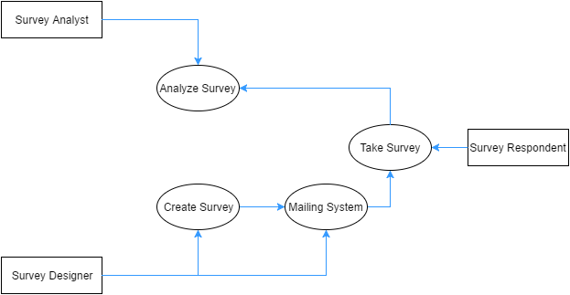
Data Flow Diagrams cont.
Level 1 DFD:

Slide 14
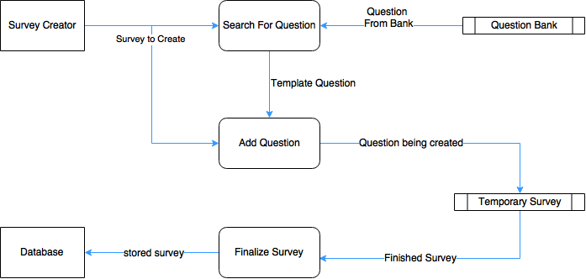
Data Flow Diagrams cont.
Level 2 DFD: process of creating survey

Slide 15
Design

Slide 16
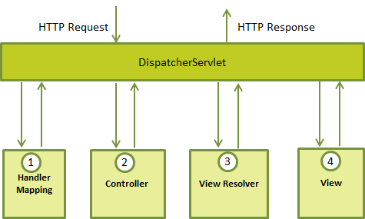
Architecture Diagram
The Spring Model-View-Controller (MVC) framework will be used
The DispatcherServlet handles all HTTP requests and HTTP responses
A controller is chosen using the HandlerMapping and the DispatcherServlet is notified
https://www.tutorialspoint.com/spring/images/spring_dispatcherservlet.png
Notes:
After receiving an HTTP request, DispatcherServlet consults the HandlerMapping to call the appropriate Controller.
The Controller takes the request and calls the appropriate service methods based on used GET or POST method. The service method will set model data based on defined business logic and returns view name to the DispatcherServlet.
The DispatcherServlet will take help from ViewResolver to pickup the defined view for the request.
Once view is finalized, The DispatcherServlet passes the model data to the view which is finally rendered on the browser.

Slide 17
Architecture Diagram cont.
The controller calls service functions to set the model data and returns a view name
The View Resolver uses the view name to determine the view to be used
The model data is passed to the View which then renders it to the user
https://www.tutorialspoint.com/spring/images/spring_dispatcherservlet.png

Slide 18
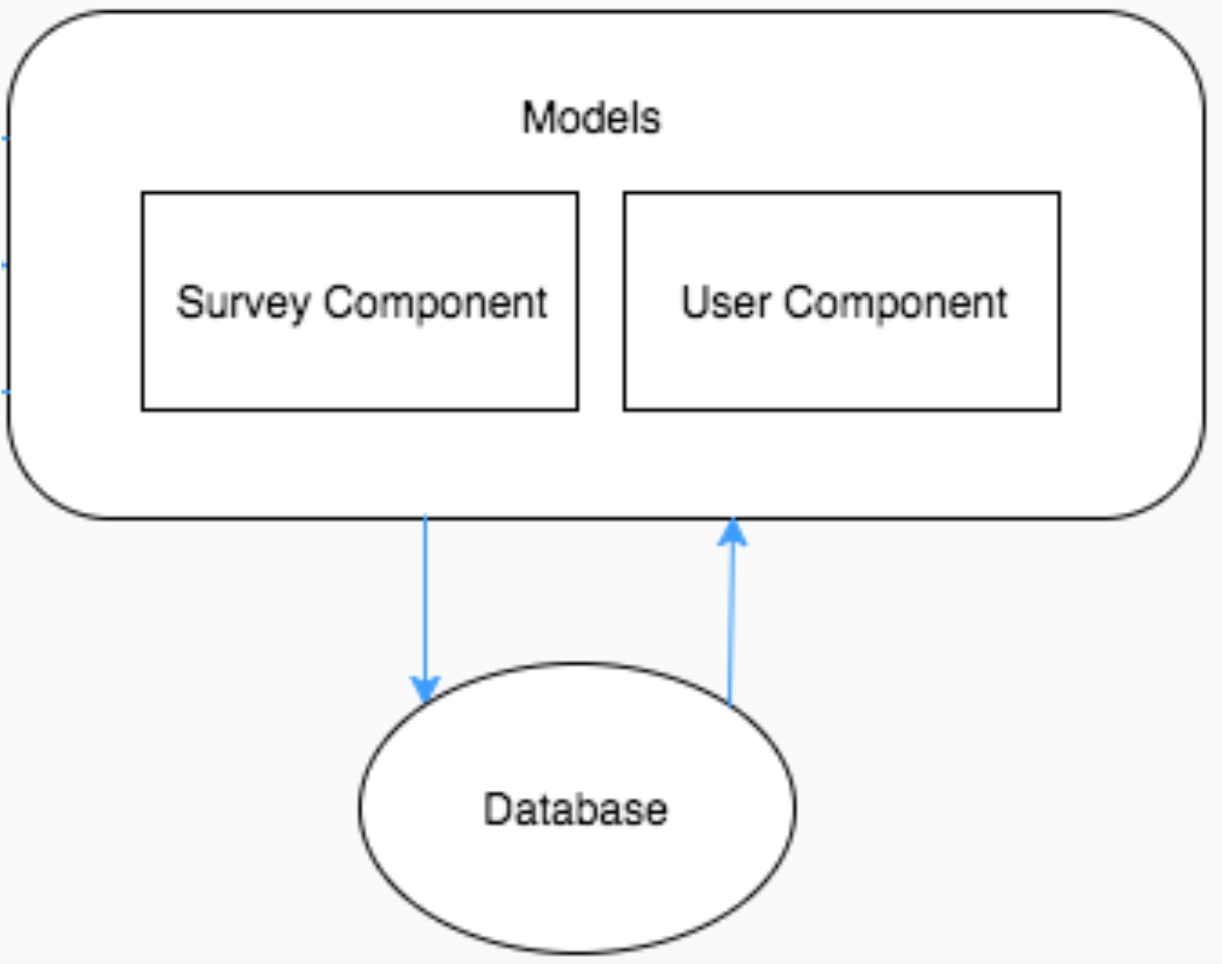
Architecture Diagram cont.
Models
The models are split into two groups:
The survey component:
Survey, questions, responses, question bank
The user component:
Users, employees, respondents
These models will interact with our mySQL database where all survey data is held

Slide 19
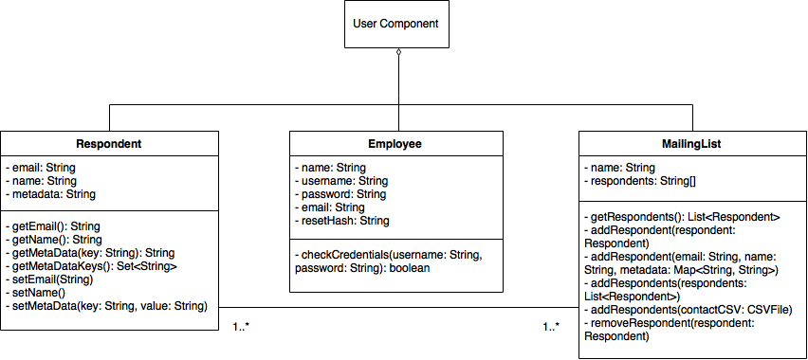
Class Diagram - User Component

Slide 20
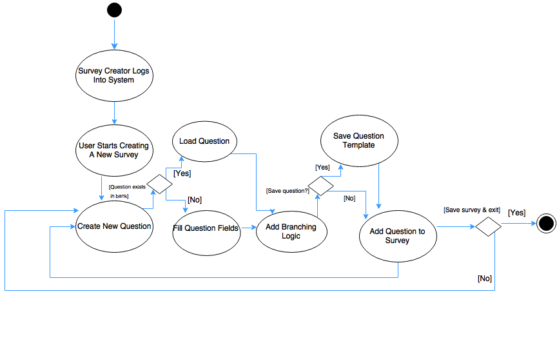
Activity Diagram - Creating a Survey

Slide 21
User Interface

Slide 22
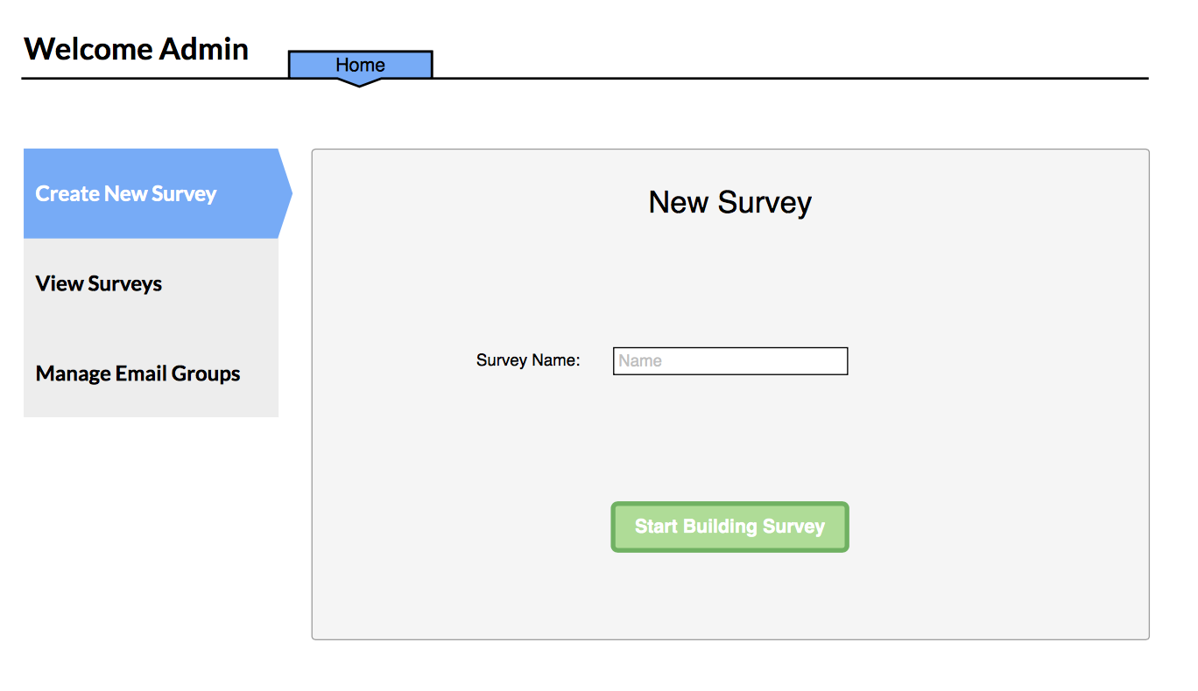
Home Screen

Slide 23
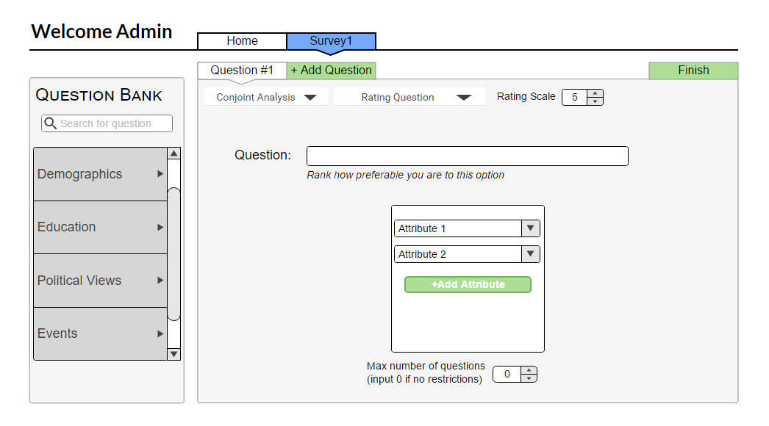
Adding Conjoint Trade off Questions (Engine Created)

Slide 24
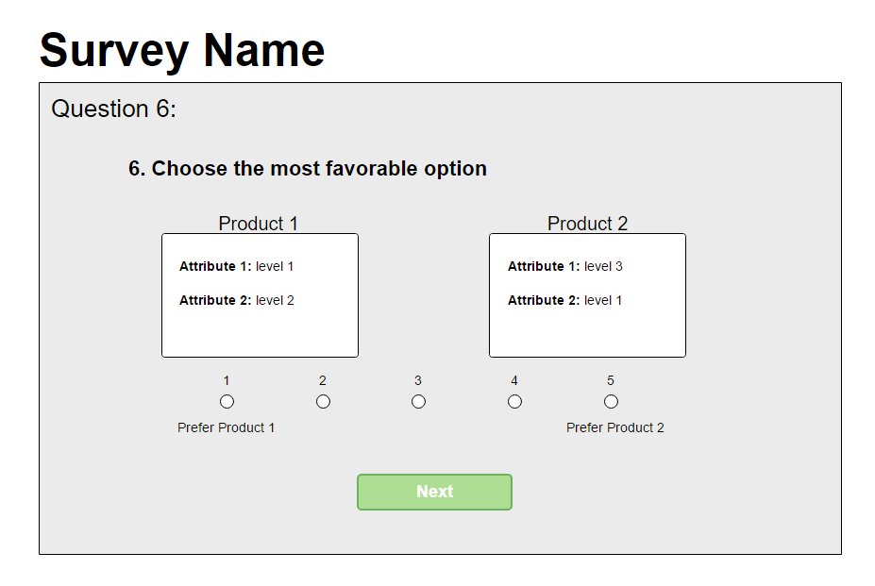
Example Engine Created Conjoint Analysis Question

Slide 25
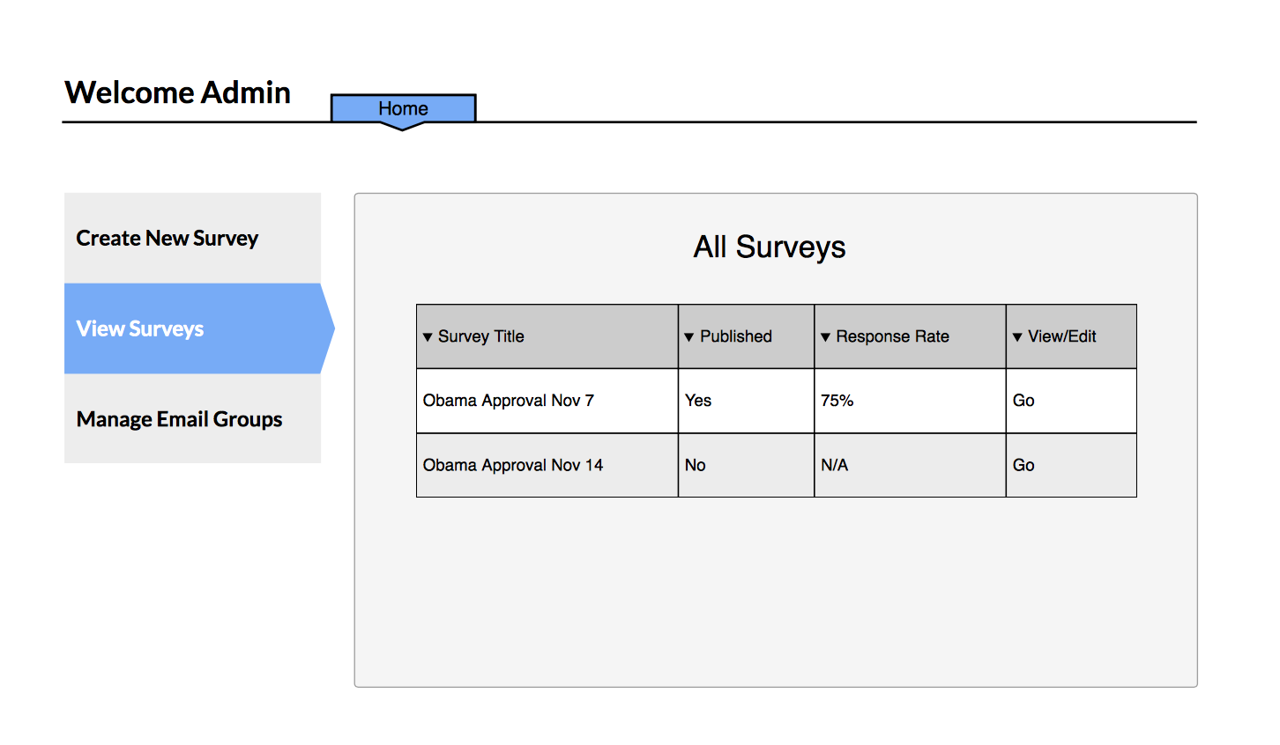
View Survey Analysis

Slide 26
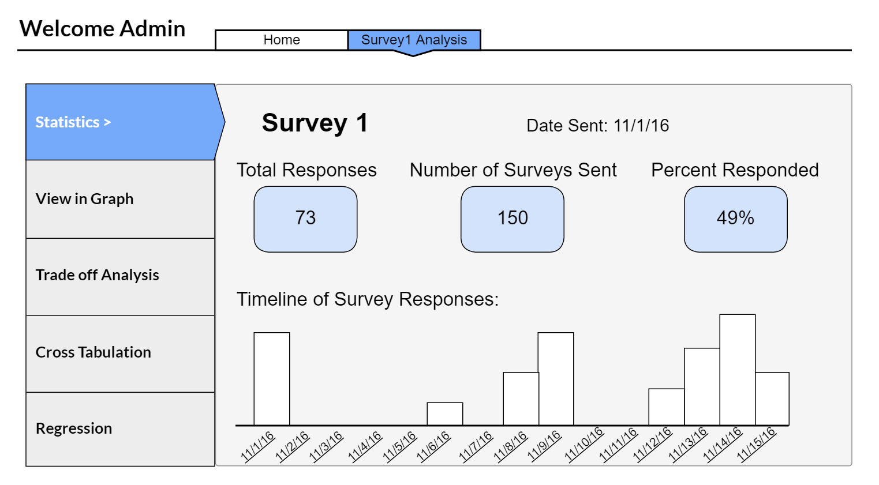
Analysis Main Page

Slide 27
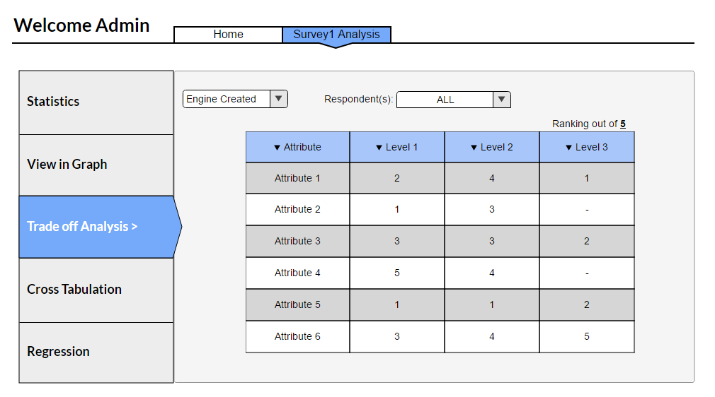
View Trade-Off Analysis

Slide 28
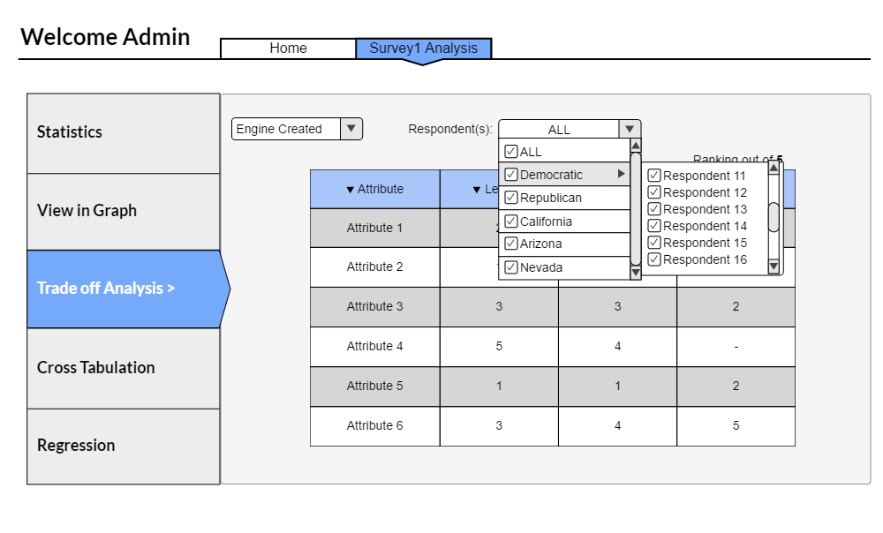
View Trade-Off Analysis (Cont.)

Slide 29
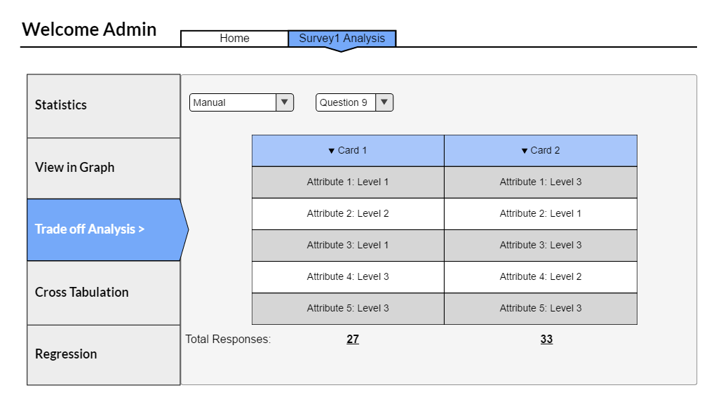
View Trade-Off Analysis (Cont.)

Slide 30
Testing Strategy

Slide 31
Approach
Manual Testing
Manual Conjoint Analysis Question Creation
Branching Logic Creation and Behavior
Cross Tab Analysis
At least 5 runs each for the manual tests
Performance and Stress Testing
Use of scripts

Slide 32
Test Case - Manual Conjoint Analysis Question Creation
Test conditions:
User inputs attributes correctly
User does not specify attribute(s)
User does not specify level(s)

Slide 33
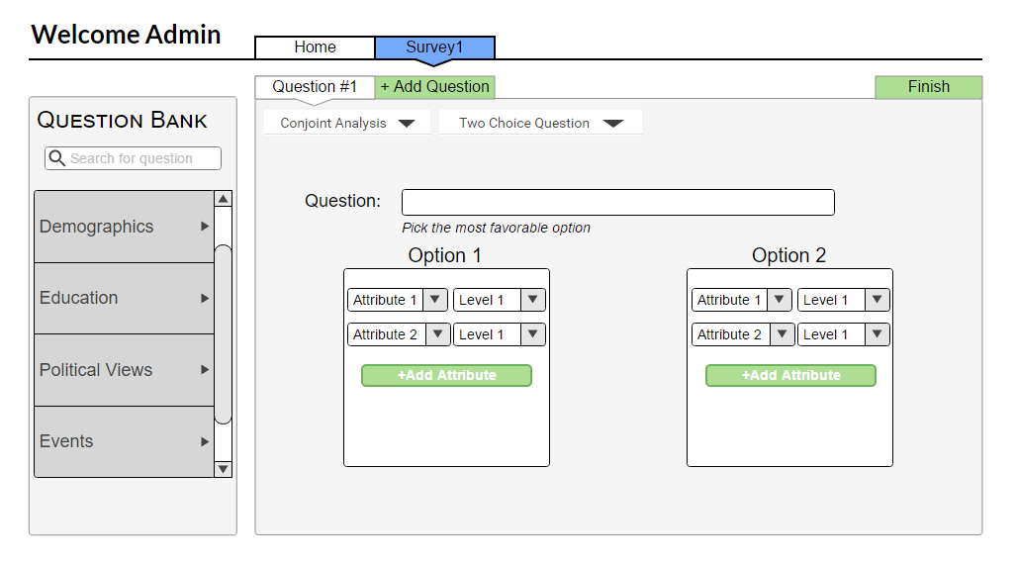
Adding Conjoint Trade off Questions (Manual)

Slide 34
Wrap-Up
Vision & scope, major requirements, design, user interface, testing strategy
Our tool is different in that it will be hosted in-house and supports conjoint analysis
We hope to have the opportunity to implement and deploy this project
“Great things in business are never done by one person. They’re done by a team of people.” - Steve Jobs
Questions?

