Slide 1
Reliability in real-time systems
Examples and basic principles

Slide 2

Overview
Real-Time Systems need to be reliable!
In this slide set, we will talk about some of the techniques to make fault-tolerant systems (this is a pre-requisite to making a safe system).
Rather than focus on the large amount of theory in this area, we’ll emphasize a few examples:
Therac-25
CANDU Reactors
Space Shuttle
Modern Passenger Jets

Slide 3
What should you learn?
What is the difference between reliability, security and safety?
What are the steps from the time an error occurs to when a system fails?
What are some of the causes of errors?
What are some of the approaches to fault tolerance?
What are the differences between hardware and software schemes?

Slide 4
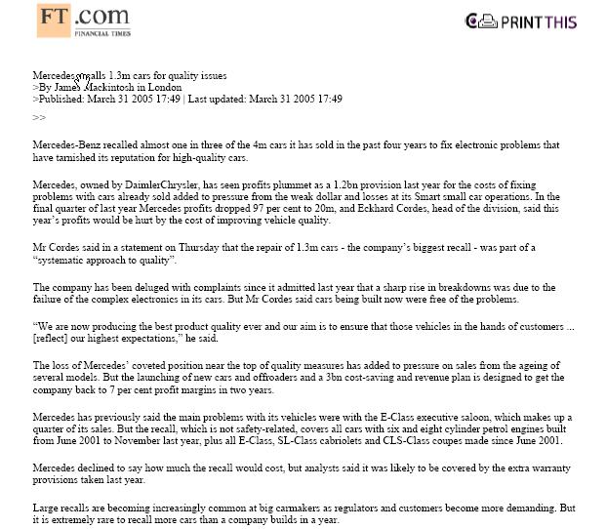
Financial Times: March 31, 2005
Mercedes-Benz recalled 1 in 3 of the cars it produced in the past 4 years to fix electronic problems…
…Final quarter of last year, Mercedes’s profits dropped 97%...
… sharp rise in breakdowns was due to the failure of the complex electronics in its cars…
…it is extremely rare to recall more cars than a company builds in a year.

Slide 5

Motivating example: Therac-25
Medical linear accelerator
Used to treat tumors with either:
Electron beams for shallow tissue
X-Ray beams for deep tissue
Eleven Therac-25s were installed
Six in Canada
Five in the United States
Developed by Atomic Energy of Canada Limited (AECL).

Slide 6
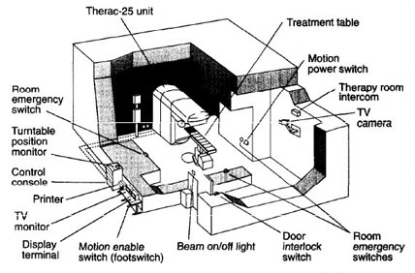

Slide 7
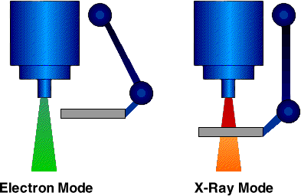
Therac-25
Could deliver either electron therapy or X-ray therapy
Notes:
Beam flattener

Slide 8
Field Light Mirror
Counterweight
Beam Flattener (X-ray Mode)
Turntable
Scan Magnet (Electron Mode)
Source: W. Leubke, 2003

Slide 9
Six patients were delivered severe overdoses of radiation between 1985 and 1987.
Four of these patients died.
Why?
The turntable was in the wrong position.
Patients were receiving x-rays without beam-scattering.

Slide 10
Therac-25
How could this happen?
Race conditions in the software
Multiple threads did not lock variables properly
Overflow error.
The turntable position was not checked every 256th time a certain variable was incremented.
No hardware safety interlocks.
User interface errors, and wrong information on console.
Non-descriptive error messages.
“Malfunction 54”
“H-tilt”
Too easy to just hit “P” (Proceed)

Slide 11
For details on this, there is a very complete article linked to the course web site.

Slide 12

Some definitions
Security: A measure of confidence that the system can resist attempts to modify its behavior.
Reliability: A measure of confidence that the system produces accurate and consistent results over a specific period of time
Safety: A measure of confidence that the system will not cause accidents/harm
Absence of unreasonable risk
Reliability is neither sufficient nor necessary for safety
Notes:
Safety ISO 26262 + SOTIF combined: The absence of unreasonable risk due to hazards resulting from any of
Malfunctioning of the E/E function
functional insufficiencies of the intended functionality (not necessarily failure of the function)
by reasonably foreseeable misuse by persons, or
the ability of a system or component to function under stated conditions for a specified period of time.
Reliability engineering relates closely to safety engineering and to system safety, in that they use common methods for their analysis and may require input from each other. Reliability engineering focuses on costs of failure caused by system downtime, cost of spares, repair equipment, personnel, and cost of warranty claims. Safety engineering normally focuses more on preserving life and nature than on cost, and therefore deals only with particularly dangerous system-failure modes.

Slide 13

Note that safety and reliability can be in conflict.
“The safest plane is one that never leaves the ground”.
Good engineering always involves a tradeoff between safety and reliability.

Slide 14
Reliability Engineering
The objectives of reliability engineering, in decreasing order of priority, are:
To apply engineering knowledge and specialist techniques to prevent or to reduce the likelihood or frequency of failures.
To identify and correct the causes of failures that do occur despite the efforts to prevent them.
To determine ways of coping with failures that do occur, if their causes have not been corrected.
To apply methods for estimating the likely reliability of new designs, and for analysing reliability data.

Slide 15
What should we be worried about?
Computers are composed of hardware, software, and data
The software defines the operations
The hardware performs the operations
The data records the results of the operations
We have to worry about all three of these

Slide 16
 | Hardware | Software | Data
Cause of Failure | Deficiencies in design, production or maintenance | Design (logic) errors | Transient Events
Occurrences | Will eventually fail | Might never fail | Might never fail
Failure Rates | Can be predicted in theory from physical principles | Can not be predicted from physical principles | Some upset rates can be predicted from test
Redundancy | Will improve reliability, but may be susceptible to common cause failures | Will not improve reliability, since this will only replicate same failure | Might improve reliability
Diversity | Will improve reliability, should be less susceptible to common cause failures | Will improve reliability since it minimizes possibility of same error occurring in separate modules | Will improve reliability since it minimizes possibility of same error occurring in separate modules
Modified from A. Tribble, 23rd Digital Avionics System Conference

Slide 17
 | Hardware | Software | Data
Environmental Factors | Dependant on temperature, humidity, stress, etc. | Dependent on internal environment of computer (memory, clock speed, etc.) | Dependent on both external (radiation, EMI, etc.) and internal environment (memory, clock speed, etc.)
Time Dependence | Is time dependent. Failures can be increasing, constant or decreasing | Not time dependent. Failures occur when path that contains error is executed | Is time dependent. Failures can be increasing, constant or decreasing
Wear-Out | Responsible for some failures. May be preceded by a warning. | Not responsible for any failures | Not responsible for any failures
Preventative Maintenance | Can improve reliability | Will not improve reliability, and might actually worsen it | Will not improve reliability
Modified from A. Tribble, 23rd Digital Avionics System Conference

Slide 18
A fault is a passive flaw;
An error is a manifestation of a fault: A discrepancy between a computed,
observed, or measured value or condition and the true,
specified, or theoretically correct value or condition.
A failure is behavioral deviation from the user requirements or compliance with the product specification.
A failure is an observable effect outside the system boundary arising from an internal error or fault
An error or fault does not always lead to a failure
Modified from A. Tribble, 23rd Digital Avionics System Conference
Notes:
Why the circle? An error at one level of the system might cause a fault to be introduced in another level of the system ... Coming up ☺
HAZARD (STPA Definition):
A system state or set of conditions that, together with a particular set of worst-case environmental conditions, will lead to an accident (loss). Can be caused by failure but not necessarily.
Failure: behavioral deviation from the user requirement or the product specification. It is a deviation of the delivered service from compliance with the specification. What is perceived by end user. A failure has occurred if a functional unit is no longer able to perform its required function
The Patriot Missile battery failure:
Error (arithmetic): inaccurate calculation of the time since boot
Fault: not programming correctly the calculation function.
Not all errors cause failures. In AI algorithms there’s an error due to approximation but it is within tolerable limits that it does cause faults.
Faults do not always result in failures; they might be occurring without even knowing about them (Fault may stay dormant for a long time before it manifests itself as an error) but failures might happen depending on the conditions in which the fault occurred (memory bit got stuck but CPU does not access this data)

Slide 19
Examples
A programmer types char x[11] to define a variable when char x[10] was intended
Is this a fault, error, or failure?
This is fault, until the system becomes really short of memory
Becomes an error then
A programmer created a system that opened a file every 10 seconds, but failed to close those files
What is the fault, error, failure? When do they happen?
This is a fault that causes an error (file descriptor leakage) every 10 seconds
When would this error cause a failure?
When the allowed # of open file descriptors in the OS is reached

Slide 20
Faults vs. Errors vs. Failures
The Patriot Missile battery failure:
Error (arithmetic): inaccurate calculation of the time since boot
Fault: not programming correctly the calculation function.
Faults do not always result in failures. They might be occurring without even knowing about them (Fault might stay dormant for a long time before it manifests as an error) but failures might happen depending on the conditions in which the fault occurred
memory bit got stuck but CPU does not access this data
Not all errors cause failures. In AI algorithms there’s an error due to approximation but it is within tolerable limits that it does not cause failures.
Notes:
Patriot: failed to track and intercept an incoming Iraqi Scud missile. The Scud struck an American Army barracks, killing 28 soldiers and injuring around 100 other people

Slide 21
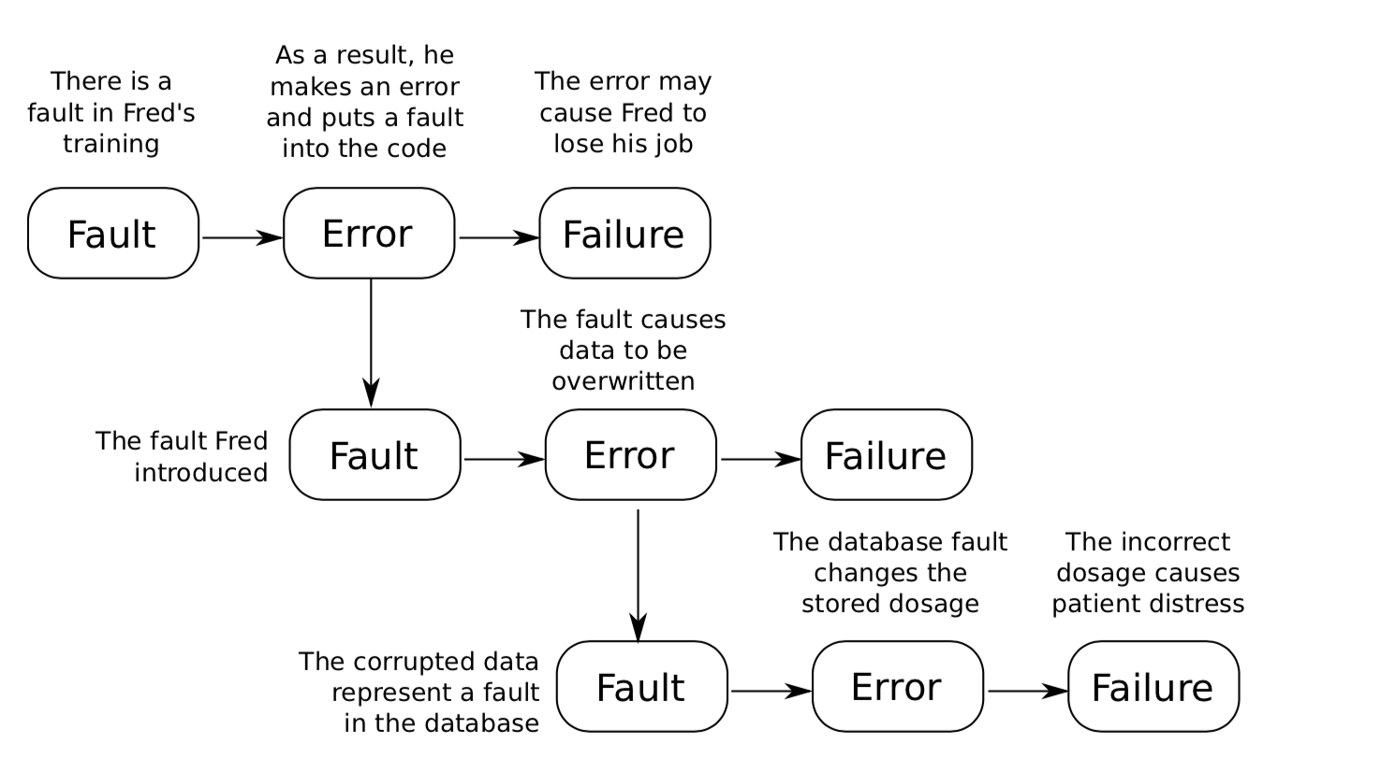
An error at one level in a system might cause a fault at another
A fault is a passive flaw;
An error is a manifestation of a fault: A discrepancy between a computed,
observed, or measured value or condition and the true,
specified, or theoretically correct value or condition.
From Hobbs, Embedded Software Development for Safety-Critical Systems
Notes:
First level: Fred’s level. Fred is the functional unit and he (it) deviated from the his expected behaviour by inserting a bug (due to a fault in his training)

Slide 22
Fault Tolerance
The ability of a functional unit to continue to perform a required function in the presence of faults or errors

Slide 23
Fault Tolerance – Relies on Redundancy
Triple Modular Redundancy (TMR) [passive redundancy]
Hardware Redundancy
Software Redundancy
Information Redundancy
Temporal (Time) Redundancy
What if the error is in the voting unit?
(who guards the guard?)
Diversity: Each of these blocks could be designed by a different design team using different techniques.
Example: Used in the logic section of the launch vehicle digital computer (LVDC) of Saturn 5. Saturn 5 is a rocket carrying Apollo space crafts to the orbit (reliability of the logic section for a 250-hr mission is approx. 20x larger than the reliability of an equivalent simplex system)
Notes:
Passive redundancy: Mask faults
If N modules used: N must be be odd, it is called N-modular redundancy, and it masks $\left\lfloor \frac{N}{2}\right\rfloor$faults.
As a result of using TMR, the reliability of the logic section for a 250-hr mission is approximately twenty times larger than the reliability of an equivalent simplex system.

Slide 24
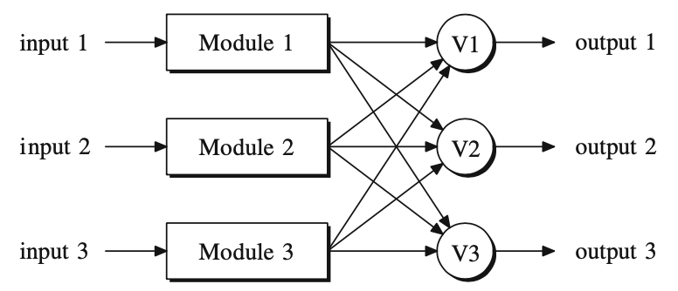
TMR with triplicate voters
Can replicate voters if single voter is imperfect
Removes single point of failure (simplex voter)
input
> Requires consensus to be established among three voters to decide final output
> In order to reach consensus, the voters typically exchange several rounds of messages

Slide 25
Multistage TMR
Can apply TMR + voter replication to networked systems; e.g., simplex modules connected in series
(Boeing 777 uses triple-triple redundancy for its multistage primary flight computer)
Problem with voters:
Module outputs might become valid at slightly different times
Differences in hardware paths
Differences in sensor locations
Different approximation errors of different modules (e.g., A/D conversion)
Notes:
YC Yeh. Triple-triple redundant 777 primary flight computer
Different approximation errors of different modules (e.g., A/D conversion): For instance, the least significant bits might be different (those that contribute least to the accuracy). Remedy: have voters ignore least significant bits in voting decision.

Slide 26

Detecting Faults (Errors)
For some applications, this might be OK.
But, how do we detect a fault?

Slide 27
Detecting Faults (Errors)
Functionality Checks:
Periodically execute code and check results
For example, write to then read from RAM
Consistency Checking:
Example: Range checking
Signal Comparison:
In some systems, you can compare signals at various points within a module
Information Redundancy:
Checksums, parity checking

Slide 28
Detecting Faults (Errors)
Instruction Monitoring:
If the processor fetches an illegal instruction, something is probably wrong
Loop-back Testing:
Useful for testing communication channels. Make sure what is received is the same as what is sent
Bus Monitoring:
Watch the bus and make sure that the program accesses memory within an allowable range
Power Supply Monitoring:
Possibly a dead system will draw less power
Also, the power supply might fail: this would cause major system failure. There might be a warning you could watch for

Slide 29
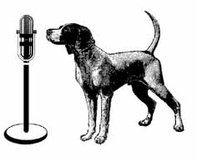
Detecting Faults (Errors)
9. Watchdog Timers:
Detect the crash of a microprocessor by arranging a timer such that it will cause a reset (or error condition) if it is allowed to time-out
While the processor is operating normally, it periodically loads a value into this register
Problem: Time delay until fault
is detected
Problem: It is conceivable that
the system could crash in such
a way that the timer is still loaded
with a value, or it is possible that
the watchdog timer fails

Slide 30
Standby Spares (Active redundancy)
When an error is detected, switch in a spare:
Hot Standby: during normal operation, run the spare in parallel with the active unit. Allows for a fast transfer of control with minimum of delay
Used in systems where infrequent, occasional errors are allowed, as long as the system recovers back to normal operation in a specified interval of time.
Notes:
Active redundancy achieves fault tolerance by first detecting the faults which occur and then performing actions needed to recover the system back to the operational state
Active redundancy techniques are common in applications where temporary erroneous results are preferable to the high degree of redundancy required to achieve fault masking. Infrequent, occasional errors are allowed, as long as the system recovers back to normal operation in a specified interval of time.
Example: The Apollo spacecraft’s telescope mount pointing computer
Another example of using standby sparing is Saturn 5 launch vehicle digital computer (LVDC) memory section. The section consists of two memory blocks, with each memory being controlled by an independent buffer register and parity-checked. Initially, only one buffer register output is used. When a parity error is detected in the memory being used, operation immediately transfers to the other memory. Both memories are then re-generated by the buffer register of the "correct" memory, thus correcting possible transient faults.

Slide 31
Standby Spares (Active redundancy)
Common in applications where temporary erroneous results are preferable to the high degree of redundancy required to achieve fault masking.
Example: Memory section of the Saturn 5 launch vehicle digital computer (LVDC)
section consists of two memory blocks, with each memory being controlled by an independent buffer register and parity-checked

Slide 32
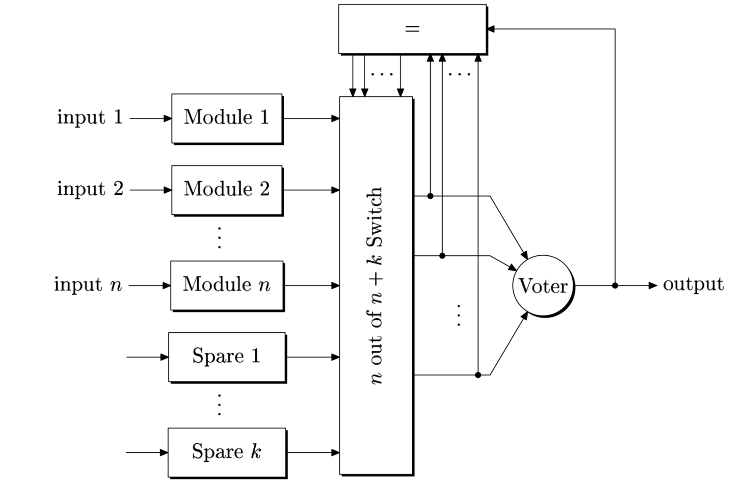
N-Modular Redundancy with Spares
disagreement detector
Normal Operation: Use first n modules
the output of the voter is compared to the individual outputs of the modules
module which disagrees is labeled as faulty and removed from the NMR core
spare is switched to replace it
Notes:
only n modules provide input to a majority voter. Additional k modules serve as spares.

Slide 33
N-Modular Redundancy with Spares
disagreement detector
Note: fault tolerance capability depends on voter implementation (fixed input vs variable input [threshold])
Fixed input voter:
Initially k faults are tolerated by means of the k spares
After k faults, disagreement detector turned off, tolerating extra (n-1)/2 faults
Notes:
If voter is fixed-input (n-input), then initially k faults are tolerated by means of the k spares, then after k faults, the disagreement detector is switched off, with n modules working in n-modular redundancy mode, thus tolerating extra $\left\lfloor \frac{n}{2}\right\rfloor$ faults.
If voter is threshold voter, then when the (k+i)th fault occurs (for 1 <= i <= n-1), the voter votes on (n-i) modules in total with the disagreement detector being on.

Slide 34
Time (Temporal) Redundancy
Achieved by repeating the computation or data trans- mission and comparing the result to a stored copy of the previous results
Does not require physical replication
Can be used to detect transient and permanent faults
Apart from detection and correction of faults, useful for distinguishing between transient and permanent faults
Notes:
Apart from detection and correction of faults, time redundancy is useful for distinguishing between transient and permanent faults. If the fault disappears after the re-computation, it is assumed to be transient. In this case the hardware module is still usable and it would be a waste of resources to switch it off the operation.

Slide 35
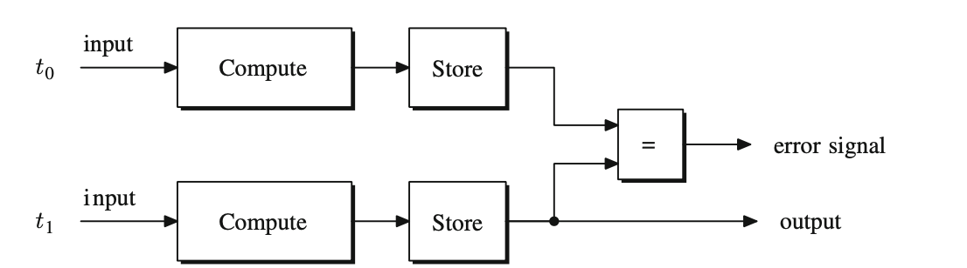
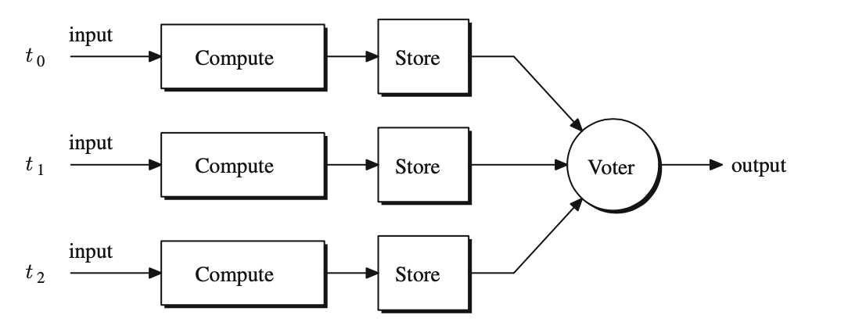
Transient Faults - Repeated Computation
If repetition is done twice, then stored copy will differ from recomputed result, so fault will be detected
If the repetition is done three or more times, a fault can be corrected

Slide 36
Transient Faults: Repeated Computation
If repetition is done twice, then stored copy will differ from re-computed result, so fault will be detected
Problem: the assumption that the data required to repeat a computation is available in the system. Transient faults might cause a system failure, so computation might be difficult or not possible to repeat
If the repetition is done three or more times, a fault can be corrected

Slide 37
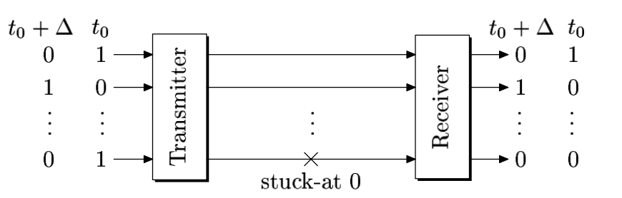
Temporal Redundancy - Permanent Faults
Example: Detecting permanent stuck-at faults at bus lines
Scheme: Alternating logic time redundancy
Reynolds and Metze, 1978

Slide 38
Software Fault-Tolerant Techniques
Main difference between S/W and H/W fault tolerance
Simply replicating code and executing it 3 times doesn’t help
If there is a bug in the code, it will happen each time
Thus, with software, it really only makes sense if you have different implementations of the module
N-Versions programming: have N different versions of the software, and execute all N versions
Significant Run-time overhead
Development time/cost overhead

Slide 39
Handling Software Errors: Recovery Blocks
Problem: primary module might
have changed the state of the system
→ need to checkpoint at the start so
we can “roll back” system state
primary module
acceptance test
if (acceptance test failed) {
secondary module [different implementation, simpler]
acceptance test
if (acceptance test failed) give up [prepare for failure in as controlled a manner as possible]
}
Notes:
A realization of N-version programming.
Our purpose is to prevent an error (invalid state within the boundary of the system) to become a failure (invalid state observable outside the boundary of the system).
→ if that is not possible, to prepare for the failure in as controlled a manner as possible

Slide 40
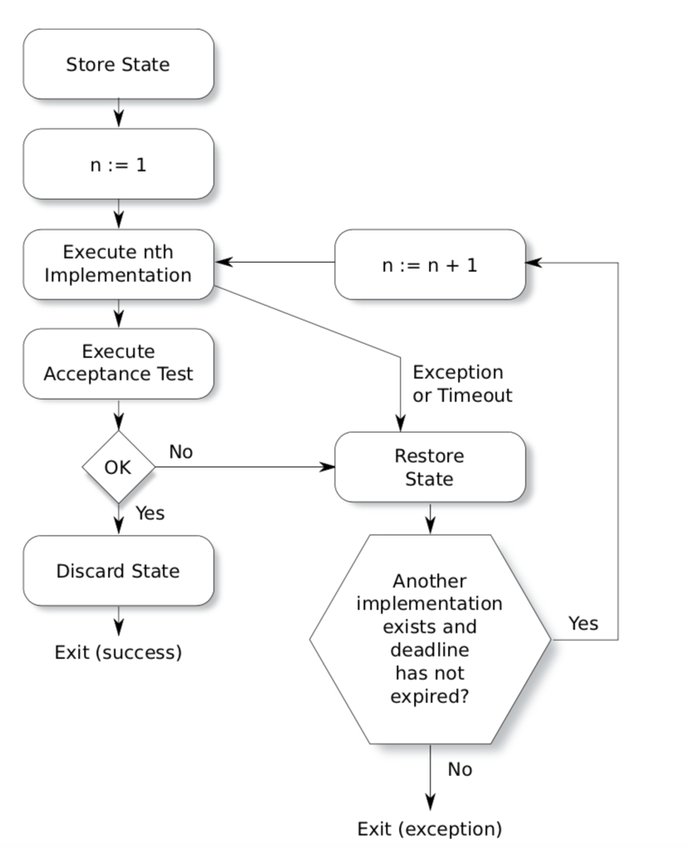
Recovery Block Structure
From Hobbs, Embedded Software Development for Safety-Critical Systems

Slide 41
Data Errors
Even if the hardware and software is fine, data can be corrupted:
One mechanism: Single-Event Upset faults
Radiation continuously strikes earth
It is possible that a bit can be flipped
Flipping a bit can cause memory errors, or if you are using reconfigurable logic, it can even cause circuit/processor errors

Slide 42

Does it really happen?
Documented strikes in large servers found in error logs
Normand, “Single Event Upset at Ground Level,” IEEE Transactions on Nuclear Science, Vol. 43, No. 6, December 1996.
Sun Microsystems, 2000 (R. Baumann, Workshop talk)
Cosmic ray strikes on L2 cache with defective error protection
caused Sun’s flagship servers to suddenly and mysteriously crash!
Companies affected
Bell, America Online, Ebay, & dozens of other corporations
From: S. Mukherjee, Intel, HPCA 2005

Slide 43
Strike Changes State of a Single Bit
0
1
From: S. Mukherjee, Intel, HPCA 2005
Notes:
Transition: The physics of this is, of course, a little more involved

Slide 44
Impact of Neutron Strike on a Si Device
neutron strike
source
Strikes release electron & hole pairs that can be absorbed by source & drain to alter the state of the device
drain
+
+
-
+
+
-
-
-
Secondary source of upsets: alpha particles from packaging
From: S. Mukherjee, Intel, HPCA 2005

Slide 45

Cosmic Rays Come From Deep Space
p
n
p
n
p
n
n
p
n
p
n
Earth’s Surface
Neutron flux is higher in higher altitudes
From: S. Mukherjee, Intel, HPCA 2005

Slide 46
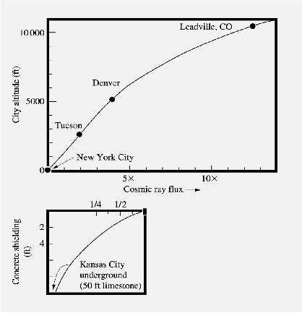
Impact of Elevation
Figure 8, Ziegler, et al., “IBM experiments in soft fails in computer electronics (1978 - 1994),” IBM J. of R. & D., Vol. 40, No. 1, Jan. 1996.
3x - 5x increase in Denver at 5,000 feet
100x increase in airplanes at 30,000+ feet
From: S. Mukherjee, Intel, HPCA 2005
Notes:
Transition: Underground we can slow down the neutrons to almost completely mitigate the effect, so the question is does shielding work?

Slide 47
Error Correction/Detection
Most memories have extra bits to detect when there has been an error (and possibly correct)
Every time you read a word, the parity bit(s) are checked
If there is an error, and it can not be corrected, inform the processor via an interrupt
Note that it can affect your registers too, and registers often do not have any parity bits.
Any system will fail eventually
Quantified by “Mean Time Between Failure” (MTBF)
FPGAs have an extra problem: the configuration (the circuit implemented in the FPGA) is stored in memory bits
A neutron strike can change the circuit!
Is this a problem? Some researchers are working on it, some say no big deal

Slide 48
Redundancy in Memory Arrays

Slide 49
Some Example Fault-Tolerant Systems

Slide 50
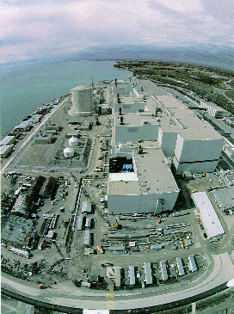
Example: Darlington Nuclear Power Plant
Two ways of shutting down reaction:
SDS1: Drop Neutron-absorbing shut-off rods into the reaction
SDS2: Injects liquid Gadolinium Nitrate into the reaction
Both systems use separate sensors and separate software:
SDS1: 7000 lines of Fortran
SDS2: 13000 lines of Pascal
Written by two different teams (but managed by the same person)

Slide 51

Example: Space Shuttle

Slide 52
Space Shuttle Computer Systems

Slide 53
Space Shuttle Computer Systems
Four CPUs are configured in a N-Way Modular Redundancy scheme
Each CPU executes the same code
Hardware voting is done, but each processor also compares its results to those from its neighbour
If there is a disagreement, voting is used to remove the offending computer
When one computer fails, there are three left
Use TMR (Triple Modular Redundancy) techniques
When another computer fails, there are two left:
Two remaining computers compare their results to detect failure
When another computer fails, there is one left:
Inform the crew, try to detect what the problem is and maybe fix it?

Slide 54
Space Shuttle Computer Systems
The fifth computer is normally used for non-critical functions such as communications.
In an emergency, it can take over critical operations
It contains flight control software written by a different contractor
Provides some software diversity
However, all processors are of the same type (potential problem)

Slide 55
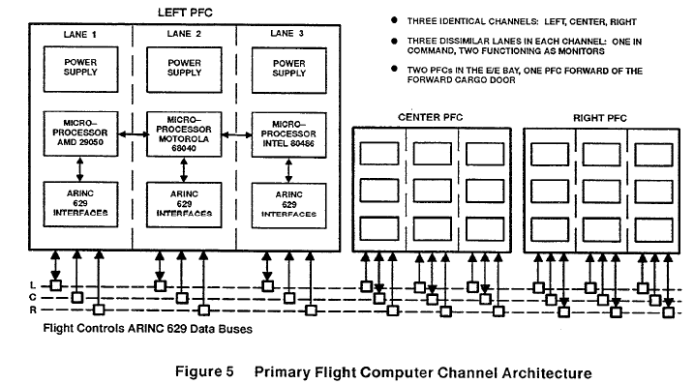
Modern Passenger Jet Processor Architecture

Slide 56
Mariner 1 Venus Probe
Hardware/Software problems go way back…
Mars 1 Venus Probe: Launched in July of 1962: “The first American attempt to send a probe to Venus. Guidance instructions from the ground stopped reaching the rocket due to a problem with its antenna, so the onboard computer took control. However, a bug in the guidance software caused the rocket to veer off course and it was destroyed by the range safety officer.”
The problem was traced to the following line of Fortran code:
DO 5 K = 1. 3
The period should have been a comma.
An $18.5 million space exploration vehicle was lost

Slide 57
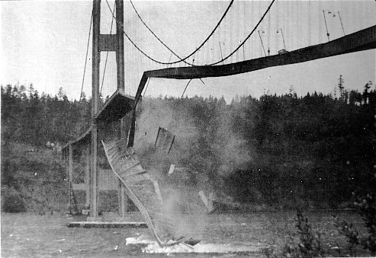
Learning from Other Fields…
In the 1800’s, ¼ of iron truss
railroad bridges failed!
Today: safety is now part of the
Civil Engineering culture
- margin of safety: 3x-6x vs.
calculated load
- What is the EE/CE margin
of safety?
What will people in the future
think of our computers?
Modified from Patterson, 2004

Slide 58
Estimating system reliability Definitions and basic mathematical modeling
CPEN 432– Design of Real-Time Systems

Slide 59
Overview
Basic concepts
Reliability expressions
Mean time to failure (& mean time between failures)
Availability
Maintainability

Slide 60
Improving reliability via redundancy
Triple modular redundancy

Slide 61
Improving reliability via redundancy
Space shuttle systems

Slide 62
Definitions
Reliability: The probability that the given system will perform its required function under specified conditions for a specified period of time.
MTBF (Mean Time Between Failures): Average time a system will run between failures. The MTBF is usually expressed in hours. This metric is more useful to the user than the reliability measure.

Slide 63
Increased system reliability
Worst case design
Use high quality components
Strict quality control procedures
Redundancy
Typically employed
Less expensive

Slide 64
Reliability expressions - Assumptions
If a device is operable (up) then it produces perfect responses
Reliability defined in terms of lifetime of device
Applicable to hardware only
Not suitable for software and many lower-grade or “imperfect” systems → not practical
However, mathematically convenient
Will be relaxed later

Slide 65
Reliability expressions
Exponential failure law
Mostly applicable to hardware components
The reliability of a system is modeled as
where λ is the failure rate expressed as the number of failure per time unit (the time unit could be hours, days, …).

Slide 66
Mean Time Between Failures (MTBF)
MTBF is the expected (average) length of contiguous uptime (it is the expected lifetime if system is not repairable)
The mean time between failures is the reciprocal of the failure rate.
If λ is the number of failures per hour, the MTBF is expressed in hours/failure
If, after repair, a system behaves like it was new, there is no difference between MTTF and MTBF. Else there might be some difference

Slide 67
Example
A system has 4000 components, each with a failure rate of 0.02% per 1000 hours. Calculate λ and the MTBF.
Assumption: The components fail independently, and the entire
system fails as soon as one component fails
R(t) = P(T > t) = P(T₁ > t, T₂ > t, …, T_{n} > t)
= P(T₁ > t)P(T₂ > t) … P(T_{n} > t)
= exp[-(λ₁ + … + λ_{n})t]
Notes:
If Ti is the lifetime of a single component, as the system fails as soon as one component fails, then the lifetime T of the system is min(T1, …, Tn).
Then P(T >t) = P(t < min(T1, …, Tn) ) = P(t < every Ti).

Slide 68
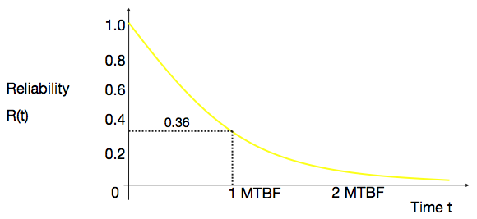
Relation between MTBF and reliability
When λt is small: R(t) = e^{-λt} ≈ 1 - λt = 1 - (t/MTBF)
MTBF = t/(1-R(t))

Slide 69
Another example
A first generation computing system contains 10,000 components, each with λ = 0.5% per 1000 hours. What is the period of 99% reliability? (All components have to function correctly.)
t_{0.99}

Slide 70
Reliability of different system configurations
Series configuration
R
R
R
R
P(T > t) = P(T₁ > t, T₂ > t, …, T_{n} > t)
= P(T₁ > t) P(T₂ > t) … P(T_{n} > t)
Overall reliability, R_{o} = R x R x … x R = R^{n}
(Assuming independent failures)

Slide 71
Reliability of different system configurations
Parallel configuration
R
R
R
R
Overall reliability, R_{o} = 1 - (probability of all failures) = 1 - (1-R)^{n}

Slide 72
Reliability of different system configurations
Hybrid configuration
R
R
R
R
R
R
R

Slide 73
Reliability of different system configurations
Triple modular redundancy
R
R
VOTER
R
Assuming an always reliable voter

Slide 74
An exercise
You have five modules of the same type to design a fault-tolerant system. Each module has a failure rate λ_{m}. You have several possibilities for building redundancy. You can use a 5-input majority voter (with failure rate λ₅), a 3-input majority voter (λ₃), a 2-to-1 selection circuit (λ_{2s}), and a 2-input comparator (λ_{2c}). Assume that
λ₅ = 2λ₃
λ₃ = 2λ_{2s}
λ_{2s} = λ_{2c}
What would be the best configuration to connect the modules?
You may make reasonable assumptions to ease calculations.

Slide 75
Maintainability
Maintainability of a system is the probability of isolating and repairing a fault in the system within a given time duration.
M(t) = P(S ≤ t), where S is the service time random variable
If S is exponentially distributed, then M(t) = 1 - e^{-μt}, where μ is the repair rate and t is the permissible time for the maintenance action
M(t) is the probability that the system has been repaired at time t.
μ = 1/MTTR
MTTR is the Mean Time To Repair

Slide 76
Availability – Repairable Units
So far we assumed that if a module fails it stays in the failed state forever
If system is repairable (maintenance, replacement, etc) then its behavior in time will not only depend on its lifetime and on failure mode but also on the way in which it can be recovered and the duration of recovery time
One possible definition of availability: A measure of the degree in which a system is in the operable (up) state at the start of mission when the mission is called for at an unknown random point in time. “MIL-STD-721”
Repair action/policy is crucial to achievable availability
In this context, a highly available system is a system with a low probability of breaking down (high reliability) and a high probability of being quickly repaired (high maintainability)
Under the assumption that an up (operable) system is reliable, if system is not repairable then availability = reliability

Slide 77
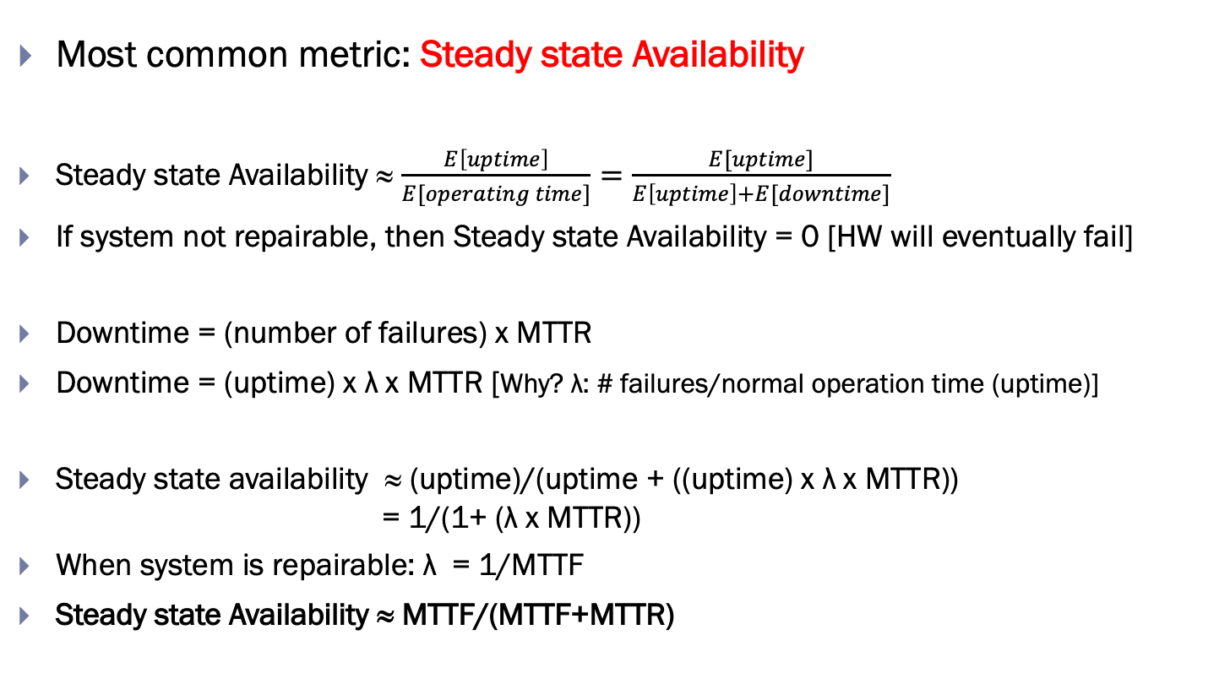
Availability – Repairable Units
Most common metric: Steady state Availability
Steady state Availability ≈ $\frac{E\left[uptime\right]}{E[operating time]}=\frac{E[uptime]}{E\left[uptime\right]+E[downtime]}$
If system not repairable, then Steady state Availability = 0 [HW will eventually fail]
Downtime = (number of failures) x MTTR
Downtime = (uptime) x λ x MTTR [Why? λ: # failures/normal operation time (uptime)]
Steady state availability ≈ (uptime)/(uptime + ((uptime) x λ x MTTR)) = 1/(1+ (λ x MTTR))
When system is repairable: λ = 1/MTTF
Steady state Availability ≈ MTTF/(MTTF+MTTR)

Slide 78
A Broader View of Reliability
So far we assumed that if a system is up (operable) then it provides perfect answers (i.e., is “reliable”)
This is rarely the case, however:
Sensors are noisy (imperfect measurements)
Object detection algorithms (false positives/negatives)
A medical equipment that analyses blood or urine samples might produce inaccurate results
(most dangerous of which are false negatives: missing a diagnosis/disease when it is present in the sample!)

Slide 79
A Broader View of Reliability
Should incorporate “accuracy/quality/correctness” of response
Reliability is not lifetime
Reliability becomes much harder to measure but availability still relatively easy
In this more realistic reliability definition, availability and reliability can be at conflict

Slide 80
Reliability Redefined
A system might fail in one of two ways:
It might fail to give a timely response at all [availability problem], or
It might respond in a timely manner but with the wrong answer [reliability problem]
Increasing availability might reduce reliability and vise versa
Example: Increasing reliability by using two subsystems that both compute answers and then should compare their answers to produce final result
It is important to understand the main objective of system design (does reliability have priority over availability?)
Software testing is almost always concerned with reliability, checking availability just in passing
Notes:
Users cannot measure reliability but can measure availability.

Slide 81
Software systems
How do we improve reliability?
Apart from N-versions programming and recovery blocks…
Better operating systems support
Stricter programming language primitives
Rigorous engineering practice
Formal verification of correctness

Slide 82
Redundancy… but at what cost?
Discussion: What is an important factor affecting most engineering decisions that has been excluded in reliability estimation? How would you account for the impact of this factor?
The price of redundancy. If we had a finite budget, is it better to improve the reliability of a component or rely on redundant (and less reliable) versions of that component?

Slide 83
Summary
Building a reliable system involves integrating several redundant components.
In this lecture we discussed:
Reliability and failure rates;
MTTF and MTBF;
Maintainability;
Availability.
We also analyzed the reliability of different configurations.
Parallel, Serial, Hybrid, TMR.

