Slide 1
Periodic task scheduling
Static priorities
Better utilization bounds
Deadlines less than periods
Exact test for schedulability
1

Slide 2
Quick review
Why is rate monotonic scheduling optimal (among static priority policies)?
Critical instant theorem: The worst-case execution time of a job when tasks are scheduled with fixed priorities occurs when jobs belonging to all tasks release at the same instant
It is sufficient, then, to verify that the job that is released at the critical instant meets its deadline
In this worst case, rate monotonic scheduling is optimal (easy to see; if tasks are feasibly scheduled in any other order, swap based on deadlines)
Utilization bound and optimality of EDF
The utilization bound is 1 (or 100%)
EDF is optimal because no policy can do better (may do as well but not better)
2

Slide 3
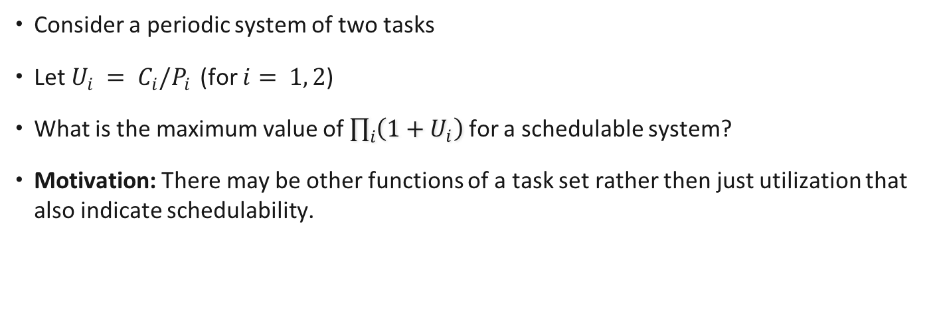
Exercise Know Your Worst Case Scenario
Consider a periodic system of two tasks
Let $U_{i} = C_{i}/P_{i}$(for $i= 1, 2$)
What is the maximum value of $\prod_{i}{\left(1+U_{i}\right)}$ for a schedulable system?
Motivation: There may be other functions of a task set rather then just utilization that also indicate schedulability.
3

Slide 4





Hyperbolic bound for RM
worst case conditions
for schedulability
of 2 tasks under RM
Critically schedulable
Schedulable
Hyperbolic bound
4

Slide 5
Solutions
Generalizes to task sets with n tasks
Critically schedulable
Schedulable
Hyperbolic bound
5

Slide 6
Hyperbolic bound for rate monotonic scheduling
A set of periodic tasks is schedulable if
6

Slide 7

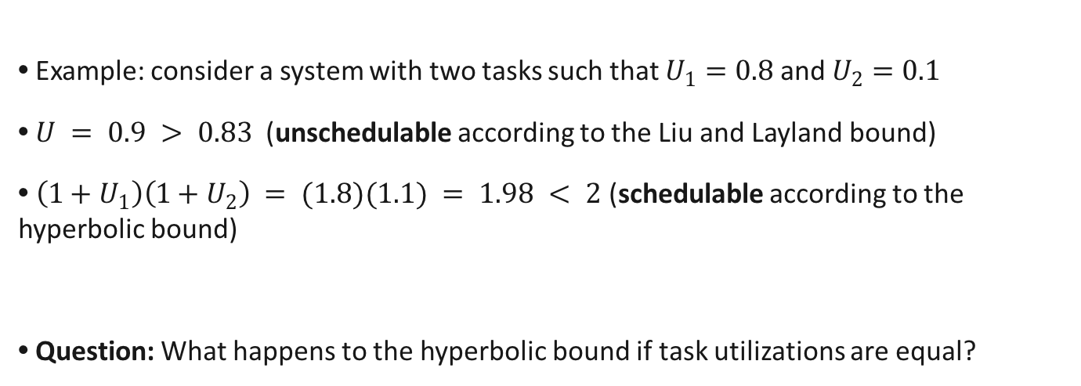
Hyperbolic bound for rate monotonic scheduling
A set of periodic tasks is schedulable if
It is a better bound than the Liu and Layland bound
Example: consider a system with two tasks such that $U_{1}=0.8$and $U_{2}=0.1$
$U = 0.9 > 0.83$ (unschedulable according to the Liu and Layland bound)
$\left(1+U_{1}\right)\left(1+U_{2}\right) = (1.8)(1.1) = 1.98 < 2$(schedulable according to the hyperbolic bound)
Question: What happens to the hyperbolic bound if task utilizations are equal?
7

Slide 8
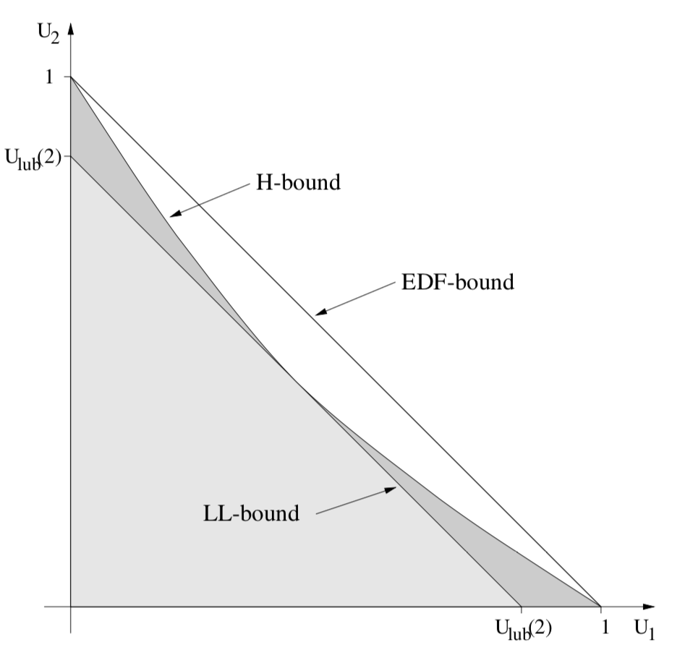
Feasibility regions in U-space

Slide 9
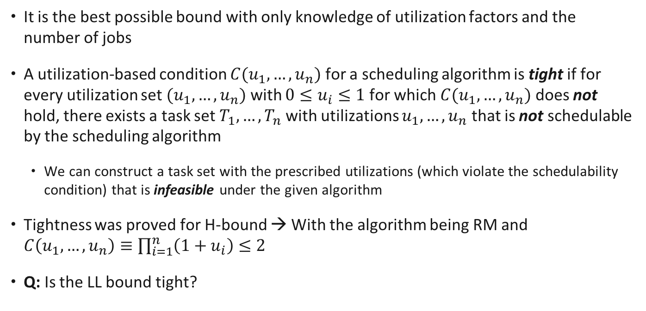
Hyperbolic bound is tight
It is the best possible bound with only knowledge of utilization factors and the number of jobs
A utilization-based condition $C(u_{1}, …, u_{n})$ for a scheduling algorithm is tight if for every utilization set $(u_{1},…, u_{n})$ with ${0≤u}_{i}≤1$for which $C(u_{1}, …, u_{n})$ does not hold, there exists a task set $T_{1}, …,T_{n}$with utilizations $u_{1},…, u_{n}$ that is not schedulable by the scheduling algorithm
We can construct a task set with the prescribed utilizations (which violate the schedulability condition) that is infeasible under the given algorithm
Tightness was proved for H-bound → With the algorithm being RM and $C\left(u_{1}, …, u_{n}\right)≡\prod_{i=1}^{n}{\left(1+u_{i}\right)≤2}$
Q: Is the LL bound tight?
9
Notes:
Note: there might exist tasksets with those utilization that are schedulable, but there is at least one that is not (here because the bound is utilization-based, it cannot distinguish those tasksets and that’s why it deems this utilization vector infeasible).

Slide 10
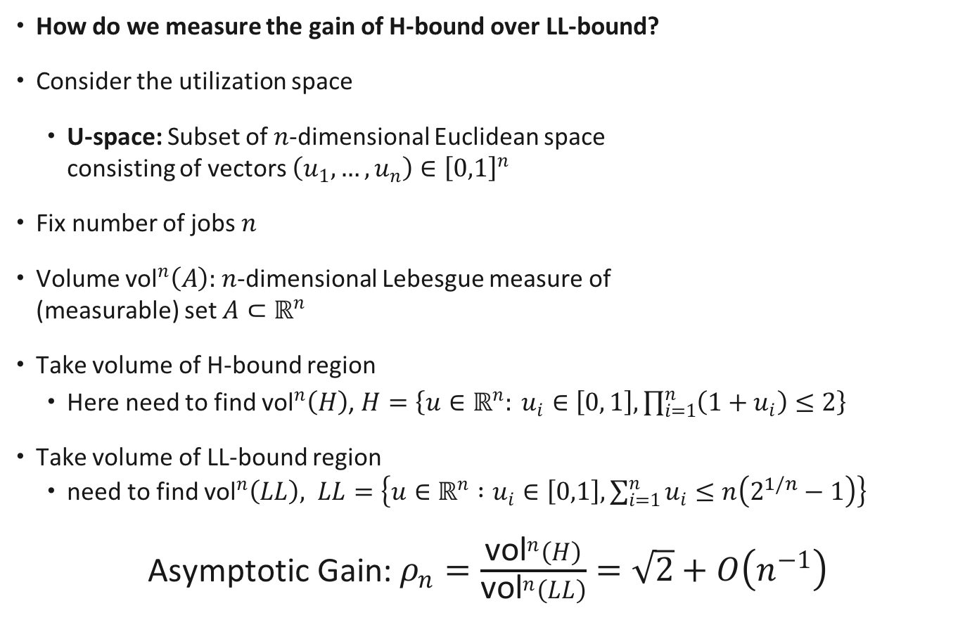
How much better is Hyperbolic bound relative LL?
How do we measure the gain of H-bound over LL-bound?
Consider the utilization space
U-space: Subset of $n$-dimensional Euclidean space consisting of vectors $\left(u_{1},…, u_{n}\right)∈{\left[0,1\right]}^{n}$
Fix number of jobs $n$
Volume ${\text{vol}}^{n}\left(A\right):$ $n$-dimensional Lebesgue measure of (measurable) set $A⊂ℝ^{n}$
Take volume of H-bound region
Here need to find ${\text{vol}}^{n}\left(H\right)$, $H=\left\{u∈ℝ^{n}: u_{i}∈\left[0, 1\right], \prod_{i=1}^{n}{\left(1+u_{i}\right)≤2}\right\}$
Take volume of LL-bound region
need to find ${\text{vol}}^{n}\left(LL\right), LL=\left\{u∈ℝ^{n} :u_{i}∈\left[0,1\right], \sum_{i=1}^{n}{u_{i}}≤n\left(2^{1/n}−1\right)\right\}$
Asymptotic Gain: $ρ_{n}=\frac{{\text{vol}}^{n}\left(H\right)}{{\text{vol}}^{n}\left(LL\right)}=\sqrt{2}+O\left(n^{−1}\right)$

Slide 11
Scheduling taxonomy
Periodic task scheduling
Rate monotonic
EDF
Bound
Optimality
Bound
Optimality
11

Slide 12
Scheduling taxonomy
Periodic task scheduling
Rate monotonic
EDF
Bound
Optimality
Bound
Optimality
Hyperbolic bound
12

Slide 13
Scheduling taxonomy
with period =
relative deadline
Periodic task scheduling
Rate monotonic
EDF
Bound
Optimality
Bound
Optimality
Hyperbolic bound
13

Slide 14
Scheduling taxonomy
with period >
relative deadline
Periodic task scheduling
Rate Deadline monotonic
EDF
14

Slide 15
Deadline monotonic scheduling
Consider a set of periodic tasks where each task, i, has a computation time, C_{i}, a period, P_{i}, and a relative deadline D_{i} < P_{i}.
D_{i}
P_{i}
15

Slide 16
Deadline monotonic scheduling
Consider a set of periodic tasks where each task, i, has a computation time, C_{i}, a period, P_{i}, and a relative deadline D_{i} < P_{i}.
D_{i}
P_{i}
What is the schedulability condition?
Can not be worse than when the period of each task is reduced to Di.
16

Slide 17

Deadline monotonic scheduling
Consider a set of periodic tasks where each task, i, has a computation time, C_{i}, a period, P_{i}, and a relative deadline D_{i} < P_{i}.
D_{i}
P_{i}
What is the schedulability condition?
Can not be worse than when the period of each task is reduced to Di.
17

Slide 18
Deadline monotonic scheduling
Consider a set of periodic tasks where each task, i, has a computation time, C_{i}, a period, P_{i}, and a relative deadline D_{i} < P_{i}.
D_{i}
P_{i}
What is the schedulability condition?
Can not be worse than when the period of each task is reduced to Di.
What is the problem?
18
Notes:
This will overestimate the utilization of the taskset ☹

Slide 19
A better condition for schedulability
Worst case interference from a higher priority task, j?
P_{j} = D_{j}
C_{j}
Task j
D_{i}
Task i
P_{i}
19

Slide 20
A better condition for schedulability
Worst case interference from a higher priority task, j?
Time required by a higher priority task in an interval of length that corresponds to the relative deadline of task i.
P_{j}
C_{j}
Task j
D_{i}
Task i
P_{i}
Worst case Interference task j exercises on task i
→ upper bound on total workload requested
by task j during D_{i} at the critical instant
Number of execution requests of task j in duration of length D_{i} assuming critical instant
20
Notes:
Why the ceiling? We are counting the number of arrivals of task j in [0,Di]; the execution of the last such arrival might spill over Di and thus does not contribute to interference but we are including it entirely to be safe (pessimistic)

Slide 21
A better condition for schedulability
Worst case interference from a higher priority task, j?
P_{j}
C_{j}
Task j
D_{i}
Task i
P_{i}
21

Slide 22
A better condition for schedulability
Worst case interference from a higher priority task, j?
P_{j}
C_{j}
Task j
D_{i}
Task i
P_{i}
Interference from higher priority tasks
Execution time of Ti
22

Slide 23
A better condition for schedulability
Worst case interference from a higher priority task, j?
There still is a problem!
P_{j}
C_{j}
Task j
D_{i}
Task i
P_{i}
Interference from higher priority tasks
Execution time of Ti
23

Slide 24
An exact condition for schedulability
Interference exists only till a job completes execution, i.e., up to the response time Ri
Not necessarily up to the relative deadline Di
P_{j}
C_{j}
R_{i}
Task j
D_{i}
Task i
P_{i}
R_{i}
24

Slide 25
An exact condition for schedulability
(1)
Because task j has higher priority than task i so all instances of task j
that arrive in interval of length R_{i} finish before task i
25

Slide 26
An exact condition for schedulability
Interference exists only till a job completes execution, i.e., up to the response time Ri
Not necessarily up to the relative deadline Di
P_{j}
C_{j}
Task j
D_{i}
Task i
P_{i}
R_{i}
Interference on task i from all
higher priority tasks
26

Slide 27
An exact condition for schedulability
Interference exists only till a job completes execution, i.e., up to the response time Ri
Not necessarily up to the relative deadline Di
P_{j}
C_{j}
Task j
D_{i}
Task i
We also have the following relation:
P_{i}
R_{i}
27

Slide 28
An exact condition for schedulability
Interference exists only till a job completes execution, i.e., up to the response time Ri
Not necessarily up to the relative deadline Di
P_{j}
C_{j}
Task j
D_{i}
Task i
We also have the following relation:
P_{i}
R_{i}
Solve iteratively for the smallest
Ri to satisfy both relations
28

Slide 29
Computing Response Time
variable
What is a solution to this recurrence?

Slide 30
Computing Response Time
variable
What is a solution to this recurrence?
The smallest t > 0 such that → called fixed-point
Does a solution always exist?
If so, how can a solution be computed in a finite number of steps? (convergence)
Finding Response Times in a Real-Time System M. Joseph P. Pandya.
The Computer Journal, Volume 29, Issue 5, 1 January 1986, Pages 390–395.

Slide 31
Computing Response Time
What is a proper initial value ?
Any lower bound on the response time → take
Affects the rate of convergence

Slide 32
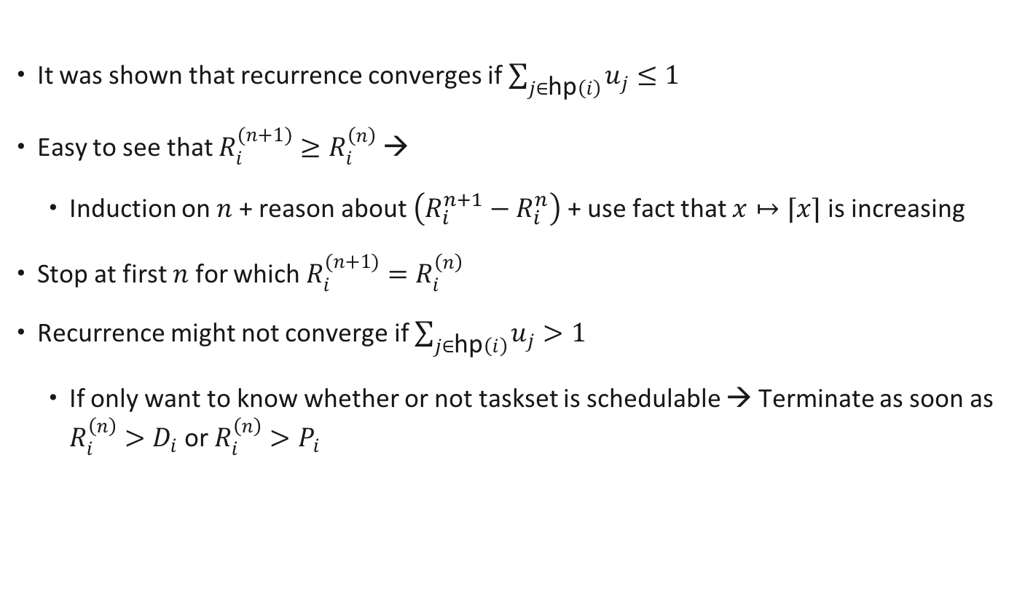
Exact Response Time: Solution Existence
It was shown that recurrence converges if $\sum_{j∈\text{hp}\left(i\right)}{u_{j}≤1}$
Easy to see that $R_{i}^{(n+1)}≥R_{i}^{\left(n\right)}$ →
Induction on $n$ + reason about $\left(R_{i}^{n+1}−R_{i}^{n}\right)$ + use fact that $x↦⌈x⌉$ is increasing
Stop at first $n$ for which $R_{i}^{(n+1)}=R_{i}^{\left(n\right)}$
Recurrence might not converge if $\sum_{j∈\text{hp}\left(i\right)}{u_{j}>1}$
If only want to know whether or not taskset is schedulable → Terminate as soon as $R_{i}^{\left(n\right)}>D_{i}$ or $R_{i}^{\left(n\right)}>P_{i}$

Slide 33
Example
P_{j}
C_{j}
D_{i}
P_{i}
R_{i}
Consider a system of two tasks:
Task 1: P₁=1.7, D₁=0.5, C₁=0.5
Task 2: P₂=8, D₂=3.2, C₂=2
33

Slide 34

Example
P_{j}
C_{j}
D_{i}
P_{i}
R_{i}
Consider a system of two tasks:
Task 1: P₁=1.7, D₁=0.5, C₁=0.5
Task 2: P₂=8, D₂=3.2, C₂=2
34

Slide 35
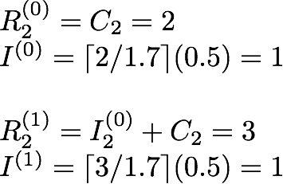
Example
P_{j}
C_{j}
D_{i}
P_{i}
R_{i}
Consider a system of two tasks:
Task 1: P₁=1.7, D₁=0.5, C₁=0.5
Task 2: P₂=8, D₂=3.2, C₂=2
35

Slide 36
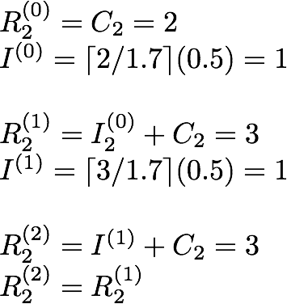
Example
P_{j}
C_{j}
D_{i}
P_{i}
R_{i}
Consider a system of two tasks:
Task 1: P₁=1.7, D₁=0.5, C₁=0.5
Task 2: P₂=8, D₂=3.2, C₂=2
3 < 3.2; Task 2 is schedulable.
36

Slide 37
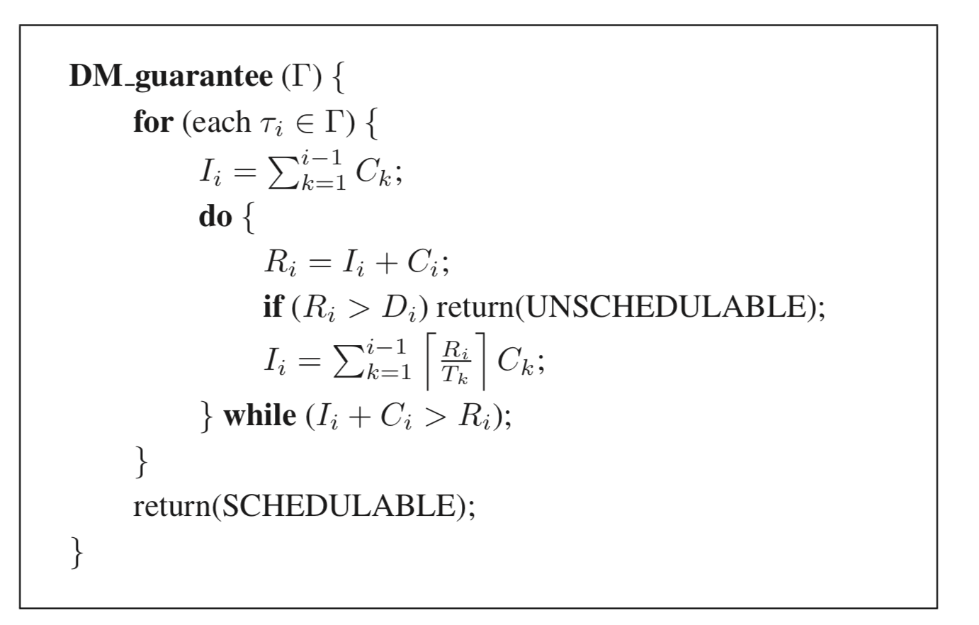
RTA Algorithm

Slide 38
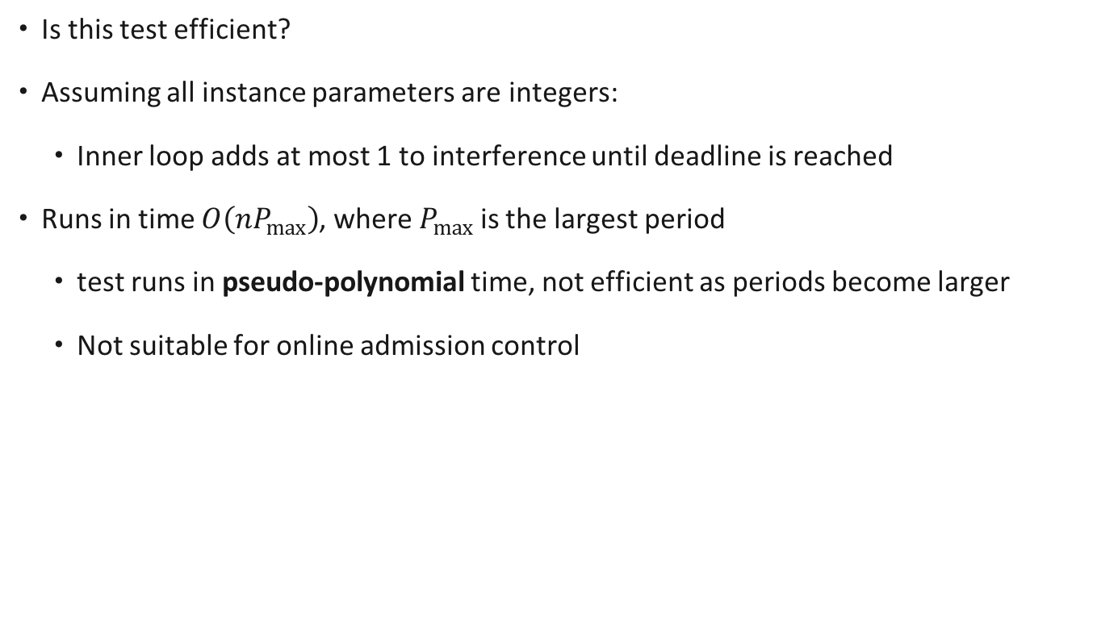
Response Time Analysis: Complexity
Is this test efficient?
Assuming all instance parameters are integers:
Inner loop adds at most 1 to interference until deadline is reached
Runs in time $O\left(nP_{max}\right)$, where $P_{max}$ is the largest period
test runs in pseudo-polynomial time, not efficient as periods become larger
Not suitable for online admission control
38

Slide 39
Lecture summary
There are better utilization bounds than the Liu & Layland utilization bound: the hyperbolic bound
When the relative deadline of a task is less than its period, we can apply utilization bounds
But such tests are even more pessimistic than normal
We can apply exact tests for schedulability when deadlines are less than or equal to periods
Such tests require more computation
Iterative process
39

