Slide 1





Project
Database Project
Academic Skill
Development Center
Teacher : Heang Sopagna
Member
Sat Panha
Phy Vathanak
Chhun Sivheng

Slide 2
Database
Introduction
The Academic Skill Development Center is a physical short-course school that enhances students’ skills through hands-on learning. While teaching is in person, the system supports student and teacher management, course creation, enrollment and attendance tracking and performance evaluation, and report analytics for monitoring student progress and behavior.
1

Slide 3
Database
Objective
Automate core academic workflows
Enable data tracking and reporting
Improve efficiency of class and student management
2

Slide 4
Database
School Feature
1. User Management
-Teacher Registration
-Student Registration
2. Course Management
-create course
-create class and allocate class
3. Enrollment & Attendance
- Student Enrollment (Assign student to class)
- Attendance Tracking
3

Slide 5
Database
School Feature
4. Learning Management System
- Quizzes create and tracking student attempt
-Teacher provide grade to student
5. Reports & Analytics
- Student Performance Reports
- Attendance and Behavior Analytics:
4

Slide 6
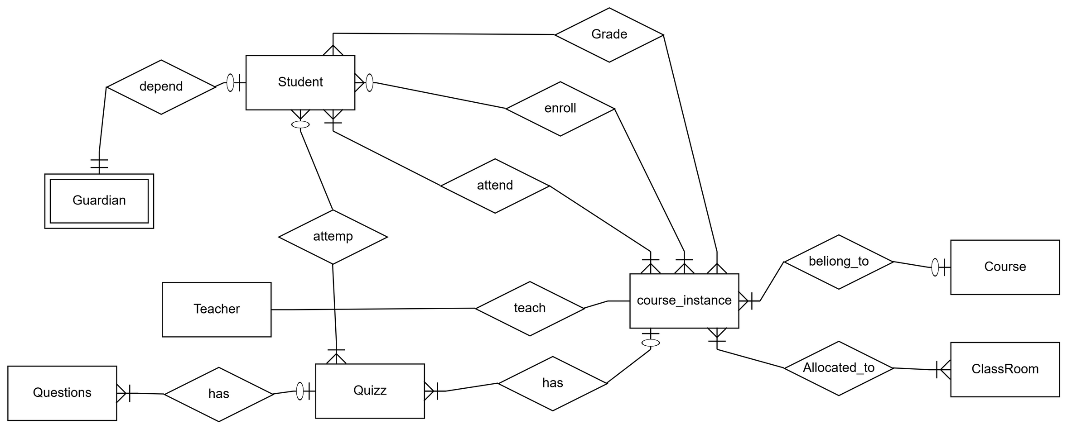
ER
5

Slide 7
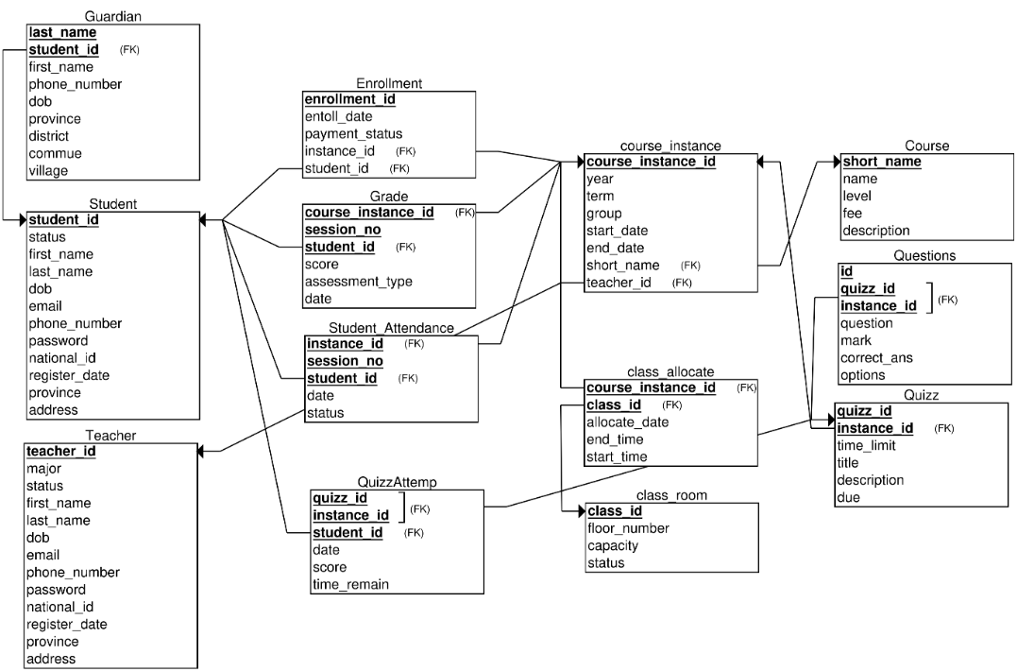
Relational Model
6

Slide 8

DDL
After we complete the ER and RM, we move on to writing SQL scripts to create the tables needed for the project requirements. For this project, we have created 15 tables.
Tables
Class_allocate
Class_room
Course
Course_instance
Enrollment
Grade
Guardian
Question
Quizz
QuizzAttempt
StudentAttendance
Students
Teachers
7

Slide 9
Function
Concept
A reusable SQL block that returns a value
Used for calculations, checking logic, or data retrieval
Does not change data (read-only)
Functions We Used:
IsStudentInClass | Checks if a student is enrolled in a class
getAttendanceScore | Calculates attendance score based on status
getCharGrade | Converts average score to letter grade
getCourseInstanceID | Finds course instance ID using course info
GetStudentCount | Counts students in a course instance
findMaxGradeSection | Gets the latest grade session in a course
findMaxAttendanceSection | Gets the latest attendance session
CheckClassAvailability | Checks if class timing is available
We used functions wherever we needed to return a value without modifying the database, which keeps our system clean and efficient.”
8

Slide 10
View
In our database system project, we implemented several views to manage and present student-related data more efficiently. These views help simplify complex queries and support various features of the system:
AvgGrades – Calculates average & total scores per student/course.
AttendanceScores – Computes total attendance score per student.
StudentPerformance – Combines grades & attendance into one score.
StudentReport – Generates final scores, letter grades & rankings.
listStudentInClass – Lists students enrolled in each class.
student_guardians – Shows student-guardian relationships & contacts.
students_not_enrolled – Finds students not enrolled in any course.
revenue_per_term – Calculates revenue per academic term.
quiz_with_questions – Lists quiz questions per course instance.
9

Slide 11
Procedure
Procedures We Used:
Function Name | Purpose
IsStudentInClass | Checks if a student is enrolled in a class
getAttendanceScore | Calculates attendance score based on status
getCharGrade | Converts average score to letter grade
getCourseInstanceID | Finds course instance ID using course info
GetStudentCount | Counts students in a course instance
findMaxGradeSection | Gets the latest grade session in a course
findMaxAttendanceSection | Gets the latest attendance session
CheckClassAvailability | Checks if class timing is available
Concept
A block of SQL code that performs actions like INSERT, UPDATE, or DELETE
Can handle multiple steps in one command
Useful for managing data and reducing errors
We used functions wherever we needed to return a value without modifying the database, which keeps our system clean and efficient.”
10

Slide 12
Trigger
A trigger is automatic code that runs when certain actions happen (INSERT, DELETE, or UPDATE).
In our project, we mainly use triggers to log DELETE and UPDATE actions.
DELETE Triggers
Purpose: Log when data is deleted.
What it logs:
Record ID
Deletion Time
Table Name
UPDATE Triggers
Purpose: Track changes to records.
What it logs:
Table Name
Record ID
Column Updated
Old & New Value
Timestamp
Triggers in our project ensure data integrity, security, and consistency by logging deletions and updates. They also make data recovery easier if something goes wrong.
11

Slide 13
Conclution
Outcome
Organized & efficient structure for school data management
Can perform Academic operation and report analysis
keep track when data was changed
Planned Improvements
Advanced indexing for query performance.
Backup & recovery mechanism for data safety.
Web integration: real-time school management via web app.
11

Slide 14
Conclution(cont)
Challenge
Complex Relationships: Difficulties in distinguishing between entities and relationships, and in choosing appropriate primary keys for each table.
Data Redundancy Risks: Preventing duplicate data entries while maintaining ease of data access.
Multi-Table Queries:Challenges in writing complex joins and aggregate queries involving multiple related tables.
12

Slide 15




DEMO

Slide 16

អរគុណ

