Slide 1
Expected Regret Minimisation for Bayesian Optimisation with Student’s-t Processes
Conference: REDACTED
Mr. Conor Clare, School of Computing, Ulster University, Northern Ireland Supervisors: Dr. Glenn Hawe Professor Sally McClean

Slide 2
Motivation
University of Oxford Machine Learning Group paper, "Knowing The What But
Not The Where in Bayesian Optimization“ [10]; Dr. Vu Nguyen and Prof. Michael A. Osborne, 2020 https://arxiv.org/abs/1905.02685v1
Designed two new ‘acquisition functions’ to enhance input x sampling for Bayesian optimisation
Uses multivariate Gaussian regression to train supervised learning surrogate [11]
Multivariate Gaussian regression: flexible and easy-to-implement; BUT: issues with capturing outliers and covariance calculation [12, 13, 17]
Existing literature: multivariate Student's-t offers solutions to Gaussian weaknesses => combine with Oxford paper => exploit gap in current knowledge
Results' presentation: based on MIT paper (pages 8,9) "Upgrading from Gaussian Processes to Student’s-t Processes"; Brendan D. Tracey and David H. Wolpert, 2018 [17] https://arxiv.org/abs/1801.06147
https://github.com/CPJClare/ERM-for-BayesOpt-with-STPs

Slide 3
What is Bayesian optimisation?
Widely-used technique for mathematical optimisation [2, 7, 14]
Applications include:
- hyperparameter tuning for machine learning applications [15,18]; - aero-structural engineering [17];
- nuclear science [3].
Uses supervised machine learning; input-output pairs (x, y) to train surrogate [11]
Surrogate learns expensive, black-box functions by seeking optimum x* [6, 7]
Two user choices:
- Multivariate regressor (typically Gaussian);
- Acquisition function: used to sample inputs x for supervised learning.
Acquisition uses posterior distribution of the multivariate regression surrogate [10]
Oxford defined two acquisition functions for multivariate Gaussian regression [10]
These will differ for multivariate Student's-t (versus Gaussian) “knowledge gap”
https://github.com/CPJClare/ERM-for-BayesOpt-with-STPs

Slide 4


Gaussian vs. Student’s-t Processes
Gaussian Processes (GPs):
- Outputs y jointly-sampled are multivariate Gaussian [11]:
Student’s-t Processes (STPs):
- Outputs y jointly-sampled are multivariate Student’s-t [12, 13, 17]:
https://github.com/CPJClare/ERM-for-BayesOpt-with-STPs

Slide 5



Gaussian vs. Student’s-t Processes
GP Weaknesses [12, 13, 17]:
- Despite flexibility and (relative) ease-of-implementation:
1.) GP posterior covariance does not contain output y [11]:
2.) GPs underestimate outliers e.g. aero-structural engineering [17]
STP Strengths [12, 13, 17]:
- Extra parameter ʋ (ʋ > 2) , “degrees-of-freedom”; controls STP tails.
1.) STP posterior covariance now contains output y:
2.) STP posterior covariance now captures outliers using:
https://github.com/CPJClare/ERM-for-BayesOpt-with-STPs

Slide 6


Expected Regret Minimisation (ERM)
Gaussian Processes (GPs):
- Expected Regret Minimisation with GPs (Nguyen and Osborne, 2020) [10]:
Student’s-t Processes (STPs):
- Expected Regret Minimisation with STPs (Clare et al, 2020) “knowledge contribution”:
https://github.com/CPJClare/ERM-for-BayesOpt-with-STPs

Slide 7
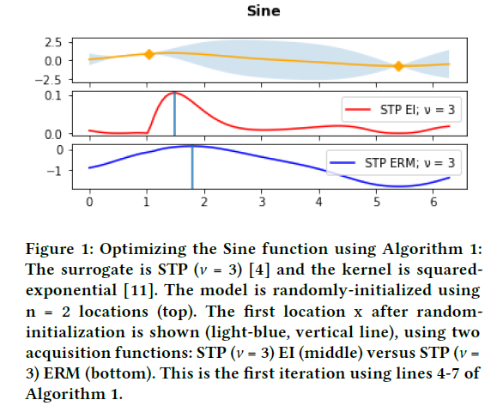
Acquisition functions: Expected Regret Minimization vs. Expected Improvement
https://github.com/CPJClare/ERM-for-BayesOpt-with-STPs

Slide 8
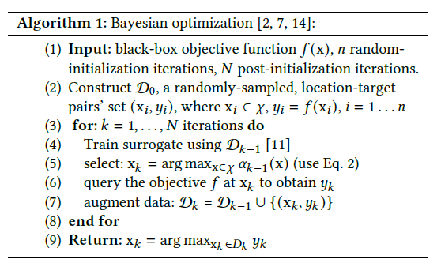
Algorithm 1: Bayesian Optimisation
NB: This paper was submitted to a New York-based publisher
(ACM) – hence the US spelling convention of certain words e.g. “optimization” vs. “optimisation”, “minimization” vs. “minimisation”, etc.
https://github.com/CPJClare/ERM-for-BayesOpt-with-STPs

Slide 9
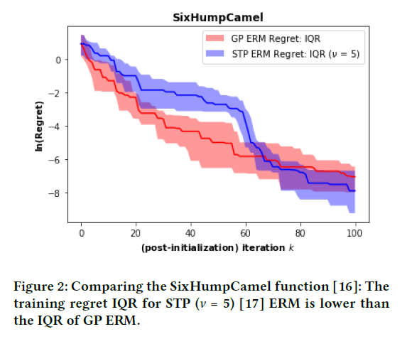
Application 1: Six-Hump Camel [16]
https://github.com/CPJClare/ERM-for-BayesOpt-with-STPs

Slide 10
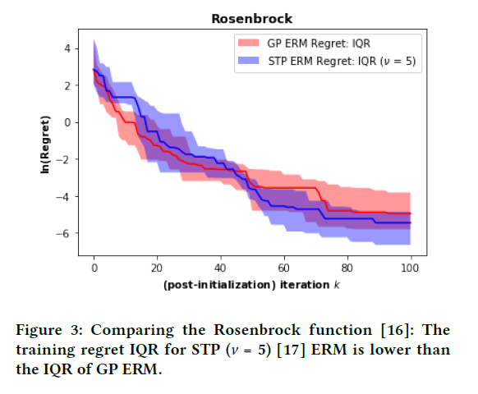
Application 2: Rosenbrock [16]
https://github.com/CPJClare/ERM-for-BayesOpt-with-STPs

Slide 11
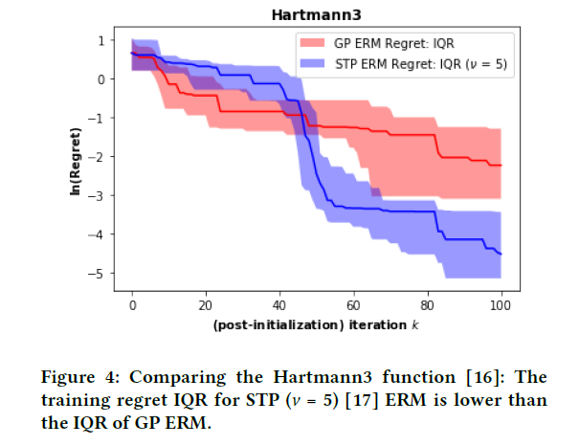
Application 3: Hartmann3 [16]
https://github.com/CPJClare/ERM-for-BayesOpt-with-STPs

Slide 12
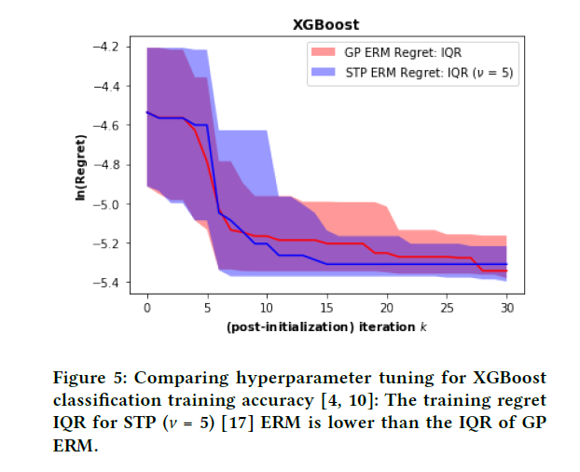
Application 4: Hyperparameter Tuning [4, 10]
https://github.com/CPJClare/ERM-for-BayesOpt-with-STPs

Slide 13
Knowledge Contribution: Summary
Exploiting prior knowledge of a global optimum [10] for Bayesian optimisation
with Student’s-t Processes
A derivation of Expected Regret Minimisation [10] for Bayesian optimisation with Student’s-t Processes
Comparing [17] Expected Regret Minimisation for Bayesian optimisation using Student’s-t Processes versus Gaussian Processes, on four benchmark problems [10, 16] popular in mathematical optimisation
Dr Vu Nguyen (Post-Doctoral Researcher, University of Oxford) has read both my Student’s-t Processes’ abstracts on ResearchGate (I emailed Dr. Nguyen the paper’s preprint (with conference details’ removed) last Friday, April 3rd 2020)
https://github.com/CPJClare/ERM-for-BayesOpt-with-STPs

Slide 14
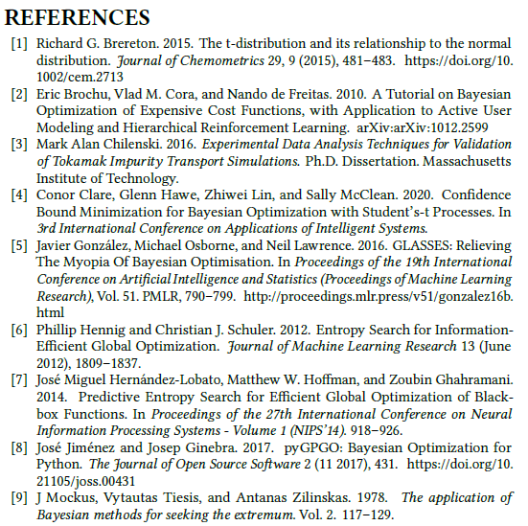
Citations (1/2)

Slide 15
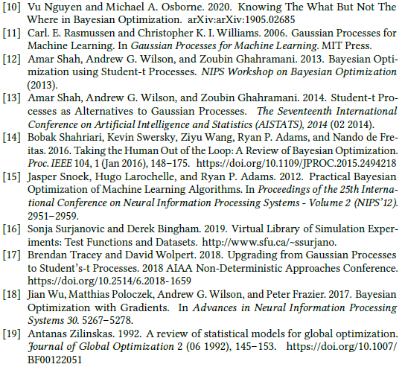
Citations (2/2)

Slide 16
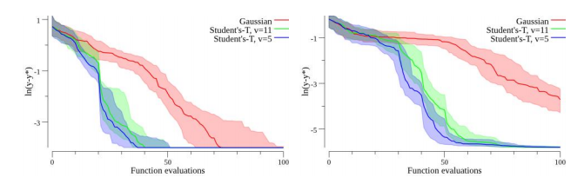
Conclusion
Take ‘top-level’ research e.g. University of Oxford [10]
Find gap in current literature e.g. multivariate Gaussian regression weaknesses
Exploit using literature solution e.g. multivariate Student’s-t regression [12, 13, 17]
Multivariate student's-t [12, 13, 17] + Oxford paper [10] => knowledge contribution
Results' presentation: based on MIT paper (pages 8,9) "Upgrading from Gaussian Processes to Student’s-t Processes"; Brendan D. Tracey and David H. Wolpert, 2018 [17] https://arxiv.org/abs/1801.06147
https://github.com/CPJClare/ERM-for-BayesOpt-with-STPs

Slide 17
Comments / feedback / criticisms – all welcome
Thank you for your time
https://github.com/CPJClare/ERM-for-BayesOpt-with-STPs

