Slide 1
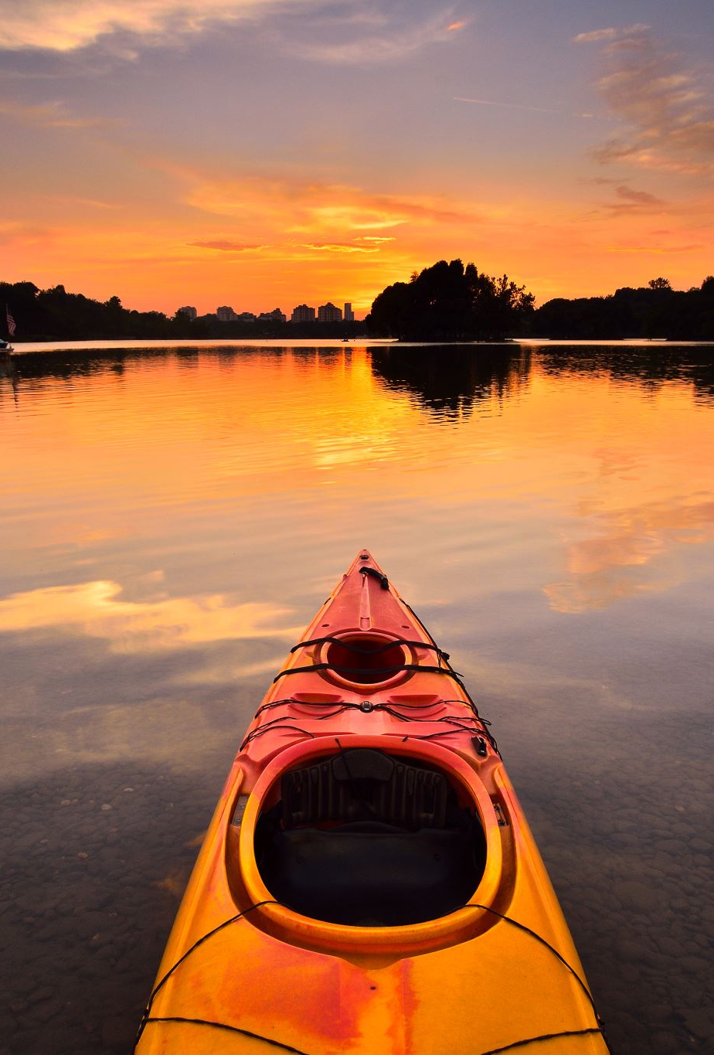
Waterfront Recreations along Delaware River
Are there specific places/activities that should be built on the waterfront?
- Current situation - possible improvement

Slide 2
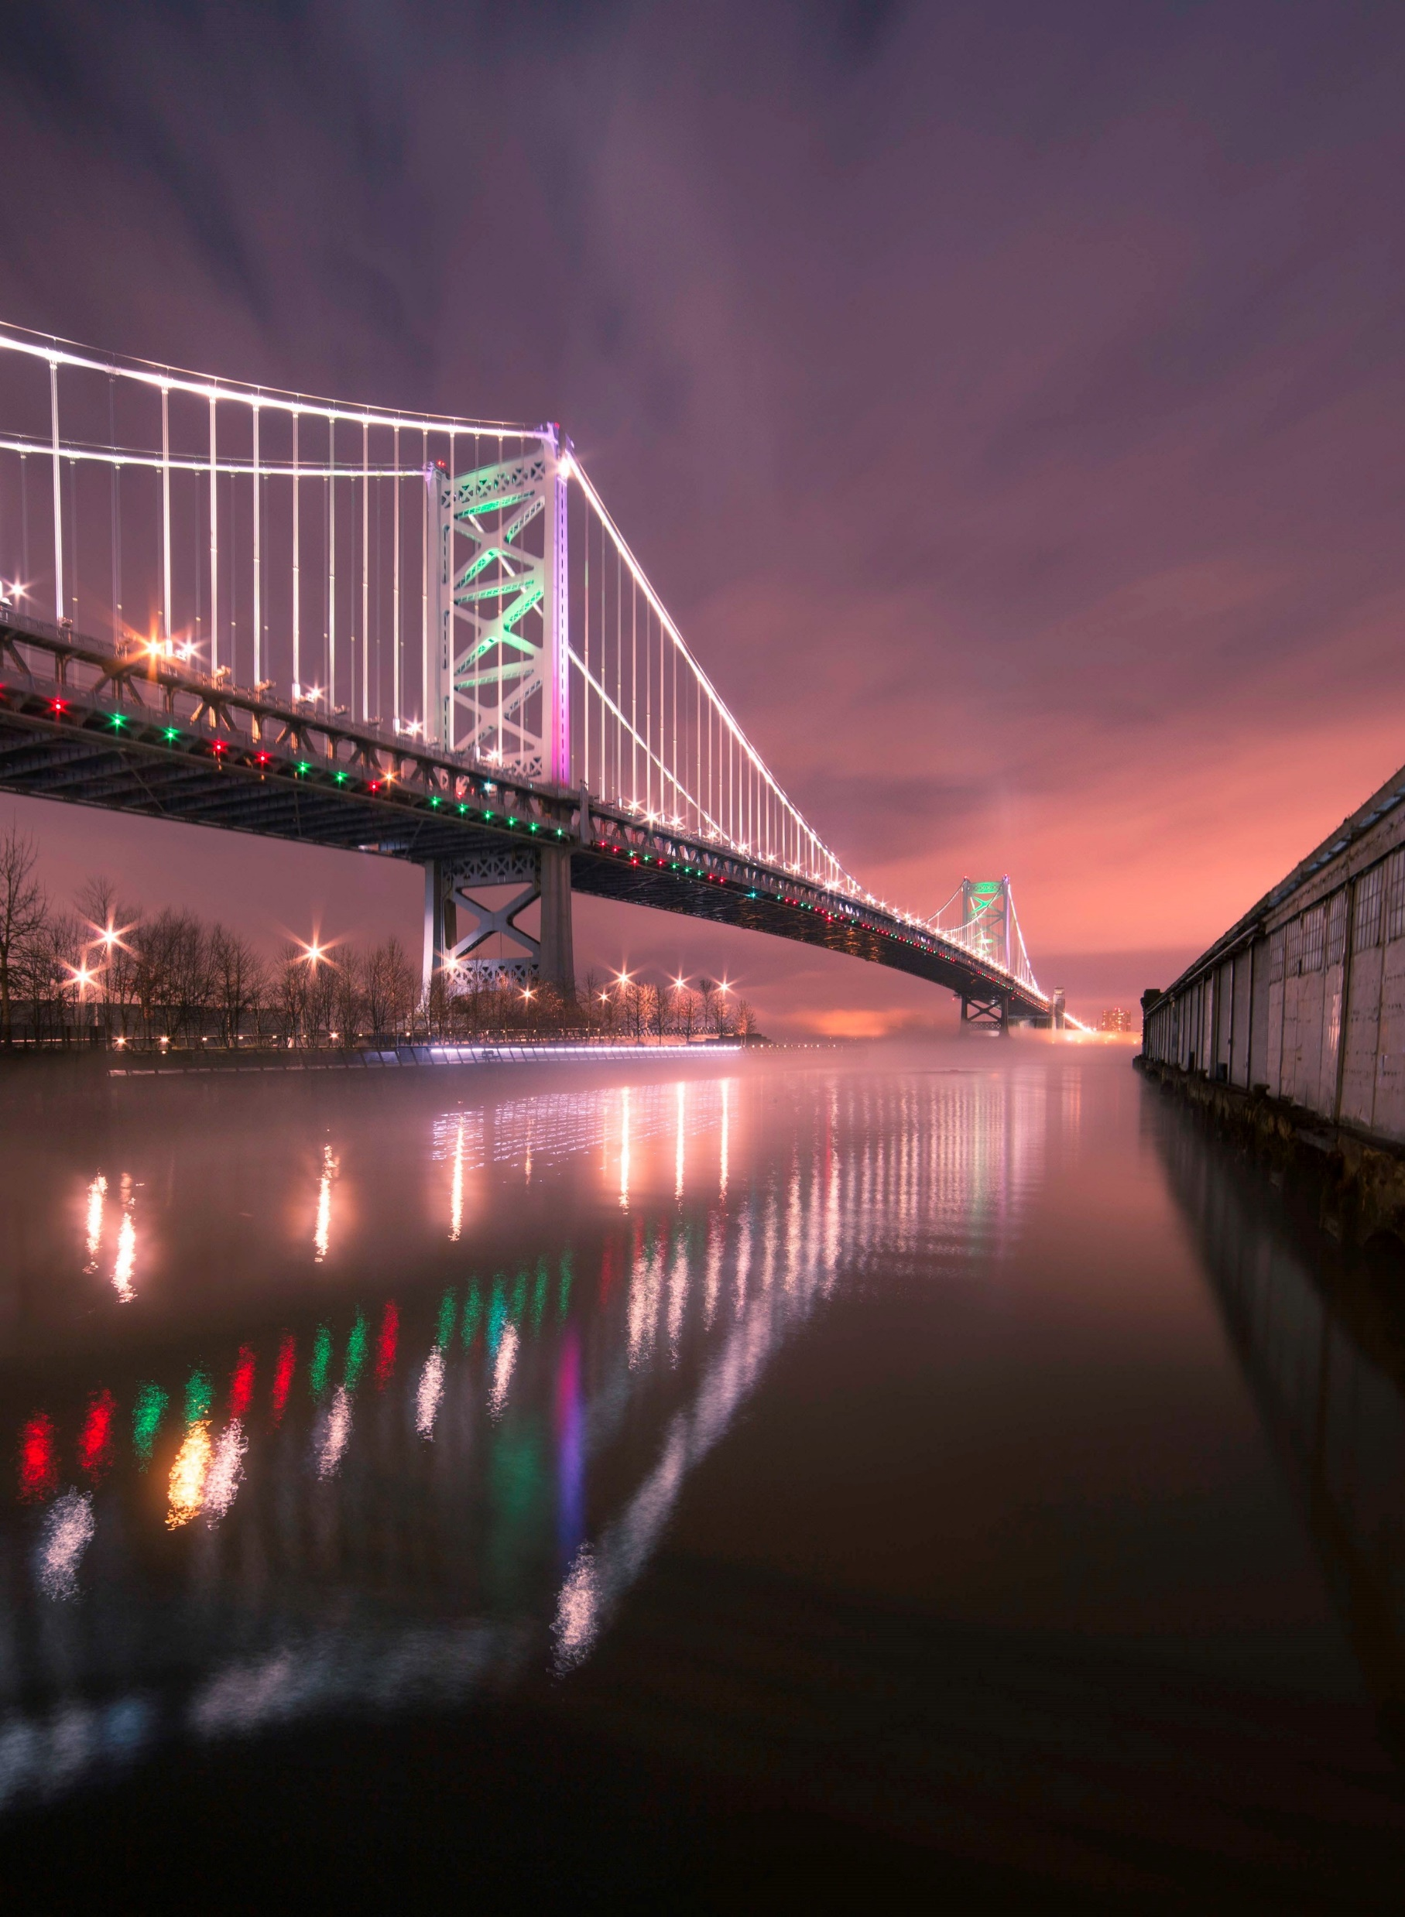
Background – Delaware River
- the River of the Year for 2020
- serves fifteen million people
- a 27-mile stretch of the river between Philadelphia, PA, Camden, NJ and Chester, PA that needs improvement
- many projects are currently working on this improvement
- potential for waterfront recreation
Notes:
Although the Delaware River was named as River of the Year for 2020 and serves fifteen million people’s drinking water needs as well as a fishing, kayaking, and other recreation, there is still a 27-mile stretch of the river between Philadelphia, PA, Camden, NJ and Chester, PA that needs improvement. This stretch is considered safe for only secondary contact recreation, which means immersion and ingestion, and any high degree of bodily contact with the water might be dangerous for people.The Water Center at Penn is developing a roadmap for water quality improvements-grounded in science and based on the river's current state. This project will focus on determining the source(s) of pollution of the Delaware River by using technologies such as ArcGIS and Python.
adjacent communities could be informed on the fairest opportunities to access recreational activities for each resident in the safest possible way

Slide 3
Recreation
Clean Up: Waterfront Location, Address, Activity Types, Access to Shore
Transportation
Water Quality
Community
Bus Stations
Combined Sewer Outfall
Population
Subway
Precipitation
Social Vulnerability
Current Situation
Parking
Bacteria
Possible Improvement
Shuttle
Forecast
Seasonal Activities
Propaganda
Guide

Slide 4
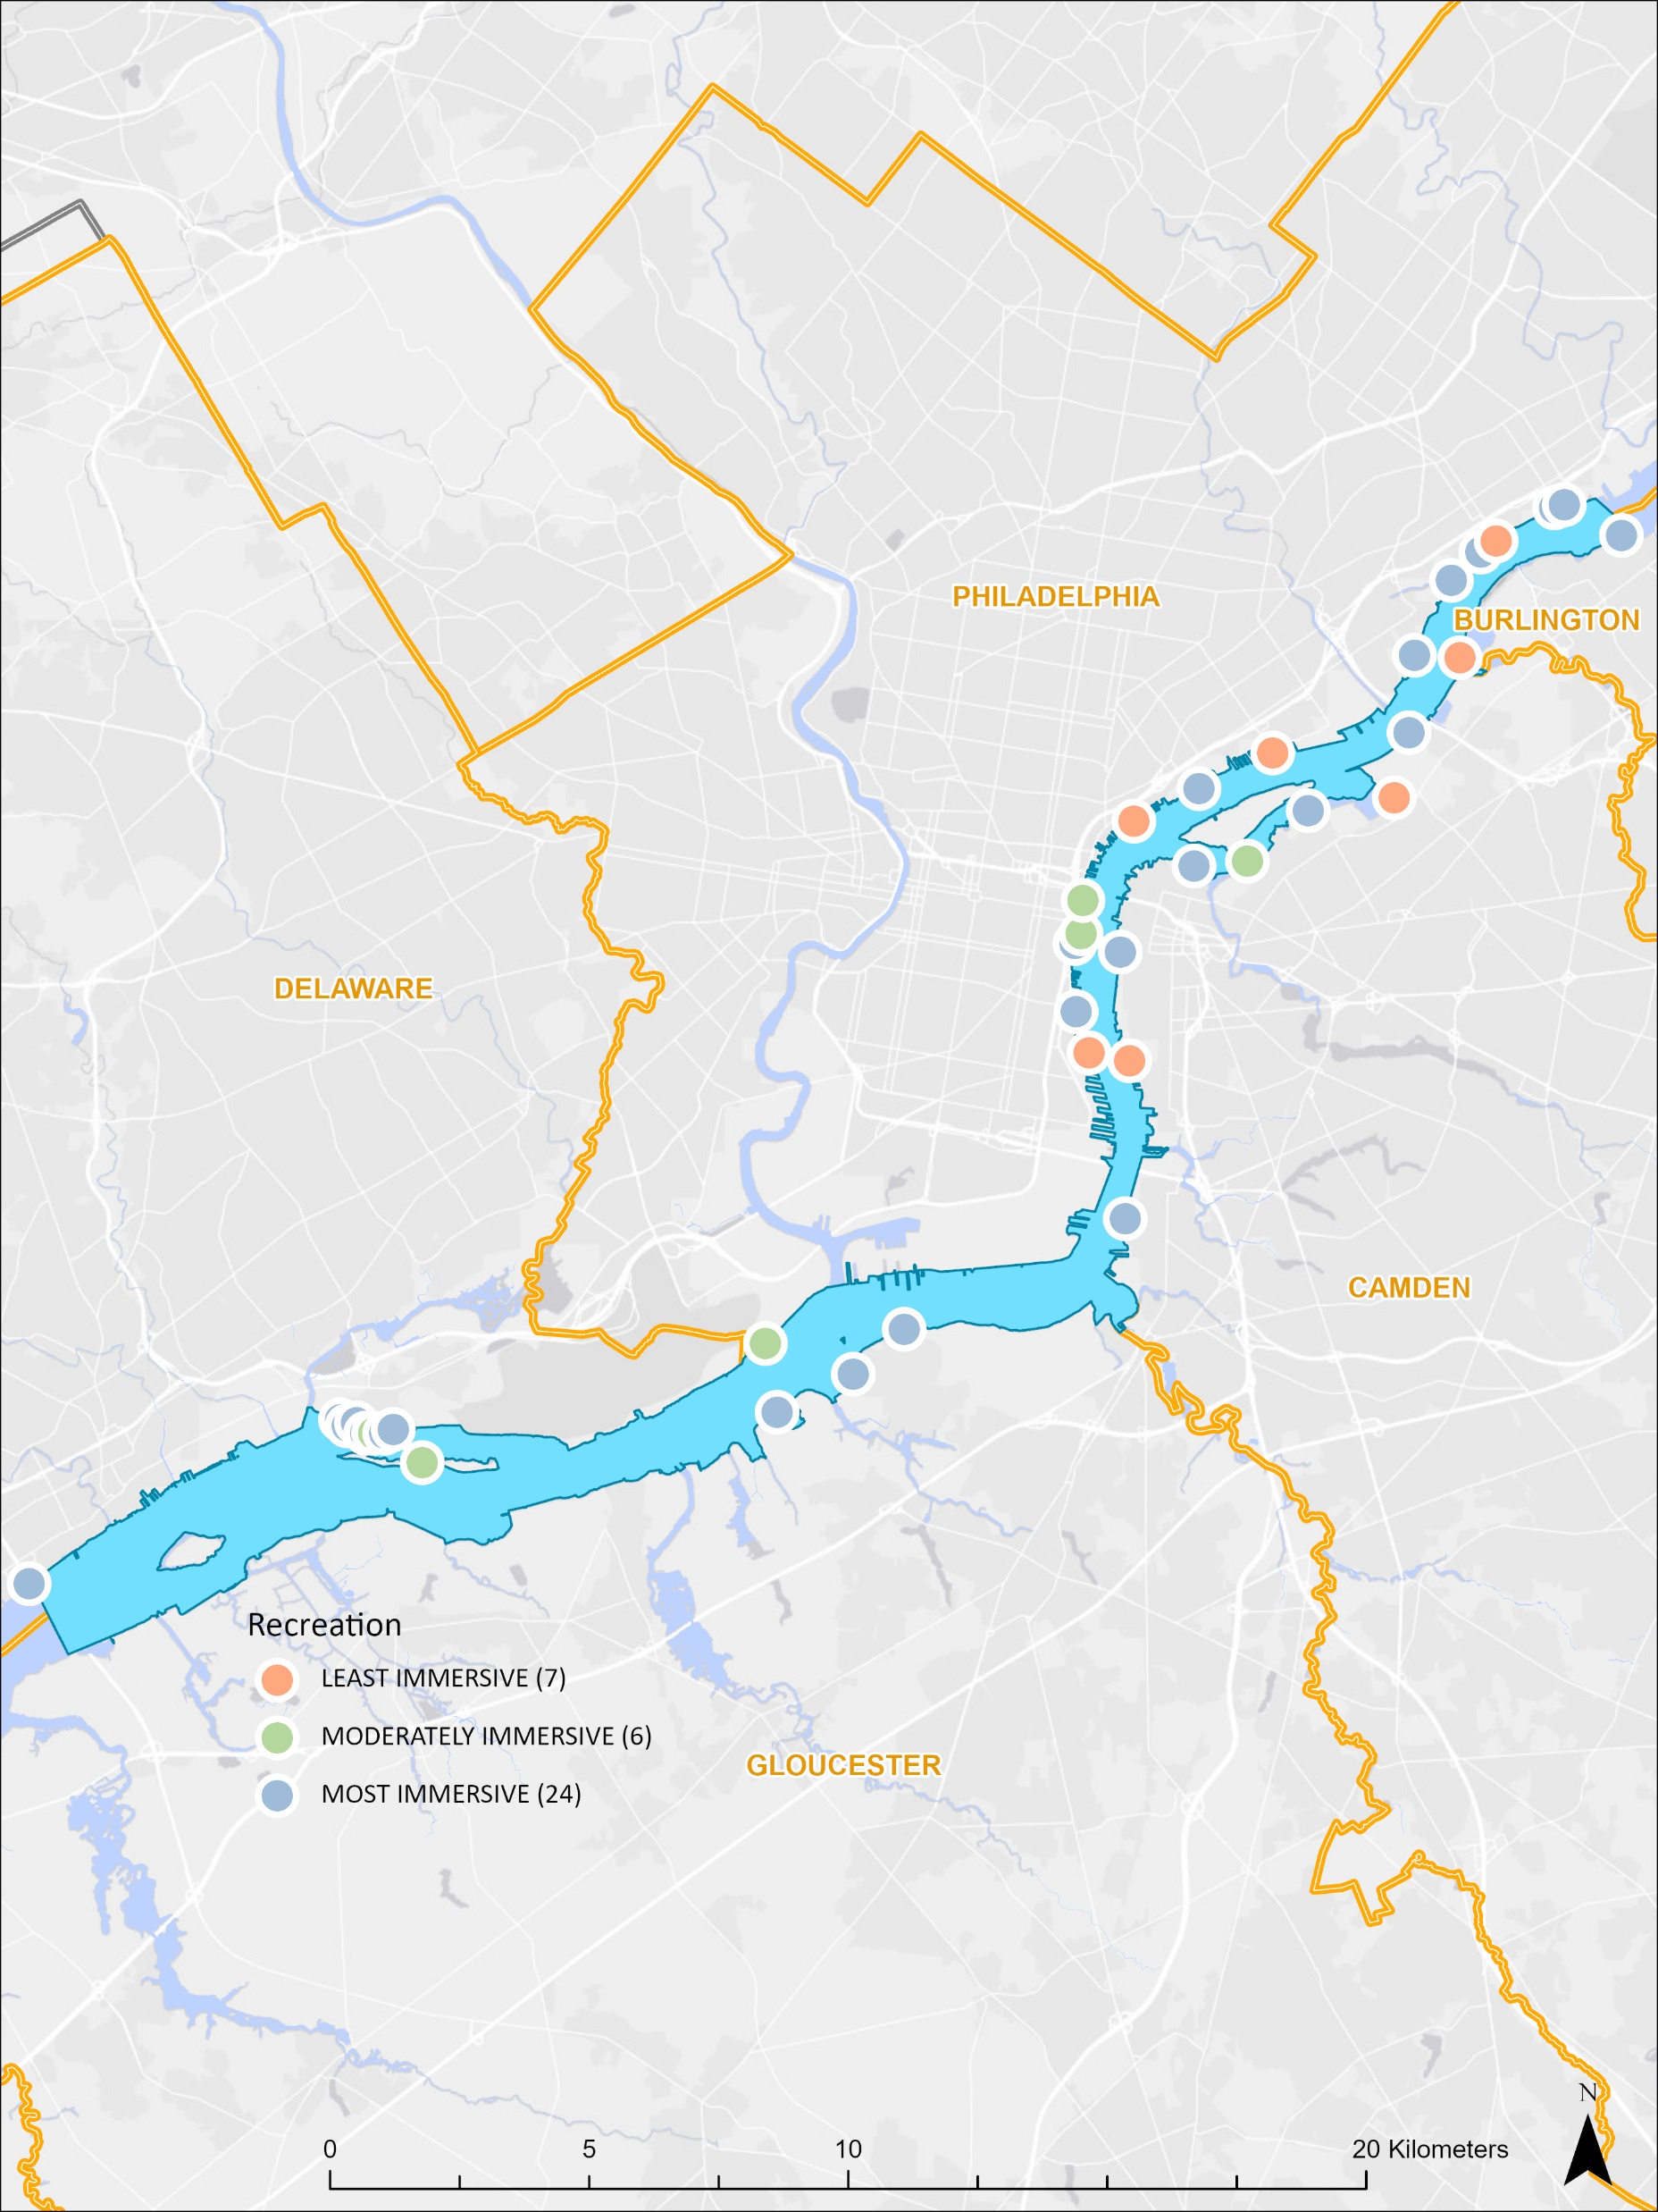
Analysis Recreation Category
Most Immersive:
Swimming, Wading, Jet Skiing, Paddle Boarding, Kayaking
Moderately Immersive:
Paddle Boating, Motor Boating, Sail Boating
Least Immersive:
Fishing

Slide 5
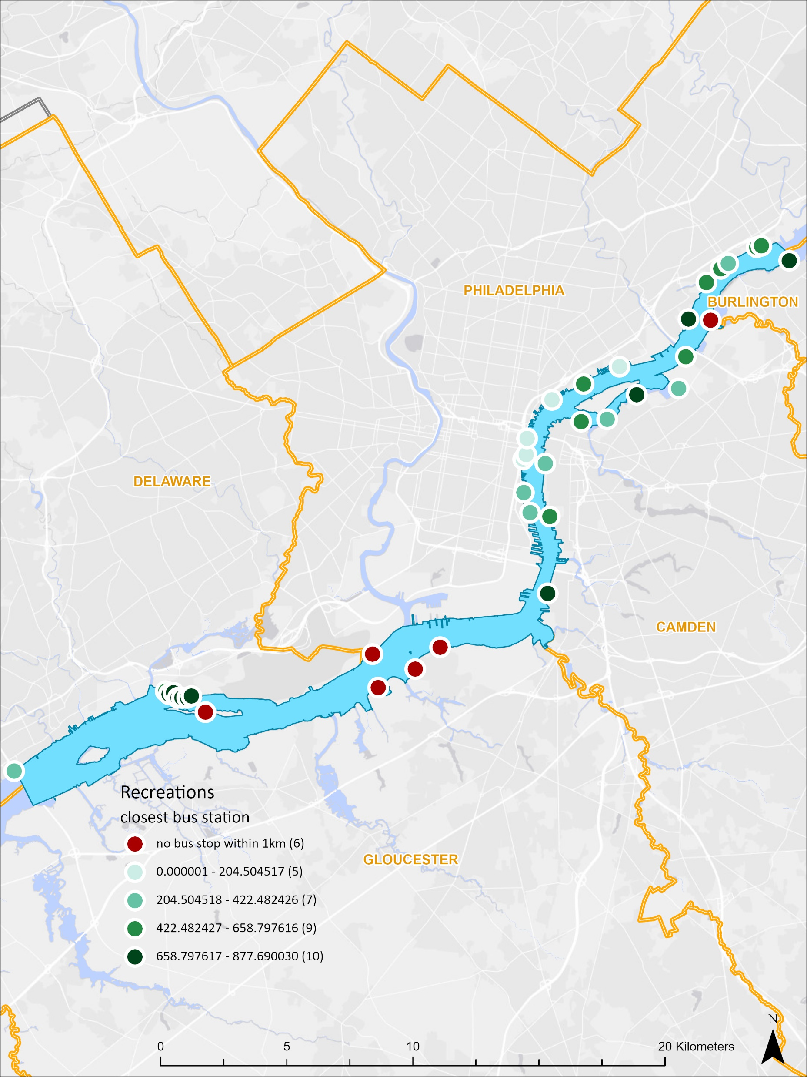
Analysis Bus station

Slide 6
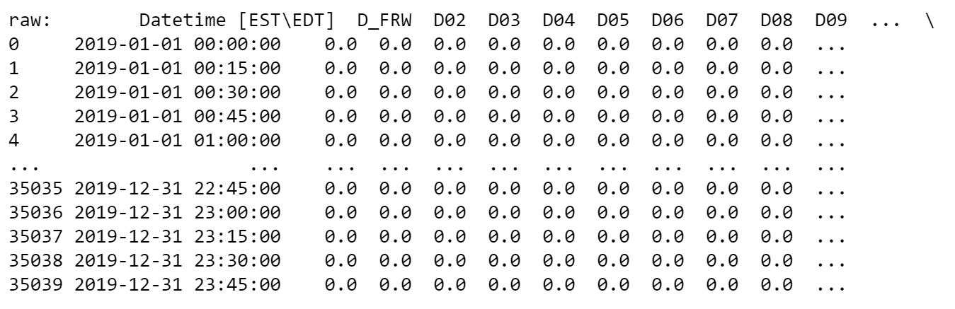
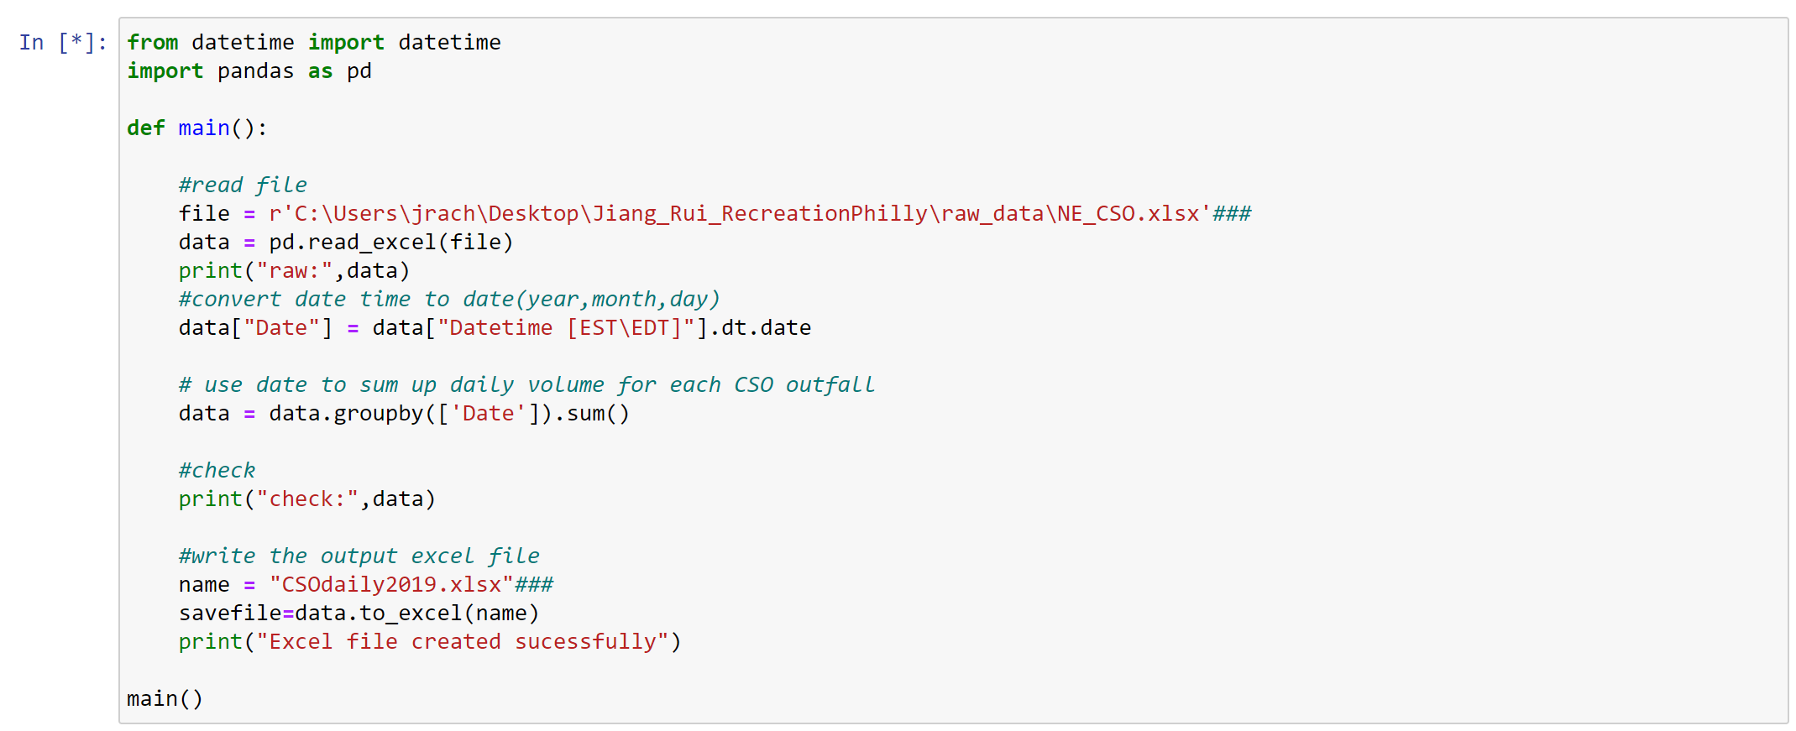
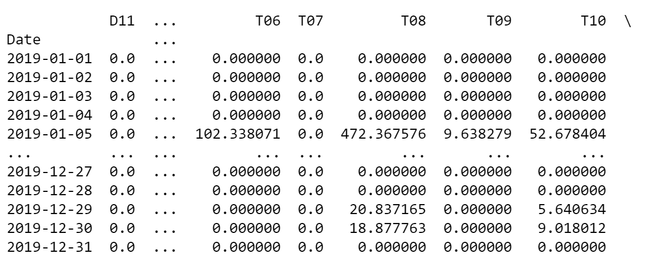
CSO

Slide 7
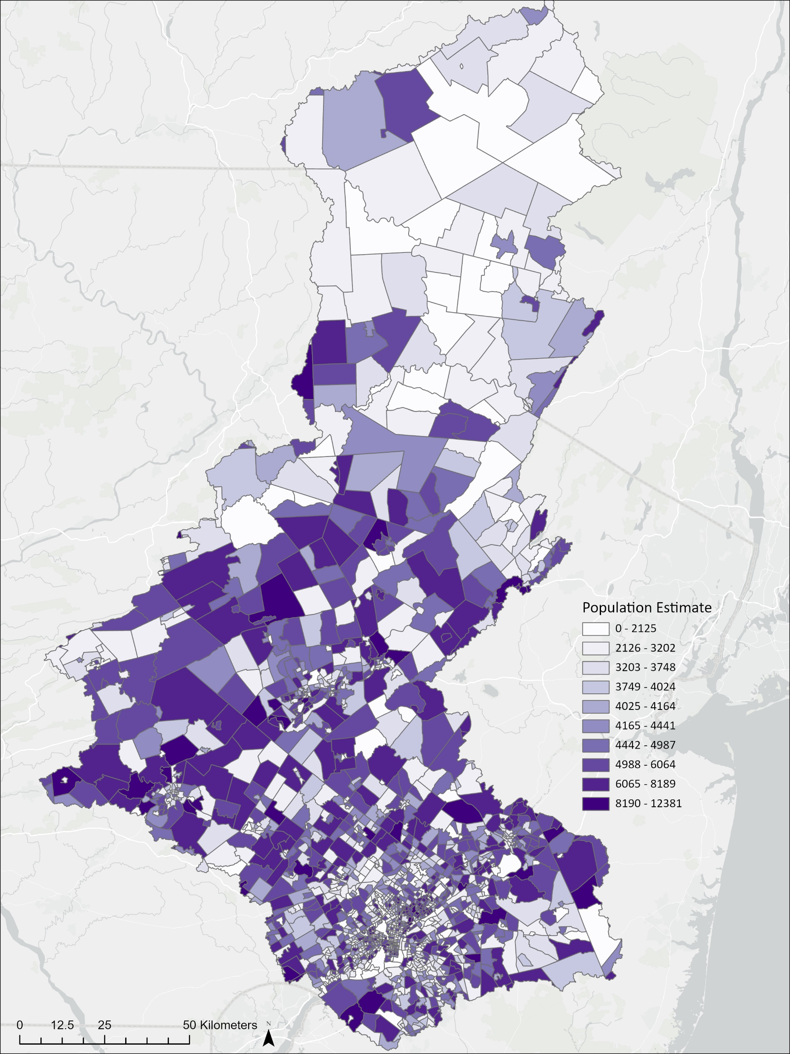
Analysis Population

