Slide 1

Asian American College Access

Slide 2
Overview
Literature Review
Framework
Methodology and data
Analysis
Findings and conclusions
Implications

Slide 3
Literature Review
Asian American Geography

Slide 5
Framework: Critical Geographic College Access
(Dache, 2021)

Slide 6
List of Methods
Moran’s I
Local Moran’s I
Nearest Neighbor Analysis

Slide 7
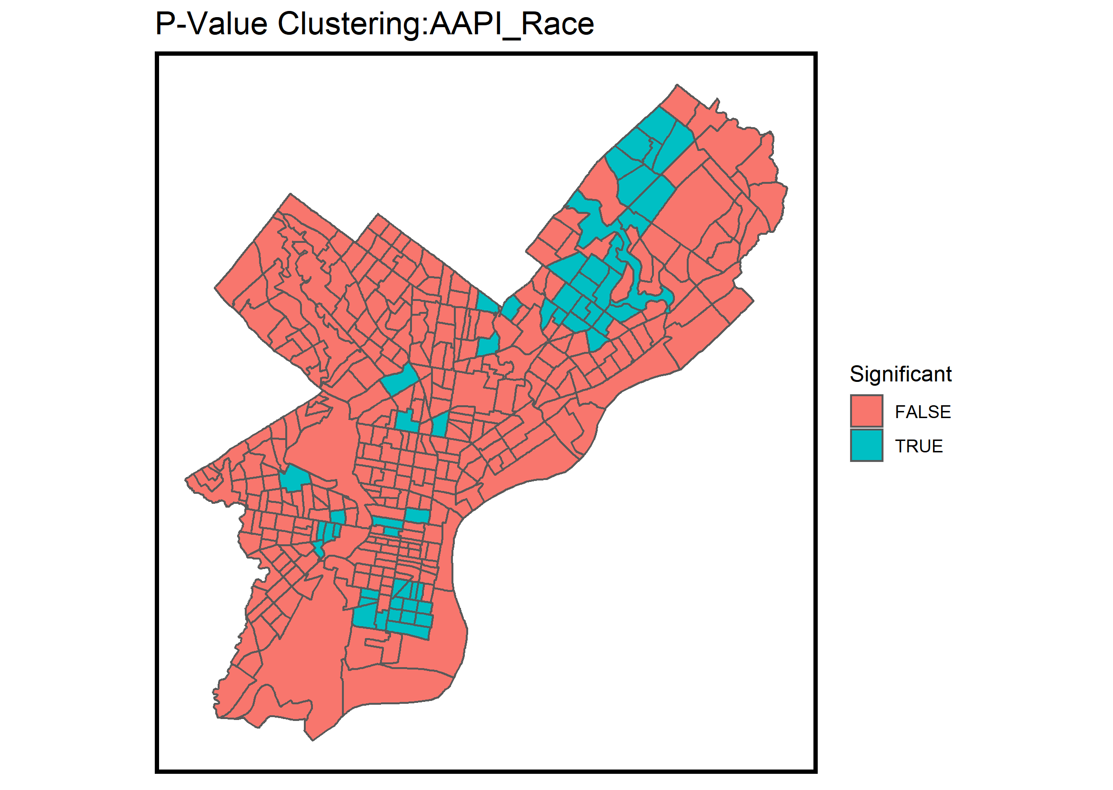
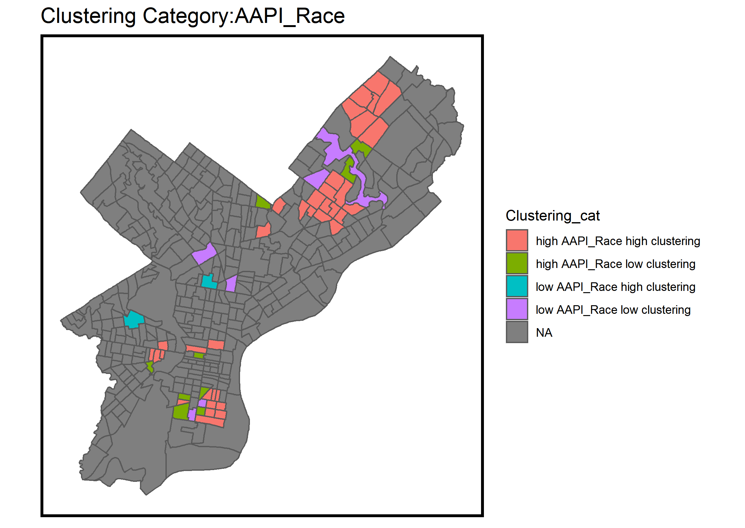
Morean’s I

Slide 8
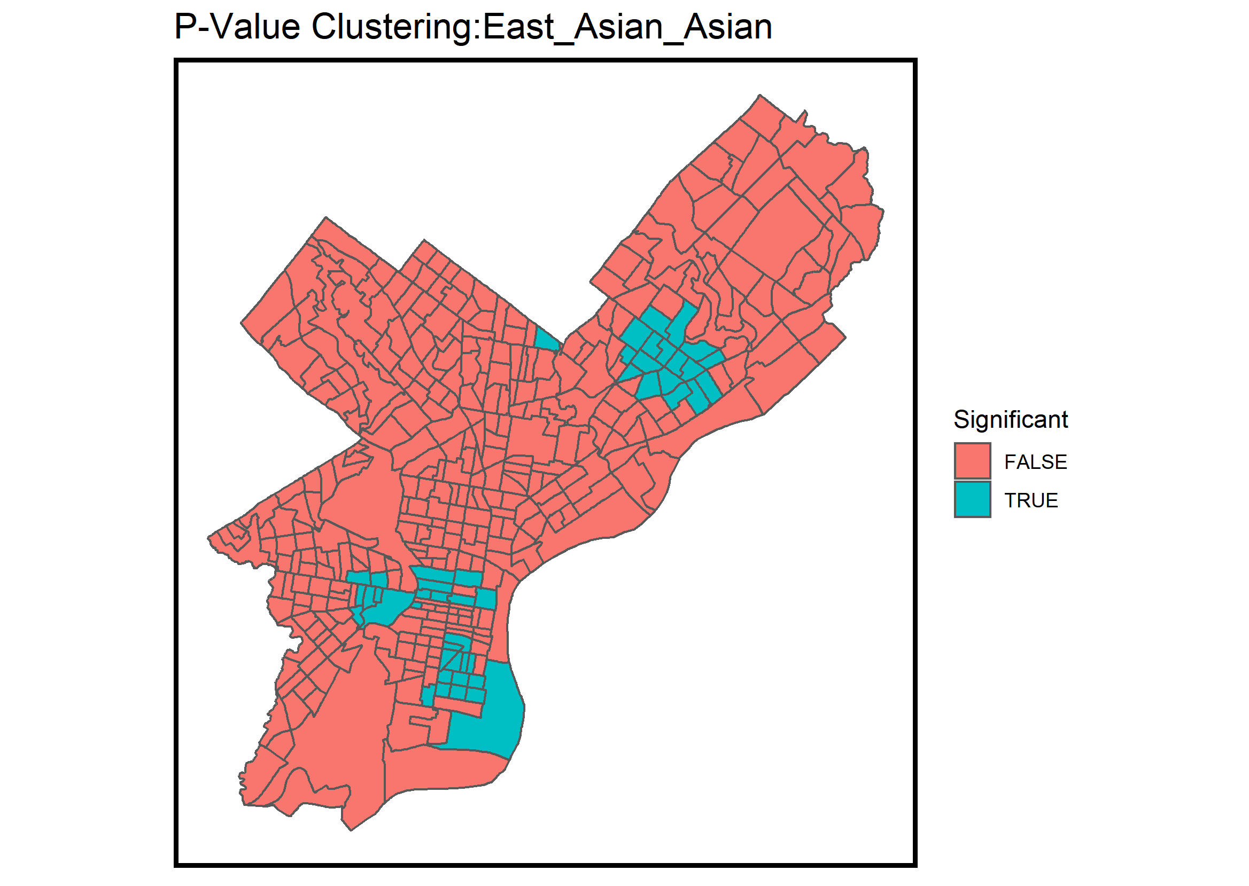
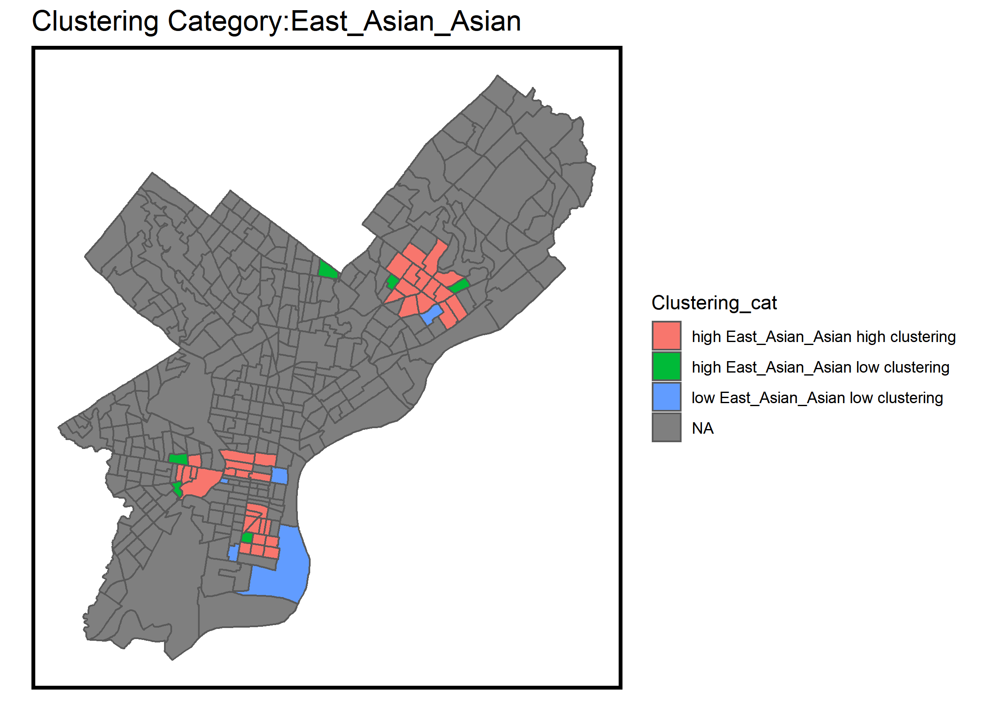
Moran’s I
Are Asian Americans Clustered?

Slide 9
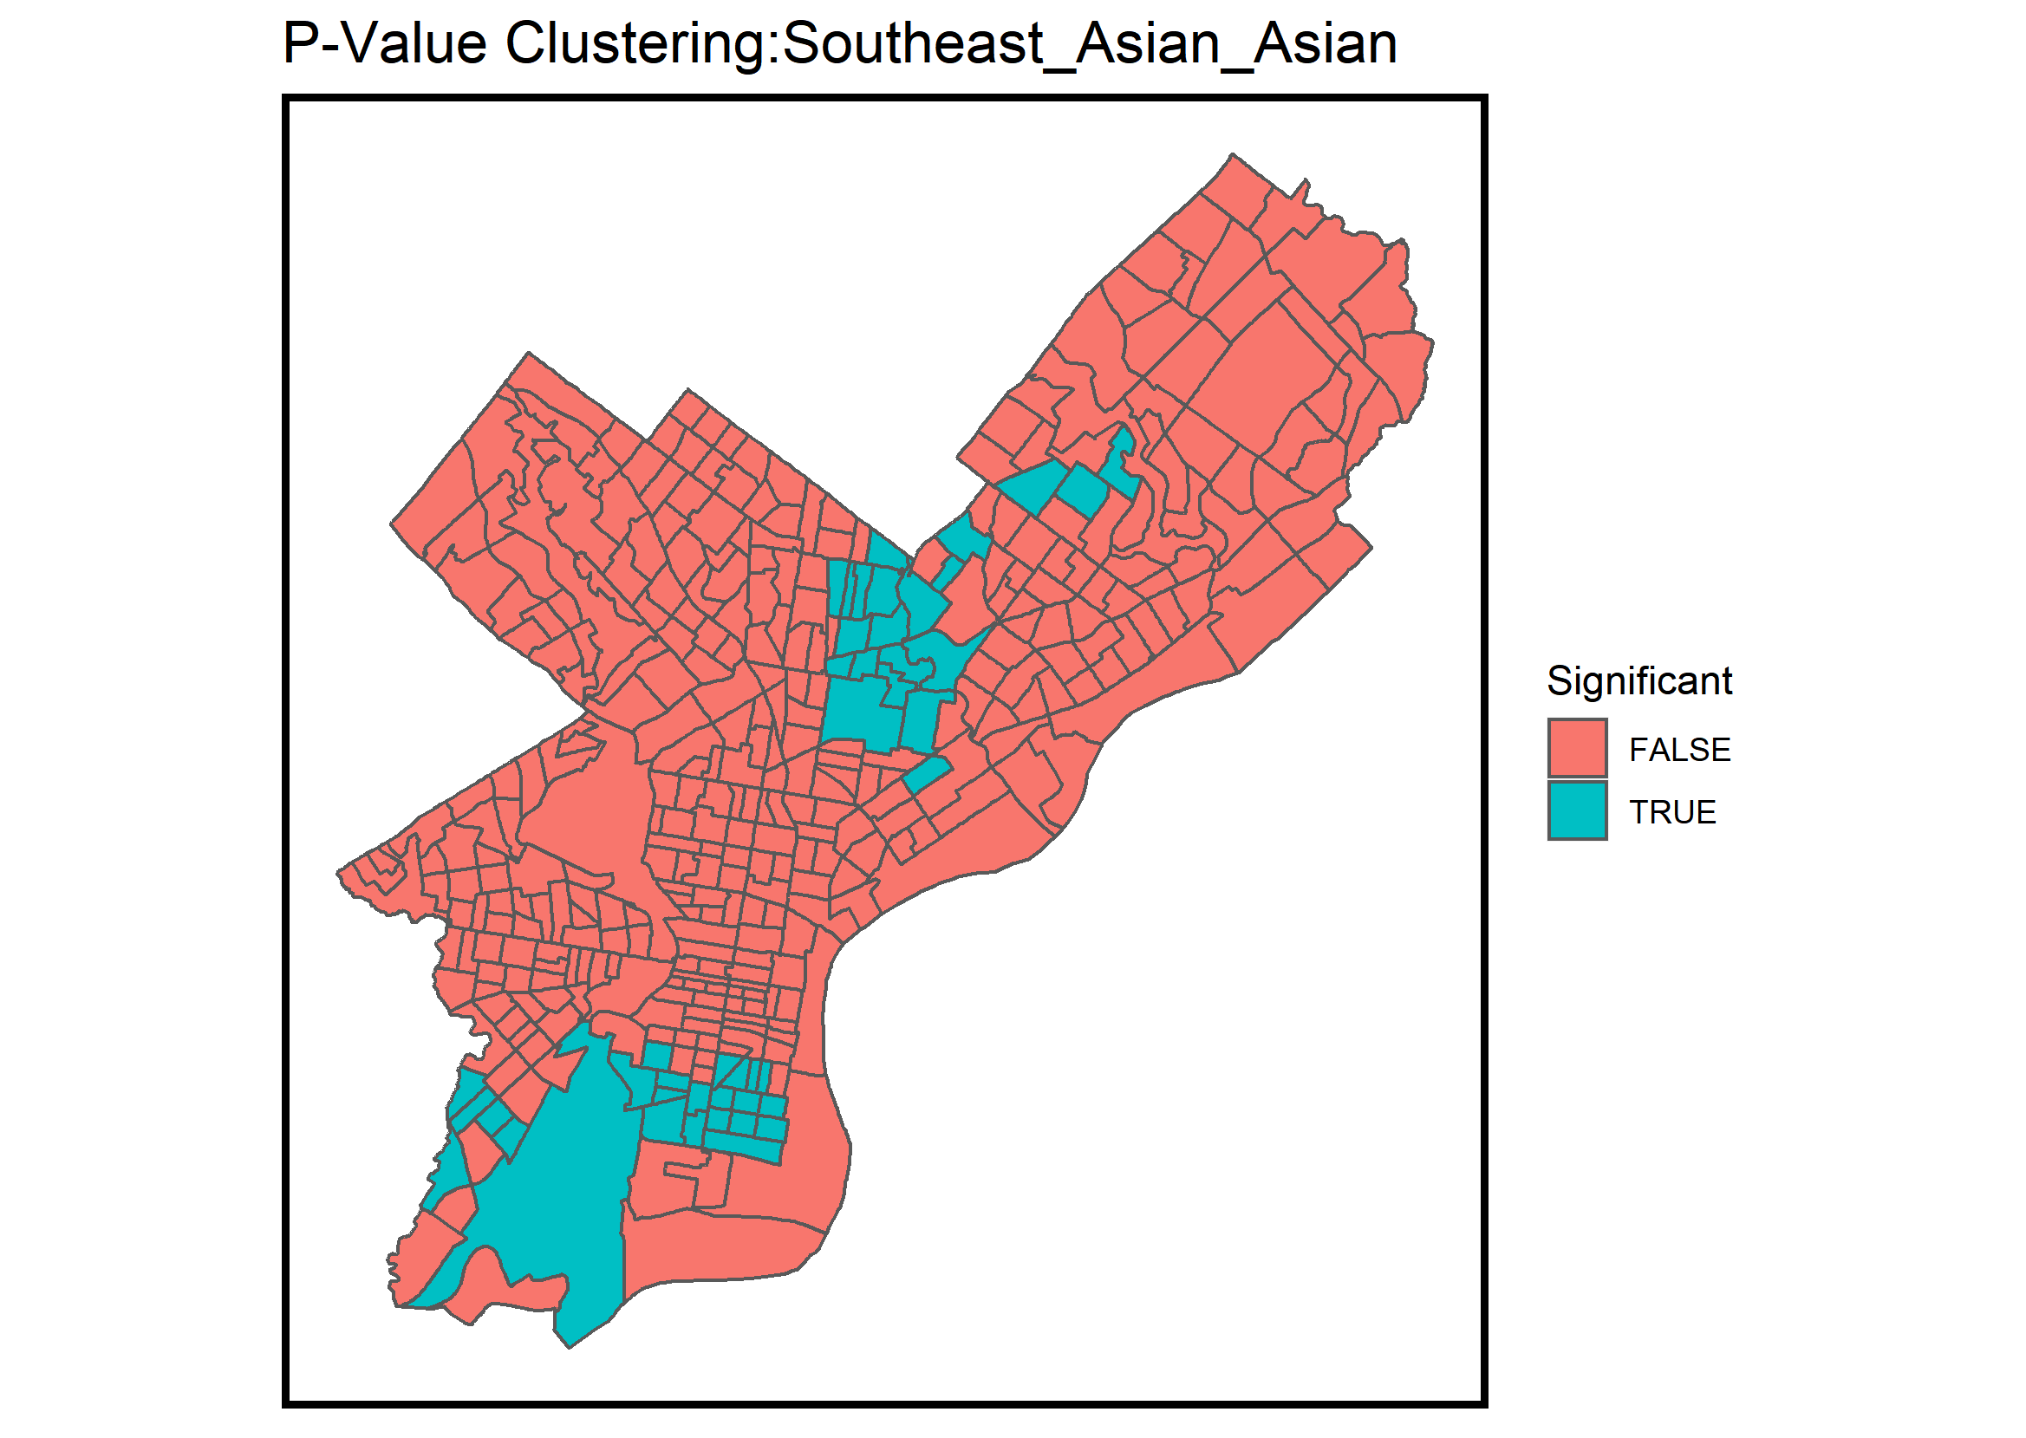
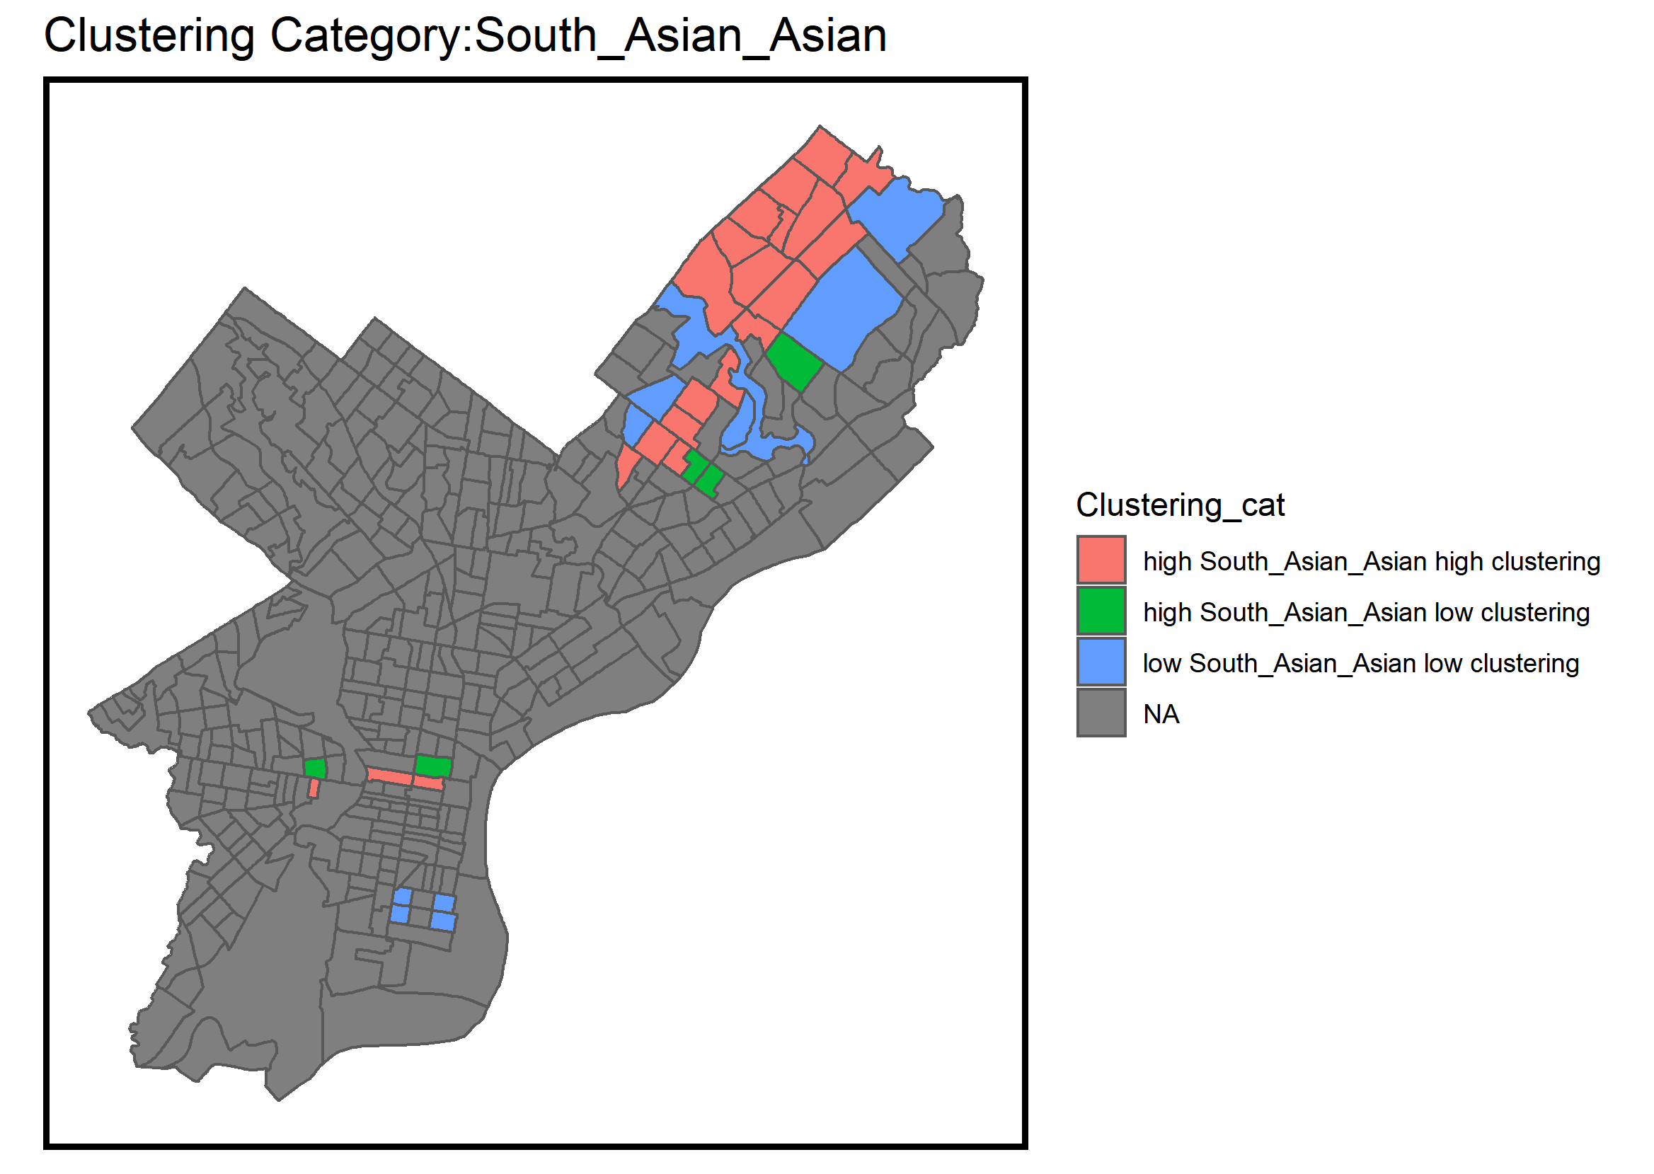
Moran’s I
Are Asian Americans Clustered?

Slide 10
