Slide 1
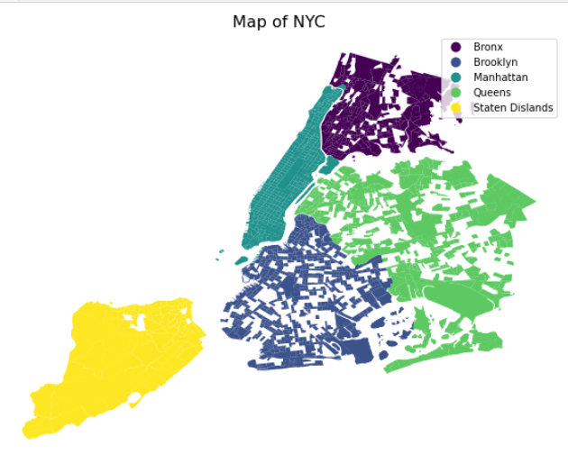
COVID-19’s Impact on Human Mobility in NYC
Xiaoyi Wu
2022/03/24
Notes:
2-min introduction
Problem-current way vs method- results

Slide 2
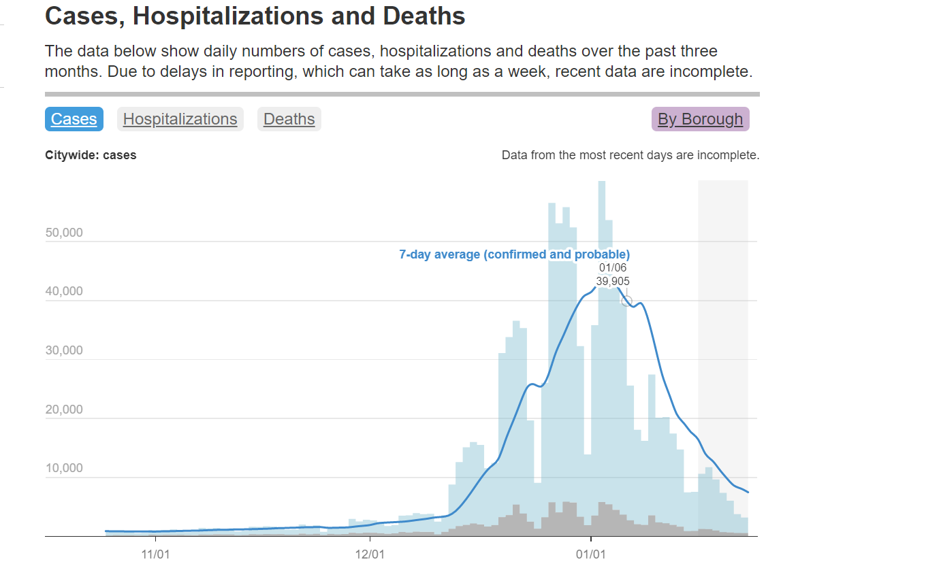
Motivation
Before/During COVID-19
What are the places people usually visit?
How long they stay?
Where are they from? Where are they to?
Spatio-termporal changes of customer preference?
Travel behaviors and necessary needs/services satisfaction in different contexts?
Political implications?
COVID-19 develop trend in NYC
Data from NYC Health https://www1.nyc.gov/site/doh/covid/covid-19-data.page#daily
Notes:
Overview of master program
In-class projects
Choose one which is deepest
Starting with the research problem, how to do, results

Slide 3
Pipeline
Data Aggravation
Spatial Analysis
Temporal Analysis
Initial Demographic Analysis
Human Mobility Pattern in Different Contexts
Spatial Autocorrelation Analysis
Notes:
Overview of master program
In-class projects
Choose one which is deepest
Starting with the research problem, how to do, results

Slide 4
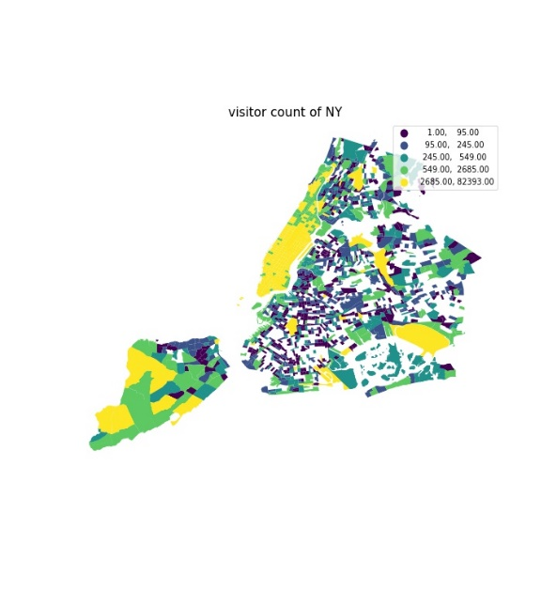
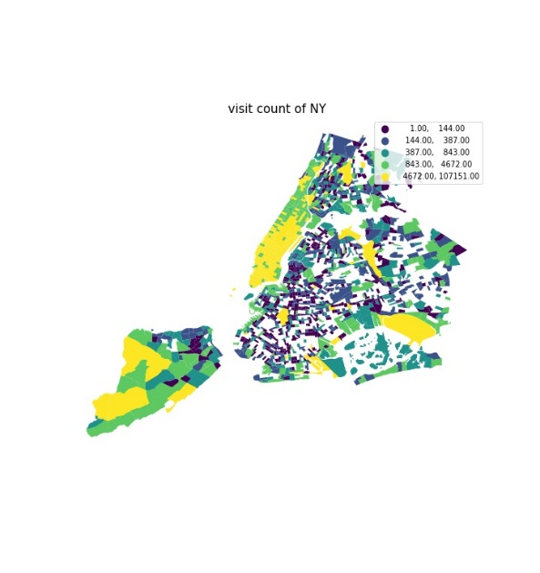
1. Spatial Analysis
Clustering pattern of high volume of visitors and visit count in mid and lower Manhattan, south and east Staten Island and areas around John F. Kennedy (JFK) International Airport.

Slide 5
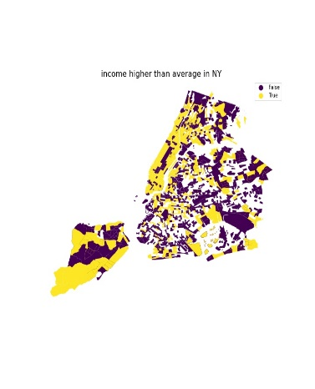
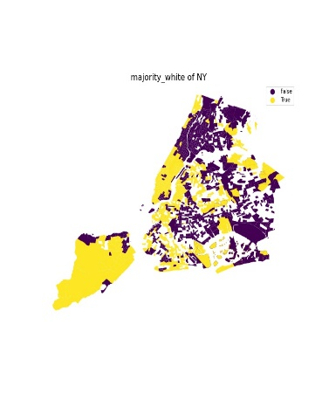
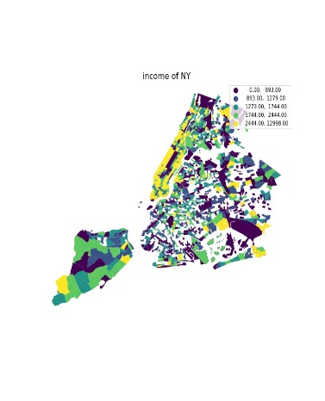
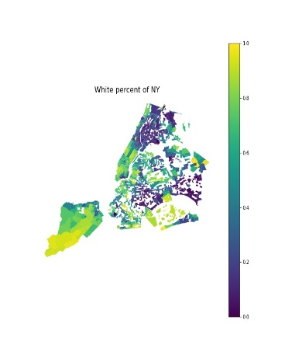
1. Spatial Analysis
tracts in Staten Island and Manhattan with higher volume of visiting counts and visitor number tend to have higher income and white majority ratio than that of low visiting counts and visitor number

Slide 6
2. Demographic Analysis

Slide 7
2. Demographic Analysis

Slide 8
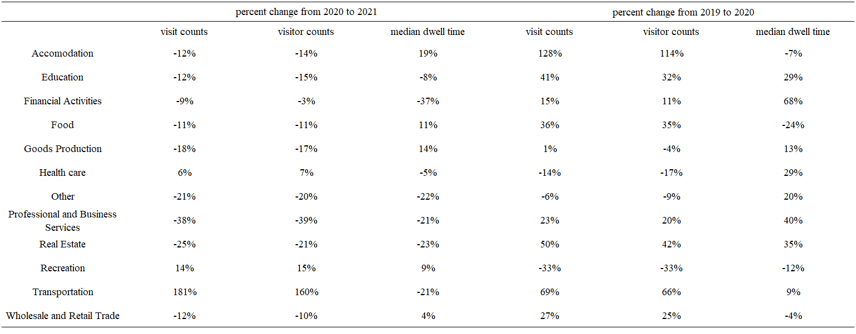
3. Temporal Analysis

Slide 9
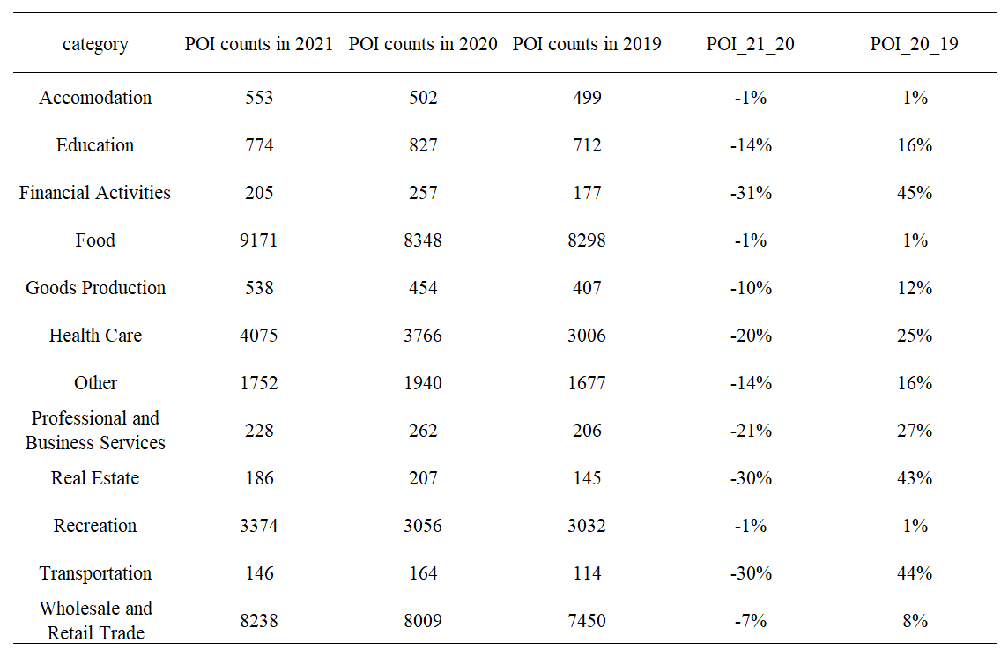
3. Temporal Analysis

Slide 10
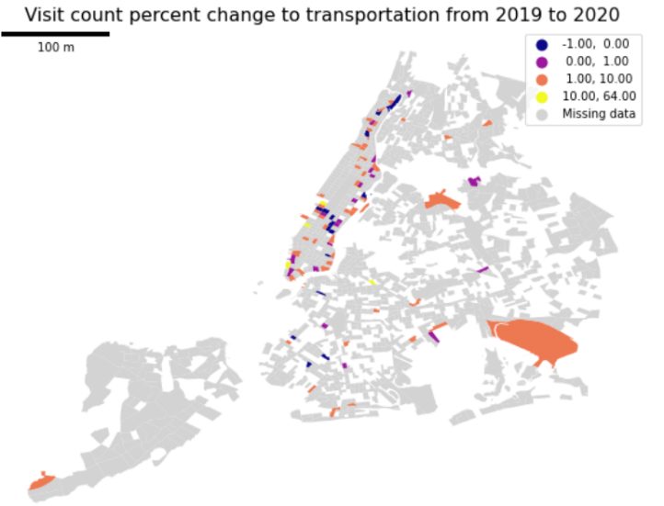
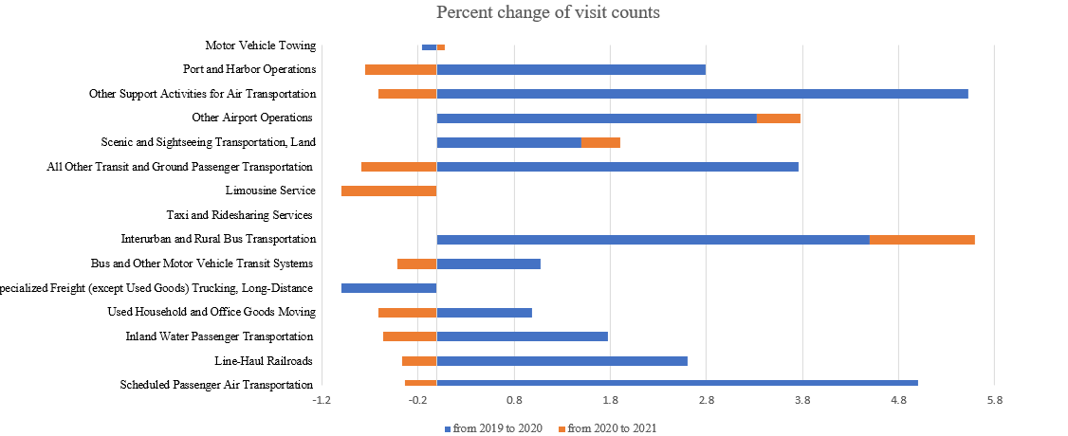
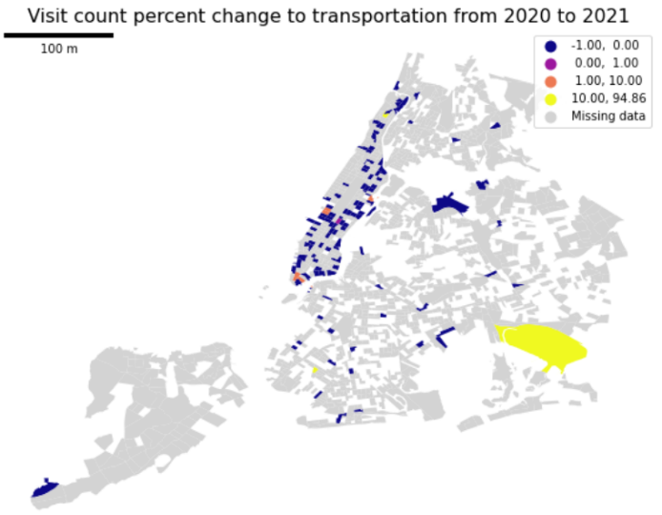
3. Temporal Analysis

Slide 11
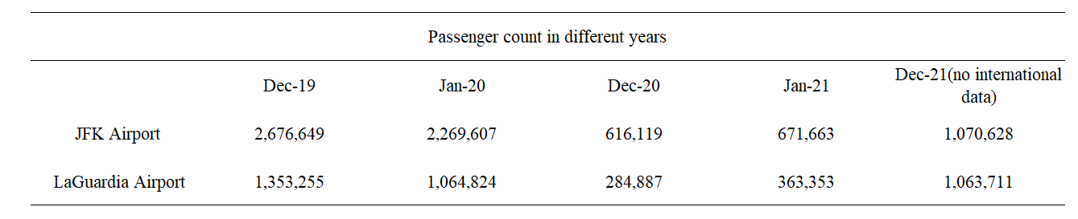
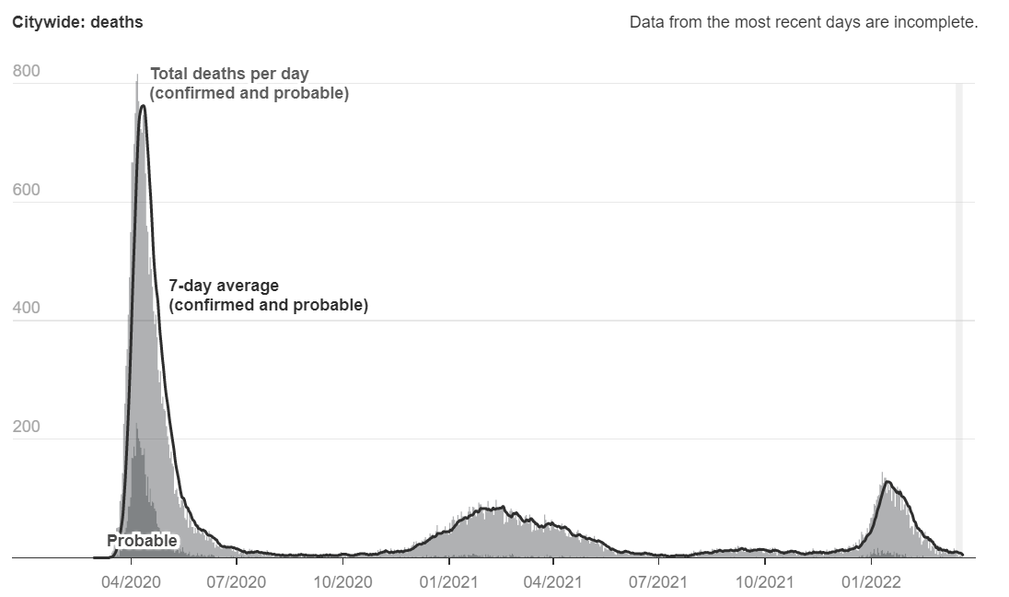
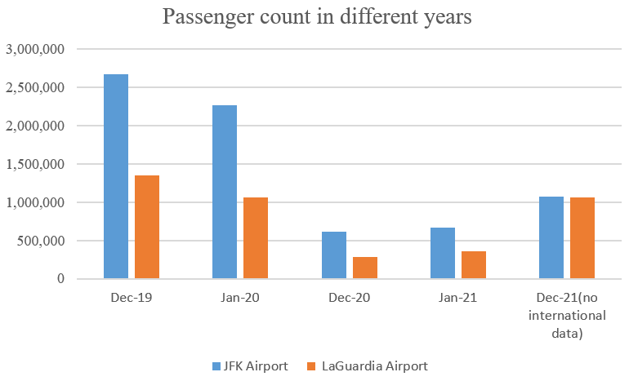
Increasing in visit count to public transportation place after COVID-19? ? ?
4. Bomb!

Slide 12
Future work 1. Analyze mobility pattern in March 2091, 2020, 2021 2. Review paper using SafeGraph data 3. Regression model to analyze the correlation between human mobility and demographic factors

