Slide 1
Musa Capstone
PokemonStay
Ziyuan Cai

Slide 2
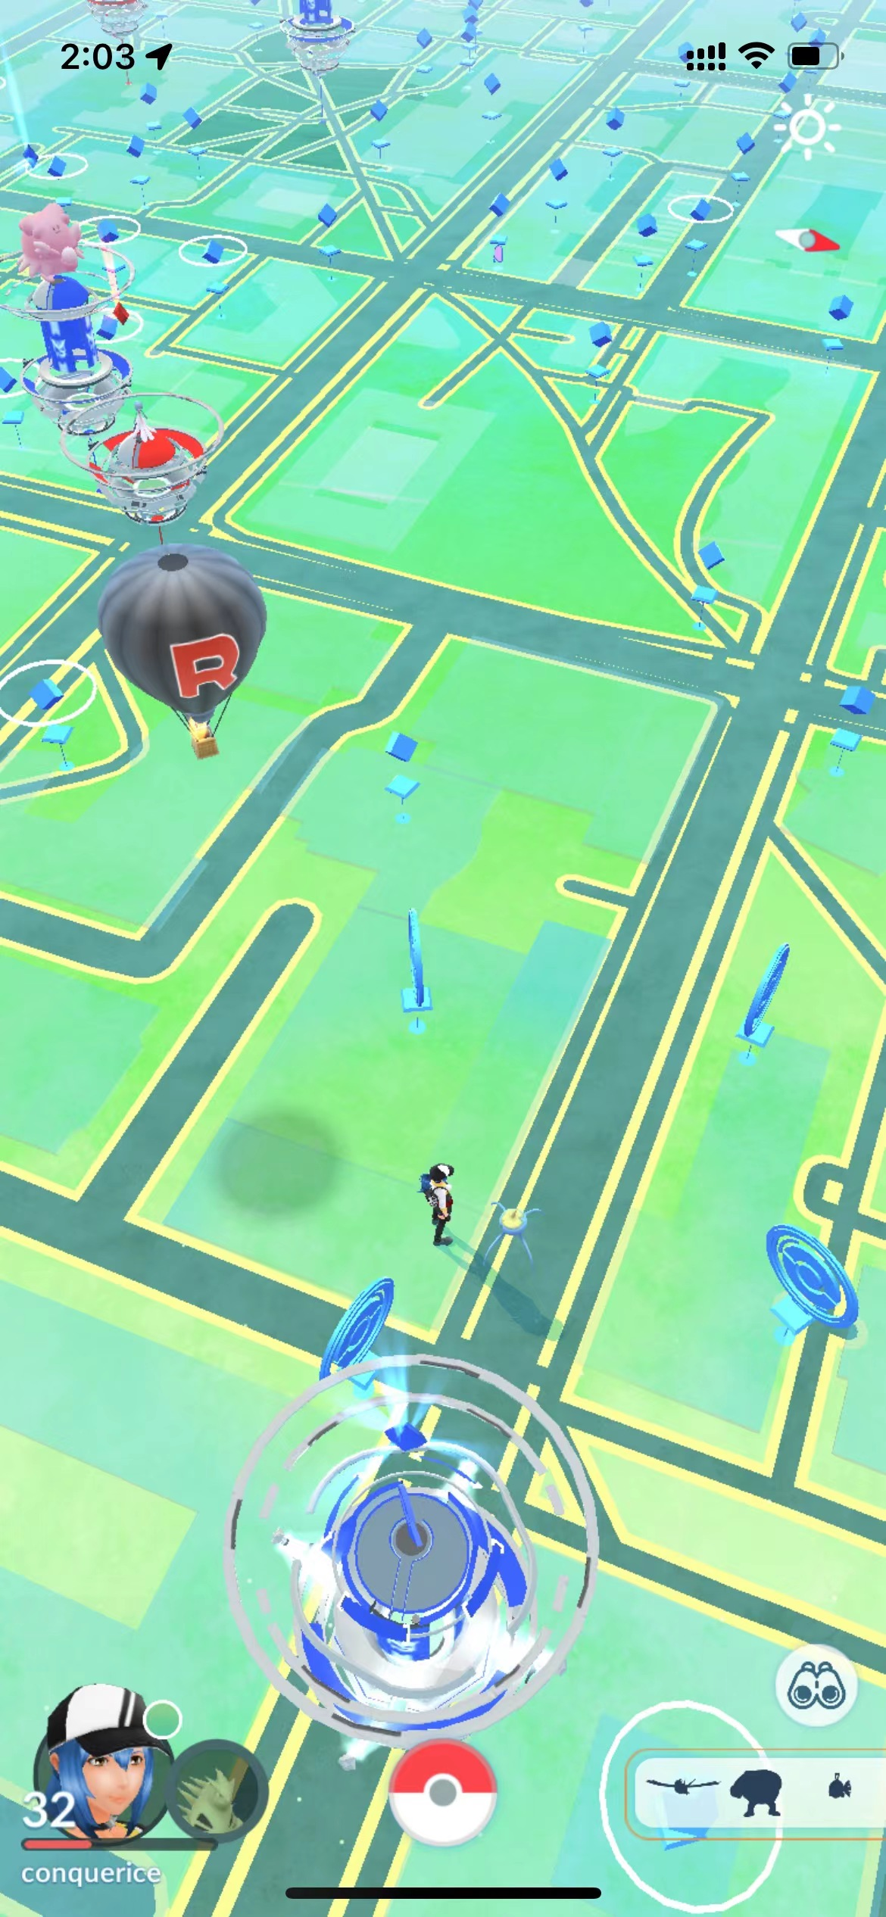
Problem
Nested Pokemon
Poke Stop
Pokemon
Gym
Where should people new to Philadelphia go to get Pokémon faster and safer?

Slide 3
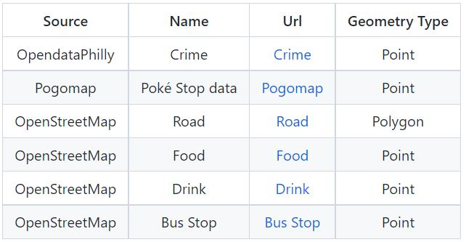
Data

Slide 4
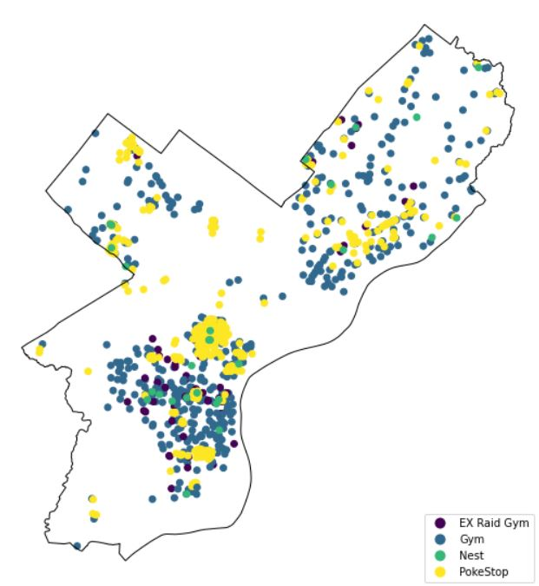
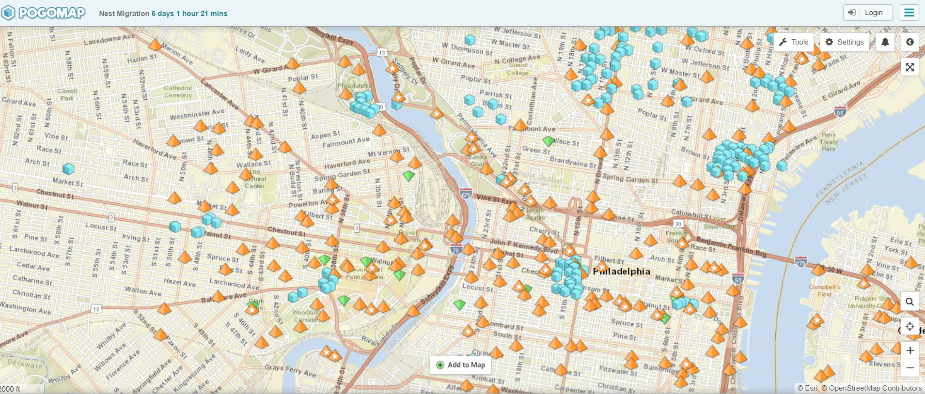
Data
https://www.pogomap.info/location/39,958412/-75,181057/14

Slide 5
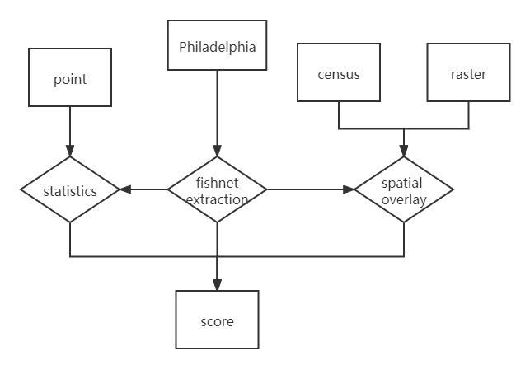
Method
$$des=a_{1}∗NPS+a_{2}∗NR+a_{3}∗C+…$$

Slide 6


Method

Slide 7
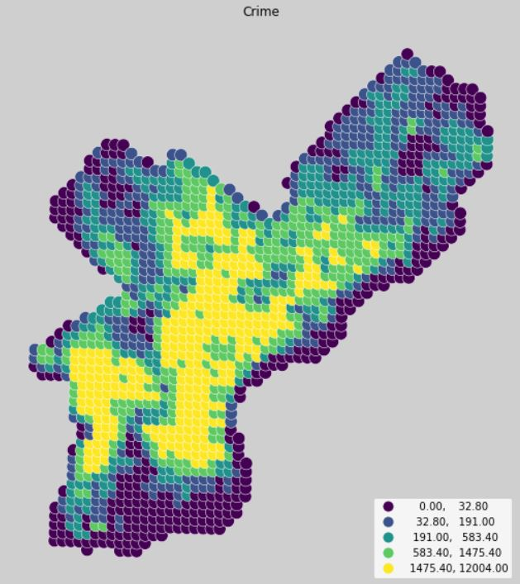
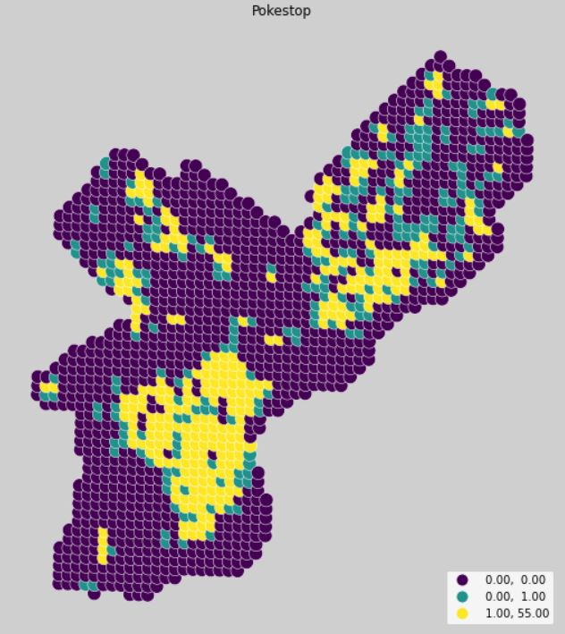
Method

Slide 8
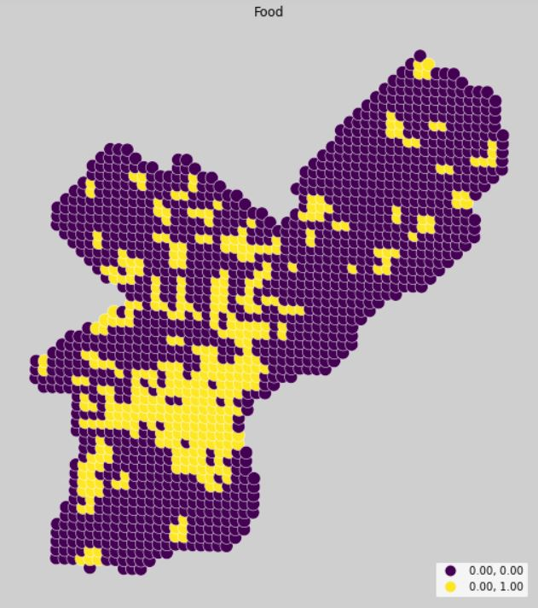
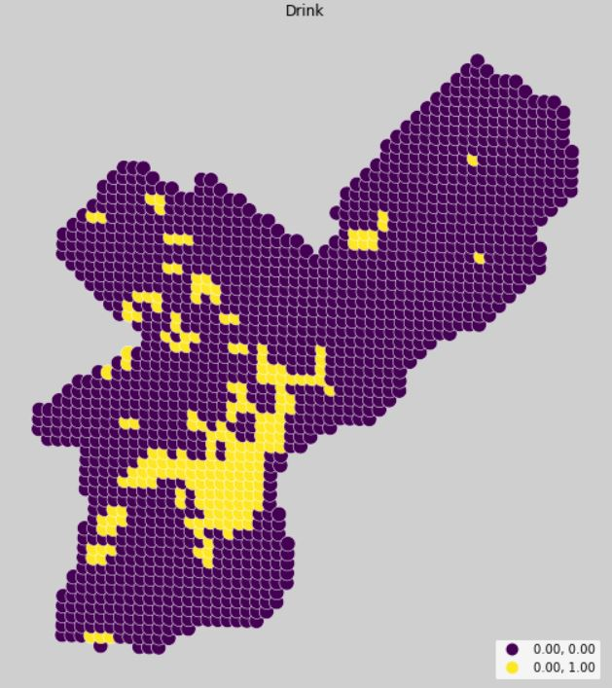
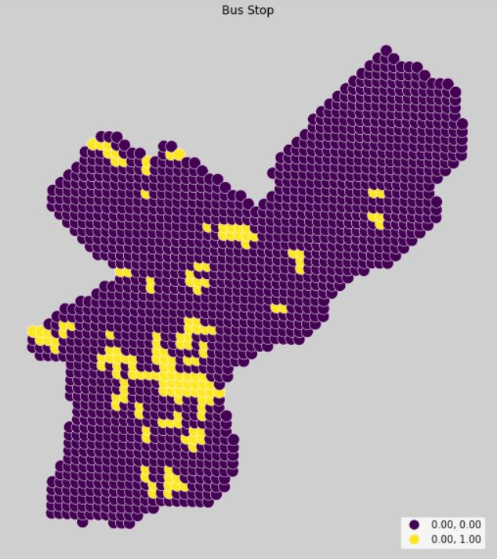
Method

Slide 9
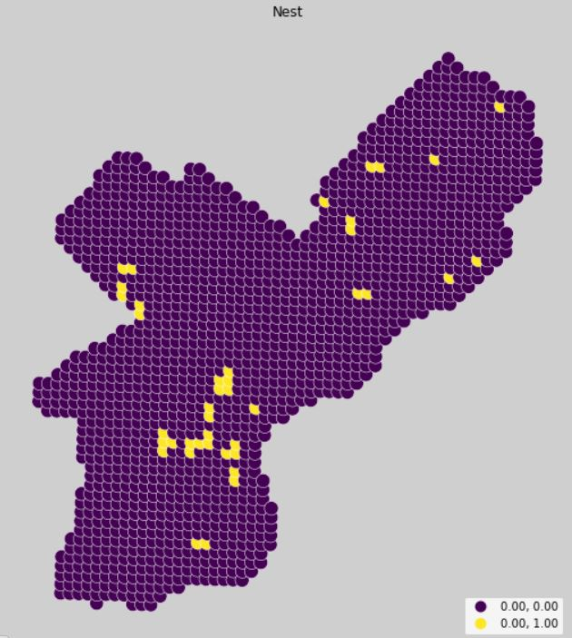
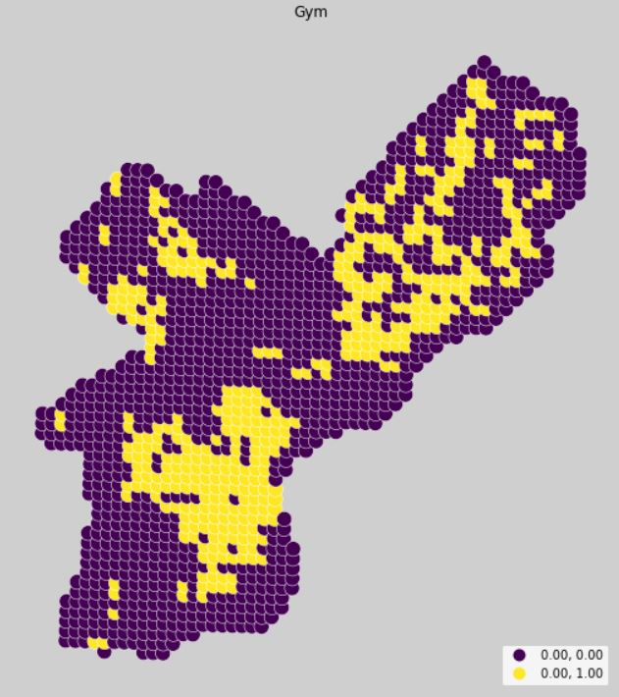
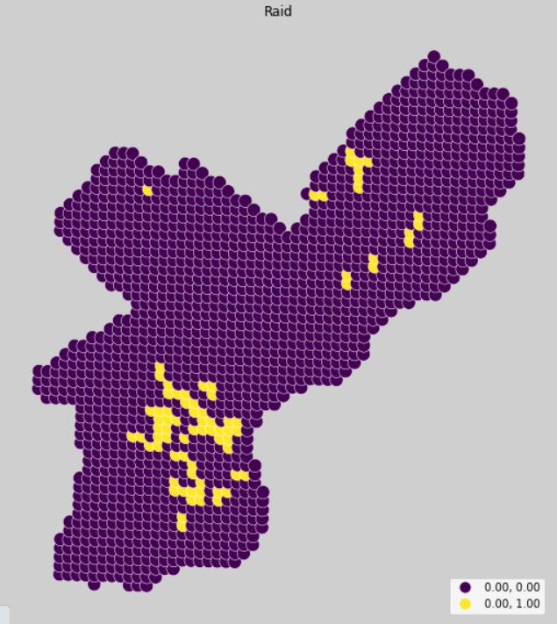
Method

Slide 10
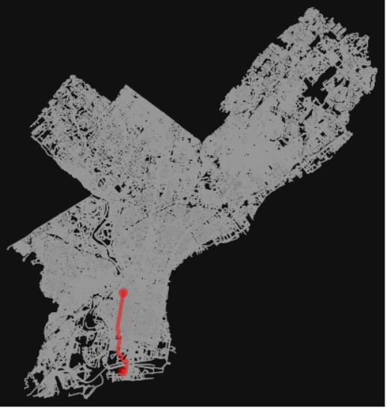
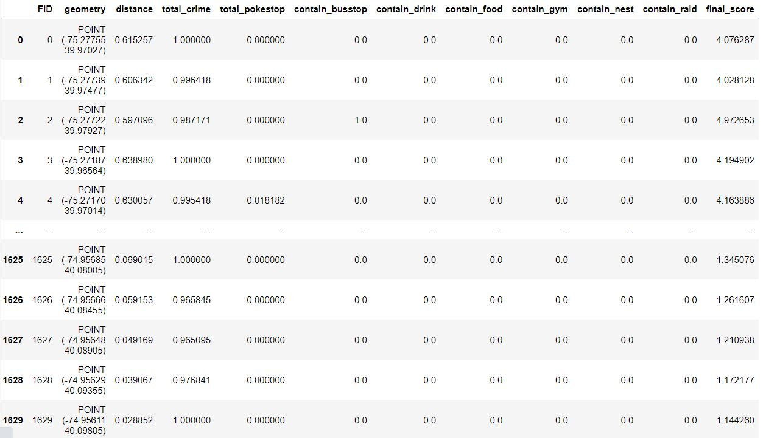
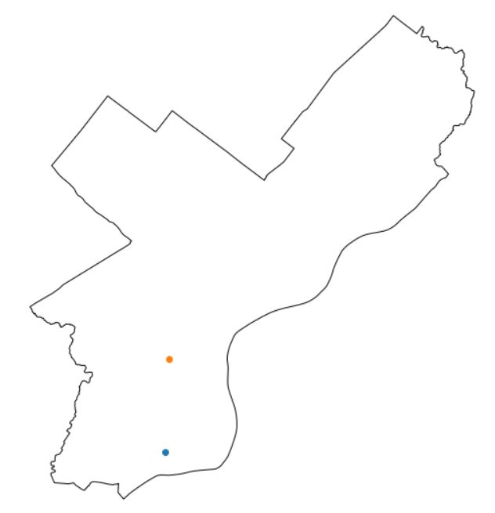
Result

Slide 11
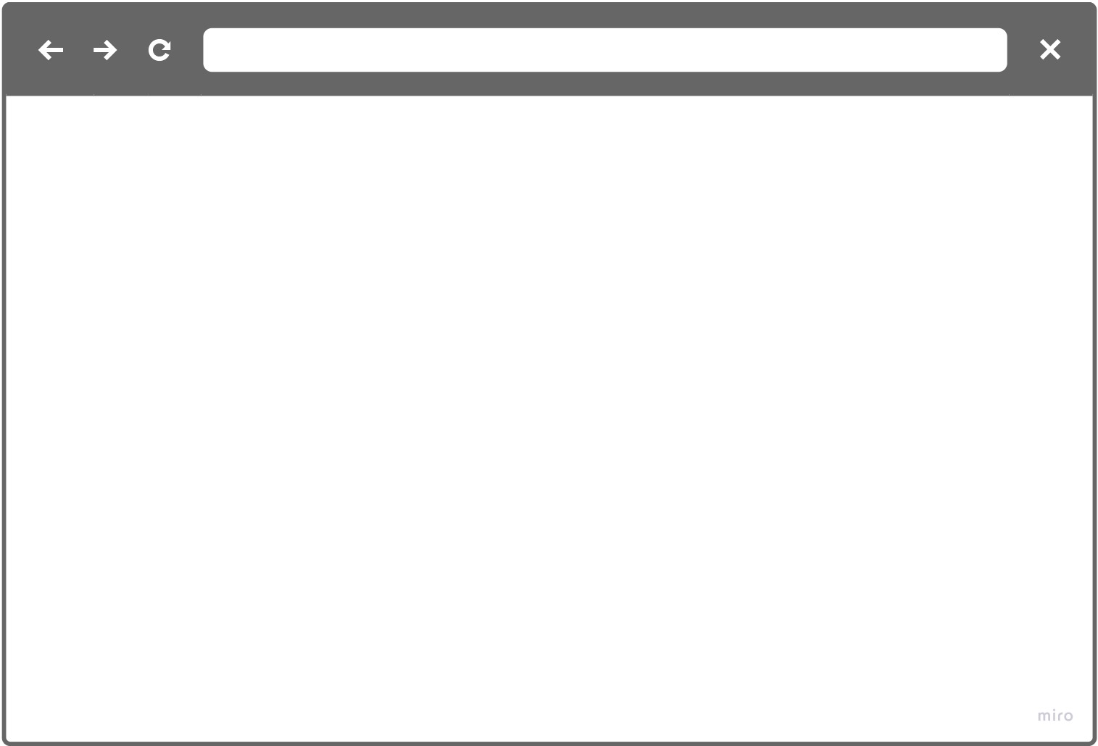
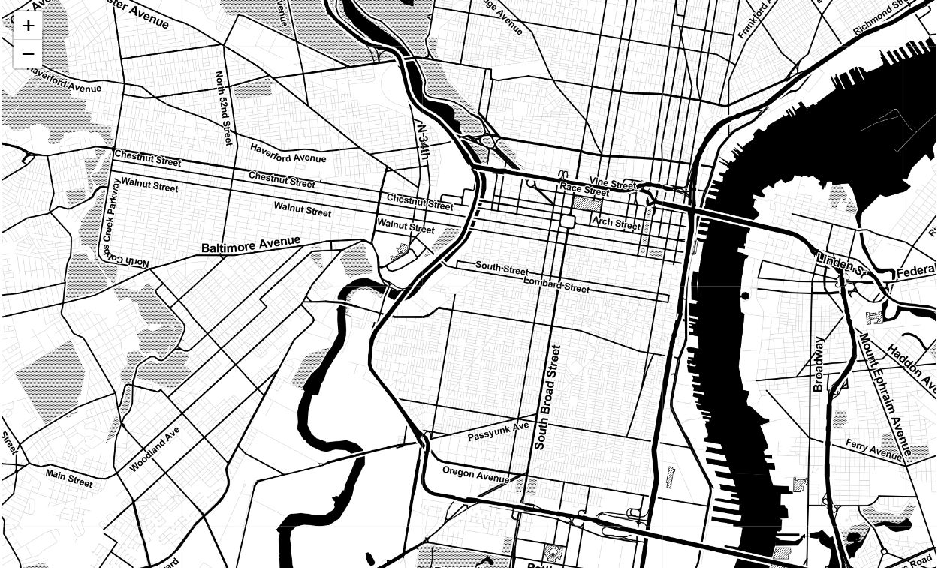



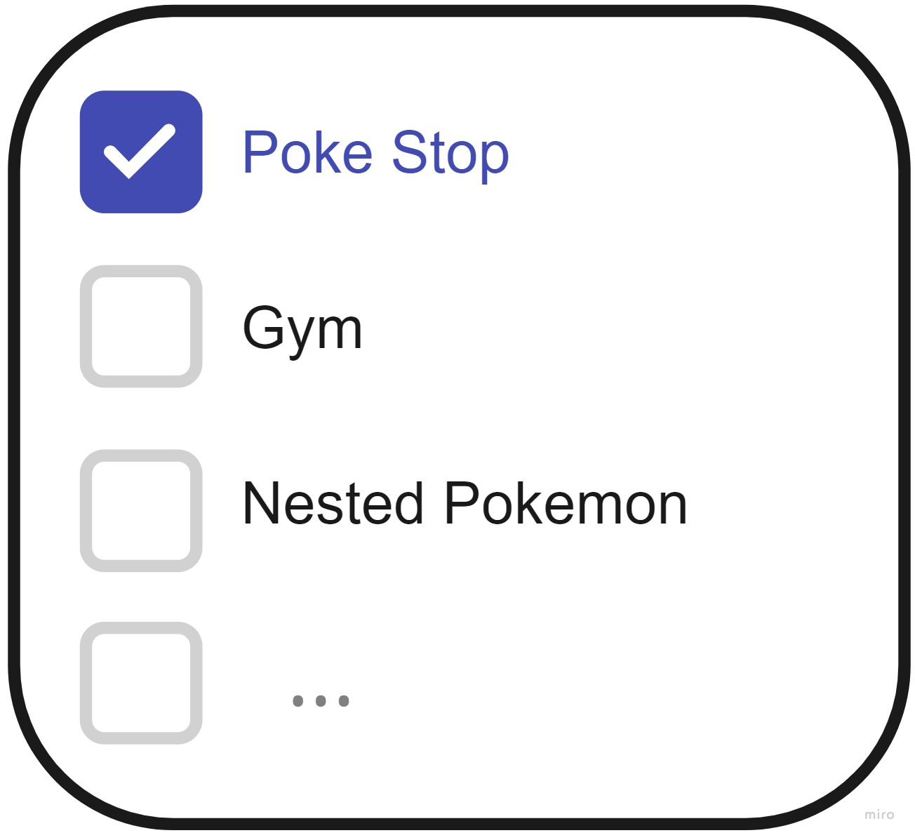
pokemonstop

Slide 12
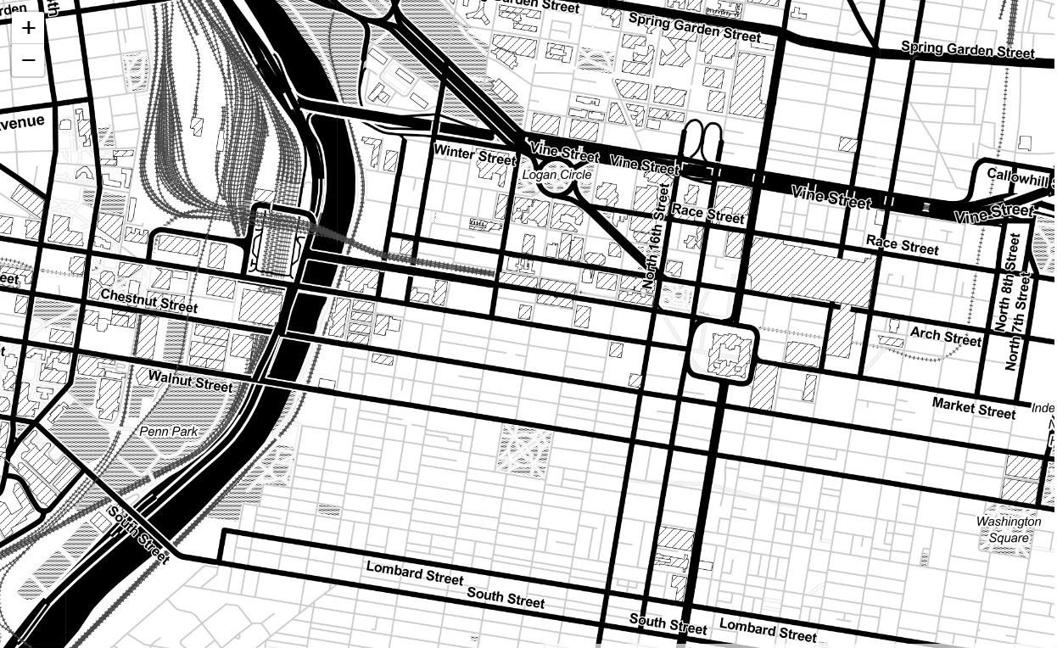

pokemonstop

Slide 13
Next Step
1
Adjust to find the most appropriate coefficients for this analysis.
3
Add Features
Coefficient Adjustment
Map Building
Add features through data collection and investigation.
Use javascript and html to build a map!
2

Slide 14
Thanks
Musa Capstone
Ziyuan Cai
Q&A

