Slide 1
Musa Capstone
PokemonStay
Ziyuan Cai

Slide 2
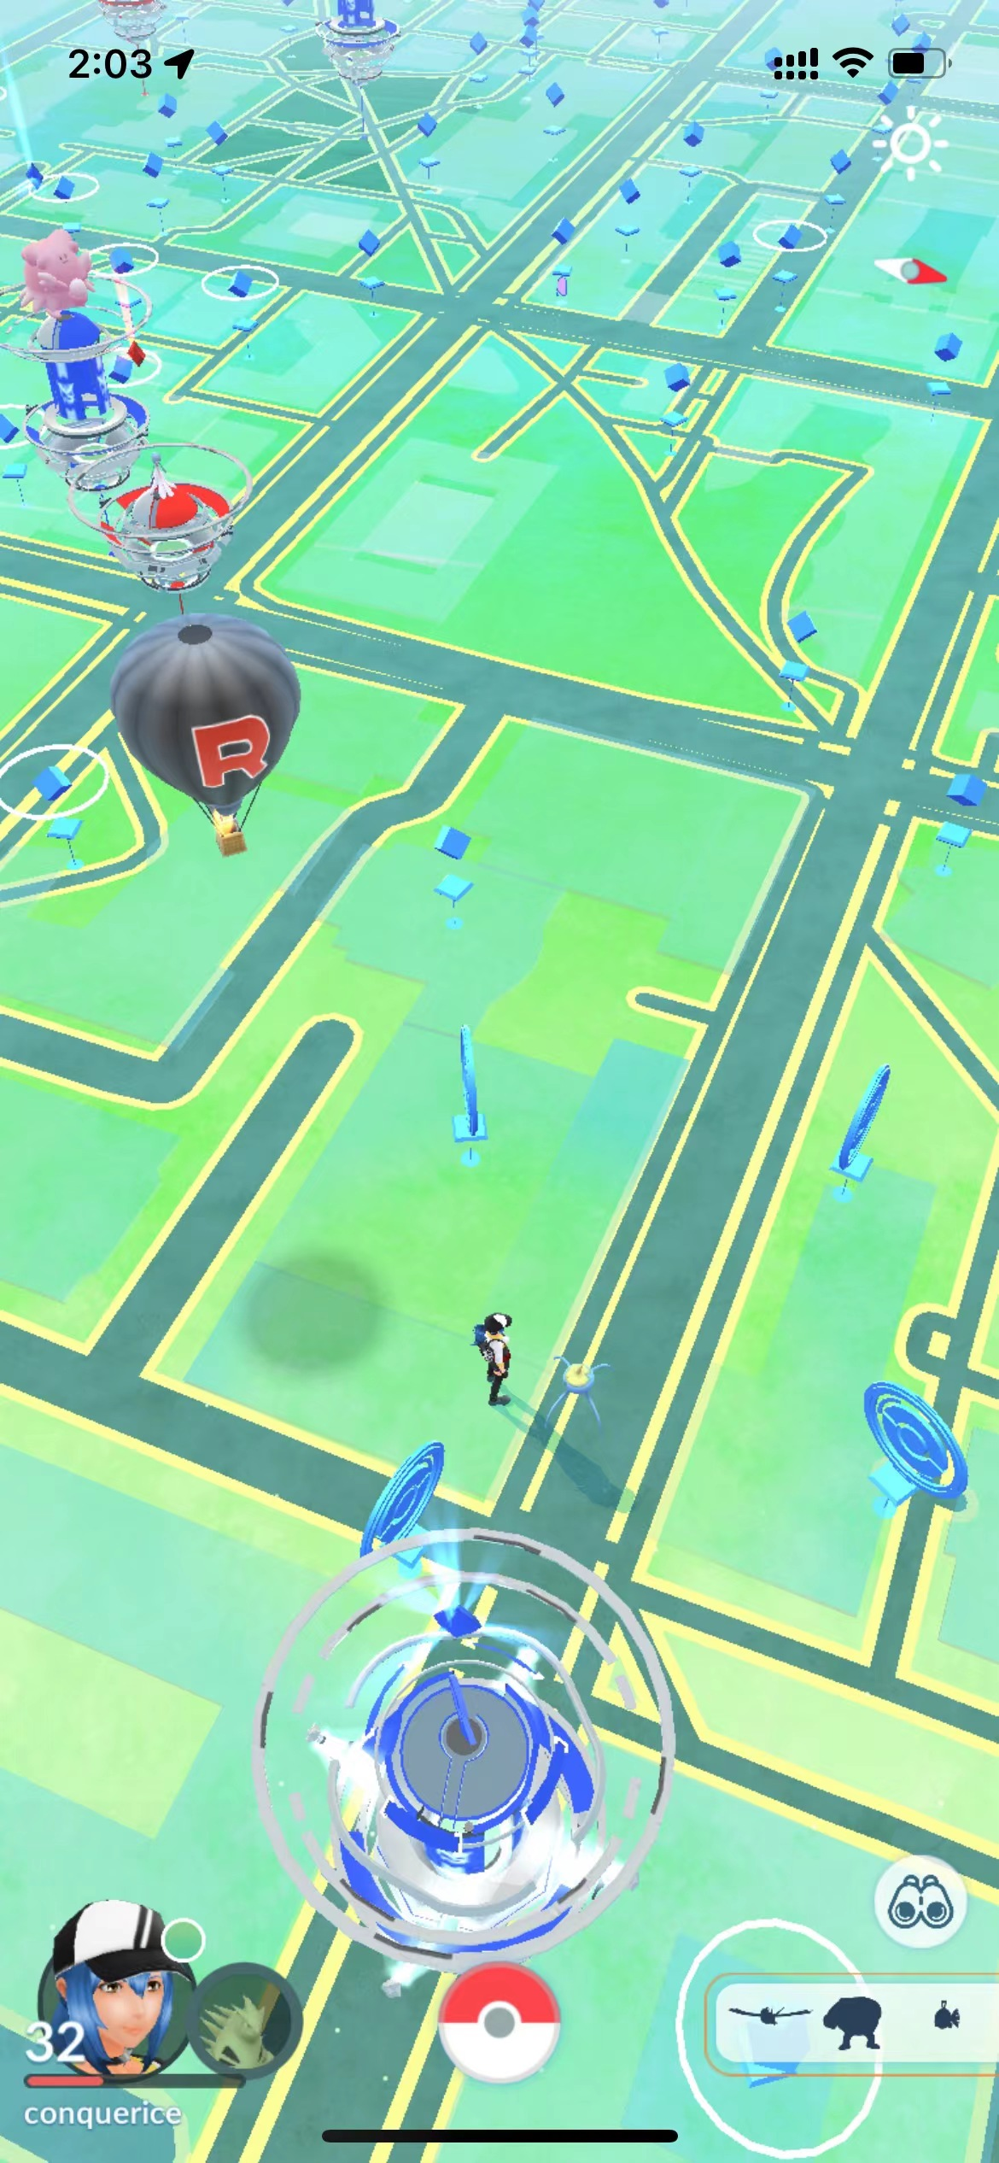
Problem
Nested Pokemon
Poke Stop
Pokemon
Gym
Where should people new to Philadelphia go to get Pokémon faster and safer?

Slide 3
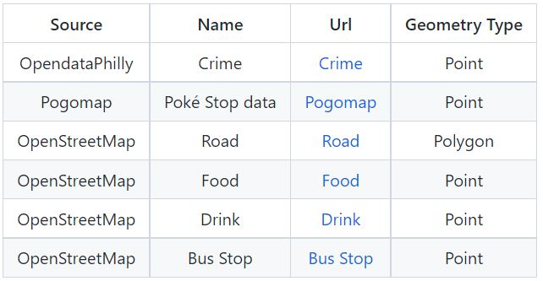
Data

Slide 4
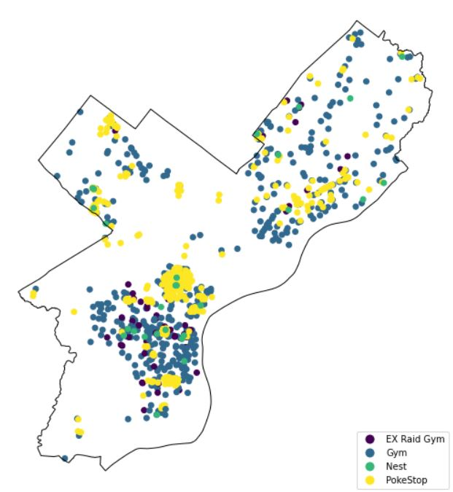
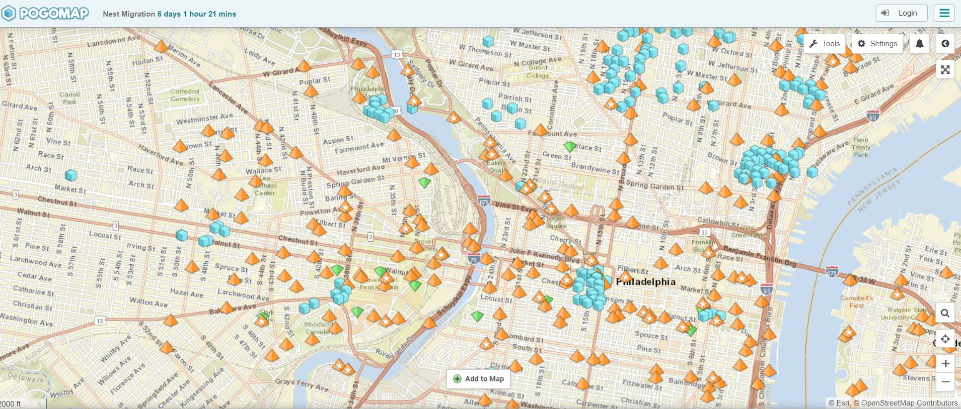
Data
https://www.pogomap.info/location/39,958412/-75,181057/14

Slide 5
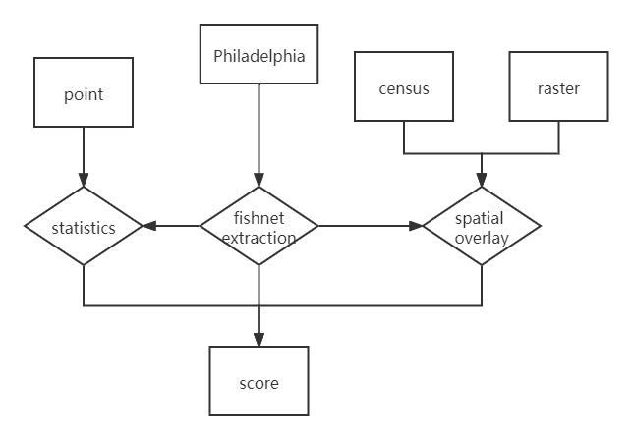
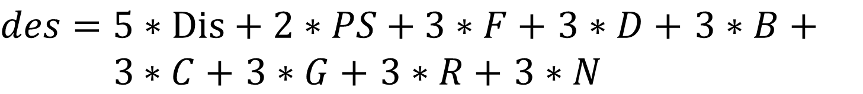
Method
$des=5∗Dis+2∗PS+3∗F+$ $3∗D+$ $3∗B+$ $3∗C+$ $3∗G+$ $3∗R+$ $3∗N$
$$des=a_{1}∗NPS+a_{2}∗NR+a_{3}∗C+…$$

Slide 6


Method

Slide 7
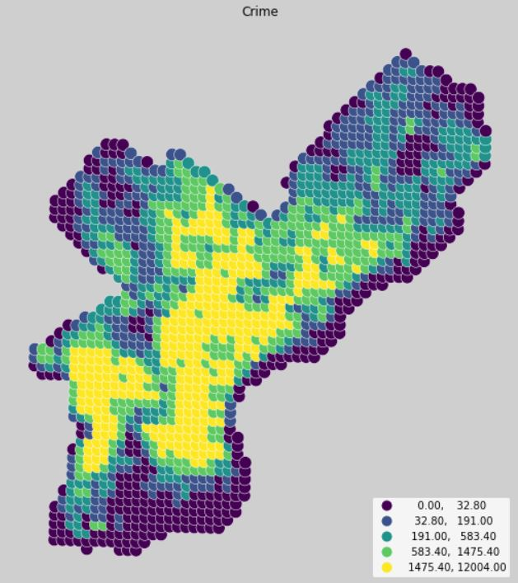
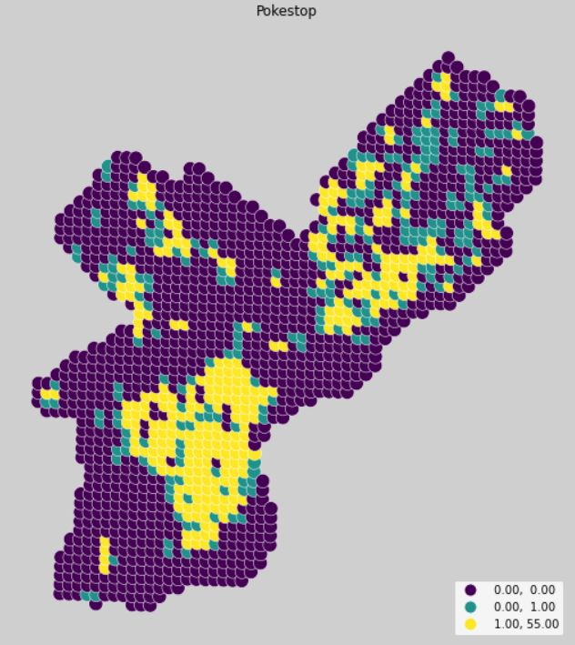
Method

Slide 8
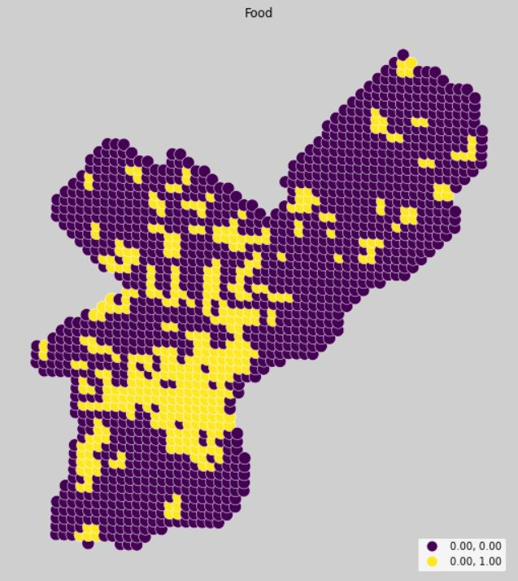
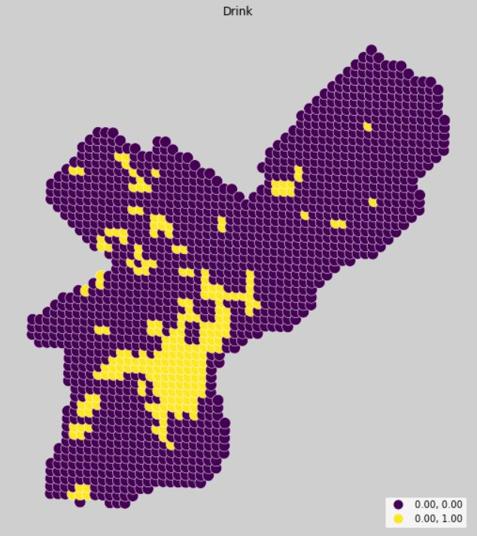
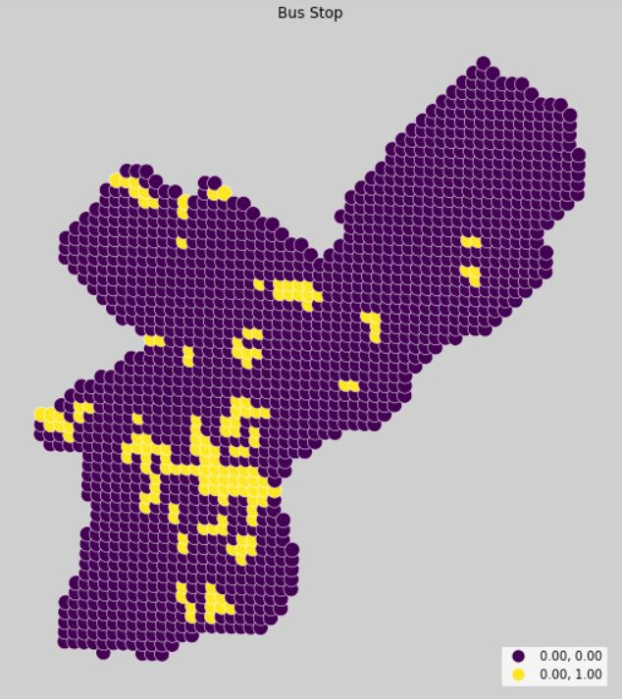
Method

Slide 9
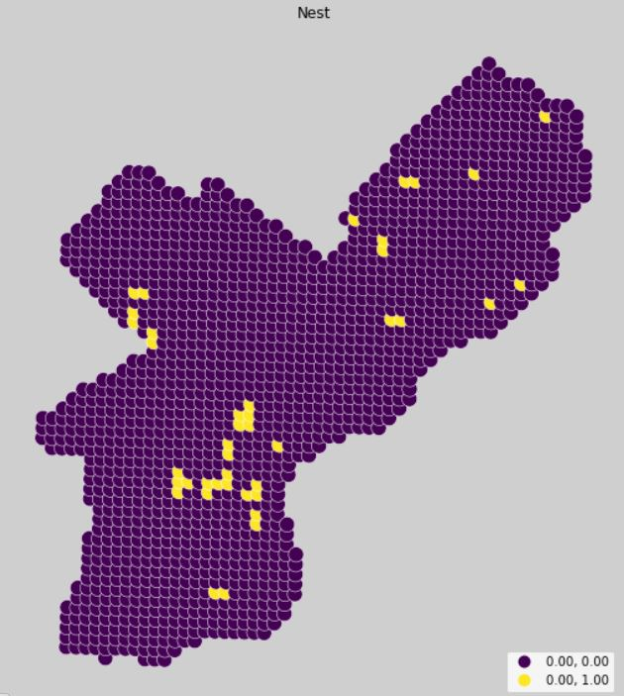
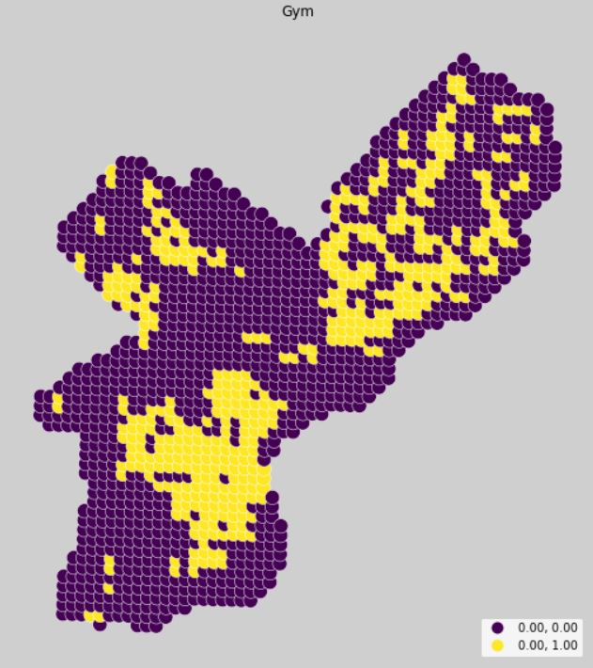
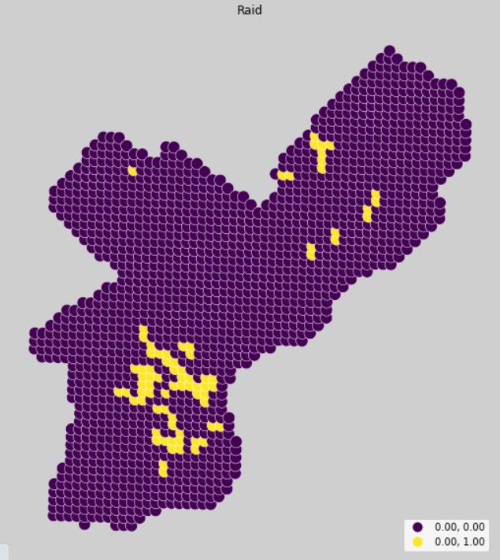
Method

Slide 10
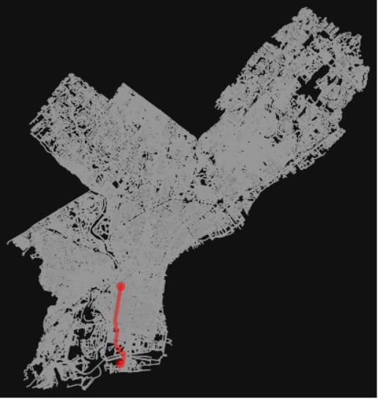
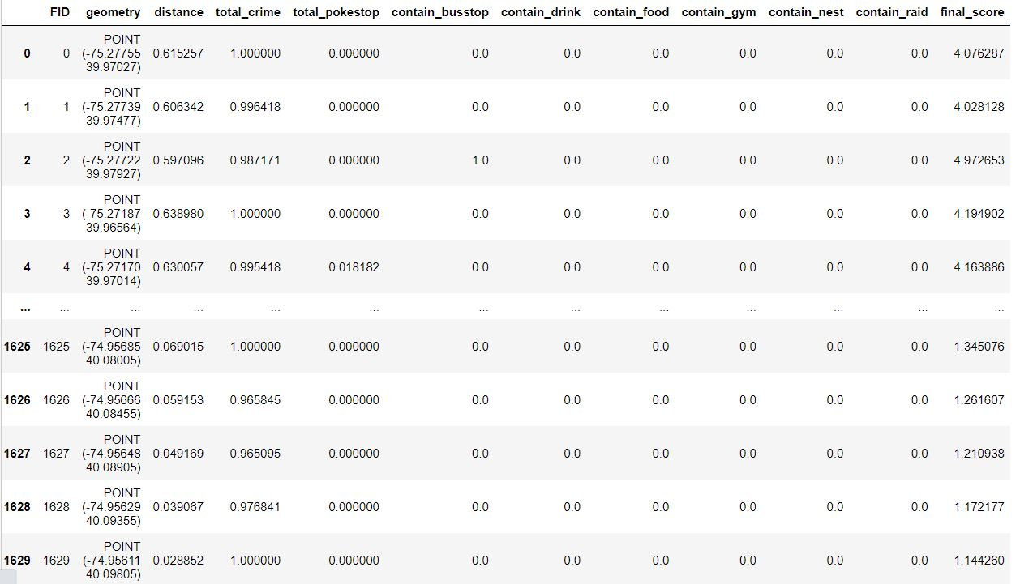
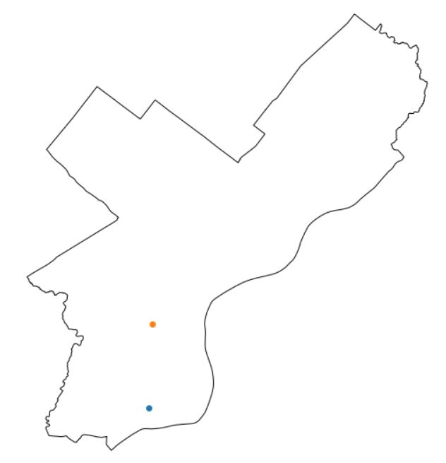
Result

Slide 11

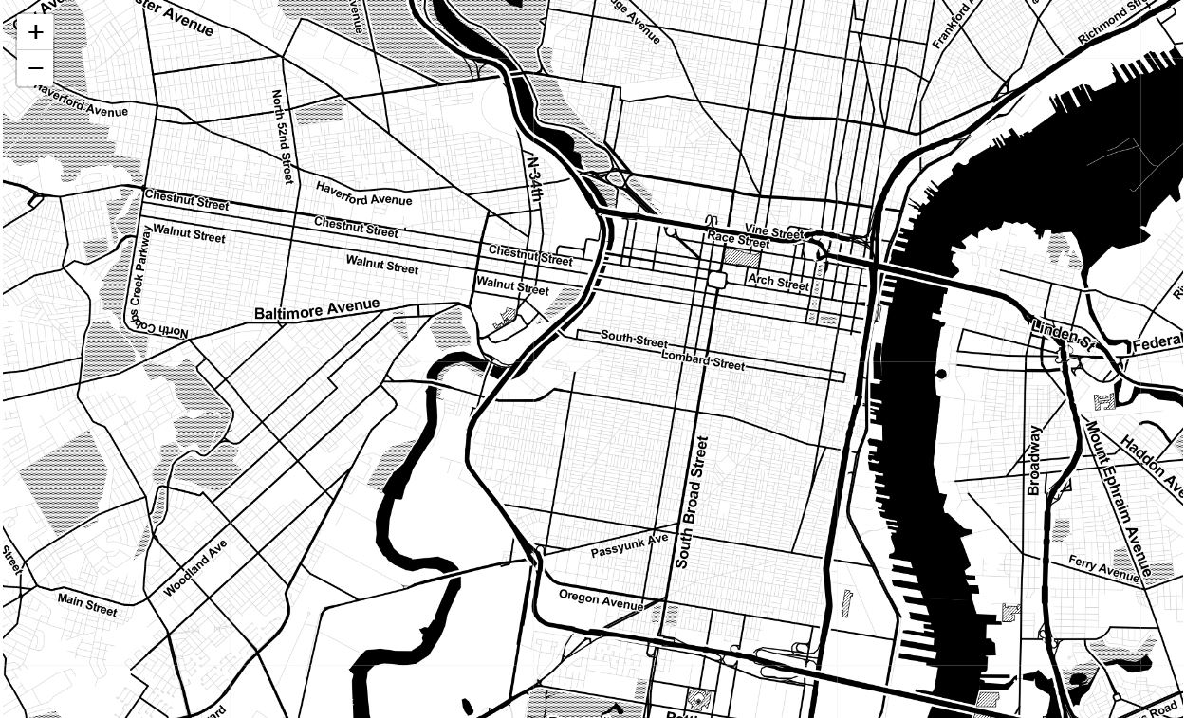



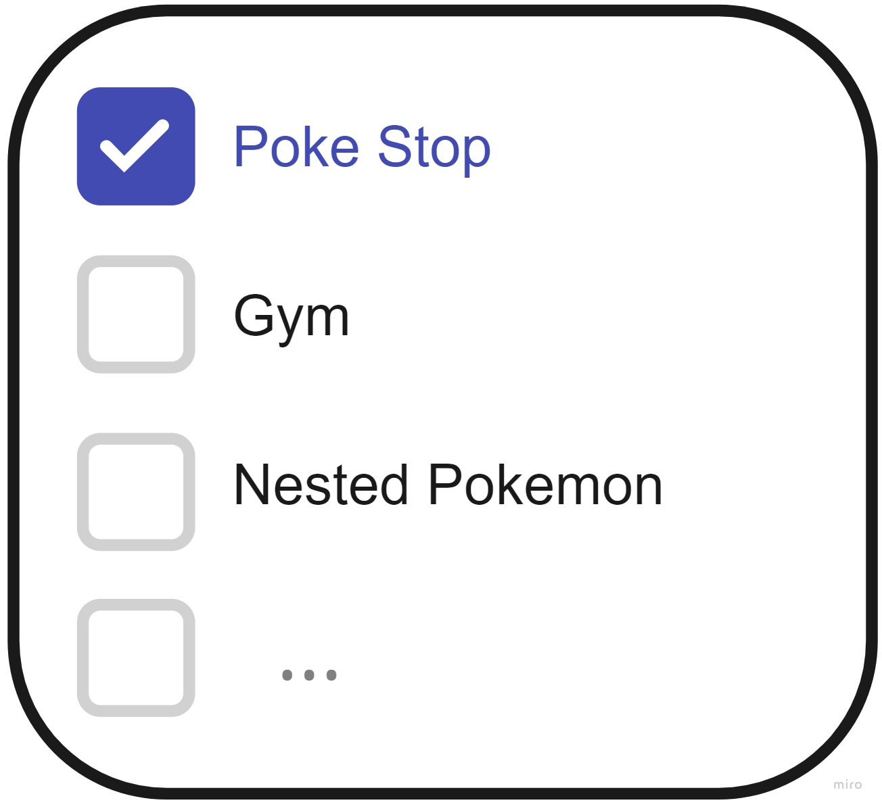
https://krmeteor.github.io/Pokemon-Stay/

Slide 12
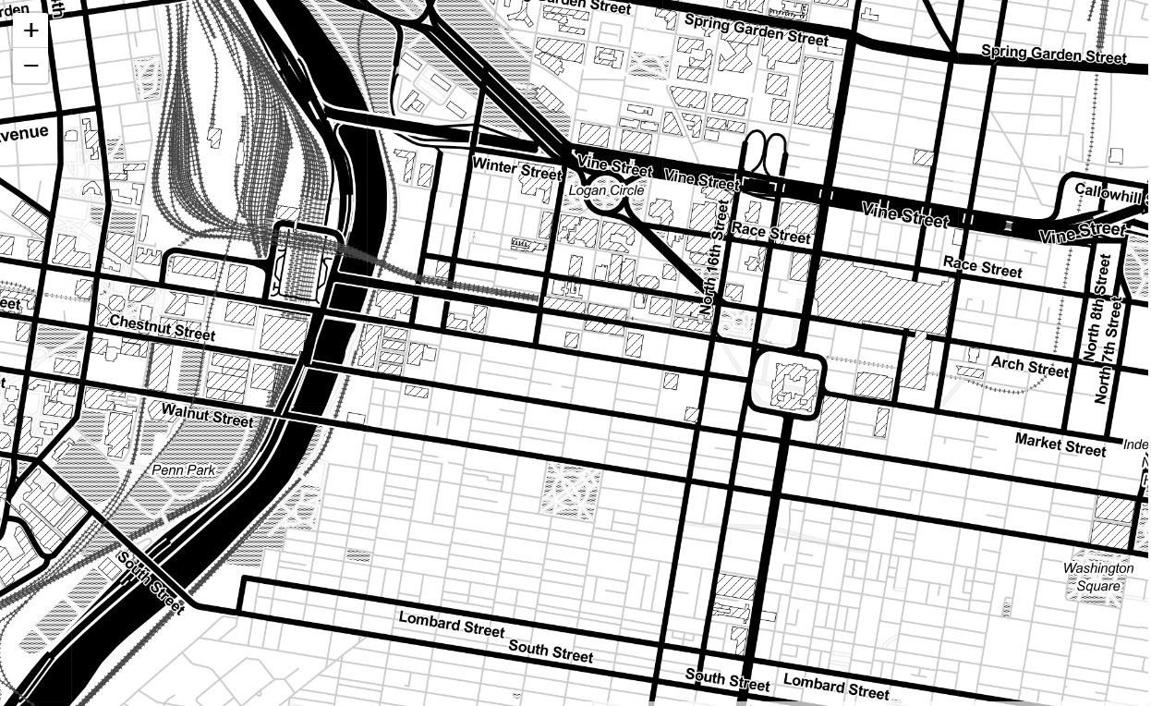

https://krmeteor.github.io/Pokemon-Stay/

Slide 13
Next Step
1
3
Get more accurate poke stop data.
Wireframe Improvement
Data Adjustment
Project extension
Add instructions for users and add routes for walking.
Expand the area from Philadelphia to Pennsylvania and United States. Finally make it worldwide.
Consider more factors.
2

Slide 14
Thanks
Musa Capstone
Ziyuan Cai
Q&A

